Slide 1
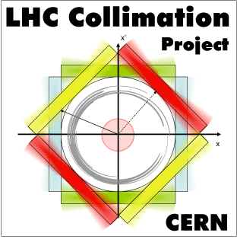
Recap. of crystal simulations for MD configurations
Daniele Mirarchi,
Stefano Redaelli, Walter Scandale

Slide 2
Introduction
Two crystals in the horizontal and vertical plane installed in the LHC-IR7 at beginning of April
Preliminary tests of Crystal-assisted Collimation are foreseen after the machine commissioning in 2015
Extensive campaign of simulation needed to prepare them in the best way to get clear and fast results (hope for a few shifts of MD time in the 2nd half of 2015)
Main questions to be addressed:
Can crystal-assisted collimation improve the present, already very good, cleaning system?
Can crystal-assisted collimation ensure stable performance in any machine configuration?
Is crystal collimation compatible with safe operations in any beam condition?
Do crystal properties, observed so far at lower beam energies, scale to the LHC energy as expected?
Preliminary plan for machine conditions:
low intensity
top energy (main goal) & injection
full chain of TCSGs in place
If everything safe
higher intensity (still within safe boundaries)
dedicated TCSGs settings
and under control

Slide 3
Scope of these studies
Systems performance evaluated through simulations made using the Collimation version of SixTrack, in which a routine to simulate interactions with bent crystals is implemented
The validation of such performances for the different systems and layouts will rely on LHC-BLMs measurements
Given the low circulating intensity we have to address if clear signals will be always visible on such detectors, and how to link those signals in terms of energy deposited on the magnets coil
SixTrack output:
density of protons lost per meter
What we need:
evaluation of BLM’s signal and energy deposition on IR7-DS magnets coil for different layout configurations
Energy deposition simulations are therefore needed
SixTrack outputs given to the FLUKA team to access if clear signals on BLMs are within reach with low intensity beams, and how to correlate them with energy released on the IR7-DS magnets coil, for any system and layout configuration
http://lhc-collimation-upgrade-spec.web.cern.ch/lhc-collimation-upgrade-spec/Sim7TeV_crystals.php

Slide 4
Simulations environment
Machine conditions:
Perfect machine (no optics and orbit errors, no collimator setup errors)
7TeV beam with nominal collision optics (β*=55cm IP1/5, β*=10m IP2/8)
Crystal conditions:
Silicon crystal (strip) 4mm long with 50μrad bending, in the horizontal plane
Perfect crystal (no miscut angle, no amorphous layer)
Simulated systems to compare:
Present collimation system using nominal settings at 7TeV
Present collimation system using relaxed settings at 7TeV (most likely the settings will be used at the restart)
Crystal-assisted collimation system, with dedicate TCSGs settings and crystal in optimal channeling orientation (CH)
Crystal-assisted collimation system, with dedicate TCSGs settings and crystal in amorphous orientation (AM) (acting as any 4mm long Si scraper)
Statistics of >10⁷ protons intercepted by the collimation system, to allow estimation of losses ~10⁻⁶

Slide 5
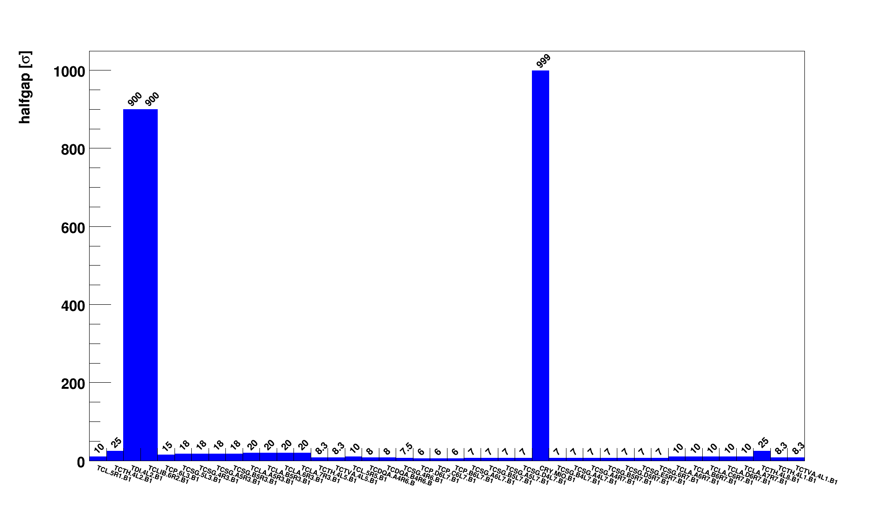
Nominal Settings for std. Coll.
Nominal LHC collimation chain settings at 7 TeV
IR8
IR1
IR2
IR3
IR5
IR6
IR7
IR1

Slide 6
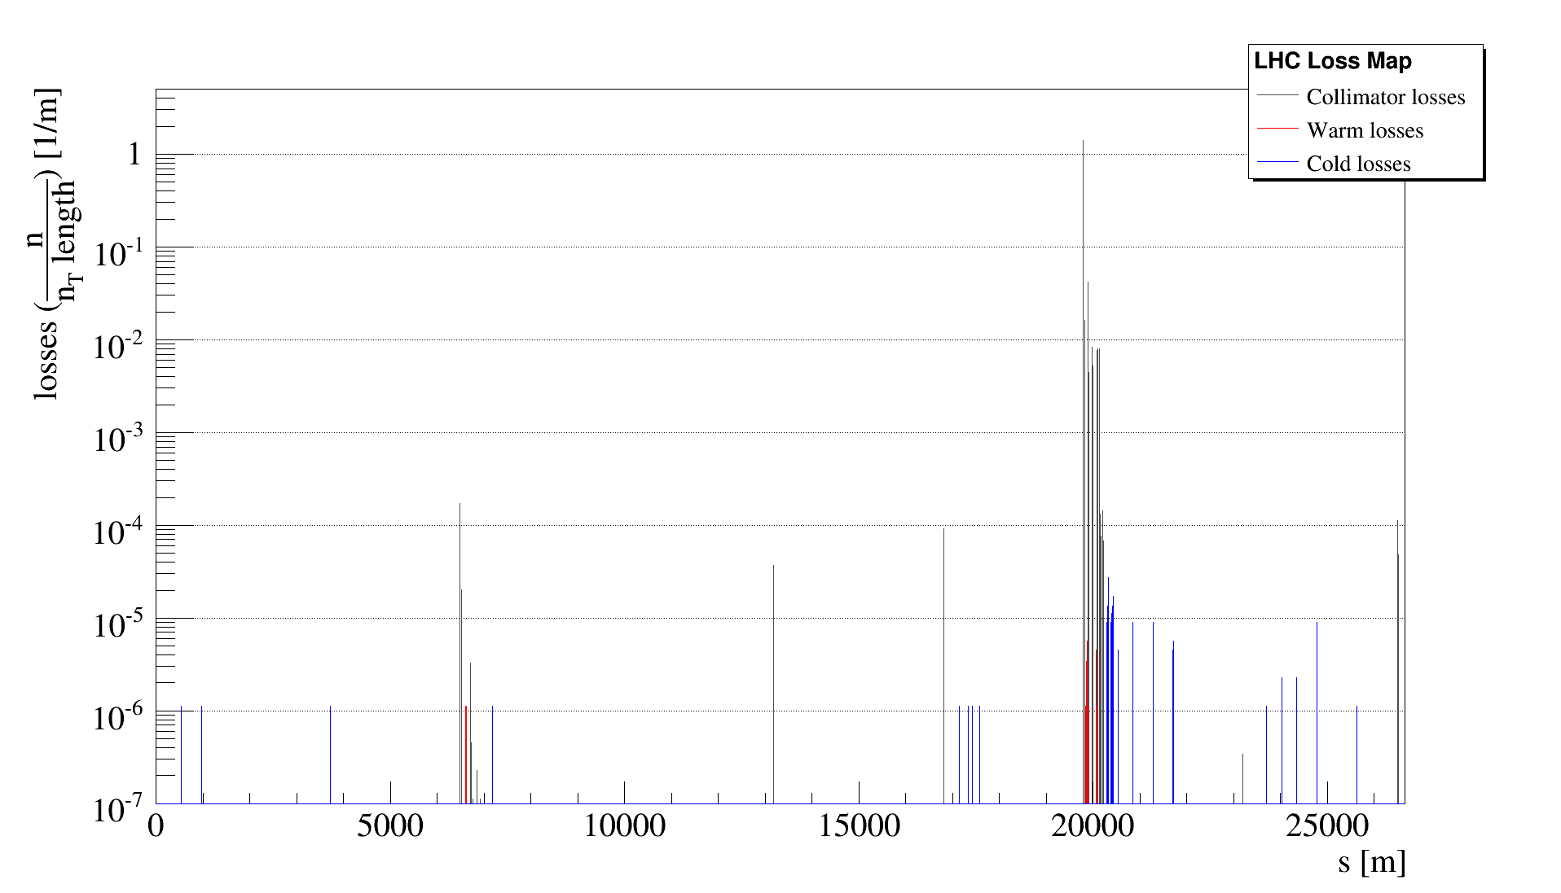
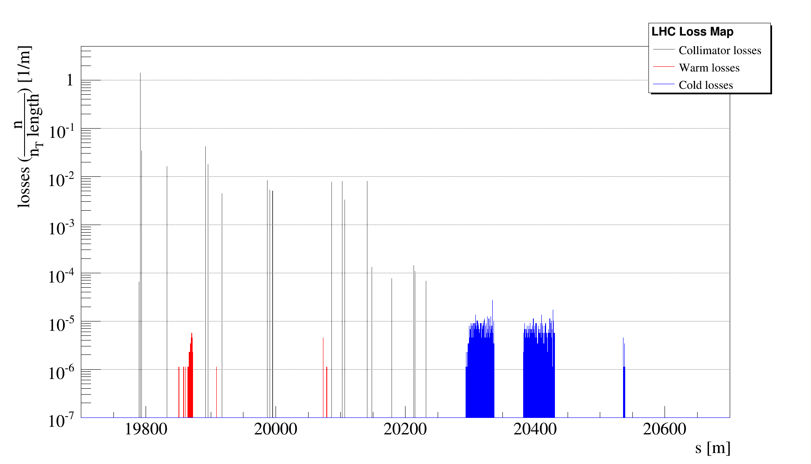
Performance for std. Coll.
Predicted performance of the present LHC collimation system at 7 TeV with nominal settings
Local inefficiency
~1.4 10⁻⁵

Slide 7
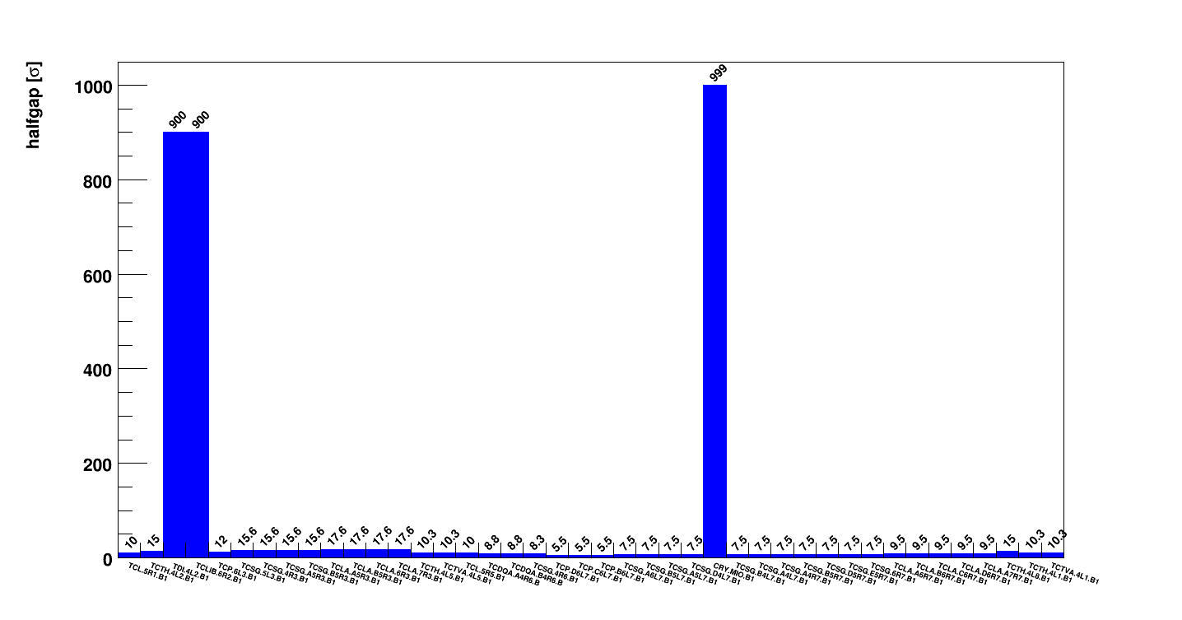
Relaxed Settings for std. Coll.
Relaxed LHC collimation chain settings at 7 TeV (most likely used at the restart in 2015)
IR8
IR1
IR2
IR3
IR5
IR6
IR7
IR1

Slide 8
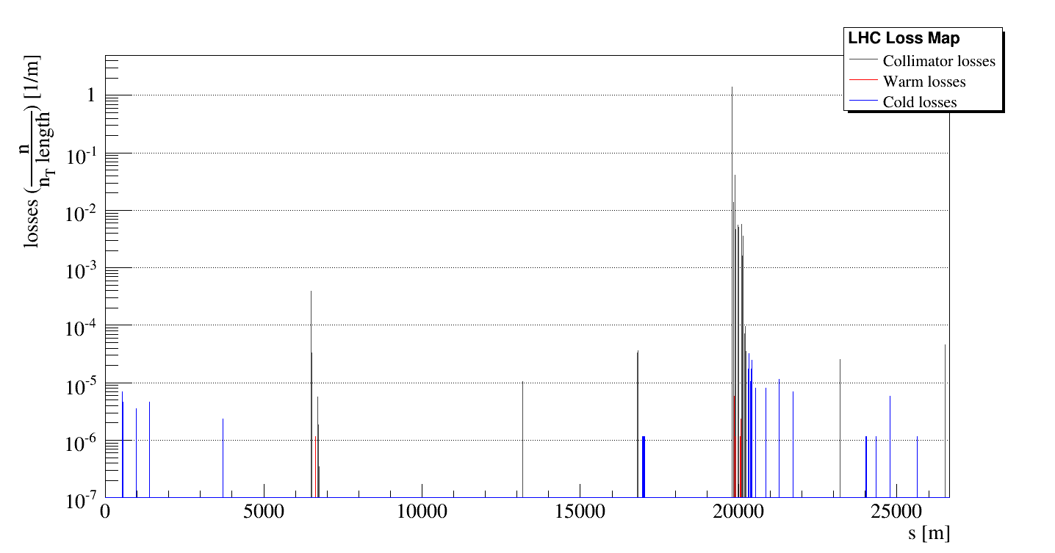
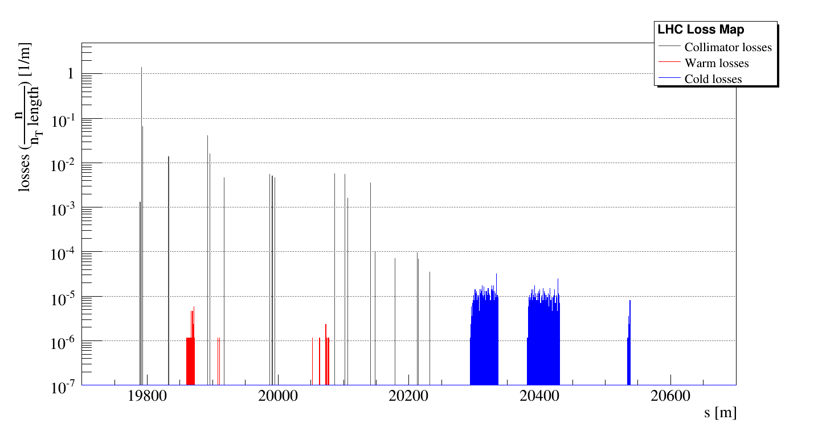
Performance for std. Coll.
Predicted performances of the present LHC collimation system at 7 TeV with relaxed settings
Local inefficiency
~1.8 10⁻⁵

Slide 9
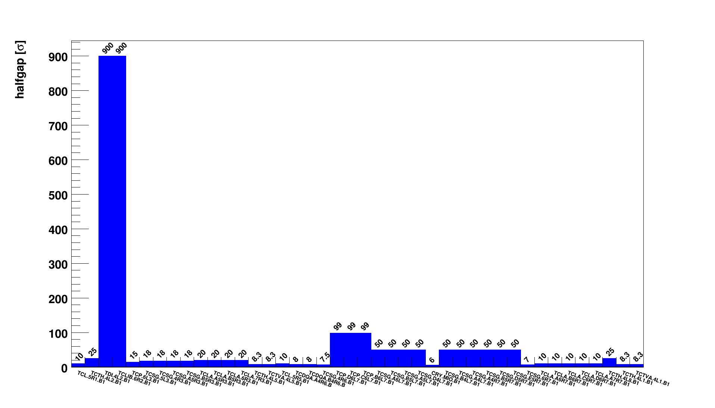
Settings for Cry. Coll.
Dedicated LHC collimation chain settings at 7 TeV for crystal-collimation tests with minimal TCSGs
IR8
IR1
IR2
IR3
IR5
IR6
IR7
IR1

Slide 10
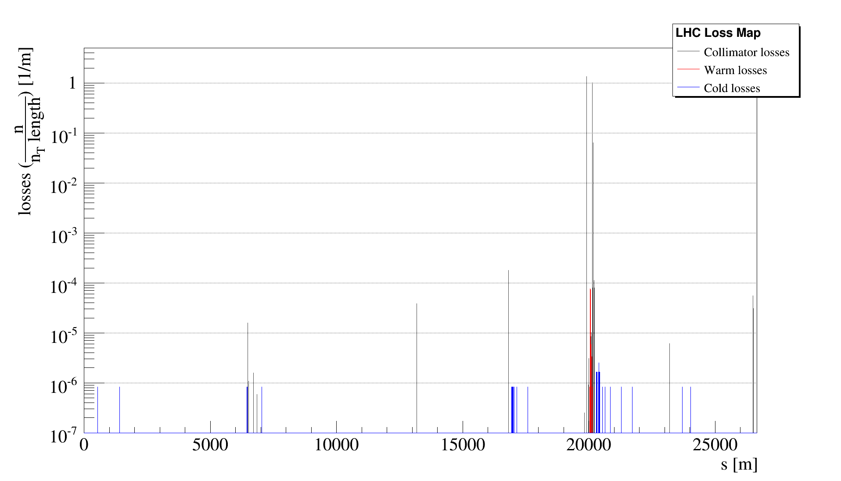
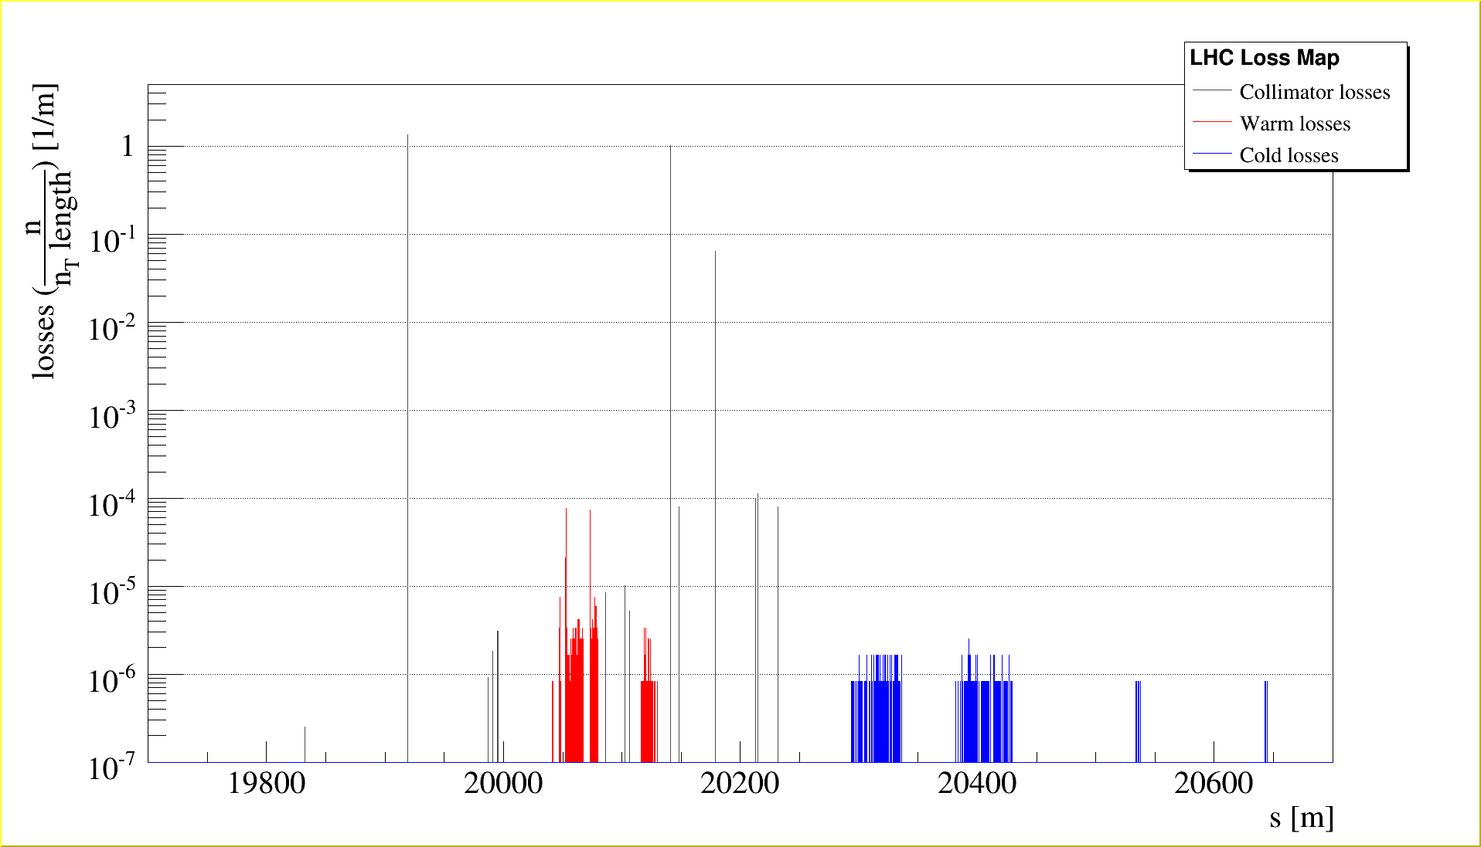
Performance for Cry. Coll. CH
Predicted performances of crystal-assisted collimation in the LHC at 7 TeV with minimal TCSGs
Crystal in optimal Channeling orientation
Local inefficiency
~1.2 10⁻⁶

Slide 11
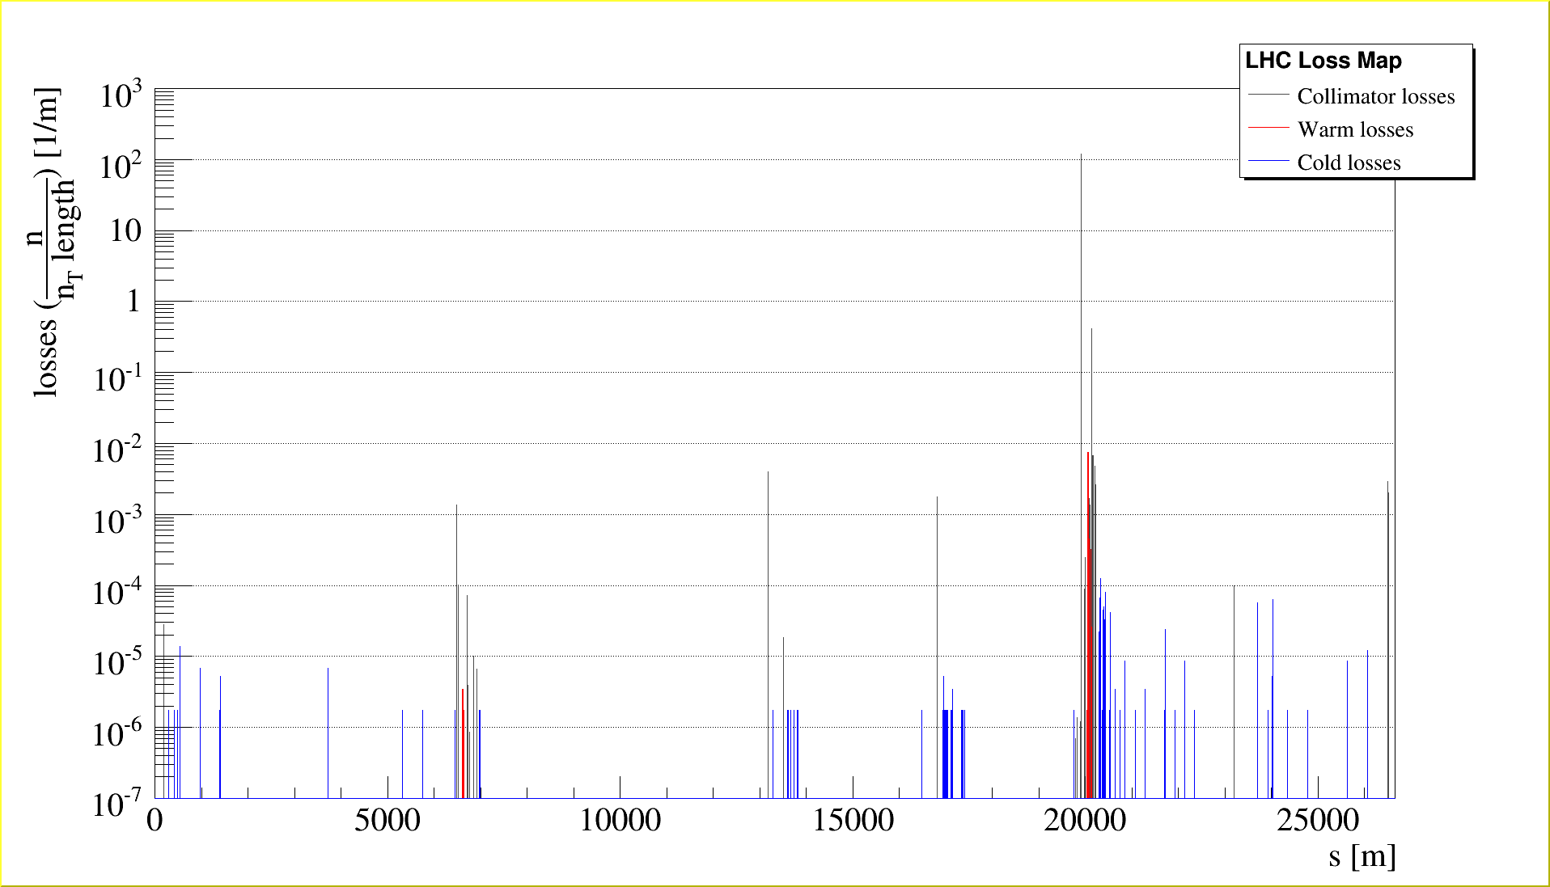
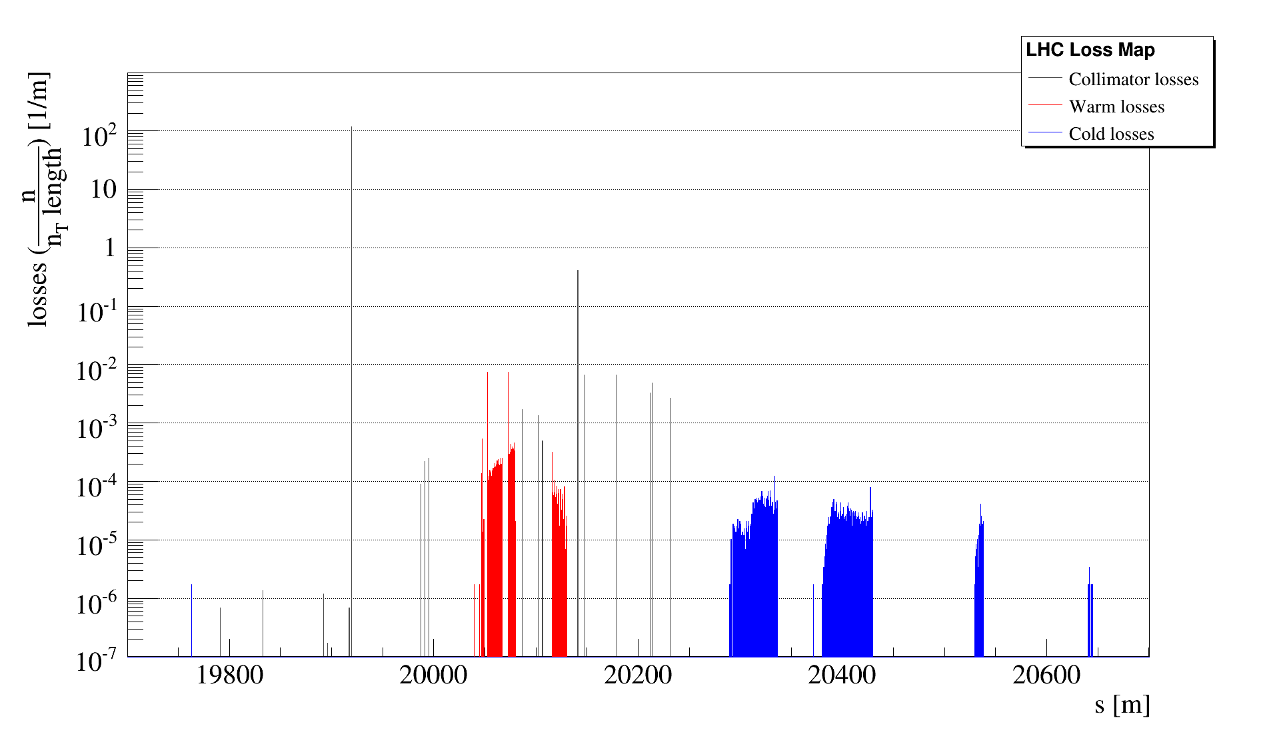
Performance for Cry. Coll. AM
Predicted performances of crystal-assisted collimation in the LHC at 7 TeV with minimal TCSGs
Crystal in Amorphous orientation (acting as any 4mm long Silicon scraper)
Local inefficiency
~5.9 10⁻⁵

Slide 12
Conclusions
Simulations of cleaning performance performed for different systems and layouts, useful for first validations of crystal-assisted collimation w.r.t. the present one
From SixTrack outputs we expect (in terms of IR7-DS losses):
Crystal-assisted collimation about a factor 8 better than the present one, with crystal in optimal channeling orientation (CH) and minimal set of TCSGs in place
Crystal-assisted collimation about a factor 4 worse than the present one, with crystal in amorphous orientation (AM) and minimal set of TCSGs in place
Crystal-assisted collimation about a factor 30 worse with crystal in AM w.r.t. CH, and minimal set of TCSGs in place
SixTrack outputs were provided to the FLUKA team to access if same reductions are expected in terms of LHC-BLMs signal and energy deposition on IR7-DS magnets coil
Note that: SixTrack scattering routine upgraded by the time of these simulations were made.
However, relative results should be not affected, possibility to re-run them if required
for upgraded estimation of absolute losses

