Slide 1
Crystal routine studies
ALEXEI SYTOV
European Organization for Nuclear Research
Belarusian State University, Research Institute for Nuclear Problems
BSU INP
Supervisor in Belarus
VICTOR TIKHOMIROV
Supervisor:
STEFANO REDAELLI

Slide 2
Outline
CRYSTAL-channeling simulation code
Introduction
Algorithm
Specific details
Single passage simulation
Comparison of the results with SixTrack crystal module simulations
Observation of interesting effects for the LHC
Considering of the miscut angle problem for the LHC
New effects for the LHC collimation
A technique to improve crystal channeling efficiency of charged particles (crystal cut)
Multiple volume reflection in one bent crystal (MVROC)
Combination of MVROC and channeling

Slide 3
My mission at CERN:
CRYSTAL-channeling* simulation code
To compare CRYSTAL-channeling simulation results with CRYAPR modeling.
To check the proper consideration of all possible effects by both of these codes, to look for new interesting effects.
To understand, if some our ideas can be useful for the LHC collimation.
CRYAPR**
Statistical treatment of various interactions between protons and crystal, optimized for multi-turn tracking in an accelerator.
CRYSTAL-channeling*
Routine for the tracking proton trajectories in crystal by solving equation of motions with interplanar field potential***:
*Designed by V. Tikhomirov, A. Sytov.
**I.Yazynin, 4th Crystal Channeling Workshop 2009, CERN, March 24-27, 2009;
V. Previtali, These de Doctorat. Lausanne, 2010;
D. Mirarchi, S. Redaelli, W. Scandale, V. Previtali, MOPWO035, IPAC2013.
***V.M.Biryukov, Y.A.Chesnokov, V.I.Kotov,
Crystal channeling and its application at high energy accelerators, Springer, 1997.

Slide 4
Creation and evolution of CRYSTAL-channeling
Main conception: Victor Tikhomirov codes.
Spring 2011 – first version on Delphi
Summer 2011 – first attempts of simulation
(UA9 experiment, miscut angle influence)
Summer 2012 (Fermilab summer student internship PARTI) – rewriting the code on Fortran language and its considerable modification, combining of it with STRUCT*, first attempts of simulation of experiment at the Recycler Ring**
Autumn 2012 – winter 2013 – Simulation of experiment at the Recycler Ring**, comparison of the results with Yazynin code***
Spring 2013 – MPI modification for parallel simulations
*I. Baishev, A. Drozhdin, N. Mokhov, X. Yang, ‘STRUCT Program User’s Reference Manual’,
SSCL–MAN–0034 (1994), http://www-ap.fnal.gov/users/drozhdin/.
**V.Shiltsev, Novel Slow Extraction Scheme for Proton Accelerators Using Si Bent Crystal,
Proc. IAAA IPAC12, New Orleans, USA, 2012.
***I.Yazynin, 4th Crystal Channeling Workshop 2009, CERN, March 24-27, 2009.

Slide 5
Initial coordinates and angles, energy
x₀, θ_{x0}, y₀, θ_{y0}, E₀
Simulation of dθ_{x}, dθ_{y}, Gaussian profile;
simulation of energy losses.
No
Yes
No
Was a diffractive scattering?
Does particle hit either the face
or lateral surface of the crystal?
Simulation of dθ_{x}, dθ_{y},
Gaussian profile
Yes
No
Recalculation of coordinates and angles
in crystal reference system, considering the miscut
Was an elastic nuclear scattering?
Yes
A trajectory calculation
x_{i+1}= x_{i+1}(x_{i}, θ_{xi}),
θ_{xi+1} = θ_{xi+1} (x_{i}, θ_{xi})
Simulation of dθ_{x}, dθ_{y},
Rutherford formula
No
Was a single coulomb scattering
on nuclei (Rutherford cross-section)?
Yes
No
Was an enter into
another channel?
Yes
x=x-d*Sign(x)
Simulation of dθ_{x}, dθ_{y},
Gaussian profile
No
Was an escape from the crystal
through either its lateral or back surface?
Yes
Yes
No
Was a multiple coulomb
scattering?
Calculation of ionization losses
from average value of electron
density, along the trajectory
Was an inelastic
nuclear scattering?
Yes
Particle is lost
No
Final coordinates and angles,
energy x_{f}, θ_{xf}, y_{f}, θ_{yf}, E₀

Slide 6
Specific features
Spline interpolation of:
Interplanar potential
Interplanar electric field
Density of nuclei
Density of electrons
Advantages:
At least 10 mathematical operations necessary for function calculation
Reading spline coefficients from input file makes an algorithm universal for any potential type
1000 interpolation nodes is more than enough for accuracy of 10⁻⁷ – 10⁻⁸.
Step changing:
Channeling step:
Amorphous step:
Usually N_{steps}=350.
Starting from:

Slide 7
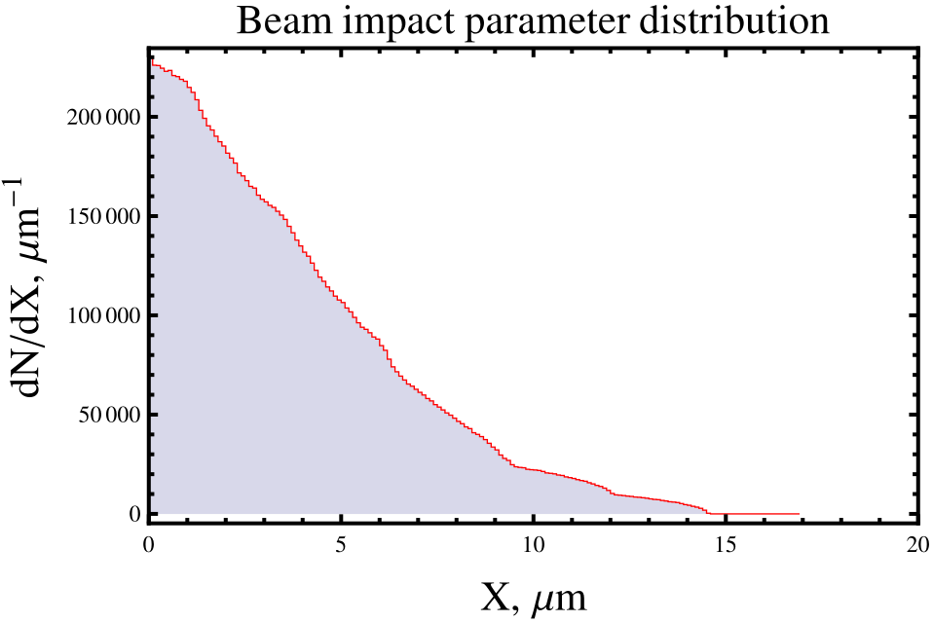
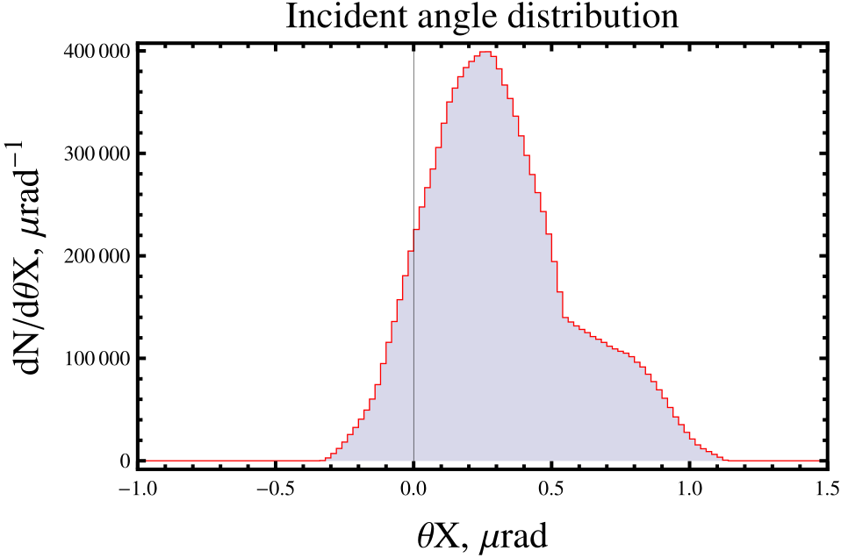
Simulations input
Crystal parameters: crystal length l_{cr}=3, 4, 5 mm; bending angle θ_{b}=40, 50, 60 μrad; θ_{cr}=0, –25, –35, –100, 100 μrad for l_{cr}=3 mm, θ_{b}=40 μrad; l_{cr}=4 mm, θ_{b}=50 μrad and θ_{cr}=0 μrad for remaining combinations of length and bending angle.
Ideal crystal without amorphous layer, miscut, crystal torsion, imperfections, …
Input beam distrubution at the crystal entrance was calculated for the LHC case with SixTrack* for 7 TeV energy.
Only output distribution from crystal was considered (single passage effects).
A similar setup was used for comparison between the SixTrack module and Taratin's code.
*F. Schmidt, CERN/SL/94-56-AP.
G. Robert-Demolaize, R. Assmann, S. Redaelli, F. Schmidt, FPAT081, PAC2005.
D. Mirarchi, S. Redaelli, W. Scandale, V. Previtali, MOPWO035, IPAC2013.

Slide 8
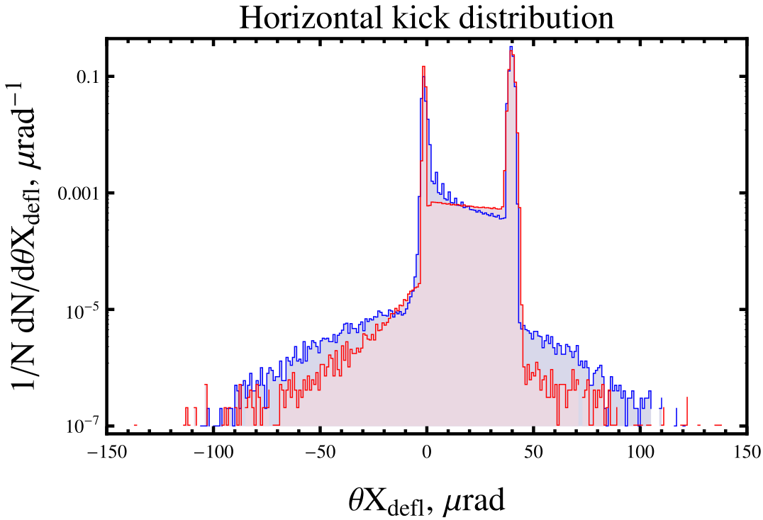
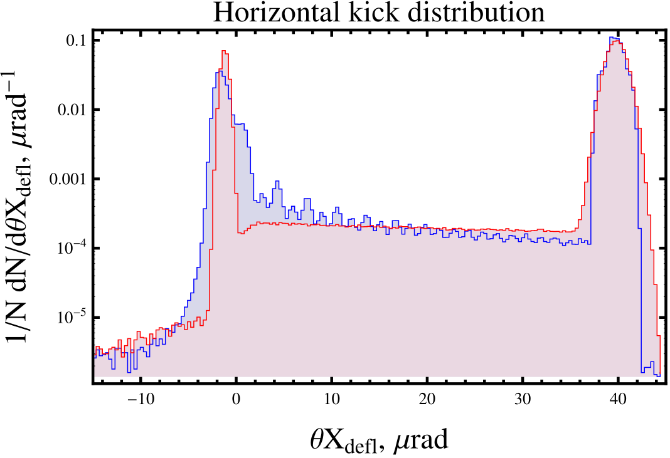
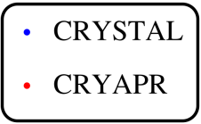
Horizontal kick distribution, channeling orientation
VR
Channeling
VR
Dechanneling +
amorphous
Fast dechanneling +
amorphous
Nuclear + diffractive
scattering
Channeling
Single
coulomb
scattering
Dechanneling +
amorphous
High dechanneling probability is achieved
at maxima of channeling oscillations, low dechanneling probability at minima of them.
At 7 TeV very few number of oscillations:
4 per mm + low angular divergence of the incident beam => high correlation between phase of different particles => “dechanneling peaks”.
About 1.3 % of particles dechannel at the first mm of crystal (4 oscillations). It may be important for collimation.
High dechanneling
probability
Low dechanneling
probability

Slide 9
Dechanneling peaks and initial angular distribution*
Peculiarities of the LHC case:
Very high energy => very few oscillations in
crystal => good correlation between trajectories
Rather large impact parameter => initial
angular distribution is asymmetric and shifted
from ideal angle value for left crystal point.
Bending radius is rather small=>
interplanar potential is considerably asymmetrical.
Optimal orientation for left
point of the crystal is
$θ_{tilt}=−α∗\sqrt{ε/β}$
Asymmetry of both plane potential in bent crystal and initial angular distribution is the reason of less height of a half of “dechanneling peaks”.
Ideal alignment of the crystal is important for collimation.
Higher dechanneling
probability
Lower dechanneling
probability
*Calculated with SixTrack,
D. Mirarchi, S. Redaelli, W. Scandale, V. Previtali, Layouts for crystal collimation tests at the LHC, IPAC2013.

Slide 10
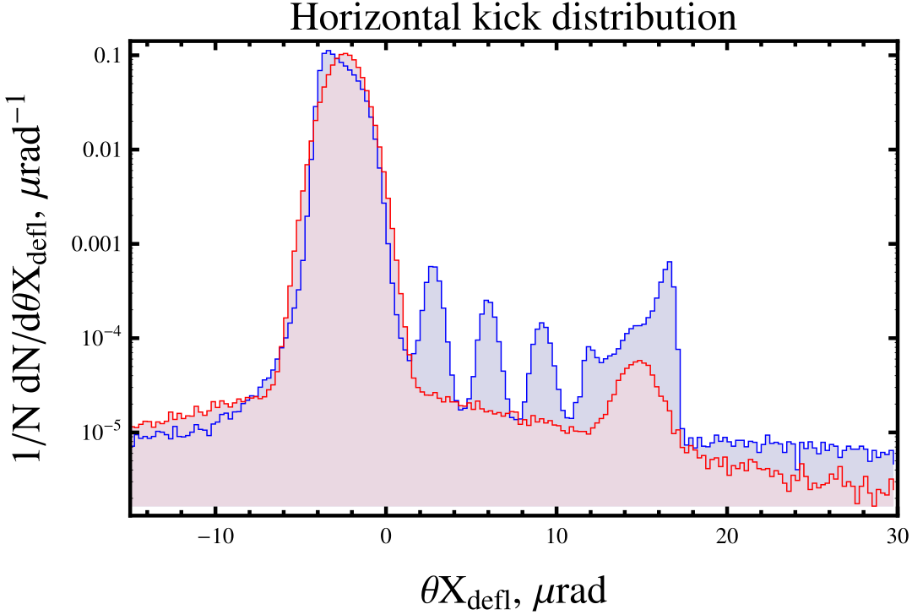
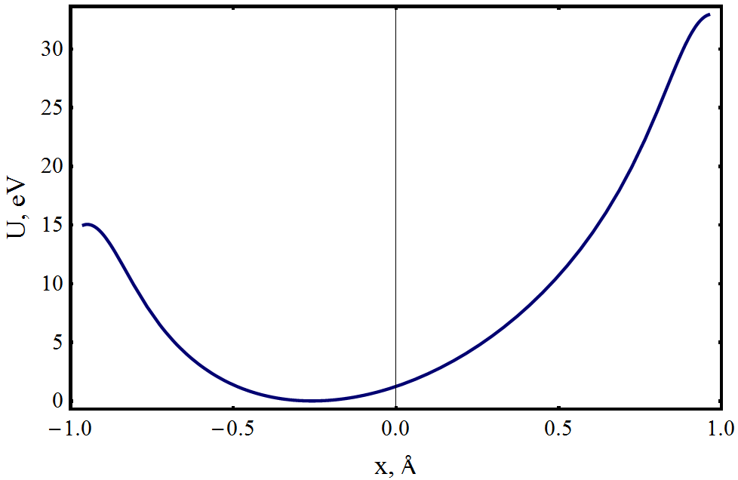
Volume capture, VR orientation: –25µrad
Volume capture:
CRYAPR: 0.05%.
CRYSTAL-channeling: 0.3% + ~0.3% (dechanneled) ≈0.6%.
By Biryukov approximation formula*:
R=75m, L_{De}≈3m,
θ_{c}=2.1μrad (bent)=>η_{VC}=0.008%.
But for 7 TeV L_{Dn}~l_{cr} and L_{De}>>l_{cr}.
So, the main mechanism for both the volume capture and dechanneling at 7 TeV is scattering by nuclei but not by electrons. So, L_{Dn}~2.6cm and:
VR
Dechanneling
Volume capture
in channeling
Nuclear + diffractive
scattering
Interplanar potential in bent crystal
Phase is almost the same =>only high dechanneling peaks are visible
Volume
capture
*V.M.Biryukov, Y.A.Chesnokov, V.I.Kotov,
Crystal channeling and its application at high energy accelerators, Springer, 1997.

Slide 11
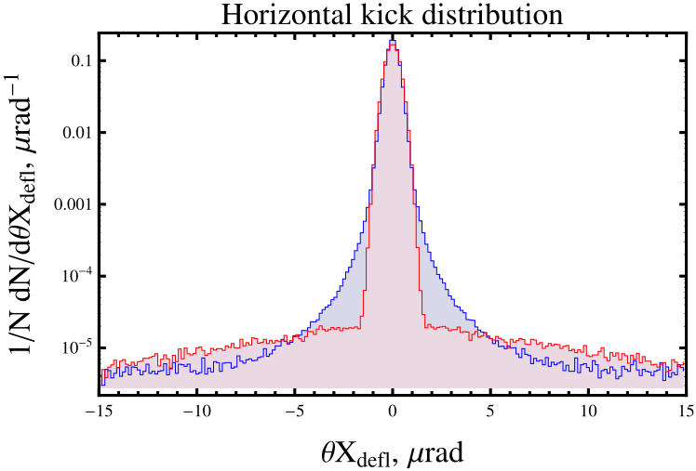
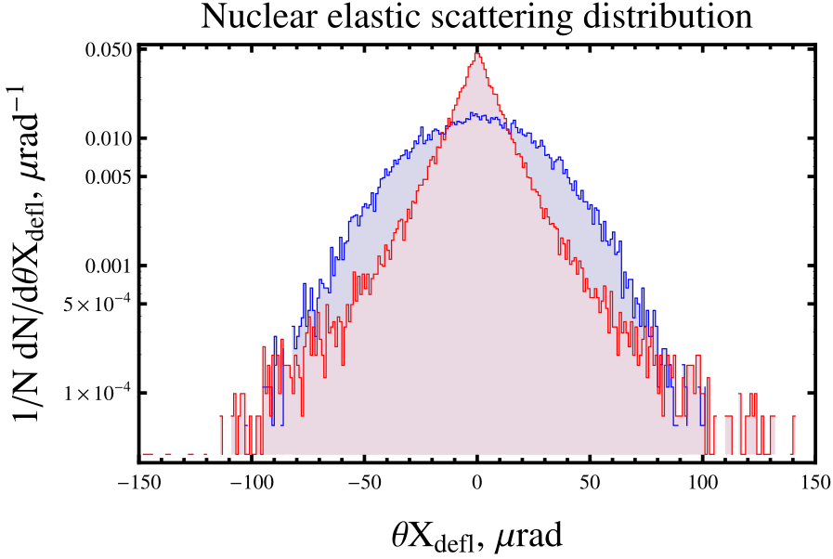
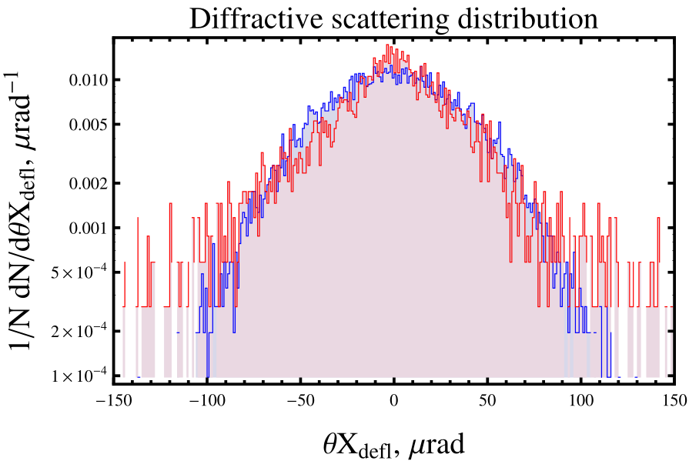
Horizontal kick distribution, amorphous orientation
Multiple
coulomb
scattering
Single
coulomb scattering
Nuclear +
diffractive
scattering
Nuclear +
diffractive
scattering
About 0.7% of particles are scattered by single coulomb scattering. It may be important for collimation.
About 0.3% of particles will be scattered by either elastic or diffractive nuclear scattering. A correct model for such events can be also essential.

Slide 12
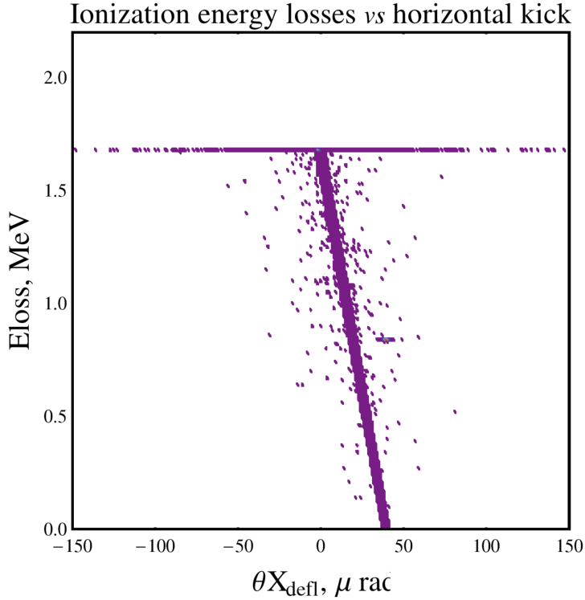
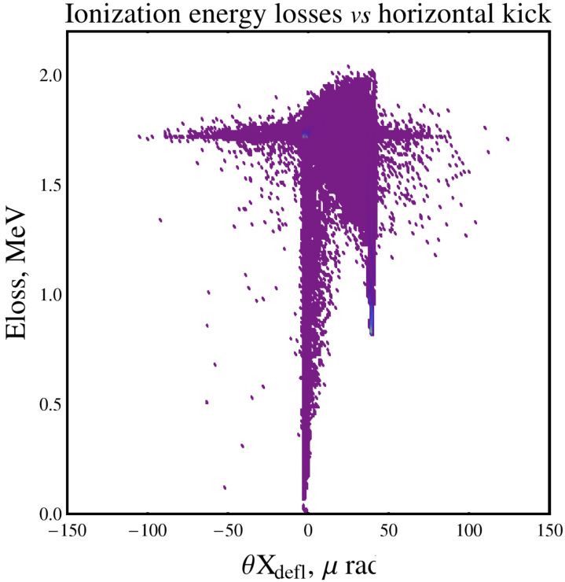
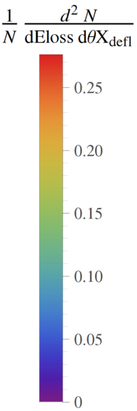
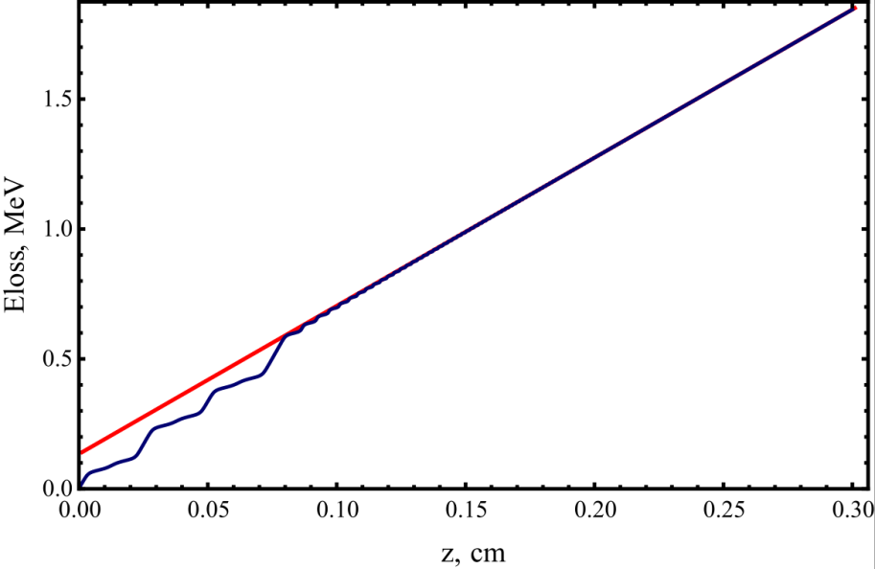
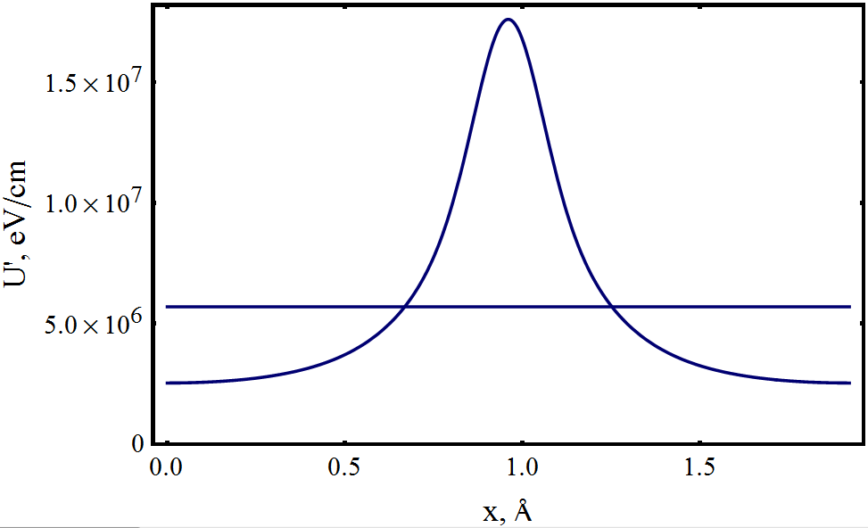
Ionization losses, channeling orientation
Dechanneling + amorphous
Dechanneling + amorphous
Nuclear + diffractive
scattering
Nuclear + diffractive
scattering
Exit through
crystal lateral
surface + VR
Channeling
Channeling,
dechanneling
Ionization energy losses vs passed distance
Ionization energy losses per cm vs transverse coordinate
Amorphous
Crystal plane
Losses in
amorphous
direction
Dechanneling
Increasing of losses
up to 15% w.r.t. amorphous orientation;
10% of particles
Channeling with
high amplitude

Slide 13
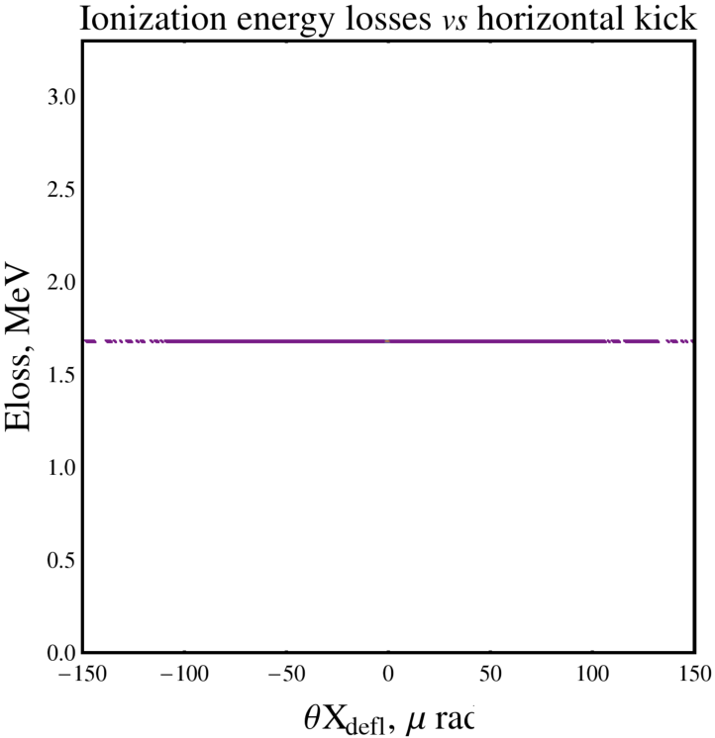
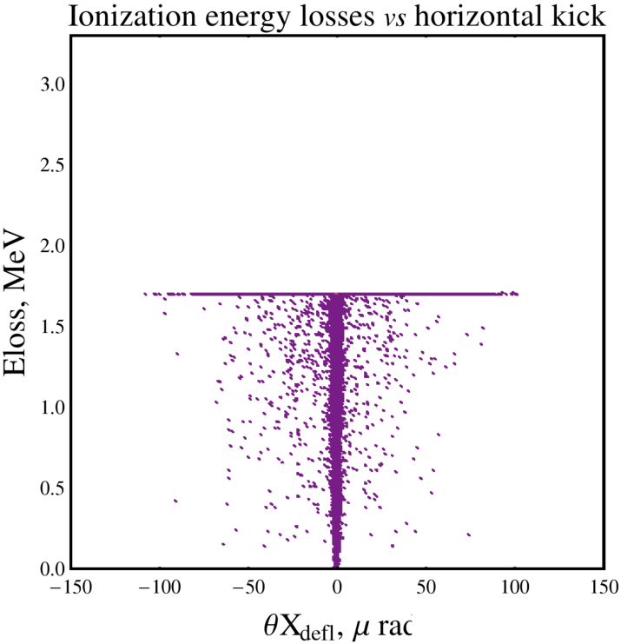
Ionization losses, amorphous orientation: 100μrad
Nuclear + diffractive
scattering
Nuclear + diffractive
scattering
Coulomb
scattering
Coulomb
scattering
Exit through
crystal lateral
surface
About 7% of particles will escape the crystal through its lateral surface at amorphous orientation.
It may be important for collimation.
Exit through
crystal lateral
surface
Ionization losses for LHC proton beam are not important, but for heavy ion beam they are im-
portant: dEloss~20-50GeV/cm for 574TeV ions.

Slide 14
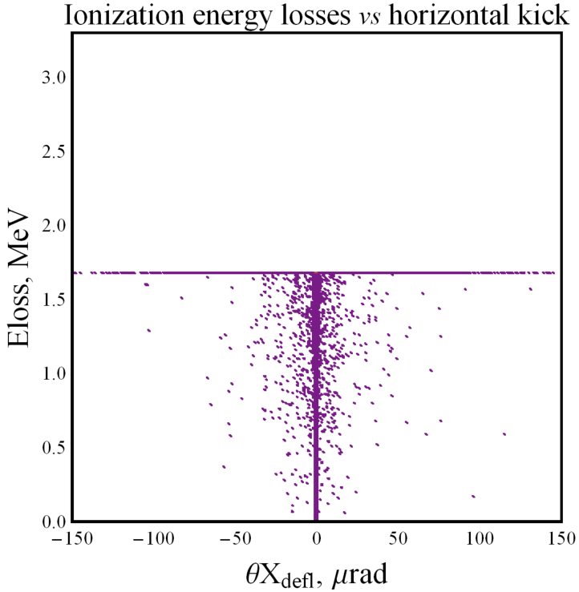
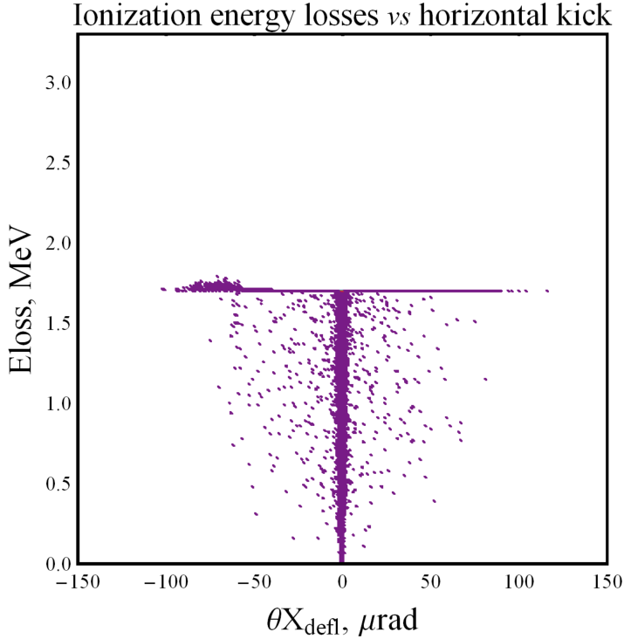
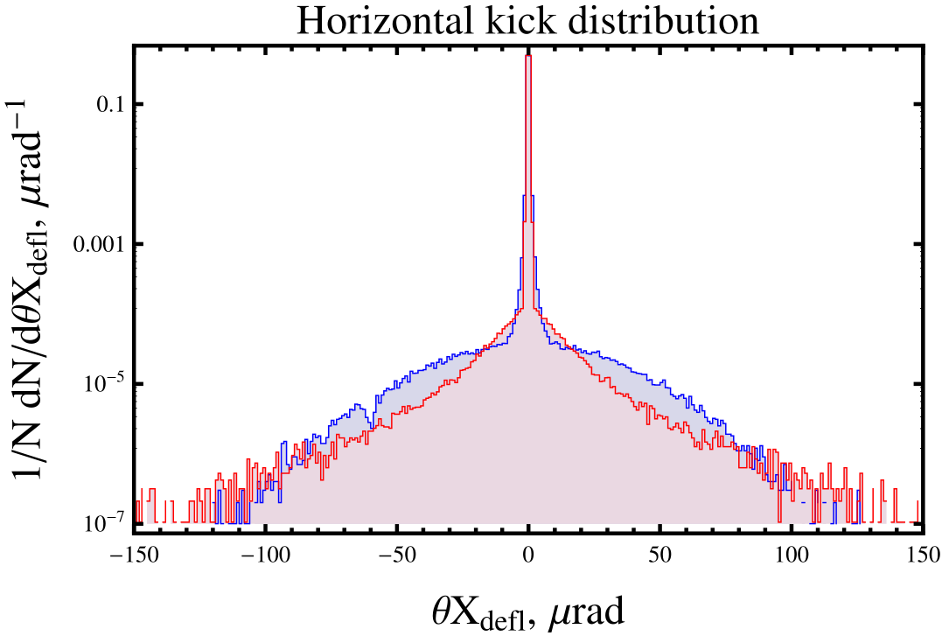
Ionization losses, amorphous orientation: –100μrad
Nuclear + diffractive
scattering
Nuclear + diffractive
scattering
VR of
strongly
scattered
particles
Coulomb
scattering
Coulomb
scattering
Entrance
through
crystal lateral
surface
Entrance
through
crystal lateral
surface
Nuclear or diffractive
scattering
Reflection of strongly
scattered particle
Single
coulomb scattering
Multiple
coulomb
scattering
VR of strongly
scattered particles
Nuclear +diffractive
scattering

Slide 15
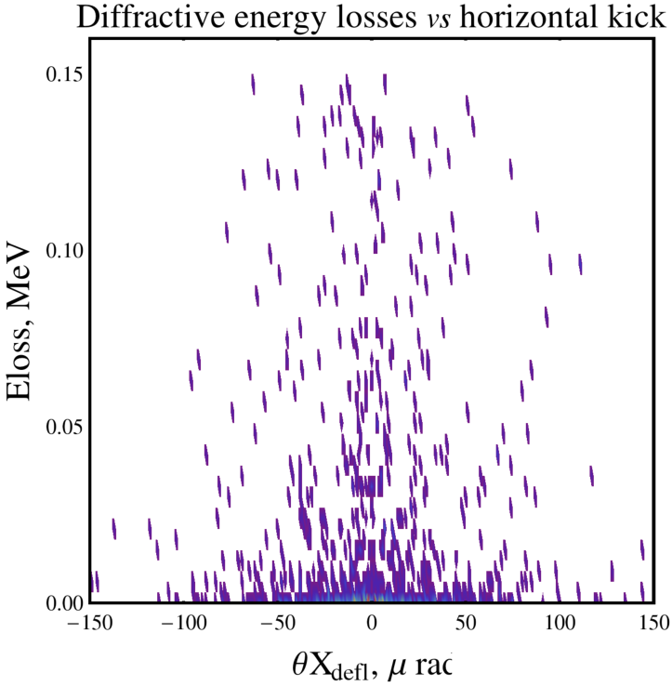
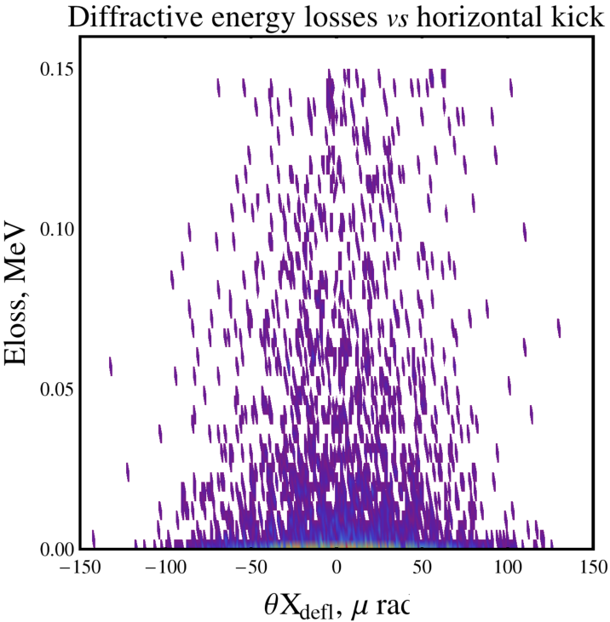
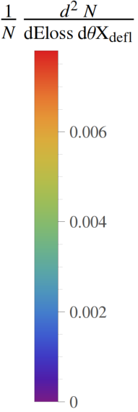
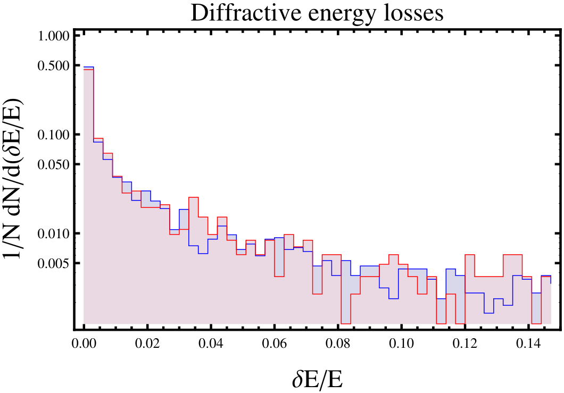
Diffractive losses, channeling orientation
Difference is explained simply by different statistics caused by different models of elastic nuclear scattering.
About 0.3% of particles will be scattered by either elastic or diffractive nuclear scattering. Energy deposition is enough for considerable changing the trajectory in accelerator. A correct model for such events is important.

Slide 16
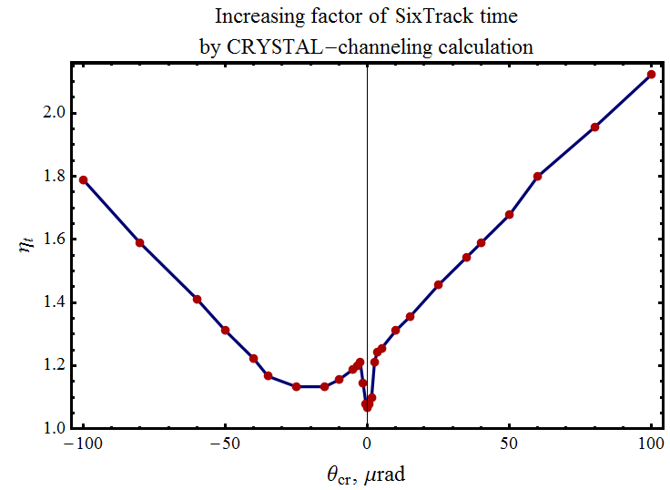
Percentage of different effects and calculation time analysis
For about 10 millions of particles the average time of calculation of SixTrack at lxplus was 5 h.
The calculation time by CRYSTAL-channeling strongly depends on crystal orientation.
Calculation was performed by
i7 processor, 4 cores, 2.3 GHz.
For estimation it was put that calculation at lxplus is 3 times faster.
amorphous
VR
50 % increasing
30 % increasing
channeling

Slide 17
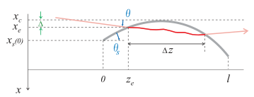
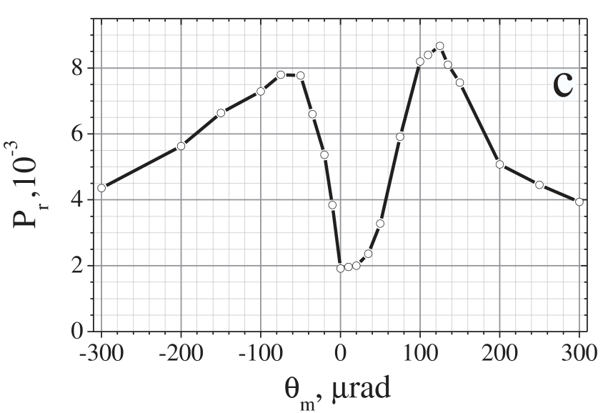
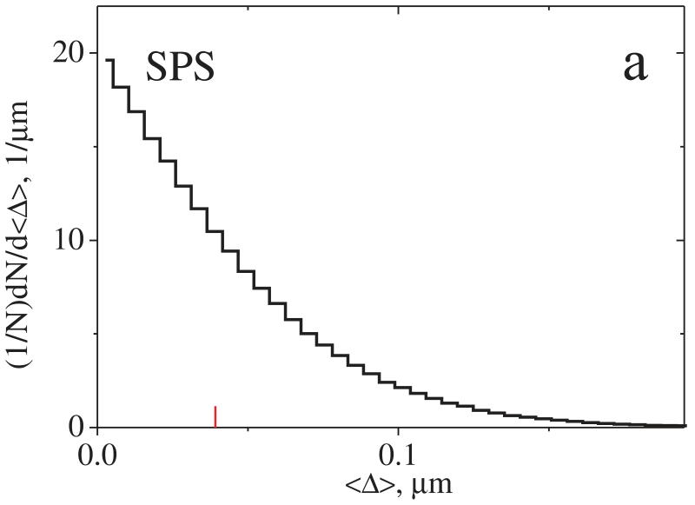
UA9
miscut
influence
zone
average
impact parameter

Slide 18
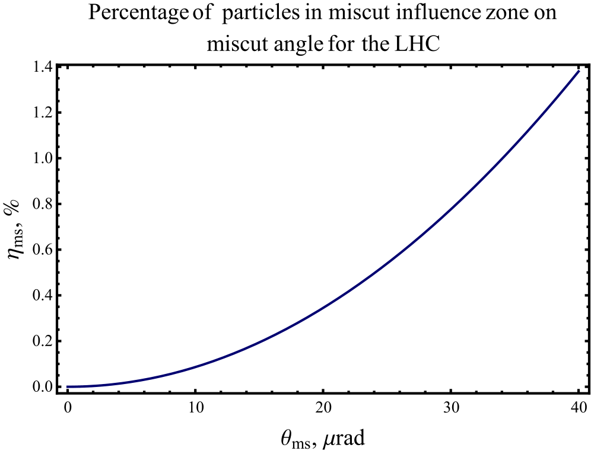
Miscut angle influence for the LHC
LHC miscut influence zone:
1.4% of particles for θ_{ms}=40µrad
0.78% of particles for θ_{ms}=30µrad
0.35% of particles for θ_{ms}=20µrad
0.086% of particles for θ_{ms}=10µrad
Depending on its value miscut angle
may be important for collimation
LHC
miscut
influence
zone
miscut
influence
zone
average
impact parameter

Slide 19
Overview of important effects for collimation
Channeling profile: may be important only for a large negative miscut.
Volume reflection profile is important for any crystal orientation.
Single coulomb scattering at large angle (more than 1μrad) occurs with 0.25% and 0.7% of particles for channeling and amorphous orientation correspondingly. So, it may be important for any crystal orientation.
Fast dechanneling occurs with about 1.3% of particles for channeling orientation. So, it may be also important.
Nuclear elastic, diffractive and inelastic scattering and diffractive energy losses are essential for crystal collimation. So, the correct model for such effects is very important.
Ionization energy loss map reflects almost all effects occurring in crystal. It may be important for heavy ions.
Escape of particles through the lateral surface of the crystal involves about 0.25%, 2% and 7% for channeling, VR and amorphous orientation correspondingly. It is very important for collimation.
Miscut angle can be important for the same reason as the previous effect for values θ_{ms}>10-20 µrad.

Slide 20
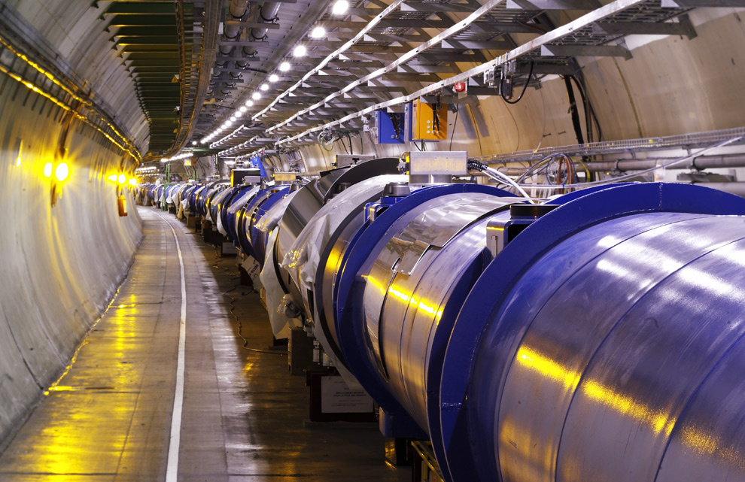
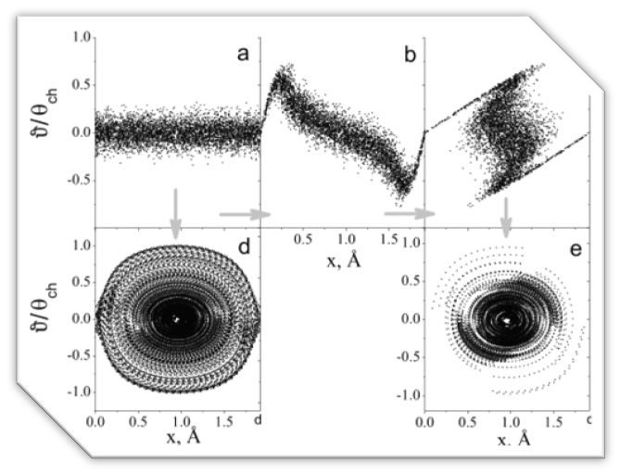
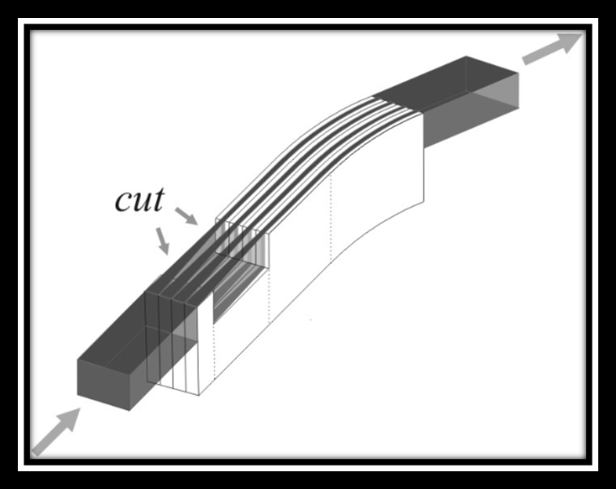
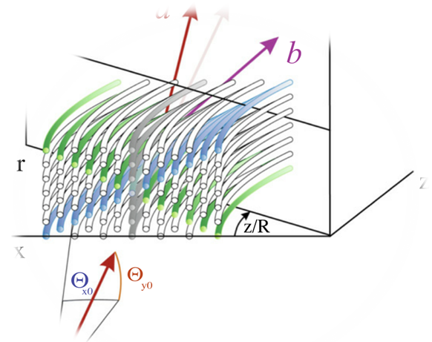
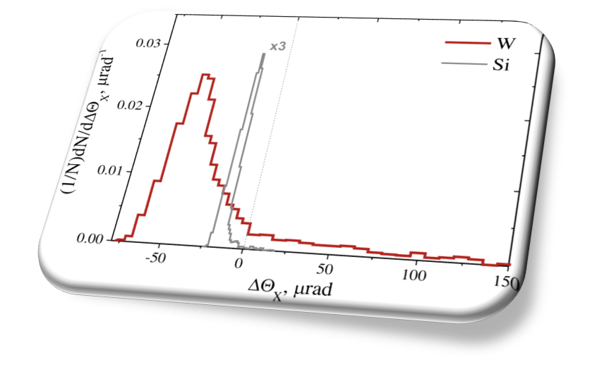
New effects for the collimation at the LHC

Slide 21
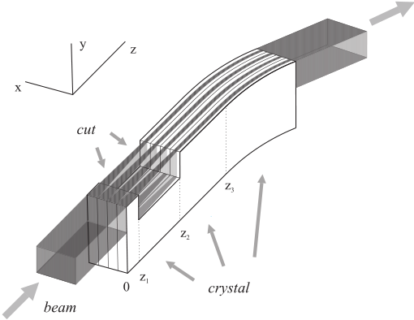
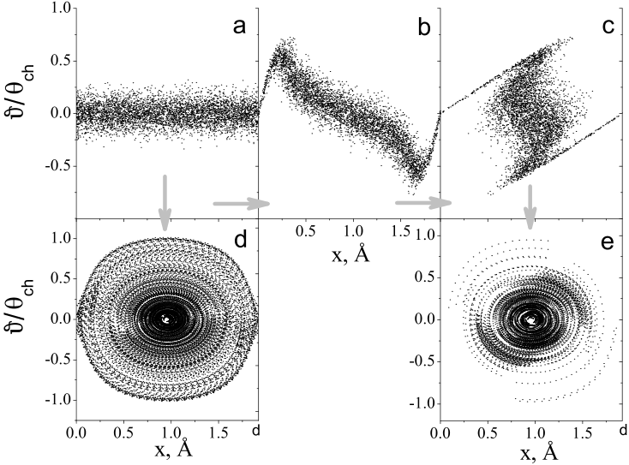
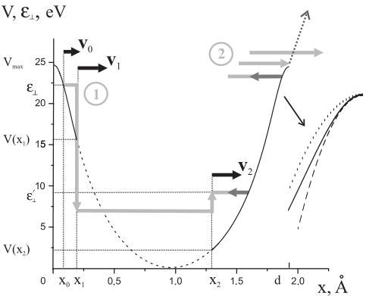
Proton "phase space" a) at z = 0, b) at z = z₁,
c) at z = z₂ and e) at z = z₂+πν||/2ω in the cut presence and d) at z = z₁+πν||/ω in the absence of the latter

Slide 22
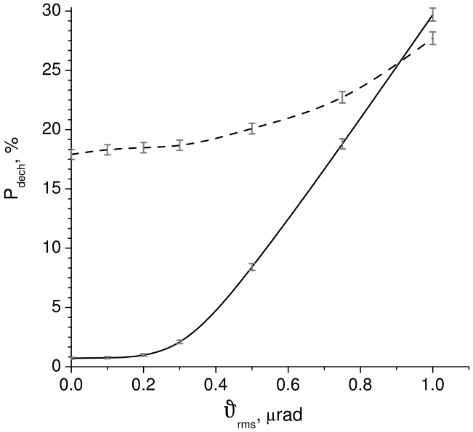
no cut
cut
Angular divergence of the beam is small enough for application of this technique.
Dependence of the 7TeV proton dechanneling probability in a 1 cm bent Si crystal on the r.m.s. incidence angle

Slide 23
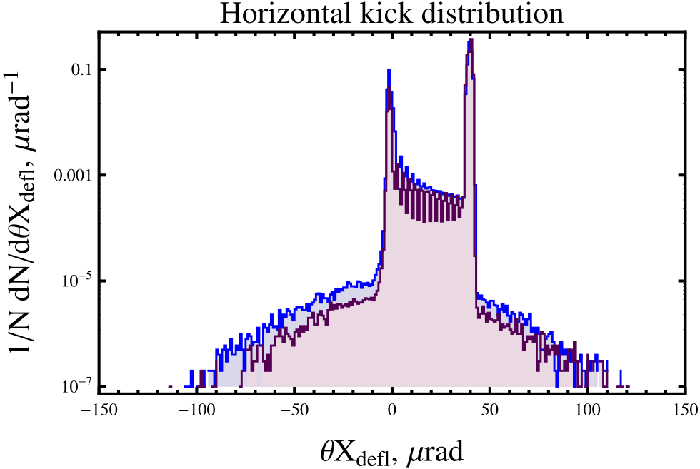
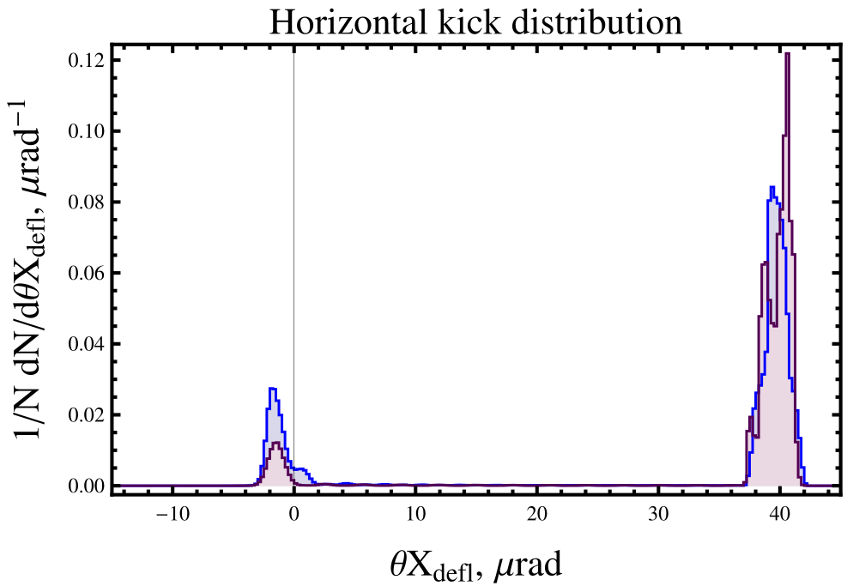
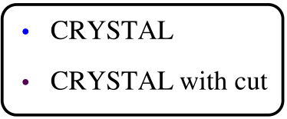
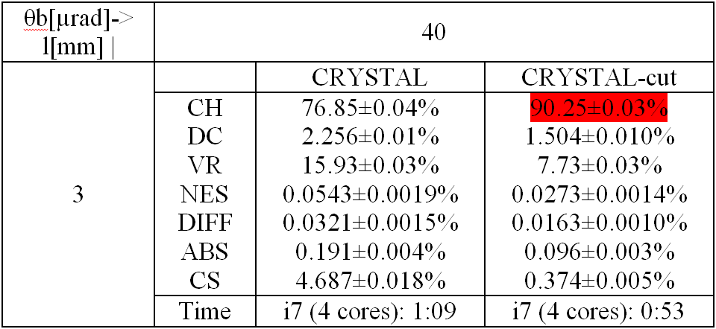
A technique to improve crystal channeling efficiency
for the LHC!
Channeling
Channeling
Dechanneling +
amorphous
VR
Nuclear + diffractive
scattering
VR
Fast dechanneling +
amorphous
Channeling efficiency increases by 13.5%!
Nuclear interactions decrease in 2 times!
Cut parameters: z₁=17μm; cut thickness z₂-z₁ 54μm for the LHC energy. Quite real!

Slide 24
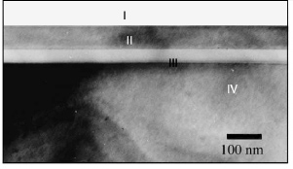
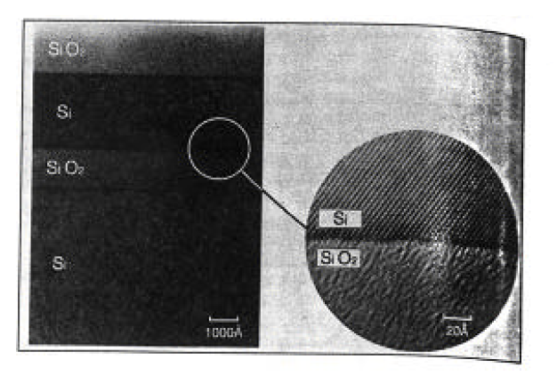
Cut parameters: the crystal layer before 17μm; cut thickness 54μm for the LHC energy.
Quite real! Much simpler to make an amorphous layer instead of the cut.

Slide 25
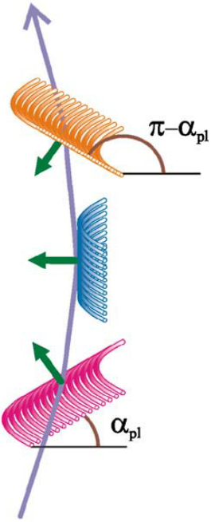
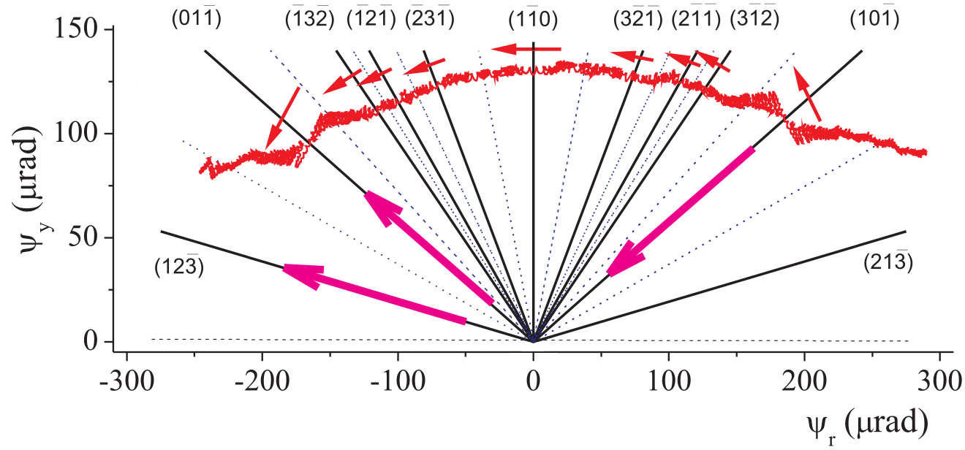
Multiple Volume Reflection in one bent crystal (MVROC)*
Axes form
many inclined
reflecting planes
x
Evolution of particle transverse velocity in the ry plane**
*V. Tikhomirov,
PLB 655 (2007) 217;
V. Guidi, A. Mazzolari
and V. Tikhomirov,
JAP 107 (2010) 114908
**V.V. Tikhomirov,
A.I. Sytov, NIM B 309 (2013) 109–114.

Slide 27
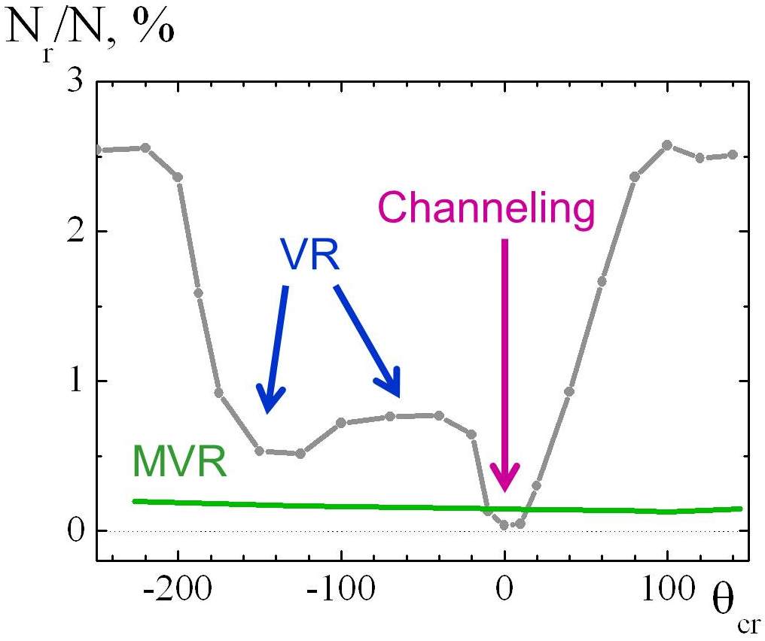
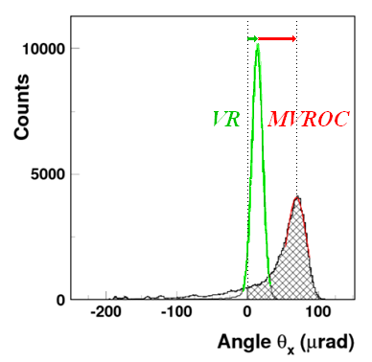
Applications of MVROC
MVROC for
the UA9 experiment
First MVROC observation
W. Scandale et al, PLB 682(2009)274
MVROC
MVROC indeed increases reflection angle 5 times

Slide 28
Distributions of the impact parameter and
number of the crystal transversals
in usual Si crystal and crystal in MVR orientation
Impact parameter distribution
Crystal passages number distribution
MVR both increases the impact parameter and decreases
the crystal transversals number at rough alignment

Slide 29
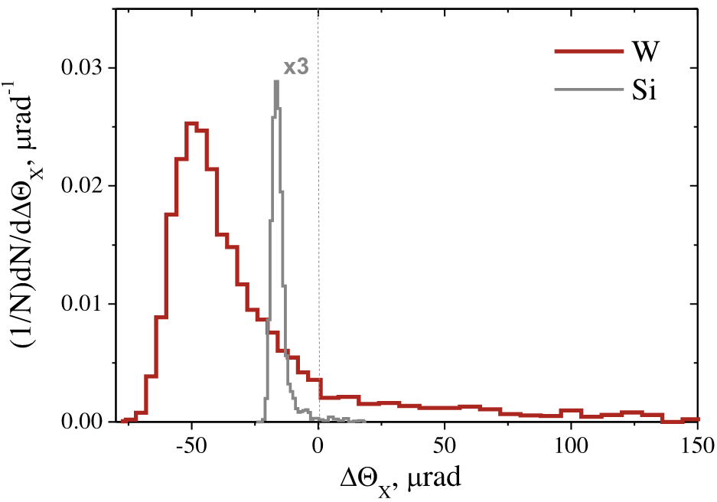
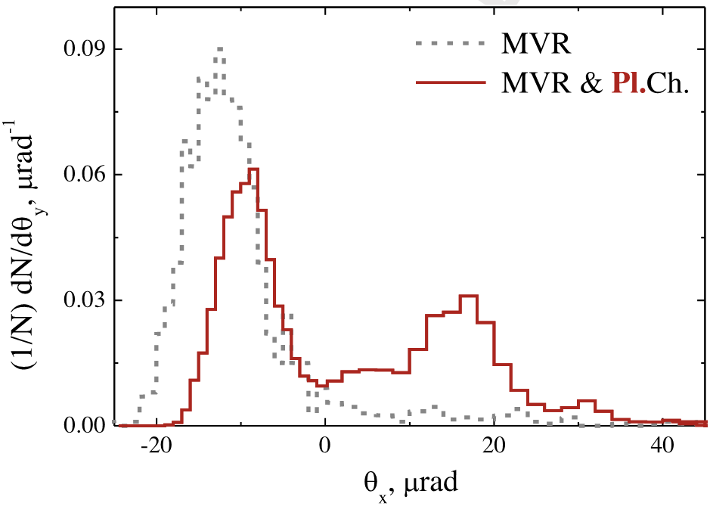
Modifications of MVROC*
Angular distributions of 7 TeV protons behind 5 mm W <111> (left peak) and Si <111>
(right peak) crystals for MVROC deflection.
δΘ_{X,Y} = 4 μrad in both cases.
Angular distributions of 7 TeV protons behind 5mm Si <111> crystal. Dashed line – for the unperturbed by channeling MVROC and solid line for MVROC accompanied by planar channeling. δΘ_{X,Y} = 4 μrad in both cases .
The MVROC in tungsten crystal could deflect a majority of halo particles onto secondary collimators at the first passage through the primary crystalline collimator.
Combined action of the MVROC and planar channeling increases the r.m.s. angle nearly three-four times.
*V.V. Tikhomirov, A.I. Sytov, NIM B 309 (2013) 109–114.

Slide 30
Conclusions
Systematic comparison of CRYSTAL-channeling with different crystal routine was performed.
I found some difference related to the physics treatment of the particles dynamics in the crystal:
dechanneling peaks well correlated with channeling oscillations;
channeling/VR profile;
volume capture;
single coulomb and nuclear elastic scattering;
correlation between horizontal kick and ionization losses;
simulation of escape through the crystal lateral surface.
Crystal cut can considerably increase the channeling efficiency and decrease inelastic losses in crystal. Additionally it can be the first experimental test of this effect.
MVROC in Tungsten crystal and combined action of MVROC and channeling are also nice effects for experimental test at the LHC.

Slide 31
INP
Thank you for attention!

