Slide 1
Long-range beam-beam compensation at HL-LHC
Tatiana Rijoff, Frank Zimmermann
ColUSM #19 - 01/03/2013

Slide 2
long-range beam-beam collisions
perturb motion at large betatron amplitudes, where particles come close to opposing beam
cause ‘diffusive aperture’ (Irwin), high background, poor beam lifetime
increasing problem for SPS, Tevatron, LHC,...
that is for operation with larger # of bunches
 | #LR encounters
SPS | 9
Tevatron Run-II | 70
LHC | 120

Slide 3
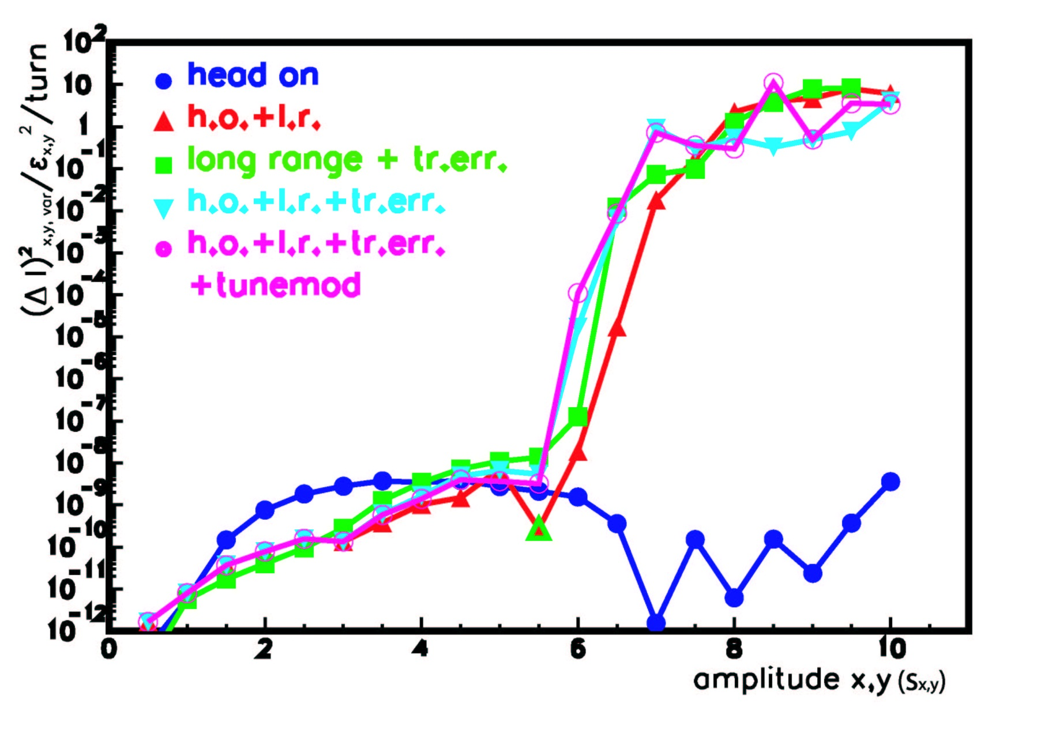
result of weak-strong simulations for LHC
center
of other
beam
Y. Papaphilippou
& F.Z., LHC 99
‘diffusive aperture’

Slide 4
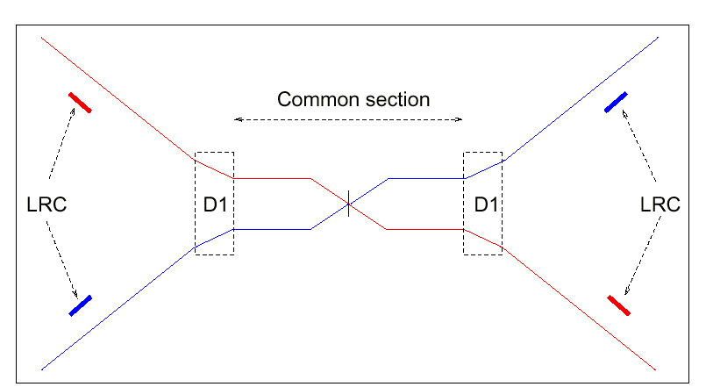
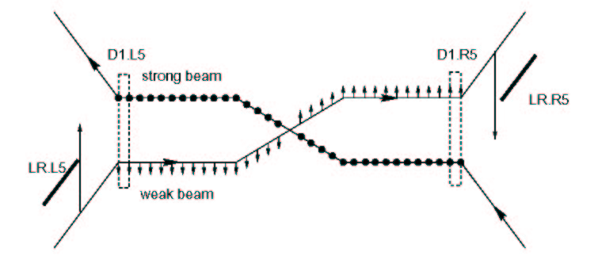
Proposed Long-Range Beam-Beam Compensation for the LHC
To correct all non-linear effects correction must be local.
Layout: 41 m upstream of D2, both sides of IP1/IP5
Phase difference between BBLRC &
average LR collision is 2.6º
(Jean-Pierre Koutchouk)

Slide 5
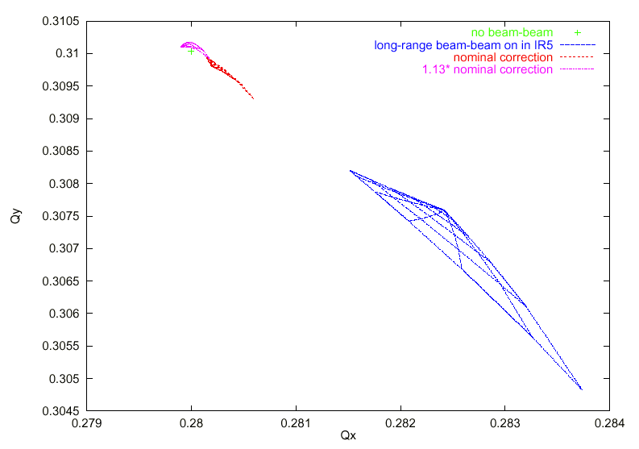
simulated LHC tune footprint with & w/o wire correction
.16σ
.005σ
.016σ
Beam
separation
at IP
(Jean-Pierre Koutchouk, LHC Project Note 223, 2000)

Slide 6
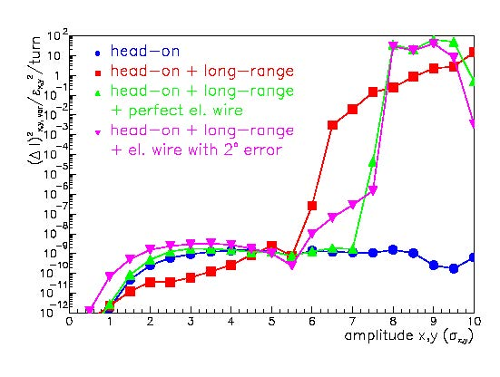
Frank Zimmermann, 2001 Beam-Beam Workshop, Fermilab

Slide 7
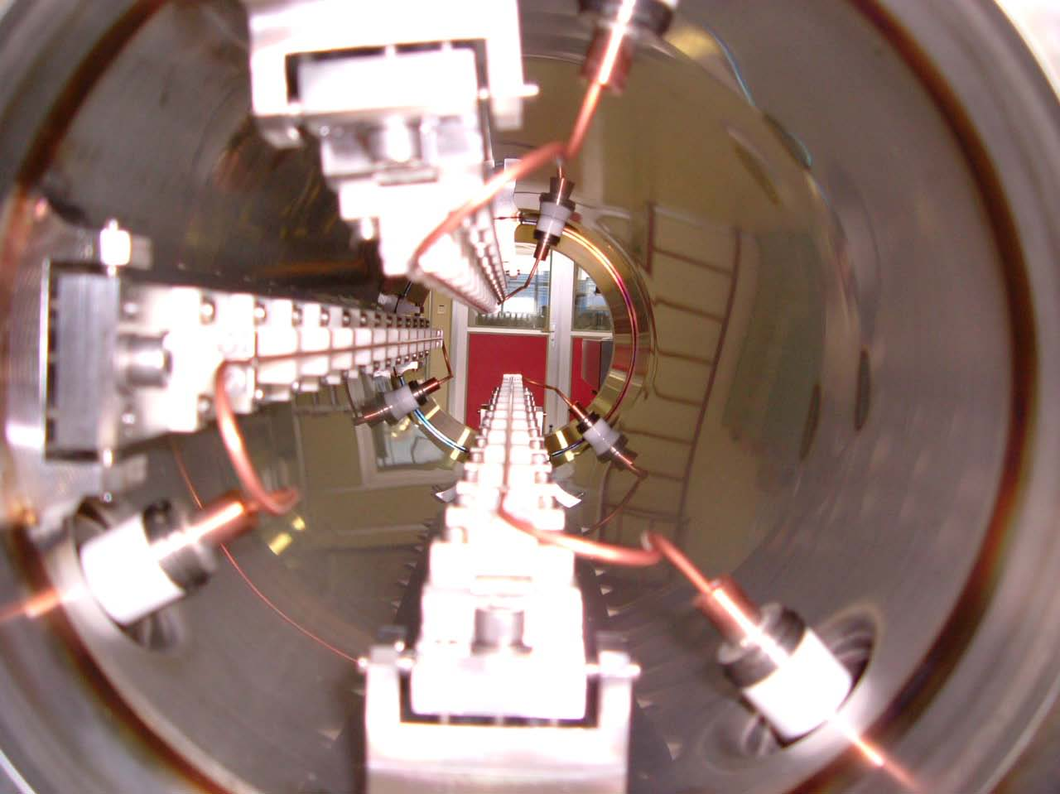
SPS single-beam MDs with multiple wires
2002-2010
2x2 water-cooled
units
presently
installed
in the SPS
(two with remote
control)
1x2 spare units
ready
1st RHIC
BBLR stored
at CERN
2nd RHIC
BBLR
being shipped
in total 5
sets available
J.-P. Koutchouk, G. Burtin, J. Wenninger, U. Dorda,
G. Sterbini, F. Zimmermann, et al

Slide 8
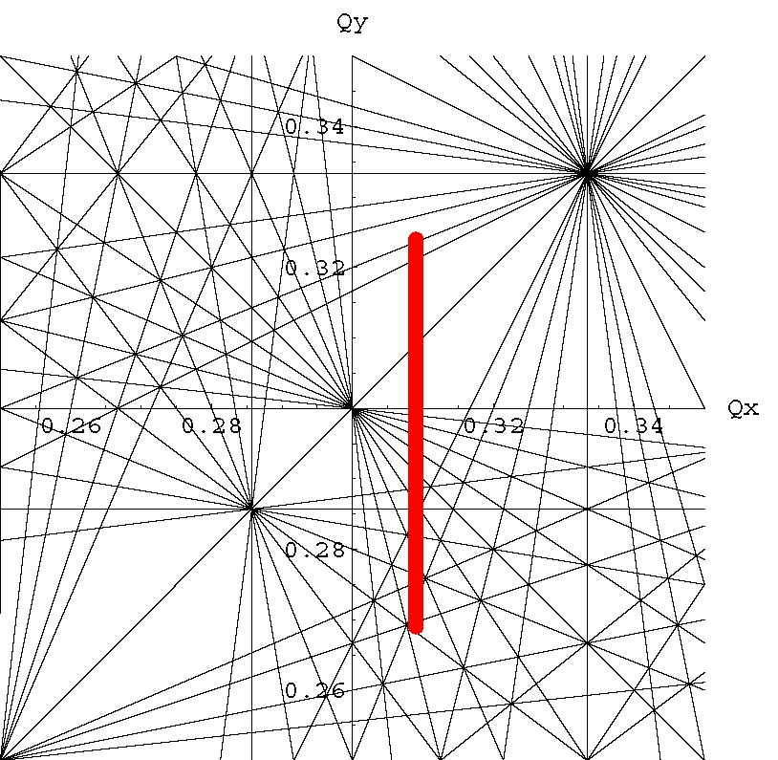
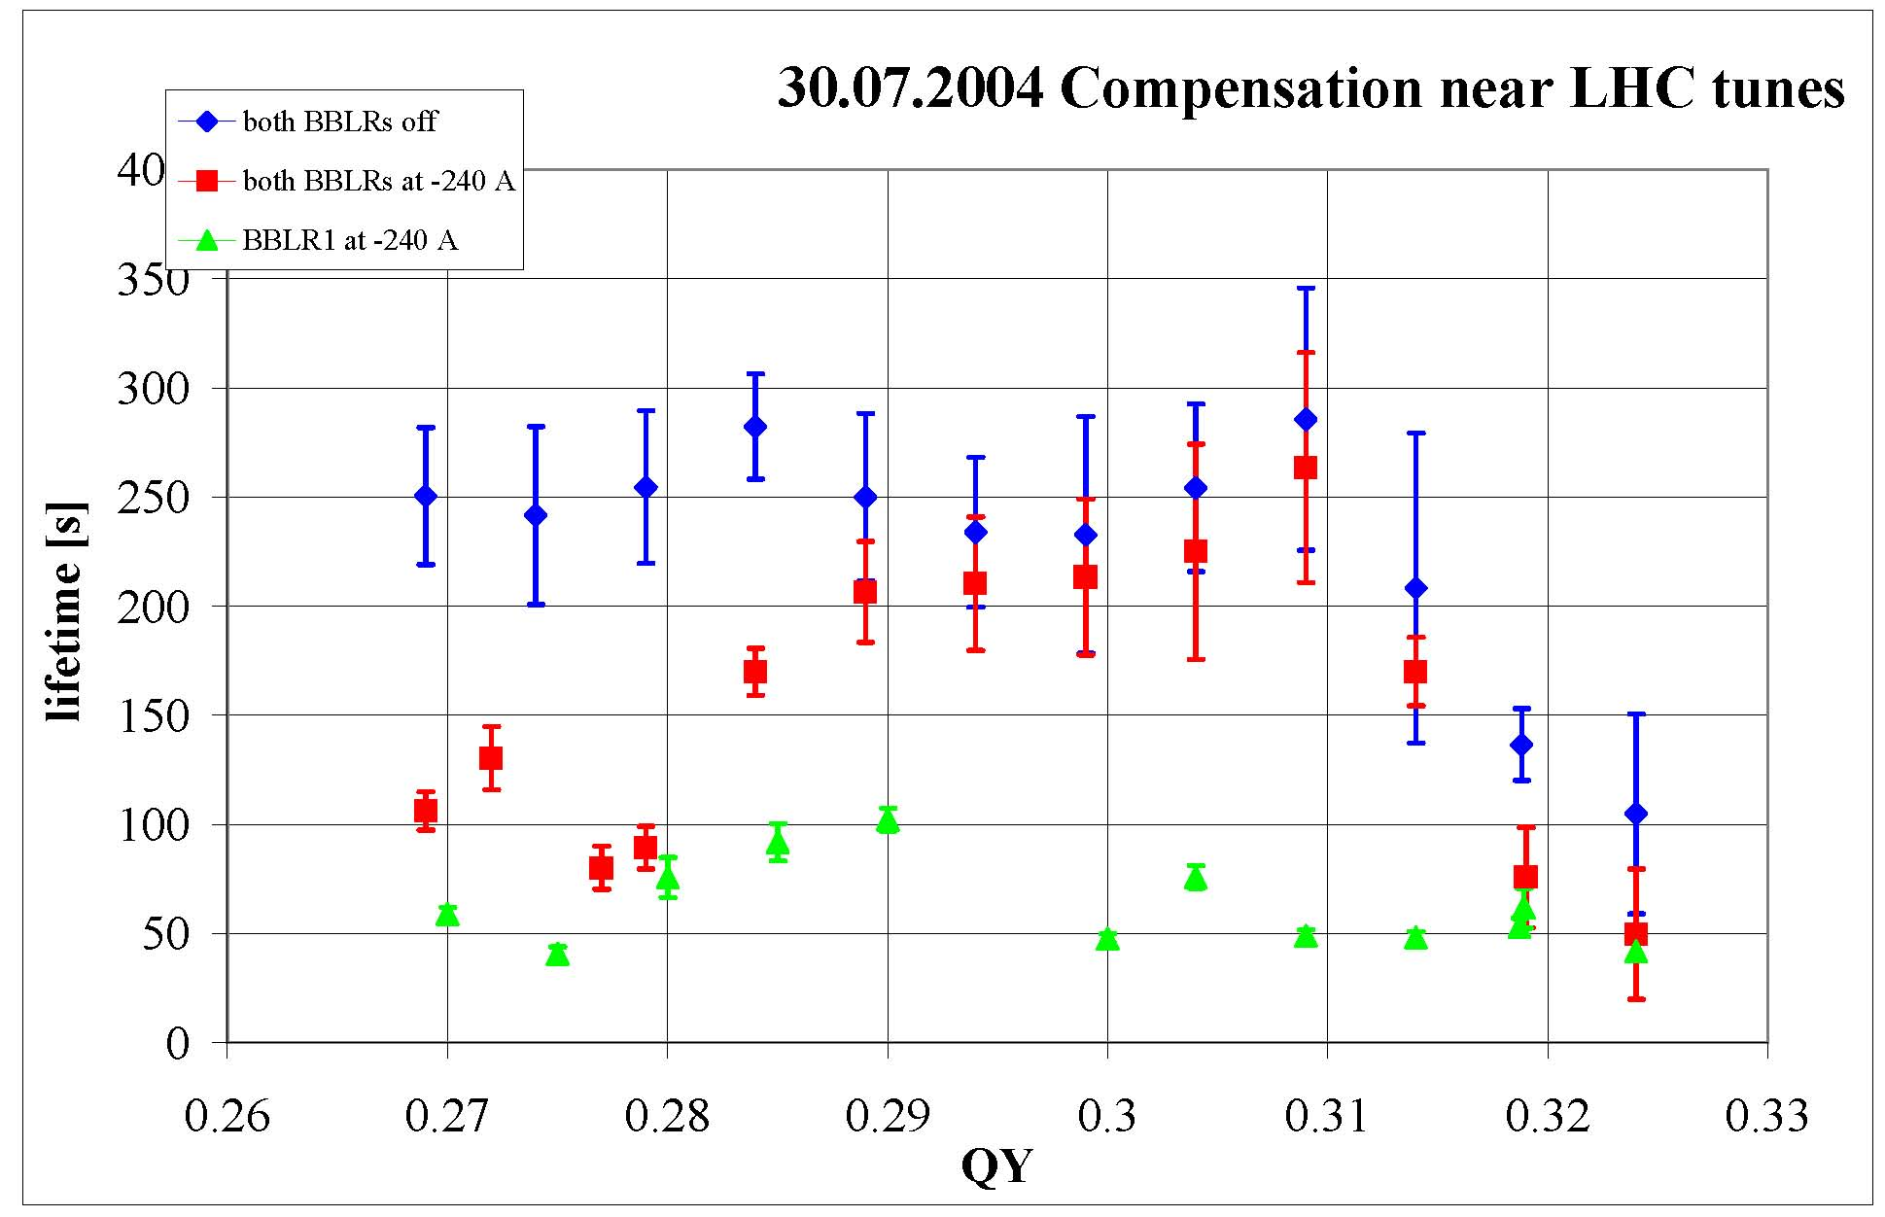
measured BBLR compensation efficiency vs. working point
- scan around LHC tunes
we scanned QY w/o BBLRs, with BBLR1 only, and with BBLR1 & BBLR2
30.07.04
3rd
10th
7th
4th
nearly perfect
compensation
what happens here?
compensate BBLR1 by BBLR2

Slide 9
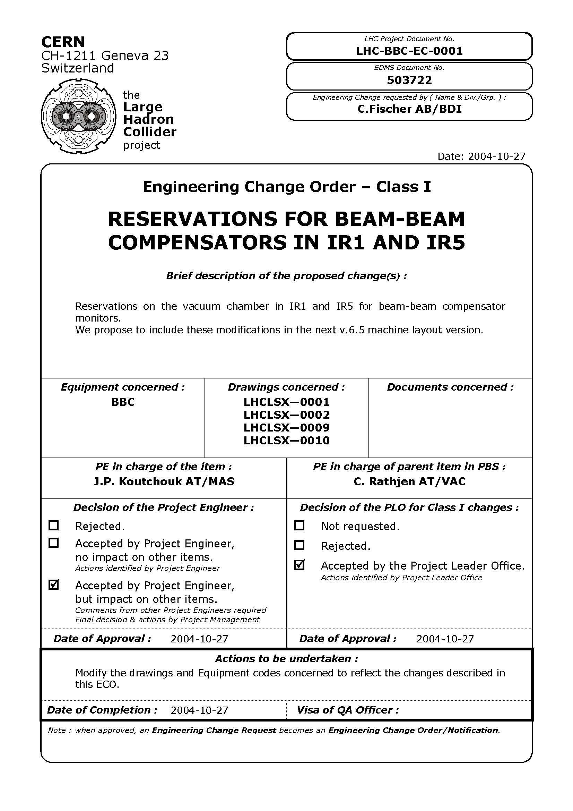
for future wire
LR beam-beam
compensators,
3-m long sections
had been reserved
in LHC at 104.93 m
(center position)
on either side of
IP1 & IP5

Slide 10
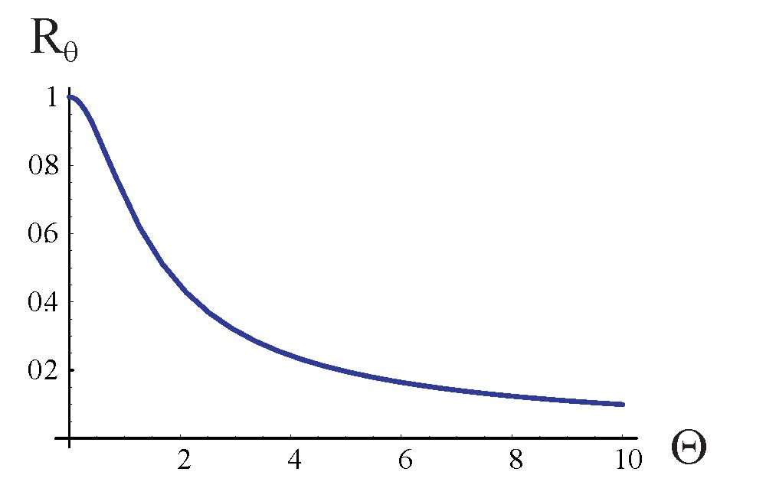
Piwinski angle
luminosity reduction factor
nominal LHC
HL-LHC
~1/β*

Slide 11
minimum crossing angle from LR b-b
“Irwin scaling”
coefficient
from simulation
note: there is a threshold - a few LR encounters
may have no effect! (2nd PRST-AB article
with Yannis Papaphilippou)
minimum crossing angle with wire
compensator
need dynamic aperture
of 5-6 σ &
wire compensation not
efficient within 2 σ
from the beam center
independent of beam current

Slide 12
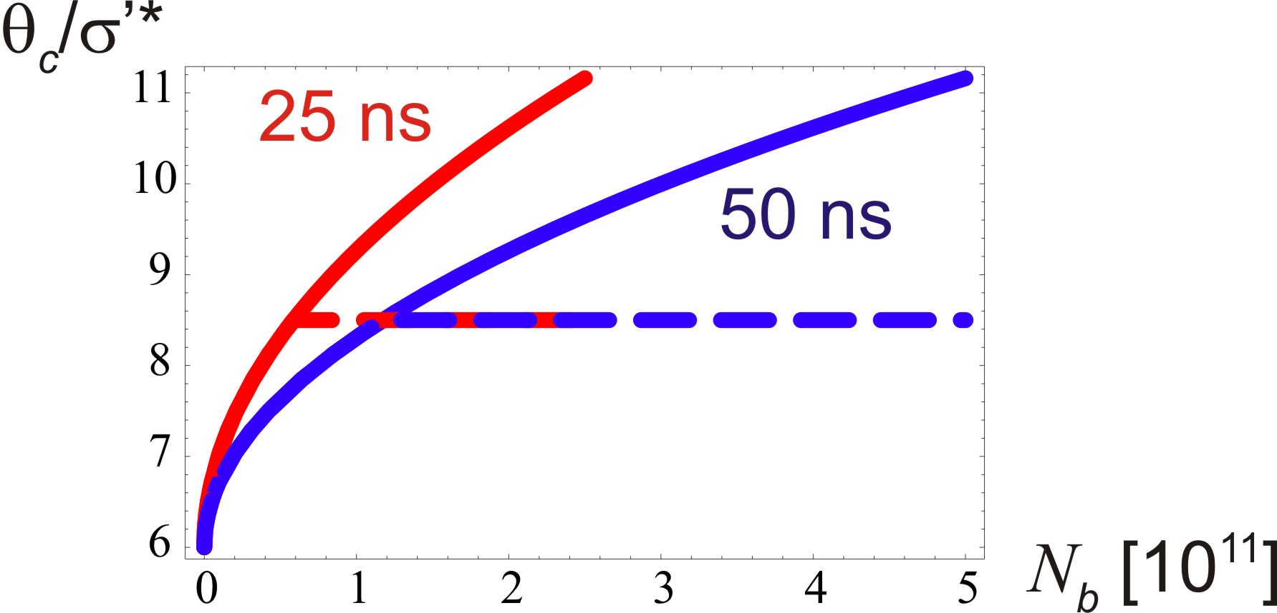
normalized crossing angle versus bunch intensity
with LR compensation
long range compensation will reduce the crossing angle

Slide 13
wire compensation & crab cavities?
wire compensator allows for smaller
crossing angle and hence smaller β* for
a given triplet aperture;
it also reduces the required crab voltage
(RF limits, machine protection issues,…)

Slide 14
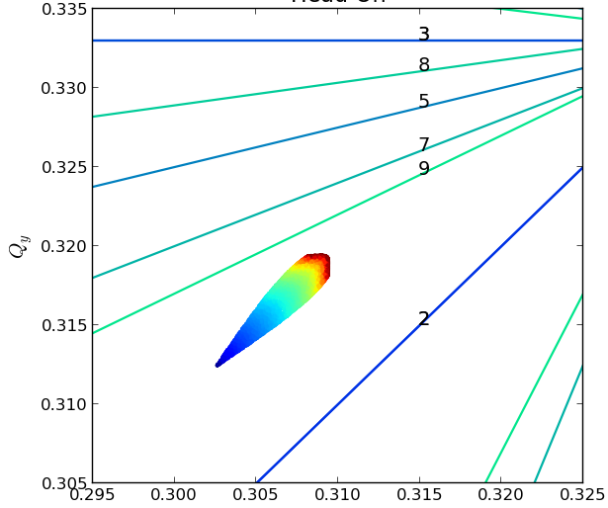
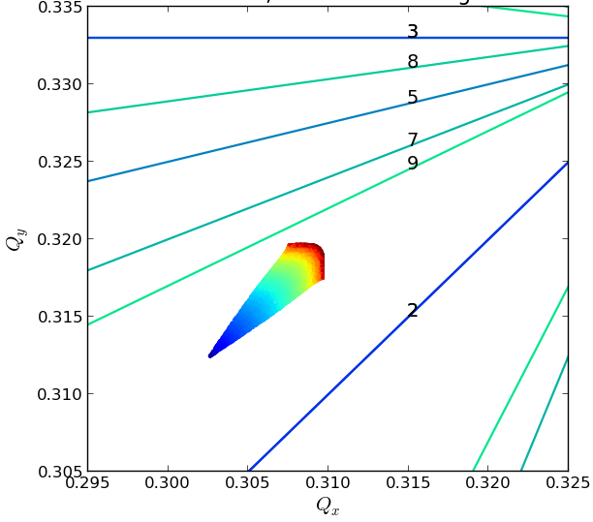
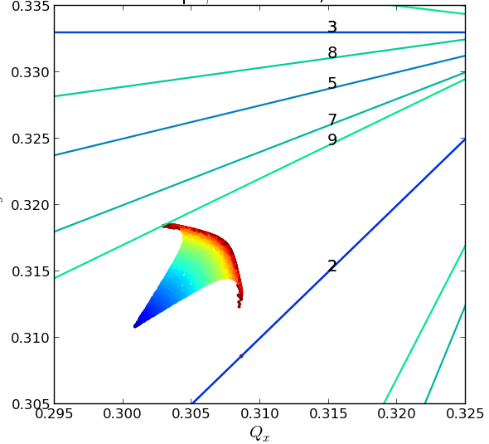
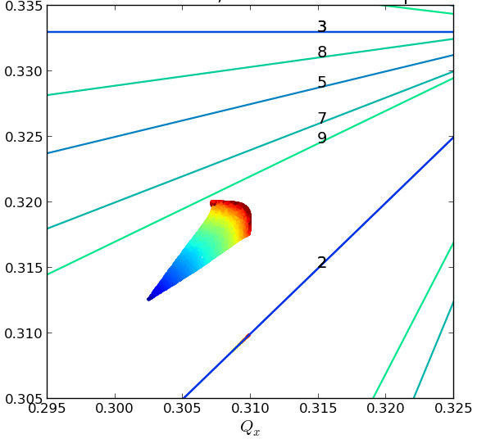
recent simulation results - tune footprints
Head on |  | Head on Long Range
BBC Wire | TCT opt β |  | TCT mod opt
Wire at 9.5 σ – 177 A
T. Rijoff

Slide 15
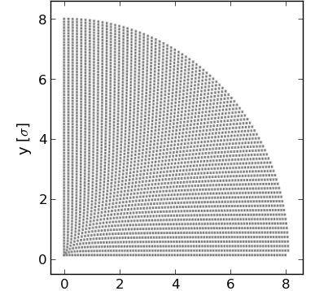
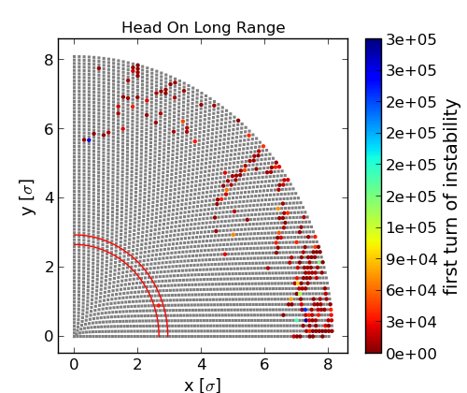
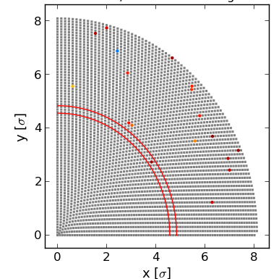
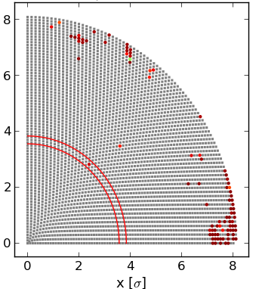
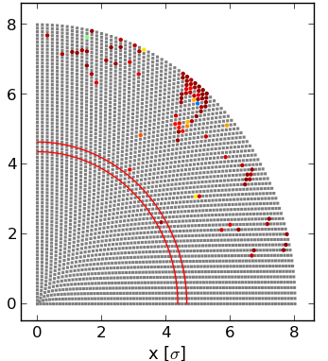
recent simulation results – unstable trajectories (Lyapunov)
Head on |  | Head on Long Range
BBC Wire | TCT opt β |  | TCT mod opt
T. Rijoff
Wire at 11 σ – 237 A

