Slide 1
11 T Dipole Status
May 2012
M. Karppinen CERN TE-MSC
On behalf of CERN-FNAL collaboration

Slide 2
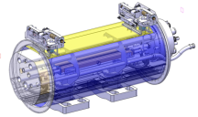
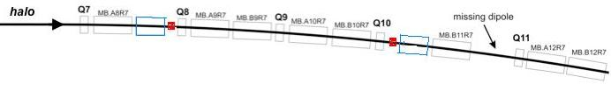
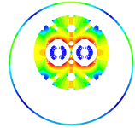
DS Upgrade
Create space for additional (cryo) collimators by replacing 8.33 T MB with 11 T Nb₃Sn dipoles compatible with LHC lattice and main systems.
MB.B8R/L
MB.B11R/L
11 T Nb₃Sn
15,66 m (IC to IC plane)
LS2 2018: IR-2
LS3 2022: IR-1,5, Point-3,7
5.5 m Nb₃Sn
3 m Collim.
5.5 m Nb₃Sn
5.5 m Nb₃Sn
5.5 m Nb₃Sn
3 m Collim
Joint development program between CERN and FNAL underway since Oct-2010 to demonstrate the feasibility of Nb₃Sn technology for this upgrade by 2014.

Slide 3
11 T Dipole & Collimator
Cryo-Assembly options
15,66 m (IC to IC plane)
11,48 m (L_{CM})
10,6 m (L_{mag})
3 m (collimator)
Line X (H.exch.)
beam tubes
Line M
(B.Bar line)
12 m (L_{CM})
5,3 m (L_{mag})
5,3 m (L_{mag})
3 m (collimator)
6,18 m (L_{CM})
6,18 m (L_{CM})
5,3 m (L_{mag})
2,27 m (collimator)
5,3 m (L_{mag})

Slide 4
11 T Design Challenges
Iron saturation effects
Transfer function matching with MB
Coil magnetization effects
  Conductor development
  Cable development
Quench protection
  Heater development
  QPS
Mechanical structure
  Forces almost 2 X MB
Coil fabrication technique
  Reproducibility
  Handling
Thermal
  Resin impregnated coils
Integration
  Optics
  Cold-mass
  Collimator
  Machine systems

Slide 5
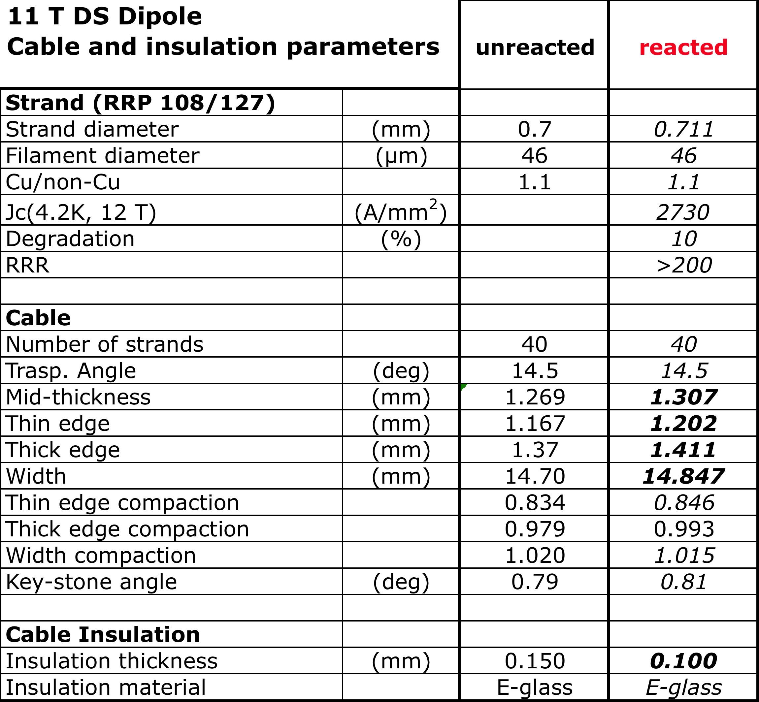
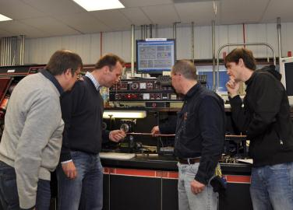
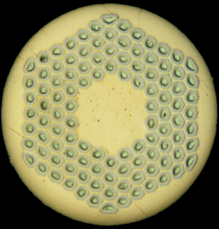
Strand & Cable
Cable samples made with and without SS core show I_{c}-degradation well within the initial goal of 10 %.
Cored cable with RRP 151/169 being developed at FNAL.
  Large aspect ratio, low compaction. Presently 20 µm additional compaction
  FNAL roll the cable in two stages with an intermediate anneal
  CERN use single pass process

Slide 6
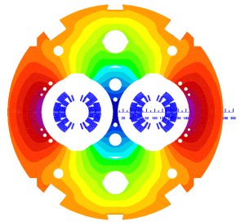
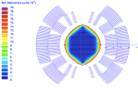
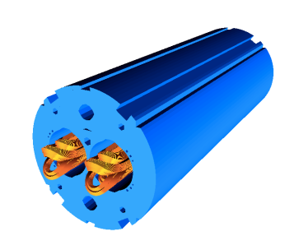
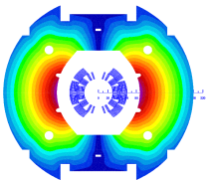
11 T Dipole Coil Design
B₀(11.85 kA) = 11.21 T
B₀(11.85 kA) = 10.86 T
Coil optimization
  >11 T at 11.85 kA with 20% margin at 1.9 K
  Field errors below the 10⁻⁴ level
6-block design, 56 turns (IL 22, OL 34)
  14.85-mm-wide 40-strand Rutherford cable, no internal splice
  Several X-sections were analyzed with and without core
  Coil ends optimized for low field harmonics and minimum strain in the cable

Slide 7
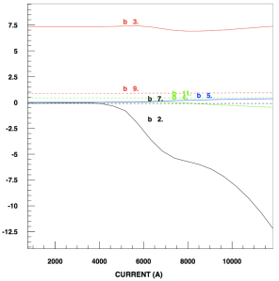
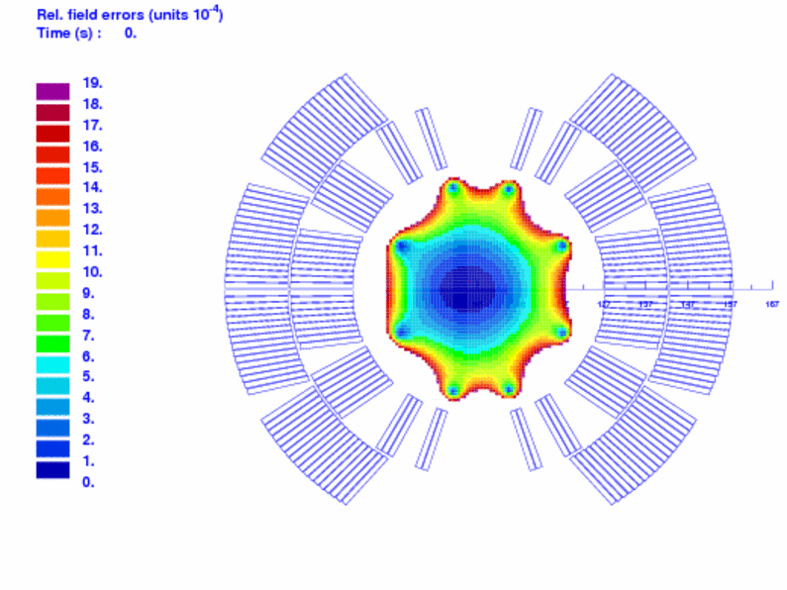
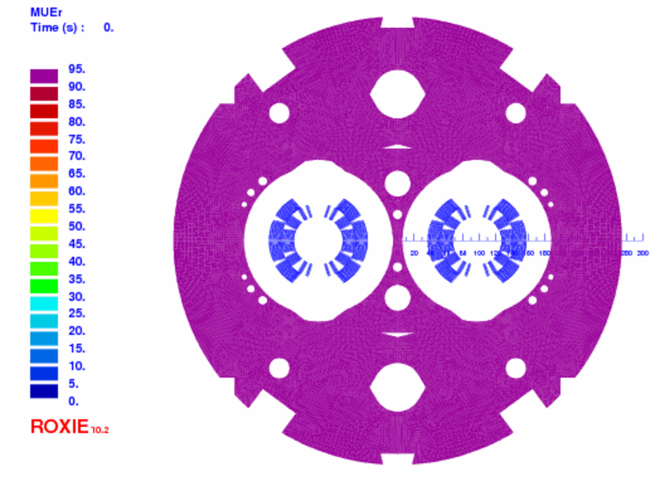
Iron Saturation
Yoke design
  The cut-outs on top of the aperture reduce the b₃ variation by 4.7 units as compared to a circular shape.
  The holes in the yoke reduce the b₃ variation by 2.4 units.
  The two holes in the yoke insert reduce the b₂ variation from 16 to 12 units.
Relative FQ (units)
Relative permeability

Slide 8
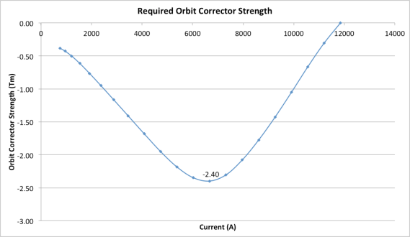
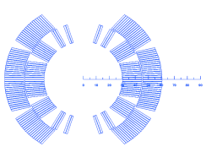
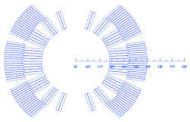
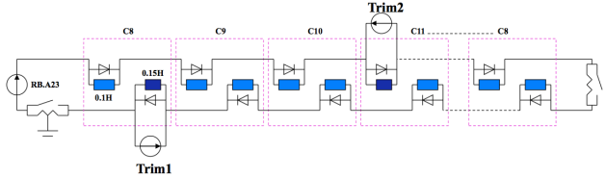
Transfer Function
TF of 11 T dipole is different from MB:
  More turns than MB (56 vs. 40) ➔ 11 T dipole is stronger at low field.
  More saturation ➔ reduction of transfer function at high field.
11 T
MB
2.4 Tm
300 A Monopolar
Trim PC
Courtesy of H. Thiessen

Slide 9
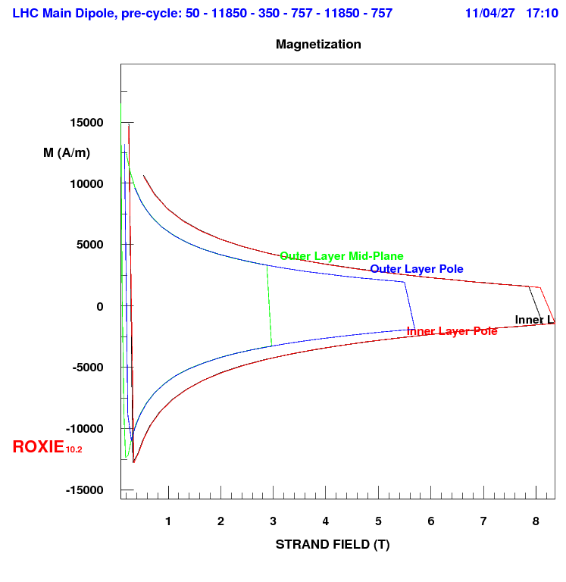
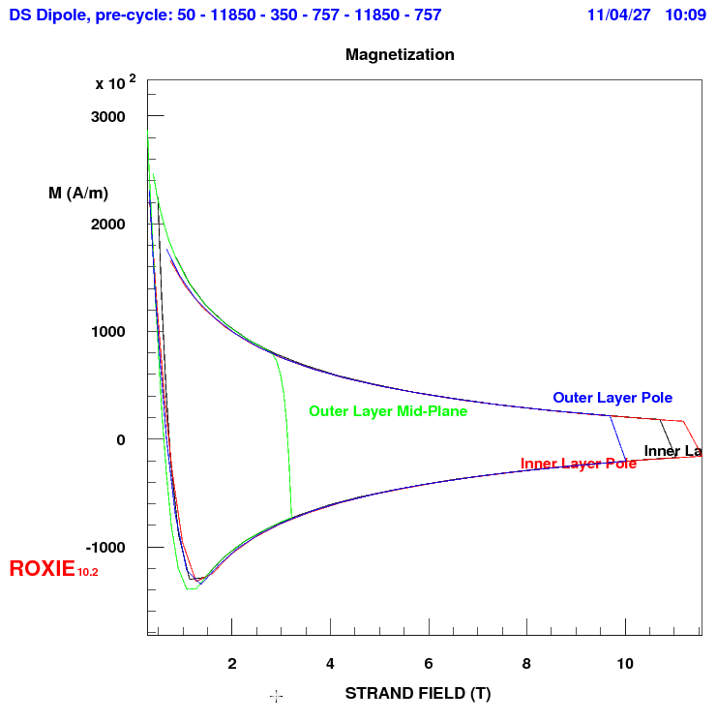
Coil Magnetization
MB (NbTi)
>10 X
11 T Dipole Nb3Sn
Mid-Plane Inner Layer
Mid-plane Outer layer
Inner Layer Pole
Outer Layer Pole

Slide 10
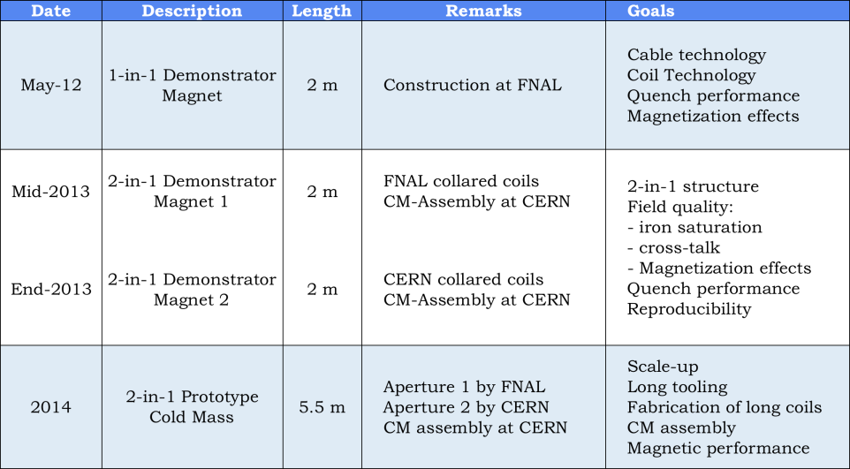
11 T Dipole Model Program

Slide 11
11 T Model Dipole Parameters
FNAL 1-in-1 demonstrator based on existing HFD components. Coils with integrated poles.
CERN 1-in-1 model based on CTF (MB). Coils with non-integrated poles (pole-loading concept).
2 m long 2-in-1 magnets of both concepts.

Slide 12
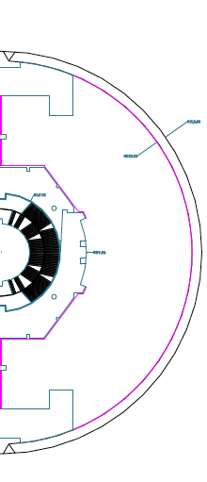
1-in-1 Demonstrator Mechanical Concept
I. Novitski FNAL
Coil mechanical support is provided by stainless collars, vertically split iron yoke, aluminium clamp and welded stainless steel skin.
Strong collars and iron yoke create the “rigidity belt” around Nb₃Sn coil for conductor protection.
Coil mid-plane and radial shims generate initial coil azimuthal pre-stress at collaring stage.
Skin and clamp tensions deform the iron and produce the desired coil compression. The collar also acts as gap-controller.
Collar-yoke-clamp-skin interfaces are tuned to sustain the horizontal EM force component.
Stainless Steel Skin
Stainless Steel
Collars
AL Clamp
controls
Outer
Yoke Gap
Iron Yoke
Nb₃Sn
Coil
Shims
Uniform
MP Shims
Phosphor
Bronze Key
CS-Bump
controls
Inner
Yoke Gap
Titanium Poles with
stress-relive slot
Aluminum Clamp

Slide 13
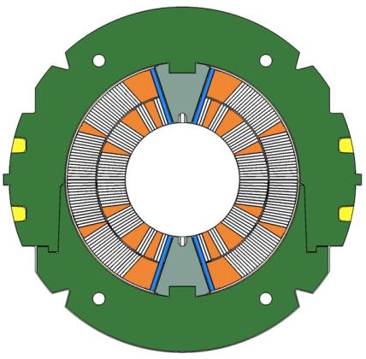
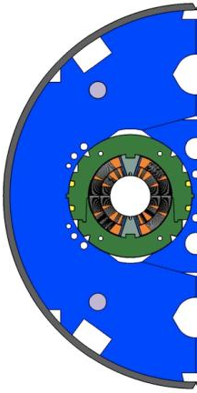
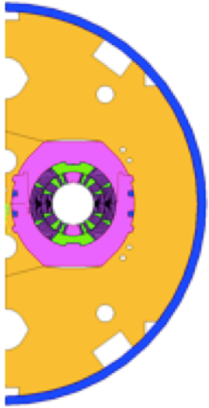
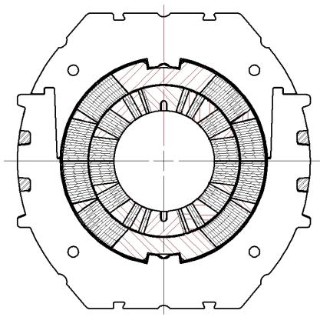
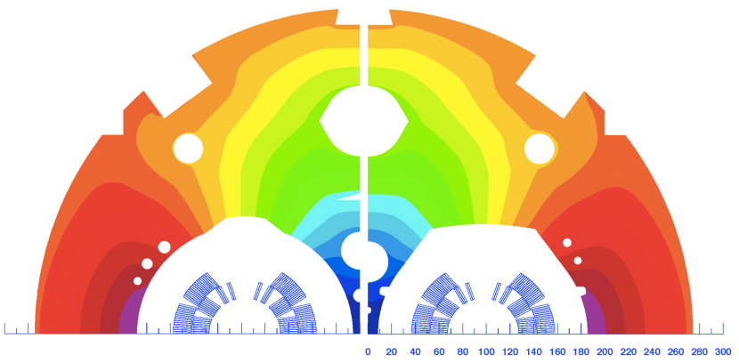
2-in-1 Demonstrator Design
Two alternative design concepts
Pole loading design
Integrated pole design

Slide 14
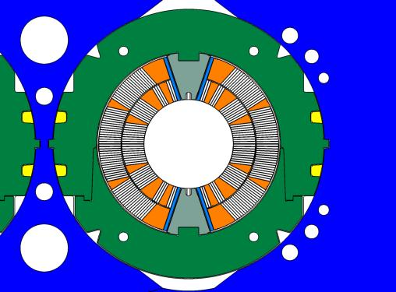
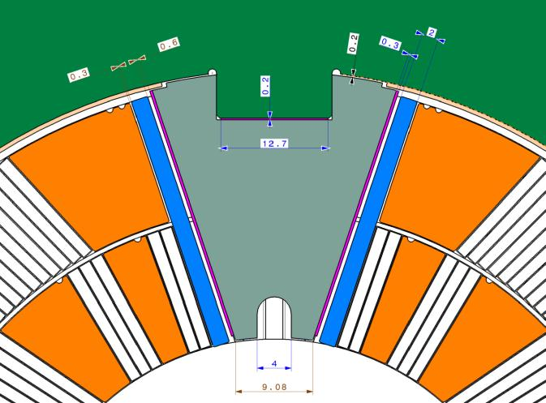
Pole Loading Concept
Shim
Loading plate
Filler
wedge
Pole wedge

Slide 15
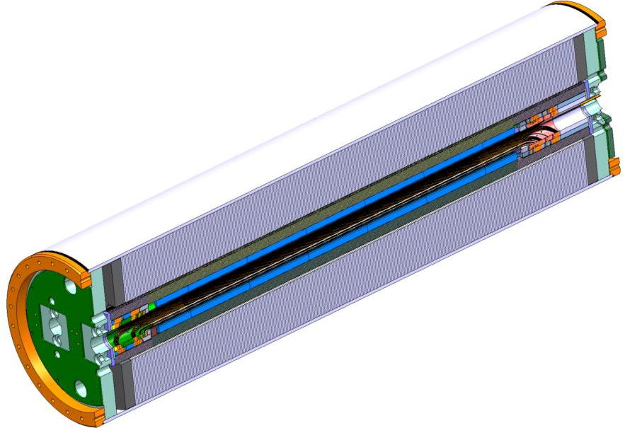
CERN 2-in-1 Model

Slide 16
FNAL 1-in-1 Demonstrator Status
2 coils completed and fully instrumented with strain gauges and V-taps. CMM revealed dimensional distortions the origin of which is yet to be fully understood. All three coils made so far appear to be similar.
Spare coil wound from CERN supplied cable has been reacted and is ready for epoxy impregnation.
Mechanical model of the straight part (about 500 mm) was assembled and used for determining the initial shimming for the Demonstrator.
Cold mass assembly completed. Electrical connections (splice, instrumentation, heaters) underway
Magnet test expected as of 4 June.

Slide 17
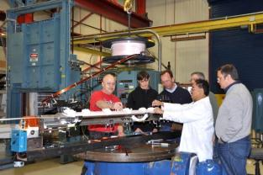
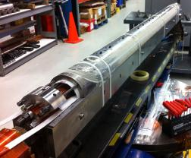
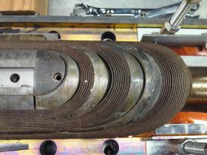
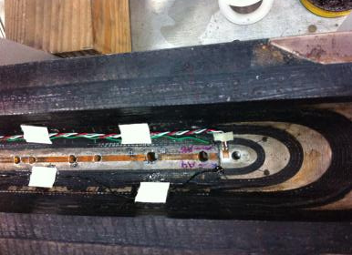
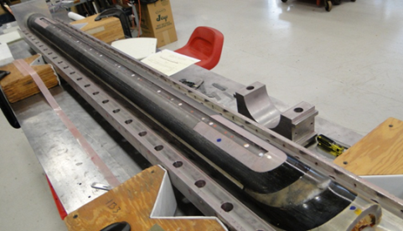
Coil Fabrication
Wind
Cure
Reaction
Epoxy impregnation
Instrumentation

Slide 18
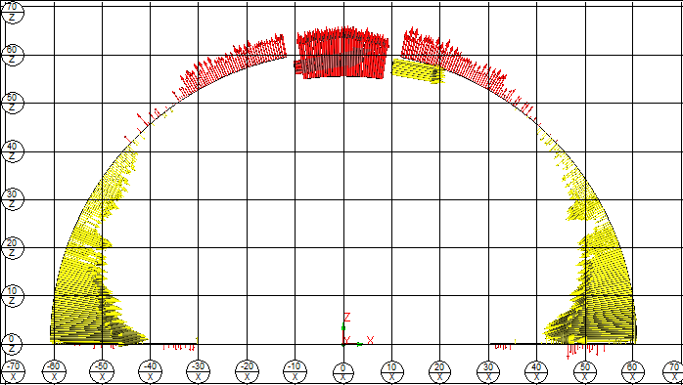
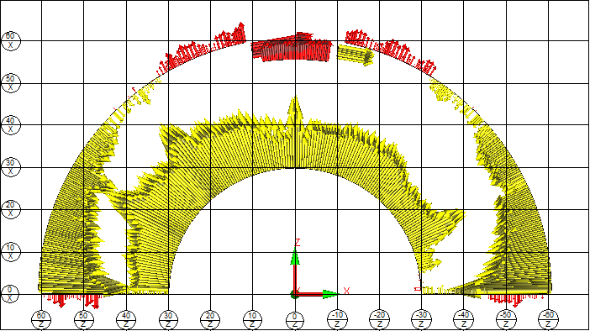
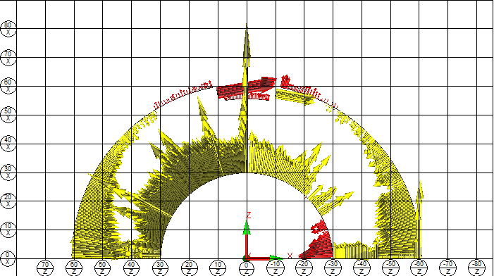
Coil Dimensions
MBH02
900 mm from RE
1 box = .004”
PC01
908 mm from RE
MBH03
900 mm from RE
1 box = .004”
Reasons for dimensional distortions being investigated.
All 3 coils appear similar.
Different from previous coils made at FNAL.
Post-assembly measurement show smaller (approx. 50 µm) distortions.

Slide 19
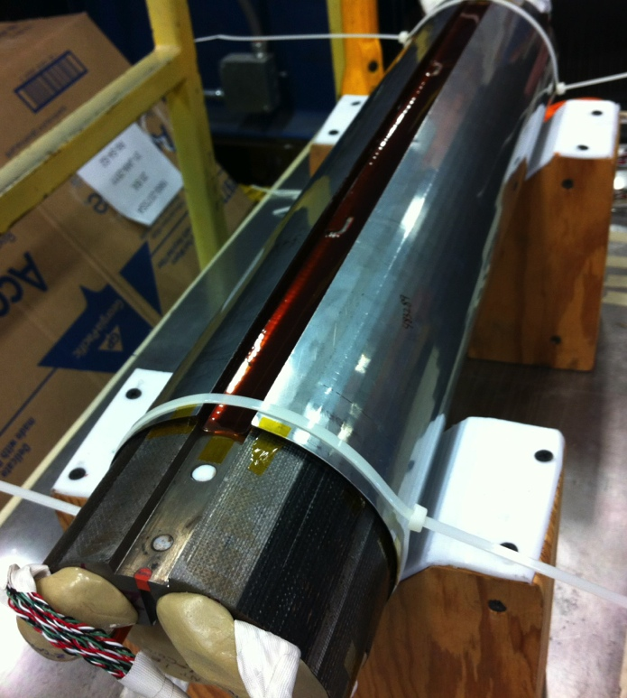
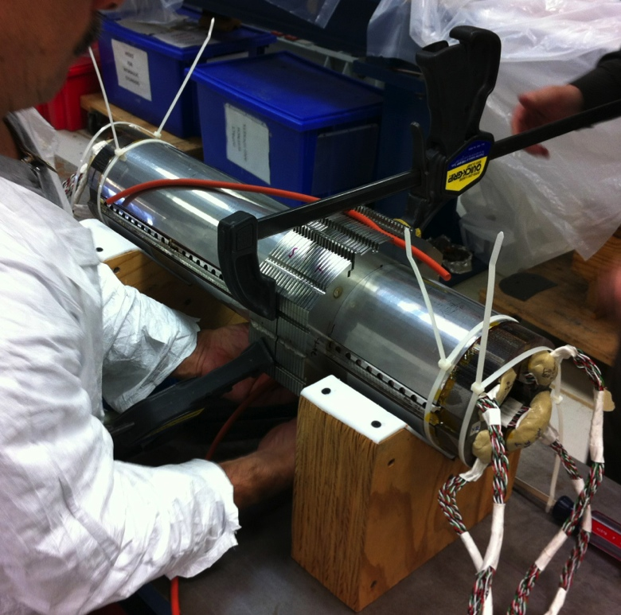
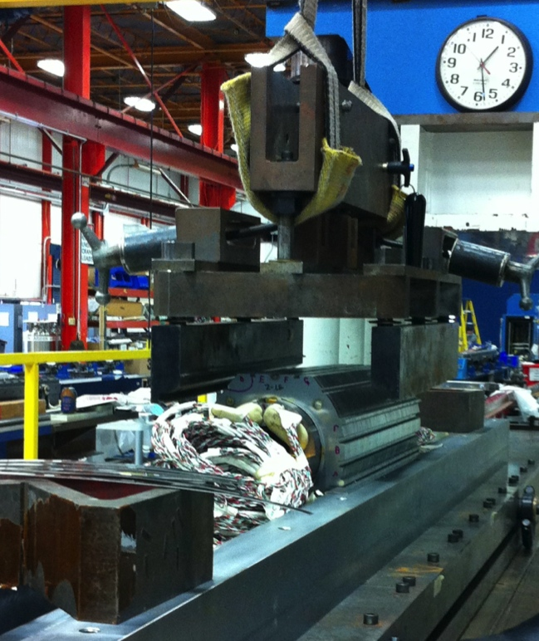
Mechanical model 1
Mechanical model based on Nb3Sn practice coil (PC-0) instrumented with strain gauges
Assembly parameters were explored with 5 different sets of shims
Validation of the assembly tooling and procedure
Coil and collared coil dimensional control before and after the assembly

Slide 20
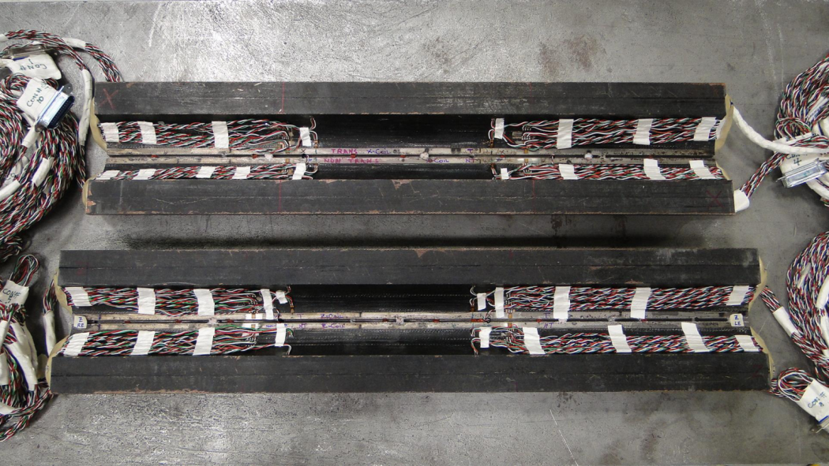
MM Measurement Locations (4)
1160 mm from RE
1260 mm from RE
552 mm from RE
652 mm from RE

Slide 21
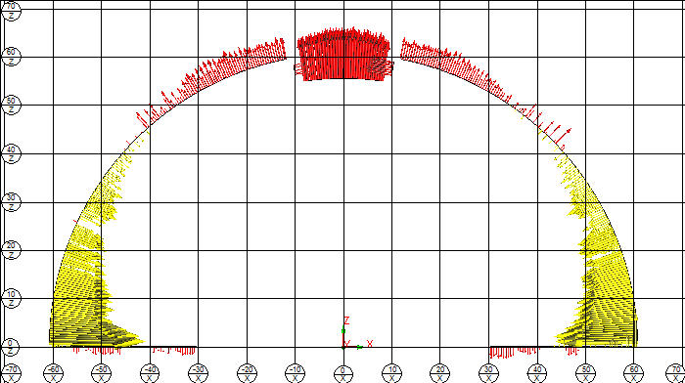
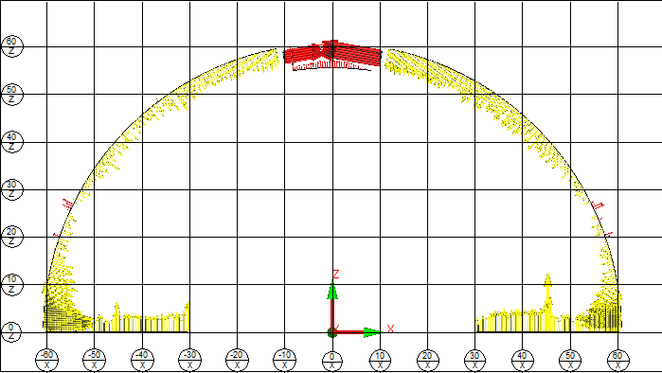
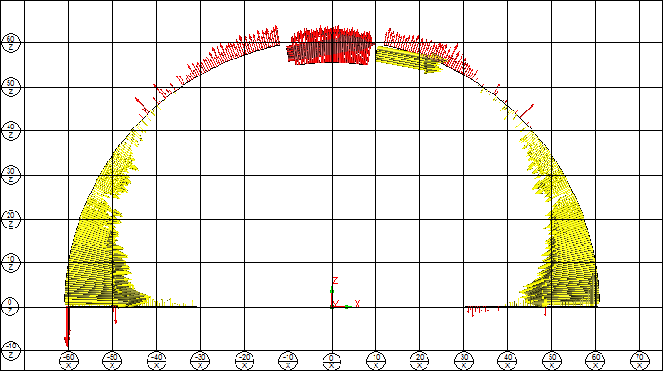
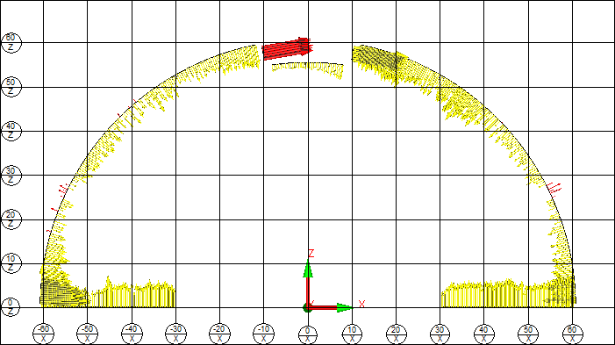
455 mm from RE
552 mm from RE
Before MM
After MM
705 mm from RE
652 mm from RE

Slide 22
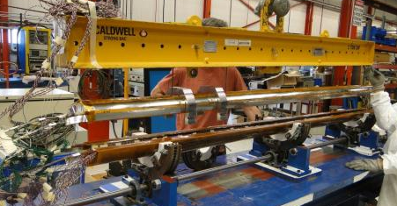
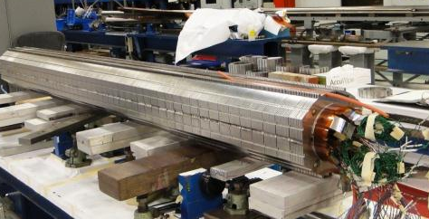
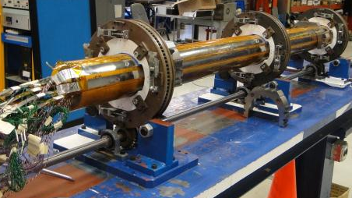
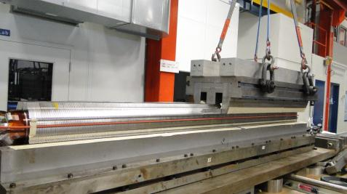
Demonstrator Collaring
Measured signals from the strain gauges in line with the mechanical model.

Slide 23
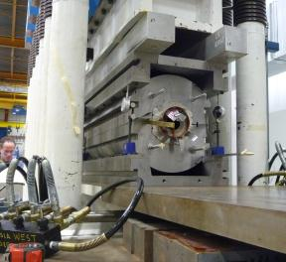




Demonstrator Cold-mass Assembly

Slide 24
FNAL Activities
Demo test in June
2 lengths of cored RRP 151/169 cable available for 1 m coils.
Cabling trials in progress to validate single pass process (like CERN).
Design of 5.5 m long coil fabrication tooling in progress.
Infrastructure for 5.5 m long coils exists (winding, curing, reaction, impregnation, coil assy, collaring).

Slide 25
FNAL Milestones
1-in-1 Demonstrator test Jun-12
1 m model (cored RRP-151/169)
  Coil fabrication Jun..Aug-12
  Cold mass assembly Nov-12
  Test Dec-12
2-in-1 Demonstrator (2 m)
  Coils for aperture-1 Aug..Oct-12
  1-in-1 assembly and test Feb-13
  Coils for aperture-2 Nov..Feb-13
  1-in-1 assembly and test Q2-13
  2-in-1 assembly and test (@cern) Q3-13
5.5 m prototype magnet
  Practice coil (Cu) Q2-13
  Practice coil (Nb3Sn) Q4-13
  Coils for aperture-1 & mirror tests Q2-14
  Collared coil Q3-14

Slide 26
CERN Design Effort
1-in-1 (2 m) magnet assembly and fabrication drawings being completed.
2-in-1 (2 m) magnet assembly in progress.
Design of 5.5 m long tooling has begun.
Collaring tooling design complete.
Conceptual design of coil handling and assembly tooling complete. Fabrication design in progress.

Slide 27
Procurement
Collar laminations for the mechanical model were delivered and inspected in CERN metrology lab. The order for collars for the aperture #1 was raised. Invitation to tender for the supply of collar laminations for aperture #2 to #5 being launched.
1-in-1 yoke laminations ordered.
Order for the outer shells to raise.
ODS copper alloy based wedges (Discup C3/30 material) expected in July.
Winding tooling completed and commissioned.
Curing tooling delivered.
Reaction tooling delivered at CERN. Dimensional control underway.
Reaction furnace commissioning planned for late July.
Vacuum impregnation tooling order placed (lead-time 18 w)
Vacuum impregnation tank expected in August.

Slide 28
CERN Milestones
Practice coils (2 m)
  Practice coils #1-#2 (Cu) Jun..Aug-12
  Practice coil #3 (ITER Nb₃Sn) Aug..Sep-12
  Practice coil #4 (LARP RRP 54/61) Oct..Nov-12
  Mirror test at FNAL Jan-12
2-in-1 Demonstrator (2 m)
  Coils for aperture-1 (RRP 108/127) Jan..Mar-13
  1-in-1 assembly and test Q2-13
  Coils for aperture-2 (PIT) Apr..Jun-13
  1-in-1 assembly and test Q3-13
  2-in-1 assembly and test Q4-13
5.5 m prototype magnet
  Practice coil (Cu) Q1-14
  Practice coil (Nb₃Sn) Q2-14
  Coils for aperture-1 & mirror tests Q4-14
  Collared coil Q1-15
  2-in-1 cold-mass and cryo-magnet Q2-15
  Cold test Q3-15

