Slide 1
HEL longitudinal view and cross section

Slide 2
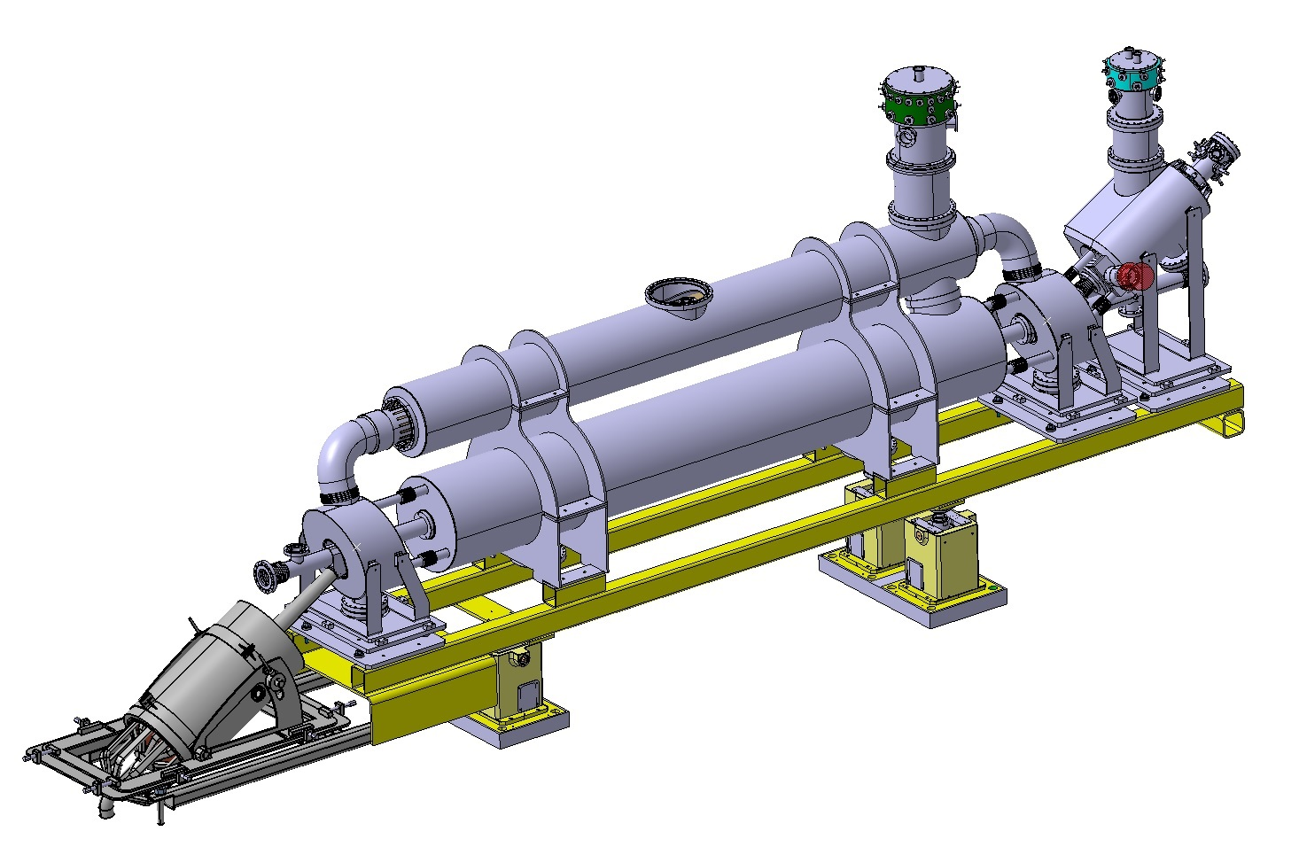
Current leads
Cryogenic jumper
e-gun
Bending s.
Main solenoid
Bending s.
Collector
Support structure + positioning tables

Slide 3
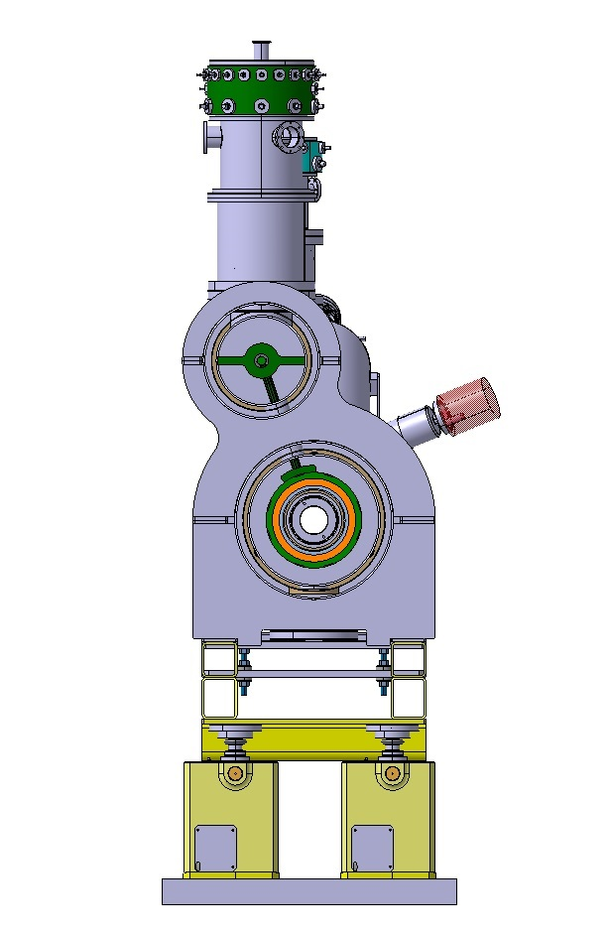
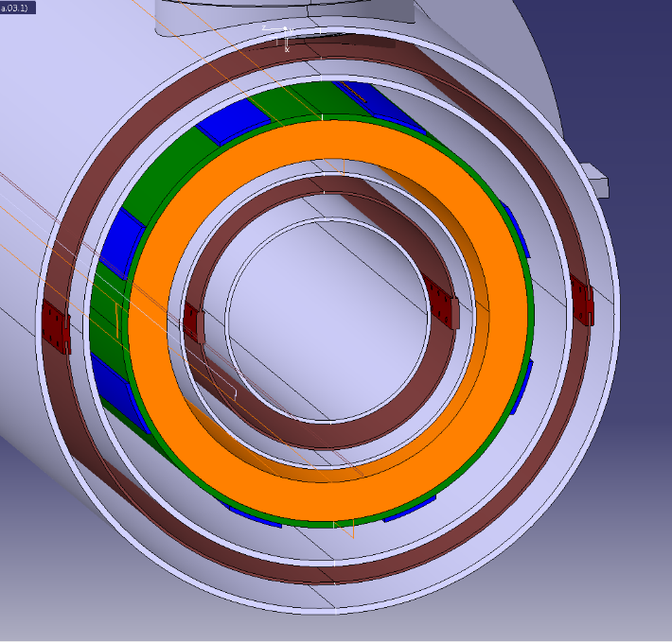
Survey space
Ø 454 mm

