Slide 1
E-GUN Hollow Electron Lens
HEL E-GUN Design Review
30/1/2020
antti.juhani.kolehmainen@cern.ch

Slide 2
OVERVIEW
MOTIVATION
OVERVIEW
FUNCTIONAL GEOMETRY
ELECTRICAL CONNECTIONS
GAPS BETWEEN COMPONENTS
HEAT LOADS AND CERAMICS
MECHANICAL TOLERANCES
DESIGN OFFICE TO DO
CONCLUSION

Slide 3
MOTIVATION
TO SOLVE ISSUES OF THE FIRST CERN DESIGNED E-GUN FOR THE HEL
TO CREATE DESIGN FULLY COMPATIBLE WITH THE HEL

Slide 4
INSPIRATION – TEL E-Gun Design
LHCNEHE_0026
LHCNECGP0075
CHG-16-sc
DESIGNED FOR THE HOLLOW ELECTRON LENS!

Slide 5
MAIN DIMENSIONS
MASS ≈ 10 kg

Slide 6
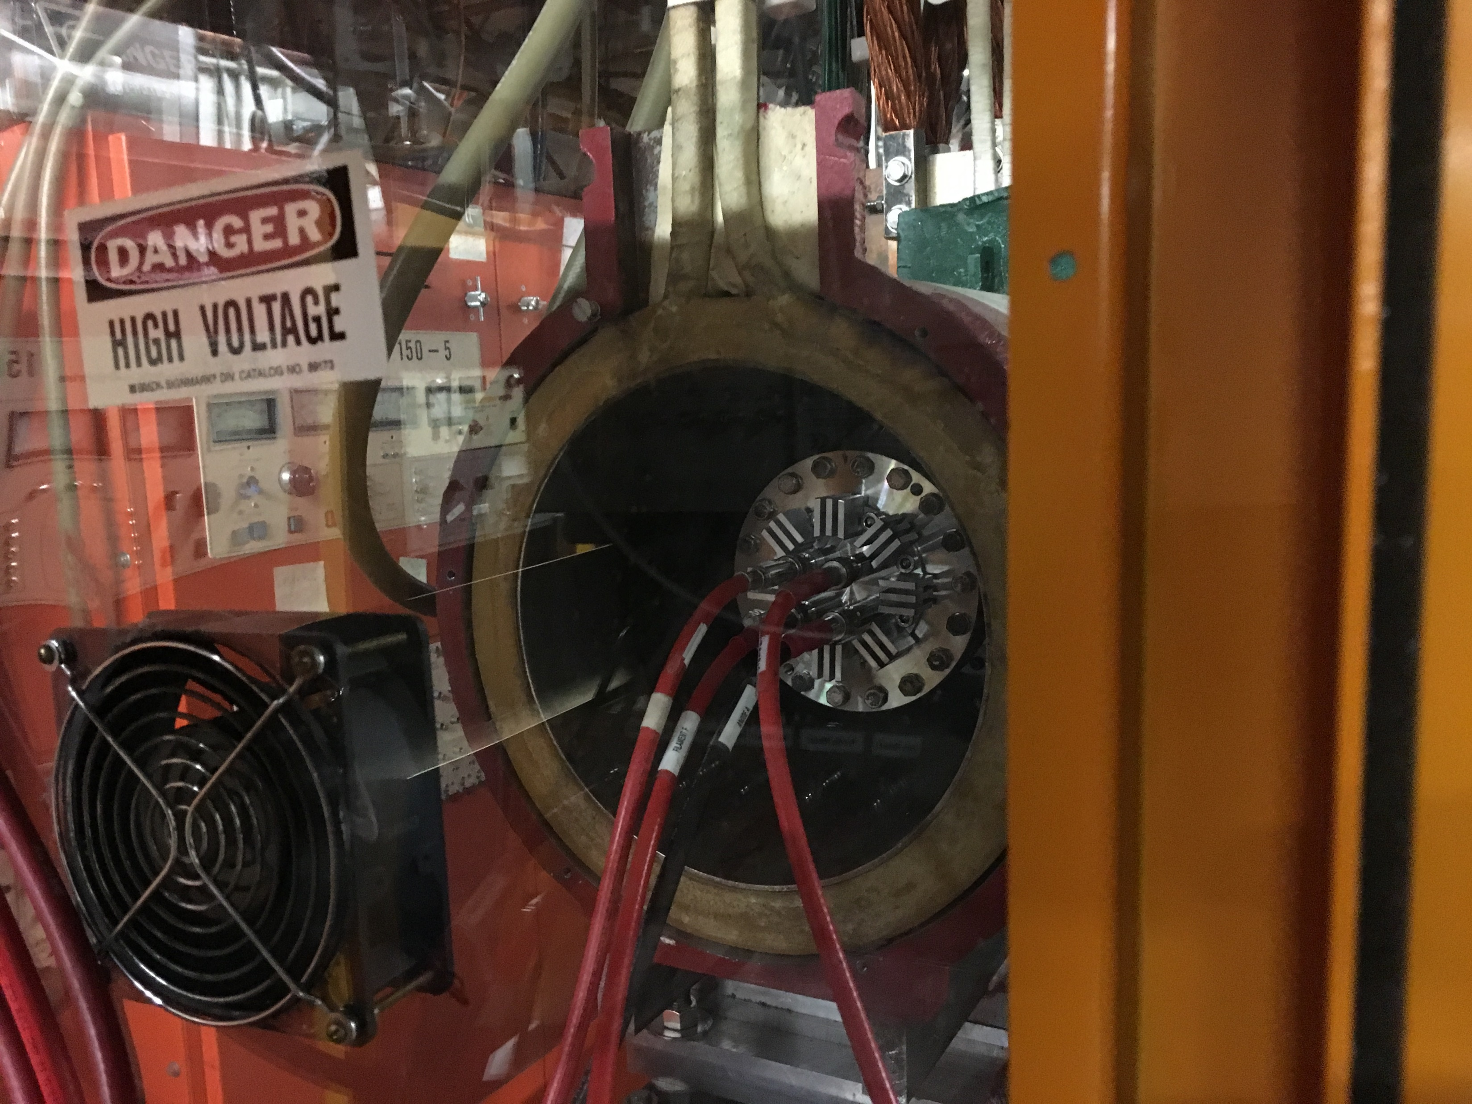
FIT TO THE FERMILAB TEST STAND
ADJUSTMENT CHAMBER POSITIONS GUN CORRECTLY
INTEGRATION TO THE TEST STAND TO BE VERIFIED BY THE FERMILAB TEAM
Total length increased
Access to the flange connection
3D available from CERN

Slide 7
FUNCTIONAL GEOMETRY
LHCNEHE_0026
LHCNEHEP0001 – CHG-16-sc-e)
LHCNEHEP0014
LHCNECGP0075
CHG-16-sc
CORRECT WHEN SCALED FROM 25.4 mm E-Gun!

Slide 8
ELECTRICAL CONNECTIONS
CONTROL ELECTRODE IN Ø1.27 mm COPPER
CONNECTED TO THE BASE FLANGE
CATHODE WIRES IN Ø1 mm NICKEL
GUIDED WITH REGULAR CERAMIC PIECES IN MACOR

Slide 9
ELECTRICAL CONNECTIONS
ANODE WIRE GUIDED THROUGH
SHORT CERAMIC TUBES CONNECTED TO THE ANODE SUPPORT
CERAMIC STAND-OFF TO ISOLATE
ANODE FROM SUPPORT
ANODE SUPPORT ELECTRICALLY FLOATING!

Slide 10
CATHODE – CONTROL ELECTRODE GAP
POTENTIAL DIFFERENCE < 1000V
GAP IN VACUUM ~ 2 mm
GAP THROUGH CERAMIC ~ 14 mm

Slide 11
CATHODE – GROUND GAP
POTENTIAL DIFFERENCE ≤ 15 kV
GAP IN VACUUM ~ 4.5 mm
GAP THROUGH CERAMIC ~ 19 mm

Slide 12
CATHODE – ANODE GAP
POTENTIAL DIFFERENCE ≤ 15 kV
GAP THROUGH CERAMIC = GAP TO GROUND:
2. ANODE TO GROUND ≈ 21 + 15 mm
1. CATHODE TO GROUND ≈ 19 mm
GAP IN VACUUM ≈ 5.3 mm

Slide 13
CONTROL ELECTRODE – ANODE GAP
POTENTIAL DIFFERENCE ≤ 15 kV
GAP THROUGH CERAMIC ≈ 21 + 15 mm
GAP IN VACUUM ≈ 5.5 mm

Slide 14
MECHANICAL TOLERANCES
ALLOWED ERROR?
CATHODE – ANODE
CATHODE – CONTROL ELECTRODE
ACHIEVABLE TOLERANCES BEING DISCUSSED WITH CERN EN/MME WORKSHOP
ADJUSTABILITY:
CATHODE – ANODE SPACING WITH RE-MACHINABLE SHIM = EASY
CATHODE – ANODE ALIGNMENT WITH RE-MACHINABLE SHIM = RELATIVELY EASY
CATHODE – CONTROL ELECTRODE LONGITUDINAL SPACING WITH CONTROL ELECTRODE REMACHINING
CATHODE – CONTROL ELECTRODE ALIGNMENT WITH CONTROL ELECTRODE REMACHINING OR FORMING = NOT EASY
COMPONENT DEFORMATION UNDER OPERATION TO BE STUDIED
BEST POSSIBLE ESTIMATION FOR COMPONENT TEMPERATURES REQUIRED

Slide 15
HEAT LOAD
Courtesy of Sergey Sadovich

Slide 16
CERAMICS AROUND THE CATHODE
11 mm
43 mm
20 mm

Slide 17
CERAMICS AT DISTANCE
WIRE SUPPORTS AT 100, 150 and 215 mm FROM THE CATHODE
217 mm

Slide 18
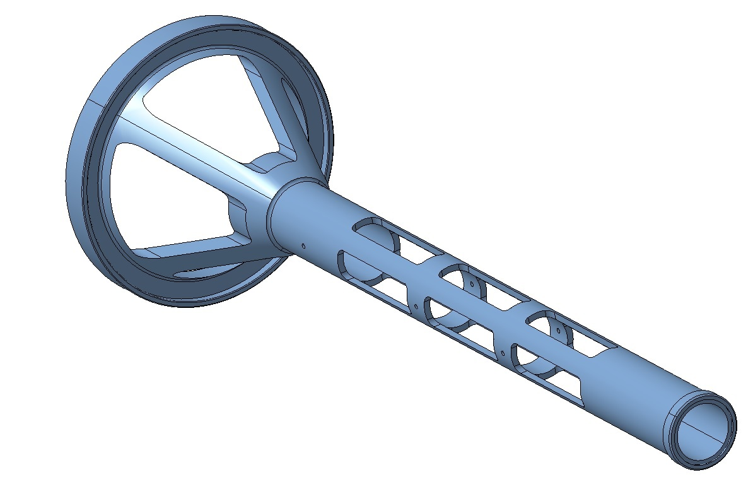
TACKLING THE HEAT – AND LEAK CURRENT
RADIATORS
HEAT SHIELD
CUT-OUTS TO REDUCE SURFACE AREA FOR HEAT CONDUCTION
COPPER SUPPORT FOR HEAT CONDUCTION

Slide 19
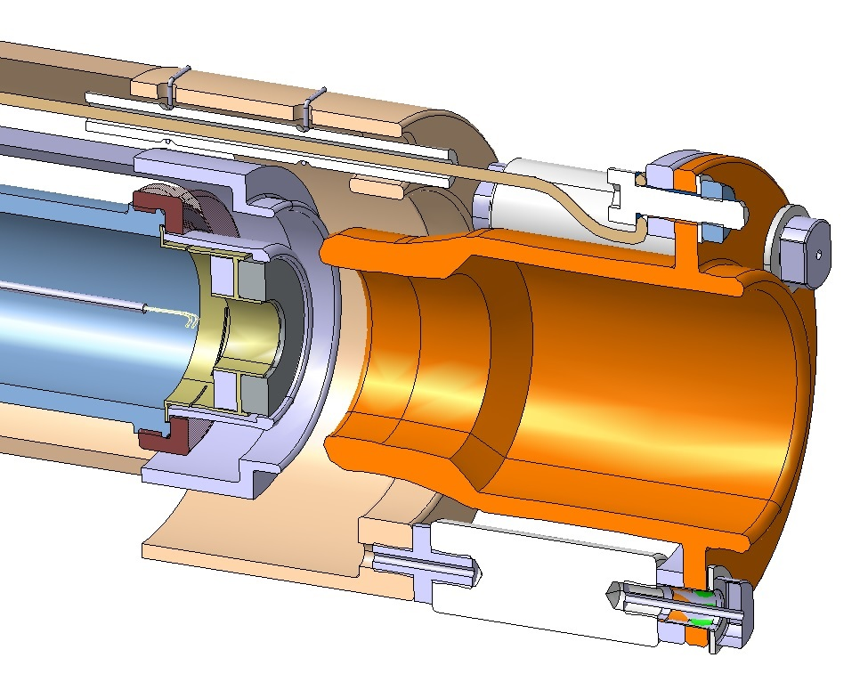
DESIGN TASKS TO DO
MACHINED SPRING TO CLAMP COMPONENTS:
MUST ALLOW TOLERANCES
MUST ALLOW THERMAL EXPANSION
ANODE POSITION w.r.t. CATHODE
PRECISION ↑ COMPLEXITY ↑
INDICATION REQUIRED

Slide 20
DESIGN TASKS TO DO
FINISH MANUFACTURING DRAWINGS, ≈ 75 % CREATED
DEFORMATION OF
CATHODE SUPPORT
CONTROL ELECTRODE
ANODE SUPPORT
YOUR FEEDBACK TO IMPLEMENT!

Slide 21
OPTIONAL CONCEPT
SHORTER CATHODE SUPPORT AND CONTROL ELECTRODE → SMALLER TOLERANCE LEVER-ARM
MORE COMPLEX CERAMIC SUPPORT
SIMILAR ANODE ALIGNMENT SCHEME WITH RE-MACHINABLE SHIM

Slide 22
CONCLUSION
TWO CONCEPTS CREATED TO TACKLE THE LEAK CURRENT ISSUE AND TO FIT TO THE HEL – FIRST ONE BEING DETAILED
ALIGNMENT OF FUNCITONAL GEOMETRY TO BE CONFIRMED
THERMAL ANALYSIS DESIRED
MANUFACTURING OF THE FIRST VERSION PREVIEWED – NO SHOWSTOPPERS

Slide 23
THANK YOU FOR YOUR ATTENTION!
!/?
YOUR QUESTIONS PLEASE!

