Slide 1
Dispersion Suppressor Collimators for Heavy-Ion Operation
John Jowett, Michaela Schaumann
Thanks for valuable input to:
L. Bottura, R. Bruce, F. Cerutti, P. Fessia, M. Giovannozzi, M. Karpinnen, S. Redaelli, G. E. Steele, D. Tommasini

Slide 2
Plan of talk
Heavy-ion beam losses in LHC – recap
Pb beams are very different from protons
HL-LHC heavy-ion performance goals
Quench limits from luminosity
Radiation damage to dipoles
Cure by DS collimators
Layout of DS collimators in IR2 (and IR1)
Quench limits from cleaning efficiency
Alternative mitigation methods

Slide 3
Steady-state losses during Pb-Pb Collisions in 2011
Bound-free pair production secondary beams from IPs
IBS & Electromagnetic dissociation at IPs, taken up by momentum collimators
Losses from collimation inefficiency, nuclear processes in primary collimators
??

Slide 4
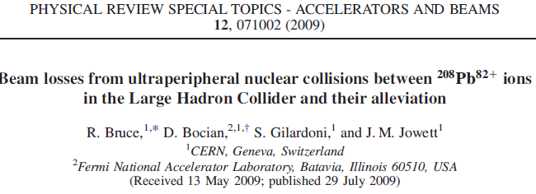
Electromagnetic processes in Pb-Pb collisions
Discussed since Chamonix 2003 …
Each of these makes a secondary beam emerging from the IP with rigidity change
Hadronic cross section is 8 b (so much less power in debris).

Slide 5
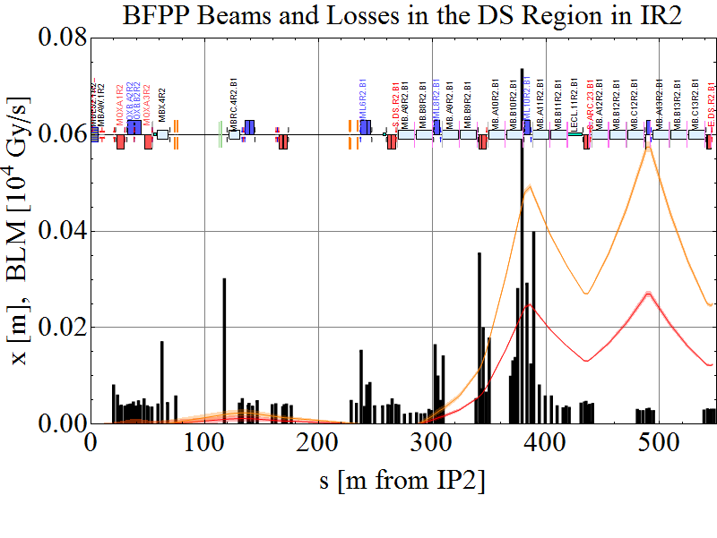
2011 Pb-Pb operation

Slide 6
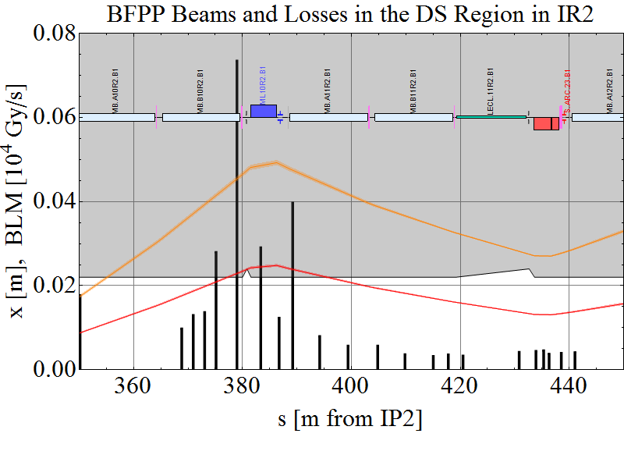
Zoom in to loss region

Slide 7
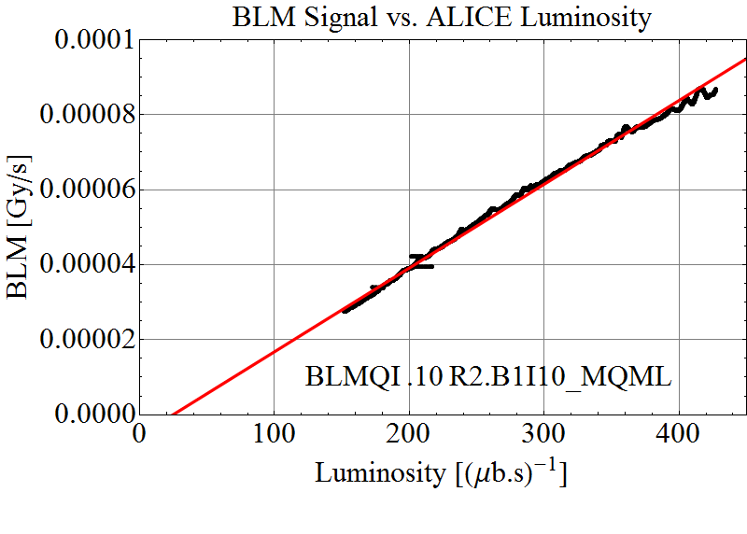
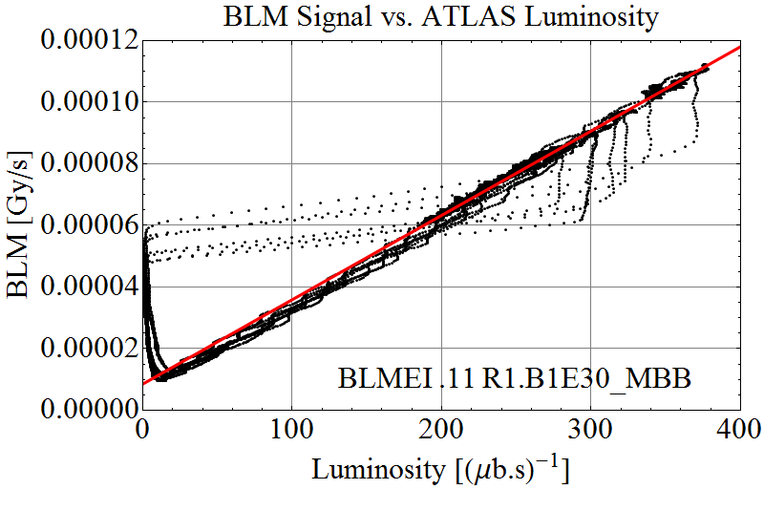
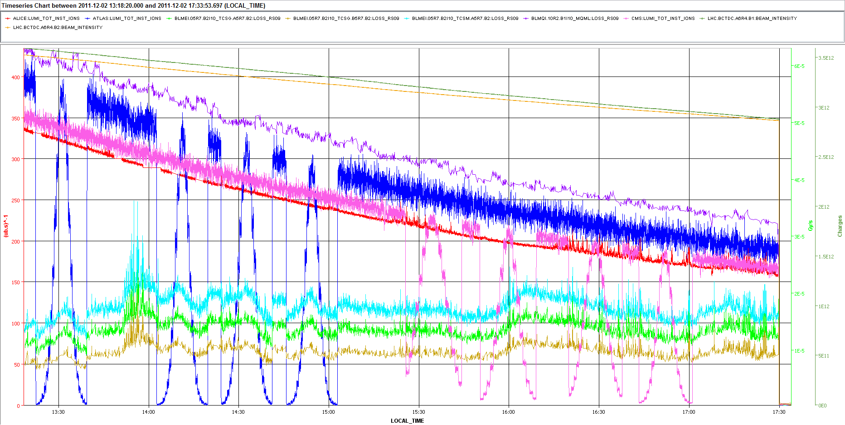
Main losses in DS are due to luminosity
Regular physics fill
From van der Meer scans

Slide 8
HL-LHC Performance Goals for Pb-Pb collisions
With upgrade of Pb injectors, etc, indicative parameter goals:
ATLAS and CMS also taking luminosity (high burn-off).
Levelling strategies may reduce peak luminosity but we must aim for high intensity.
Comparison data: p-Pb runs every few years are less demanding from beam-loss point of view
Runs with lighter species (unlikely ?) are not considered here.

Slide 9
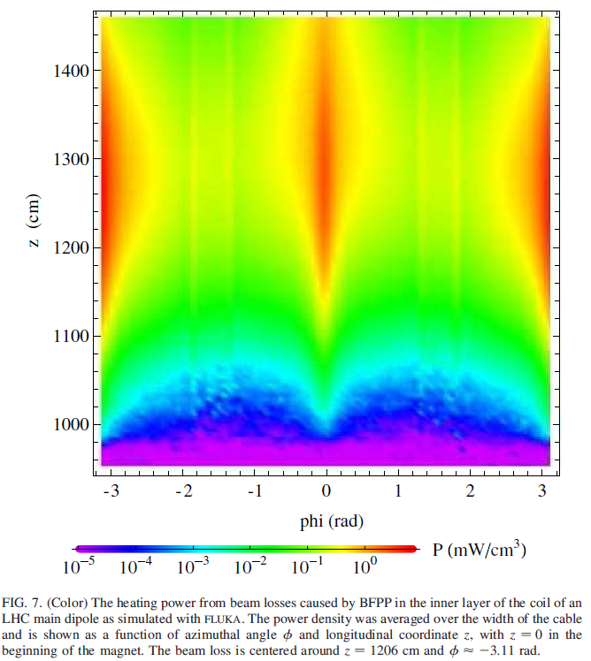
Power density in superconducting cable
FLUKA shower simulation
See other talks!
Nevertheless, expect to quench MB and possibly MQ!
FLUKA studies confirmed recently (next talk).

Slide 10
DS collimator solution
First discussed for heavy ion operation at Chamonix workshop in 2003
Idea of modifying cold sections of LHC was not well-received at that time.
Switch to CDF file to show that:
Well-placed collimator can stop the secondary beams and stay well clear of main beam.
By adjusting collimator gap it is possible to also select EMD1 beam and reduce losses in IR3 (possibly IR7).

Slide 11
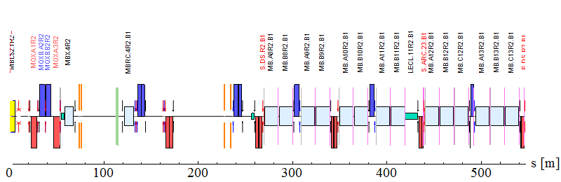
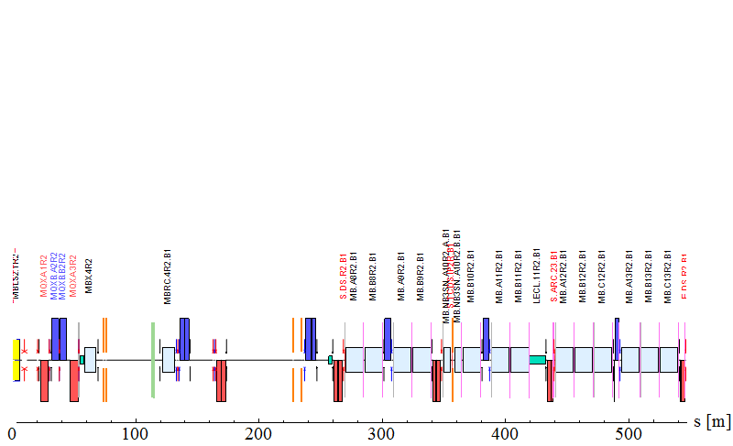
DS collimator installation in IR2
Magnet to be replaced MB.A10R2
Nominal Beam Line
IP2
Tracking with this configuration sent to FLUKA team – see next talk for results.
Modified Sequence
2 $×$11T dipole with L = 5.3m
Collimator jaw with L = 1m

Slide 12
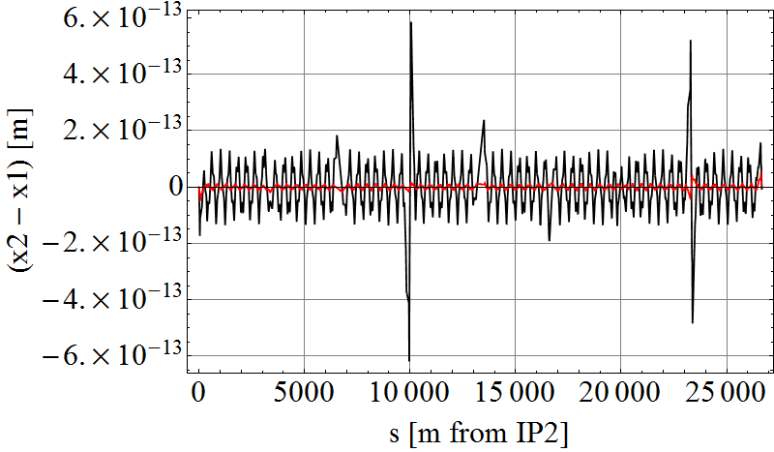
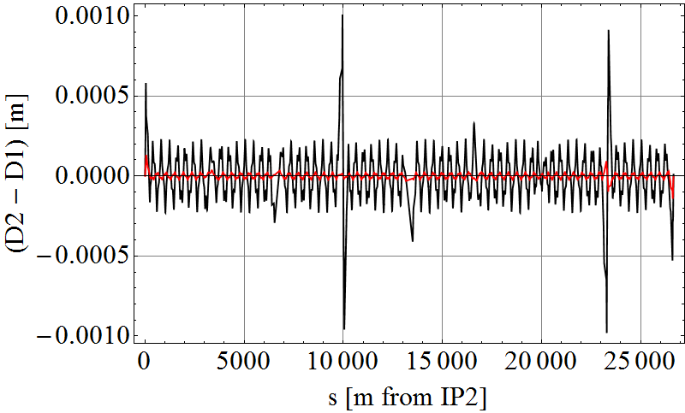
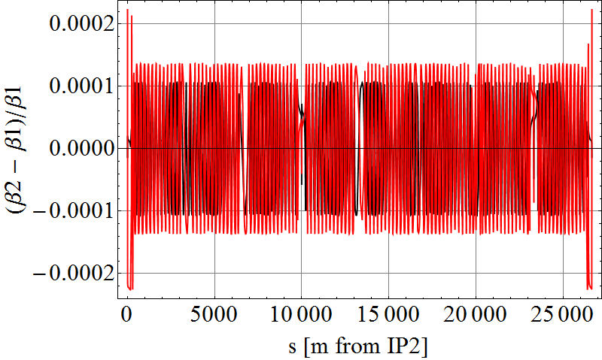
Optics and orbit perturbations
Orbit change in X and Y
Dispersion change in X and Y
β-Beat in X and Y
Change are very small, not worth correction.

Slide 13
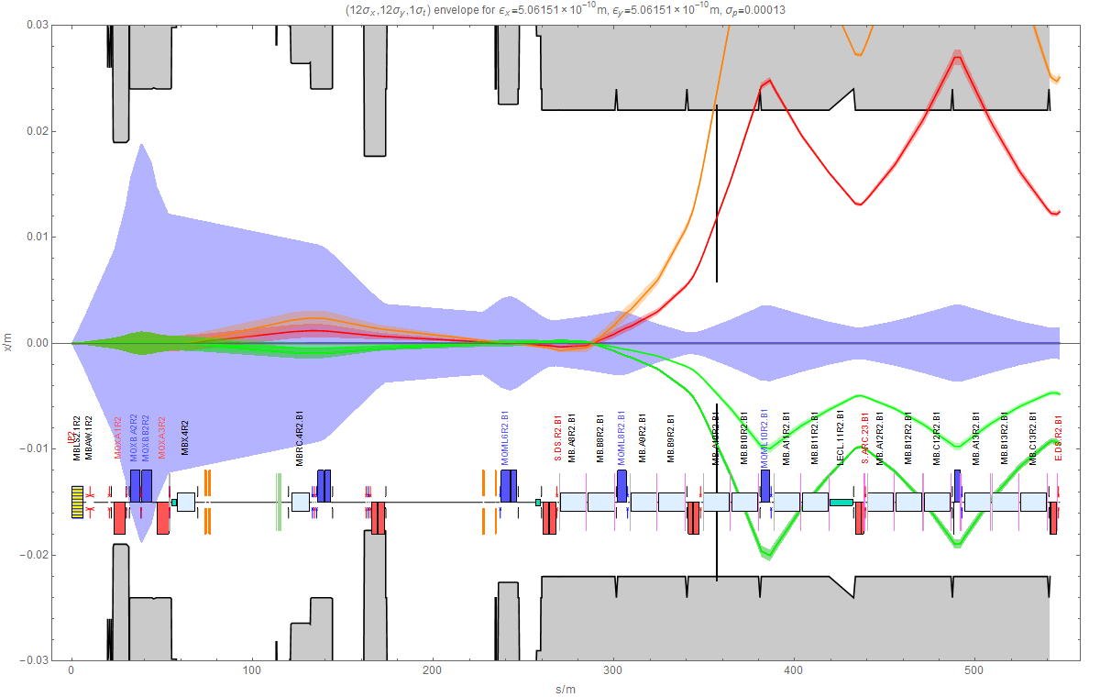
DS collimator absorbs most powerful losses
Can select addition beams by adjusting collimator gap

Slide 14
ATLAS and CMS ?
ATLAS and CMS also take high-luminosity Pb-Pb
The same problem of BFPP losses exists in the DSs around IP1 and IP5
Details of loss locations somewhat different
Highest BLM signals from BFPP in 2011 were right of IP5
Previously we assumed the priority would be an installation (LS3?) designed for proton-proton luminosity debris. Now less clear …
Motivation could now be to install DS collimators to avoid a peak luminosity limit from quenches and/or long-term radiation damage in Pb-Pb operation ?

Slide 15
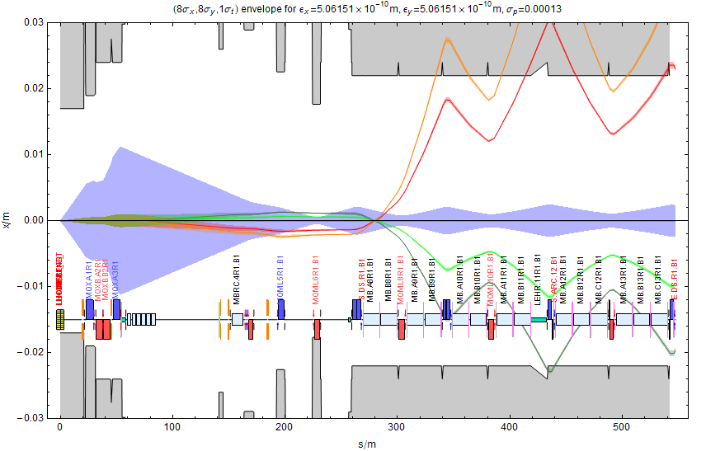
DS Collimator locations around ATLAS
Different from IR2 but various locations seem effective

Slide 16
Strategy and Decision Points for HL-LHC Heavy Ions
First Pb-Pb run at ~6.5 Z TeV will be in November 2015
Expect data on quenches for luminosity up to ~ 3×10²⁷cm⁻²s⁻¹ around ATLAS and CMS, hope for Pb quench tests but may be difficult to get the time
ALICE will be levelled at 10²⁷cm⁻²s⁻¹
Operational experience with BFPP mitigation by bumps
Probably some relevant data also from proton operation and quench tests
End 2015: assess need for DS collimator installation in LS2 along with ALICE upgrade
Also consider ATLAS and CMS in LS3
DECISION

Slide 17
BFPP mitigation by bumps
Proposed in R. Bruce et al, Phys Rev STAB, 12, 071002 (2009)
Apply bump to main beam orbit in loss region, also moves BFPP beam away from impact point, reducing flux, angle of incidence, peak power density.
Tested opportunistically in 2011 Pb-Pb run gained on BLM signals.
If truly effective and reliable, and accepted by Machine Protection, could be an alternative to DS collimators.
May have to rely on this in the period after LS1.

Slide 18
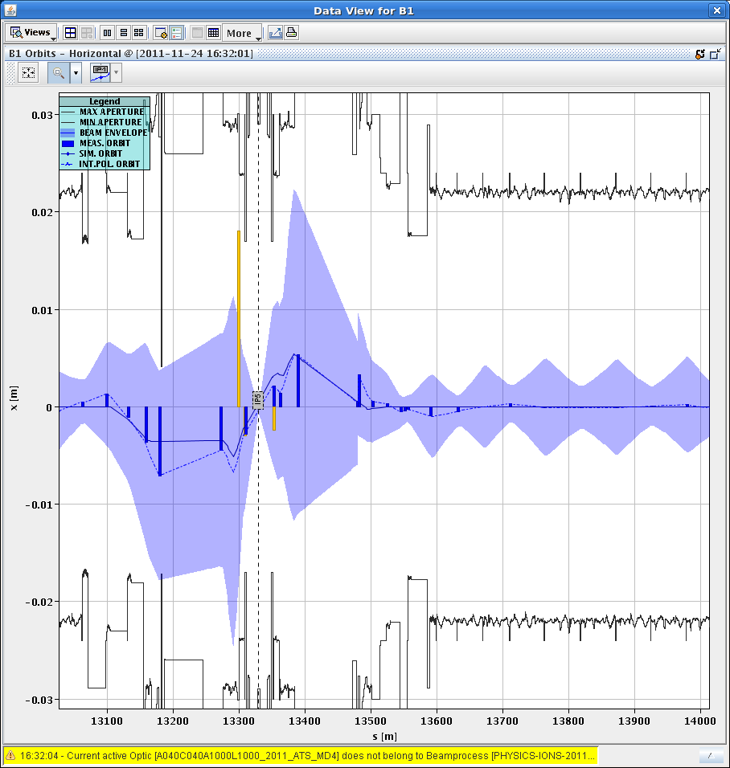
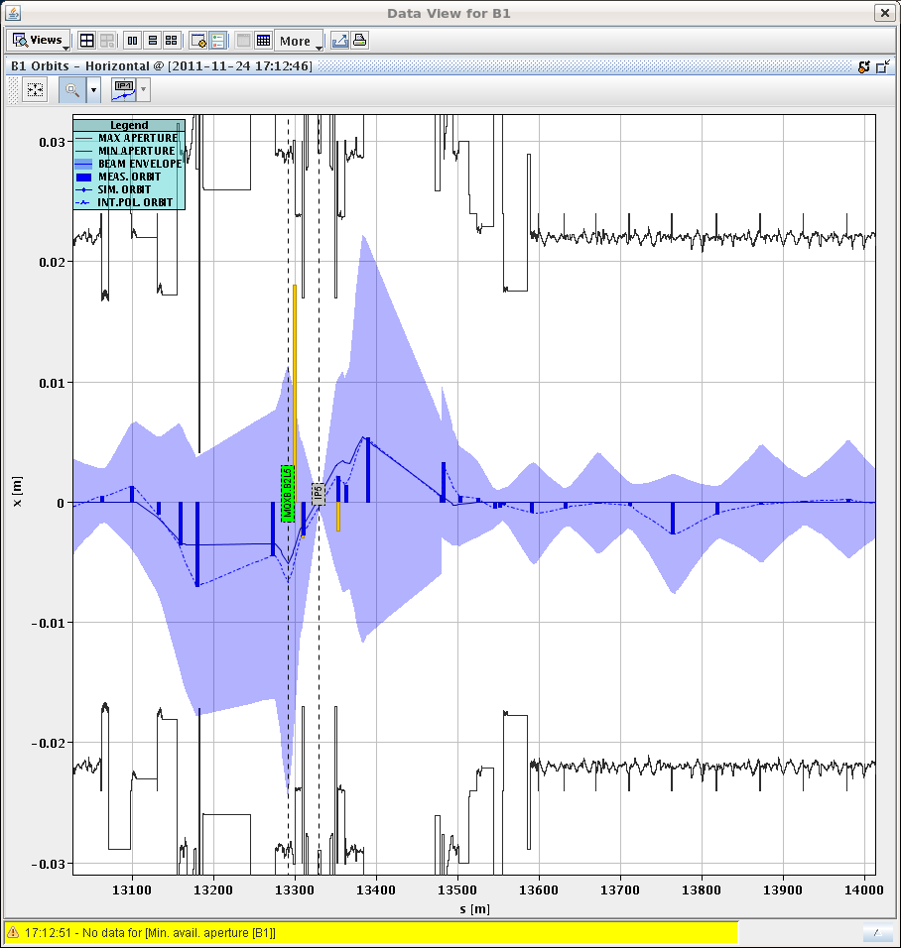
Orbit bump: -2.6 mm at Q11.R5.B1 in steps
12 sigma envelopes from online model
without bump with bump

Slide 19
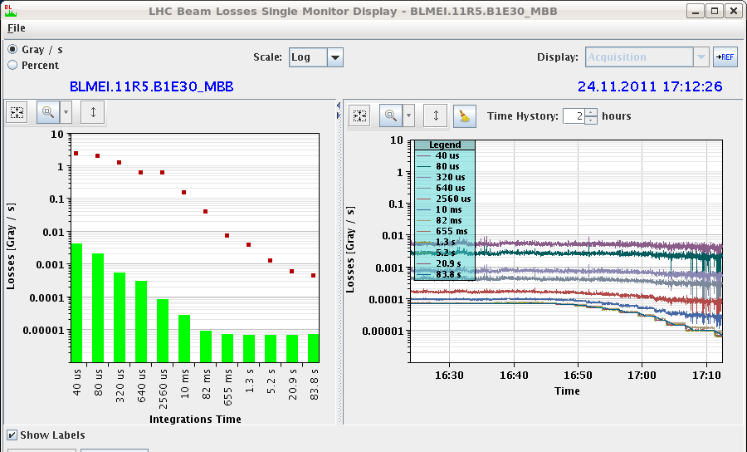
Effect on losses
No losses or lifetime drops

Slide 20
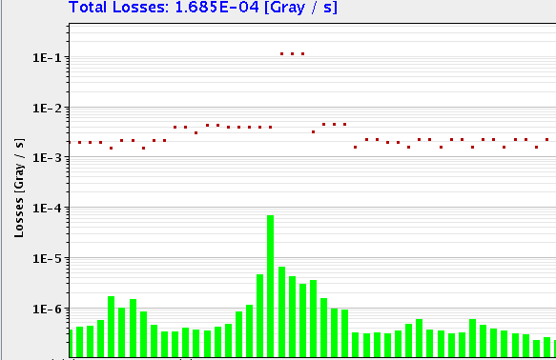
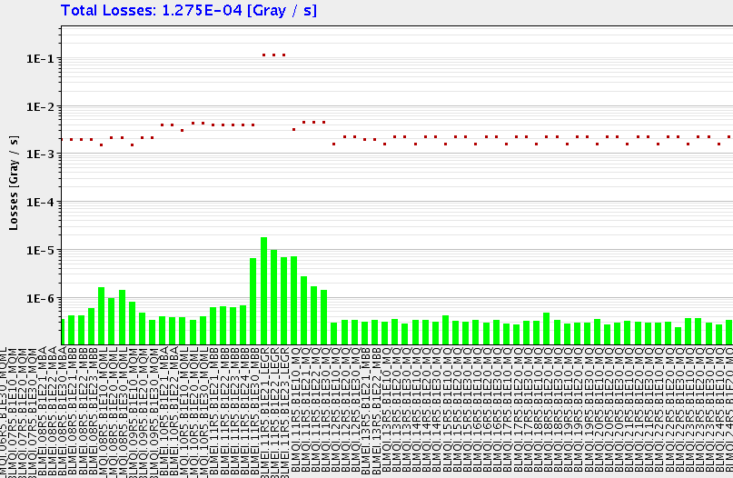
Effect on loss pattern
Before
Bump -2.6 mm
Not enough to create 2nd loss peak

Slide 21
Alternative solution?
There is a possibility that we can combine bumps and an alternative location of the TCLD
No 11 T magnets
Different but simpler integration

Slide 22
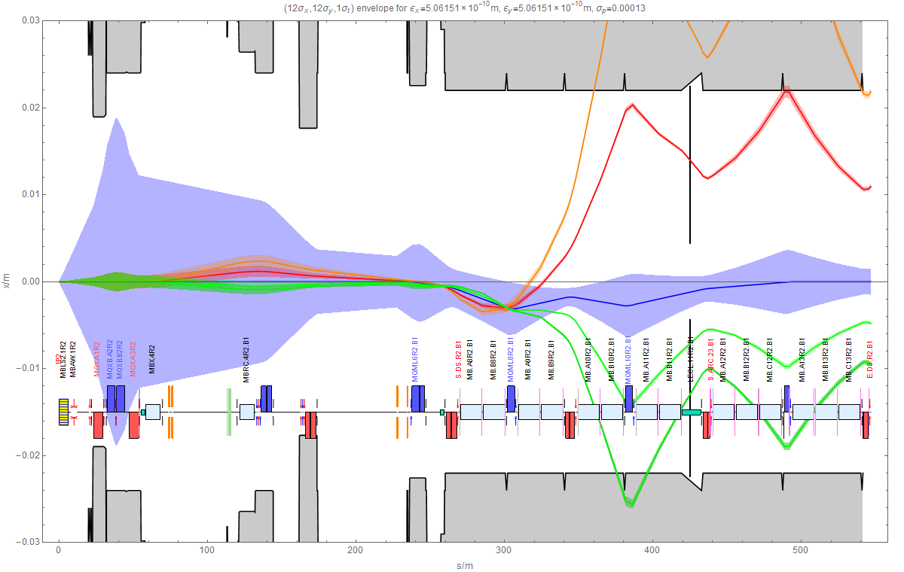
TCLD in connection cryostat

Slide 23
Remarks on alternative of TCLD in connection cryostat
Might work for ALICE in IR2
Cannot work for ATLAS or CMS (or IR7 … )
different dispersion function
11 T magnets will be needed in other IRs
Orbit bumps of a few mm over ~200 m of dispersion suppressor
Requires machine protection discussion!
Possibility of selectively controlling losses from various mechanisms is retained
Further study required
Is there sufficient remaining corrector strength for regular orbit correction purposes ?
Shower calculations in FLUKA, etc

Slide 24
Conclusions
DS collimators are very effective means to raise Pb-Pb luminosity limit
Four 11 T dipoles + 2 DS collimators required for ALICE in LS2
Some variation possible in IR1, IR5 if required for ATLAS, CMS
Could also be installed in IR1, IR5 dispersion suppressors to increase peak luminosity limit for ATLAS and CMS in LS3
DS collimators in IR7 (8 dipoles, 4 collimators) may still be needed for high-intensity heavy-ion operation
Experience from first 6.5 Z TeV Pb-Pb run (with Pb quench tests!!) at end of 2015 crucial for decision-making on DS collimator installation
Possible alternative without 11 T dipoles for ALICE only – needs validation

Slide 25
BACKUP SLIDes

Slide 26
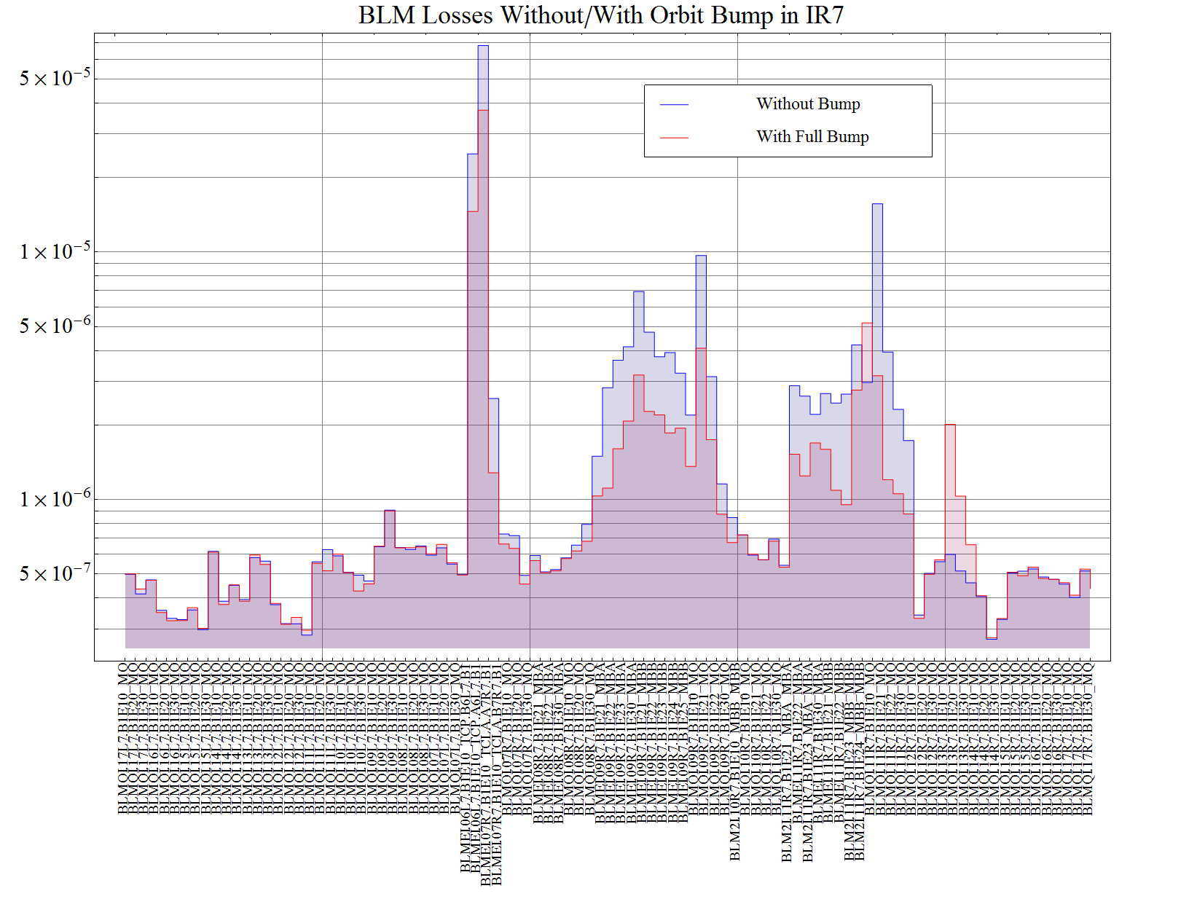
Unnormalized BLM losses during bump method test in IR7

Slide 27
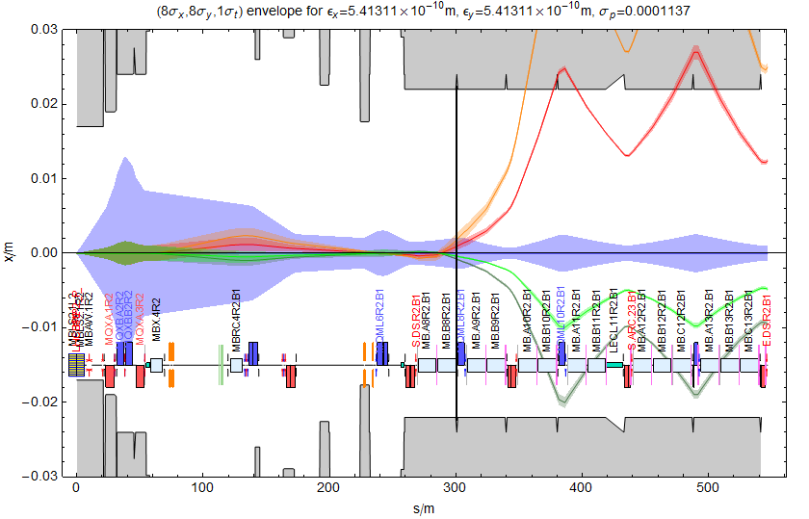
Secondary beams from Beam 1 in IR2
BFPP1
BFPP1
EMD1
EMD2
Cannot separate BFPP and main beam in warm area (TCLs not useful)
BFPP beam is smaller than main beam (source is luminous region).

Slide 28
Polyimide radiation damage data
Invoke superposition principle: radiation damage from heavy ions is similar to equivalent nucleons once they have fragmented after passing through a few cm of matter.
For the polyimide mechanical damage, that normally comes before the electrical damage see the picture here below coming from the CERN 96-05. As you can see there is no degradation surely till 10 MGy and probably till 20 .After that the degradation is very mild. The magnet is designed with margin therefore I would expect no mechanical failure probably until 30MGy (even the measured value at 50 are still ok but let’s keep margin)
from P. Fessia

Slide 29
Radiation damage
Is there a risk of magnet short-circuit over lifetime of HL-LHC unless magnets are pre-emptively replaced?

Slide 30
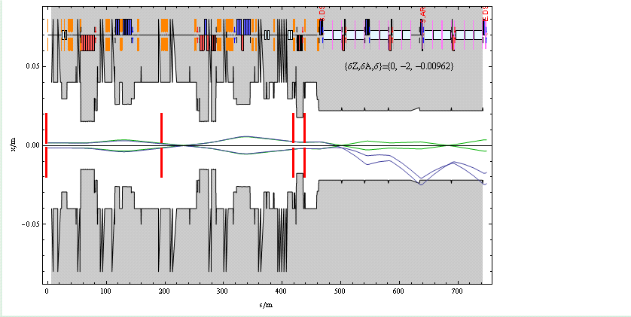
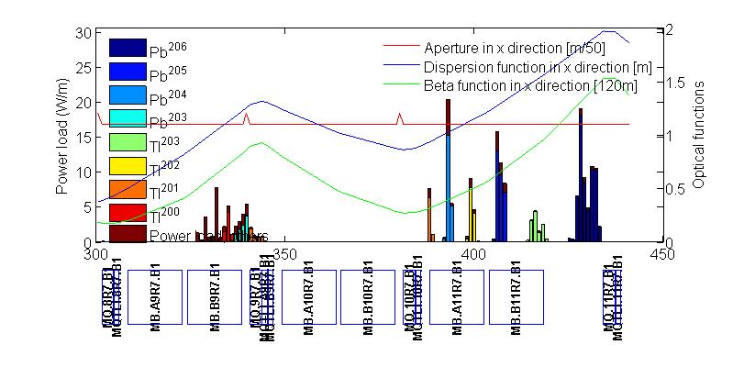
Example of ²⁰⁶Pb created by EMD2 in primary collimator
Green rays are ions that almost reach collimator
Blue rays are ²⁰⁶Pb rays with rigidity change
Beam pipe in IR7 of LHC
“Obvious” solution is to put more collimators here.
Primary collimator
Notes:
Dispersion suppressor section acts as spectrometer

Slide 31
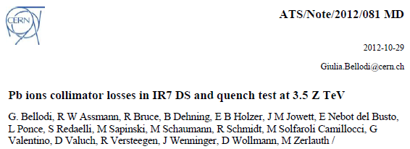
DS collimators in IR7 for heavy ions
No quench test with ion beams in 2013
Some results from 2011 only showed that upgraded design intensity is just OK with 1 h lifetimes (questionable?).
In 2013 p-Pb run, we were forced to raise BLM thresholds to nominal quench limit in squeeze because of losses
Pb beams are larger than p beams
Partly related to movements of orbit, tight collimators
Experience after LS1 essential to allow better evaluation of need for DS collimators in IR7. Need to watch this!
DS collimators very effective for Pb in IR7 (see simulations by G. Bellodi in 2011 Collimation Review).

Slide 32
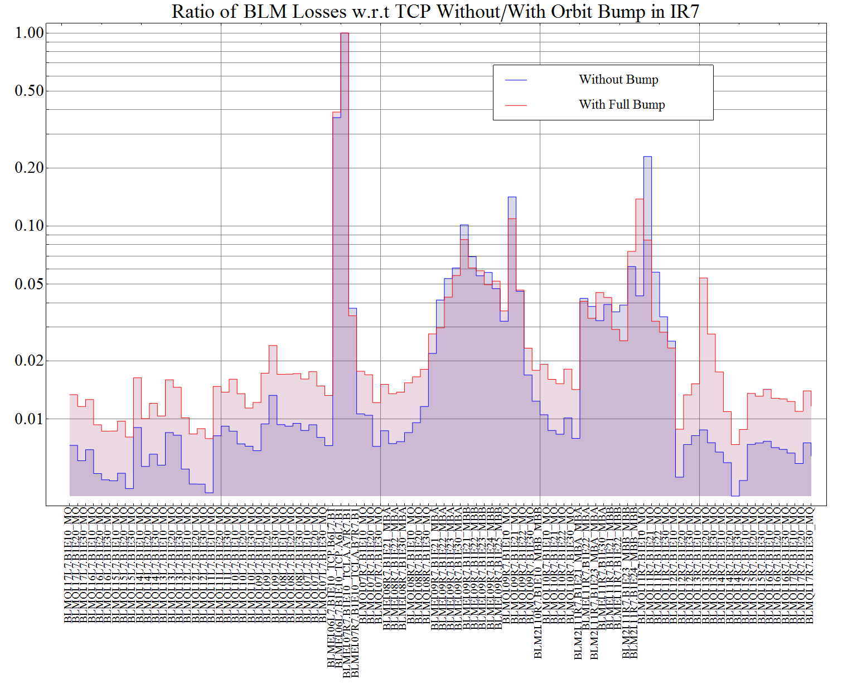
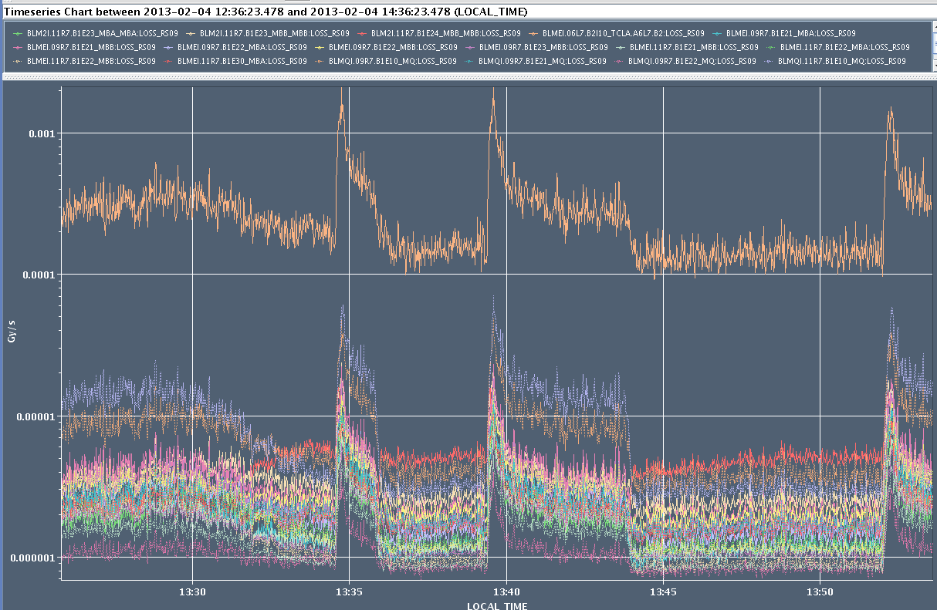
Bump method to mitigate losses in IR7 (test in 2013)
Test of B1 horizontal orbit bump in IP7 around Q11.R7 (+2.5 mm), to spread the losses longitudinally,
It worked, we observe a factor 1.62 ± 0.04 gain on the maximum loss peak,
But losses were reduced at the primary collimator, which should not be influenced, → was there an orbit non closure propagating through the ring?
R. Bruce, E.B. Holzer, J. Jowett, S. Redaelli, B. Salvachua, M. Schaumann
without
with
Bump OFF
Bump OFF
Bump OFF
TCP.A6L7.B1
Bump OFF
Bump ON
Bump ON
Bump ON

Slide 33
Remark on collimator jaws
Loss patterns for heavy-ion collimation (some isotopes go to other side of chamber) suggest that two-sided jaws are preferable
Supported also by FLUKA simulations of shower from one jaw (see next talk) – the other jaw helps to protect the magnets

