Slide 1




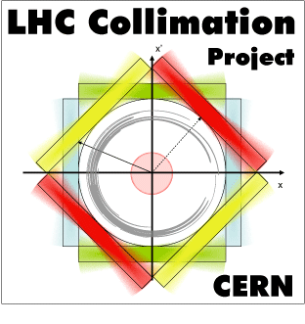

FLUKA studies: channeled ions on LHC TCSGs @ IP7
L. Lari (CERN & IFIC (CSIC-UV))
D. Mirarchi (CERN & ICL)
A. Lechner (CERN)
ColUSM#32
December the 6th, 2013

Slide 2
Motivation
To investigate the worst cases of energy deposition on different TCSGs location in IP7, due to channeled ions from crystal foreseen to be installed in Beam1 line in the first preliminary tests after LS1:
TCSG.B4L7.B1 (h) → in the middle of IR7
TCSG.6R7.B1 (h) → at the end of IR7
TCSG.B4L7.B1
TCSG.6R7.B1

Slide 3
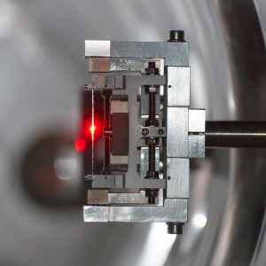
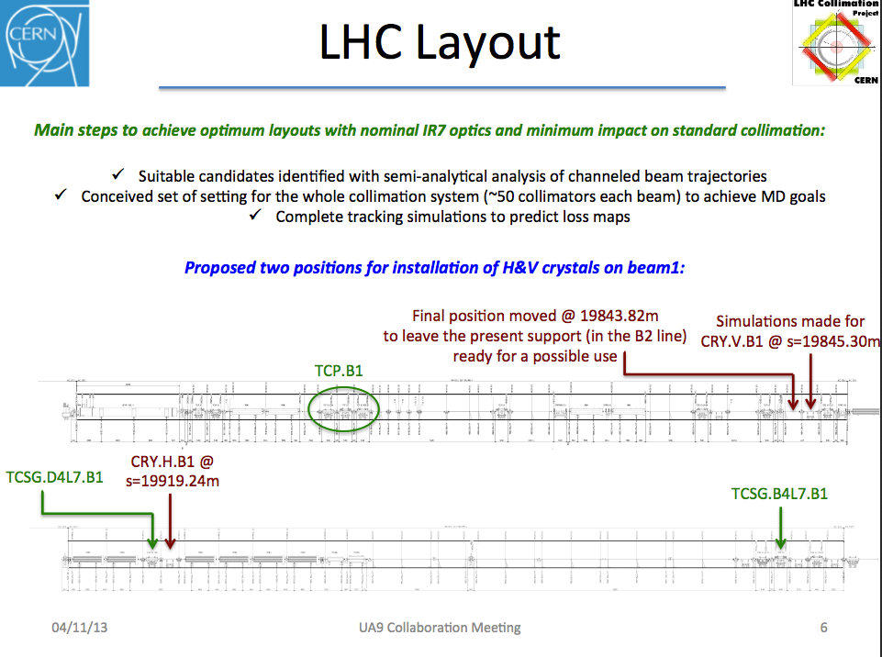
LHC IR7 post LS1
Fluka studied only horizontal losses from the horizontal oriented crystal
In case of using the TCSG.B4L7.B1 as absorber the downstream coll. @ nom 7TeV aperture to avoid secondary losses on DS area.
Or on
Or on
TCSG.6R7.B1
In case of using the TCSG.6R7.B1 the downstream TCLAs closed at 10 σ are sufficient to protect the DS area.
Presented by D. Mirarchi at the UA9 Collaboration Meeting (5-7 November 2013)

Slide 4
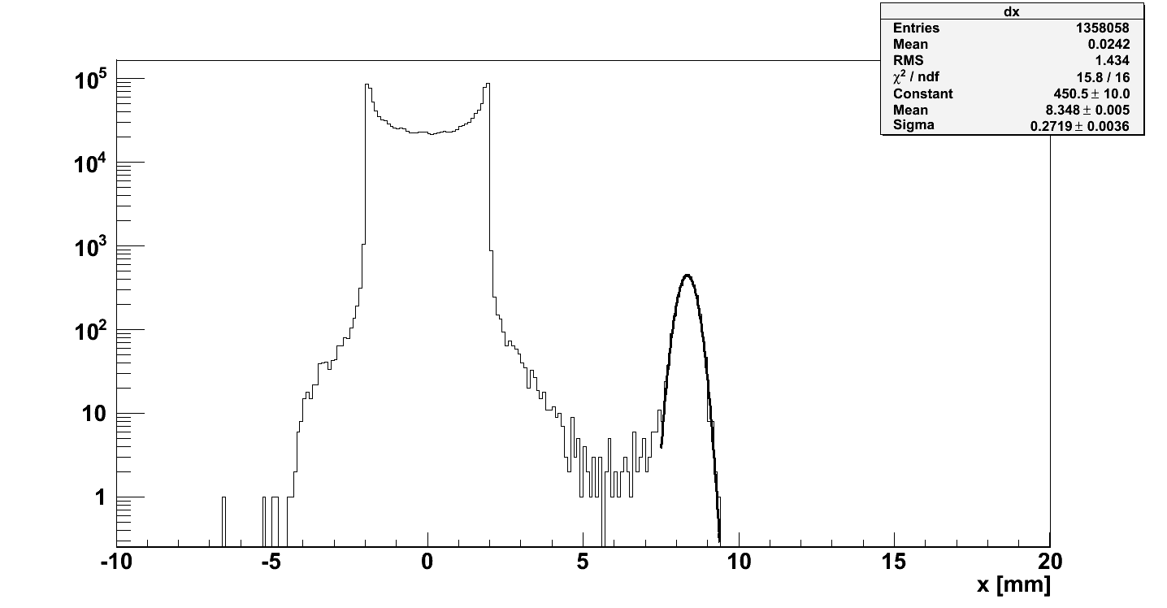
SixTrack benchmark w.r.t. data
Screen placed at the Medipix location to evaluate the particle distribution
SixTrack simulation:
made for the UA9 layout in the SPS
Experimental data:
Profile of the extracted halo on the Medipix
beam core
channeled beam
Protons
Theoretical position expected of the extracted halo:
8.4 mm and full spot width ~700μm
Sigma gauss fit~11.27 pixel * 55μm ➔ ~600μm
Many impacting halo distribution tested:
from an average b of <2μm up to 100μm
Spot of channeled beam on absorber determined
by: crystal angular acceptance and optics
Ions
Dimension in the orthogonal plane:
“natural” beam size at the Abs. (i.e. only optics)
Sigma gauss fit~11.30 pixel * 55μm ➔ ~600μm

Slide 5
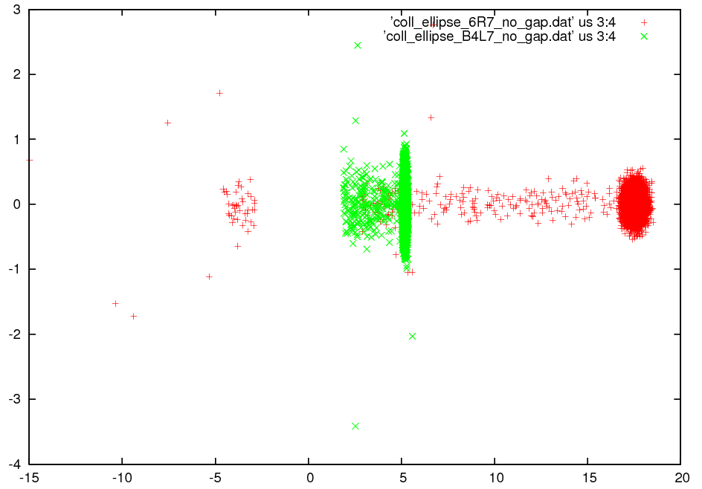
Fluka Input data (SixTrack)
[mm]
Tracking studies with SixTrack performed for protons.
only the spots were used as input for fluka studies.
Coll.
Half
gap
Spot on TCSG.6R7.B1
Spot on TCSG.B4L7.B1
[mm]

Slide 6
Fluka simulations (1/2)
Performed:
By using ²⁰⁸Pb⁸² @ energy/nucleon 2759 [GeV]
By impacting ions beams on CFC surface
By normalizing the results using as data:
  Cleaning efficiency of 1 → we considered the worst case in which all the ions are channeled by the hor. Crystal during the whole lifetime.
  Beam lifetime of 1 hours and 0.2 hours investigated.
  Intensity after LS1: 1.8x10⁸ ions each 600 bunches (note that after LS2 a factor 2 more should be considered)
  (Courtesy J. Jowett & M. Schaumann)

Slide 7
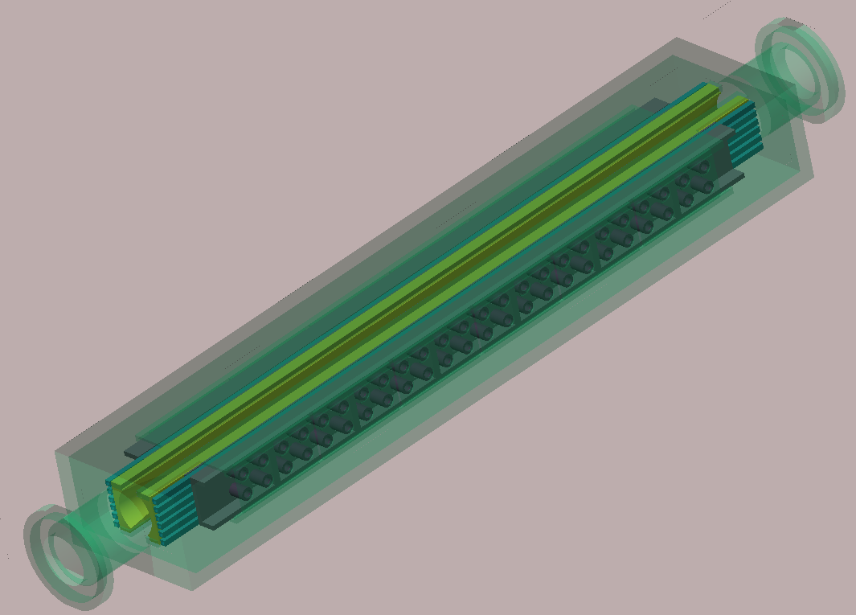
Fluka simulations (2/2)
By using a detailed TCSG fluka geometry developed by the fluka team.
Remember that the TCSG has CFC jaws!
Scoring using binning size properly set, with reference to the spot sizes under study:
TCSG.B4L7.B1 (0.005x0.01x2.2 cm)
TCSG.6R7.B1 (0.01x0.008x1 cm)

Slide 8
Fluka Results (1/3)
Peak power density longitudinal profile into the jaw that intercept the ions spot
[W/cm³]
TCSG.B4L7.B1
TCSG.6L7.B1
Peak due to a fraction of the beam lost with respect to the 0.2h lifetime considered
[cm]

Slide 9
Fluka Results (2/3)
Peak power density longitudinal profile into the jaw that intercept the ions spot
[W/cm³]
TCSG.B4L7.B1
TCSG.6L7.B1
0.2 h beam lifetime
1 h beam lifetime
3 h beam lifetime
[cm]

Slide 10
Fluka Results (3/3)
TCSG Power load distribution (ref.0.2h lifetime)
TCSG.B4L7.B1
TCSG.6L7.B1
Power deposition results for some components of the most loaded jaw.
[W]

Slide 11
Conclusions
The energy deposition values for worst cases were presented for 2 different impact cases on TCSGs. The case of collimation in the horizontal plane has been taken as reference for both planes, during the first feasibility tests.
Results similar to the TCSG.B4L7.B1 case are expected for the vertical case in terms of beam spot size on TCSG.D4L7.B1.
Results show low energy deposition values, but in small volumes. Fluka maps have been provided to the MME team for needed detailed structural analysis.
Local degradation of the CFC material should be evaluated.
Note that in case of orbit errors the peak of energy deposition follows the location of the channeled spot, which is always inside of the TCSG under consideration.

