Slide 1
Longitudinal integration of a cold collimator
January 25, 2013
Presented at ColUSM by D. Ramos on behalf of the Cold Collimator Feasibility Study Working Group
https://espace.cern.ch/CCFS/default.aspx

Slide 2
How can we integrate a collimator in the LHC continuous cryostat?
Move magnets and DFBA’s to create space for a cryogenic module and collimator
Create space by replacing LHC dipoles with shorter high field magnets (minimum impact on installed equipment)

Slide 3
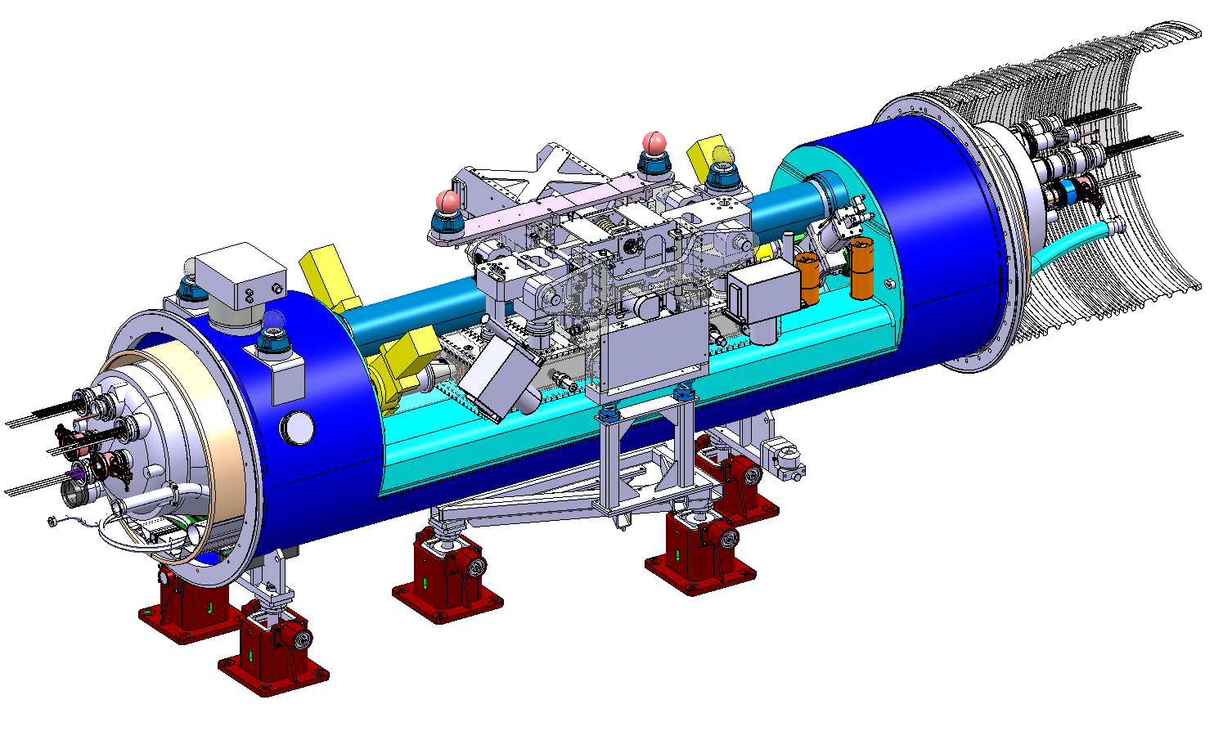
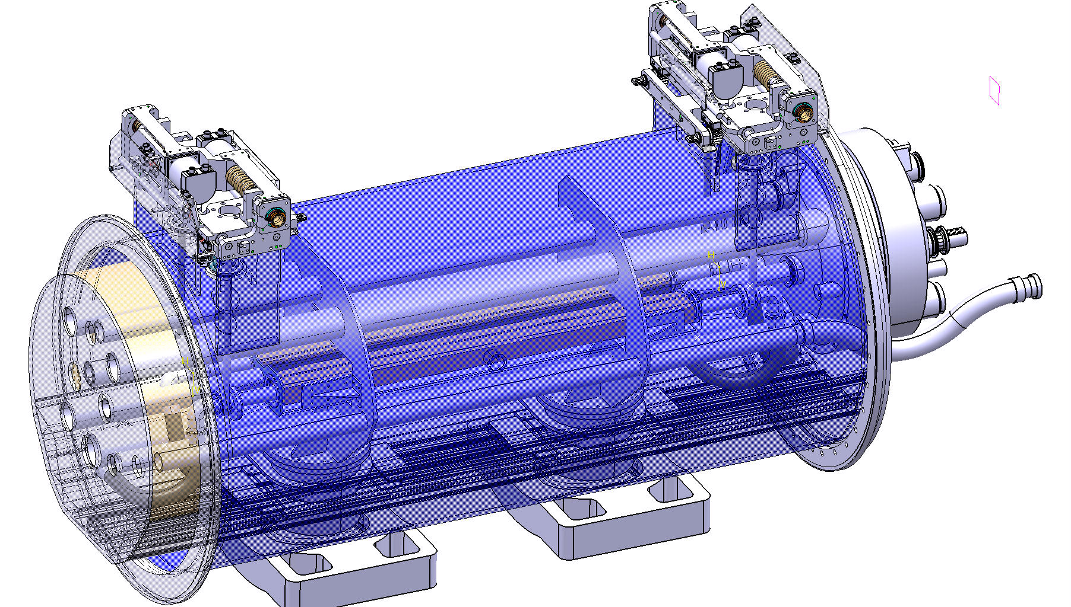
1. Move magnets and DFBA’s to create space
Design started in 2010 aiming for installation in LS1 (schedulled for 2012 at the time)
Displace magnets to create space
See last status report by V. Parma
Cold collimator vs Warm collimator
Potentially shorter but not feasible within schedule
Many open issues, possible showstoppers
Design completed, 4.5 m integration length
Prototyping of collimator actuation and cryostat

Slide 4
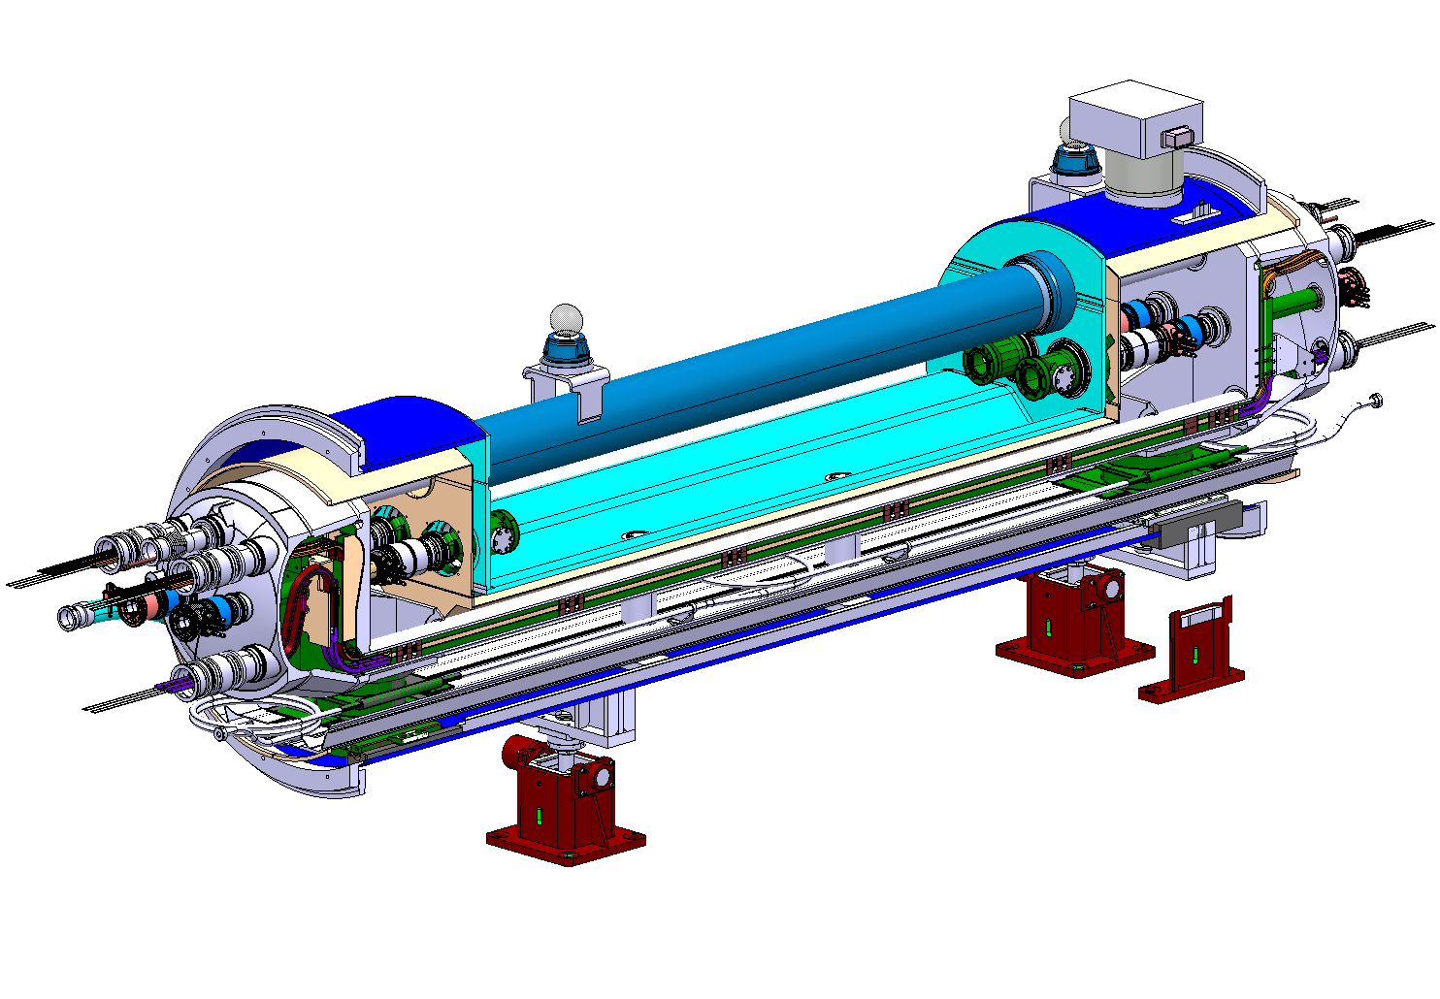
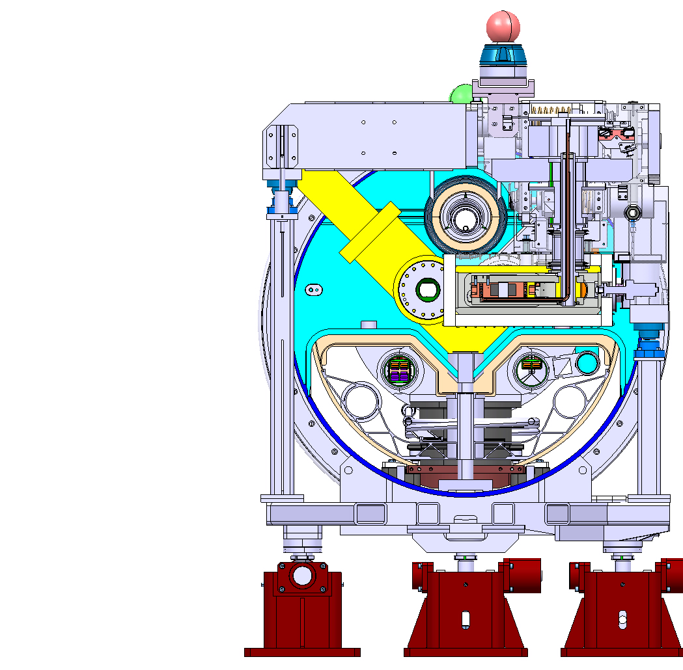
Why considering a cold collimator?
Since it’s cold, no need for cold to warm transitions, hence the overal installation length may be shorter.
If placed in the insulation vacuum, possibly more compact in cross section.
Could it be enough to get away without moving all those magnets and DFBA’s?

Slide 5
2. Replace LHC dipole with high field magnet
Possible layout options as presented last time:
Most likely not possible to fit netiher the collimator nor sector valves between standard bus bar lines. New routing needed to make vertical space for the collimator
Additional module needed to create a standard interconnect interface and thermal compensation.
Interference with W sleeve.
Looks more promising…
New end covers may be made to route the bus bars in a way to provide enough space for the collimator. The cost is loss of interchangeability betwen cold masses…

Slide 6
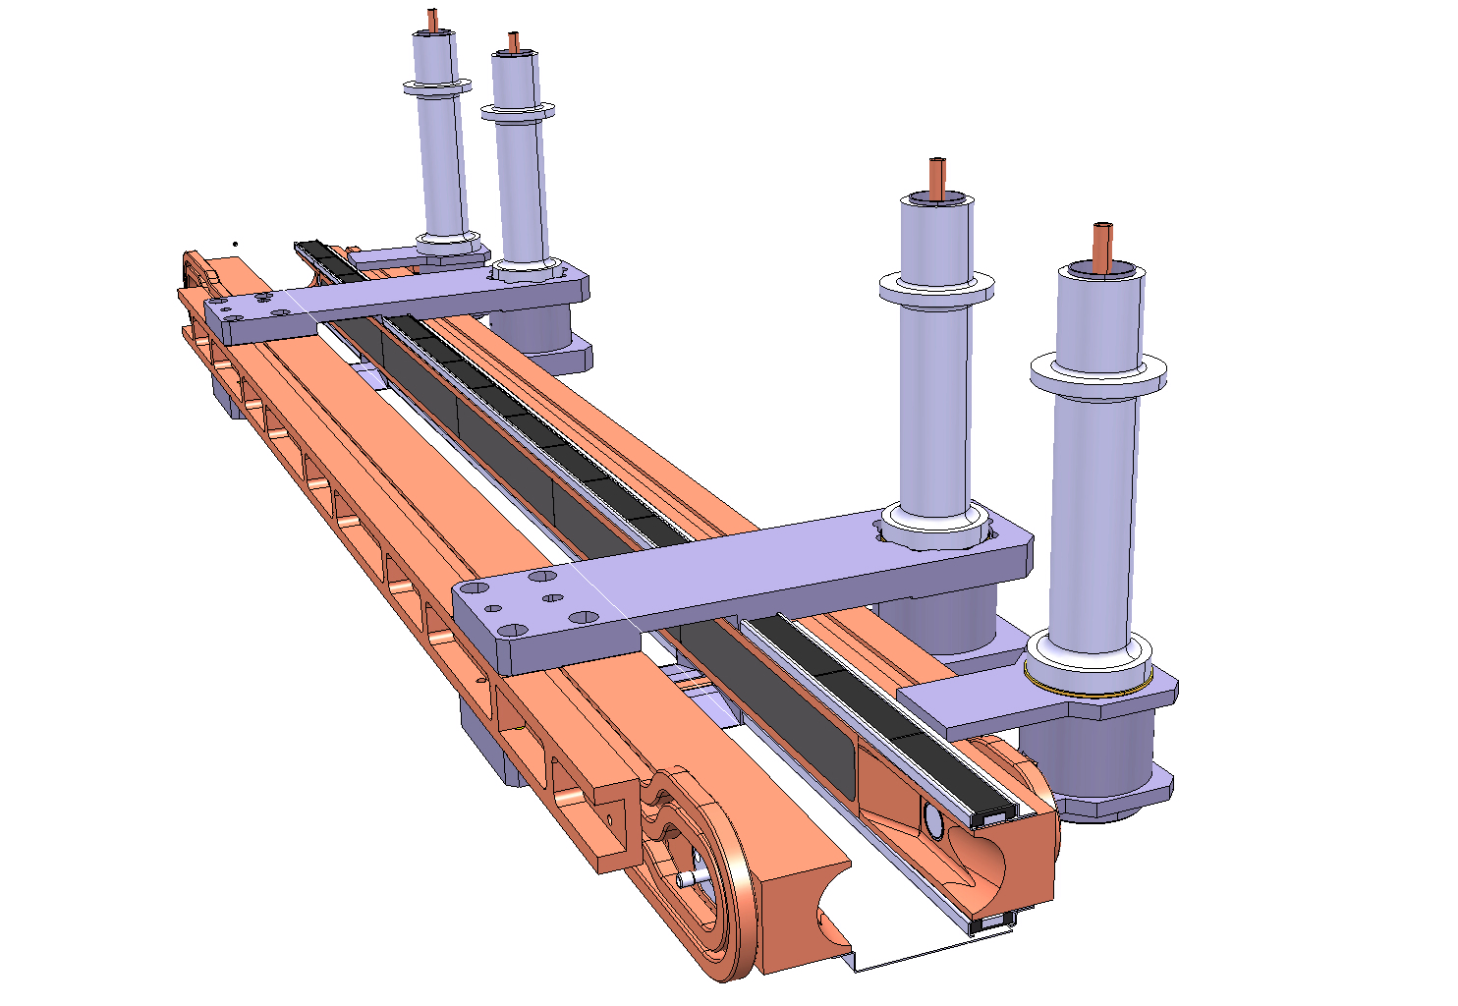
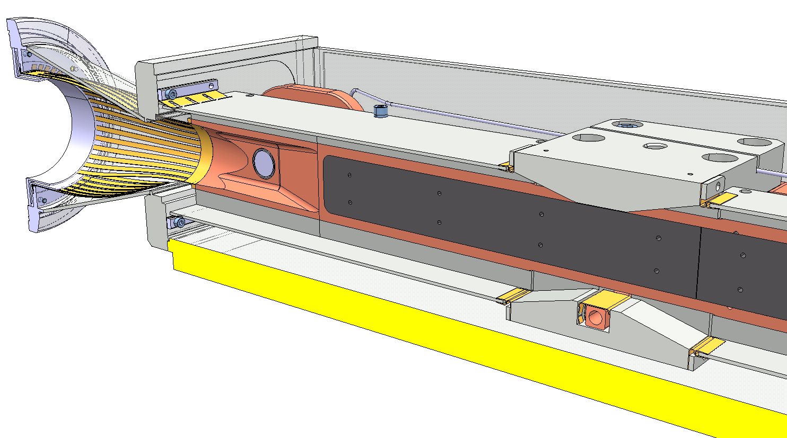
Collimator length
1000 mm tungsten active length: (should it be re-evaluated?)
2x100 mm for tapering and pick-ups
2x140 mm for RF transitions
Total: 1480 mm

Slide 7
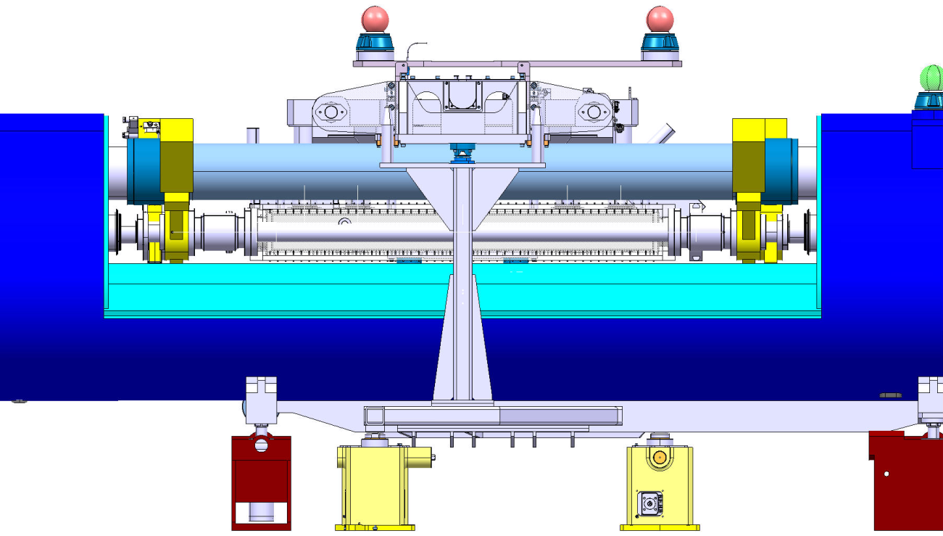
Mechanical and vacuum decoupling
RF shielded gate valves
For independence of vacuum operation
Must be staggered: 2x75 mm
Do not exist for low temperature operation! External actuator with long stem. Lets assume stationary wrt vacuum vessel.
RF shielded expansion joint modules for:
Installation and removal
Thermal compensation
Independent alignment of the collimator:
Possibly down to 100 mm, if special design
Port for RF ball plug-in module test after LHC warm-up: 100 mm
Total length
2x(100+2x75+100) = 700 mm

Slide 8
Magnet cold mass and beam lines
Assuming cold bore diameter 50 mm
Beam screen termination with compensation for differential displacements: 213 mm if standard; eventually 181 mm if optimised with a short nested bellows
Sector valve interface fixed to the vacuum vessel
Beam screen termination, fixed side: 122 mm
“Standard” length scenario;
6176+213+165+165+122+
6176 = 13017 mm
If optimisation proves feasible:
6176+181+147+147+6176 = 12949 mm
RF bellows module for magnet thermal contraction: 165 mm if standard; 147 mm if new design with shorter stroke in proportion to cold mass length

Slide 9
High field magnet + cold collimator length
 | Length (mm)
Collimator | 1480
Decoupling (bellows, sector valves, RF ball) | 700
Magnet, beam screens, bellows | 13017 (12949)
Interconnect | 500
Total length | 15697 (15629)
LHC dipole | 15660
Margin | -37 (31)

Slide 10
To think about…
Very tight longitudinal integration: already searching for the mm and haven’t even started the design!
In the transversal plane the task will not be easy either: volume for sector valves; additional cooling pipes and feedthroughs; mechanical feedthroughs, supports, thermal shielding…
The impact on LHC machine availability: introduction of moving parts into the LHC continuous cryostat, machine warm-up for interventions
The amount of R&D: beam vacuum dynamics; sector valves; collimator mechanics,vacuum chamber and cooling; support and alignment…
Since vacuum operation and thermo-mechanics require anyway beam screen terminations and bellows on either side of the sector valves, adding cold to warm transitions represents about 2 x 165 mm, i.e 330 mm (2% of 15660 mm…)

