Slide 1
Preliminary integration of Hollow e-lenses EDMS No: 1764989 v.2 (V.1. Presented on 26th TCC 16/03/2017) References: 1765930.v.1
Draft
M. Alcaide Leon, Paolo Fessia
Contributions
HEL conceptual design and parameters: D. Perini, C. Zanoni Beam optics and HEL technical coordination: A.Rossi
HEL 3D Modelling: A. Kolehmainen
3D Integration Modelling: M. Gonzalez QPS requirements: D. Wollmann, R. Denz, A. Verweij
Power Converters requirements: M. Martino & Y. Thurel Vacuum requirements: P. Santos
Cryogenics requirements: S. Claudet
EDMS No: 1764989 v.2. 22/05/2017

Slide 2
INDEX
Preliminary integration of HEL in HL-LHC machine and technical services in the tunnel of 4L
Preliminary integration of technical services in service caverns of 4L
Conclusions

Slide 3
REMARK
This is a preliminary integration study of the Hollow e-lenses in the machine lay-out for HL-LHC and its technical services in the tunnel and service caverns with the present conceptual design of the device (EDMS No: 1765930.v1). The conceptual design is subject to change due to further technical optimizations and definitions by the WPs involved in its design. In particular possible integration in the Hollow e-lenses of Beam Instrumentation that are not accounted here and for which the possible impact on the device and layout is not known.

Slide 4
Preliminary integration of HEL in HL-LHC machine and technical services in the tunnel of 4L*
*Please note that 4R is symmetric to 4L

Slide 5
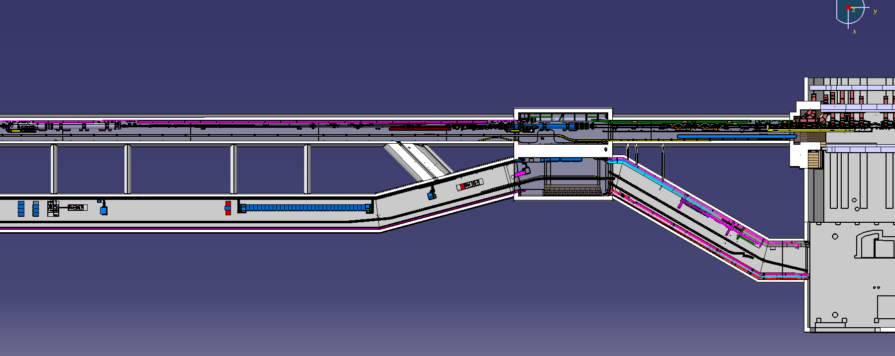
Overview of LSS4 P4L
B2
B1
RB44
RA43
D3L4
HEL
ADT
ACS
UJ44
UA43
UL44
US45
ST0676534_01

Slide 6
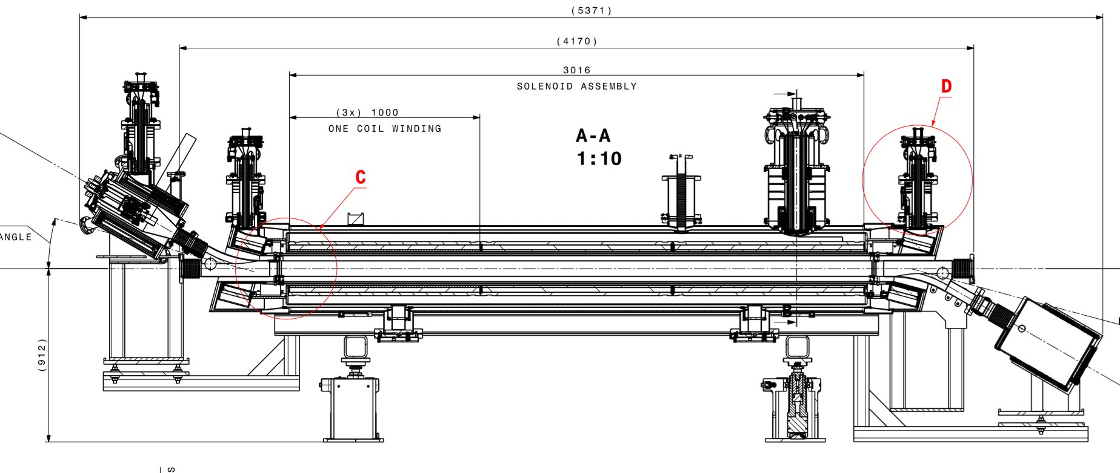
HEL – Dimensions
Previous design was used in May 2017.
Integration being redone with new optimized design

Slide 7
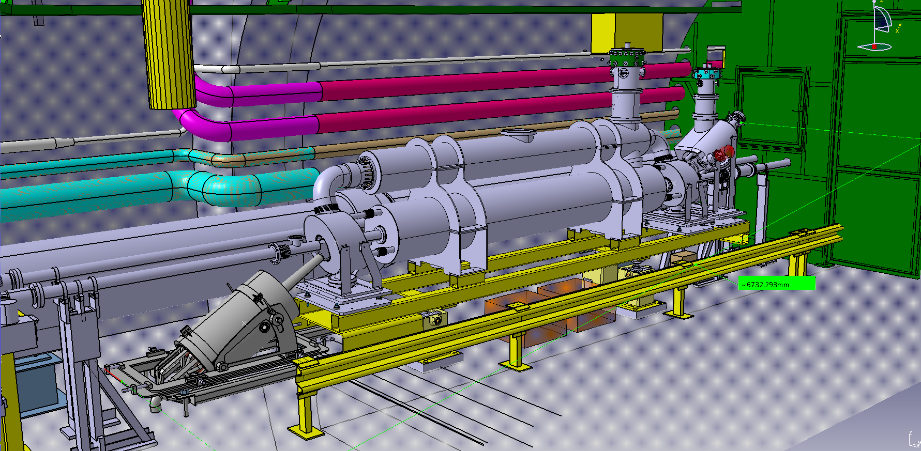
HEL – Dimensions
New optimized design
Previous total length used for this integration 6171 mm
New design total length used for this integration 6630 mm

Slide 8
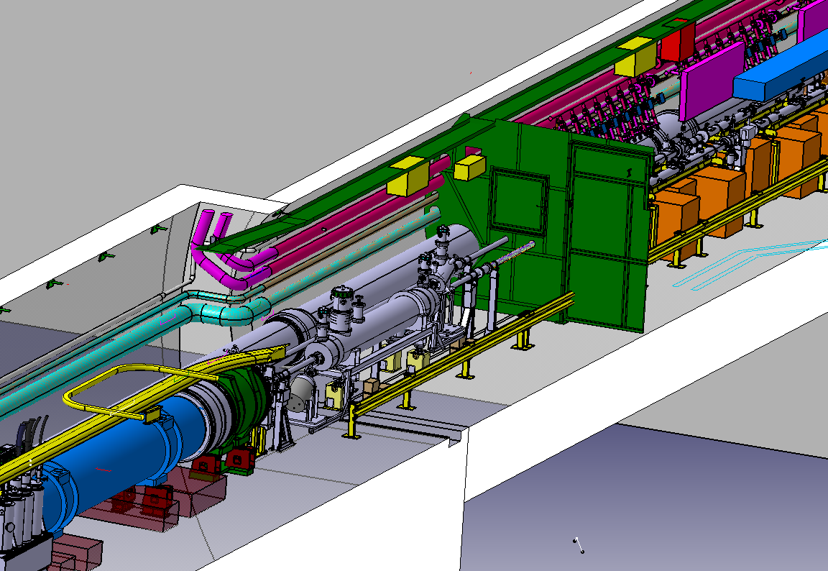
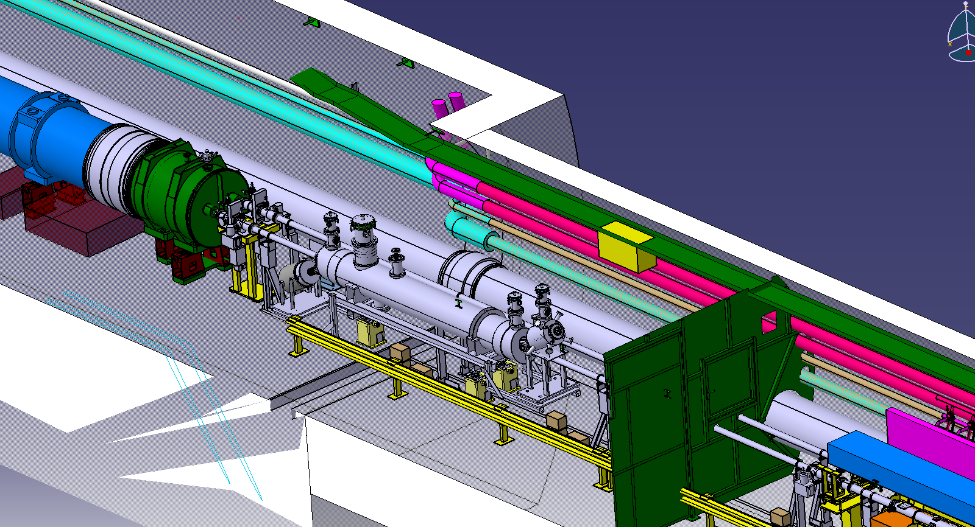
Layout integration in HL-LHC machine
ADT
Images to be updated
Ventilation door
V.C Supports
HEL
D3
DFB
ST0676534_01
ST0676534_01

Slide 9
Interface with other equipment in the tunnel
Cryogenics supply:
New dedicated service module and jumper. Options:
Possibility to install one dedicated service module for HEL leaving space for a future service module for new xxxMHz module or,
install a double service module with two jumpers for HEL and future xxxMHz module
ST0676534_01

Slide 10
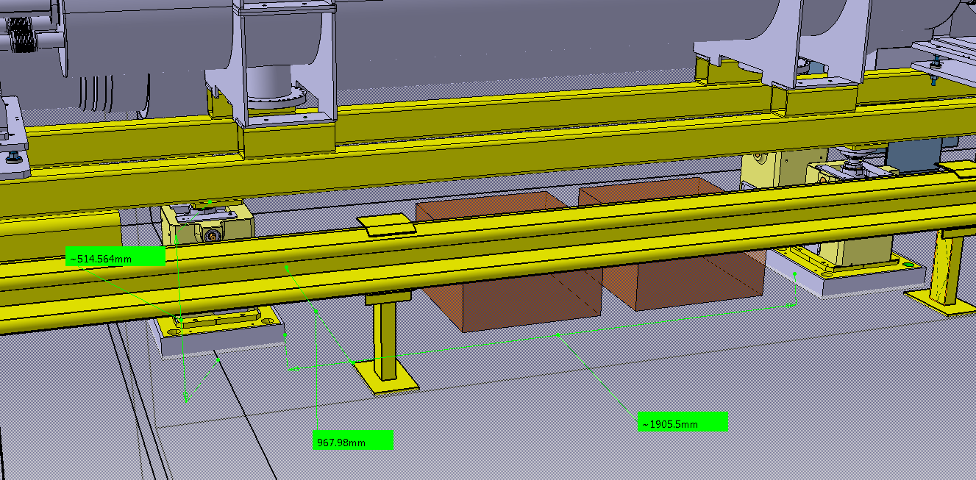
Tunnel general services
Water cooling pick up for collector: needed. Integration being studied
Services for e-gun powering:
1 or 2 modulators placed under the e-lens.
Modulator envelope
- 50x50 cm x 30cm height
Available space under HEL:
- Width: 2 m (space between jacks)
- Depth: 1m
- Height: 500mm

Slide 11
Preliminary integration of technical services in Service caverns of 4L*
*Please note that 4R is symmetric to 4L

Slide 12
Power supplies - Circuit rating
450 A
450 A
Total number of independent circuits: 17
7 PC x HL-LHC600A-10V
10 PC x Cancun 50
Total number of racks: 6 PC racks + 1 control rack
Spare slots taken into account
Water cooling for HL-LHC600A-10V

Slide 13
Power supplies - Characteristics
Cabling characteristics:
Waiting for AC and DC cabling definition and integration
First check from EN-EL→ Installed power in UA43/47 should be enough

Slide 14
HEL – Other racks needs
To be revised
QPS:
EE system needed?→ Study by WP7 to see if they are self protected
Racks → 2 min, 6 max (if EE needed)
Location: together with the PCs
BI: 2 racks for control
E-gun:
An Electrical Cabinet roughly, 2m wide, 1.2m deep, and 2.5m high. Into this cabinet all equipment at 15kV potential. (water cooling no needed)
A standard 19 inches rack with control electronics, cathode PC (referred to ground) and the main circuit breaker
Integration of these 2 elements is being studied

Slide 15
Racks needs summary
System | Min. racks | Max. racks
Power converters | 7 | 8
QPS | 2 | 6
BI | 2 | 2
E-gun | 1 | 2
Total | 12 | 18

Slide 16
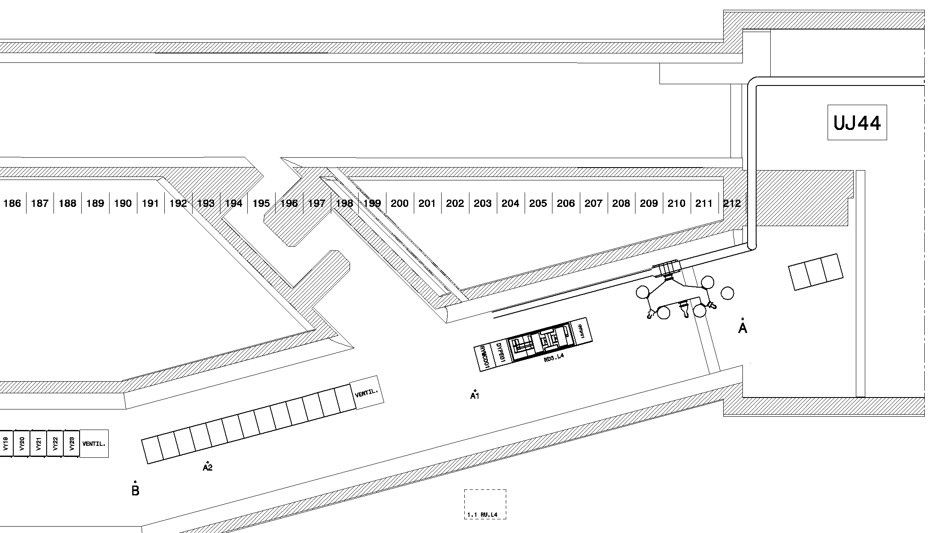
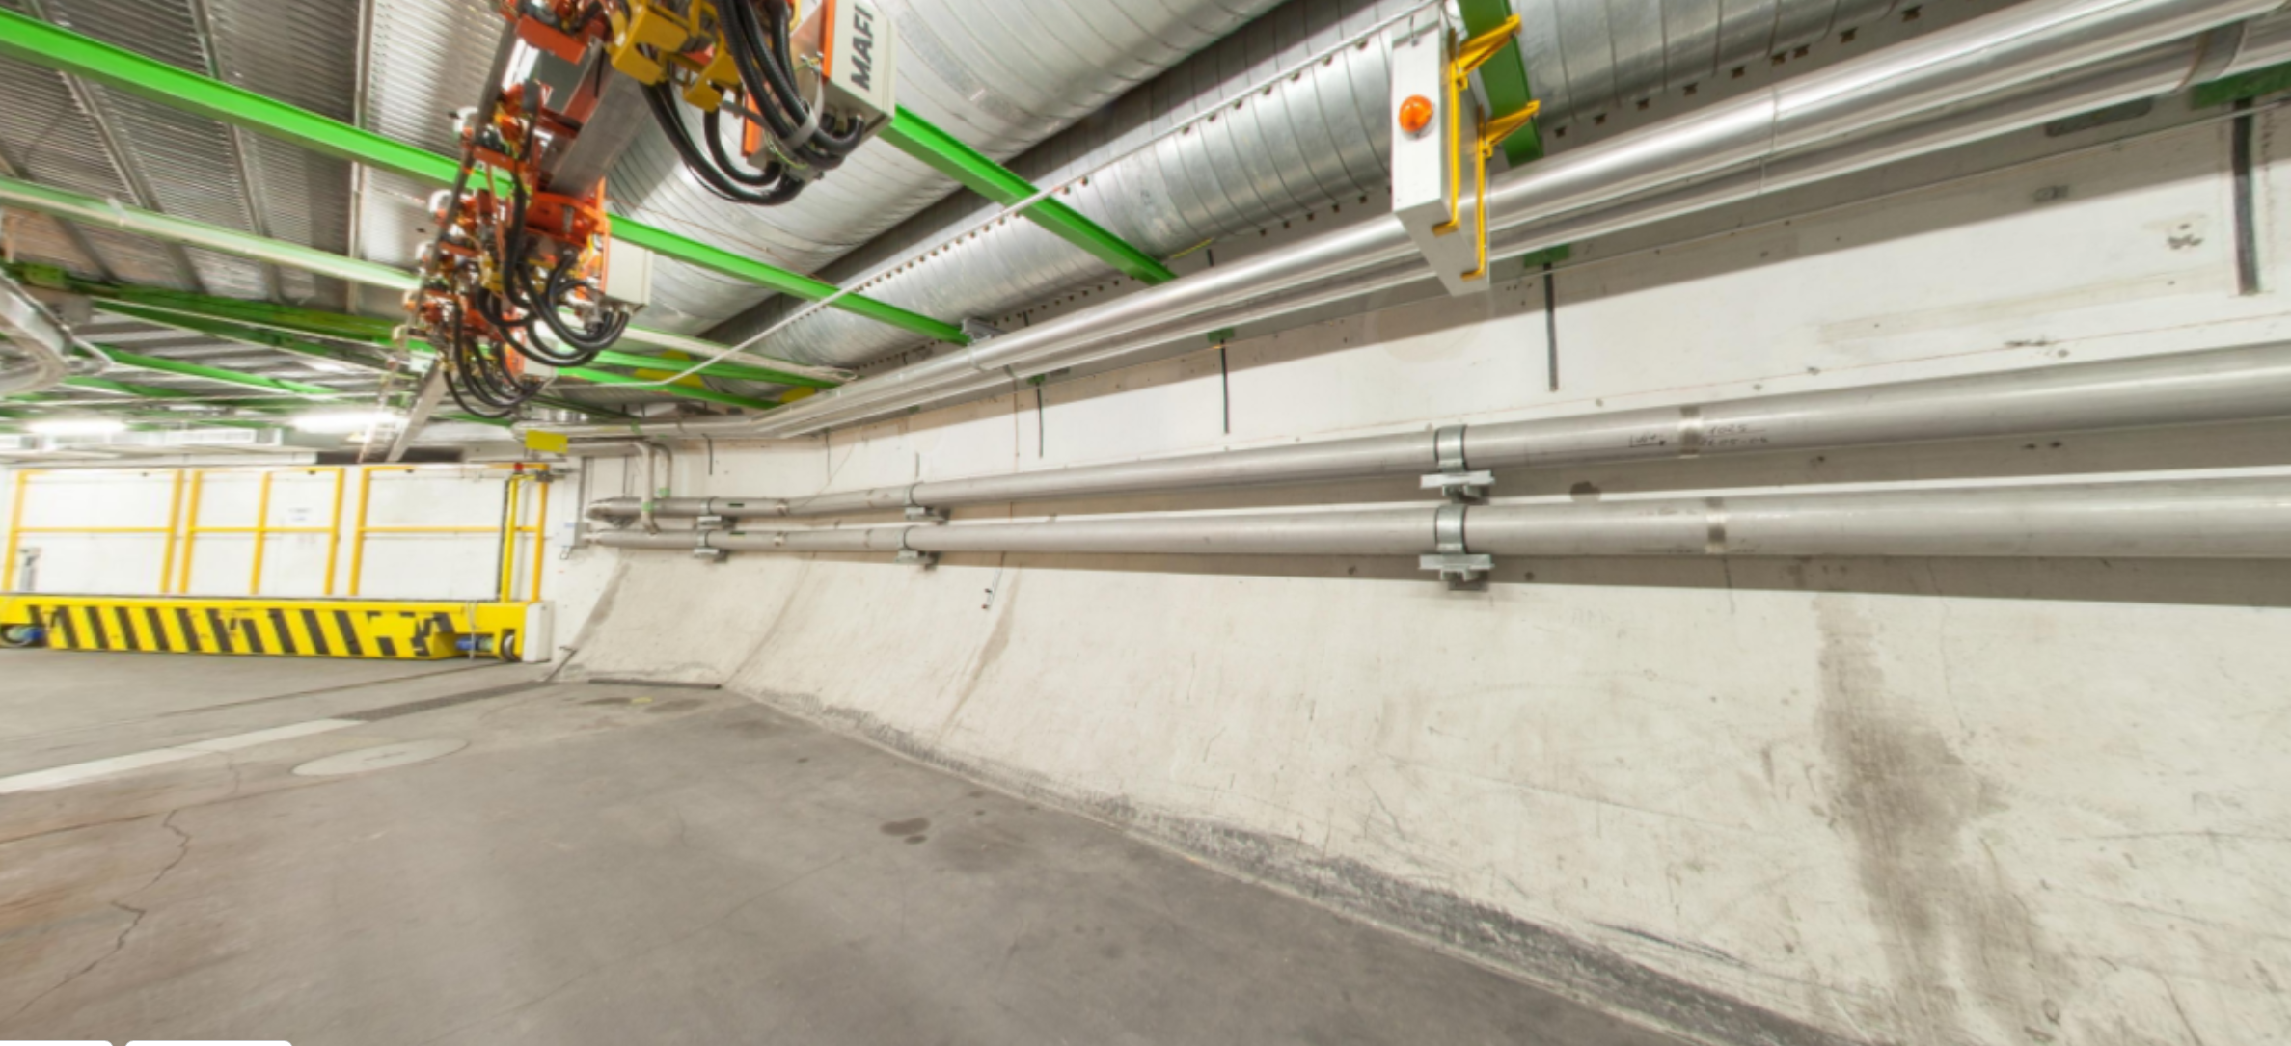
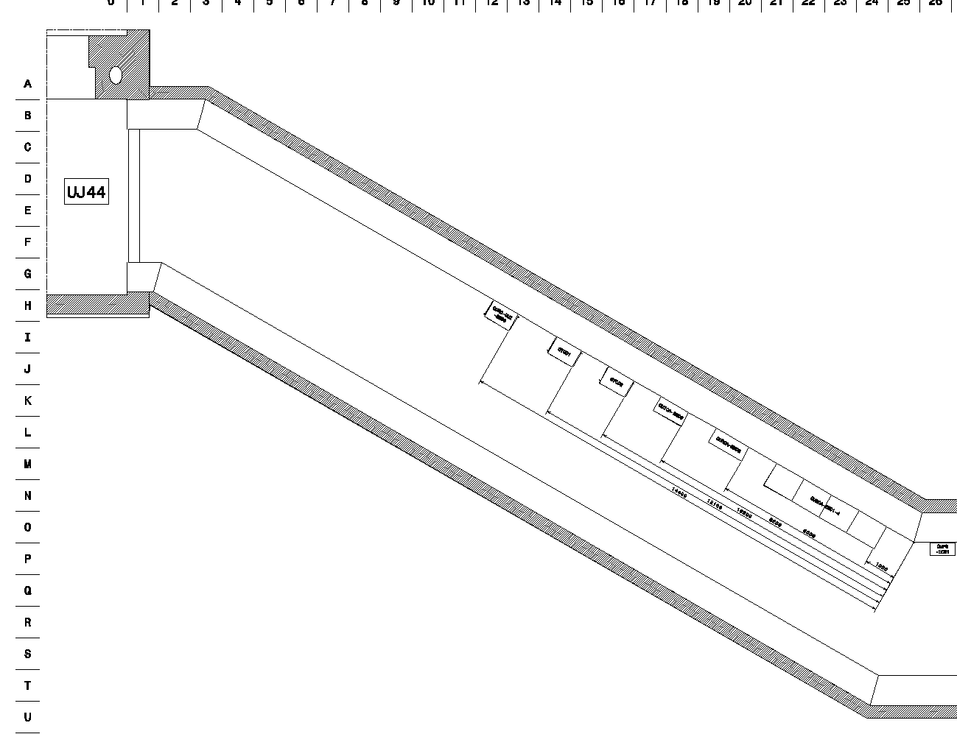
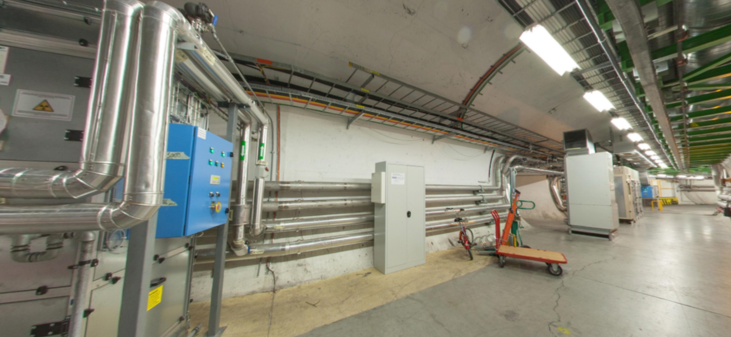
Option 1: UA43 & UL44 (P4L) / UA47 & UL46 (P4R)
Racks- Location
UA43
4 racks
14 racks
UL44

Slide 17
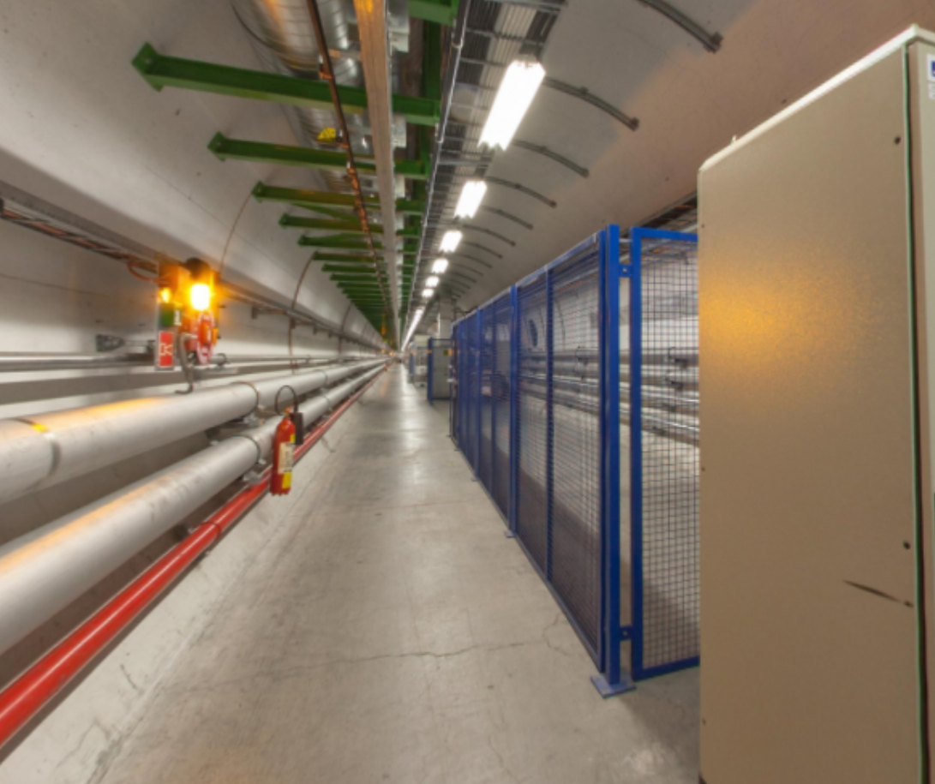
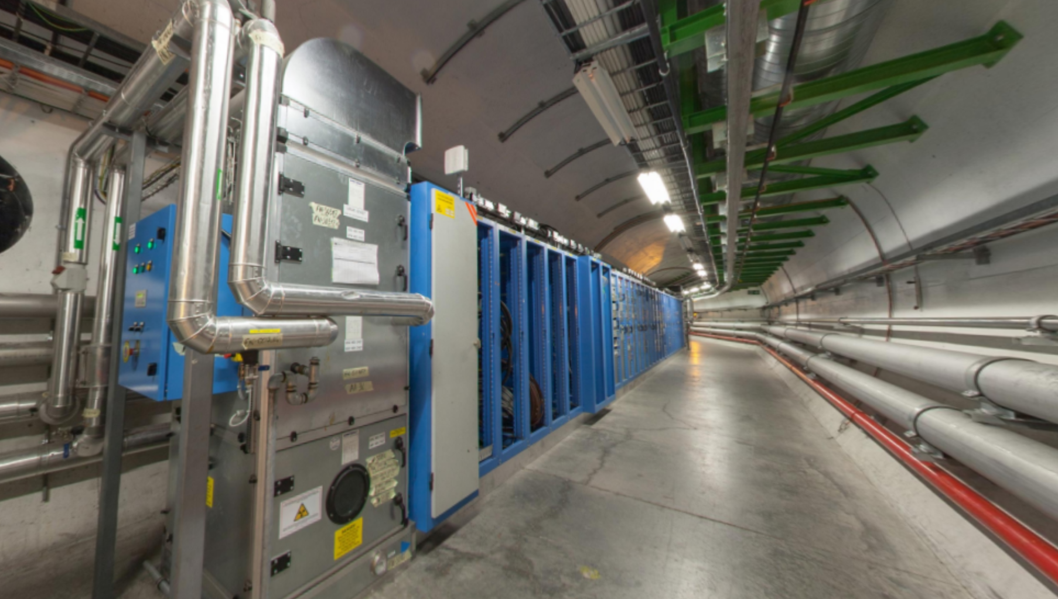
Option 2: UA43 (P4L) / UA47 (P4R)
Racks- Location
4 racks or more
4 racks or more
UA43
14 racks

Slide 18
Conclusions

Slide 19
Overview of LSS4 P4L until D4 for HL-LHC
B2
UA43
B1
BSR - New extraction and hutch
BSR - Old extraction and hutch
NEW ADT: existing reservation
HEL and racks
ST0676534_01

Slide 20
HEL – Conclusions
In view of a possible technological and integration review in autumn this year the integration and service analysis should be updated taking into account:
Results of EE computation
Addition of Beam Instrumentation equipment and its impact on the HEL design and of the general services requirements
A detailed analysis of other ancillary equipment that should be placed in the LHC tunnel (e-gun ancillaries?)
Cabling routing from PC to HEL should be defined and integrated

Slide 21
Thank you

Slide 23
Extra slides

Slide 24
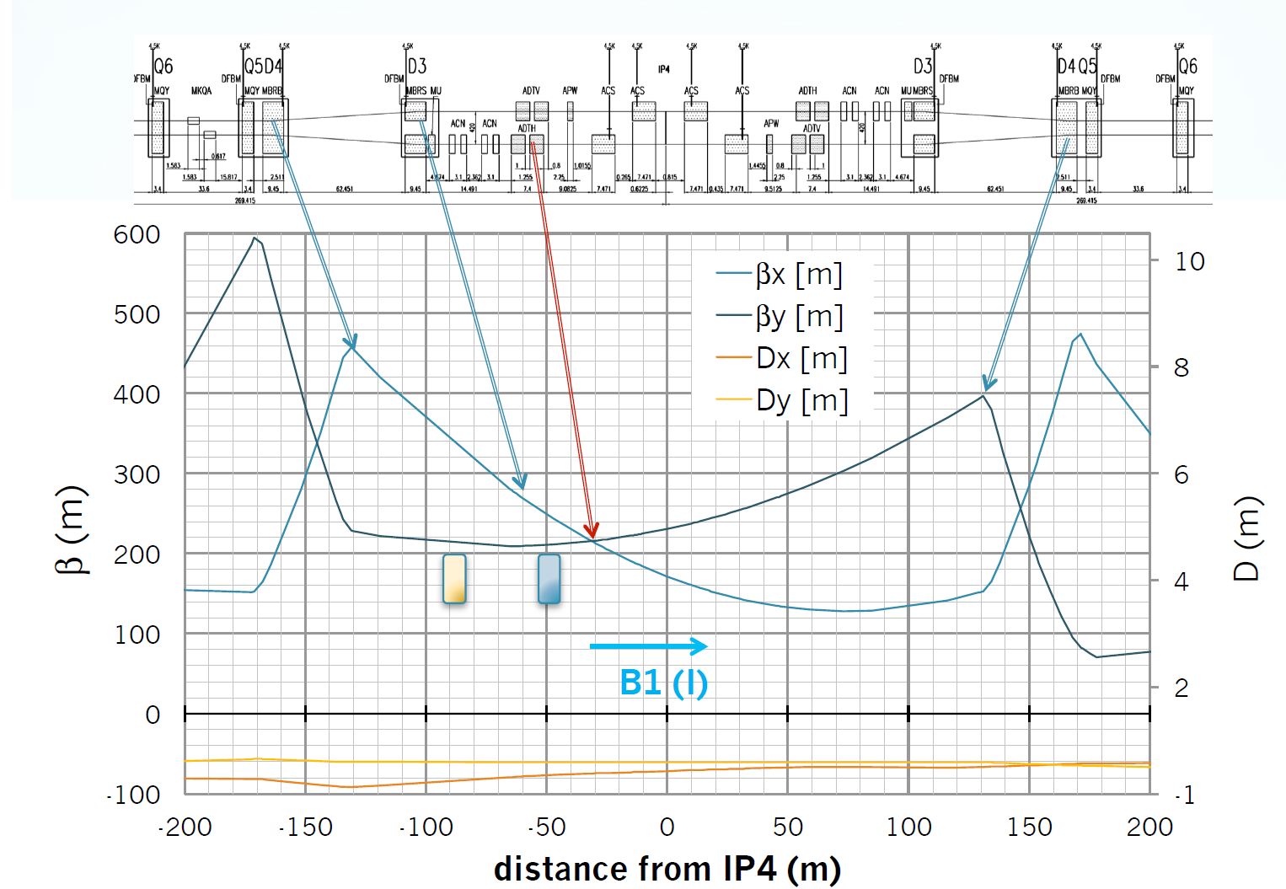
HEL- Optics
Courtesy of Adriana Rossi

Slide 25
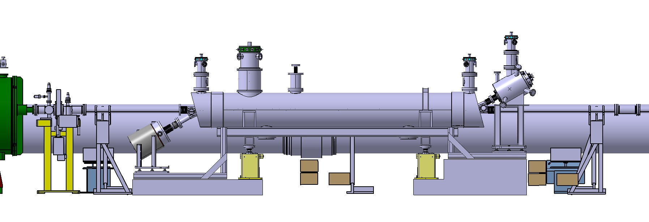
Layout integration in HL-LHC machine
New design of vacuum chamber supports to gain some space
ST0574939_01

Slide 26
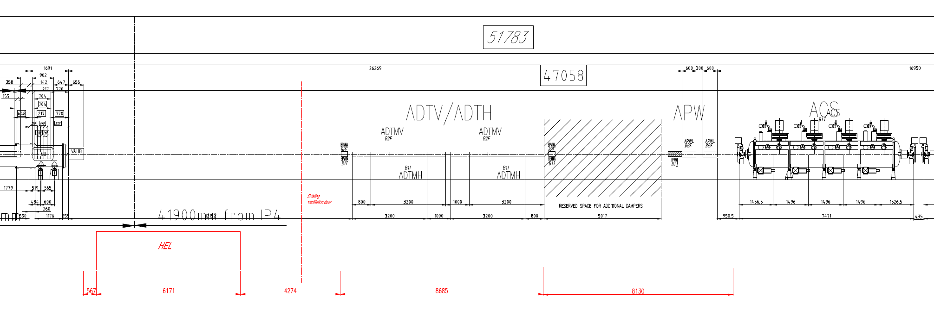
Sketch layout with HEL - 4L
Total length of RF zone (from HEL to IP): 37357 mm
Distance from IP4: 43529 mm

Slide 27
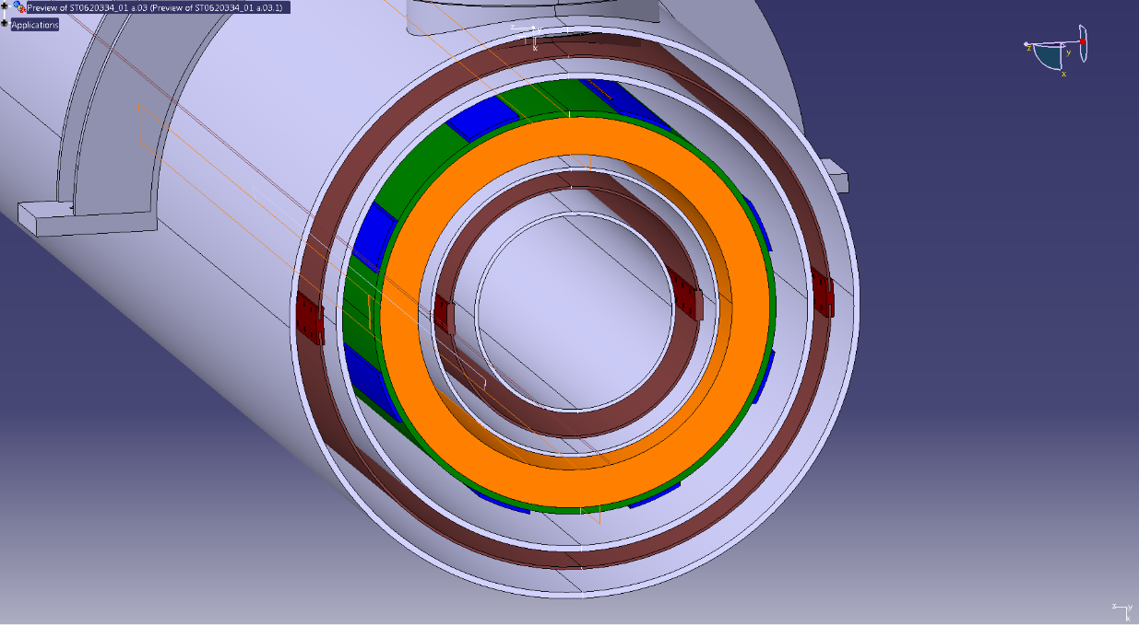
Interface of HEL with other equipment
Vacuum:
Vacuum pressure during operation must be lower 10⁻¹¹ mbar.
Vacuum chamber NEG coated.
Vacuum chamber inner diameter: 80 mm.
Vacuum chamber material: cooper.
Bake-out temperature: 250°C.
25 mm bake-out jacket.
Sector valve for the e-gun:
Exchange procedure to be study.
The design of the collector should avoid degassing.
In case of collector degassing, ion pumps or in worst case 1 m length NEG coated vacuum pipe on both sides of the HEL should be installed. (Not in present layout proposal) → to be studied by the HEL team and WP12.
2 x Current Transformer
2 x Beam Position Monitor
2 x Gas Jet Monitor
454 mm
135mm
BI:

Slide 28
Interface of HEL with other equipment
From inside to outside in grey the room temperature vacuum tank, in brown the thermal screen, in grey the helium tank wall, in orange the main solenoid, in blue the corrector coils generating a horizontal and a vertical dipole. Then follow the helium tank wall, the thermal screen and the vacuum tank. The overall external diameter is 454 mm.
454 mm
135mm
BI:

Slide 29
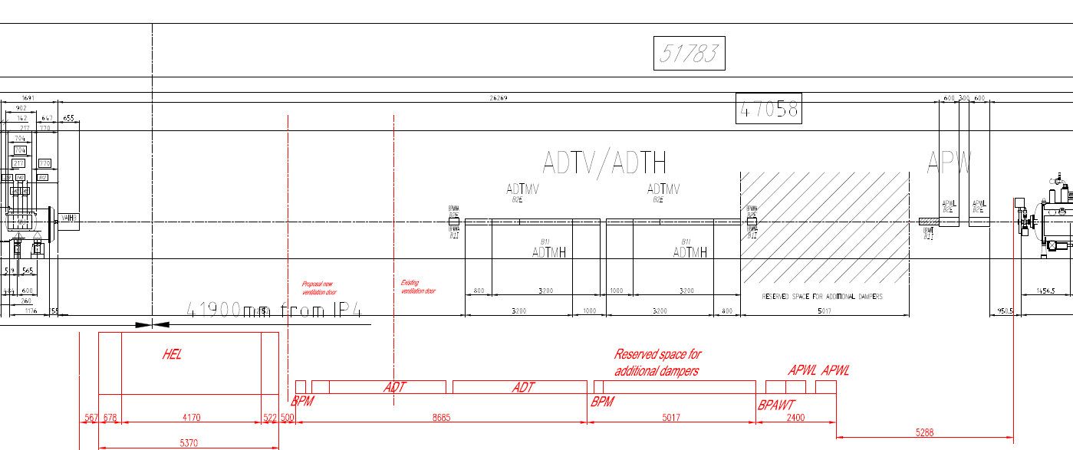
Sketch layout in case of possible RF upgrade

Slide 30
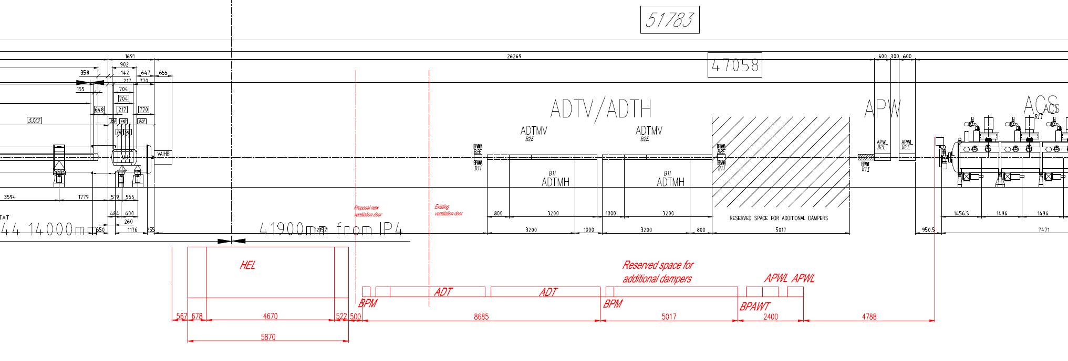
Sketch layout in case of possible RF upgrade with arbitrarily longer HEL (+500 mm for instrumentation)

Slide 31
HEL – Conclusions
System | Type | Description | Actions
Gas Position Monitor | Open option | It will increase the length of the device, therefore decrease space between HEL and BPM after ADT | Wait to see if it is going to be included
Gun and collector degassing | Design optimization | Design of electrons gun and collector to avoid degassing, otherwise 1m of vacuum chamber in both extremes of HEL with NEG coating needed | Design of the collector avoiding degassing
Space for pumps | Design optimization | Not so much space for the ion pump in e-gun | Interaction with Vacuum for HEL design
Supports for vacuum chamber | Design optimization | Support of vacuum chamber between HEL and Valve takes space maybe needed | Design of new supports
Racks options | Integration study | Two options for racks, depending on total number of racks needed and space availability | Conduct integration studies
Cryogenic supply | Technical study | Two options for cryogenic supply | Conduct studies
EE | Technical study | On-going study to see if the coils are self-protected, it will save space for EE racks | Wait for results
DC Cabling | Study | DC cabling and integration has to be studied | Conduct studies

