Slide 1
Status of the 11T cryo-assembly design and integration
Presented at ColUSM #34, February 21, 2014
Delio.Ramos@cern.ch

Slide 2
Outline
Recall from last talk (January 2013)
What are we looking for in the new solution
The 11 T cryo-assembly
Main integration issues
Status of the cold mass and cryostat design

Slide 3
From last talk (Jan. 2013)
Cold collimator discarded. The baseline is a room temperature vacuum baked collimator.
Remove one MB cryo-magnet and replace it with a new cryo-assembly of equal length, integrating:
  2x 11T short magnets
  1 collimator
Longitudinal integration benefits from placing the collimator in the middle
Fitting within the 15660 mm length of a standard MB is a challenge
MB
11 T
11 T
Collimator
15660

Slide 4
Aim for full interchangeability with a standard dipole
(no changes to neighbouring cryomagnets)
X
No changes to cryo, electrical or mechanical interfaces (different jack’s position is inevitable)
15660 mm long, interc. included
Inside the 11 T cryostat:
  X-line remains straight
  He II free cross section: 60 cm²
  Pressure drop of He II circuit: 4.3 kPa/m (50 mm smooth pipe)
  Pressures and temperatures acording to LHC-Q-ES-0001 (edms 90032)
Y
M1
M2
V1
V2
K2
K1
M3
N
E
C’
W
QRL side

Slide 5
Operation and maintenance
Mechanical decoupling from cryostat and collimator for removal and alignment of collimator without warming up the arc ⇨ bellows between collimator tank and cryostat, independent supports to the floor, compatible integration
One collimator design fits beam 1 and beam 2
Minimise exposure to residual radiation ⇨ simplify removal/installation of collimator, ex. quick CF flanges, pre-aligned collimator support system, “rapid” electrical and hydraulic connections (but not remote handling), permanent bakeout insulation
Ports for “RF-ball” test of new sectors
Transport constraints: Stay in the “shadow” of the existing arc cryostat

Slide 6
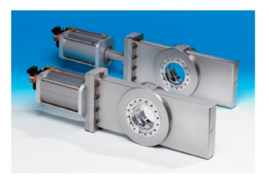
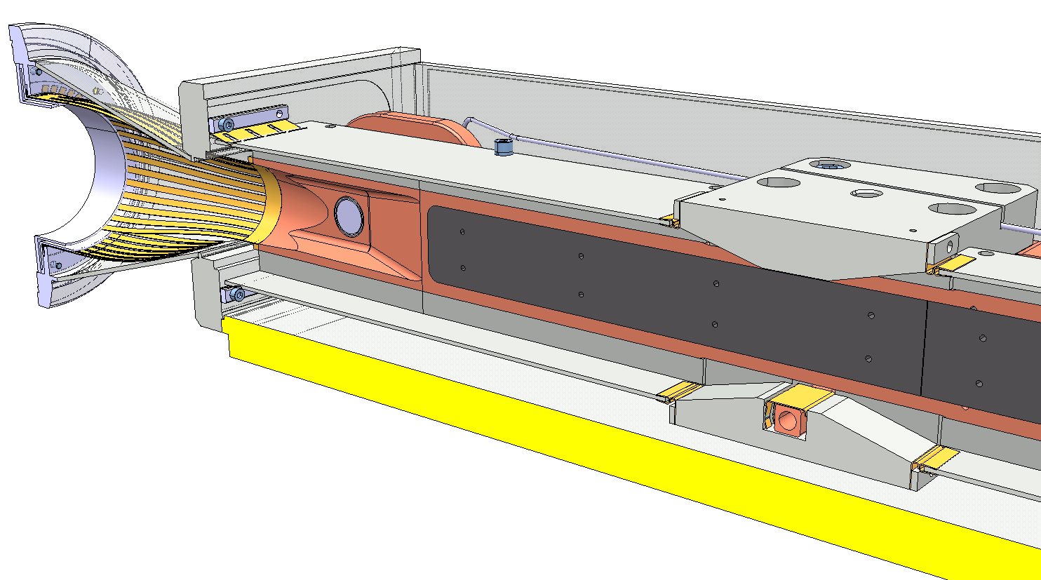
Vacuum
Room temperature (bakeable) collimator vacuum operated and maintained independently from cold beam vacuum ⇨ sector valves on both lines
Beam screens (K-line cooling) with same reliability and performance as rest or the arcs (no helium to beam vacuum welds, testing, etc.)
No demountable vacuum tight joints in cryogenic system (all welded)
Ensure pressure safety of each new beam vacuum “subsectors” ⇨ rupture disks on SSS ports
Ensure pressure safety of insulation vacuum (DN 200’s)
Respect current RF-impedance requirements: ex. shielded sector valves, shielded bellows, max 15º taper angle

Slide 7
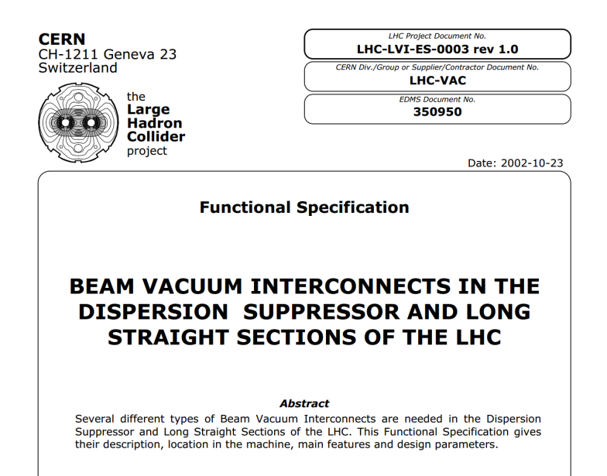
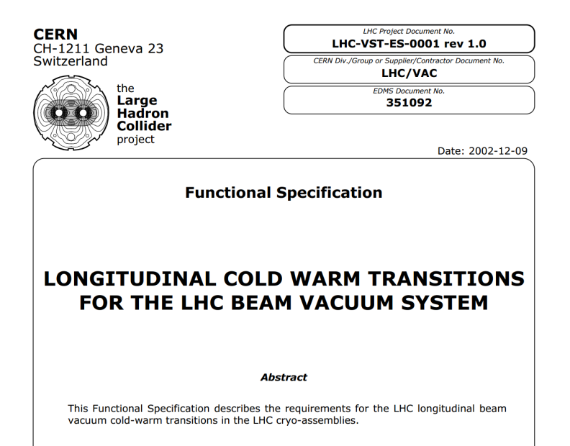
Thermo-mechanical
Busbar flexibility must take into account adjacent magnets
Temperature offset between cold mass and beam screen during transient
Temperature variation between two cold masses during transient
Cold to warm transitions on the beam lines

Slide 8
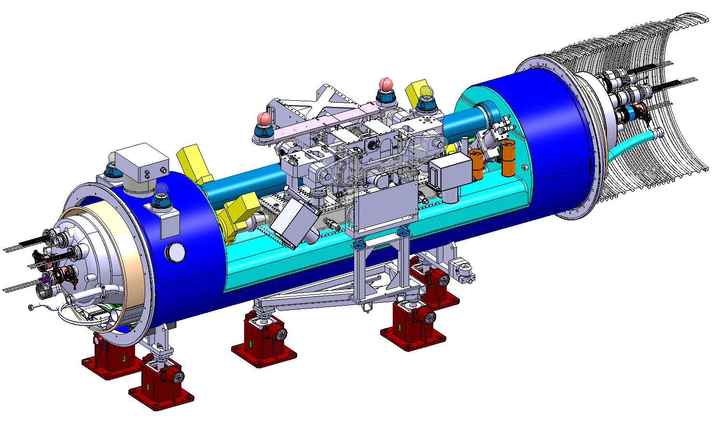
Before the 11 T magnet development: QTC (2010)
Main drawback: extensive machine layout changes to create space
4.0 m + 0.5 m interc. = 4.5 m installation length

Slide 9
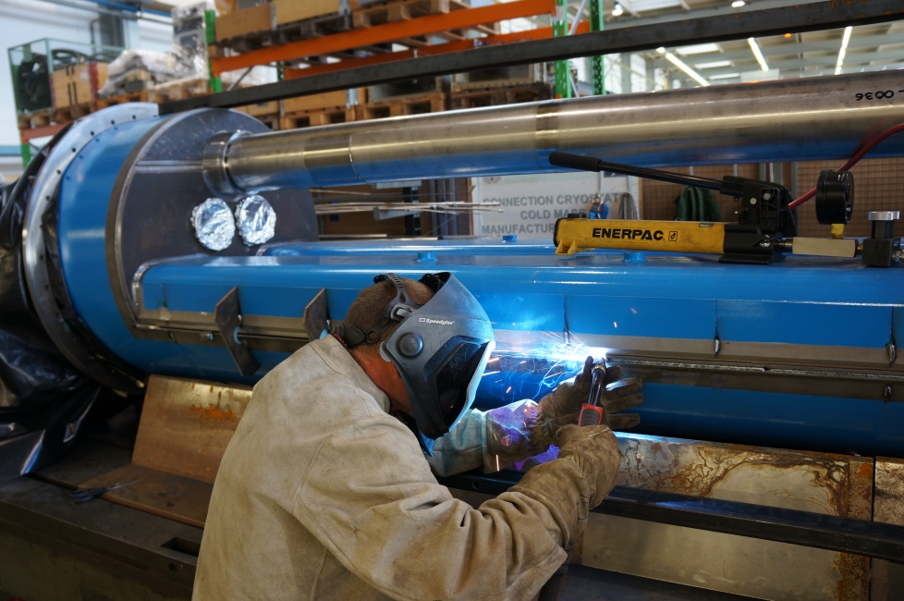
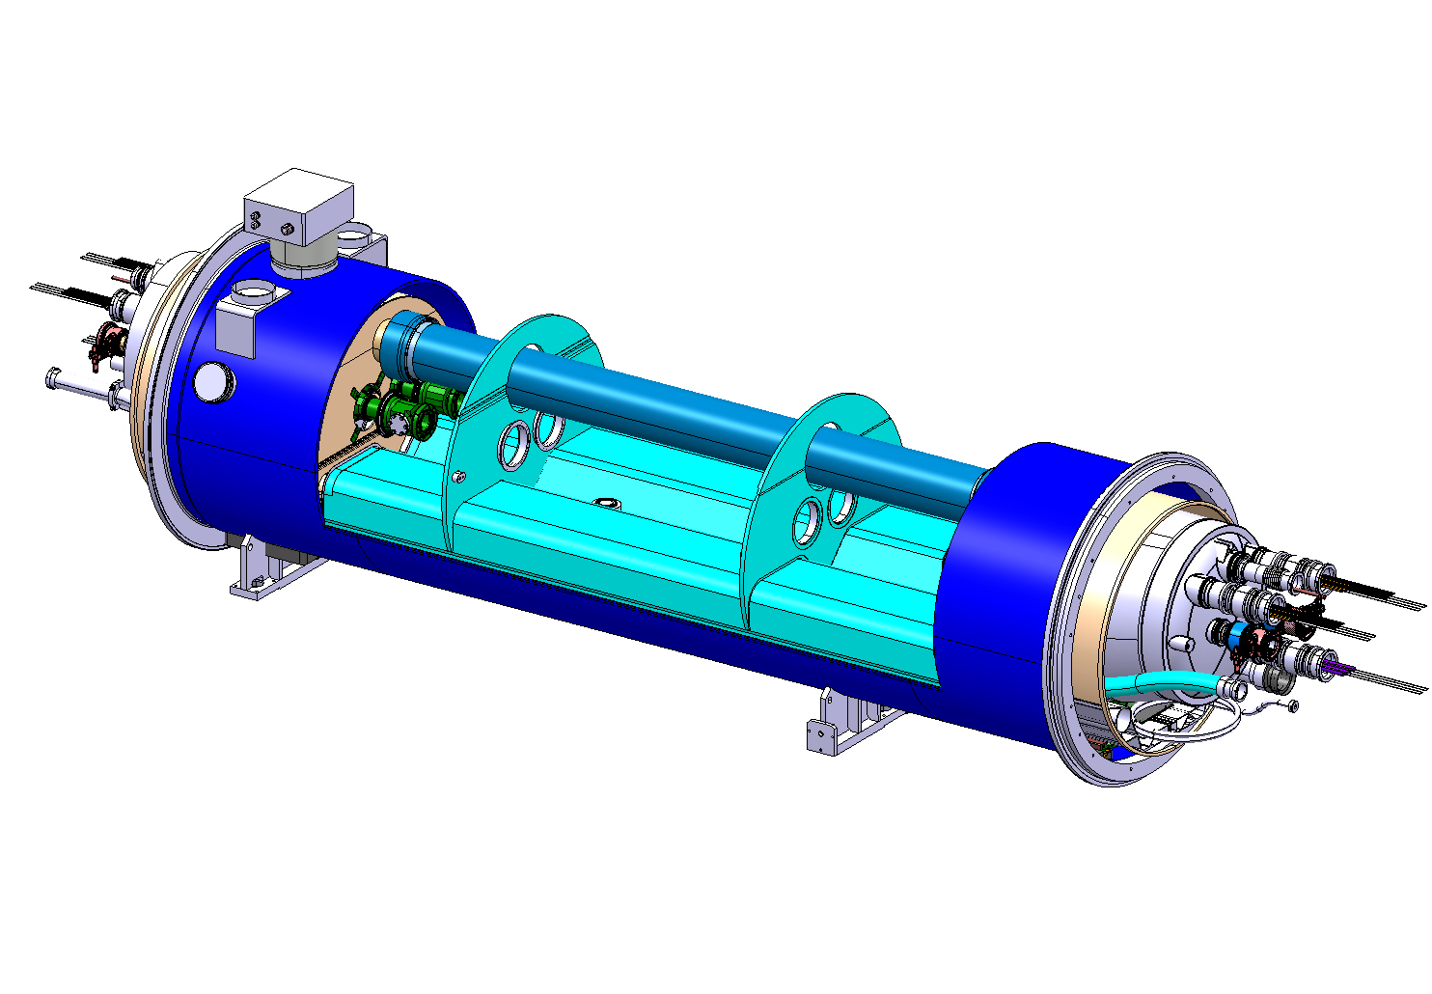
Could the QTC cryostat concept be “extended”?
Can only be finished after cryostating
Dealing with welding distortions is a major issue
  Distortions amplified with length
  Adjustment of cold supports posts is required
  Complicated assembly procedure
Cover closure w/ fillet welds
New approach needed
Longitudinal butt-welds

Slide 10
The 11 T cryo-assembly concept
Independently cryostated and handled cold masses, linked through two short transfer lines
Transfer lines with expansion joints mechanically decouple cryostats A and B
Splice and piping interconnect in the tunnel, all other work prior to installation
Can use the existing TCLD collimator design with modified the supports
Independently supported collimator
Line X
11 T cold mass A
11 T cold mass B
Collimator
Lines M, E, N, K, C’
Busbar lyra
Reinforced jacks to widstand vacuum forces
Flexible S-shaped busbar stabiliser
Busbar splice and interconnect done in the tunnel

Slide 11
Access for in-situ repair
Cold mass A
Cold mass B
Collimator
Once the collimator removed, the vacuum vessel cover can slide open
Good to have in-situ access for repair of «fragile» components:
  Expansion joints
  Flexible hoses
  Diode
  Instrumentation feedthrough (IFS)
  Current leads (?)

Slide 12
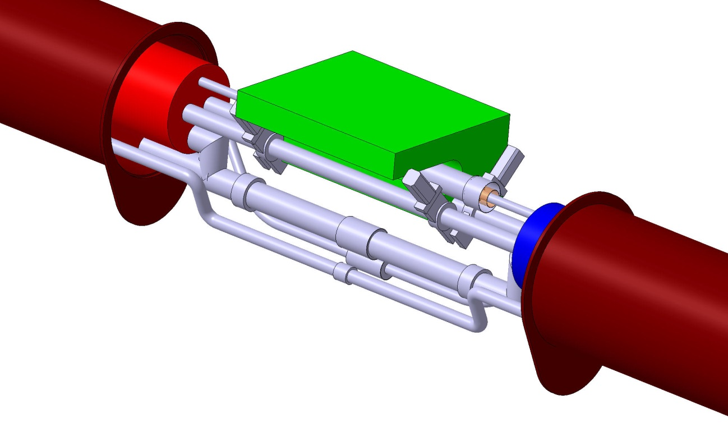
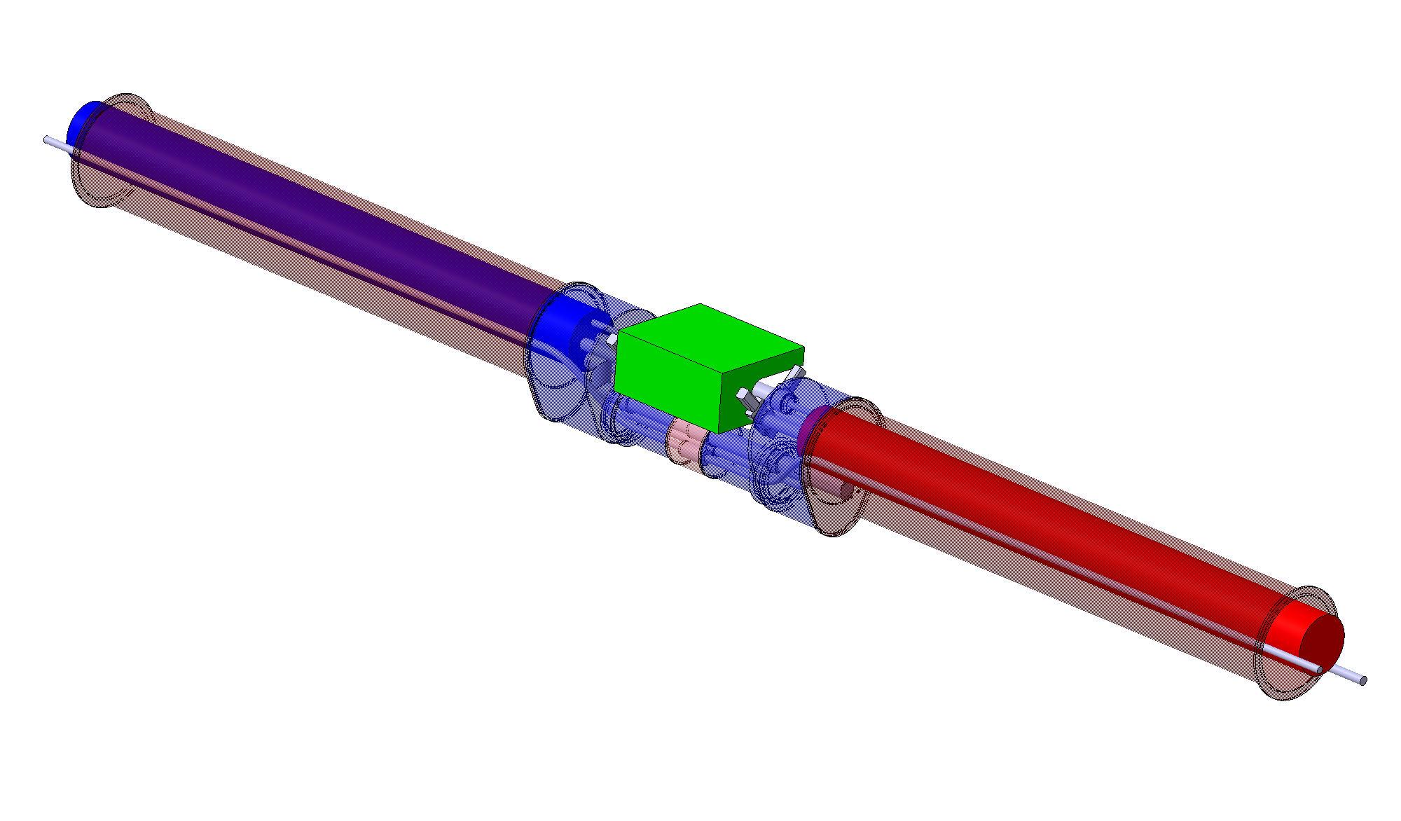
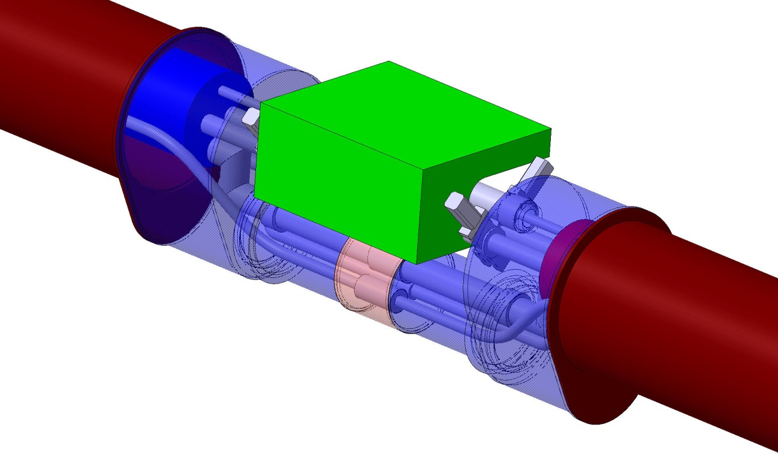
3D Integration

Slide 13
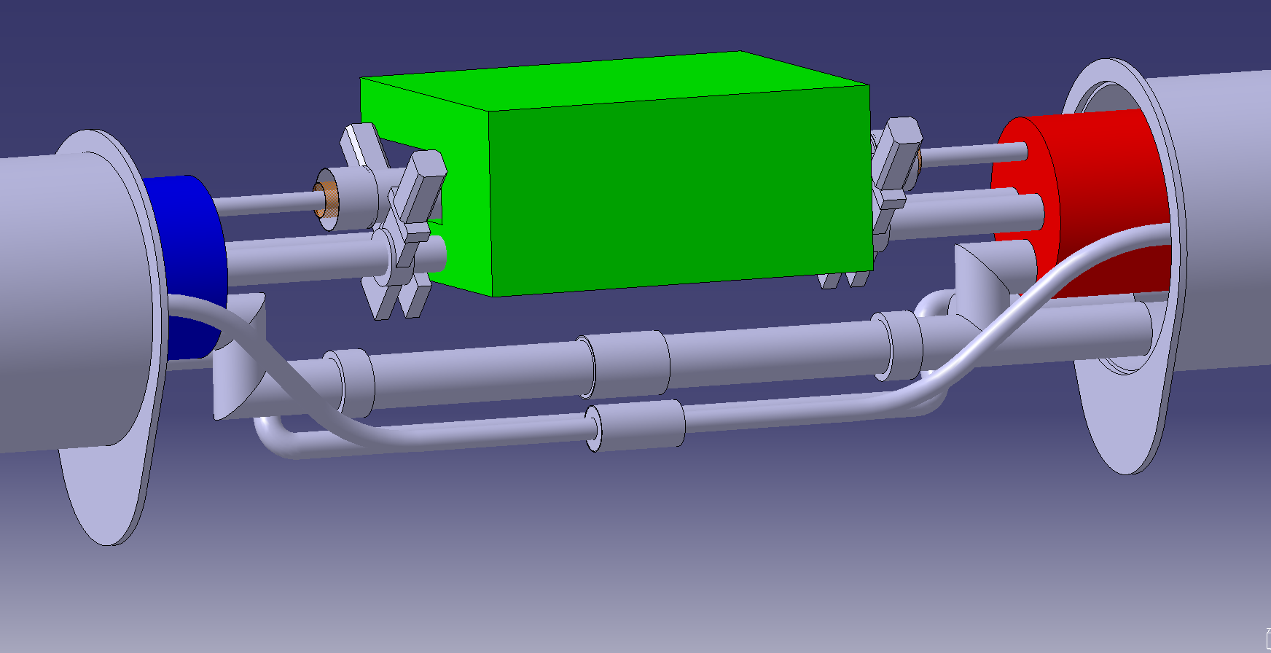
Collimator
Line X
Diode ?
Line M (6 busbars + splools)
Line E
Line N
Lines C’ and K (not shown)
Splices
C’ and K lines not shown

Slide 14
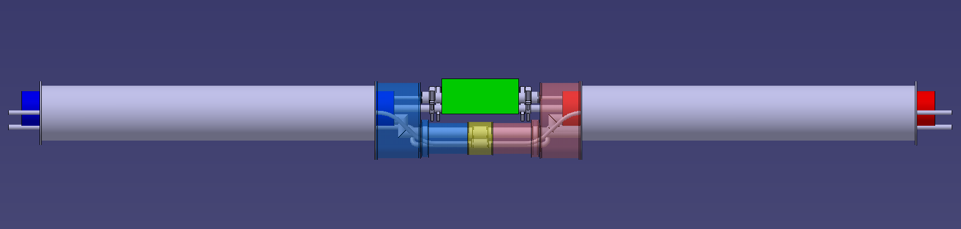
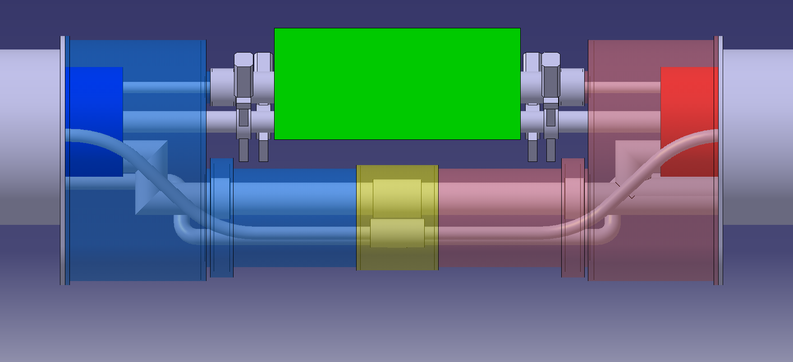
Expansion joints
RF-shielded bellows
Interconnect sleeve (rigid)
Expansion joints or flexible hoses
on all lines

Slide 15
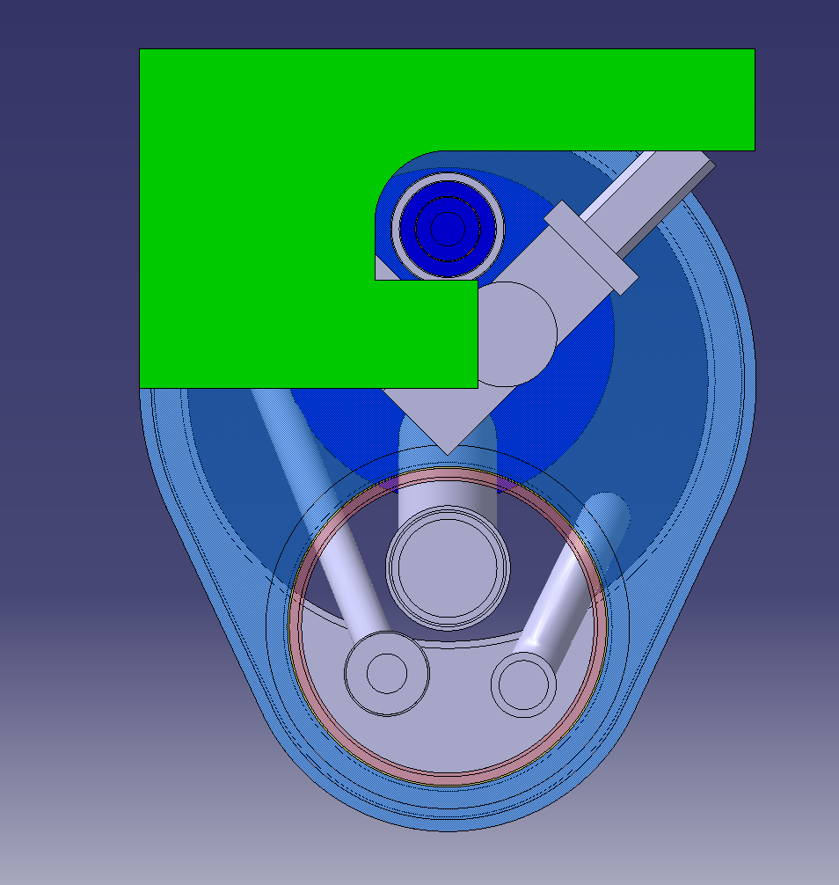
Elements defining the design in the transverse plane
X
Line X insulation
RF-shield module of gate valve
M
N
E
Transport side
QRL side

Slide 16
Main features
Seen by neighbouring magnets as standard MB cryo-assembly: Staightforward replacement in case of major problem
Can be cold tested as a single unit in a dipole test bench and split in two for handling and transport
Standard alignment procedures
Completely independent operation of collimator and cryogenic systems
Access for some in-situ repairs
Simplified construction
Non-compromised functionality wrt existing arcs
Passed a first iteration with simplified CAD model
Minimised impact on the collimator design (assuming 800 mm long TCLD)

Slide 17
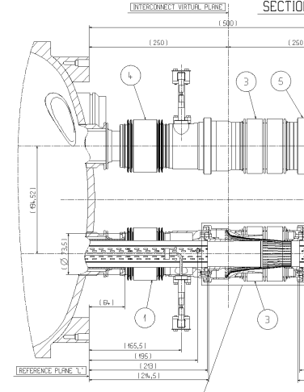
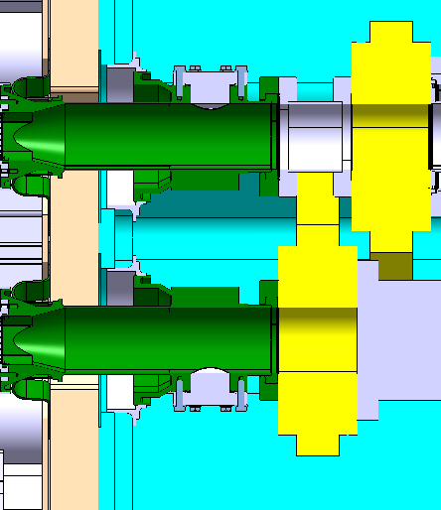

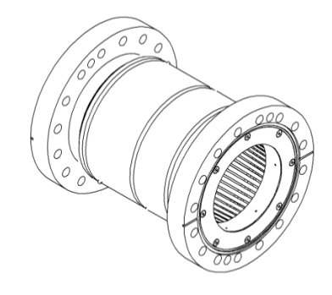
Will it fit in 15660 mm? (Layout of beam line equipped with collimator)
New: 800 mm
Estimated potential for optimisation, design work will start now...

Slide 18
Main integration topics
Topic | Issue | Status
Sizing of cold beam lines | Standard 50 mm cold bore tubes and beam screens | Approved
Powering | Current baseline: In series with MB magnets Trim circuit required 2x 300 A current leads integration | In-work
Magnet protection | Difficult integration of diode stack in cryo-assembly B | Starting soon
Spools | One pair integrated in cold mass B, downstream end cover | To be confirmed
Longitudinal integration | Re-design vacuum components to optimise length | Starting soon (TE-VSC)
Electromagnetic interference | Interference between busbar magnetic field and collimator LVDT’s? | To be discussed
Over pressure safety devices | Insulation vacuum: number and placement of DN 200’s Beam vacuum: rupture disks | To be discussed Done: All SSS equipped with rupture disks during LS1 (TE-VSC)
Interfaces | Prepare and approve interface specification | On-going

Slide 19
Current boundary conditions
Frederic Savary
One pair of spool pieces needed; any of the four magnet ends of a complete assembly (2 x 11T dipoles and 1 collimator) is acceptable, will be likely on the far right end
A cryo-magnet assembly (1 x 11T dipole in its cryostat) shall be exchangeable (the collimator, and the other cryo-magnet assembly to remain in place)
Designation | Current L [mm] | Optimized L [mm]
End cover | 154 | 154
Shrinking cylinder extension (w.r.t. end plate) | 56 | 56
End plate (longitudinal limit of the active part of the magnet) | 75 | 70
Collared coil assembly | 5622 | 5622
End plate (longitudinal limit of the active part of the magnet) | 75 | 70
Shrinking cylinder extension (w.r.t. end plate) | 56 | 56
End cover | 154 | 154
Cold mass length “C-plane” to “L-plane” (not including IC) | 6192 | 6182

Slide 20
Two concepts under study
Frederic Savary
Integrated bus bars, all (M1, M2, and M3) inside the cold mass assembly
Externally routed bus bars, for the lines M1 and M2 (quadrupoles, and spools)
The integration of the bus bars is a challenge, and a detail design study is needed to confirm the conceptual design. There are good indications today that it will be possible
In both cases, apply the solutions known from the past experience, as much as possible
The integration of a second diode stack, should it be needed for the protection, is also extremely challenging, in particular to make possible maintenance or repair work in situ. A preliminary study will be initiated in the next 2 weeks.

Slide 21
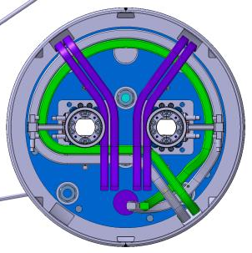
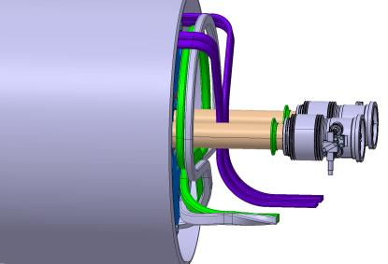
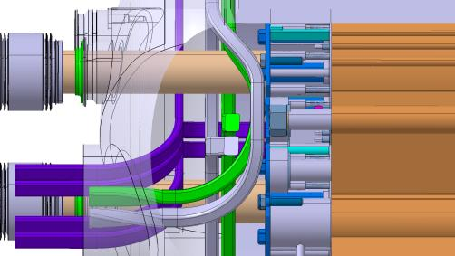
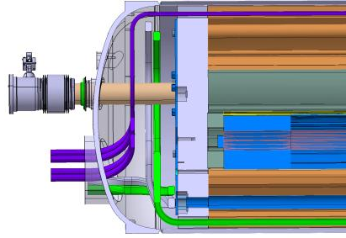
Possible bus bar routing – left of collimator
Frederic Savary
“Lyra side”
Courtesy Ch.Y. Mucher

Slide 22
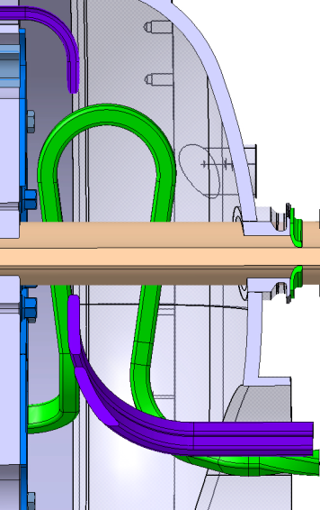
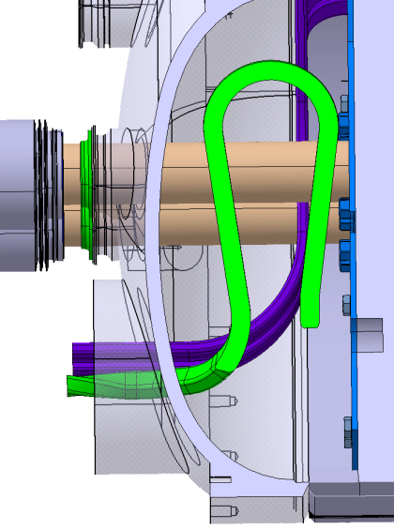
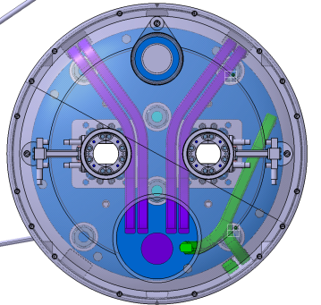
Another solution …
Frederic Savary
Courtesy Ch.Y. Mucher

Slide 23
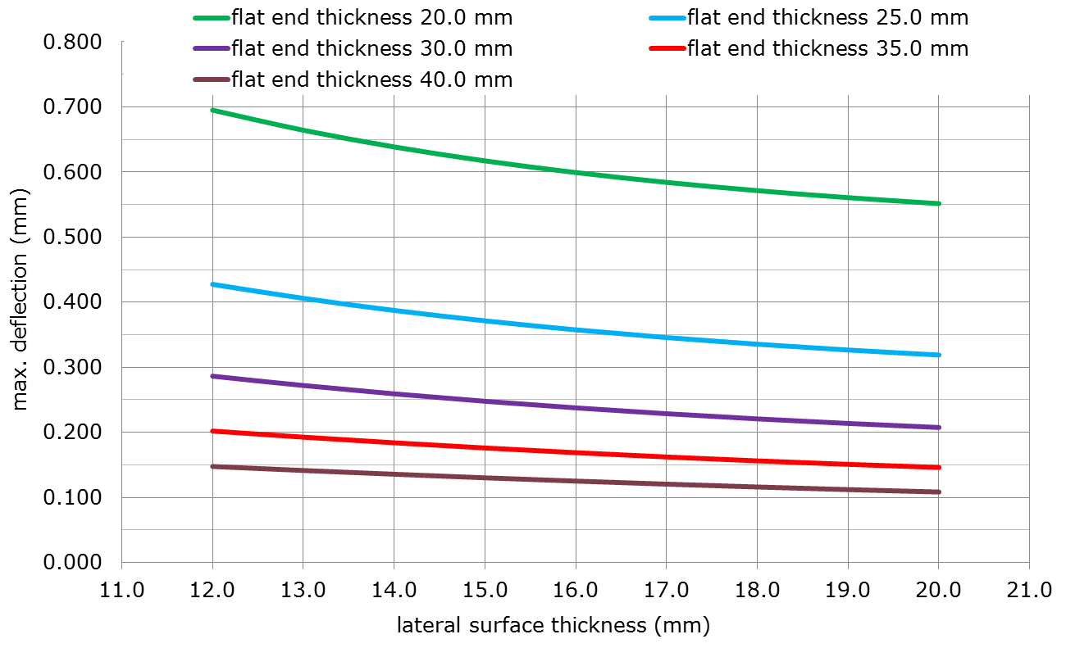
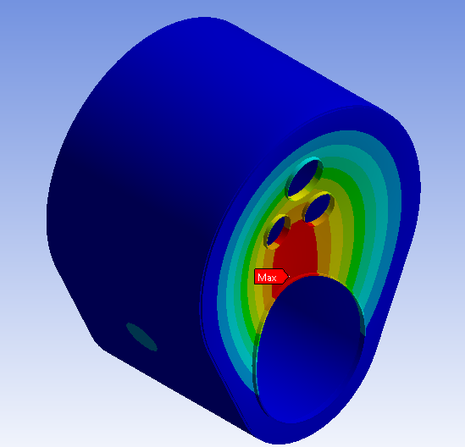
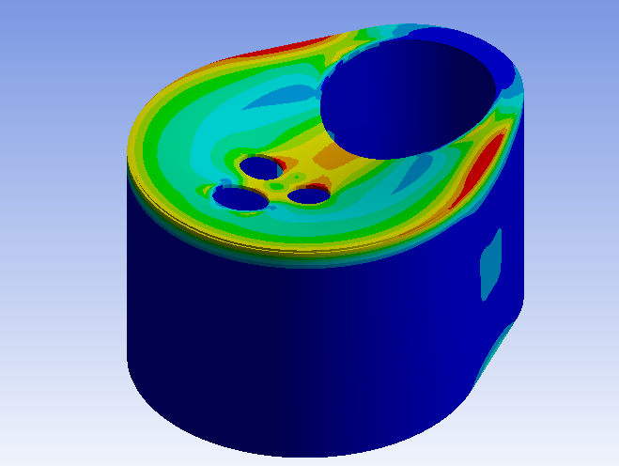
Vacuum vessel design
Engineering design of vacuum vessel cover on-going
Driven by the displacements at the beam lines
Stress analysis according to EN 13458 (European code for vacuum insulated cryostats)
Detailed design starting now, since busbar routing seems feasible

