Slide 1
Update on the modelling of crystal channeling for FLUKA
P. Schoofs, F. Cerutti, A. Ferrari, G. Smirnov
Ref. :

Slide 2
Outline
Introduction
Description of the model
Frame of reference
Continuous potential
Interactions in Channeling
Volume effects
Exit kick
Results
2D distributions – Case study
Benchmarking against UA9-H8 data
Conclusions

Slide 3
Introduction
Why an implementation of channeling inside FLUKA ?
Crystals are investigated as new possible solution for collimation @ CERN
Energy deposition and tracking of secondaries need to be evaluated
FLUKA is the Monte Carlo currently used to assess these values in the collimation system
How does it work ?
Microscopic description avoiding the use of empirical parameters
Crystals defined as a region of the FLUKA geometry layout in which
Particles can be channeled if their transverse energy is small enough
- Follow channel curvature
- Undergo reduced amount of interactions
Interactions are carried on using FLUKA models
Quasi-channeled particles can be reflected or captured
Presently, a standalone event generator has been developed and benchmarked. Integration into FLUKA not yet completed.

Slide 4
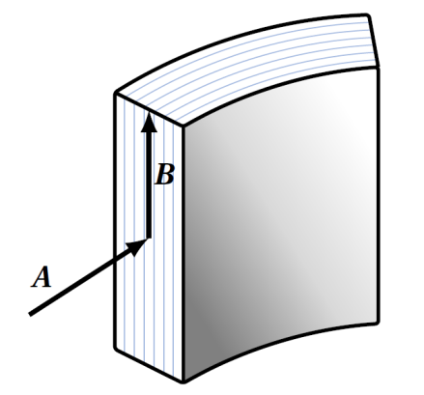
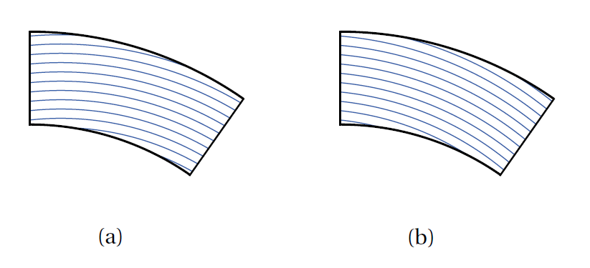
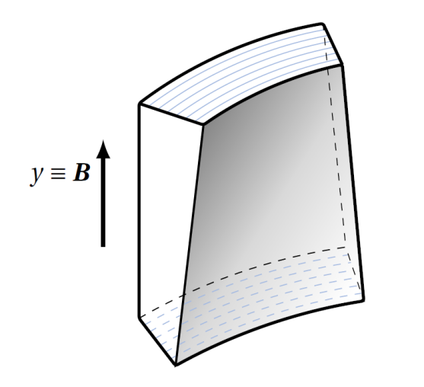
Frame of reference
Crystal defined in FLUKA combinatorial geometry
Object situated in the laboratory
Region flagged as crystal → trigger channeling-related effects
Crystal planes defined inside crystal by 2 vectors
A : along the channel direction
B : perpendicular to A, giving the crystal planes orientation
Vectors are independent from the region
Natural reproduction of miscut
Torsion
Change in the channel orientation along B
Change the radius of curvature proportional to excursion along B

Slide 5
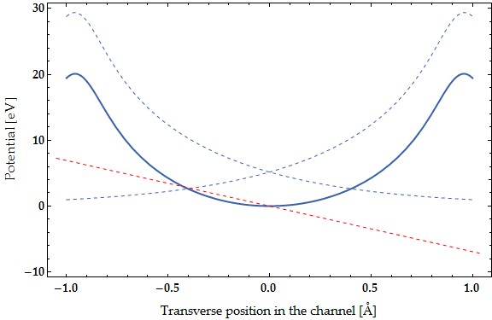
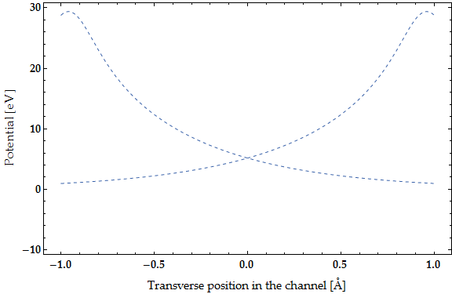
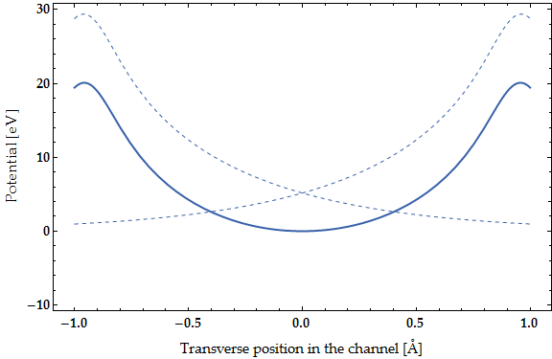
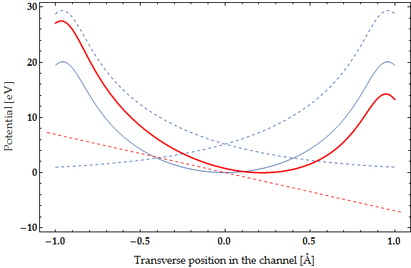
Continuous Potential in a Crystal
Straight crystal
Lindhard formalism
For small incoming angles relative to the crystal planes, successive interactions of the particle with the lattice plane are correlated.
Hence, we consider interactions with the plane as a whole
« Continuous » strings of atoms → Continuous potential
Moliere screening function
Thermal vibrations
Average the cont. pot. over the gaussian thermal motion
RMS amplitude $u_{T}$ = 0.075 Å at room temp.
Bent crystal
Centrifugal Potential $U_{c}(x)=−\frac{pv}{R}x$
The effective potential barrier is reduced on the outer side
For a certain bending, the potential well does not exist anymore
→ critical radius
Effective Potential
Inner side
Outer side
dp
$$U_{e}\left(x\right)=U_{pl}\left(x+\frac{d_{p}}{2},u_{T}\right)+U_{pl}\left(x−\frac{d_{p}}{2},u_{t}\right)+U_{c} (x)$$

Slide 6
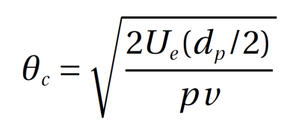
Continuous Potential in a Crystal
Channeling condition
Energy of the transverse motion
$E_{x}=\frac{p_{x}^{2}c^{2}}{2E}+U_{e}\left(x\right)$ $≈\frac{pv}{2}{θ_{x}}^{2}+U_{e}(x)$
Potential Energy ?
depends on the initial transverse position
random variable, uniform over $\left[−\frac{d_{p}}{2},\frac{d_{p}}{2}\right]$
Particle is channeled if :
$$E_{x}≤ U_{e}\left(\frac{d_{p}}{2}\right)$$
Maximal $θ_{x}$ angle allowing channeling in a given crystal at a given energy
= critical angle

Slide 7
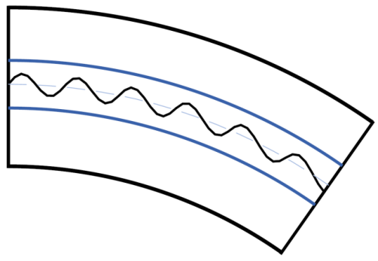
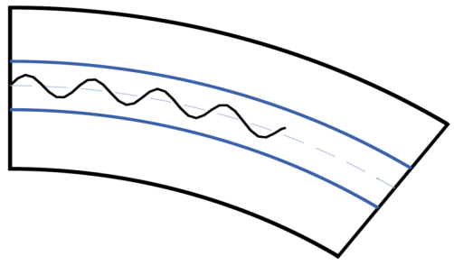
Interactions in channeling
Oscillations
Particle oscillate between planes
Approx. : Harmonic potential
→ Sinusoidal oscillations
Oscillation amplitude $x_{m}$ depends on $E_{x}$
Coulomb scattering
CH particles → single-scattering mode
Transverse energy modified by interactions
According to $x_{m}$, interaction with nuclei can be rejected
Classical view : particle never comes closer to the lattice than $r_{f}=\left(\frac{d_{p}}{2}−x_{m}\right)$
Quantum form factor relating the momentum transfer and impact parameter
Electrons taken into account through the Fano correction
Dechanneling if $E_{x}$ goes above$U_{e}\left(\frac{d_{p}}{2}\right)$
.

Slide 8
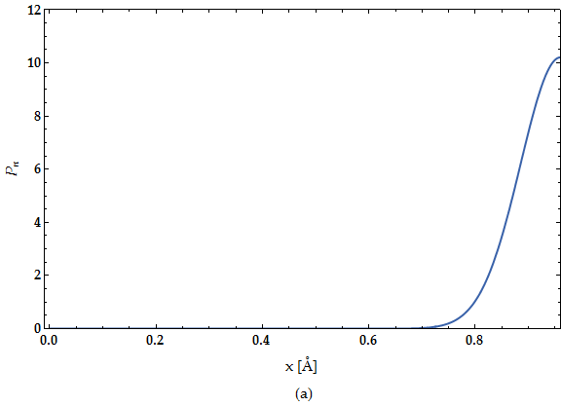
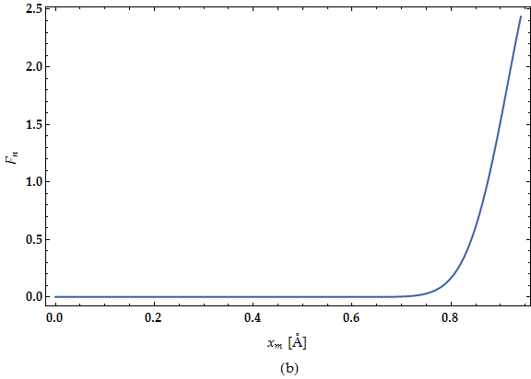
Interactions in Channeling
Nuclear Interactions
Scaling factor to the cross sections
= average nuclei density
Nuclear density in the channel :
Folding of the density over the sine trajectory
Typical scaling factors range from 0 to 2.5 for individual particles
Reduction rates of the order of 12
For 400GeV/c $p^{+}$, R=13m, σx’ = 10 urad

Slide 9
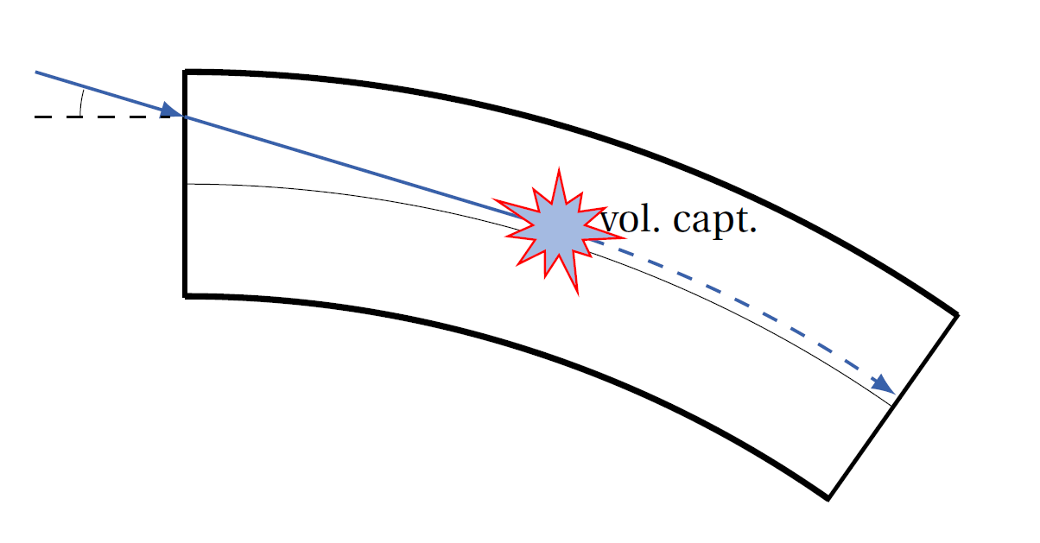
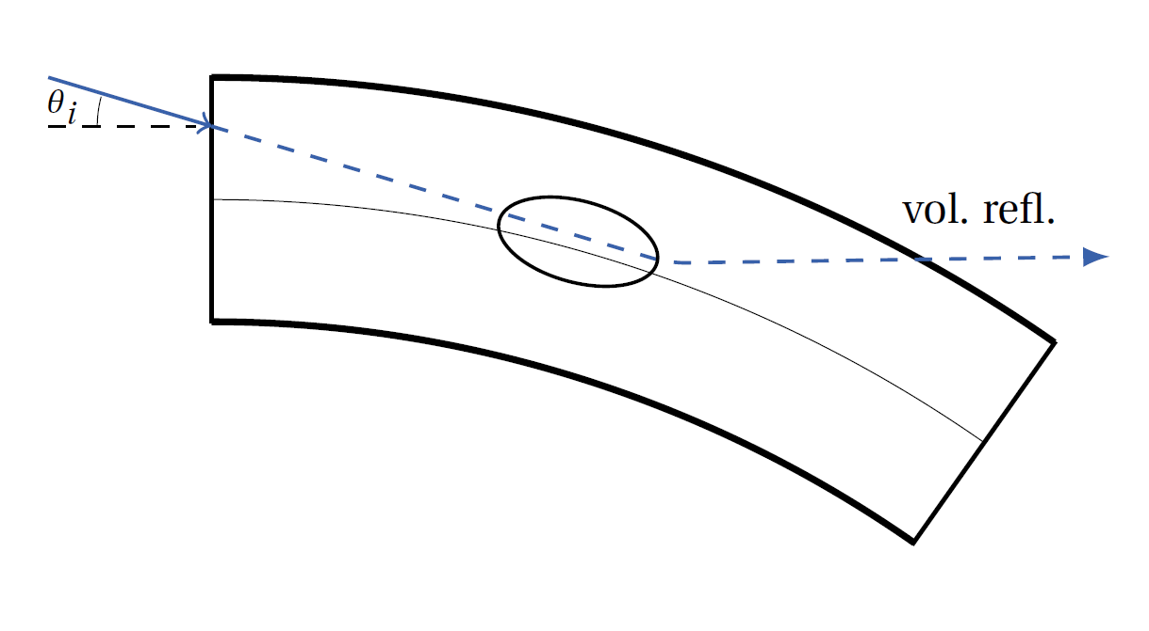
Volume effects
Quasi-Channeling
Non channeled particles
Crystal bending → Tangency at some point
Single-scattering mode
Volume capture
Tangency region begins when $θ_{x}≤θ_{c}$
$E_{x}≥U_{e}(d_{p}/2)$
Transverse energy $E_{x}$ associated with the quasi-channeled particle
$E_{x}$ can be modified by Coulomb scatterings
IF : $E_{x}$ drops below $U_{e}\left(\frac{d_{p}}{2}\right)$ → CAPTURE
Volume reflection
IF NOT : Particle escapes the region and is reflected
One-time kick towards the outer side of the bend
Exception : non-channeled particles with $\left|θ_{i}\right|≤ θ_{c}$
VR kick gradually increasing
Possible Channeling
$$\left|θ_{i}\right|≤ θ_{c}$$
Quasi-channeling
$−θ_{c}−θ_{b} ≤ θ_{i}<−θ_{c}$
Amorphous
$${ θ}_{i} >θ_{c}$$
tangency region
[M. Bondarenco, arXiv:0911.0107v3, 2010]
(Thanks to Daniele for pointing this out ! )

Slide 10
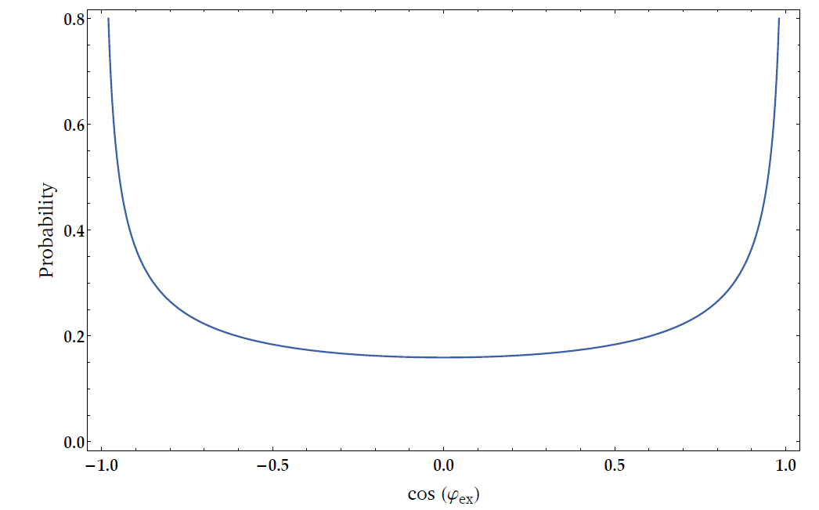
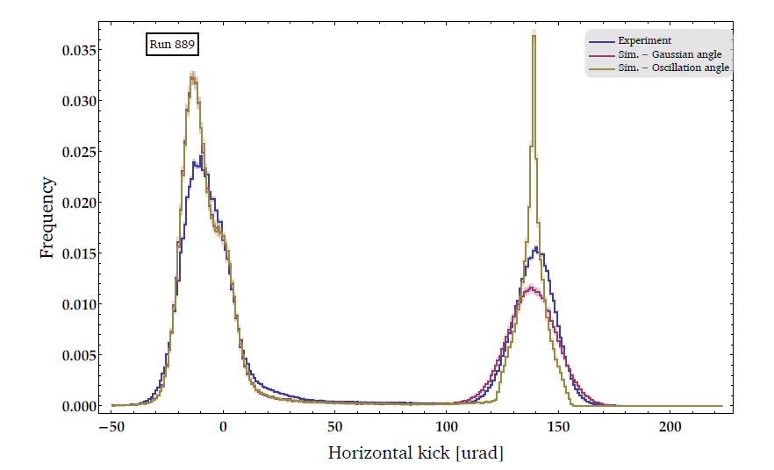
Exit kick
A particle exits channeling mode when
it is dechanneled or
it exits the crystal region of the geometry
Angular spread at exit ?
Natural angle of the oscillating particle
Arc sine distribution
Width of the distribution depending on the oscillation amplitude of the particle, itself depending on the transverse energy value
Results in a steep exit distribution
Gaussian angle with $σ=θ_{c}$
Provides satisfying results wrt the experimental data
BUT : parameter-related (even though not an entirely arbitrary parameter)
Currently the adopted method

Slide 11
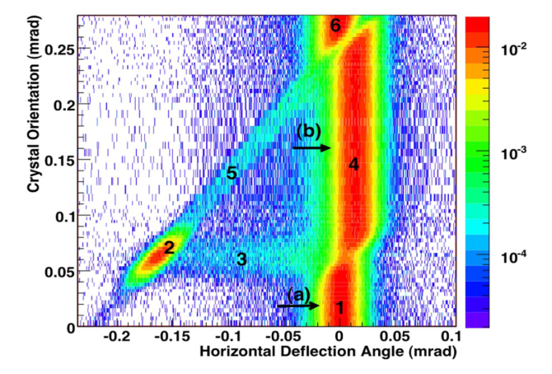
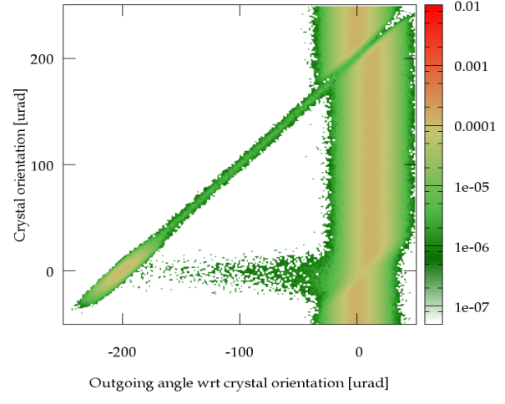
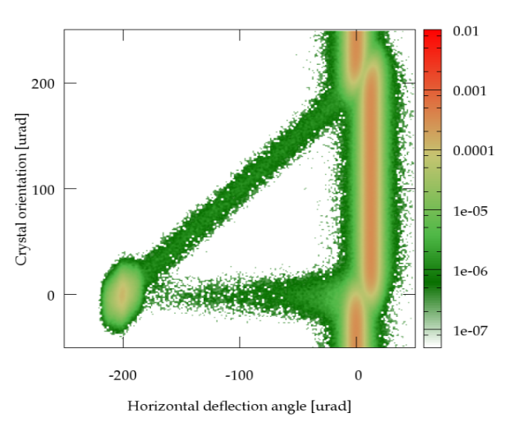
Results
Qualitative comparison of angular scan with H8-RD22
Distribution of particles against crystal orientation and hor. outgoing angle wrt crystal orientation (out-cr)
Strip crystal in 400 GeV proton-beam – divergence σx’=8 urad
Using the hor. Kick (out-in) we have
VR or.
CH or.
[Scandale, PRL 98, 2007]

Slide 12
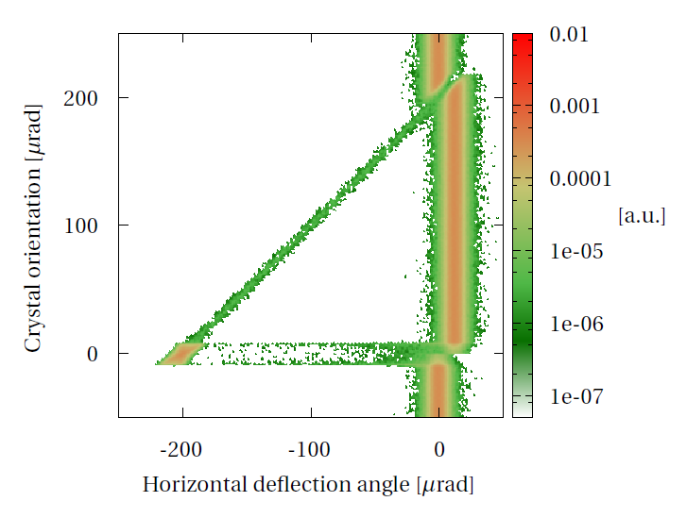
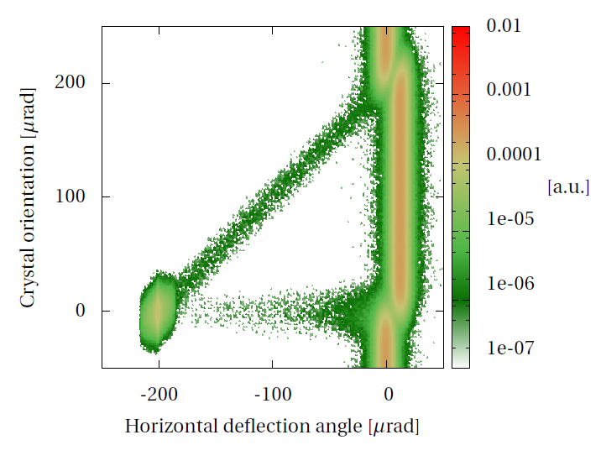
Results
Other examples:
X divergence = 0
With strong torsion (10urad/m),
no hor. Divergence,
σy=1 mm
σy’=10 urad

Slide 13
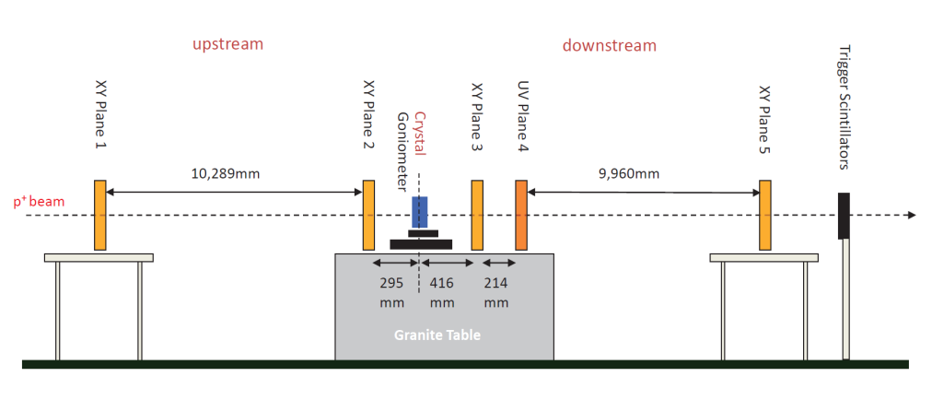
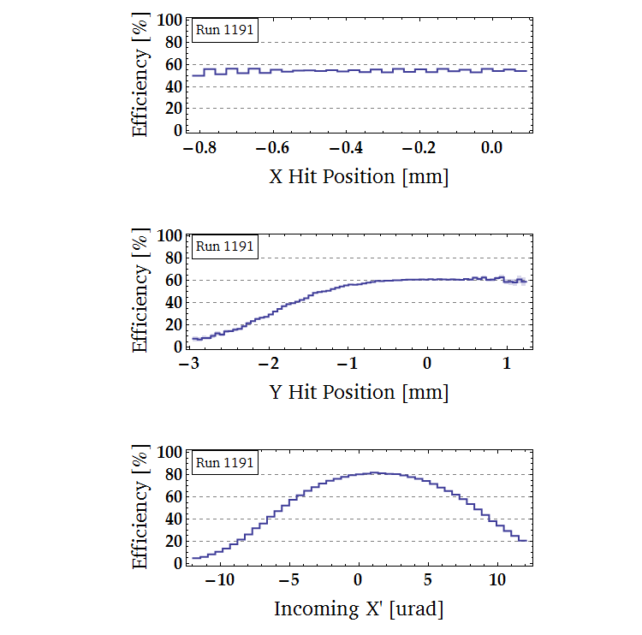
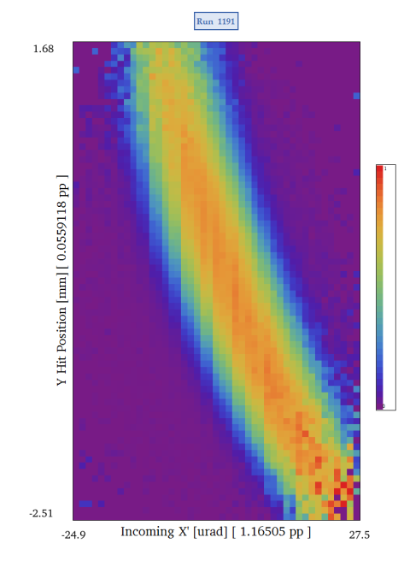
Results
UA9-H8:
Single-pass experiment
Crystal placed in the center
5 silicon strip detectors around
Track reconstruction : up- and downstream
→ yields deflection angles
(Preliminary) data analysis:
Determination of the crystal torsion
Crystal efficiency after torsion compensation
courtesy M. Pesaresi

Slide 14
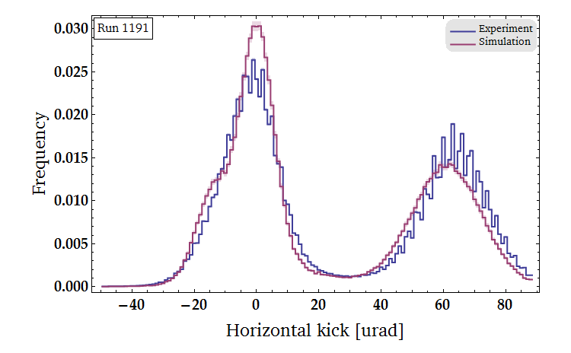
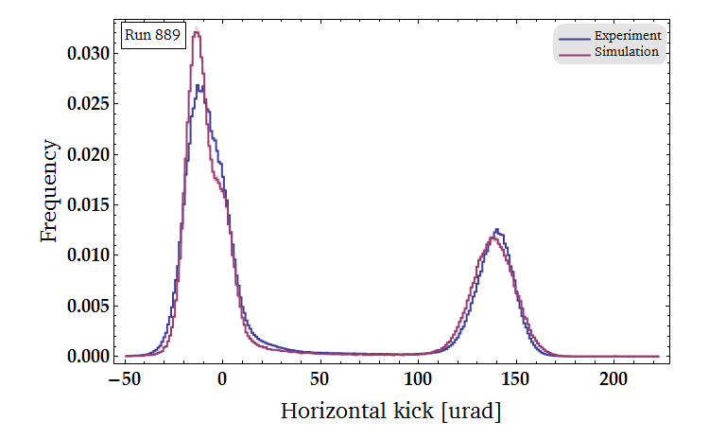
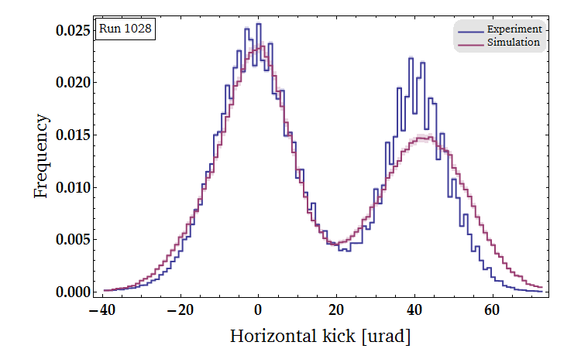
Results
Benchmarking against UA9-H8 data : channeling orientation
2 different types of crystals
Quasi-Mosaic
Strip
Bending angle
~50 urad for LHC
~100-200 urad for the SPS
LHC strip crystal (STF 71 – R.1191)
SPS strip crystal (STF 50 – R.889)
LHC QM crystal (QMP 28 – R.1028)

Slide 15
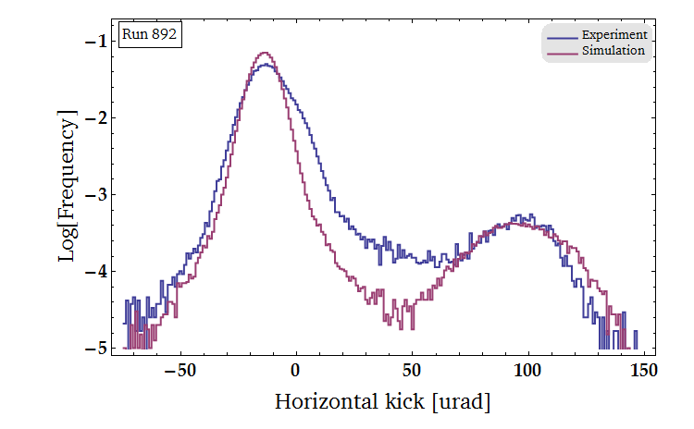
Results
Volume reflection orientation
SPS strip crystal (STF 50 – R.892)
(NB: Log scale to better appreciate VC)
Overall good agreement

Slide 16
Conclusions
Semi-classical microscopic model of channeling
Description of dechanneling, volume reflection and volume capture
Takes into account torsion and miscut
Uses FLUKA interaction models
Good agreement with results from UA9-H8 experiment
for the channeling peak description
for the dechanneling distribution
volume capture rate
But :
Slight underestimation of the dechanneling rate
Exit kick determination still an open question
In the future :
Finish implementation inside core FLUKA
EMD ? Altered ionization in channeling ?
Longer term : negatively charged particles, axial channeling,…
Acknowledgement to the UA9 collaboration !

Slide 17
Thanks for your attention !

Slide 18
Backup

Slide 19
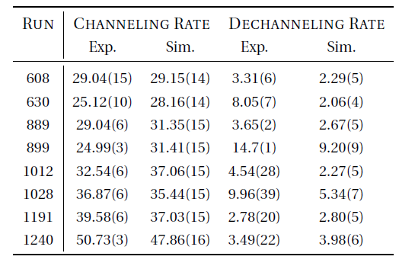
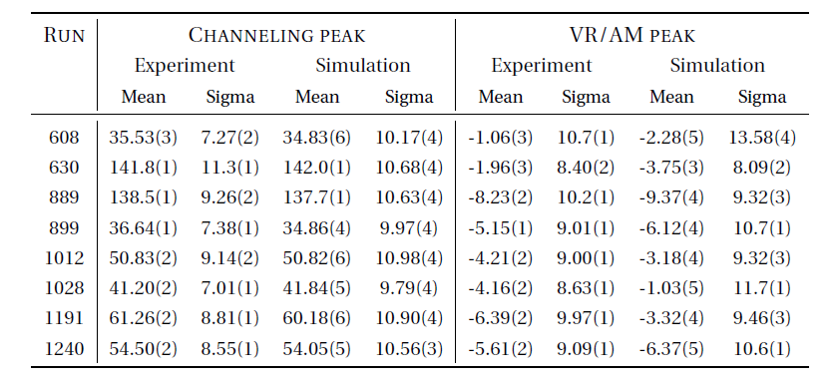
Backup

Slide 20
Backup

Slide 21
Backup

Slide 22
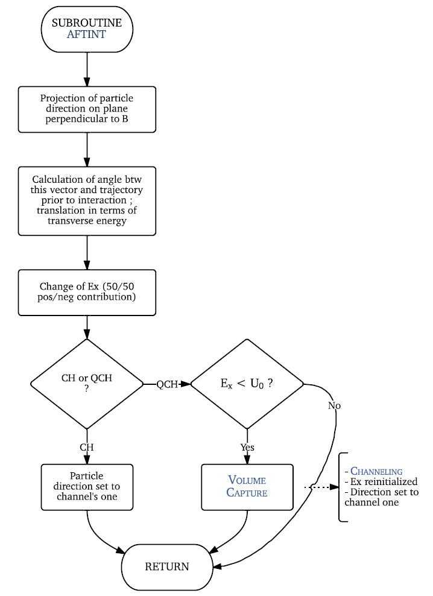
Backup

