Slide 1
STATUS of BBC DESIGN and ENGINEERING : PRELIMINARY RESULTS G. MAITREJEAN, L. GENTINI

Slide 2
Outline
Beam-Beam compensator:
Decreasing the influence of a beam on the other using electrified wire in some TCTP collimators
Specifications:
Re-use nearly 100% of existing TCTP design
Electrified wire as close as possible to the beam axis:
distance the center of the wire - the surface of the jaw <3mm
Maximum diameter of the copper 2mm
Maximum input current: 350A DC
If possible, 2 wires (1 working – 1 spare)

Slide 3
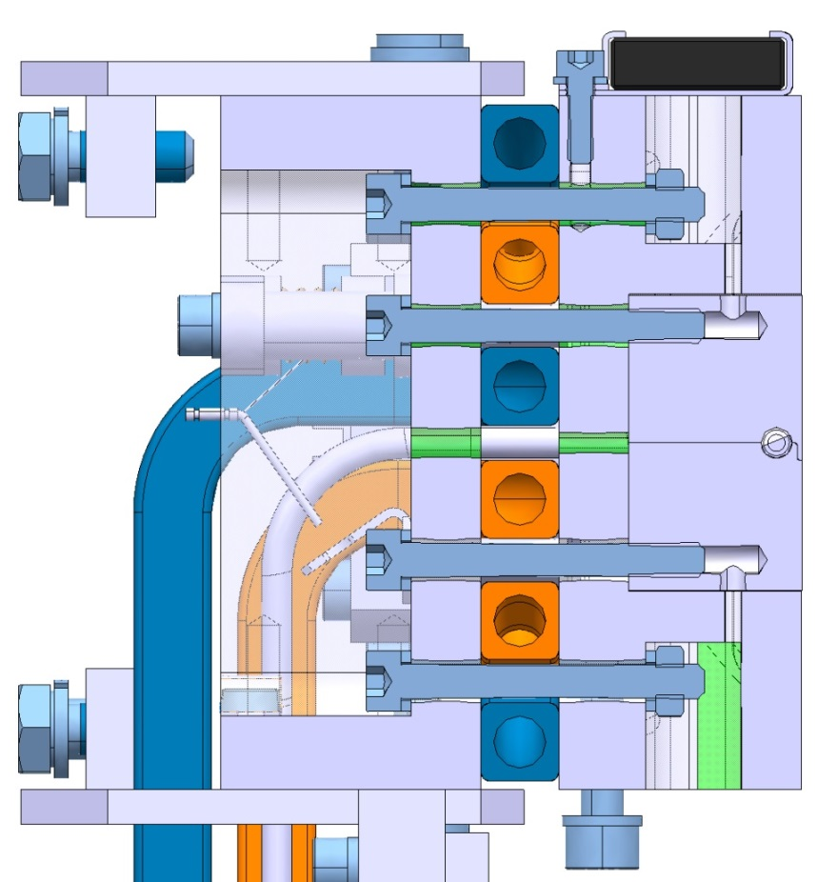
1 Wire Design
Cooling Pipes (Cu Ni)
Tungsten Jaw (Inermet)
17mm
3mm
Glidcop Jaw (Glidcop)
Back-Stiffener (Glidcop)

Slide 4
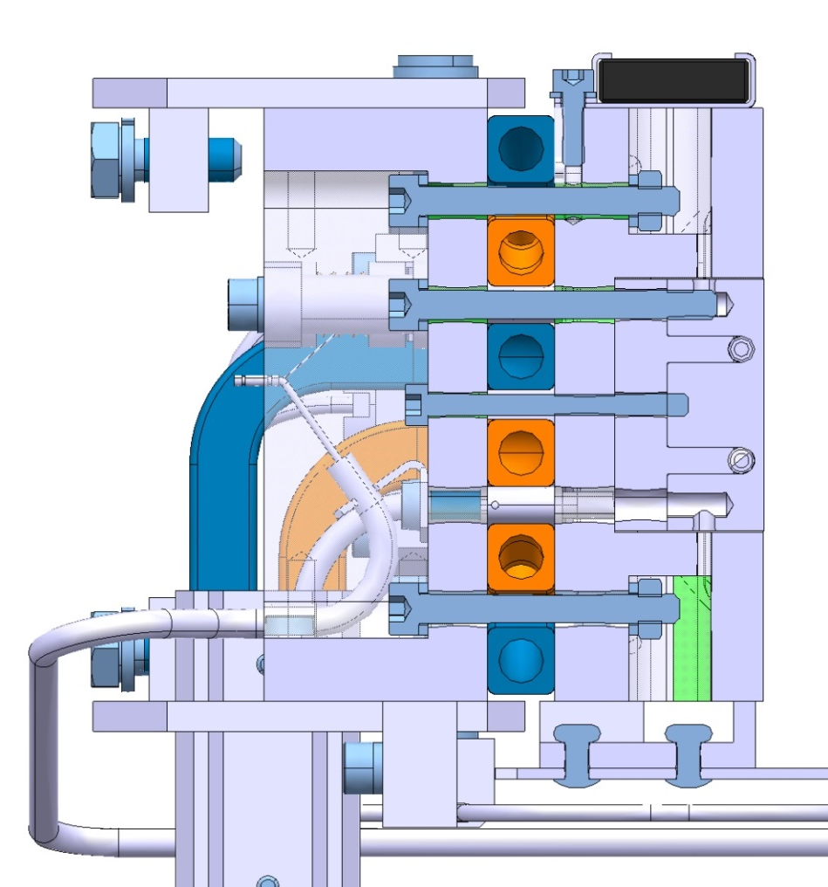
2 Wires Design
Cooling Pipes (Cu Ni)
Tungsten Jaw (Inermet)
11.4mm
3mm
Glidcop Jaw (Glidcop)
Back-Stiffener (Glidcop)

Slide 5
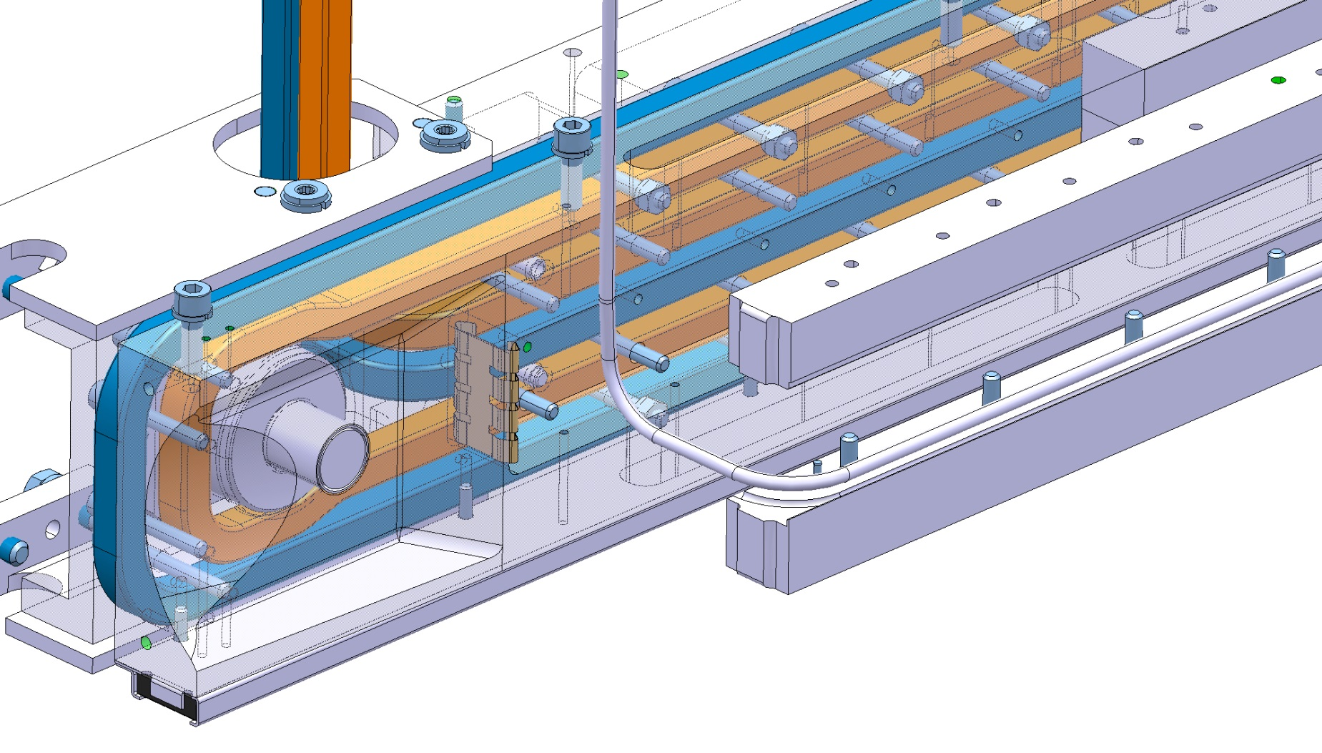
1 Wire Design

Slide 6
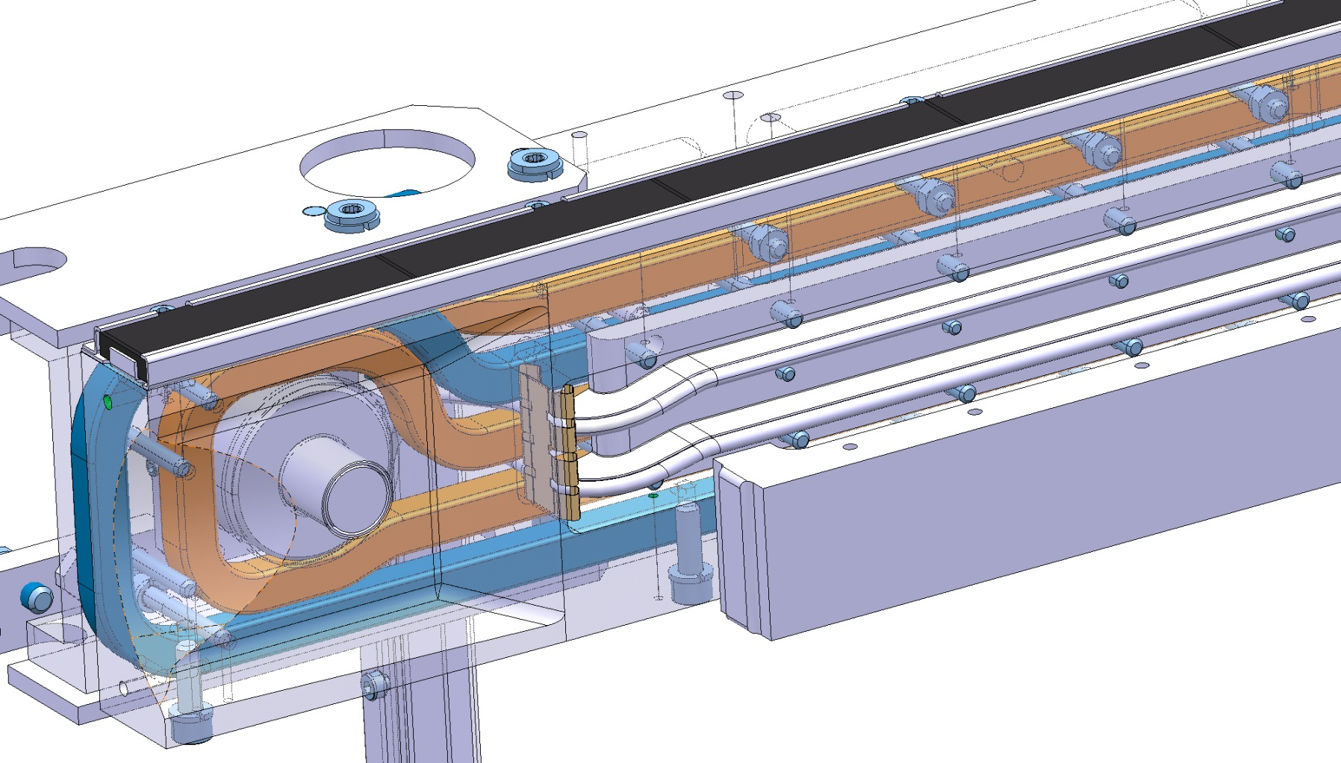
2 Wires Design

Slide 7
Wire
Thermocoax wire
3 Layers
Total diameter : 3.6mm
Electrical properties :
Magnesium Oxide layer perfect electrical insulator
Copper very good electrical conductor
Maximum admissible temperature (estimated by Thermocoax, not tested): ≈400ºC
(under testing by A. Ravni)
Stainless Steel – Thickness 0.3mm
Magnesium oxide – Thickness 0.5mm
Copper – Diameter 2mm

Slide 8
TCTP Thermal Load
TCTP without BBC
1h Beam Life Time (8.6e8 p/s) on each Jaw : 418.4W
TCTP with BBC
Heat generation due to Joule effect in the wire with 350 A :
2.11e8 W/m³ (at 300ºK)
Total thermal power dissipation:
1 Wire design at 300ºK : 940 W + 418W from beam
2 Wires design at 300ºK : 986 W + 418W from beam
BBC : adds more than twice the 1h BLT thermal load
optimisticaly assuming RT Cu electric resistivity

Slide 9
Thermal simulation : wire cooled only in Jaw
Calculation for both designs: 1 and 2 wires
Only electric load considered: 350A DC current
To achieve numerical convergence, electric load applied through internal heat generation
Power calculated from Joule heating 350A DC at 27ºC = 2.11e8 W/m³
Thermal interfaces
9000 W/(m²K)
18000 W/(m²K)
2100 W/(m²K)
Heat sink : convection inside cooling pipes
13000 W/(m²K)
6500 W/(m²K)

Slide 10
1 Wire
Temperature max
Inermet Jaw: 101.1ºC
Wire: 15800ºC
Average temperature
Inermet Jaw : 34ºC
Glidcop Jaw : 31.4ºC

Slide 11
2 Wires
Temperature max
Jaw: 116.8ºC
Wire: 19600ºC
Average temperature
Inermet Jaw : 36.6ºC
Glidcop Jaw : 31ºC

Slide 12
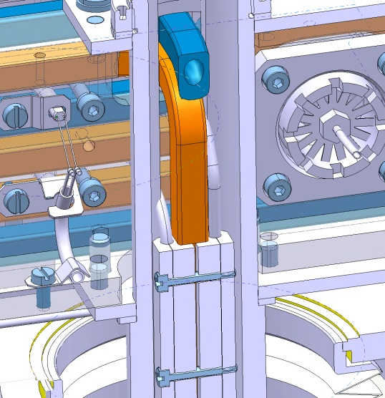
Additional thermal bridge system
Glidcop
Stainless Steel

Slide 13
1 Wire – Optimized Cooling system
Temperature max
Tungsten Jaw: 42.1ºC
Wire: 440ºC
Average temperature
Inermet Jaw : 32.5ºC
Glidcop Jaw : 30ºC

Slide 14
2 Wires - Optimized Cooling system
Temperature max
Tungsten Jaw: 49.2ºC
Wire: 431ºC
Average temperature
Inermet Jaw : 34.6ºC
Glidcop Jaw : 29.7ºC
350A DC not compatible with present design

Slide 15
Thermal issues
Electric resistivity not constant over temperature : the hotter, the higher the heat generation
Electric resistivity at 400ºC = 2.5 times the one at 27ºC
Temperatures reached are clearly underestimated

Slide 16
Preliminary conclusion : Thermal issues
350 A DC with constant electric resistivity at RT
20ºC
350 A
20ºC
350 A DC with T-dependant electric resistivity
50mm
Taking into account dependency in T :
Strong increase of the final temperature
Both designs not acceptable (yet !)
Challenge: must cool the wires in the hottest zones!

Slide 17
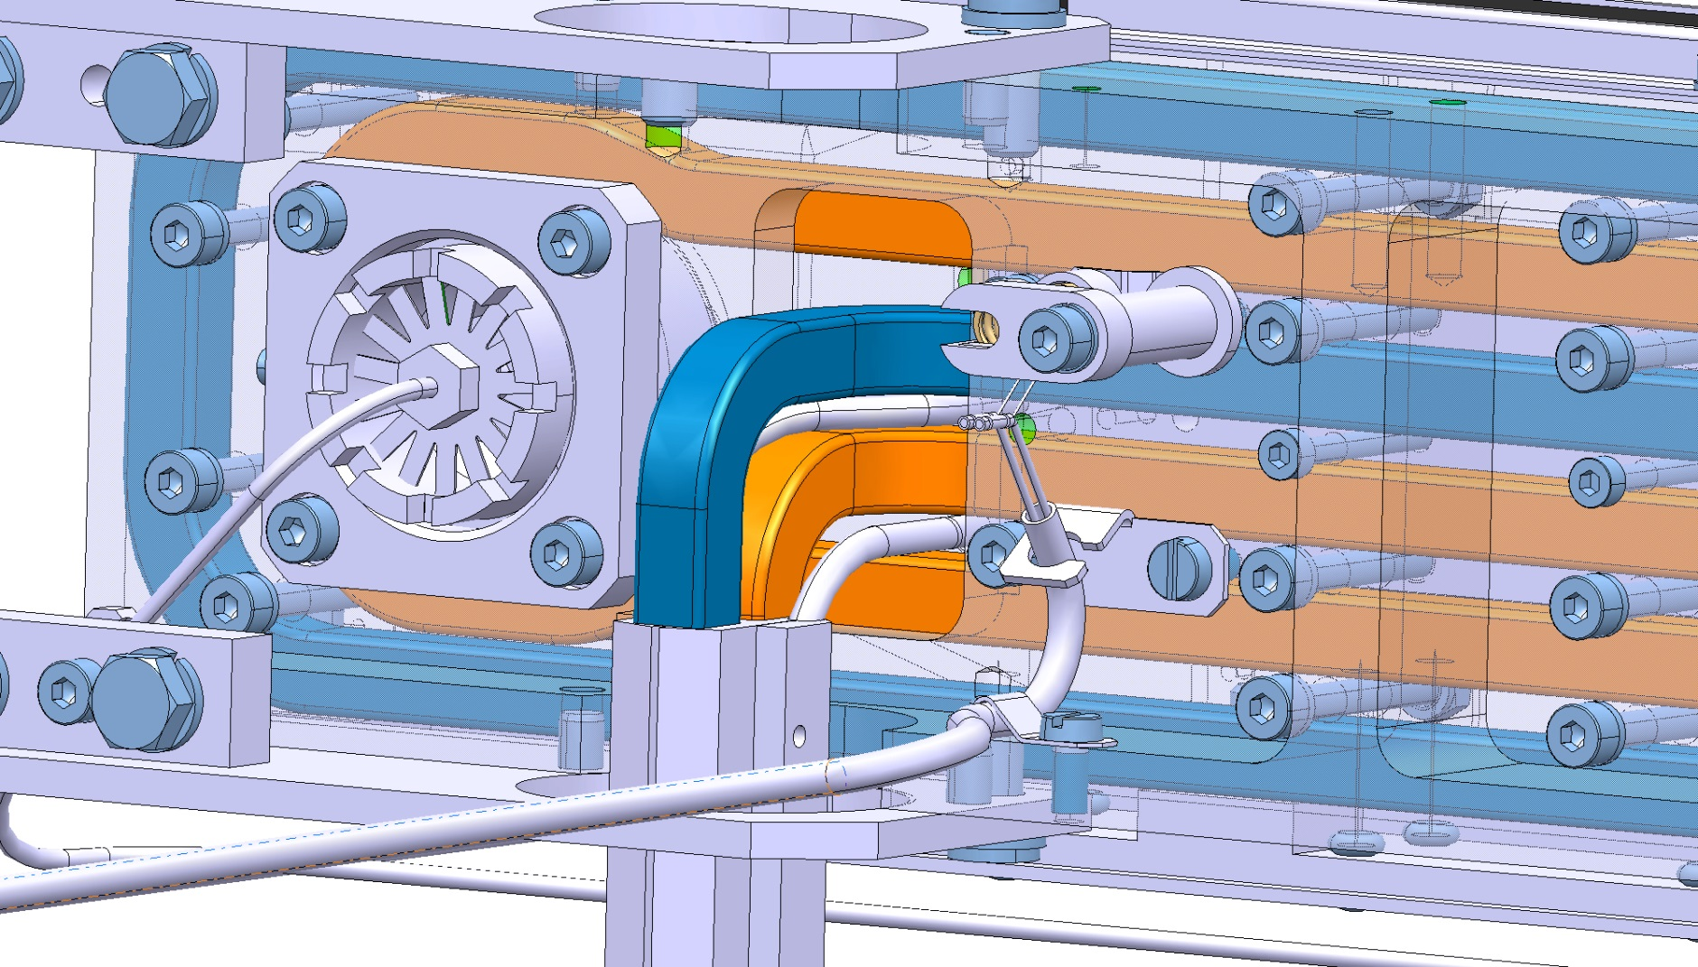
Back-up slide

Slide 18
Back-up slide
2 Wires design - Thermal load: 350 A with constant electric resistivity (at 400ºC)

Slide 19
Back-up slide
2 Wires design - Thermal load: 300 A with constant electric resistivity (at 27ºC)

