Slide 1
MBW-MQW
Some initial considerations on expected life and available options
Presented by P. Fessia
Fluka analysis: Francesco Cerutti, Anton Lechner, Eleftherios Skordis
Collimation input: Rodrick Bruce, Stefano Redaelli , Belen Maria Salvachua Ferrando
MNC team: Paolo Fessia, Pierre Alexandre Thonet, D. Tommasini
Power Converter: Hugues Thiesen
Optics: Massimo Giovannozzi
MME design office: L. Favre, T. Sahner
Analysis of Epoxy resins: E. Fornasiere (TE-MSC-MDT)

Slide 2
The problem / the magnets
Due the expected difference in losses between point 7 and point 3 we concentrate here on point 7 (after TS 2012 factor 10 less before factor 3)

Slide 3
MQW
characteristics | RQ4.LR7 | RQ5.LR7 | RQT4.L7 | RQT5.L7 | RQT4.R7 | RQT5.R7 | RQ4.LR3 | RQ5.LR3 | RQT4.L3 | RQT5.L3 | RQT4.R3 | RQT5.R3
I ultimate (from layout database) [A] | 810 | 810 | 600 | 600 | 600 | 600 | 810 | 810 | 600 | 600 | 600 | 600
Voltage I ultimate [V] | 381 | 383 | 29 | 31 | 27 | 29 | 451 | 452 | 38 | 34 | 42 | 39
I 7 TeV (Fidel report) [A] | 598 | 610 | 151 | 17 | 151 | 17 | 561 | 593 | 313 | 441 | 313 | 441
Voltage I 7 TeV [V] | 282 | 289 | 8 | 2 | 8 | 2 | 313 | 331 | 20 | 31 | 22 | 29
Number magnet in series in circuit | 10 | 10 | 1 | 1 | 1 | 1 | 10 | 10 | 1 | 1 | 1 | 1
Turn/magnet | 171
Estimated ultimate inter-turn voltage [V] | 0.22 | 0.22 | 0.17 | 0.18 | 0.16 | 0.17 | 0.26 | 0.26 | 0.22 | 0.2 | 0.25 | 0.23
Estimated inter-turn voltage at 7 TeV [V] | 0.16 | 0.17 | 0.05 | 0.01 | 0.05 | 0.01 | 0.18 | 0.19 | 0.12 | 0.18 | 0.13 | 0.17
Estimated inter layer voltage | Same as inter turn
Insulation thickness inter turn | 2X(2X0.25) mm=1 mm glass tape
Circuit energy ultimate [Kj] | 154 | 164 | 9 | 9 | 9 | 9 | 154 | 164 | 9 | 9 | 9 | 9
Circuit energy 7 TeV [Kj] | 84 | 93 | 0.6 | 0.01 | 0.6 | 0.01 | 74 | 88 | 2.5 | 5 | 2.5 | 5
Ground insulation | 1X(2X0.25) mm+3X(2X0.25)=2 mm
Resin used | EPN1138 42%+ GY 6004 42% + CY 221 16% + HY 905 100 %+ 30ml DY 073
Dielectric resin | > 20 kV/mm

Slide 4
MBW
characteristics | RD34.LR7 | RD34.LR3
I ultimate [A] (layout database) | 810 | 810
Voltage I ultimate [V] | 440 | 700
I 7 TeV (Fidel report) | 643 | 643
Voltage I 7 TeV | 350 | 556
Number magnet in series in circuit | 8 | 12
Turn/magnet | 84
Estimated ultimate inter-turn voltage [V] | 0.65 | 0.7
Estimated inter-turn voltage 7 TeV [V] | 0.52 | 0.55
Estimated ultimate inter layer voltage [V] | 9.2 | 9.7
Estimated inter layer voltage 7 TeV [V] | 7.2 | 7.8
Circuit energy ultimate [Kj] | 472 | 793
Circuit energy 7 TeV [Kj] | 297 | 500
Insulation inter turn [mm] | 2X(2X0.15)=0.6 glass tape
Insulation inter layer [mm] | 2X(2X0.15)+2X(2X0.15)+1(glass cloth) =1.6 glass tape
Ground insulation | 2X(2X0.15)+1.5(0.15Xx)=1.8
Resin used | EPC-1: resin ED-16 100 Hardener MA 2.28  K Plasticizer MGF-9 20 TEa accelerant 0.5
Dielectric resin | ? (>>15kV/mm)

Slide 5
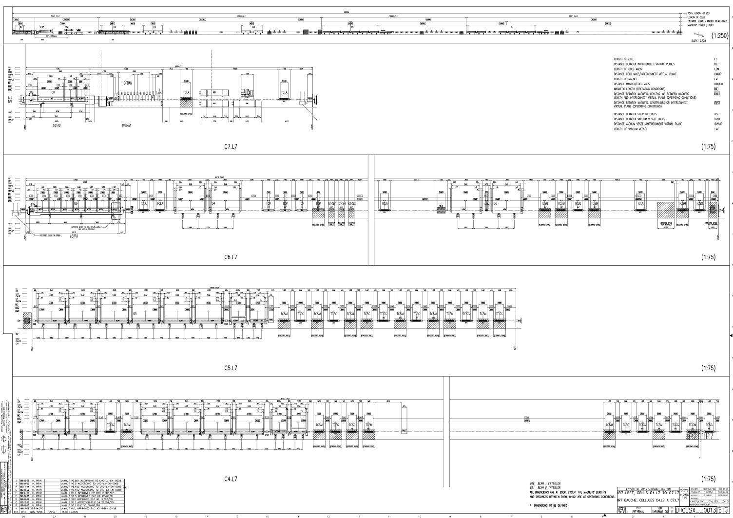

Slide 6
Do they survive till LS2 (100 fb⁻¹ >150 fb⁻¹) do they survive till LS3 (300 fb⁻¹ >350 fb⁻¹)
Do they survive till …
The questions

Slide 7
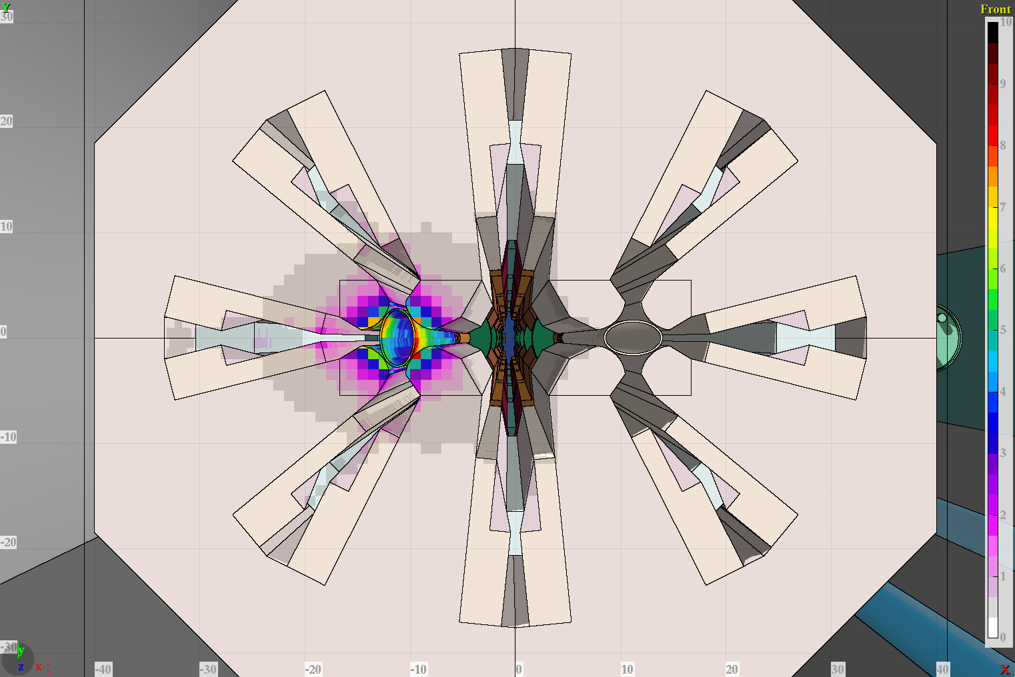
MQWA.E5R7 Dose 2d cross section at maximum
Dose (MGy)
Normalization: 1.15 10¹⁶ p (30-50 fb⁻¹ ).
Computations with E 6.5 TeV relaxed collimator settings

Slide 8
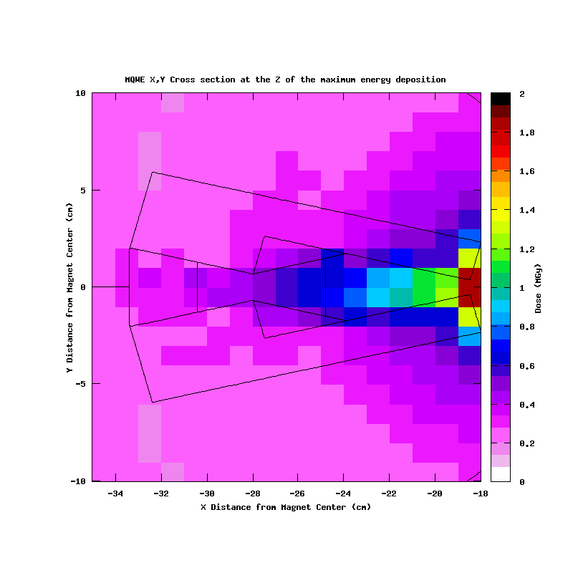
MQWA.E5R7 Dose 2d cross section at maximum
Normalization: 1.15 10¹⁶ p (30-50 fb⁻¹ ).
Computations with E 6.5 TeV relaxed collimator settings

Slide 9
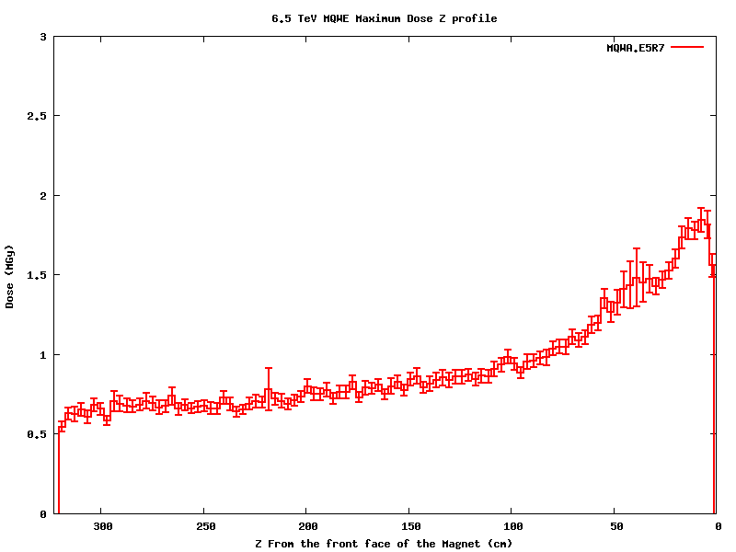
MQWA.E5R7 Dose Maximum Z profile
1.85 MGy
Beam 2
Normalization: 1.15 10¹⁶ p (30-50 fb⁻¹ ).
Computations with E 6.5 TeV relaxed collimator settings

Slide 10
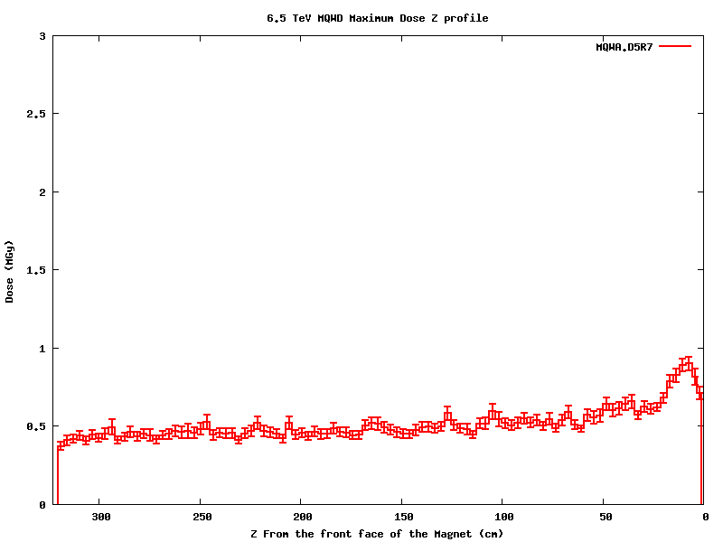
MQWA.D5R7 Dose Maximum Z profile
0.8/1.85=0.4
0.8 MGy
Beam 2
Normalization: 1.15 10¹⁶ p (30-50 fb⁻¹ ).
Computations with E 6.5 TeV relaxed collimator settings

Slide 11
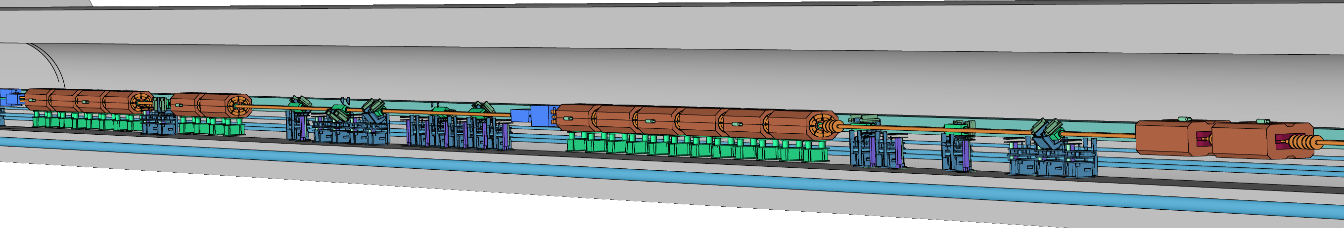
Ratio of total load on left Horizontal coils of magnets
Beam 2
MQWA.D5R7
MQWA.E5R7
MBW.A
MBW.B
TCAP
3
5
11
17
21
34
4
14
29
19
27
100
Values are in percentage (%)
Values normalized to most impacted one (MQWA.E5R7) : 12.6 GeV/p

Slide 12
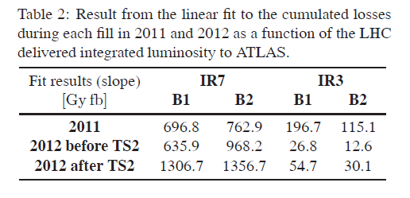
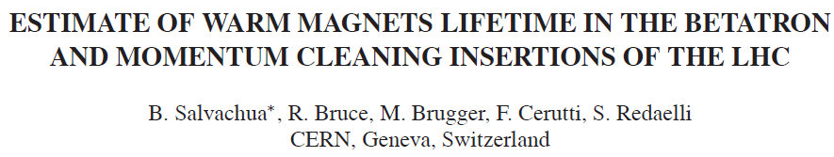
Magnet | Fluka estimation 50 fb⁻¹ old loss pattern [MGy] | Fluka ratio peak to peak [%] | Fluka ratio total load [%] | Fluka ratio peak to peak normalised second magnet [%] | Fluka ratio total load normalised second magnet [%] | Extrapolated values old loss pattern [Mgy] | Reference extrapolation 50 fb⁻¹ new loss pattern [MGy]
MQWA.A4 |  |  | 3 % |  | 9% | 0.08 | 0.2
MQWA.B4 |  |  | 4 % |  | 12% | 0.11 | 0.2
MQWA.C4 |  |  | 5 % |  | 15% | 0.14 | 0.3
MQWB.4 |  |  | 14 % |  | 41% | 0.37 | 0.8
MQWA.D4 |  |  | 11 % |  | 32% | 0.29 | 0.6
MQWA.E4 |  |  | 29 % |  | 85% | 0.77 | 1.6
MQWA.A5 | 0.39 | 21 % | 17 % | 43% | 50% |  | 0.8
MQWA.B5 | 0.52 | 28 % | 19 % | 57% | 56% |  | 1.1
MQWA.C5 | 0.61 | 33 % | 21 % | 68% | 62% |  | 1.3
MQWB.5 | 0.73 | 40 % | 27 % | 82% | 79% |  | 1.6
MQWA.D5 | 0.9 | 49 % | 34 % | 100% | 100% |  | 1.9
MQWA.E5 | 1.85 | 100 % | 100 % | 206% | 294% |  | 4.0

Slide 13
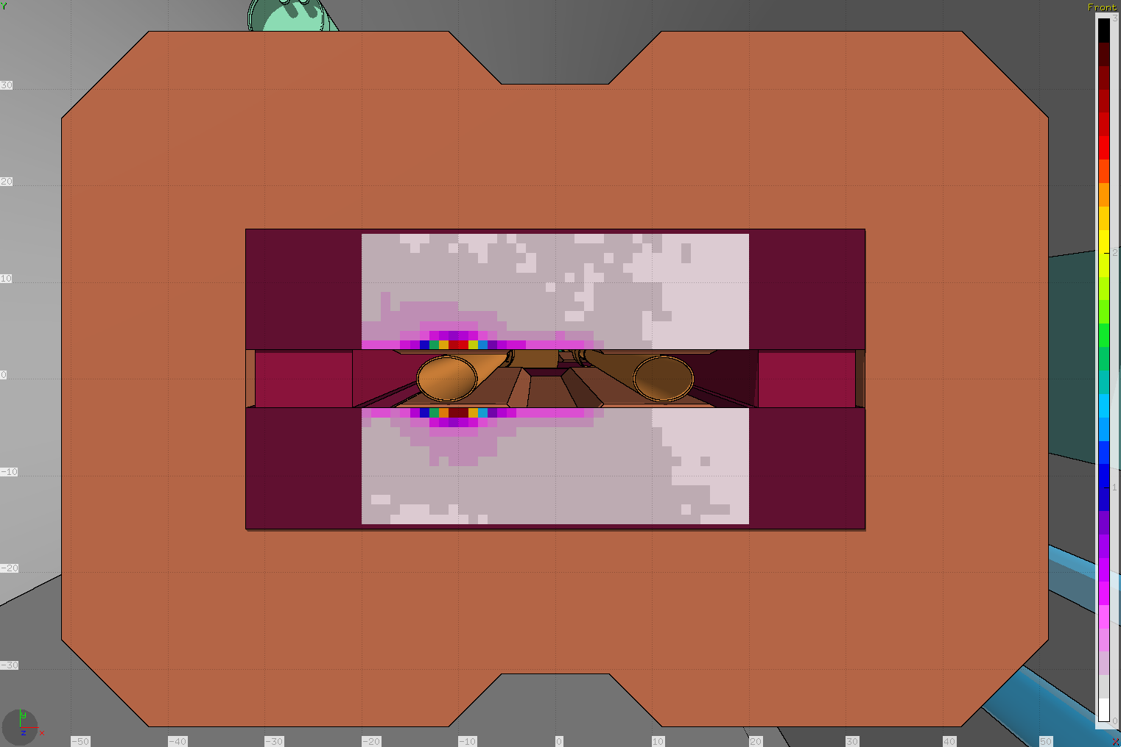
MBWB Dose 2d cross section at maximum
Dose (MGy)
Normalization: 1.15 10¹⁶ p (30-50 fb⁻¹ )

Slide 14
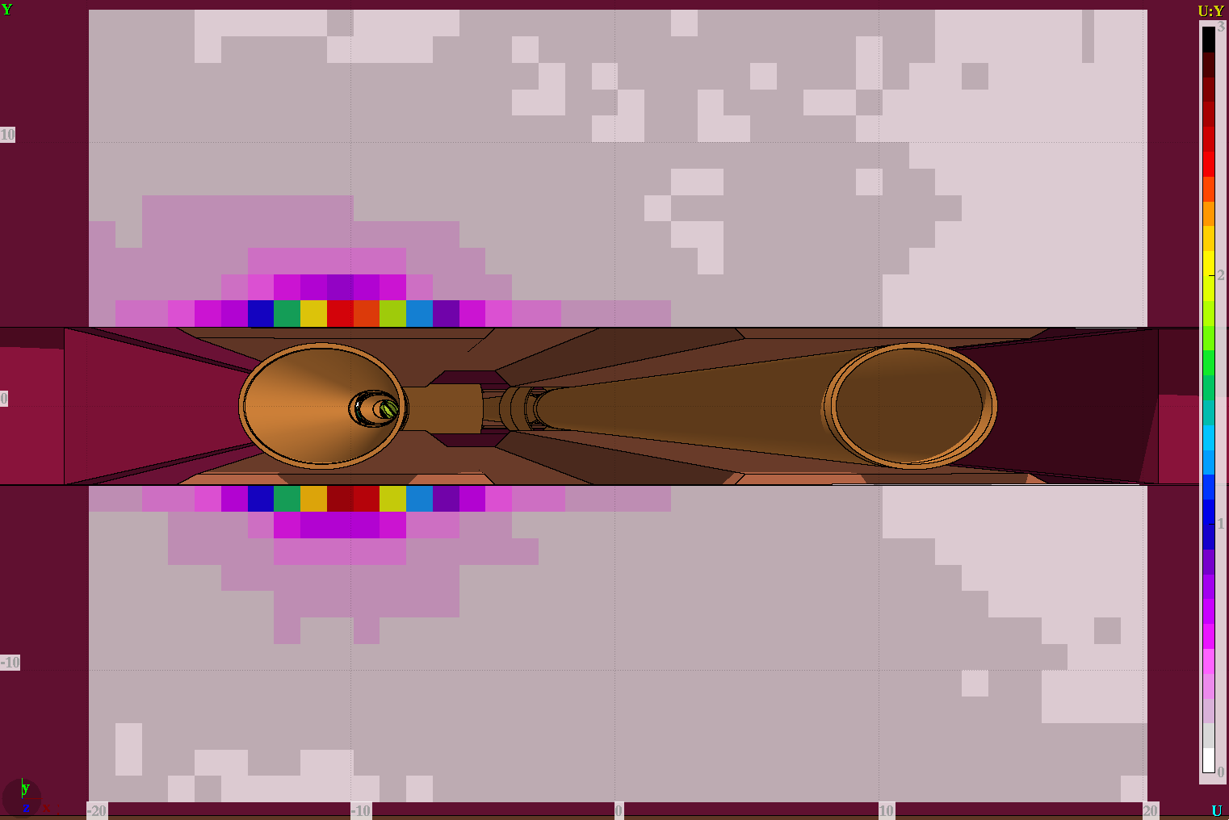
MBWB Dose 2d cross section at maximum
Dose (MGy)
Normalization: 1.15 10¹⁶ p (30-50 fb⁻¹ )

Slide 15
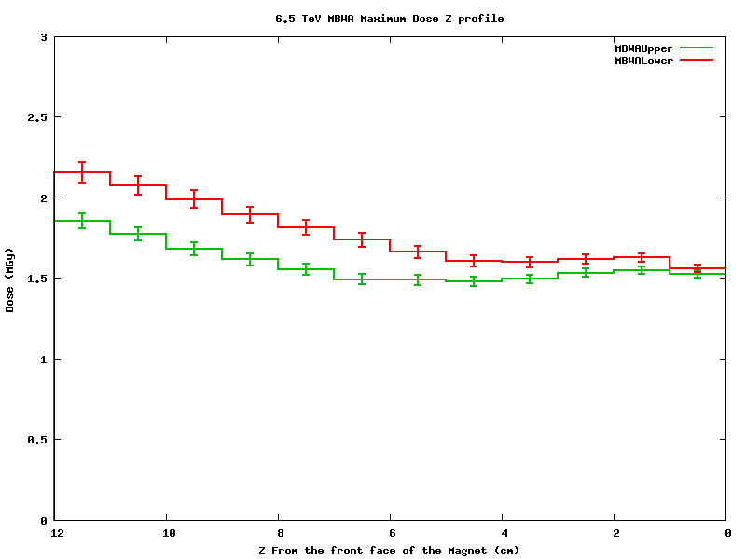
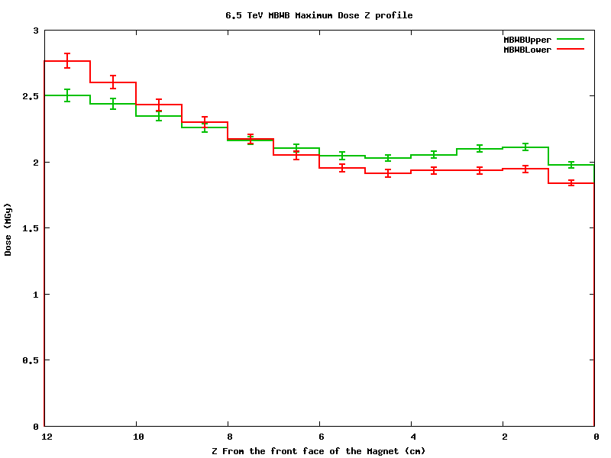
MBWA - MBWB Dose Maximum Z profile
Beam 2
MQWA.D5R7
MQWA.E5R7
MBW.A
MBW.B
MBW.B6R7-> 3 MGy/ 50fb⁻¹
MBW.A6R7->2.5 MGy/ 50fb⁻¹
Weighted on energy
MBW.B6R7-> 6 MGy/ 50fb⁻¹
MBW.A6R7->5 MGy/ 50fb⁻¹
TCAP
Beam 2
Beam 2
MBW.A6R7
MBW.B6R7
Normalization: 1.15 10¹⁶ p (30-50 fb⁻¹ )

Slide 16
Future scenarios
magnet | Reference extrapolation 50 fb⁻¹ new loss pattern [Mgy] | Till LS2 7TeV (150 fb⁻¹) [MGy] | Till LS3 7TeV (350 fb⁻¹) [MGy] | Till HL-LHC 7TeV (3000 fb⁻¹) [MGy]
MBW.B6R7 | 5 | 16 | 38 | 323
MBW.A6R7 | 6 | 20 | 45 | 388
MQWA.A4 | 0.12 | 0.6 | 1.4 | 12
MQWA.B4 | 0.14 | 0.6 | 1.4 | 12
MQWB.4 | 0.18 | 0.9 | 2.1 | 18
MQWA.C4 | 0.52 | 2.4 | 5.6 | 48
MQWA.D4 | 0.4 | 1.8 | 4.2 | 36
MQWA.E4 | 1.1 | 4.8 | 11 | 96
MQWA.A5 | 0.62 | 2.4 | 5.6 | 48
MQWA.B5 | 0.7 | 3.3 | 7.7 | 66
MQWB.5 | 0.8 | 3.9 | 9.1 | 78
MQWA.C5 | 1 | 4.8 | 11 | 96
MQWA.D5 | 1.3 | 5.7 | 13 | 114
MQWA.E5 | 3.7 | 12 | 28 | 240

Slide 17
Resin radiation resistance
Screening
Life evaluation
Alternative operation schemes

Slide 18
Radiation resistance

Slide 19
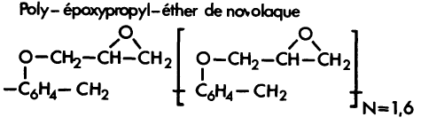
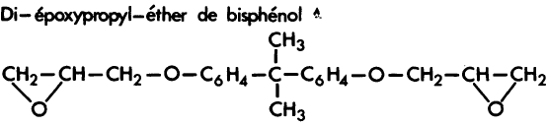

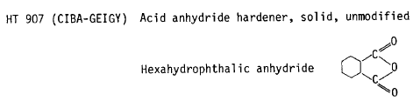
MQW resins
Resin used
component | EPN1138 | GY 6004 | CY 221 | HY 905 | 30ml DY 073
percentage | 50 % | 50 % | 20 % | 120 % | 0.03
EPN 1138 | Novolac
GY 6004 | DGEBA
CY 221 | DGEBA
HY 905 | HPA
DY 073 | flexibilizer

Slide 20
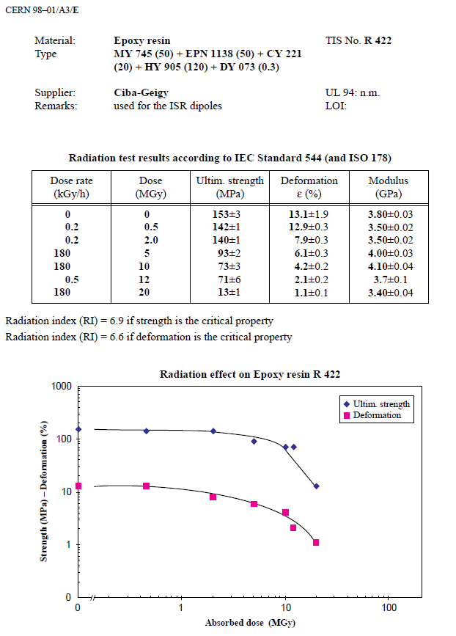
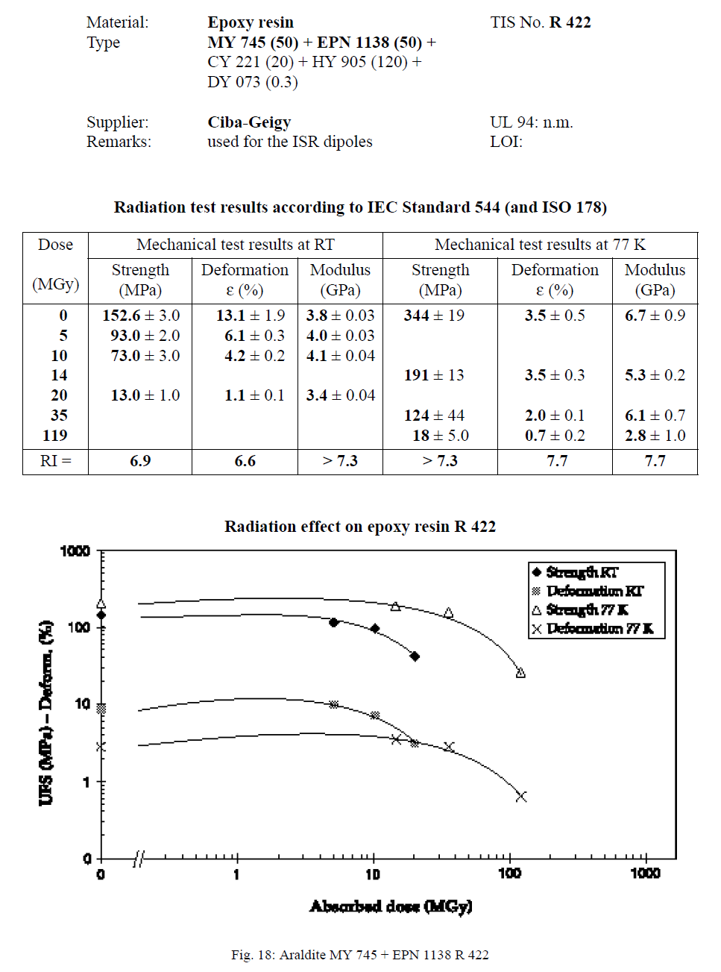

Slide 21
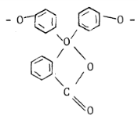
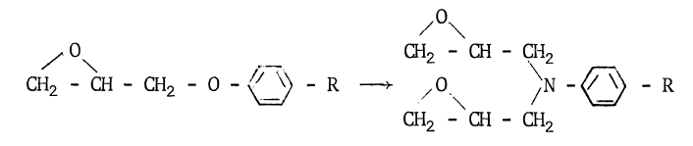
Different epoxy
Resins |  | Hardeners | Additives | Composition (p.p.) | Mix Temp (°C) | Viscosity (cPs) | Service life (mn) | Fig | Dose for 50% flex. (MGy) | Dose Range (MGy)
EDBAH |  | MA |  |  |  |  |  | 5.4 | 1.4 | 1 - 3
EDBAH |  | MA | BDMA | 100-105-0.2 | 80 | 45 | >180 | 5.1 | 1.6
BECP |  | MA |  |  |  |  |  | 5.4 | 2.5
BECP |  | MA | BDMA | 100-110-0.2 | 80 | 40 | >180 | 5.1 | 2.3
ECC |  | MA |  | 100-72 | 80 | 20 | >240 | 5.5 | 1.8 | 1 - 6
VCD |  | MA | BDMA | 100-160-05 | 60 | 20 | >180 | 5.4 | 3.7
DADD |  | MA |  | 100-65 | 80 | 180 | >240 | 5.4 | 5.5
DGEBA + | EDGDP | TETA |  | 100-20-12 | 25 |  |  | 5.21 | 1.3 | 1 - 2
DGEBA |  | TETA | DBP | 83-9-17 | 50 | 500 | few | 5.22 | 1.2
DGEBA |  | DADPS |  | 100-35 | 130 | 60 | 180 | 4.2 | 5.1 | 5 - 15
DGEBA + | EDGDP | MDA |  | 100-20-30 | 80 |  |  | 5.21 | 8.2
DGEBA |  | MDA |  | 100-27 | 80 | 100 | 50 | 5.9 | 13.0
DGEBA |  | MPDA |  | 100-14.5 | 65 | 200 | 30 | 5.7 | 23.5 | 23
DGEBA |  | AF |  | 100-40 | 100 | 150 | 30 | 5.26 | 45.2 | 45
DGEBA |  | DDSA | BDMA | 100-130-1 | 80 | 70 | 120 | 5.2 | 4.2 | 5 - 15
DGEBA |  | NMA | BDMA | 100-80-1 | 80 | 80 | 120 | 5.2 | 5.9
DGEBA |  | MA |  | 100-100 | 60 | 69 | >1440 | 5.23 | 7.1
DGEBA |  | MA | BDMA |  |  |  |  | 5.1 | 12.0
DGEBA |  | MA | BDMA + Po. Gl. | 100-100-0.1-10 | 60 | 65 | 300 | 5.23 | 12.1
DGEBA |  | AP |  | 100-70 | 120 | 26 | 180 | 5.2 | 13.0
DGPP |  | DADPS |  | 100-28 | 130 |  |  | 5.6 | 8.2 | 5 - 15
DGPP |  | MA |  | 100-135 | 120 |  |  | 5.3 | 13.0
EDTC |  | MDA |  | 100-20 | 80 |  | 40 | 5.9 | 10.0
TGTPE |  | DADPS |  | 100-34 | 125 | >20000 |  | 5.6 | 12.1
TGTPE |  | MA | BDMA | 100-100-0.2 | 125 | >15000 |  | 5.3 | 10.6
EPN |  | DADPS |  | 100-35 | 100 |  | 30 | 5.6 | 23.5 | 20 - 40
EPN |  | MDA |  | 100-29 | 100 |  | 35 | 5.10 | 37.2
EPN |  | HPA | BDMA | 100-76-1 | 80 |  | 40 | 5.10 | 13.0 | 10 - 20
EPN |  | MA | BDMA | 100-105-0.5 | 80 |  | 100 | 5.3+5.25 | 15.0
EPN |  | NMA | BDMA | 100-85-1 | 100 |  | 80 | 5.10 | 20.6
TGMD |  | DADPS |  | 100-40 | 80 |  | 50 | 5.6 | 20.6 | 10 - 25
TGMD |  | MA | BDMA | 100-136-0.5 | 60 |  | 30 | 5.3 | 11.4
TGMD |  | NMA | BDMA | 100-110-1 | 80 | 500 | 20 | 5.8 | 18.0
TGPAP |  | NMA |  | 100-137 | 80 | <20 |  | 5.8 | 23.5
DGA |  | MPDA |  | 100-20 | 25 |  | 120-420 | 5.7 | 23.5 | 20 - 30
DGA |  | NMA |  | 100-115 | 25 | 5 - 20 | 30-5760 | 5.8 | 28.6
Aromatic >
Cycloaliphatic >
Linear Aliphatic
Aliphatic amine harderner
→ poor radio-resistance
Aromatic amine hardener >
Anhydride hardener
H: Too high local concentration of benzene may induce steric hindrance disturbation
Good radio-resistance even if Cl (tendence to capture n_{th})
Novolac: HIGH Radio-resistance
Large nb of epoxy groups
→ Density + rigidity
Glycidyl-amine: HIGH R.-resistance
Quaternary carbon
→ weakness
Ether group (R – O – R’)
→ weakness
Legend
Resin
 | Linear aliphatic
 | Cycloaliphatic
 | Aromatic
Hardener
 | Aliphatic Amine
 | Aromatic Amine
 | Alicyclic Anhydride
 | Aromatic Anhydride
→ Repl. by amina

Slide 22
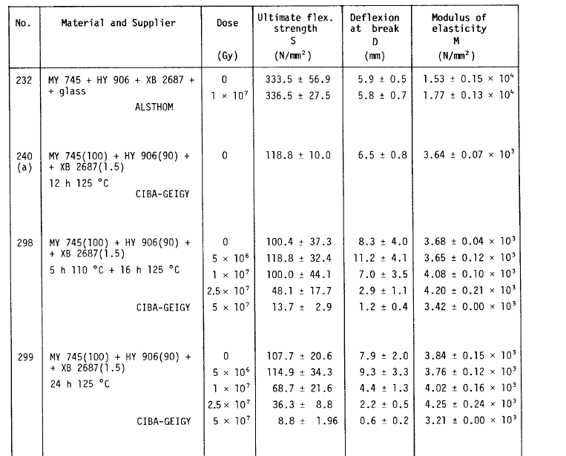
DGEBA MY 745 substituted by GY 6004

Slide 23
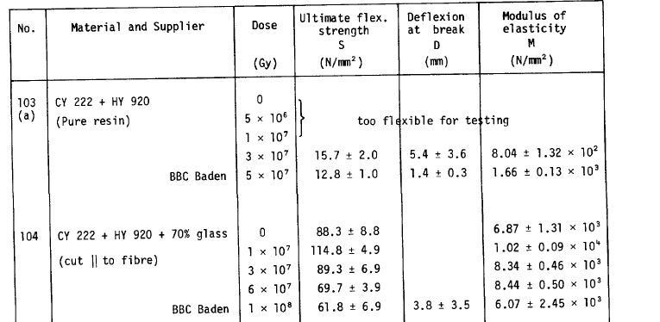
CY 222 (similar to CY 221)

Slide 24
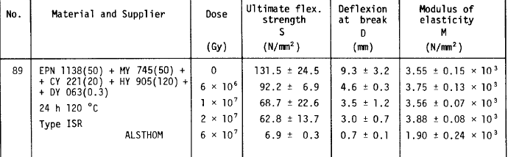

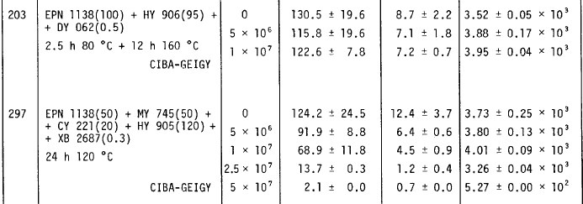

Slide 25
MBW BINP used resin.
We looked at molecule and there is good indication that it should radiation hard as witnessed by the tests

Slide 26
1st conclusion
MQW
- The pure resin mix used shall keep substantial mechanical properties at least till 15-20 MGy
MBW
- The pure resin mix used shall keep substantial mechanical properties at least till 40-50 MGy

Slide 27
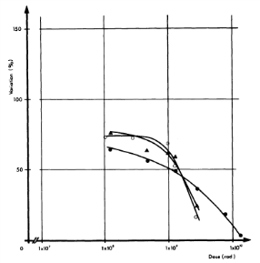

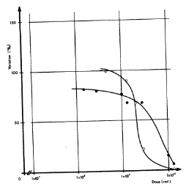

Filler contribution
2 Categories of fillers:
Powder fillers
Glass/Silice fibers
Resins | Hardeners | Additives | Filler | Composition (p.p.) | Fig | Dose for 50% flex. (MGy) | Dose Range (MGy)
DGEBA | MDA |  | Papier | 100-27-200 | 5.14 | 1.3 | 1 - 2
DGEBA | MDA |  | Silice | 100-27-200 | 5.14 | 10 | 10 - 15
DGEBA | MDA |  | Silice | 100-27-200 | 5.18 | 11.4
DGEBA | MDA |  | Silice (5 micron) | 100-27-20 | 5.16 | 14.8
DGEBA | MDA |  | Silice (20 micron) | 100-27-20 | 5.16 | 14.8
DGEBA | MDA |  | Silice (40 micron) | 100-27-20 | 5.16 | 14.6
DGEBA | MDA |  | Silice (40 micron) | 100-27-200 | 5.17 | 12.1
DGEBA | HPA | BDMA | Silice (40 micron) | 100-80-2-200 | 5.17 | <10 | <10
DGEBA | MDA |  | Aérosil + Sulphate de Barium | 100-27-2-150 | 5.14 | 15.8 | 15
DGEBA | MDA |  | Magnésie | 100-27-120 | 5.14 | 18 | 18
DGEBA | MDA |  | Graphite | 100-27-60 | 4.6 | 26.8 | 25 - 30
DGEBA | MDA |  | Graphite | 100-27-60 | 5.14 | 30.5
(DGEBA | MDA |  | Alumine | 100-27-220 | 4.7 | 23.5) | 20 - 50
DGEBA | MDA |  | Alumine | 100-27-220 | 5.14 | 51.7
DGEBA | MDA |  | Alumine | 100-27-100 | 5.15 | 20.6
DGEBA | MDA |  | Alumine | 100-27-220 | 5.15 | 42.5
DGEBA | MDA |  | Fibre de verre | 100-27-50 | 5.19 | 82 | 80 - 100
DGEBA | MDA |  | Fibre de verre | 100-27-60 | 5.18 | 100
EPN | MDA |  | Fibre de verre | 100-29-50 | 5.19 | >100 | >100
TGMD | MDA |  | Fibre de silice | 100-41-50 | 5.20 | >100 | >100
TGMD | DADPS |  | Fibre de silice | 100-40-50 | 5.20 | >100
Paper [cellulose (C₆H₁₀O₅)_{n}]
→ Strong decrease of radio-resistance
The bigger the powder, the more radio-resistant
Hardener choice not influenced by filler
High r.-resistance for Graphite and Alumina
The more fillers, the more radio-resistant
Best Radio-Resistant materials are obtain with Glass/Silice (influence of boron) fibers and aromatic resins (Novolac and glycidyl-amine)
Legend
Resin
 | Linear aliphatic
 | Cycloaliphatic
 | Aromatic
Hardener
 | Aliphatic Amine
 | Aromatic Amine
 | Alicyclic Anhydride
 | Aromatic Anhydride

Slide 28
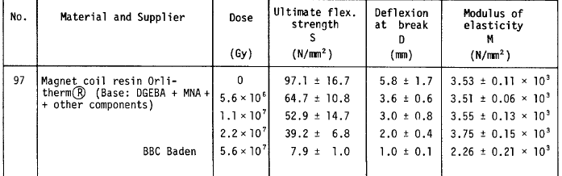
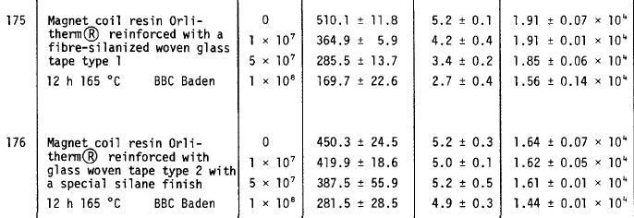
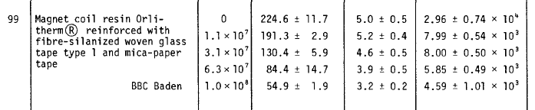
fibre

Slide 29
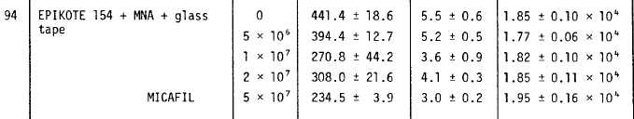
fibre

Slide 30
2nd conclusion
MQW
- Presence of glass fibre shall increase the substantial mechanical properties at least to 30-40 MGy
MBW
- Presence of fibre glass should probably extend life till 60- 70 MGy

Slide 31
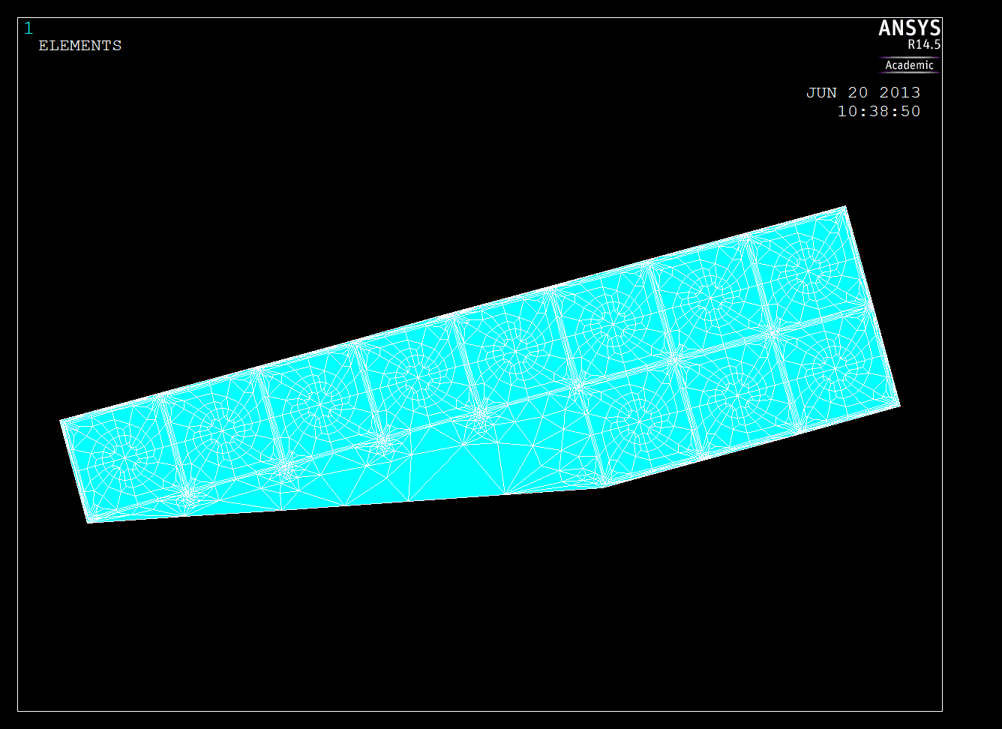
Caveat
We need to perform a rough evaluation of stresses to demonstrate that we are effectively in a low stress situation

Slide 32
Screens

Slide 33
Screen options
 | MQW | MBW
where | Between iron poles and the coil | Between coil ends and vacuum chamber
Possible thickness | 15-30 mm | 2-4 mm
Segmentation | Yes for easy extraction and possibility to tune material along the length | no
Materials | Tungsten/steel | Tungsten

Slide 34
Looking for screen efficiency of …
magnet | Till LS3 7TeV (350 fb⁻¹) [MGy] | Factor to gain | Till HL-LHC 7TeV (3000 fb⁻¹) [MGy] | Factor to gain
MBW.B6R7 | 38 | Not necessary but good for ageing | 323 | 6
MBW.A6R7 | 45 | Not necessary but good for ageing | 388 | 7
MQWA.A4 | 1.4 |  | 12
MQWA.B4 | 1.4 |  | 12
MQWB.4 | 2.1 |  | 18
MQWA.C4 | 5.6 |  | 48 | 1.5
MQWA.D4 | 4.2 |  | 36
MQWA.E4 | 11 |  | 96 | 3
MQWA.A5 | 5.6 |  | 48 | 1.5
MQWA.B5 | 7.7 |  | 66 | 2
MQWB.5 | 9.1 |  | 78 | 2.5
MQWA.C5 | 11 |  | 96 | 3
MQWA.D5 | 13 |  | 114 | 3.5
MQWA.E5 | 28 | (1.5) | 240 | 7

Slide 35
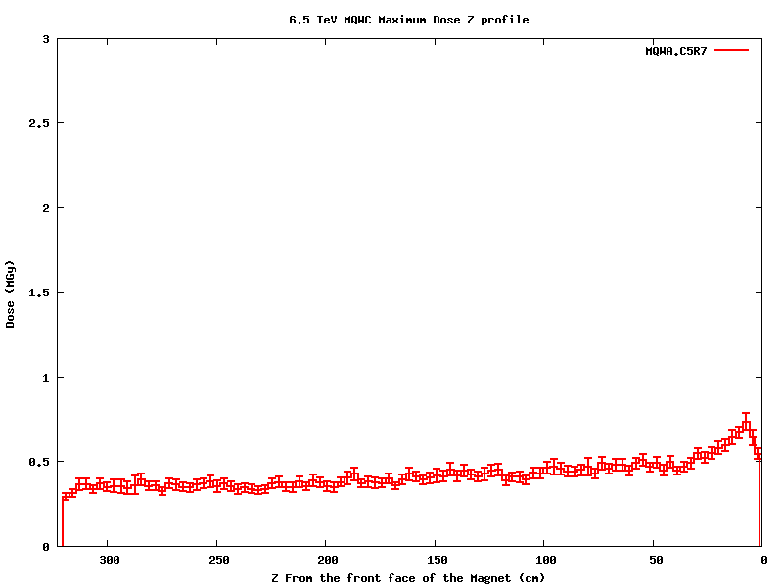
MQWA.C5R7 Dose Maximum Z profile
We need factor 3
We need factor 2
0.73 MGy
0.3 MGy
Beam 2
Normalization: 1.15 10¹⁶ p (30-50 fb⁻¹ )

Slide 36
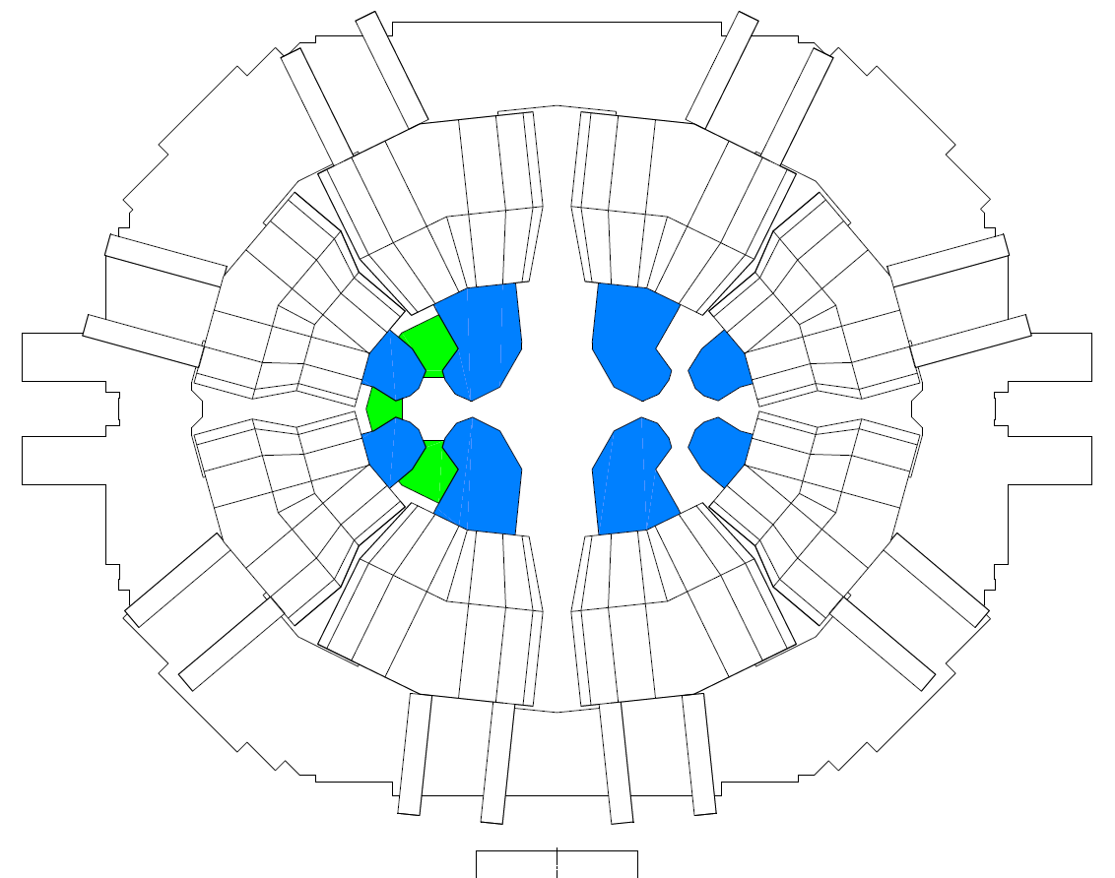
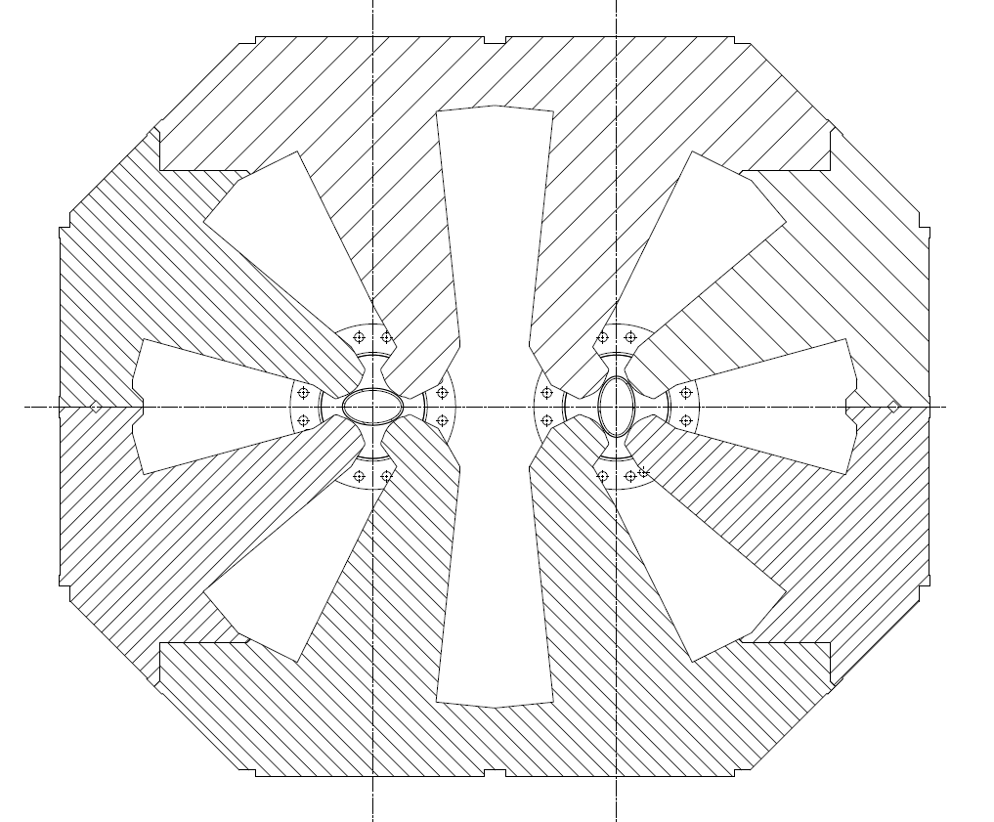
MQW screen fast prototyping pieces to be produced on Monday. Then test of insertion with the vacuum chamber and geometry to FLUKA team
MBW under design

Slide 37
The different operating scenarios

Slide 38
Different scenarios see slides from M. Giovannozzi
Option A
Reconfigure the MQWA in pos. C5 as MQWB
Remove MQWA.E5
Connect new MQWB.C5 in the circuit RQ5.LR7
Substitute MQWA.E5 with an absorber at least effective as previous MQWA.E5
Option B
Connect MQWA.E5 on a new power supply circuit (600 A)
In case of failure of MQWA.E5 ramp up the other 4 magnets to 810 A to regain the previous strength
Not applicable because of saturation and b3 increase
Other operating scenarios

Slide 39
Conclusions
LS2 shall be reached by both MQW and MBW
LS3 should be reached by both MQW and MBW, but MQWA.E5 and MBW. X6 will have accumulated some ageing dose. Run (resins test in parallel with representative geometry to confirm)
In HL-LHC perspective
  MQW could meet the target combining screening and modified operation scenario
  MBWs need a very effective screen. Due to the available space looks to be a challenge
We should try to install screens in MQWA. E5 and MQWA.D5 and MBW already in LS1 to prevent ageing
In LS2 we should target to implement the new operation scenario
Probable need to design and build a new MBW for LS3 (HL-LHC operation)

Slide 40
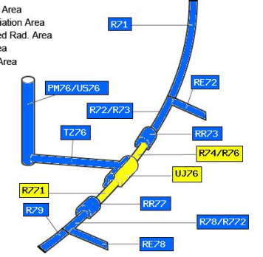
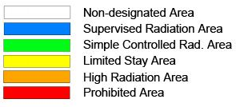
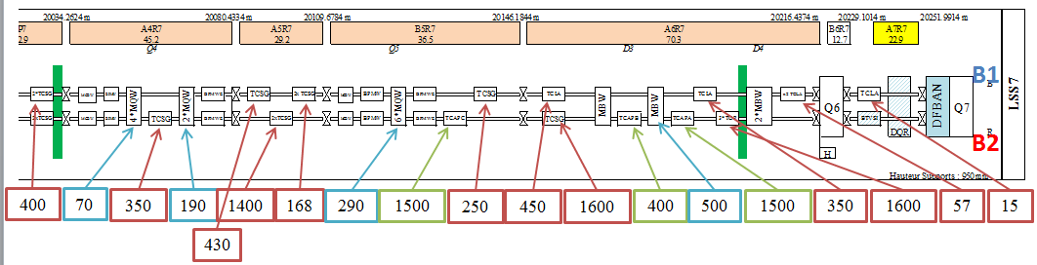

LHC Point 7
Ambient dose equivalent rates in µSv/h at 40cm
measured on Dec 20, 2012
(last “good” fill on Dec 5, i.e. cooling time >1week)
Scaling factors
based on generic
Studies for IR7:
t_{cool} | Scaling factor
One hour | 1.4
One day | 1.0
One week | 0.73
One month | 0.45
4 months | 0.20

Slide 41
appendix

Slide 42
If we put the 2 MQWA.E on 2 separate power converters 600 A …

Slide 43
History (SPS, ISR, …)

Slide 44
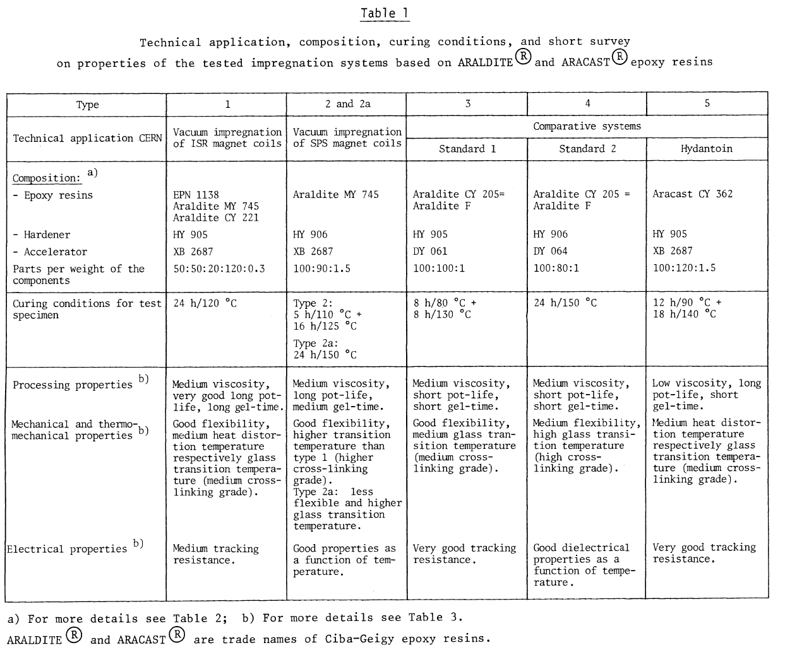

Slide 45
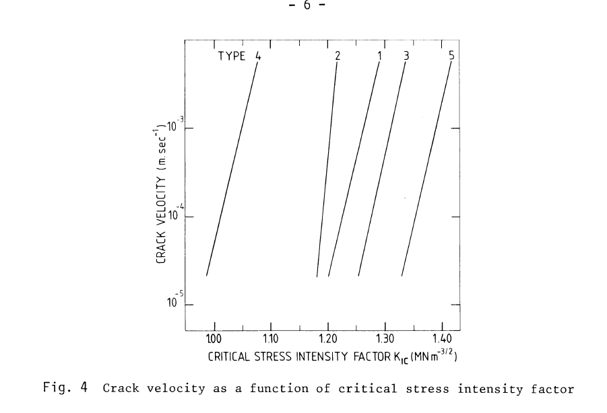
SPS
ISR~MQW

Slide 46
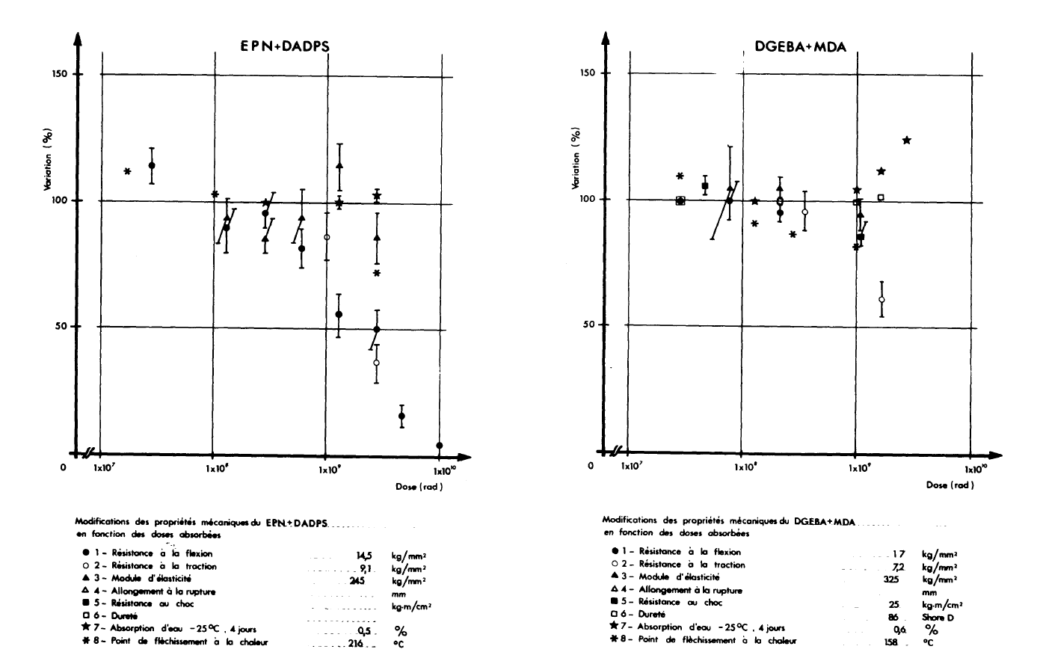

Slide 47
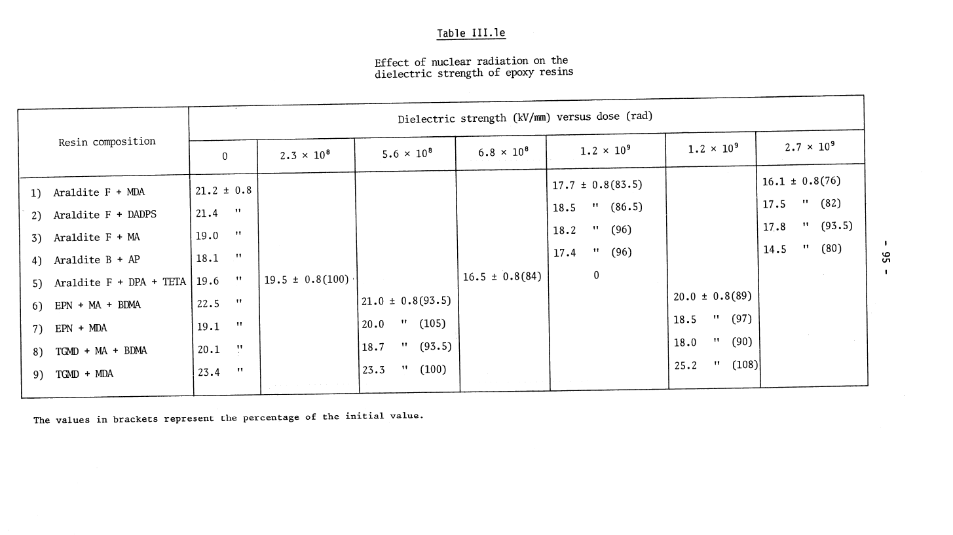

Slide 48
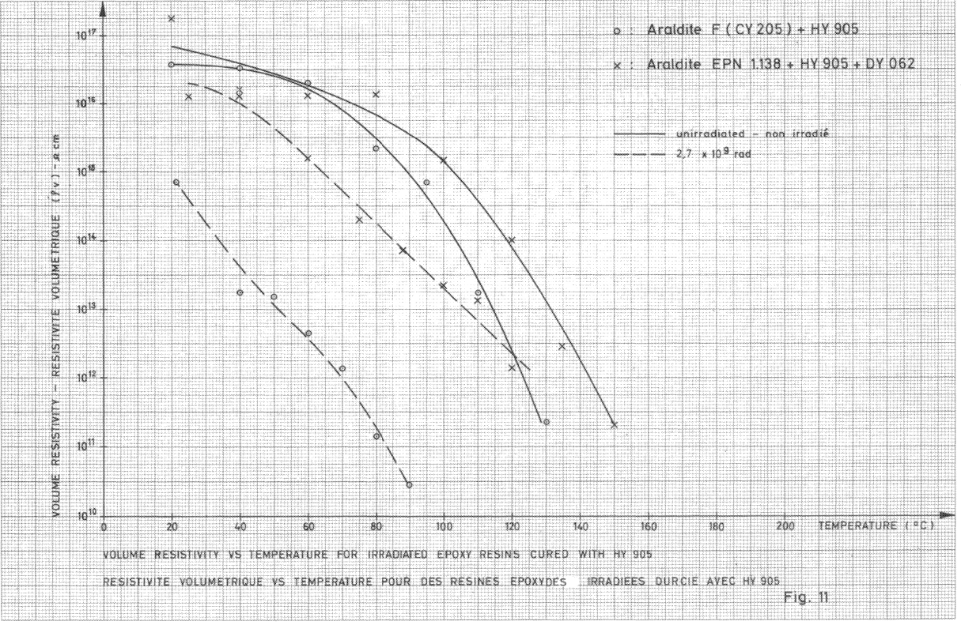

Slide 49
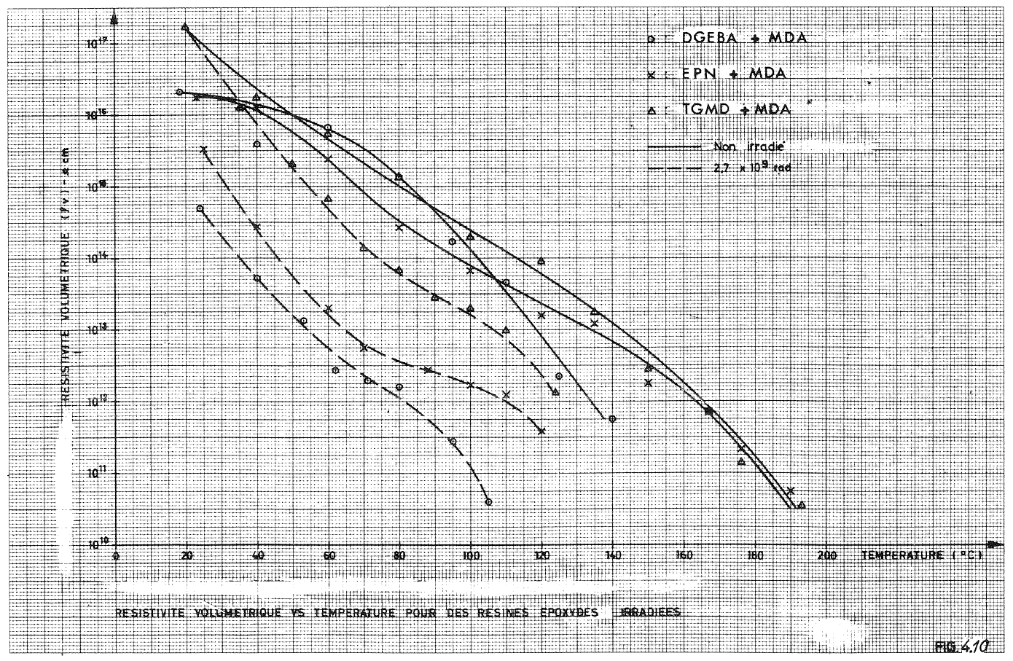
Electrical Properties Changes 2
10¹⁷
○ DGEBA + MDA
x EPN + MDA
∆ TGMD +MDA
_______ Non irradié
_ _ _ _ _ 2.7x10⁹ rad
10¹⁶
Volumetric Resistivity ρ (Ω·cm)
10¹⁵
10¹⁴
10¹³
10¹²
10¹¹
10¹⁰
0
20
40
60
80 100 120 140 160 180 200 Temp. (°C)
ρ = ~10¹⁶ Ω·cm @RT
High mechanical radio-resistance → High electrical resistance (mechanical degradation occurs first)
T ↑ => ρ ↓
Example of low mechanical-resistance system:
DGEBA-DBP-TETA → ρ = ~10¹³ Ω·cm @RT for 6.8x10⁸ rad

Slide 50
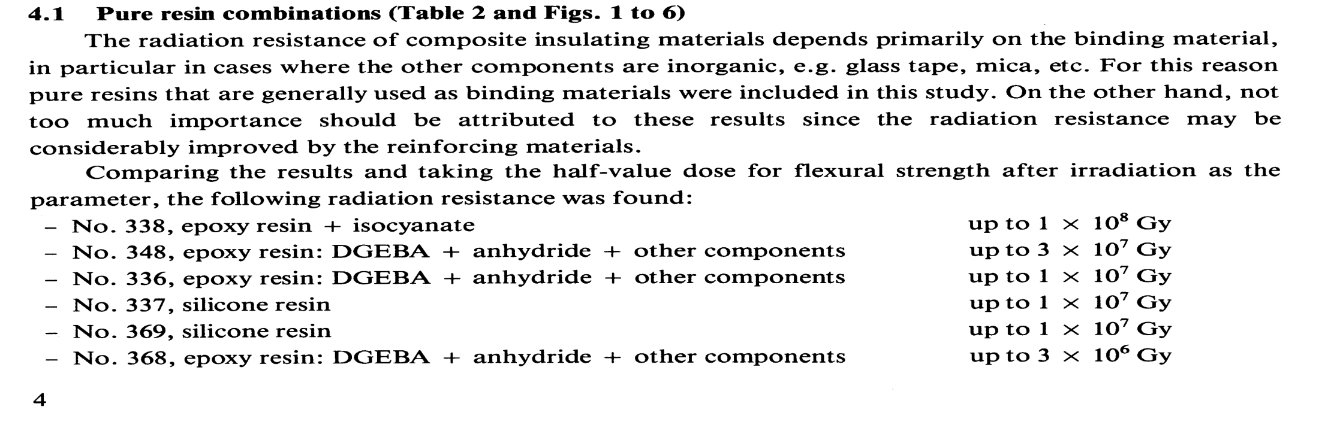
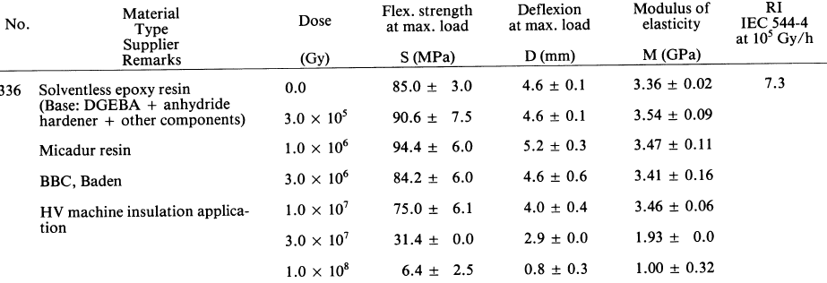
DGEBA considerations

Slide 51
PROPOSALS I
 | Traction test | Flexural test | Leakage current in air humid | Dielectric in air humid | Leakage current in air humid after 1 month in water | Dielectric in air humid after 1 month in water
0 MGy | Y | Y | (Y) | Y | (Y) | Y
10 Mgy |  | Y | (Y) | Y | (Y) | Y
20 Mgy | Y | Y | (Y) | Y | (Y) | Y
40 Mgy | Y | Y | (Y) | Y | (Y) | Y
50 MGy |  |  | (Y) | Y | (Y) | Y
60 MGy | Y | Y | (Y) | Y | (Y) | Y
70 MGy | Y | Y | (Y) | Y | (Y) | Y
Wafer 1 and 2 mm thickness resin and glass fibre

Slide 52
PROPOSALS II
 | Shear test | Leakage current in air humid | Dielectric in air humid | Leakage current in air humid after 1 month in water | Dielectric in air humid after 1 month in water
0 MGy | Y | (Y) | Y | (Y) | Y
10 Mgy |  | (Y) | Y | (Y) | Y
20 Mgy | Y | (Y) | Y | (Y) | Y
40 Mgy | Y | (Y) | Y | (Y) | Y
50 MGy |  | (Y) | Y | (Y) | Y
60 MGy | Y | (Y) | Y | (Y) | Y
70 MGy | Y | (Y) | Y | (Y) | Y
Insulated cables, 2 resins, 3 samples

