Slide 1
Integration options for collimators in the DS zones
V.Parma,
CERN, TE-MSC
With contributions/input from: V.Baglin, A. Bertarelli, M.Karppinen, H.Prin, D.Ramos, J.Ph.Tock, R.Van Weelderen
LHC Collimation Review 2013, CERN, 29-30 May 2013

Slide 2
Content
The LTC (TCLD collimators in warm sections of the DS)
LTC integration issues in Pts.1,2,3,5 and 7
Options for an 11T+collimator assembly
Warm collimator option
Why not a cold collimator?
Timeline
Summary

Slide 3
Content
The LTC (TCLD collimators in warm sections of the DS)
LTC integration issues in Pts.1,2,3,5 and 7
Options for an 11T+collimator assembly
Warm collimator option
Why not a cold collimator?
Timeline
Summary

Slide 4
Warm collimators in the DS: the LTC option studied for Pt.3
IP3
R33
RZ33
R34
11L3
10L3
9L3
8L3
7L3
QRL
Q11
Q10
Q9
Q8
Q7
DQS
Conn.cryostat
DFBA
TCLA
BTVM
4’500 mm
46 mm
4’500 mm
QRL
Q11
Q10
Q9
Q8
Q7
DQS
Short Conn.cryostat
New
Collimator assembly (LTC)
New
Collimator assembly (LTC)
DFBA
TCLA
BTVM
was aimed at Shut-Down 2012-2013 (was no time for 11 T magnets!)
move 24 existing magnets and DFBAs (considered critical but feasible)
Option studied making use of existing design solutions (for time reasons)

Slide 5
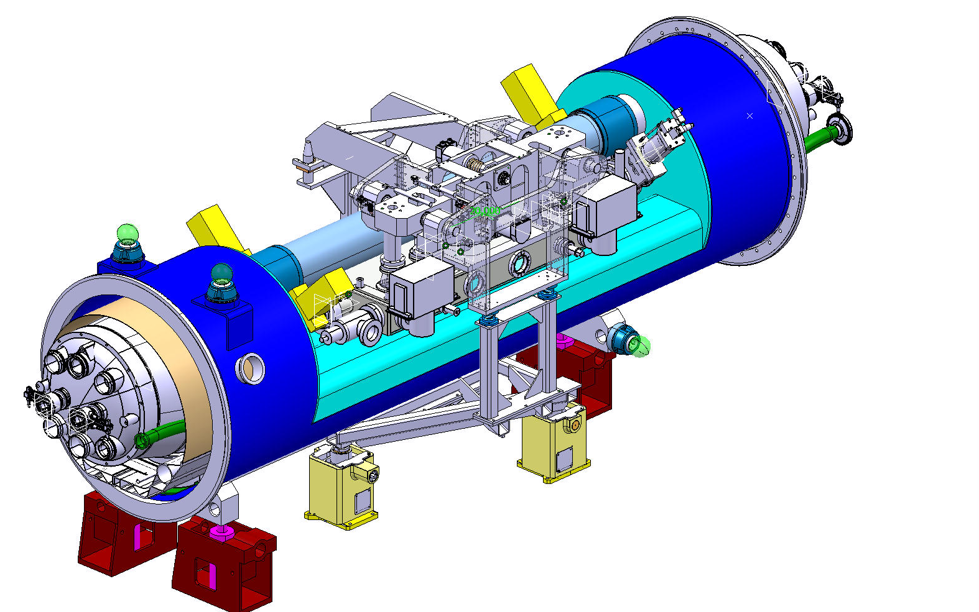
DS Collimator Assembly (LTC)
Q8
MB
LTC
(Y.Muttoni, EN-MEF)
Collimator Module (TCLD)
W jaw length → 1 m
overall length 4.5 m
Cryostat (“by-pass”)
(QTC)
1 prototype cryostat
constructed
See A.Bertarelli’s presentation

Slide 6
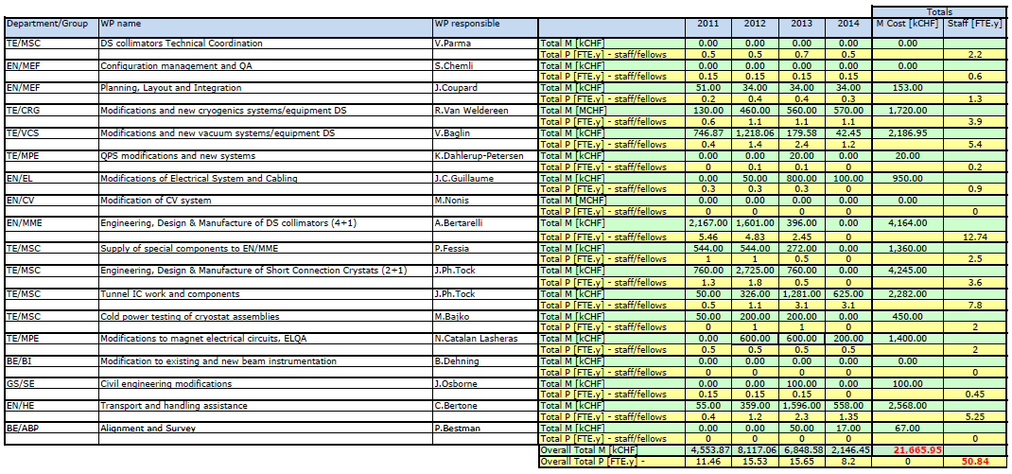
Cost Estimate (P+M)
LHC Collimation Review 2011,
CERN 14-15 June 2011
Up to date, M expenditures:
< 3 MCHF (estimate)
Includes design studies (also committed)
Components/materials ordered (end caps, supports, raw material…)
FTE.y
kCHF
Key figures:
21.5 MCHF
50 FTE.y

Slide 7
Summary of main implications
Disconnect and remove:
16 dipoles, 8 SSS, 2 Connection Cryostats, 2 DFBA
Displace by 4.5 m:
TCLA, DQS, BTVM (depending on point. In 3L)
Heavy cable re-layout work:
~600 cables to be shortened, ~800 cables to be extended (warm and cooled cables)
Re-routing (through new cable duct UP33/R34); connections
Civil engineering:
Remove, displace and fix jacks to ground
Grind passage wall (3-5 cm) on 2x100m length
Drilling new cable duct UP33/R34
Modification of jumpers of Q7, Q9 and DFBAs (on surface or in the tunnel)
Shortening of DSLC (cryostat+superc.cables) in 3R
Design and produce new equipment:
4 (+1) DS collimator assemblies (LTC)
2 (+1) Short Connection Cryostats (SCC)
2 QRL extensions
Re-install and interconnect DFBA, magnets, SCC, LTC

Slide 8
DS Collimator Assembly (LTC): reviews
Reviews:
QTC design & integration in May 2011 (http://indico.cern.ch/conferenceDisplay.py?confId=139092 )
LHC collimation review in June 2011 (https://indico.cern.ch/conferenceDisplay.py?confId=139719 )
Recommendations and decisions:
LTC option considered feasible but complex and heavy (i.e. incompatible with LS1) Recommended to delay to LS2: → still to be decided
Pursue design and prototyping of the QTC: → done (See A.Bertarelli’s talk)
Postpone decisions while endorsing the pursue of alternative scenarios with stronger dipoles magnets (11 T magnets): → in progress (see slides ahead)

Slide 9
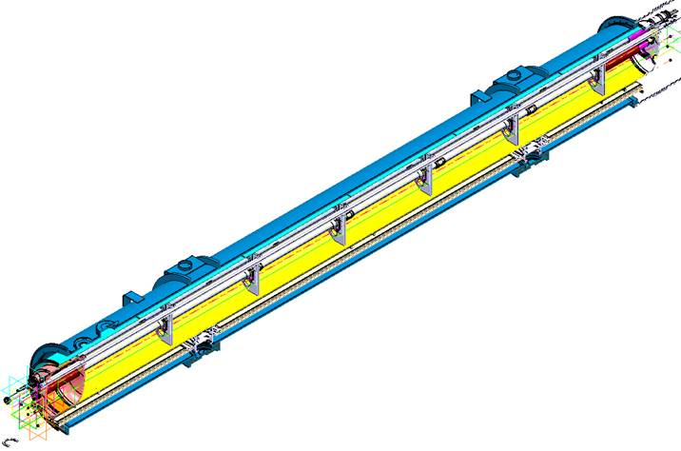
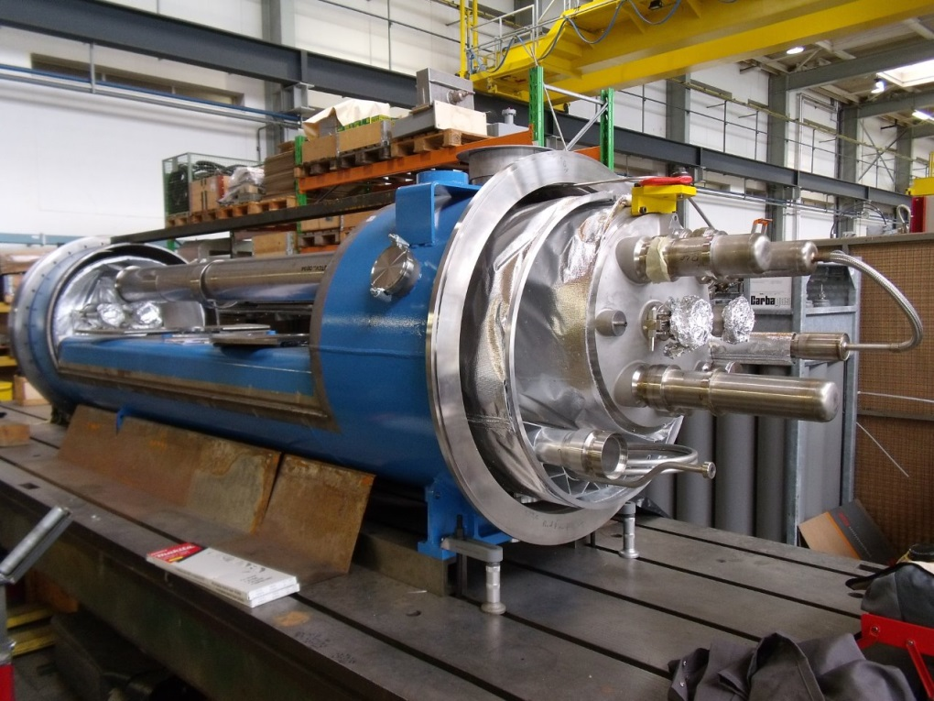
Status of QTC and SCC
QTC prototype constructed, awaiting validation cold testing (planned Sept. ‘13)
Preliminary design of Short Connection Cryostats done in 2011-12 (now stopped). In case of LTC for LS2, detailed engineering/production to be done
Remains a viable but heavy solution if needed (probably OK for 1 point at most)
Short Connection Cryostat
QTC prototype

Slide 10
Content
The LTC (TCLD collimators in warm sections of the DS)
LTC integration issues in Pts.1,2,3,5 and 7
Options for an 11T+collimator assembly
Warm collimator option
Why not a cold collimator?
Timeline
Summary

Slide 11
Dispersion suppressor zones
P1, after LS1: bus-bars QF and QD stop after Q11 → easier integration in QTC. Much easier if done in LS3 (DFB on surface)
P3, studied in detail
P5, same as P1
P6: No Q7, jumper on Q10 and not Q9 → 1 QRL extension more, 17th CC @6R, beam dumps,…
P7, similar to P3

Slide 12
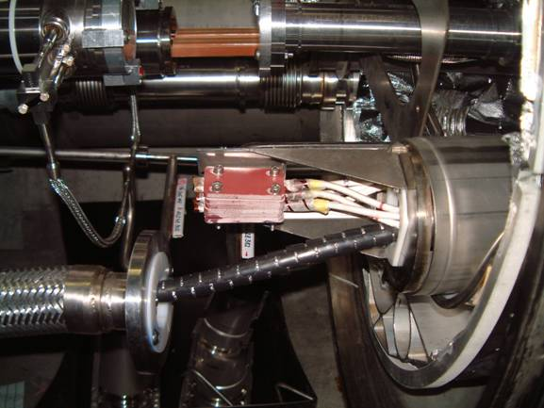
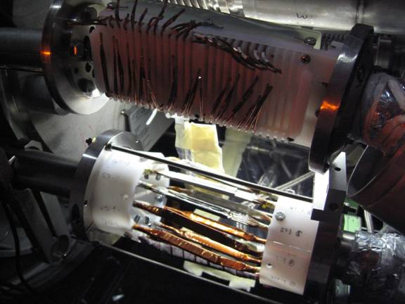
Dispersion suppressor zones : 1,2,5 (and 8)
Line N configuration (Line N needs removal/re-installation to displace magnets):
* In points 3&7: 600 A cable only = arc configuration (Experience available)
* In points 1,2,5,8: 600 A & 6 kA = No experience with removal, no procedure tested

Slide 13
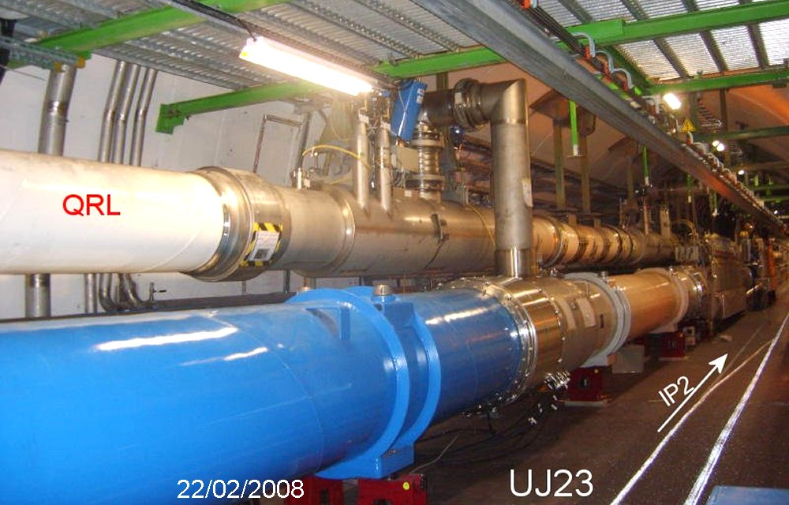
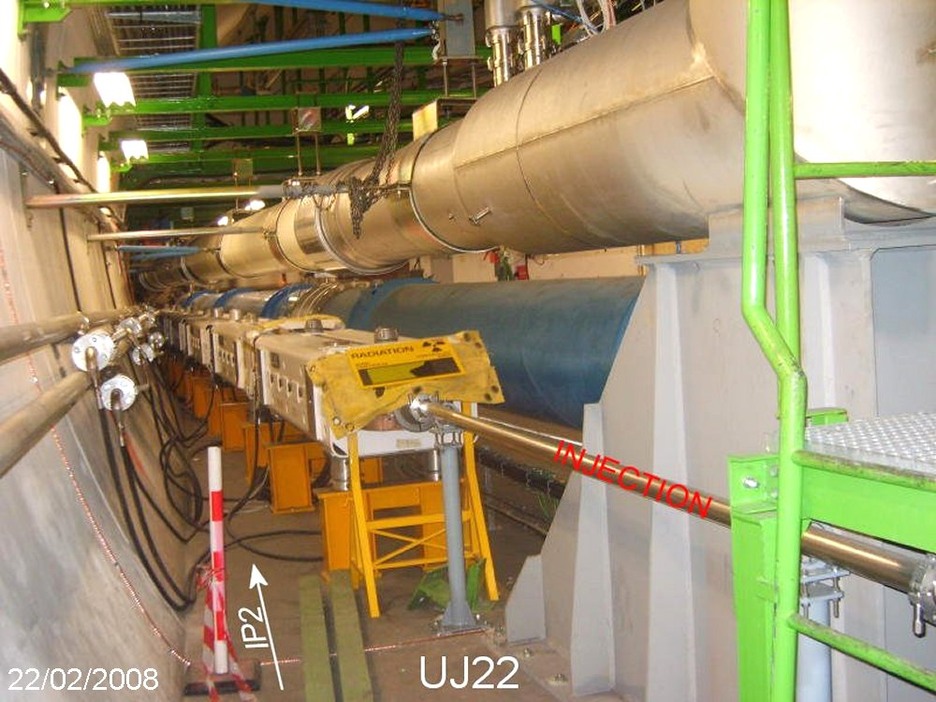
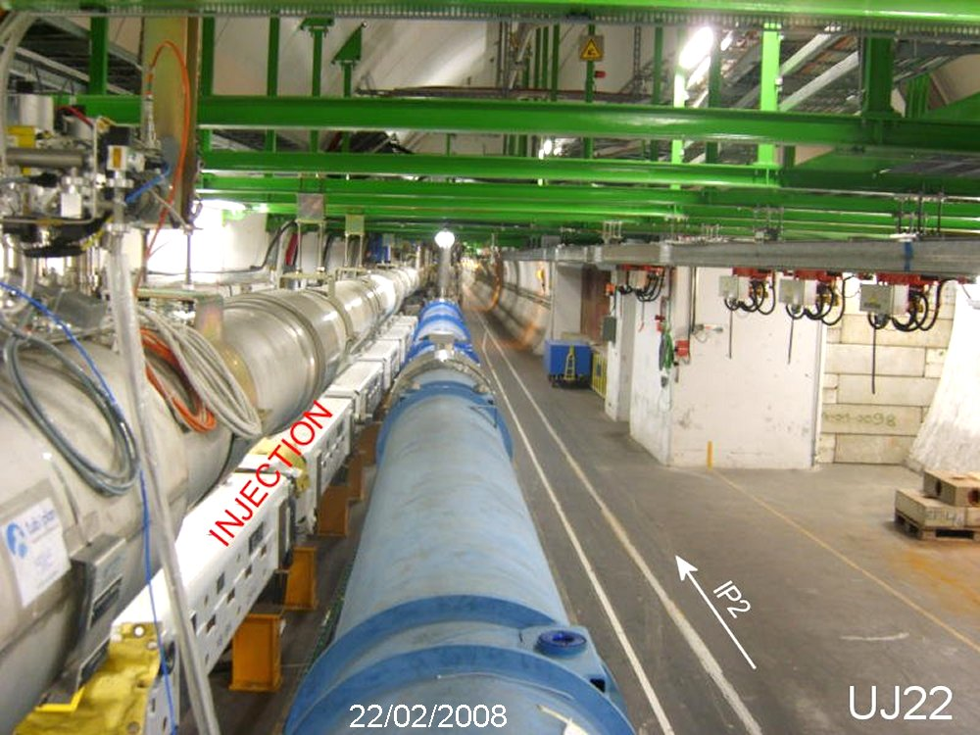
IR specificities
For Pts 1,3,5,7 : The DS zones are very similar in terms of layout (but not studied in detail!)
IR3 : Checked and validated ;
See drawings LHCLJ_3U0035 to 0045
IR2 could necessitate a different collimation optics for only one collimator slot
Left of IR2, there is the injection line and the QRL that are constraining differently the available space
Differences in design, tooling, procedures, …

Slide 14
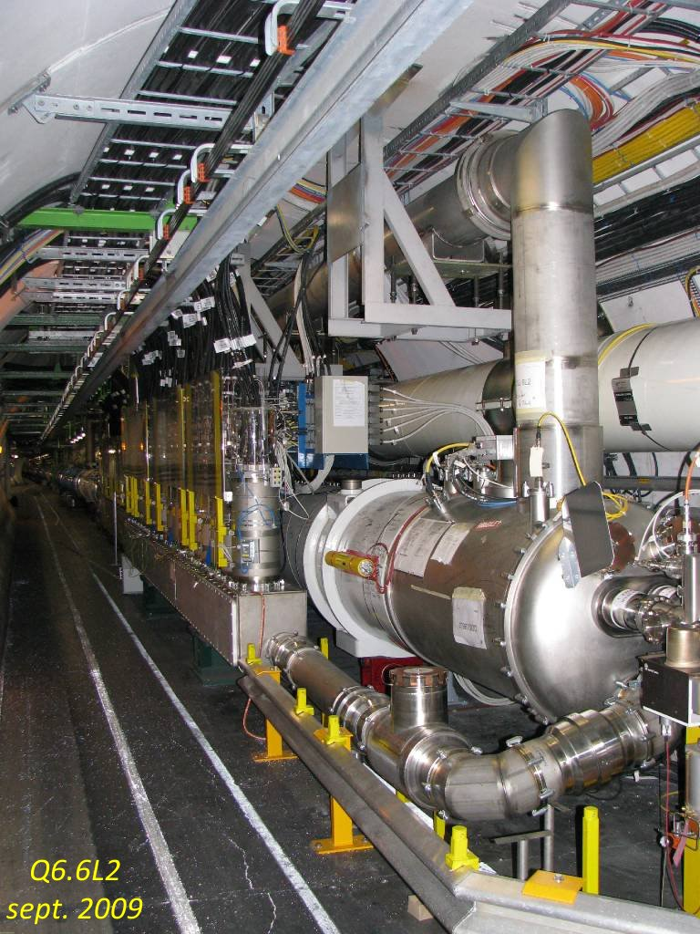
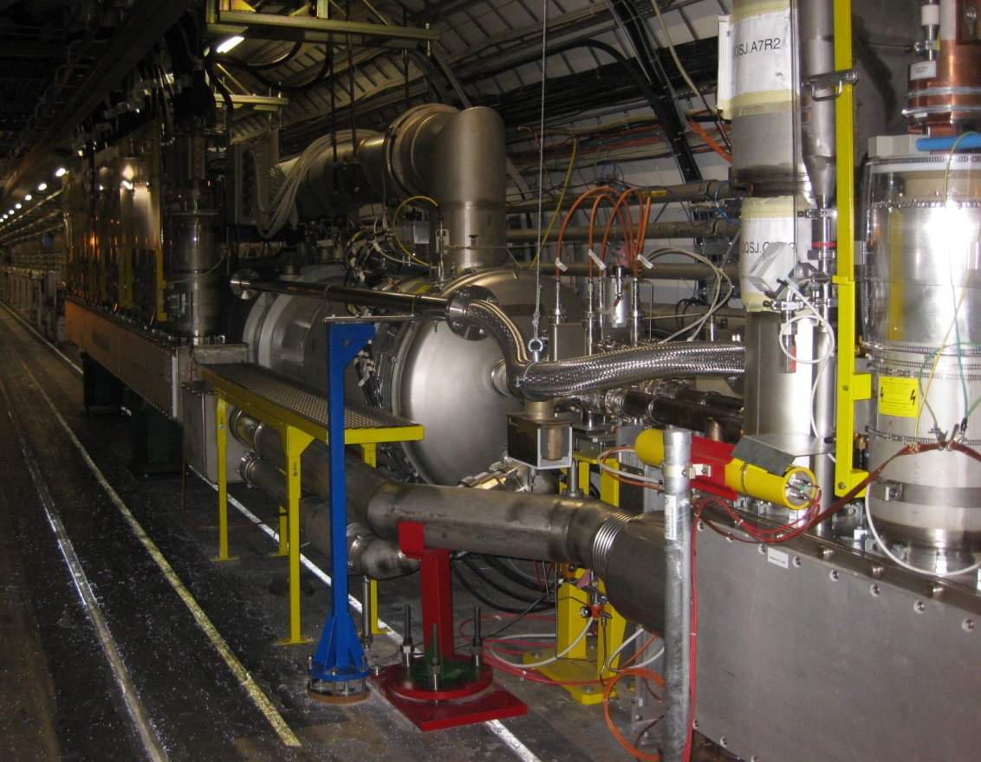
IR2 specificities
DSL2
DFBAs at P2 are also feeding Q6 so if cryomagnets have to be displaced, this would be much heavier than point 3.
DSR2

Slide 15
summary on integration issues
No show-stopper identified, but specific integration issues from point to point → each point deserves a dedicated study to confirm feasibility
IR specificities:
IR 3: Studied in detail
IR 2:
Line N configuration (600A+6kA): complex and no disassembly/re-assembly experience (also true for IR1 and 5)
DFBA also powers Q6: displacement of DFBA heavier. Integration space to be checked.
IR2 Left: injection line & QRL special routing: special space allocation, deserves a dedicated study
for a single collimator slot, what is the optics correction?
IR 1 & 5:
DS layout: similar to 3,7
Line N configuration (600A+6kA): same as IR 2
After LS1, QF and QD bus-bars stop after Q11: easier QTC construction/integration
If done at LS3, new DFBs on surface: easier integration of QTC
IR 7:
If QTC during LS2 coupled to displacement of DFB+SC link (R2E): easier integration of QTC

Slide 16
Content
The LTC (TCLD collimators in warm sections of the DS)
LTC integration issues in Pts.1,2,3,5 and 7
Options for an 11T+collimator assembly
Warm collimator option
Why not a cold collimator?
Timeline
Summary

Slide 17
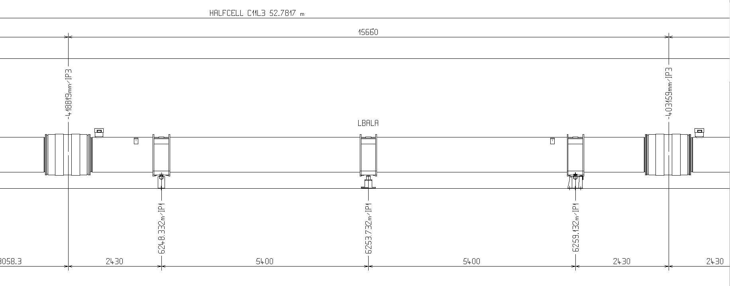
Dipole integration layout
Remove and replace MB
Preserve standard interconnect (i.e. standard interfaces)
→ 15’660 mm (IC plane to IC plane) space constraint

Slide 18
The “Collimator in the middle”, preferred option
15’660 (IC to IC plane)
~6’257 (L_{CM})
~6’257 (L_{CM})
Line X (H.exch.)
~2’400
beam tubes
Line M
(B.Bar line)
250
250
Note: 2 pairs of standard MCS and MCDO can be included.

Slide 19
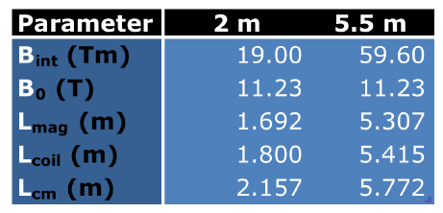
5.5m 11T magnet
Latest input from M.Karppinen
Splice-block
Lcoil = 5’415
75
38
End plate
114
6´257 (Ltotal)
5´772*
B-Bar Expansion lyra
Standard dipole end cap
B-Bar Fixed point
242.5
242.5
* end-plate to end-plate
Note: One pair of standard MCS and MCDO can be included in end caps.

Slide 20
Magnet cold mass and beam lines
Beam screen termination with compensation for differential displacements: 213 mm if standard; eventually 181 mm if optimised with a short nested bellows
Beam screen termination, fixed side: 122 mm
RF bellows module for magnet thermal contraction: 165 mm if standard; 147 mm if new design with shorter stroke in proportion to cold mass length
“Standard” length scenario;
6’257+213+165+165+122+
6’257 = 13’179 mm
If optimisation proves feasible:
6’257+181+147+147+6’257+122 = 13’111 mm
(D.Ramos)
Assuming cold bore diameter 50 mm

Slide 21
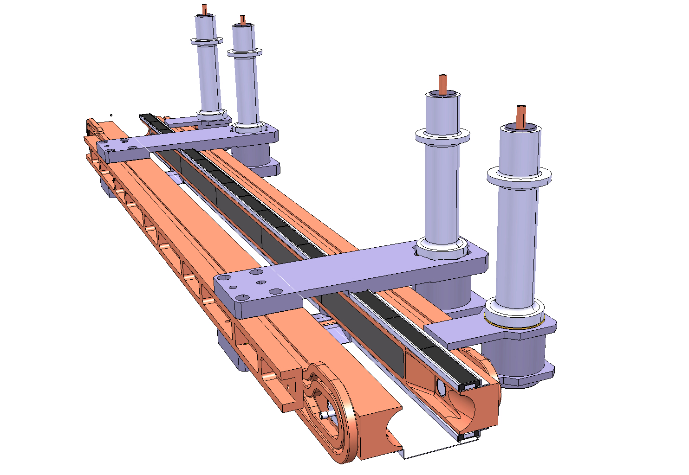
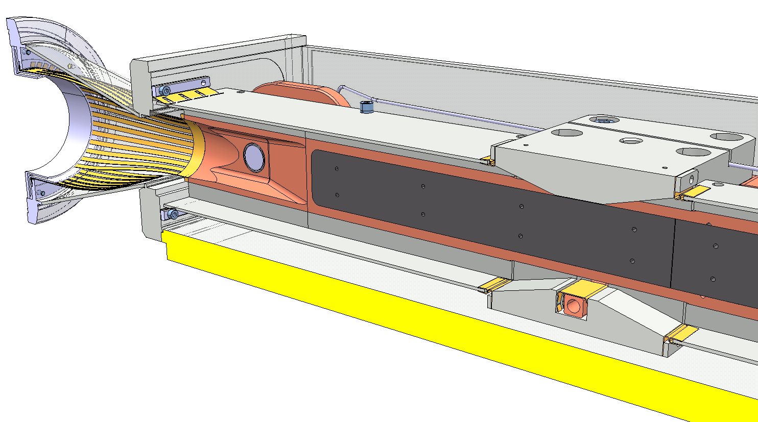
Collimator length
1000 mm tungsten active length
2x100 mm for tapering and pick-ups
2x140 mm for RF transitions
→ Total: 1480 mm

Slide 22
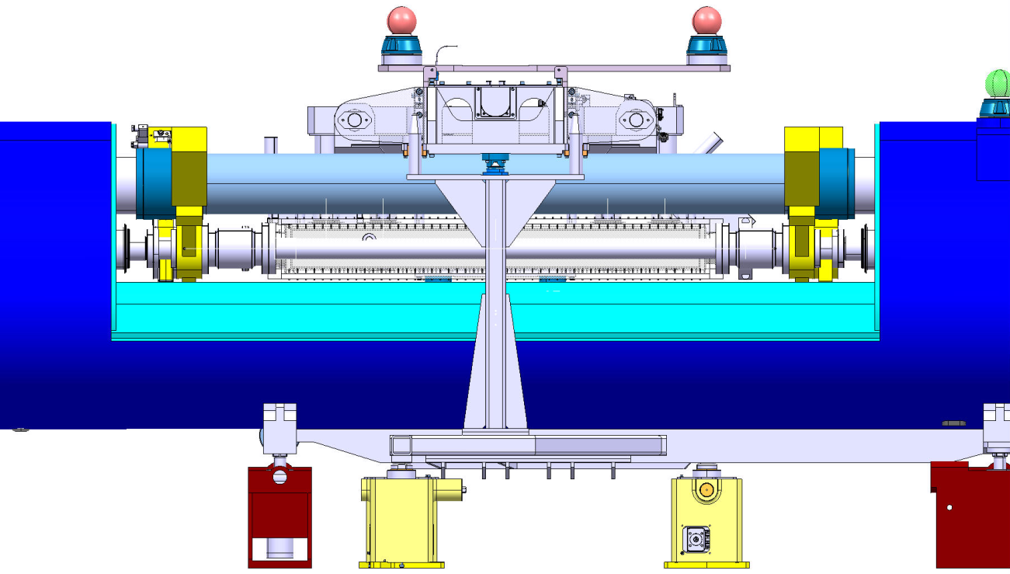
Mechanical and vacuum decoupling
RF shielded gate valves
For independence of vacuum operation
Must be staggered: 2x75 mm
Do not exist for low temperature. External actuator with long stem
RF shielded expansion joint modules for:
Installation and removal
Thermal compensation
Independent alignment of the collimator:
Possibly down to 100 mm, if special design
(D.Ramos)
Port for RF ball: 100 mm
Total length
2x(100+2x75+100) = 700 mm

Slide 23
Warm collimator layout
Warm Collimator Module
2’180÷2’380
100
÷ 200
100
150
140
1200*
PIMs
CWT
RF ball Vac. Port
Vac. Gates
Bellows
Transition
Jaw
Transition
Bellows
Vac. Gates
RF ball Vac. Port
With input from
A.Bertarelli, EN-MME
* Jaw length includes 2x100mm end taperings.

Slide 24
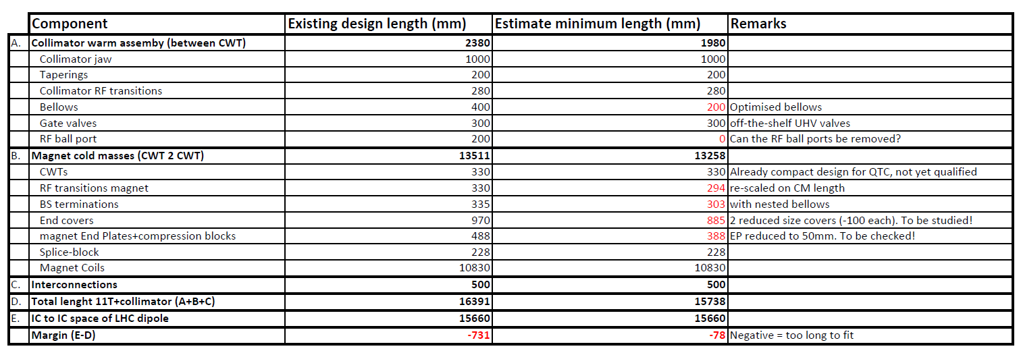
Chasing after the mm…
Space remains too tight at this stage of the study (with a 1m collimator jaw)
Optimization of many key items in parallel to make up for the missing space, not just a matter of integration
It is now the right time to start a design effort starting from the existing design (-731mm), followed by an optimization/redesign aimed at reducing length to the 15’660 mm gap:
Existing designs → Conceptual design of cryo-assembly by end of 2013 (experienced designer + PE)
Optimization/redesign → Detailed design & engineering in 2014 (experienced designer(s) + PE + system engineers)

Slide 25
Sketch of a possible layout
15’660 (IC to IC plane)
~6’214 (L_{CM})
~2’380
~6’214 (L_{CM})
MCDO
MCS
250
~142
~300*
250
~142
~300*
Splices done at assembly
Fixed support
Sliding support
B-Bar Expansion lyra
B-Bar Fixed point
External jack
* Experience from QTC bus-bars routing

Slide 26
Content
The LTC (TCLD collimators in warm sections of the DS)
LTC integration issues in Pts.1,2,3,5 and 7
Options for an 11T+collimator assembly
Warm collimator option
Why not a cold collimator?
Timeline
Summary

Slide 27
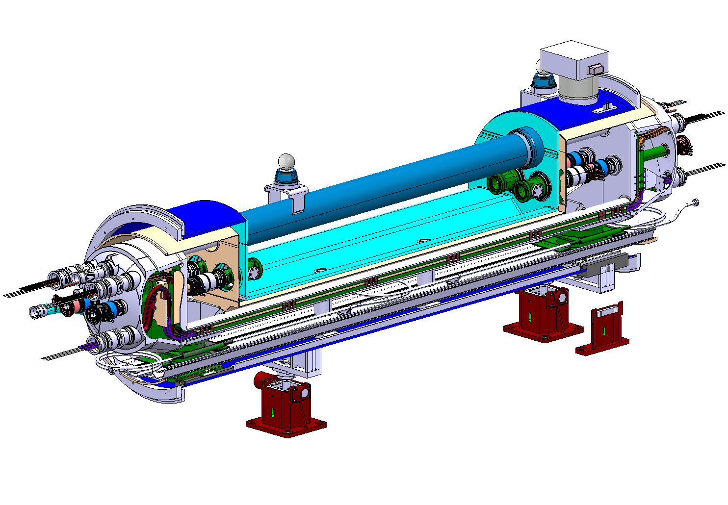
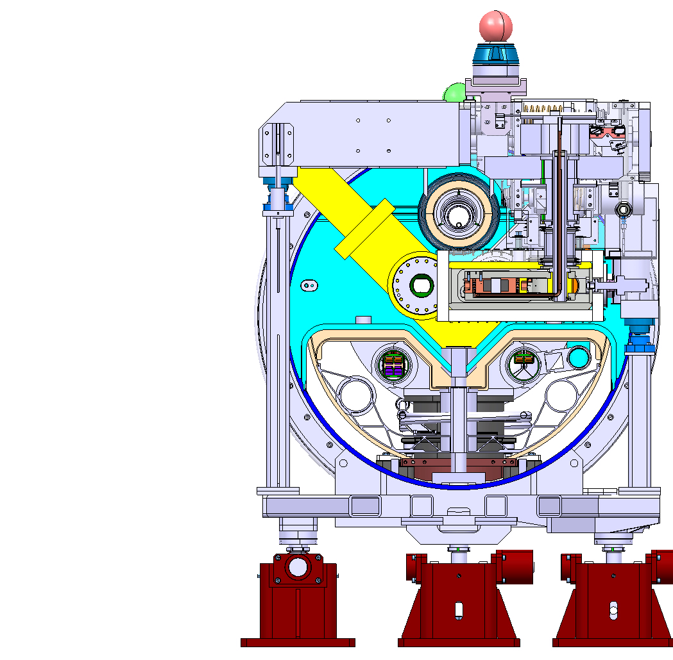
Why considering a cold collimator?
Since it’s cold, no need for cold to warm transitions, hence the overal installation length may be shorter (-330mm)

Slide 28
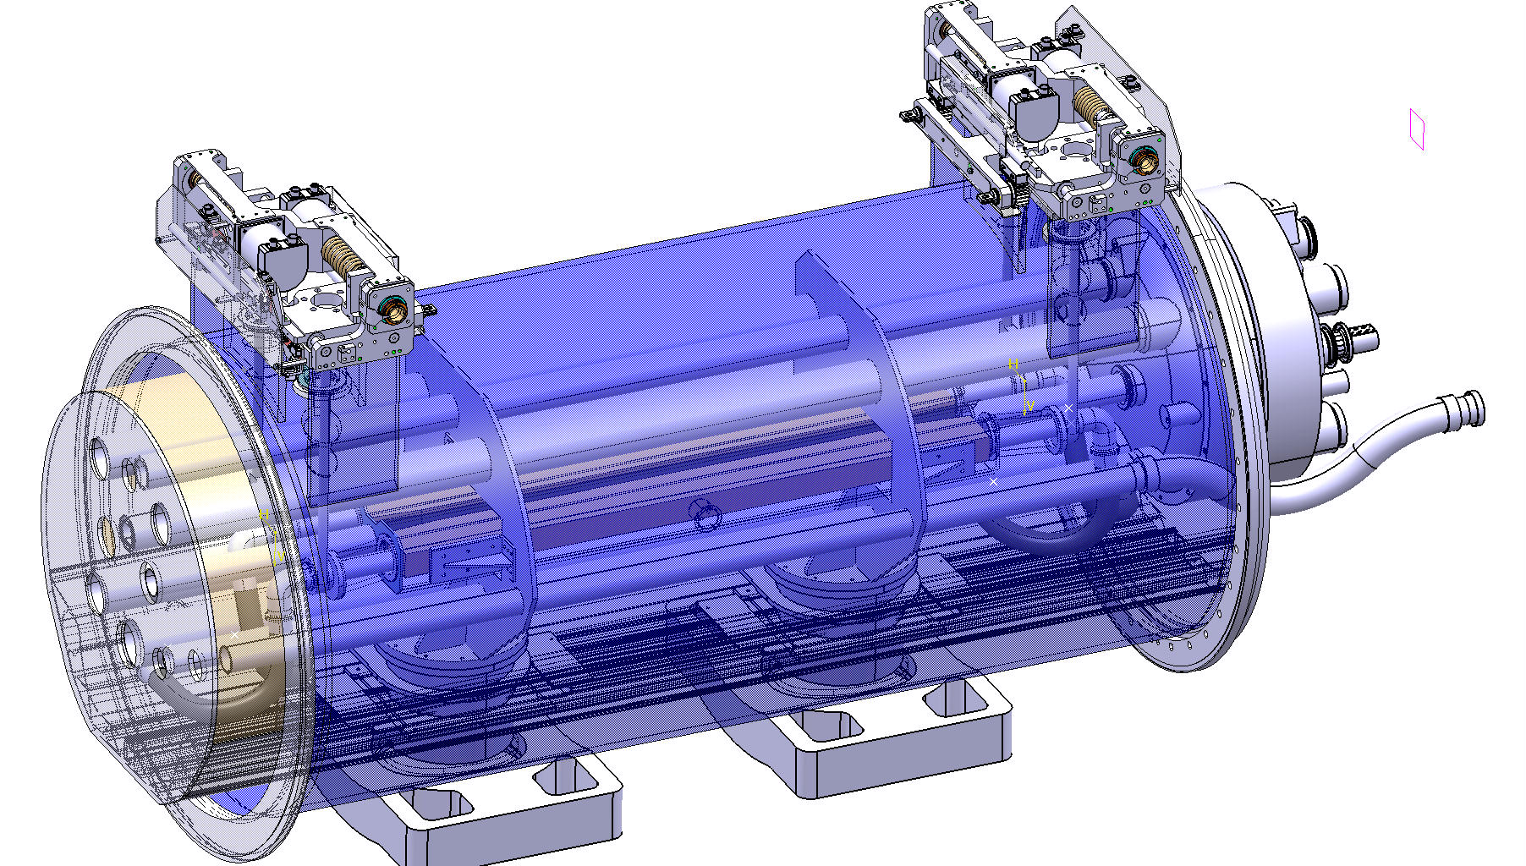
Preliminary study
DS collimation pre-study, June 2010
Cold mass
External actuation system
D. Duarte Ramos
Ch. Mucher

Slide 29
The Cold Collimation Feasibility Study (CCFS)
The Cold Collimator Feasibility Study (CCFS) worked on the issue in 2011-12:
Verify the feasibility of installing cold collimators, housed in cryo-assemblies, in the continuous cryostat during LHC’s LS2, as required by collimation in several machine IR’s (pt.1, 2, 3, 5 and 7)
Specific goals:
Analyze configurations of cold collimators coupled to 11 T magnets;
Identify potential show stoppers, related to the layout schemes or operational aspects of the technical systems (vacuum, cryogenics, machine protection, alignment, etc).
WG composition:
Collimators: A.Bertarelli, EN-MME; F.Cerutti, EN-STI; Vacuum : V.Baglin, TE-VSC; Cryogenics : R.Van Weelderen, TE-CRG; 11 T magnets: M.Karppinen, TE-MSC; Machine optics, (R.Assmann, BE-OP); Machine Layout, Cryostat & Integration: V.Parma (J.Ph.Tock),TE-MSC; Collimator project leader (R.Assmann, then replaced by S.Redaelli, BE-OP); HL LHC project leader (L.Rossi, TE)
Meetings:
Chaired by V.Parma (alternate J.Ph.Tock); Scientific secretary (all, at turns)
Minutes and workspace: https://espace.cern.ch/CCFS/default.aspx
Reporting:
Collimation Upgrade Management Meeting:
February 2012, status reported by V.Parma
January 2013, status reported by D.Ramos

Slide 30
Main findings
Cold collimator version brings limited advantage in longitudinal compactness (-330 mm of CWT) as compared to a warm version
…while adding technological complexity and challenges:
Risk on machine availability: moving parts into the LHC continuous cryostat → machine warm-up for interventions
Integration of beam vacuum functionalities:
Minimise gas reservori: → bakeout as a must; i.e. cold gate valves
Control of vacuum dynamics: → beam screens, perforated BS for H2 pumping to cold bore
T collimator > 90 K (avoid CO2 instabilities), and < 150 K (avoid H2O instabilities)
Development R&D (i.e. cost/human resources/time) essentially in :
Beam vacuum dynamics
Cold gate valves (not available on the market)
Collimator mechanics
Vacuum chamber and cooling
Support and alignment
New concept: jaw at > 90 K → requires cryogenics cooling circuitry
New designs: validation requires lots of testing
Engineering resources: heavy needs
→ Considering the marginal advantage and it is recommended not to pursue any further effort on a cold collimator version

Slide 31
Content
The LTC (TCLD collimators in warm sections of the DS)
LTC integration issues in Pts.1,2,3,5 and 7
Options for an 11T+collimator assembly
Warm collimator option
Why not a cold collimator?
Timeline
Summary

Slide 32
Timeline for LS2
11 T + collimators assy ready for installation
1st 11T proto 2-in-1
(c.f.r. M.Karrpinen’s talk)
11 T + collimators assy testing
11 T + collimators cryostat assembly
Cryostat procurement
11 T + collimators cryostat Engineering & Design
Latest start of Engineering & Detailed design
To be elaborated based on collimation needs (i.e. no. of assemblies needed)

Slide 33
Summary
The LTC option is viable but remains a heavy option; is at present the only one which satisfies machine integration in the DS.
The LTC option was studied in detail for IR3; it remains possible for other points of interest (no showstopper so far) but considering the complexity and specificity of each point it should be studied in detail.
The “11T+collimator” option (with a 1 m W jaw) still does not fit in a standard dipole gap. Should now move to a conceptual and detailed design phase.
The “11T+collimator” option can be successful only if several items are re-designed/optimized in parallel (i.e. all actors concerned have to play the same game!).
In order to be ready for LS2, there is a heavy design work ahead (which should start now) which should be supported by construction of prototypes and/or mock-ups and a qualification program before the machine units are constructed.
The “cold collimator” option is not considered a viable and interesting one.

Slide 34
Answers to specific questions from S.Redaelli for the review
Recent developments and final design choice: “warm” vs “cold” design:
Answer: Yes: “warm”
Integration issues and feasibility in the different IRs: IR1/2/5/3/7
Answer: Yes, but IR dependent: dedicated studies needed to rule out possible show-stoppers
Can/should we still keep open to option of moving magnets around in DS’s?
Answer: Yes
Review issues for different IR: Is it worth in all cases betting on the 11T dipoles?
Answer: This is the most convenient solution. Adequate resources allocation should be ensured depending on the extent of the collimation needs

Slide 35
Thank you! Questions?

Slide 36
Spare slides

Slide 37
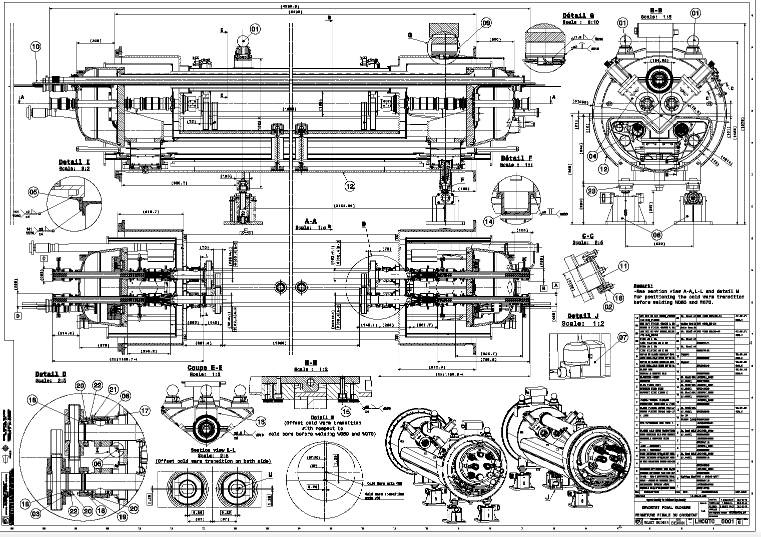
QTC assy drwg

Slide 38
Differences are coming from the DFBA type and the elements on the IR side.
P3 for reference:
P1 (5):

Slide 39
Differences are coming from the DFBA type and the elements on the IR side.
P2 (Very different):
DFBAs at P2 are also feeding Q6 so if cryomagnets have to be displaced, this would be heavier

Slide 40
Differences are coming from the DFBA type and the elements on the IR side.

Slide 41
Differences are coming from the DFBA type and the elements on the IR side.

Slide 42
Differences are coming from the DFBA type and the elements on the IR side.

