Slide 1

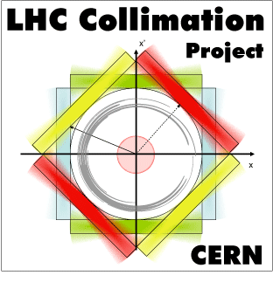

DS Heat Load Scenarios in Collision Points and Cleaning Insertions.
Prepared by F. Cerutti, A.Lechner and G. Steele on behalf of the FLUKA team (EN-STI)
With essential input from; R.Bruce, J. Jowett, M. Karppinen, V. Parma, S. Radaelli, D. Ramos, T. Sahner, M. Schaumann.

Slide 2
Contents
Investigation of ion collision debris (BFPP) in IR2:
  current MB
  new 11T 2-in-1 dipole magnet coupled to warm TCLD collimator
Summary of previous study on the effect of cryo-collimators for proton and lead beams in the IR7 dispersion suppressor.

Slide 3
Heat load in the DS due to ion collision debris (BFPP1) in IR2

Slide 4
New Simulation Parameters
Only consider BFPP, secondary beam due to bound-free pair production (208-Pb-81+)
Cases considered
  Existing layout, external crossing angle of 80μrad (total 150), impacts on the beam screen of MB.B10R2.B1
  Replacing MB.A10R2.B1 by 2 shorter dipoles and a collimator, crossing angle of 4.6μrad (74),
    half gap of 9.5mm, 0.5m Copper jaw
    half gap of 9.5mm, 1m Tungsten jaw
    half gap of 2mm, 1m Tungsten jaw
Instantaneous luminosity of 6e27 cm⁻² s⁻¹ integrated luminosity 10nb⁻¹

Slide 5
Existing layout - peak power
Results use an improved geometry with respect to a previous study: DOI: 10.1103/PhysRevSTAB.12.071002 200 (R.Bruce et. al, 2009), but are nonetheless consistent.
Peak power: 95mWcm⁻³
If radially averaged over cable thickness one gets a reduction of around a half
Peak dose of 20MGy over 10nb⁻¹

Slide 6
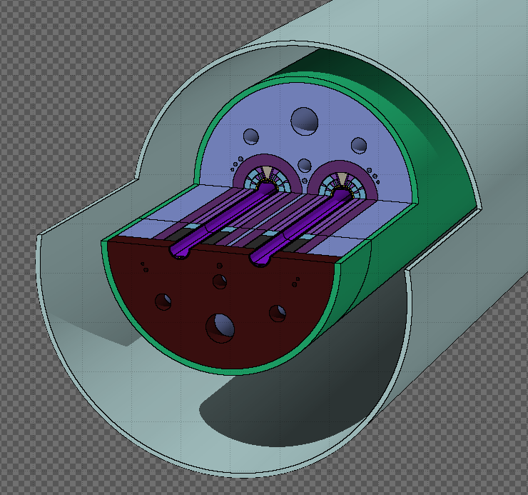
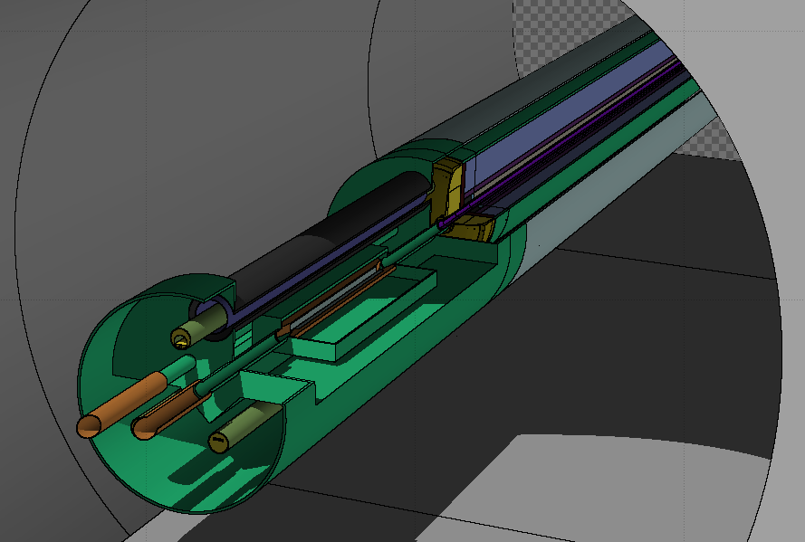
TCLD and 11T dipole (MBHDP)
Modelled in FLUKA to include all geometry essential for energy deposition studies.
For dipole, magnetic field map included to allow particle tracking.
impact parameter = 2mm
400μrad

Slide 7
DS Coll. + MBHDP - peak power
1m W
0.5m Cu

Slide 8
Peak power deposition: MBHDP - cont.
Reduction factor greater than 4 between the two cases.
0.5m copper jaws give a peak power density of 3.7 mWcm⁻³ in the coil of the magnet.
1m tungsten jaws give a peak of 0.8 mWcm⁻³

Slide 9
Comparison of scenarios
 | Peak power density (mW cm⁻³) | Reduction factor | Peak Dose (MGy) for 10nb-1 | Total power on magnet (W) | Total power on jaw1 (W) | Total power on jaw2 (W)
MB - no collimator | 95 | 1 | 20 | 105 | - | -
1m W | 0.8 | 114 | 0.2 | 8.4 | 77 | 13
0.5m Cu | 3.7 | 26 | 0.8 | 46 | 42 | 6.5
1m W 2mm half gap | <0.1 | >900 | <0.1 | 3.0 | 96 | 6.5

Slide 10
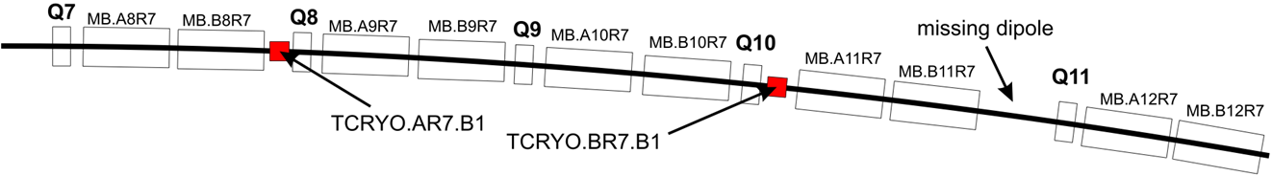
Heat load in DS due to beam halo collimation in IR7

Slide 11
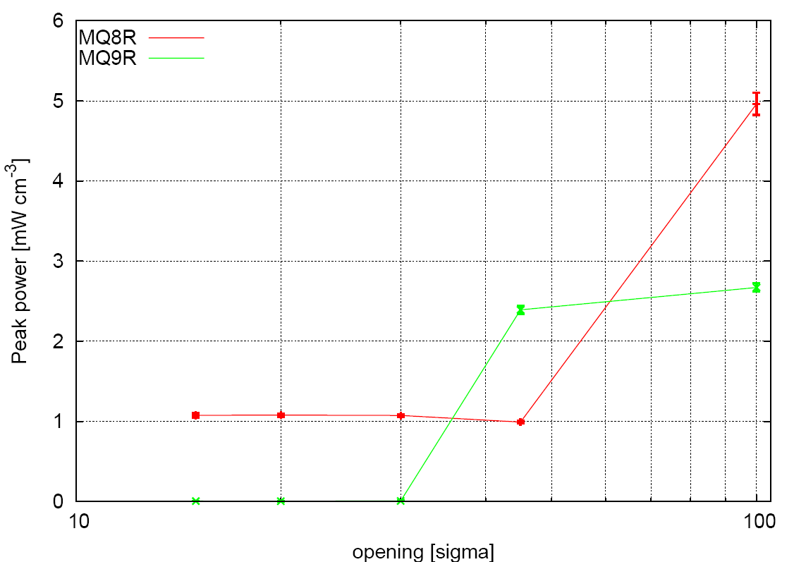
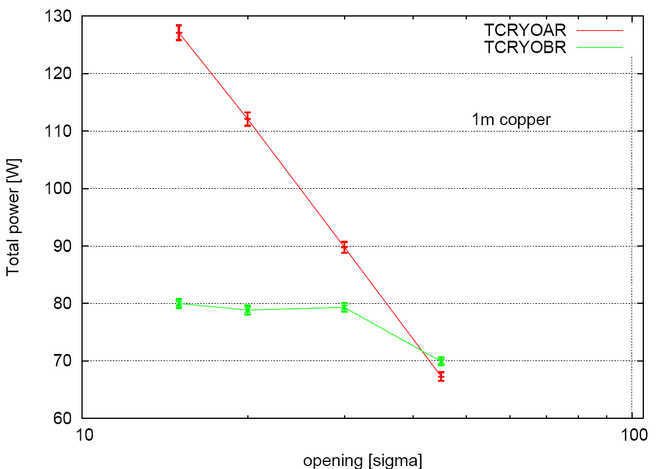
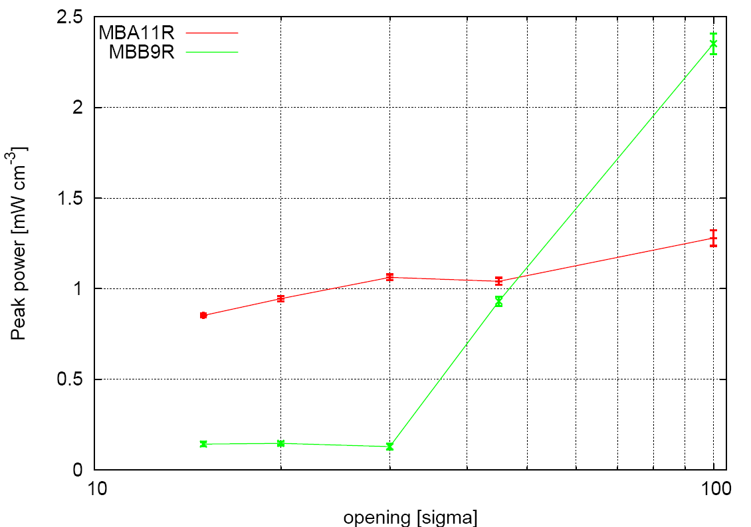
DS collimator effectiveness - protons
1m copper with 15, 20, 30, 45 sigma half-gap
(100 sigma half-gap means no TCRYO)
Study (shown by F.Cerutti at CDR LHC Phase II Collimation 02/04/09) looking at the effect of cryo-collimators on the LHC beam halo power deposition in the IR7 dispersion suppressor.
peak power in the coils
MQs
MQTLIs
~1mW/cm³ (MQTLI8R) for 15, 20, 30 sigma
a factor of 5
reduction
total power in the TCRYOs
30% less
MBs
power values for 0.2h beam lifetime

Slide 12
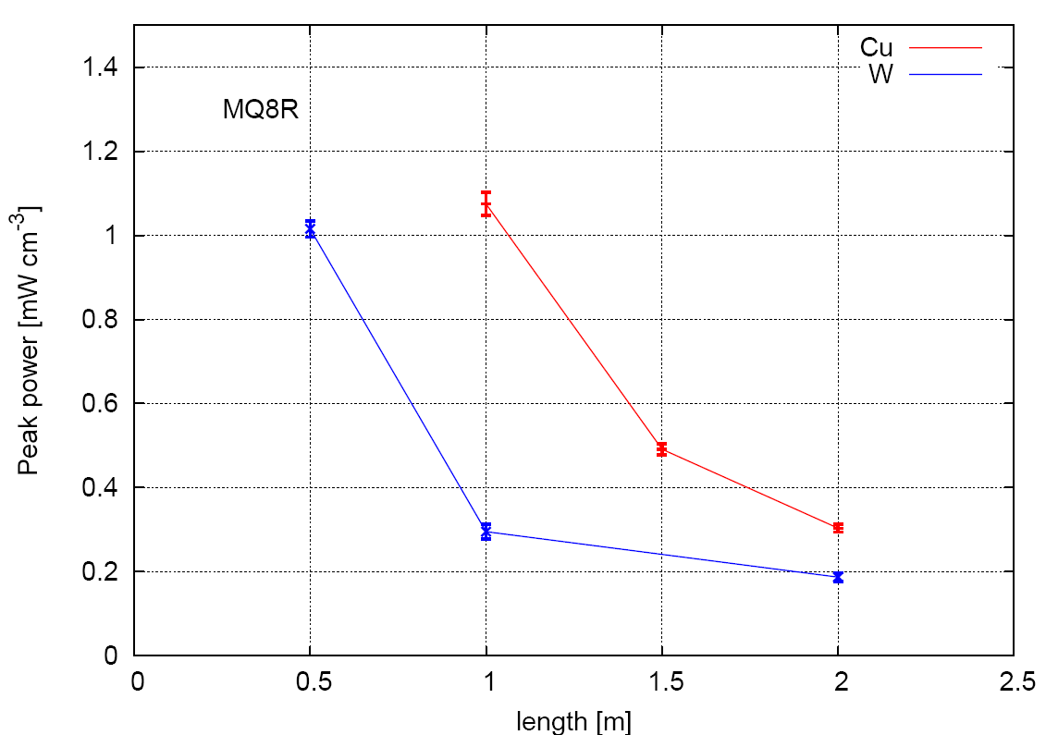
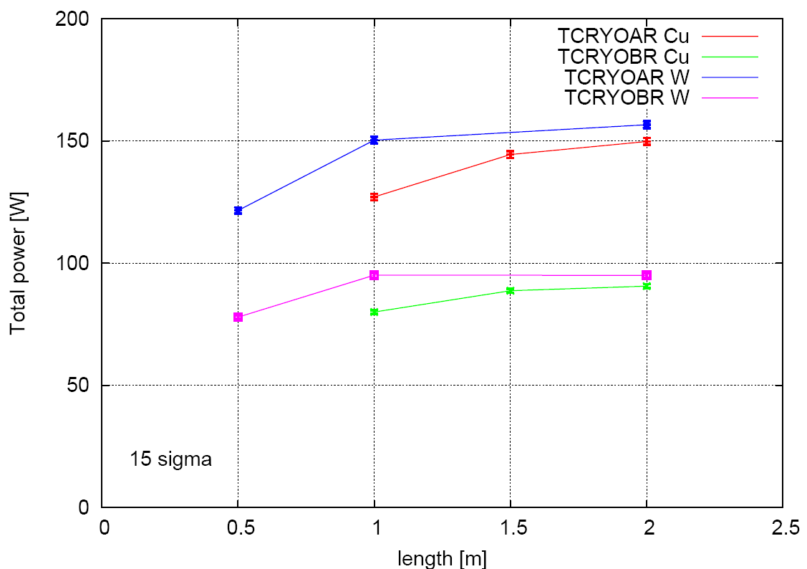
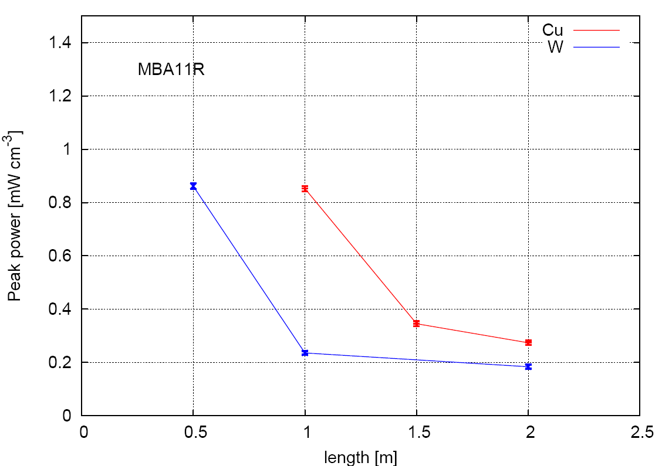
EFFECT OF THE TCRYO LENGTH/MATERIAL
F.Cerutti
0.5, 1, 1.5, 2 m copper/tungsten with 15 sigma half-gap
power values for 0.2h beam lifetime
MQs
peak power in the TCRYOs
a further factor of 3 reduction going from 1m Cu to 1m W
1.1 W/cm³ in the Cu jaw
2.6 W/cm³ in the W jaw
on a 4mm x 4mm x 1cm volume
total power in the TCRYOs
peak power in the coils
limited increase
MBs

Slide 13
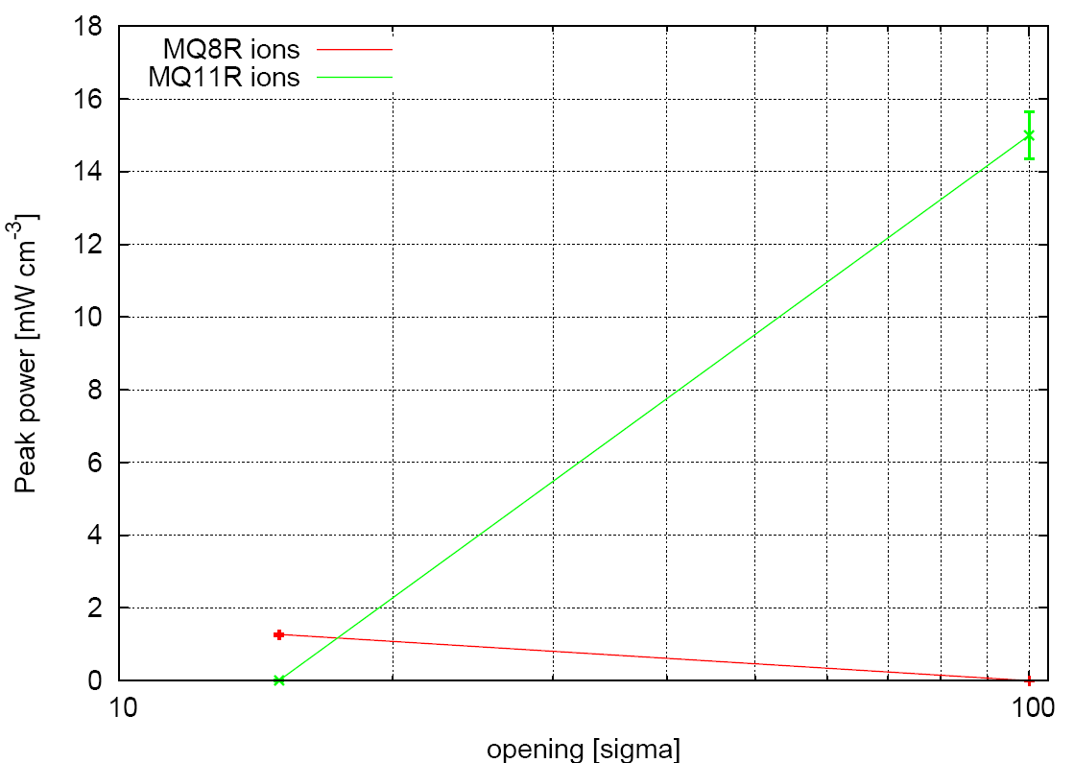
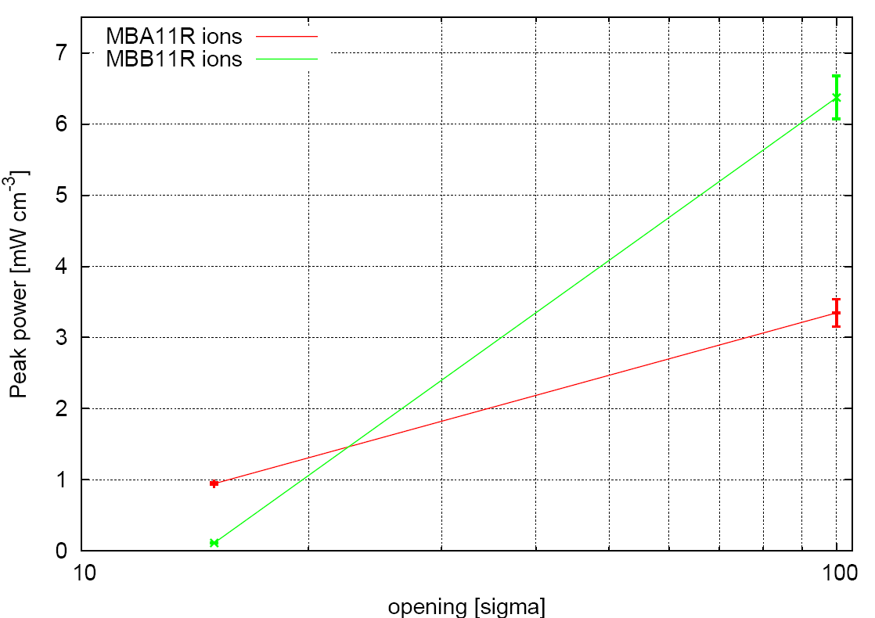
EFFECT OF THE TCRYO (LEAD BEAM)
1m copper with 15 sigma half-gap
(100 sigma half-gap means no TCRYO)
power values for 0.2h beam lifetime
peak power in the coils
F.Cerutti
a factor of 10
reduction
MQTLIs
~1mW/cm³ (MQTLI8R)
MQs
peak power in the TCRYOs
1.75 W/cm³ in the Cu jaw
on a 4mm x 4mm x 1cm volume
MBs
total power in the TCRYOs
120 W in the TCRYOAR
125 W in the TCRYOBR

Slide 14
Conclusions
  The envisaged increase in luminosity to 6e27 cm⁻² s⁻¹ will lead to peak power deposits of almost 100 mWcm⁻³ in MB.B10R2.B1 due to the BFPP secondary beam from ion collisions.
  Replacing MB.A10R2.B1 by two shorter dipoles and a collimator can reduce this by a factor of between 20 and 100 depending on the length and material of the jaws. Despite BFPP ions impacting only the external jaw, the role of the second jaw is far from being negligible.
  The peak deposits can be reduced further by reducing the collimator half gap.
  DS collimators in the halo cleaning insertions also ensure a significant reduction factor for both proton and ion beams (at least 10 with 1m metallic jaws).

