Slide 1
Collimation after LS1: cleaning and β* reach
R. Bruce, R. Assmann, M. Cauchi, D. Deboy, L. Lari,
S. Redaelli, A. Rossi, B. Salvachua, G. Valentino
Acknowledgements:
W. Herr, M. Lamont, R. de Maria,
E. Metral, N. Mounet, D. Wollmann

Slide 2
Outline
Introduction: LHC collimation system
Calculations of collimator settings so far
Changes in LS1 – BPM button collimators
Collimator settings and beta* after LS1.
Brief outlook for HL-LHC – what is different compared to
after LS1?
Conclusions

Slide 3
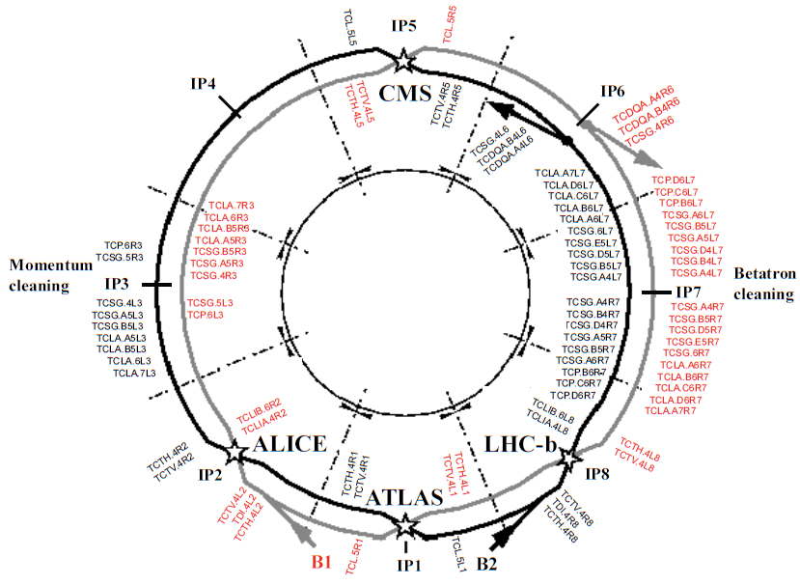
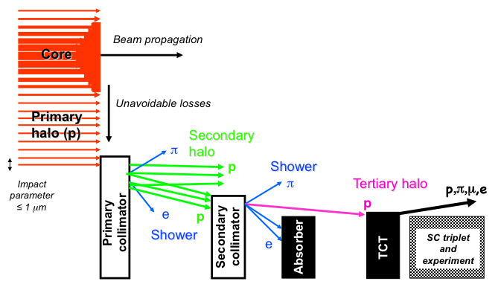
LHC Collimation system as installed
Collimators installed in IR7 (betatron cleaning) and IR3 (momentum cleaning)
Tertiary collimators (TCTs) installed
around experiments
Beam dump protection devices
in IR6 – should
intercept beam
in case of fast
dump failures
Multi-stage system
in IR7 and IR3
R. Assmann, C. Bracco

Slide 4
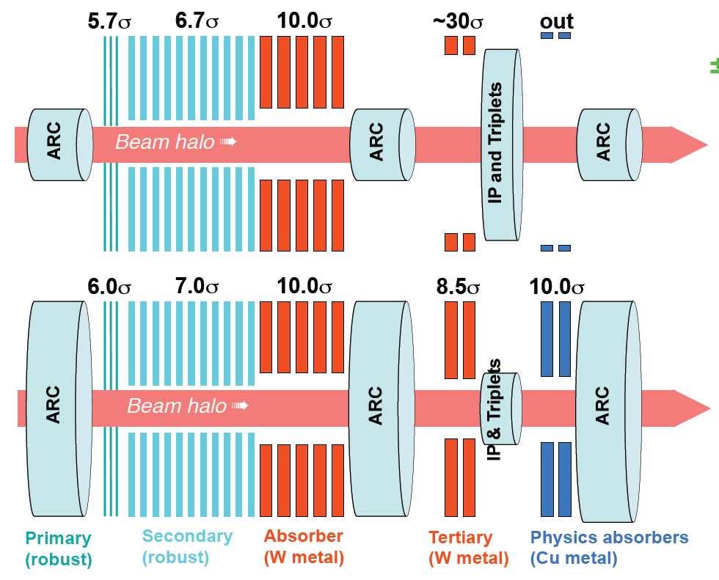
Principles for collimator settings
Collimation system designed for
  Cleaning: protect cold aperture from unavoidable beam losses as particles drift out from the core of the beam. Hierarchy in IR7 and IR3 determines performance
  Protection: If losses are too high, BLMs trigger a beam dump before a quench occurs. If single-turn failure (asynchronous dump), BLMs too slow. Rely on robustness of collimators and correct hierarchy to avoid damage. Hierarchy with respect to IR6 crucial
Bottlenecks in machine different at injection and top energy
Nominal collimator settings
Injection
Physics
R. Assmann

Slide 5
Aperture to protect
During design stage, collimator settings calculated to guarantee protection for apertures >8.4 σ (including tolerances on mechanics, orbit, beta-beat, energy offsets etc – using n1 method in MADX)
Safe approach
to avoid bad surprises
With LHC built, machine aperture
measured – larger aperture
found than the worst-case
scenario worked out beforehand
Example: measured triplet
aperture on-momentum in
IR1 = 11 σ at β*=60cm and 4 TeV,
while n1 method gives 6.3σ
(with 3mm orbit, 20% beta beat,
off-momentum).
In the future: maintain n1 approach as baseline, but consider both options
Aperture measurement with collimator scan 2012.
See S. Redaelli et al. in IPAC 12

Slide 6
β* dependence on collimator settings
More aperture available => allows to squeeze to smaller β*
Simple scaling model successfully used to extrapolate measured aperture to other β* and crossing angle – used to calculated run parameters in 2011 and 2012 (see talk Evian 2010 and 2011, S. Redaelli LMC 2011)
On the other hand, so far larger retractions used in the hierarchy than in design
Possible β* depends both on the collimator settings and the required margin as well as the available aperture

Slide 7
Calculation of margins in hierarchy
In IR7, non-critical cleaning margins in 2010 and 2011 calculated by keeping the same retraction in mm as at injection (intermediate collimation scheme) in order to provide sufficient room for imperfections (optics / orbit stability)
In 2012, we reduced margins in IR7 to “tight” settings based on empirical studies (see MD notes).
  Not yet at nominal settings, but getting closer! TCP now at 4.3 σ, same setting as nominal in mm. But larger retraction to TCS in order to keep hierarchy.
  Goal is still to achieve nominal settings (better understanding of the hierarchy limits and efficiency dependence, more frequent alignments or even new hardware (see later)
  Tighter settings gain room for protecting a smaller aperture

Slide 8
Calculation of critical margins
Critical margins: If margins IR6-TCTs-aperture are violated, sensitive equipment (TCTs or aperture) might be exposed and even damaged in the unlikely case of an accident
Critical margins calculated based on in-depth analysis of previous runs
Components of critical margins: orbit, β –beat, lumi scans, positioning errors and setup errors
Philosophy: Margins should be respected more than 99% of time => risk of damage < 1 in ~300 years for TCTs, less than 30000 years for triplet (see Evian 2010)
Summing in square the estimated margin needed for 99% safety from orbit and β variations at the collimators, reproducibility of collimator positioning, setup error. Adding van der Meer scans separately

Slide 9
Collimator settings 2010-2012
Tighter collimator settings allowed to squeeze β* down to 60cm in 2012. Present limit!
TCLA7
TCS6/
TCDQ
TCT
Aperture
TCS7
TCP
Kicked
beam
5.7 σ_{n} 8.5 σ_{n} 17.7 σ_{n} 9.3 σ_{n} 15.0 σ_{n} 17.5 σ_{n}
5.7 σ_{n} 8.5 σ_{n} 17.7 σ_{n} 9.3 σ_{n} 11.8 σ_{n} 14.1 σ_{n}
4.3 σ_{n} 6.3 σ_{n} 8.3 σ_{n} 7.1 σ_{n} 9.0 σ_{n} 10.5 σ_{n}
6.0 σ_{n} 7.0 σ_{n} 10.0 σ_{n} 7.5 σ_{n} 8.3 σ_{n} 8.4 σ_{n}
Primary halo
beam
2010, β*=3.5m, 3.5 TeV
2011, β*=1.0m, 3.5 TeV
2012, β*=0.6m, 4 TeV
Nom, β*=0.55m, 7 TeV
Secondary
halo
Tertiary
halo
σ calculated with emittance = 3.5μm

Slide 10
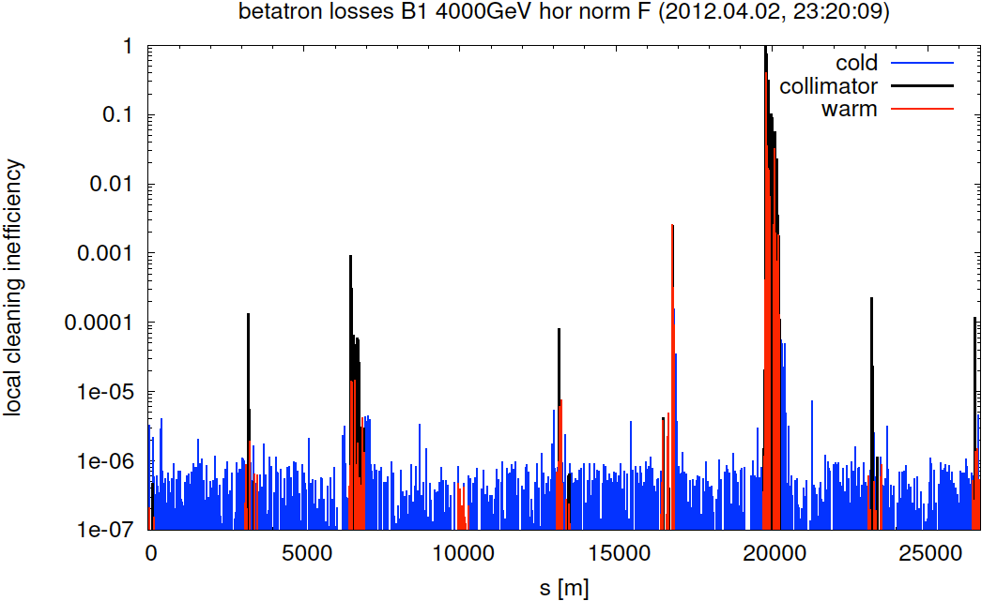
Present collimation performance
Successfully put tight settings into operation in 2012 - only 1 beam-based alignment per year sufficient!
Excellent cleaning inefficiency, factor ~5 better than with relaxed settings in 2011 (see G. Valentino, Evian 2011, and B. Salvachua, MD note)
No quenches with
circulating beam
Lifetime dips in
ramp and
squeeze due to
instabilities
(under study in
impedance team)
Careful optimization
of the LHC has reduced
losses during the year
Beam 1
Betatron
cleaning
Momentum
cleaning
Dump
ALICE
LHCb
ATLAS
CMS
Local efficiency
99.995 %
B. Salvachua et al.

Slide 11
Outline
Introduction: LHC collimation system
Calculations of collimator settings so far
Changes in LS1 – BPM button collimators
Collimator settings and beta* after LS1.
Brief outlook for HL-LHC – what is different compared to
after LS1?
Conclusions

Slide 12
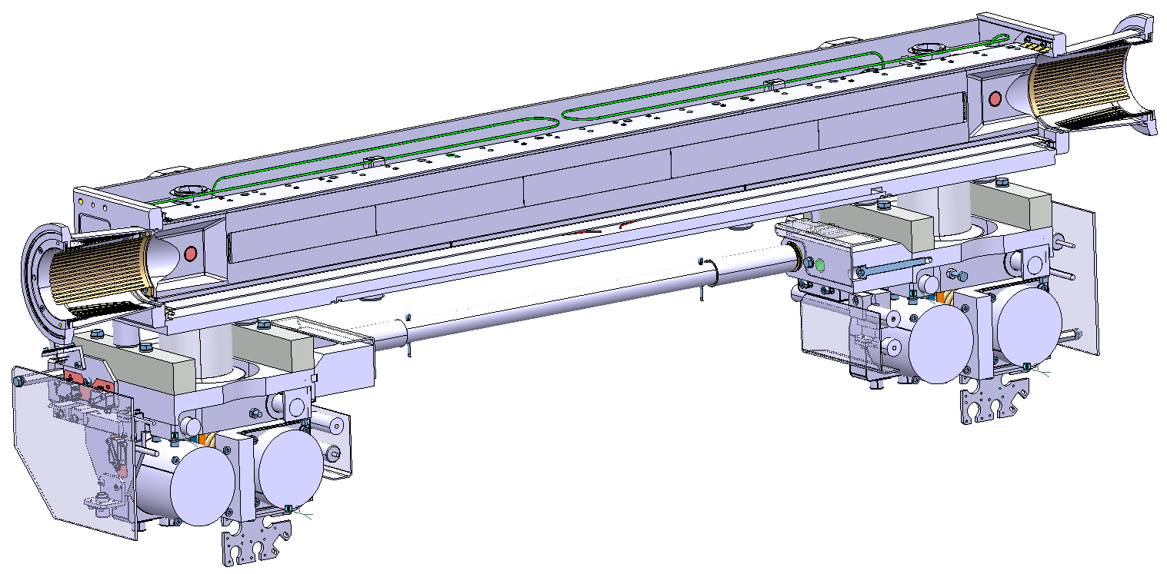
LS1 improvements – integrated BPMs
The 16 TCTs (industrial production) in all IRs and the
2 TCSGs in IR6 (in-house production)
will be replaced by new
collimators with
integrated BPMs.
Tests in the SPS
with mock-up
collimator very
successful
(see D. Wollmann et al., IPAC11, HB 2012)
Gain: can re-align dynamically during standard fills. No need for special low-intensity fills
  Drastically reduced TCT setup time (gain of a factor ~100) => more flexibility in IR configuration
  Reduce orbit margins in cleaning hierarchy => more room to squeeze β*
BPM buttons
Courtesy O. Aberle, A. Bertarelli, F. Carra, A. Dallocchio, L. Gentini et al.

Slide 13
Preliminary scenarios after LS1
Beam assumptions:
  6.5 TeV
  25 ns (beam-beam separation needs to be increased to 12 σ, the emittance from injectors can increase up to 3.5 μm but could also be as small as 1.6 μm) or 50 ns (we can keep the same beam-beam separation as 2012 and same emittance)
BPM button collimators: assume pessimistically 50 μm precision of orbit at TCTs and TCSG6 as upper limit from SPS tests – in reality better precision expected.
  Can reduce to 0.1 σ margin for orbit between dump protection and TCTs
  Can reduce to 0.8 σ margin for orbit between TCTs and triplet – orbit can still move in triplet
We can not move in the TCPs further than today in mm (impedance, orbit)
Assuming same excellent aperture, β-beat and orbit precision as 2011/2012 (2012 orbit analysis still to be done)

Slide 14
Preliminary collimator settings after LS1
Including increased margin from BPM button collimators
Using same philosophy for calculating margins IR6-TCTs-triplets as in 2012
No constraints from impedance accounted for
New iteration of needed margins will be done when HiRadMat test results on TCT damage limit are fully analyzed
 | Case 1: same as today in mm | Case 2: Keeping retractions in σ | Case 3: Nominal retractions
TCP 7 | 5.5 | 5.5 | 5.5
TCSG 7 | 8.0 | 7.5 | 6.5
TCLA 7 | 10.6 | 9.5 | 8.5
TCSG 6 | 9.1 | 8.3 | 7.0
TCDQ 6 | 9.6 | 8.8 | 7.5
TCT | 10.0 | 9.1 | 7.7
aperture | 11.4 | 10.5 | 9.1
Should work for cleaning hierarchy
Might require more frequent setups to keep hierarchy
Probably not for startup after LS1

Slide 15
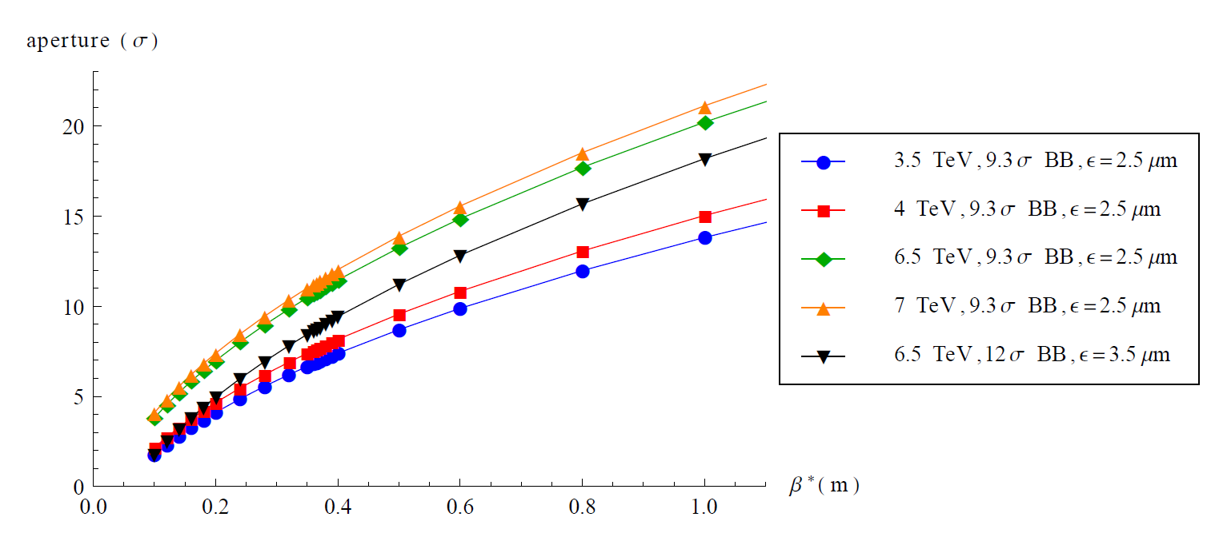
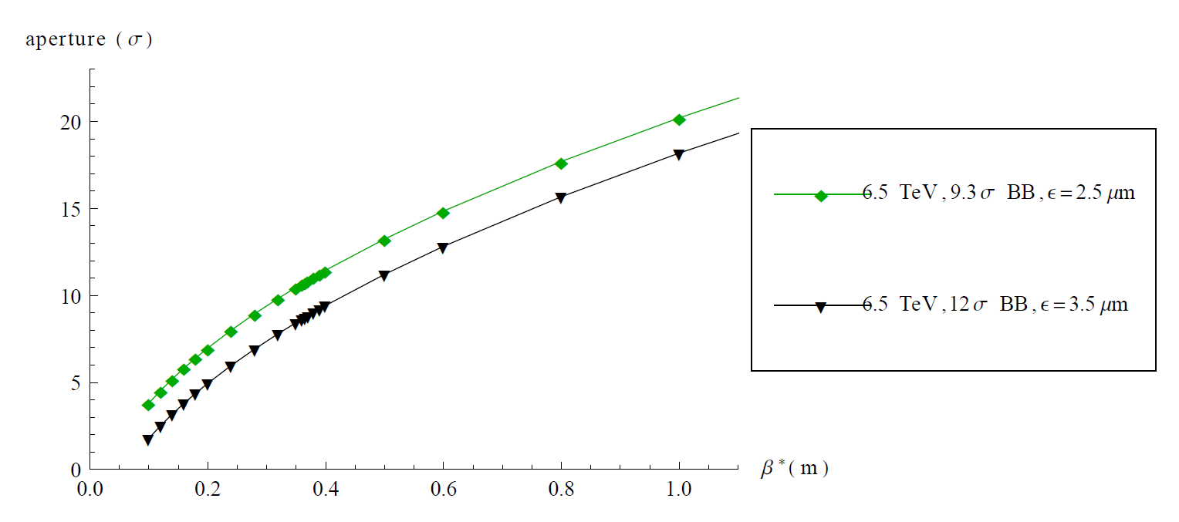
Preliminary β* and aperture after LS1
Aperture scaled from most pessimistic 2011/2012 measurements.
If we could have 1.6μm emittance at 25ns, the aperture/crossing angles are almost the same as for 50 ns and 2.5μm
By going to 25ns, we could lose 10cm in β* if the emittance is large (3.5 μm), nothing if the emittance can be pushed down to 1.6 μm
Case 1
Case 2
Case 3

Slide 16
Preliminary β* reach
Not accounting for impedance constraints, we could reach β* between 30cm and 50 cm
β* rounded to nearest 5 cm, crossing angle to nearest 10 μrad
 | Case 1: same as today in mm | Case 2: Keeping retractions in σ | Case 3: Nominal retractions
TCP 7 | 5.5 | 5.5 | 5.5
TCSG 7 | 8.0 | 7.5 | 6.5
TCLA 7 | 10.6 | 9.5 | 8.5
TCSG 6 | 9.1 | 8.3 | 7.0
TCDQ 6 | 9.6 | 8.8 | 7.5
TCT | 10.0 | 9.1 | 7.7
aperture | 11.4 | 10.5 | 9.1
Half crossing angle (50/25 ns) [μrad] | 140/190 | 150/200 | 160/210
β* (50 / 25 ns) [cm] | 40/50 | 35/45 | 30/40
Aim for this as starting scenario

Slide 17
Can we achieve these settings?
Pileup – might consider leveling
Octupoles: today running at about 500A, max current is 550A. Possibly we will be limited in octupole strength at 6.5 TeV
  Ongoing work in impedance team and beam-beam team to explore limit and optimize octupole settings. Beam-beam could possibly be used to stabilize colliding bunches (W. Herr, E. Metral et al.)
  If we do not manage stabilize the beam, we might have to open collimators and step back in β*.
Losses in ramp and squeeze: Need to carefully optimize the machine (BLM thresholds, octupoles etc) – significant improvement observed during 2012
No optics constraints treated: We know that off-momentum β-beat and spurious dispersion are more important for smaller β* (S. Fartoukh et al.). Have seen in MD that octupoles have negative influence on aperture (still to be understood in detail). Will the aperture be worse? If so, we might have to step back in β*.

Slide 18
Outline
Introduction: LHC collimation system
Calculations of collimator settings so far
Changes in LS1 – BPM button collimators
Collimator settings and beta* after LS1.
Brief outlook for HL-LHC – what is different compared to
after LS1?
Conclusions

Slide 19
Considerations for HL-LHC
Aperture:
  New inner triplets with larger aperture allow smaller β*.
  We don’t know the aperture as precisely as in present machine, where we have measured. New shape of beam screen
Collimator settings:
  Collimators will have aged – to be replaced in LS3 with an updated design (integrated BPMs, lower impedance, higher shock resistance)
  More BPM button collimators means gain in margin and β* reach
  Lower impedance from collimators, but higher intensities. Lifetime dips? Could possibly be mitigated by electron lens. Careful machine optimization necessary
  ATS optics should be carefully studied in terms of cleaning and failure scenarios. New aperture bottlenecks in Q4-Q6? Are any new protection devices needed?
Promising for β* but still a lot of work to be done!

Slide 20
Conclusions
The collimation system must protect the machine and constrains β*
Calculation of collimator settings for maximizing luminosity performance without compromising protection and cleaning
Tools for determining settings and β* based on running machine have been established during 3 years of operation.
So far machine protection has been the limiting factor for β* - has to be considered also in the future.
Tight settings introduced in 2012 based on 2011 performance and MDs. β*=60cm made possible and successfully put into operation
TCTs and TCSG in IR6 to be replaced in LS1 by collimators with integrated BPMs
Preliminary performance estimates: 35cm<β*<50cm could be in reach at
6.5 TeV provided octupole strength and impedance do not cause trouble. Collimator settings could be limited by impedance

Slide 21
Backup

Slide 22
Components of critical margins
(IR6-TCTs-aperture)
  Positioning (reproducibility of collimator setting between fills.
  Affected by e.g. power cuts). Assuming 40 μm
  Setup errors (precision of collimation setup): 10 μm steps used in setup
  Lumi scans: Assuming pessimistically 0.2 σ
  β -beat:
    not measured continuously during the year.
    Assuming 10% (actually even better this year in most parts of the machine)
  Orbit:
    margin calculated based on measured orbits in previous run.
    Reduction in margin calculated based measured orbit at both locations for all fills
    Taking a 99% confidence interval on the reduction in margin
    Result from 2011 run: 1.1 σ needed both between IR6-TCT and TCT-aperture

Slide 23
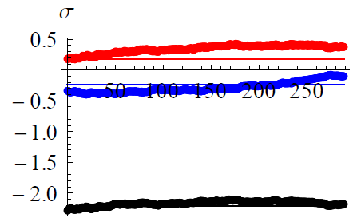
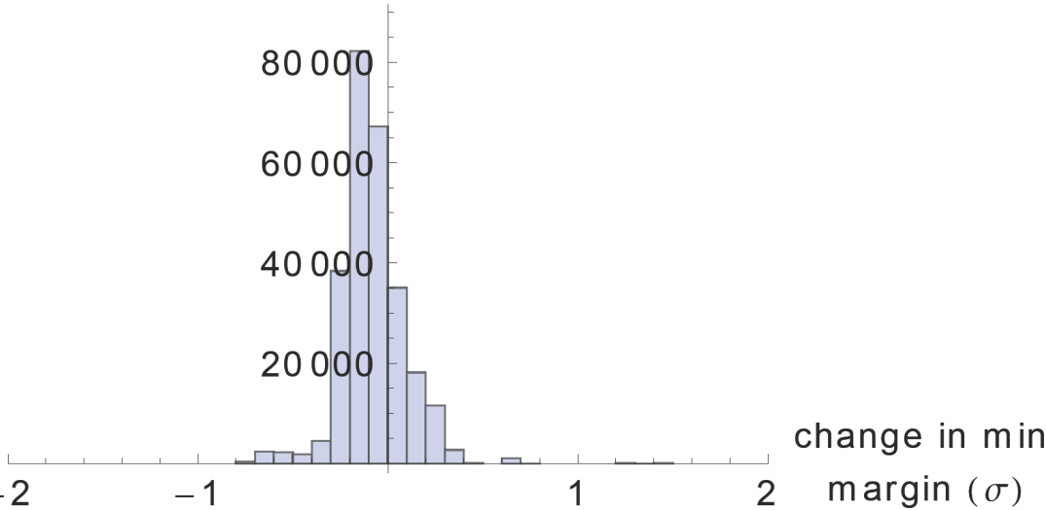
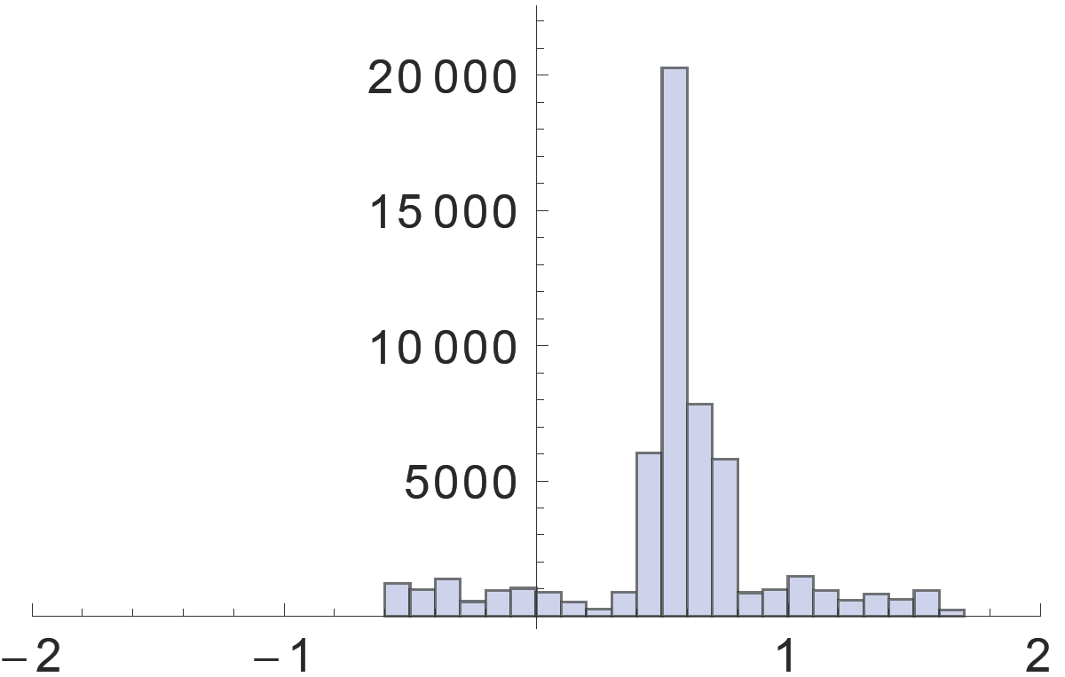
2011 orbit stability triplets/TCTs
Very good stability within fills
In many cases better than 2010 in σ. Consistent with larger beam size from smaller β*
IR1 now stable within 0.6 σ for 99% coverage. For IR5, 1.1 σ still needed in spite of β*=1m
Possibly part of margin due to temperature effects. Still room for improvement?
Upstream
triplet
IR1 H B1, fill 2158
t (min)
Downstream
triplet
Reference from
collimation setup
TCT
Occurrences
Occurrences
IR5 B1 H
IR1 B1 V
BPMS.2L5.B1 excluded –
BPM problems in IR5

Slide 24
What Can Happen?
Error case:
We need an asynchronous dump or one module pre-trigger while we are at low β* (probability 10⁻⁷ per second).
We need to be out of orbit tolerance from IR6 to a TCT in one IR (probability 10⁻²).
We need to be at maximum beta beat error from IR6 to a TCT in one IR (probability
10⁻²).
Both errors must point in the same bad direction (probability 0.25).
➔ Then one TCT is at risk for damage from single bunch (benign damage). Still
very unlikely, due to phase advance conditions that must be met.
The TCT is out of tolerance with respect to triplet aperture (probability 10⁻²).
We are fully squeezed (aperture assumption).
Beams have additional beam-beam offset reserved for van-der Meer scan.
➔ Then the triplet aperture can be hit by fraction of a bunch, if conditions for TCT hit
(see above) are met.

Slide 25
2012 collimator settings in physics
Settings of collimators at 4 TeV, using square sum of margins
except lumi scans (see Evian, Chamonix)
Settings for 2012 very similar to 2011 settings but with real emittance
No change in IR3 or at injection
With the tight settings, we can protect the aperture much closer to the beam => we can allow smaller β*.
Proposed β* =60 cm as 2012 baseline, successfully put into operation
 | 2012 tight settings, Nom. σ (ε=3.5μm) | 2012 settings, Real σ (ε=2.0μm) | 2011 settings, Nom. σ (ε=3.5μm)
TCP 7 | 4.3 | 5.7 | 5.7
TCSG 7 | 6.3 | 8.3 | 8.5
TCLA 7 | 8.3 | 11.0 | 17.7
TCSG 6 | 7.1 | 9.4 | 9.3
TCDQ 6 | 7.6 | 10.1 | 9.8
TCT | 9 | 11.9 | 11.8
aperture | 10.5 | 13.9 | 14.1

