Slide 1
Preliminary field quality and quench margins
B. Auchmann, TE-MSC
on behalf of the CERN-FNAL collaboration

Slide 2
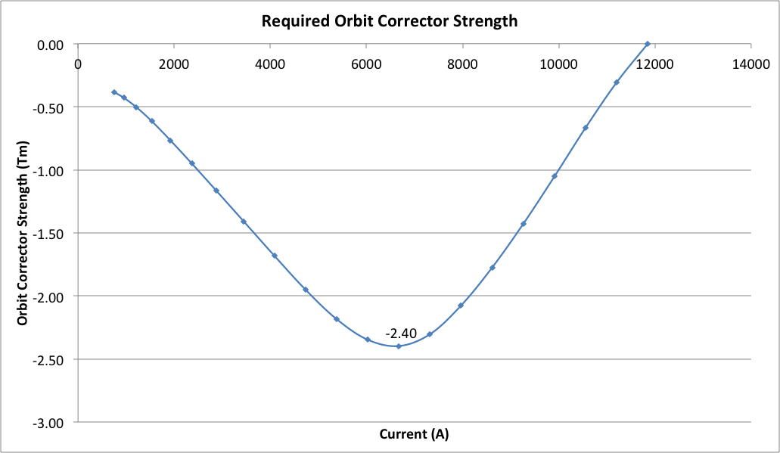
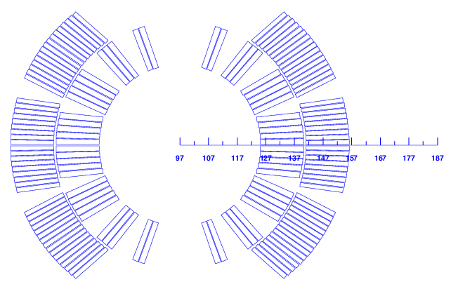
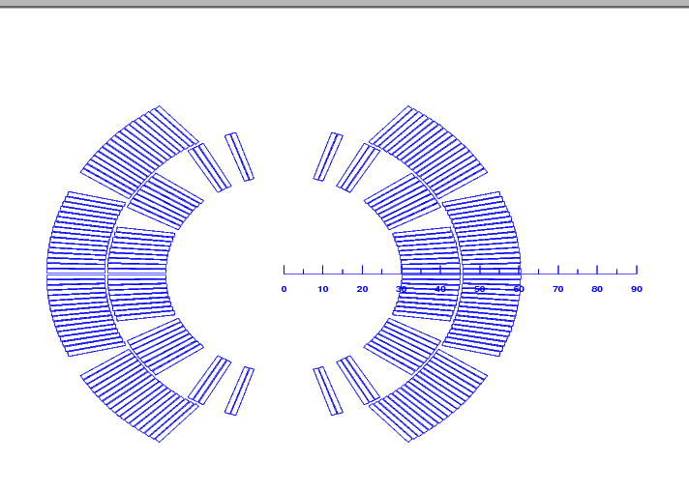
Transfer Function
A discrepancy between MB and 11 T is inevitable:
More turns than MB (56 vs. 40) ➔ 11 T dipole is stronger low field.
More saturation ➔ reduction of transfer function at high field.
Remedy:
No space for correctors (~ 1 m MCBC/MCBY needed).
300 A trim power converter. Preferred: monopolar to avoid voltage peaks that perturb QPS.
MB
11 T
Courtesy of H. Thiessen

Slide 3
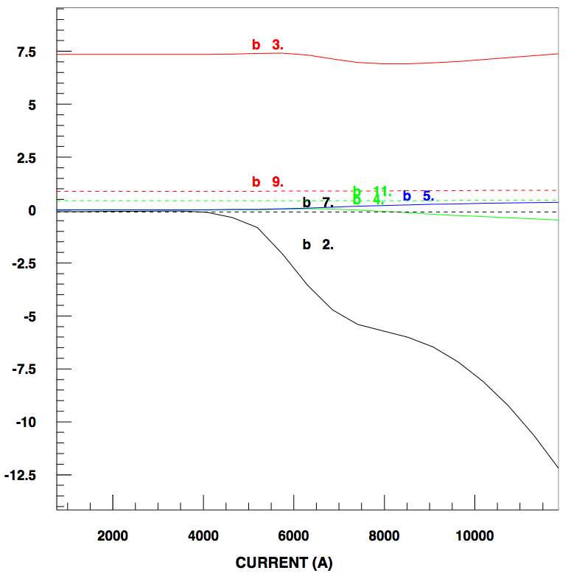
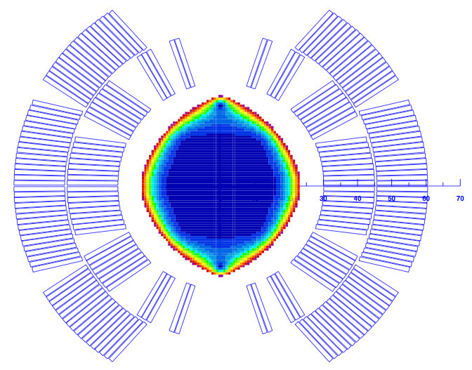
Coil and Yoke
Coil geometric multipoles < 1 unit @ 17 mm.
Yoke design
The cut-outs on top of the aperture reduce the b₃ variation by 4.7 units as compared to a circular shape.
The holes in the yoke reduce the b₃ variation by 2.4 units.
The two holes in the yoke insert reduce the b₂ variation from 16 to 12 units.
Remedy for b₂: thinner collars are being studied.

Slide 4
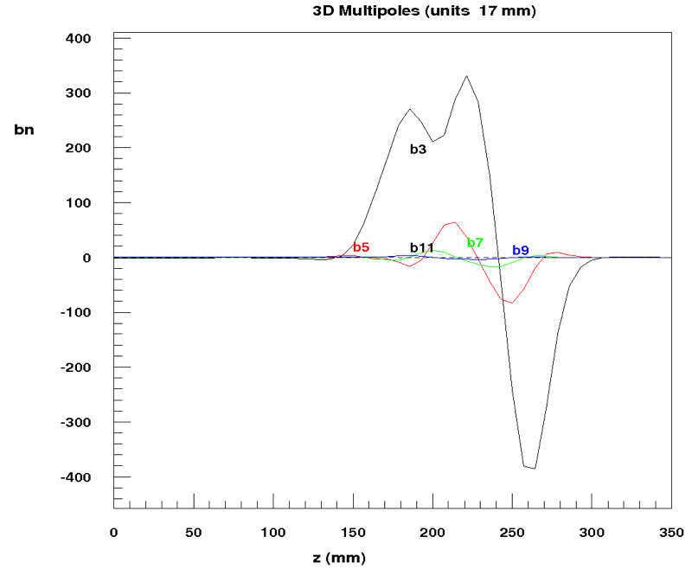
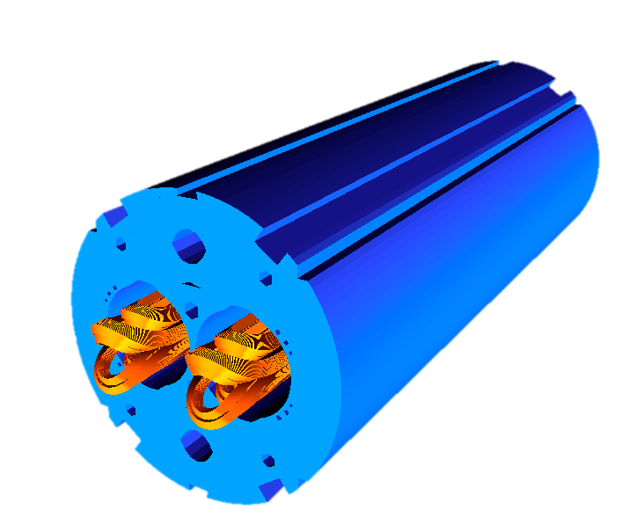
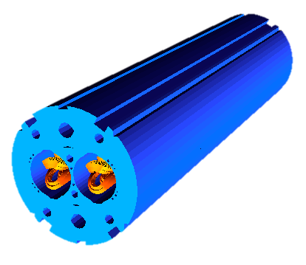
3-D Field Quality
3-D integrated harmonics vs. 2-D harmonics @ I_{nom}
Optimized 3-D coil design.
Extending the yoke over the ends reduces b₂!
Need to control winding accuracy.
 | 2-D | 3-D | 3-D
_{cutback} | n/a | yes | no
B₁ | 11.212 | 11.225 | 11.233
b₂ | -14.6 | -15.6 | -9.4
b₃ | 7.4 | 9.0 | 9.0
b₅ | 0.4 | 1.1 | 1.1
b₇ | -0.1 | 0.2 | 0.1
b₉ | 0.9 | 0.9 | 0.9
a₁ | 0.0 | 2.4 | 2.3

Slide 5
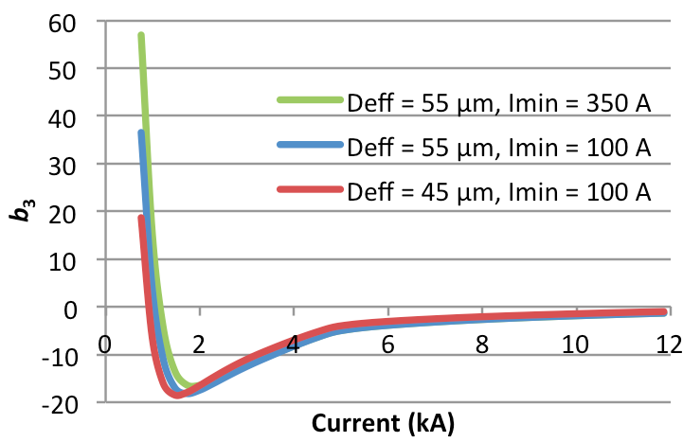
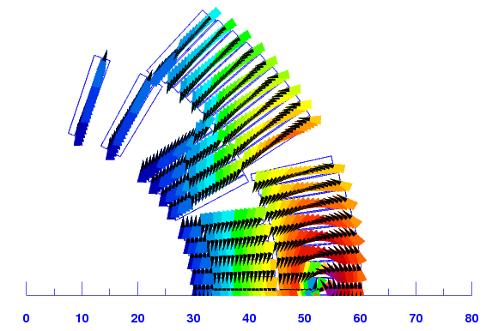
Persistent Currents
After the ramp from the pre-cycle reset current I_{min} = 100 A to injection current 757 A, the change of ramp-direction has not flipped the magnetization in the entire coil.
In this regime, the impact of persistent currents on field quality is highly non-linear w.r.t. filament size and depends strongly on the pre-cycle reset current.
Figure 3: Transfer function with (red) and without (blue) persistent current effect.
Figure 4: Persistent-current-induced coil magnetization at injection level, I = 757 A.

Slide 6
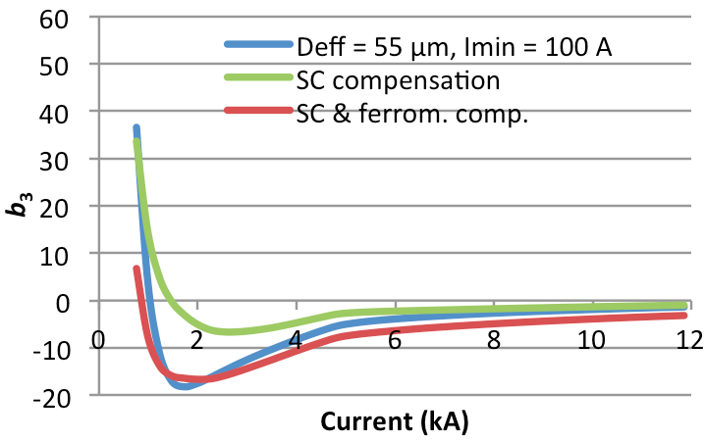
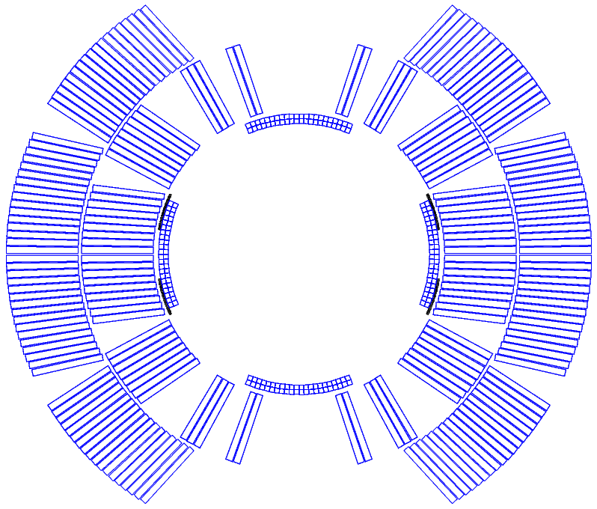
Sextupole Compensation
Passive compensation schemes by means of SC strands or ferromagnetic shims are being explored.
Compensation by SC strands is efficient once the change of ramp direction has sufficiently penetrated the coil.
Ferromagnetic shims can shift the sextupole at low fields.
The passive compensation reduces the aperture diam. by 4 mm.
Figure 5: Impact of passive compensation measures on the sextupole component.
Figure 6: 4 sectors with two rows of passive strands, and 4 ferromagnetic shims near the mid-plane.

Slide 7
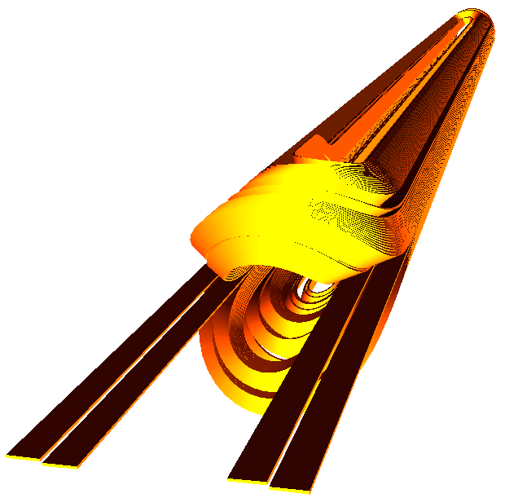
Best-Guess Error table
5.5 m 11 T Dipole Error Table
 | Iinj | Inom | Stdev
B0 | -0.758 | -11.217
B/I | -1.001 | -0.947
Lmag | 5300 | 5300
b2 | -0.80 | -14.41 | 1.93
b3 | 41.33 | 5.20 | 1.24
b4 | 0.09 | -0.45 | 0.60
b5 | 6.90 | 0.51 | 0.31
b6 | 0.01 | -0.02 | 0.18
b7 | -0.10 | 0.10 | 0.11
b8 | 0.00 | 0.00 | 0.06
b9 | 1.31 | 0.94 | 0.03
b10 | 0.00 | 0.00 | 0.01
b11 | 0.33 | 0.43 | 0.01
b12 | 0.00 | 0.00
b13 | 0.00 | 0.00
a1 | 0.87 | 4.02 | 2.87
a2 | -0.02 | -0.26 | 1.66
a3 | -0.11 | -0.08 | 1.00
a4 | 0.00 | -0.01 | 0.64
a5 | 0.09 | 0.09 | 0.38
a6 | 0.00 | 0.00 | 0.20
a7 | 0.03 | 0.03 | 0.09
a8 | 0.00 | 0.00 | 0.05
a9 | 0.00 | 0.00 | 0.03
a10 | 0.00 | 0.00 | 0.02
a11 | 0.00 | 0.00 | 0.01
a12 | 0.00 | 0.00
a13 | 0.00 | 0.00
Including
Persistent currents with Imin = 100 A, Deff = 55 µm.
Skew harmonics due to cryostat.
3-D return and lead ends with 11 cm yoke cutback.
The 3-D electromagnetic model of coil and yoke. Layer-jump, block transitions, and leads are visible in the coil.

Slide 8
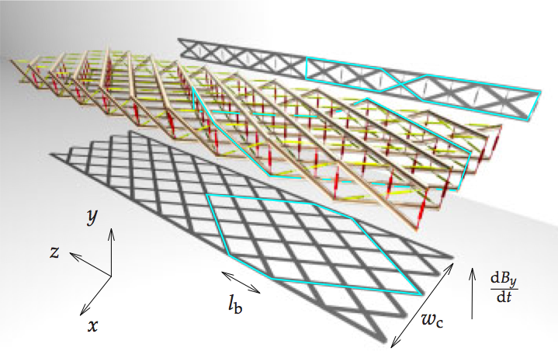
Cable Eddy Currents 1/2
Dominant effects in cable without core:
Inter-filament coupling negligible w.r.t. inter-strand coupling.
Cross-over resistance R_{c} defines dominant mode.
R_{c} varies by orders of magnitude.
HFDA measurements: 4 – 500 μΩ.
MSUT estimates: 1.2 μΩ. Called it “Eddy-Current Machine”!
HQ calculations: 0.4 – 6 μΩ.
Reproducibility is an issue.
Decay and Snap-back
Interplay of boundary-induced coupling currents and strand magnetization.
BICCS are ISCCs on large loops,with long time constants.
[8]
[7]
Notes:
Ask Ezio on Rc & Snapback correlation?

Slide 9
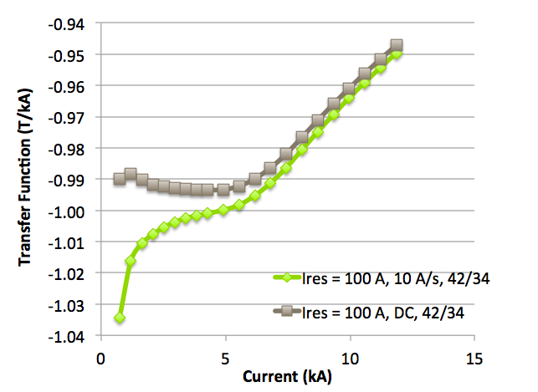
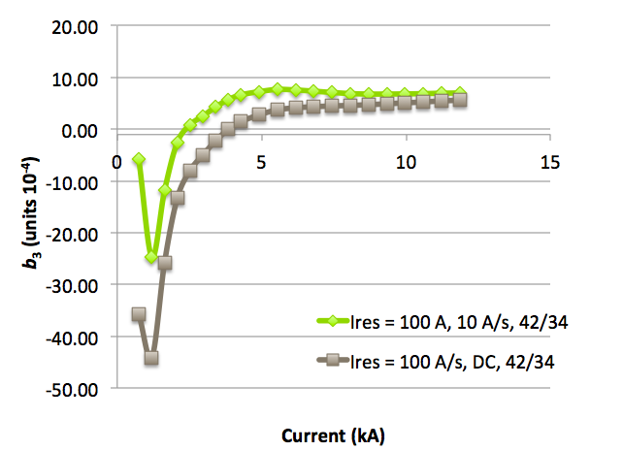
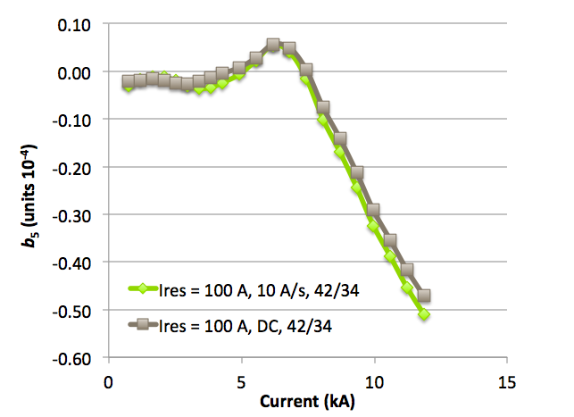
Cable Eddy Currents 2/2: 11 T
ISCCs in 11 T magnet
Based on R_{c} = 0.4 μΩ we give presumably worst-case field quality for the 11-T dipole.
“Field advance” of ~ 4% due to ISCCs clearly visible in transfer function.
Probably need a cored cable to increase R_{c}.
Need to measure snap-back at injection with and without cored cable.
Transfer Function
Sextupole
Decapole
DC
10 A/s

Slide 10
Field Quality Requirements
Beam-dynamics boundary conditions see talk by B. Holzer:
B₁ matches MB.
|b₃| below 20 units, correctable by spool-piece correctors.
|b₂| below 16 units.
|b₅| below 5 units.
…
to be confirmed by B. Holzer for updated error tables.
We can deliver with
trim power converter,
part-compensation in coil geometry,
reduction of filament diameter,
passive persistent-current compensation,
adapted precycle (trim power converter),
and cored cable.

Slide 11
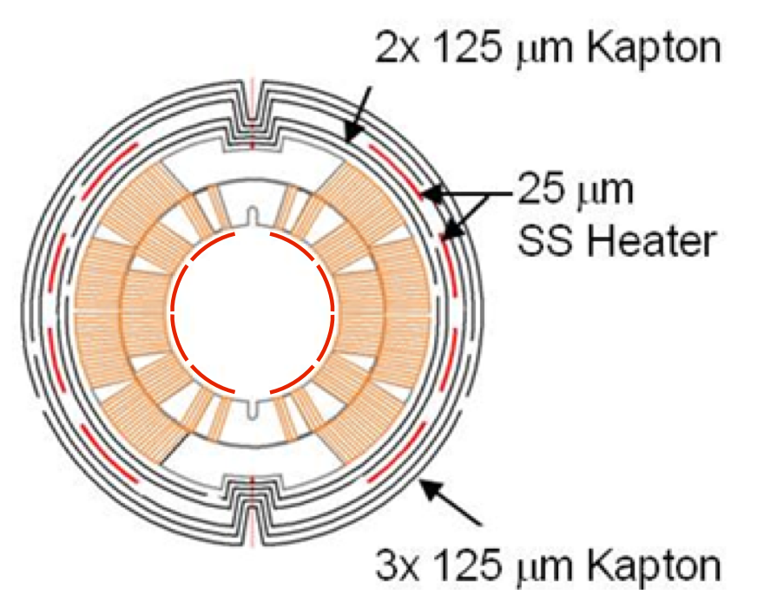
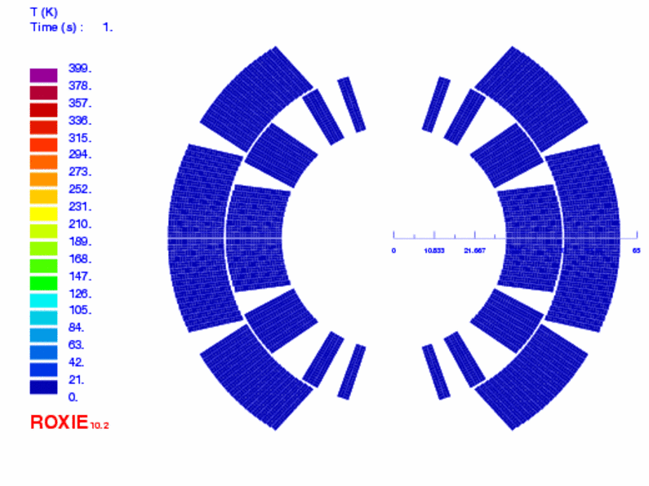
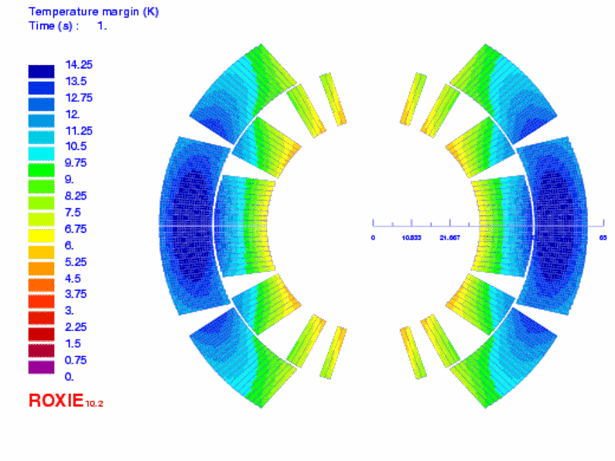
Magnet Protection
Design goals:
Max. 400 K (to be discussed).
Redundant heater systems.
Robust (enough) detection thresholds.
Challenge:
Large temperature margin in outer layer.

Slide 12
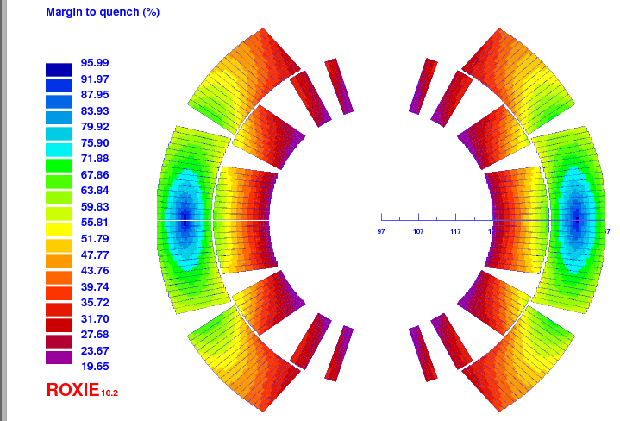
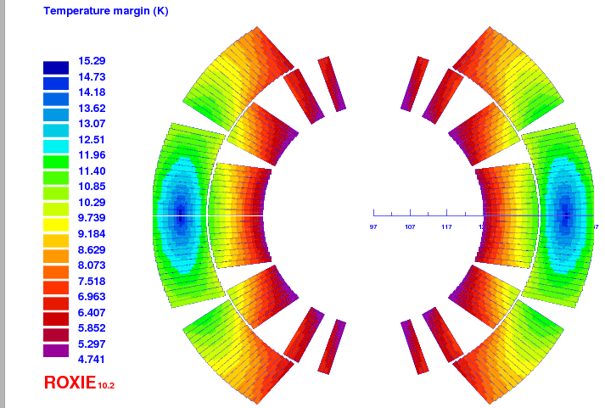
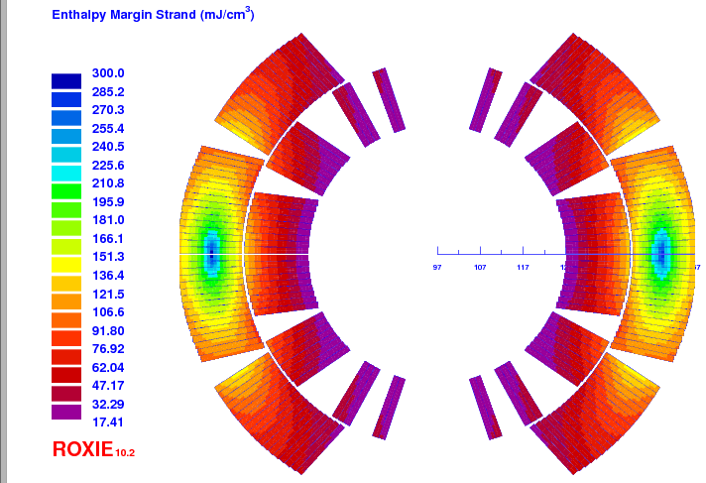
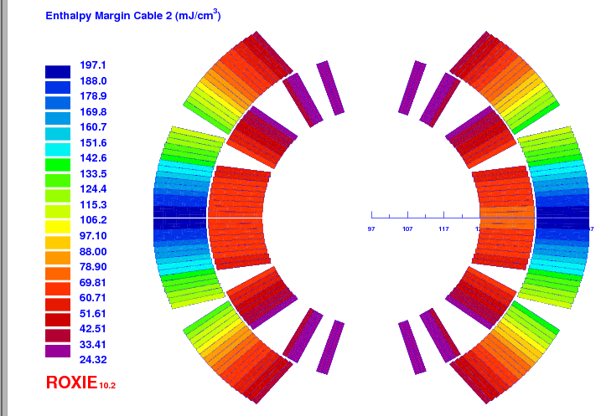
Margins to Quench
Margin on loadline
Temperature margin
Strand enthalpy margin
Cable enthalpy margin with resin

