Slide 1
Simulations of TCT beam impacts for different scenarios
R. Bruce, E. Quaranta, S. Redaelli
Acknowledgement:
L. Lari, C. Bracco, B. Goddard

Slide 2
Outline
Scope of this study:
Motivation
How to calculate damage limits of TCTs?
Dump failure cases:
LHC beam dump system
Irregularities in the beam dump
New simulations:
Simulation setup
Scan over TCT settings and summary of collimator settings
Particle statistics
Simulation results:
Impact parameter studies on TCT for different scenarios
Conclusions

Slide 3
Scope of this study

Slide 4
Motivation
This study falls within the framework of LHC collimator material R&D.
Estimation of ROBUSTNESS and DAMAGE LIMIT of TERTIARY COLLIMATORS
…in the past:
→ robustness calculated for very pessimistic scenarios:
- 1 single bunch impact
- TCT as “isolated” system
- parallel beam impacting TCT jaw
- 90° phase advance from dump kicker
…now:
→ updated robustness calculation, simulating failure in more realistic conditions
→ generate input for energy deposition and mechanical simulations with high statistics for the case of interest
Groove height ~ 1 cm
Ejected W fragments

Slide 5
How to calculate damage limit of TCTs?
Shock waves formation
and propagation
(Autodyn)
So far:
Energy deposition in TCT
(FLUKA)
Present damage estimates:
5e9 protons (Plastic deformation)
2e10 protons (Fragment ejection)
1e11 protons (“5th axis” – catastrophic case)
To more details, see A. Bertarelli-MPP workshop 2013
Now…
today’s talk
Shock waves formation
and propagation
(Autodyn)
Particle tracking
(SixTrack)
Energy deposition in TCT
(FLUKA)
All LHC ring
Many bunches
All collimation system
1 dump kicker pre-firing
Realistic particle tracking
Which the advantages in adding one more step in the simulation chain?
To get VERY REALISTIC PARTICLE DISTRIBUTION AT TCT!
Notes:
In the past: limit based on FLUKA simulations…

Slide 6
Dump failure CASES

Slide 7
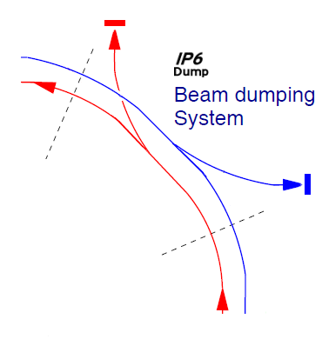
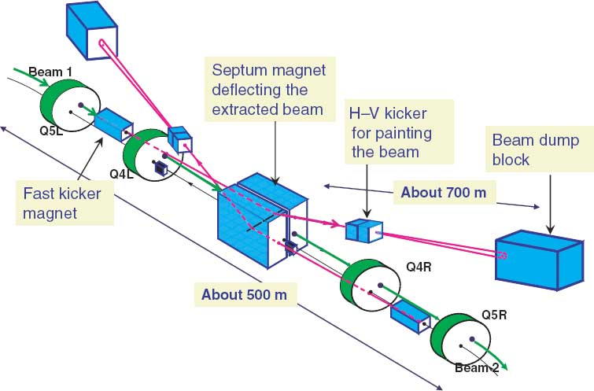
LHC beam dump system
TCDQ “dump protection” and one TCSG
protect the machine against miss-kicked beams in the dumping region IR6.
TCDQ
IR6 dump protection must protect TCTs placed at the experimental points
TCTs must protect triplet aperture
TCSG
Fast abnormal proton losses may be caused by faulty operation of the extraction dump kickers magnets (i.e. MKDs)

Slide 8
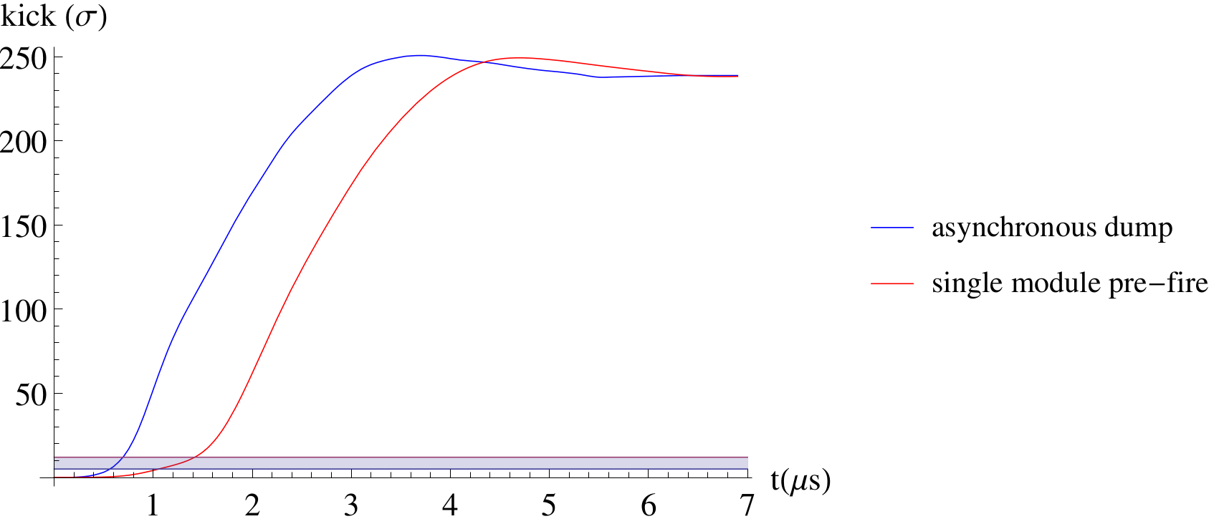
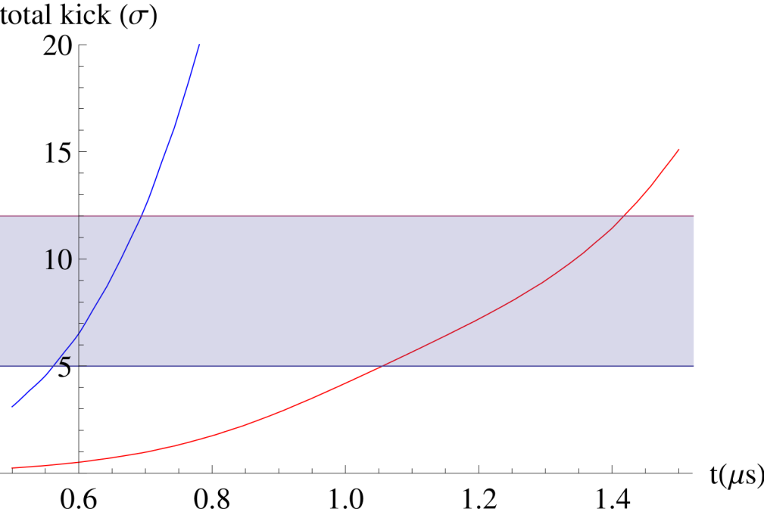
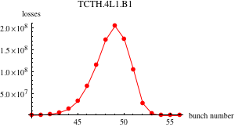
Irregularities of the beam dump
All MKDs mis-firing (Asynchronous beam dump): all the dump kickers are triggered simultaneously but not synchronized with the beam abort gap.
1 MKD spontaneously firing (Single-module pre-fire): the remaining 14 MKDs are re-triggered.
zoom
25ns-spacing bunches
Above certain kick amplitude,
everything caught by TCDQ
→ intermediate kicks to some bunches which are sent directly in TCTs or machine aperture
Below certain kick amplitude, nothing is hit
Notes:
LHC filling scheme has “hole” – abort gap – to allow rise of the 15 dump kickers (MKD) from zero to full field - standard dump.

Slide 9
New simulations

Slide 10
Simulation setup
Single MKD module pre-fire (MKD.A5R6, the most downstream kicker) Time profiles provided by B. Goddard
Energy: 7 TeV
Gaussian beam (ε=3.5 μm)
Separate simulations for each bunch with 25 ns spacing, different kicks.
Perfect machine (only “error” due to IR1/5 TCTs setting: put further in as they should be to simulate beam losses in these collimators after dump failure)
Collimator settings: 2 σ retraction
Optics:
Nominal 7 TeV (β*=55cm): B1 and B2
HL-LHC (β*=15cm): B2
ATS 2015 (β*=55cm): B2

Slide 11
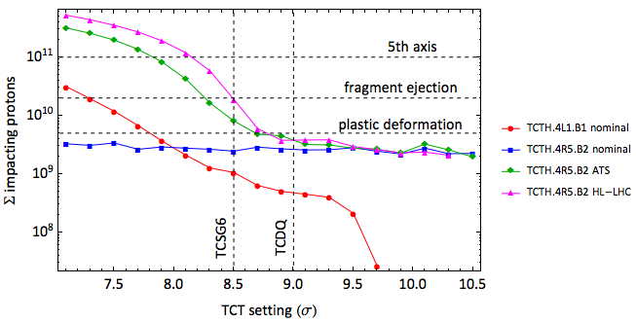
Scan over TCT settings
Scan over TCT settings for different scenarios
Compare with previous damage estimates
3. Select few relevant cases for further studies with higher statistics, trying to have cases with significantly different number of impacts
TCT setting >≈ “dump protection” → impacts dominated by secondary halo particles (TCT is “shadowed” by TCSG6)
TCT setting < “dump protection” → impacts dominated by primary halo particles (TCT is not protected by TCSG6, it sees protons coming directly from primary beam)

Slide 12
Summary of collimator settings
 |  | Simulated scenarios (E=7 TeV)
Collimator half gap |  | Nominal optics |  | HL-LHC optics B2 |  |  | ATS 2015 B2
 |  | nom. B1 | nom. B2 | HL-LHC 1 | HL-LHC 2 | HL-LHC 3
IR7 | TCPs | 5.7 | 5.7 | 5.7 | 5.7 | 5.7 | 5.7
 | TCSGs | 7.7 | 7.7 | 7.7 | 7.7 | 7.7 | 7.7
 | TCLs | 10.5 | 10.5 | 10.5 | 10.5 | 10.5 | 10.5
IR6 | TCSG.4R6 | 8.5 | 8.5 | 8.5 | 8.5 | 8.5 | 8.5
 | TCDQAs | 9.0 | 9.0 | 9.0 | 9.0 | 9.0 | 9.0
IR3 | TCPs | 15.0 | 15.0 | 15.0 | 15.0 | 15.0 | 15.0
 | TCSGs | 18.0 | 18.0 | 18.0 | 18.0 | 18.0 | 18.0
 | TCLs | 20.0 | 20.0 | 20.0 | 20.0 | 20.0 | 20.0
IR1/5 | TCTs | 8.5 | 10.5 | 10.5 | 8.5 | 7.9 | 8.5
IR2/8 | TCTs | 30 | 30 | 30 | 30 | 30 | 30
Expected integrated losses on TCT.4R5 (B2)
Expected integrated losses on TCT.4L1 (B1)
3e9 “real protons” (1.7e11p per bunch)
Safe!
2e9 “real protons” (2.2e11p per bunch)
Safe!
2e10 “real protons” (2.2e11p per bunch) fragment ejection!
2e11 “real protons” (2.2e11p per bunch)
> 5th axis limit!!
8e9 “real protons” (1.7e11p per bunch very optimistic!!)
plastic deformation!
9e8 “real protons” (1.7e11p per bunch)
Safe!
A priori, only secondary halo for this case
Beam 2 is the most critical one!
Notes:
Nom. B2 only secondary halo ← 180 degree (good) phase advance between dump kicker and IR6 protection

Slide 13
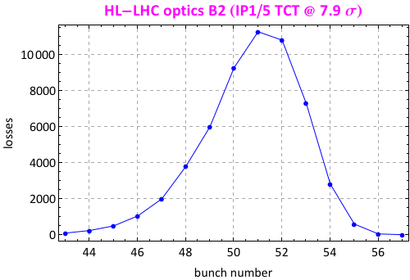
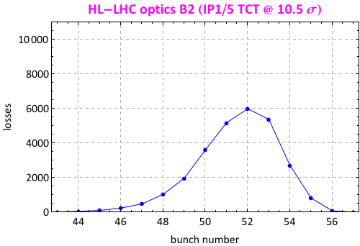
Computing time is…a matter of statistics!
These simulations are very time consuming, but it is necessary to have sufficient losses in TCT (for meaningful FLUKA simulations).
Amount of simulations to run changes depending on the specific scenario.
2 extreme scenarios:
10 simulations
per bunch
500 simulations per bunch!
Note: 6400 SixTrack particles for each simulation
Open question: is the statistics enough for FLUKA simulation?

Slide 14
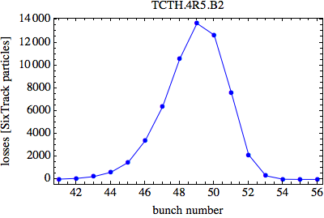
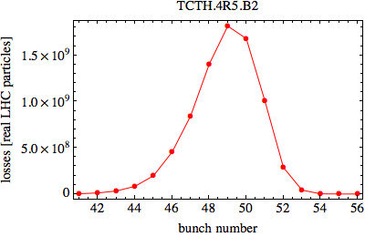
“real” LHC protons vs. SixTrack particles
ATS 2015 optics B2 (bunch population=1.7e11 protons)
SixTrack particle lost in TCT
x bunch population
Total SixTrack particles simulated
Important note: in the following slides, impact parameter refers to the position in x where the particles experience inelastic interaction inside the TCT jaw.
Notes:
Normalization factor to commute Sixtrack particles in real protons

Slide 15
Simulation results

Slide 16
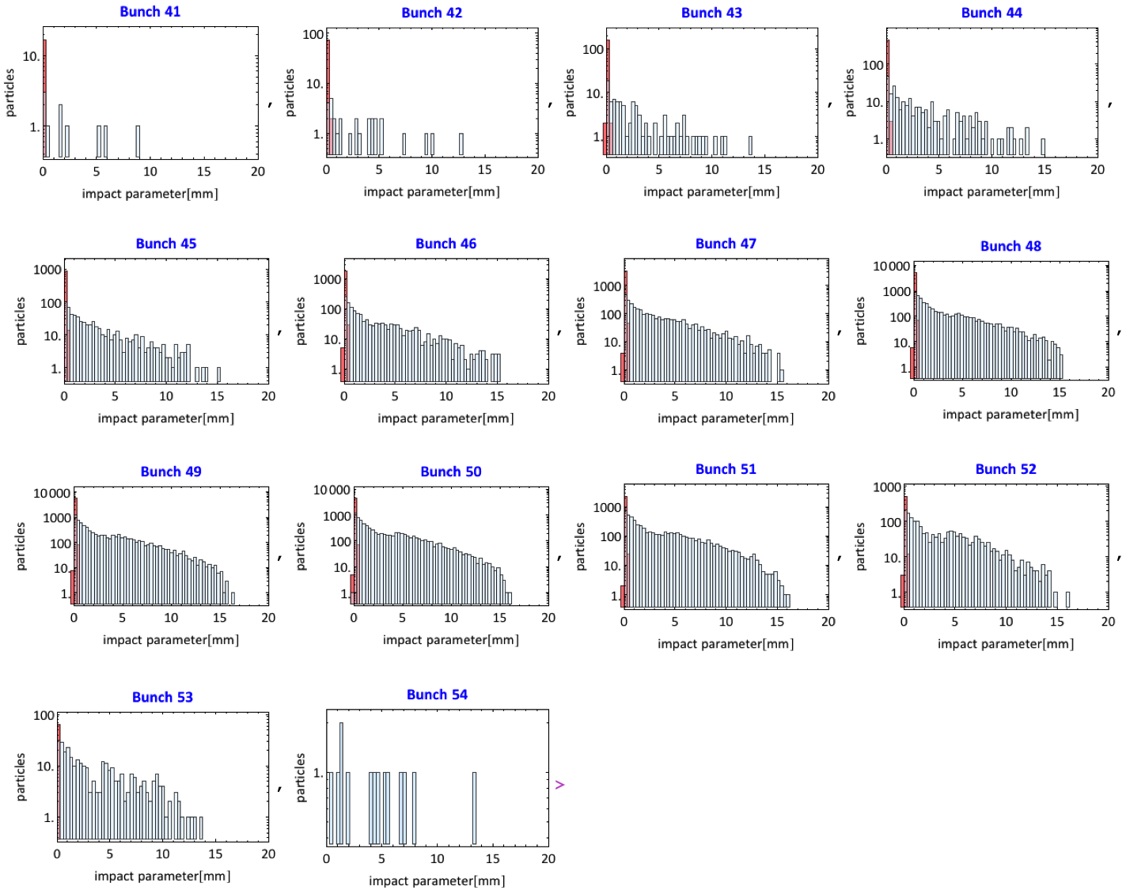
Impact parameter distribution ATS 2015 optics B2 (IR1/5 TCT @ 8.5 σ)
Primary halo particles not hit any collimator before reaching the TCT, while secondary halo ones are scattered out from dump protection (mainly TCSG).
Primary halo
Secondary halo

Slide 17
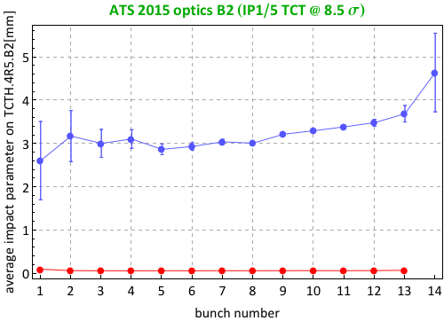
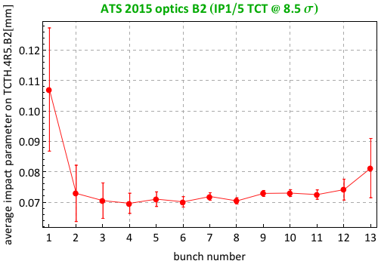
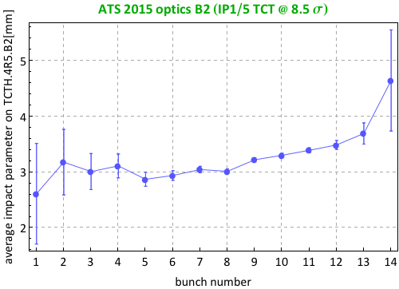
Impact parameter vs. #bunch ATS 2015 optics B2 (IR1/5 TCT @ 8.5 σ)
Primary halo particles
Secondary halo particles
zoom
Primary halo particles
Secondary halo particles

Slide 18
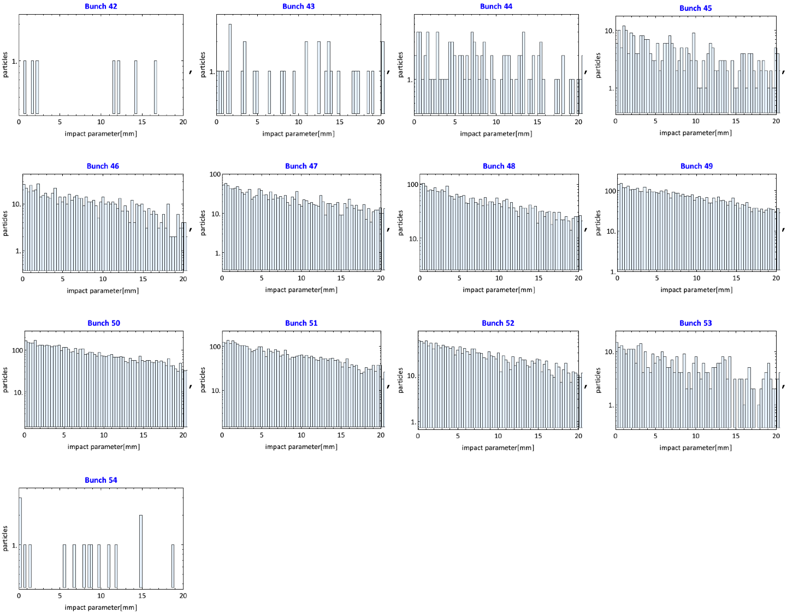
Impact parameter distribution Nominal 7 TeV optics B2 (IR1/5 TCT @ 10.5 σ)
In this case only secondary halo particles are intercepted by TCTH.4R5.B2 due to good phase advance (180°) from the MKD.
Primary halo particles
Secondary halo particles

Slide 19
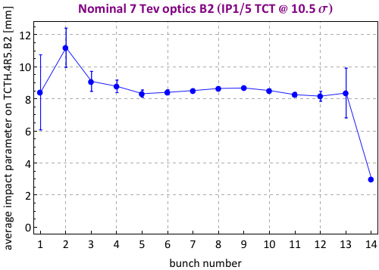
Impact parameter vs. #bunch Nominal 7 TeV optics B2 (IR1/5 TCT @ 10.5 σ)
Primary halo particles
Secondary halo particles

Slide 20
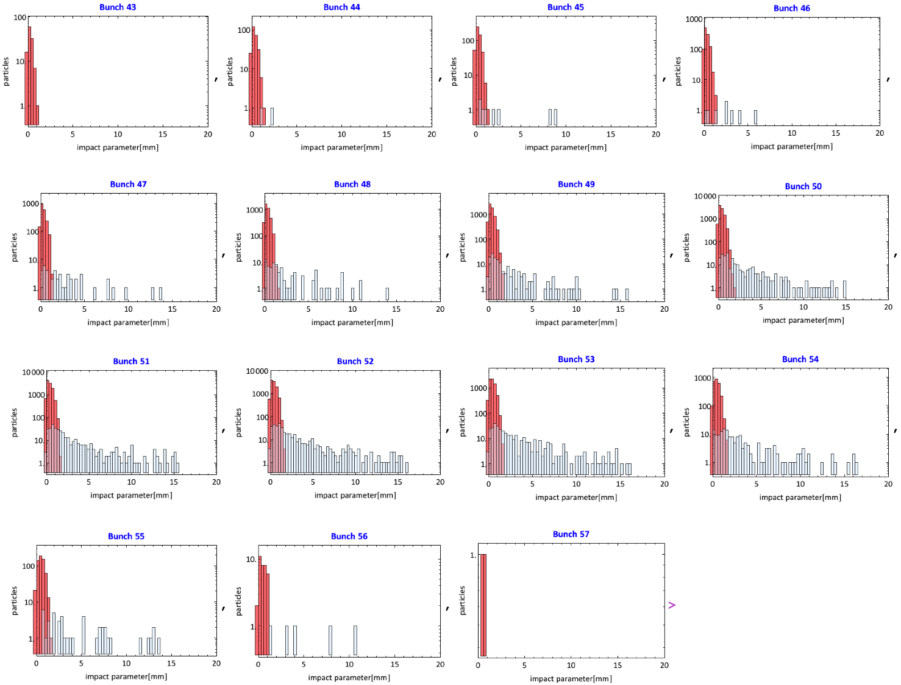
Impact parameter distribution HL-LHC optics B2 (IR1/5 TCT @ 7.9 σ)
Primary halo particles
Secondary halo particles

Slide 21
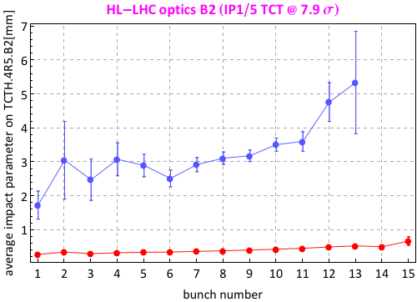
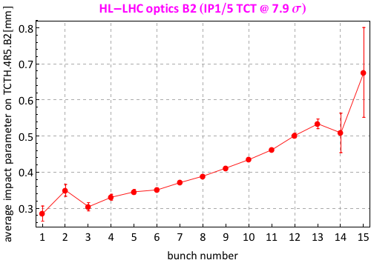
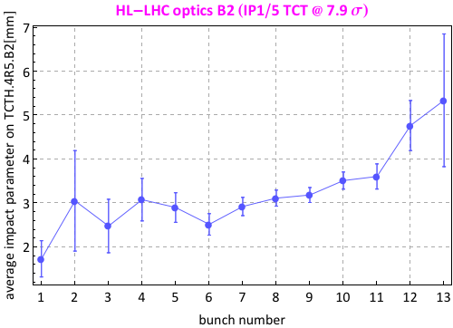
Impact parameter vs. #bunch HL-LHC optics B2 (IR1/5 TCT @ 7.9 σ)
Primary halo particles
Secondary halo particles
zoom
Primary halo particles
Secondary halo particles

Slide 22
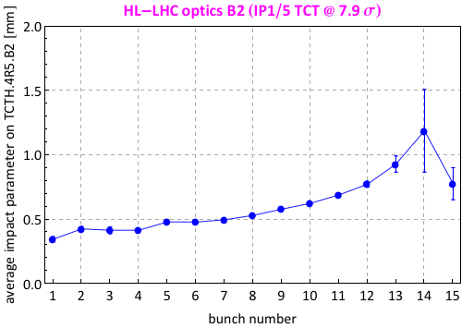
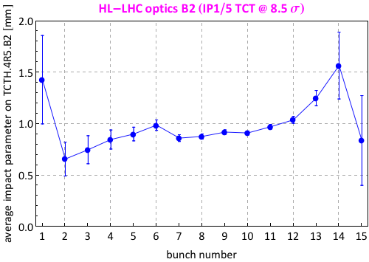
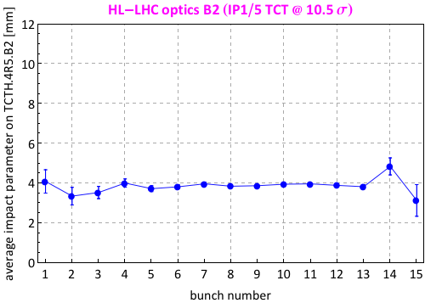
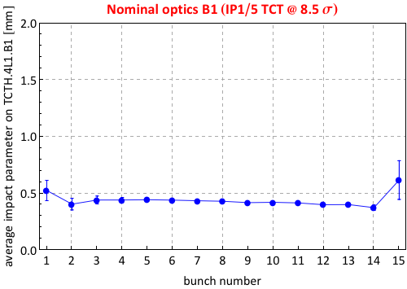
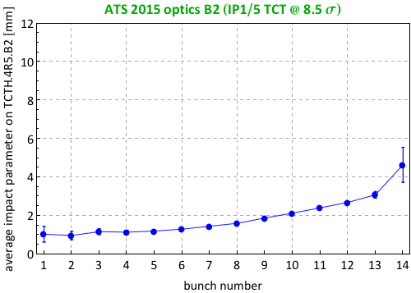
Summary of impact parameters
Average impact parameter from primary and secondary halo in the all the cases simulated.
Please pay attention to the different scale!!

Slide 23
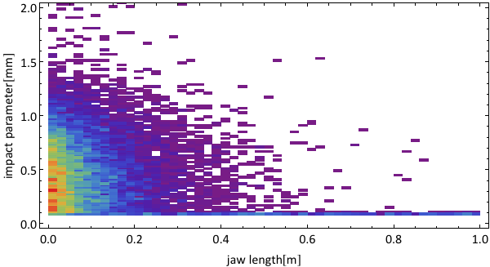
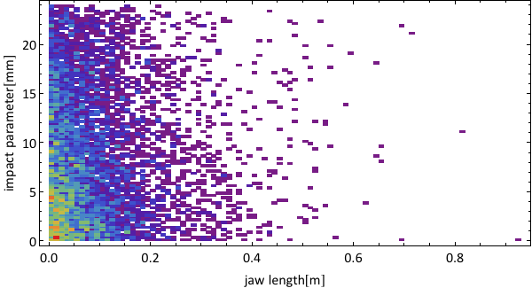
Distribution of particles absorbed in TCTH.4R5.B2
ATS 2015 optics B2
(TCT=8.5 σ)
Nominal 7 TeV optics B2
(TCT=10.5 σ)
Note: different scale!

Slide 24
Conclusions

Slide 25
Summary and Outlook
6 scenarios studied to have selection of cases with:
- different amount of total particles hitting the TCT
- different impact distribution
- different amount of primary and secondary halo particles
Coordinates of inelastic interaction available bunch by bunch for all the cases shown for further FLUKA simulations
Open discussion:
which of the cases will be simulated with
FLUKA + AUTODYN??

Slide 26
Comments after the meeting
Slide 14: for further simulations, make sure to be consistent with “real” values (1.7e11 p/b maybe will not be realistic in immediate post LS1)
Slide 23: now TCT parallel to the beam, for the future add tilt angle and see if impact distribution changes
Slide 24: check first plot (it must be primary halo, maybe something wrong in the script to generate the plots. CHECK!) → fixed!
FLUKA simulation will be time-consuming, they have to run simulation for each bunch for the cases which will be selected between the ones presented
Cases to simulate:
Nominal post LS1
One case where we are dominated by primary halo (maybe nom.B1 or HL-LHC 8.5 or 7.9-very pessimistic)
One case where we are dominated by secondary halo (nom.B2)
- Discuss with MME people

