Slide 1


Report from WP 11:
Collimator Materials for Fast High Density Energy Deposition (ColMat-HDED)
Alessandro Bertarelli (CERN)
33rd ColUSM Meeting
CERN, 24 January, 2014

Slide 2
Outline
    Context
    Partners (WP11 and beyond)
    WP11 Tasks and Deliverables
    WP11 Status and upcoming activities
    Summary and Perspectives

Slide 3
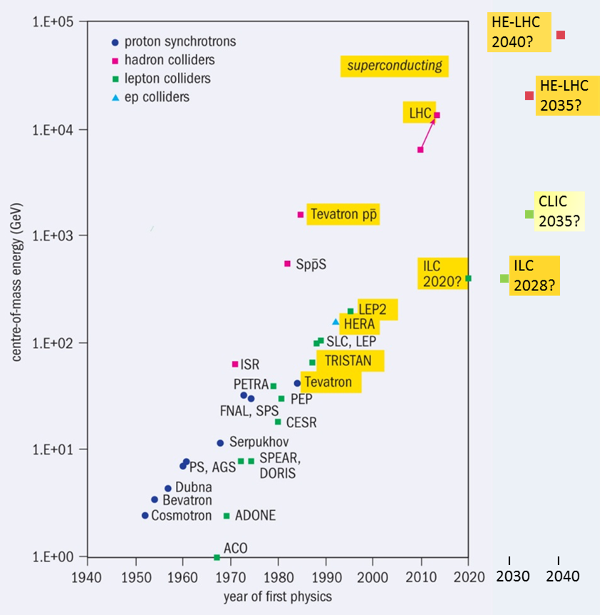
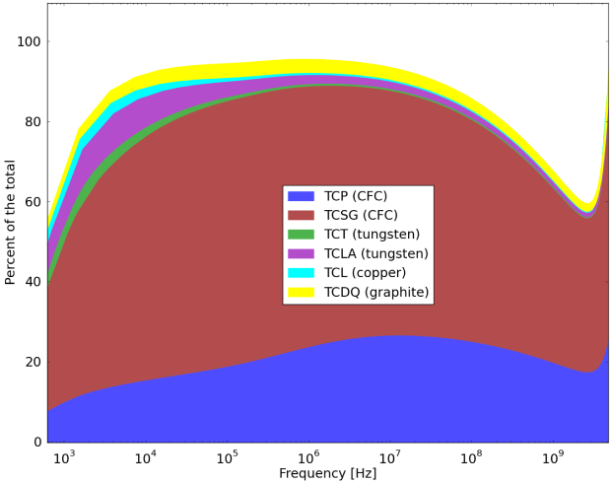
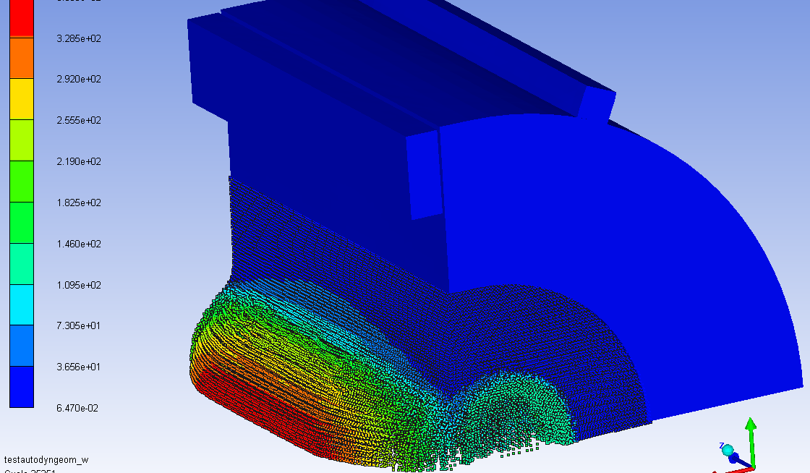
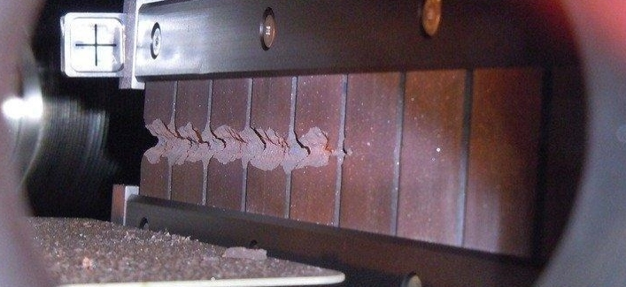
Context
LHC is reaching unprecedented beam brightness and energy leading to extreme energy density (15 GJ/mm²).
At such energy densities Beam-induced accidents are among the most dangerous events for particle accelerators.
Collimators are inherently exposed to such extreme events (β* reach is determined by collimator constraints)
Collimators are, by far, the highest contributors to machine impedance, potentially leading to serious instabilities.
Development of advanced materials,
along with state-of-the-art simulations,
are instrumental in facing these challenges!
Collimators impedance/
LHC Impedance

Slide 4

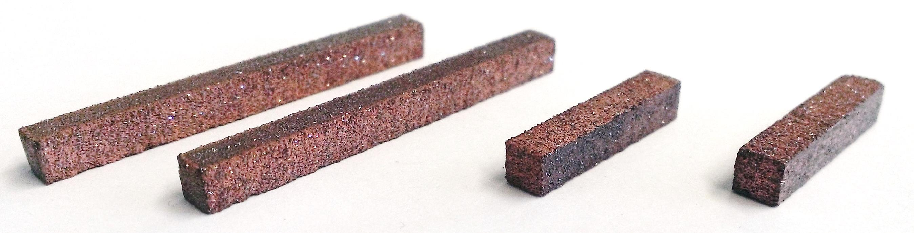
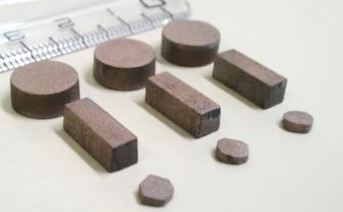
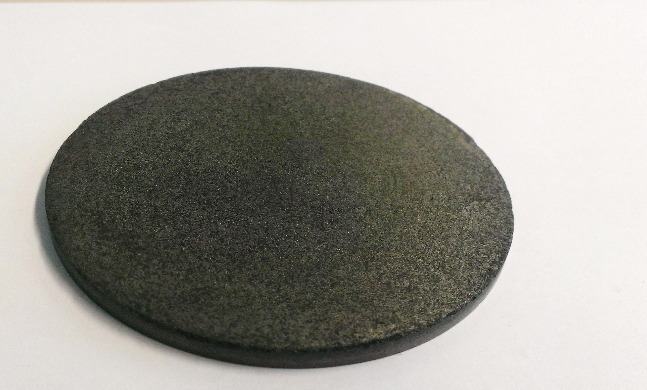

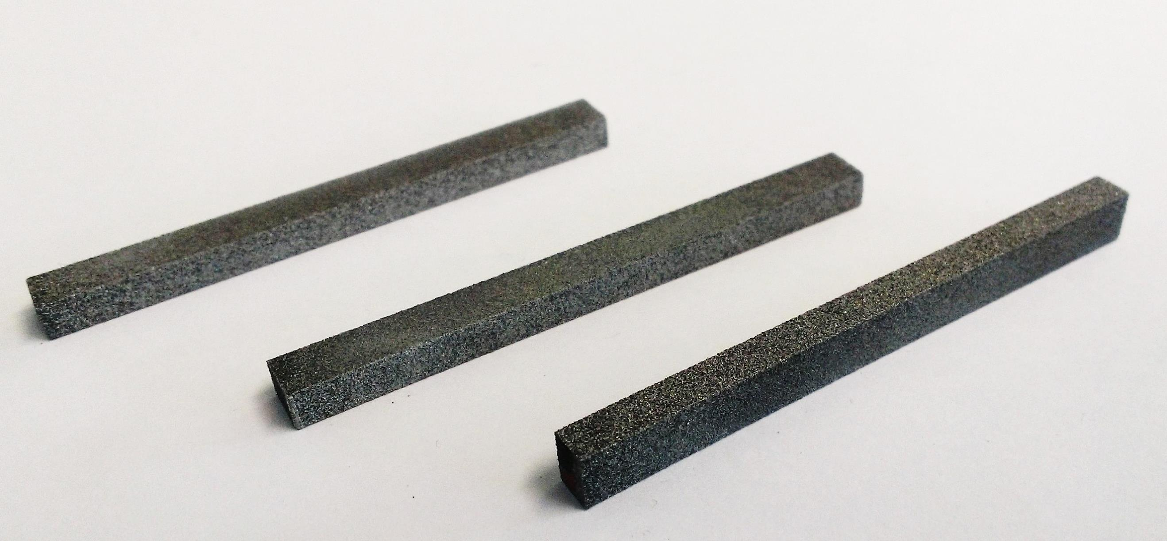

Metal Matrix Composites
Materials investigated are Copper-Diamond (Cu-CD), Molybdenum-Diamond (Mo-CD), Silver-Diamond (Ag-CD), Molybdenum-Graphite (Mo-Gr)
Most promising materials are Cu-CD and Mo-Gr.
Ag-CD and Mo-CD are, by now, sidelined as they are limited by (relatively) low melting temperature (Ag-CD) and insufficient toughness (Mo-CD).
Mo-Gr is particularly appealing as it is easy to machine, is versatile and can be coated with a Mo layer dramatically increasing electrical conductivity …
Cu-CD
Mo-CD
Mo-Gr
Ag-CD

Slide 5
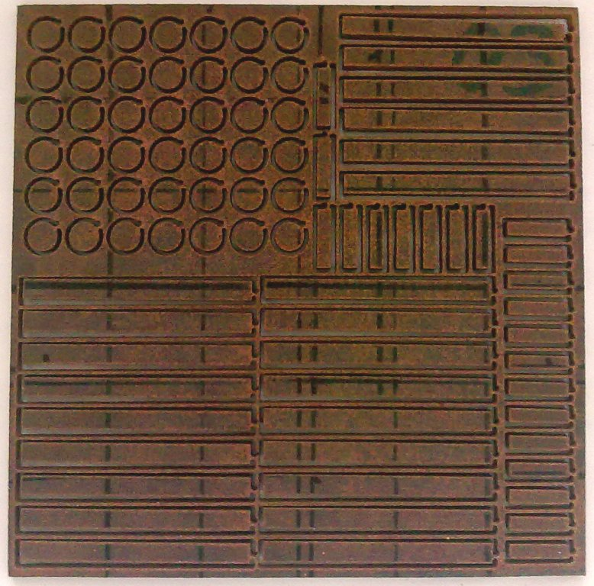
Copper-Diamond Composite
Developed by RHP-Technology (Austria)
No diamond degradation (in reducing atmosphere graphitisation starts at ~ 1300 °C)
Very good thermal (~490 Wm⁻¹K⁻¹) and electrical conductivity (~12.6 MSm⁻¹).
No direct interface between Cu and CD (lack of affinity). Partial bonding bridging assured by Boron Carbides limits mechanical strength (~120 MPa).
Cu low melting point (1083 °C) may limit Cu-CD applications for highly energetic accidents.
CTE increases significantly with T due to high Cu content (from ~6 ppmK⁻¹ at RT up to ~12 ppmK⁻¹ at 900 °C)
150 x 150 x 4mm³
BC “bridge” stuck on CD surface.
No CD graphitization

Slide 6
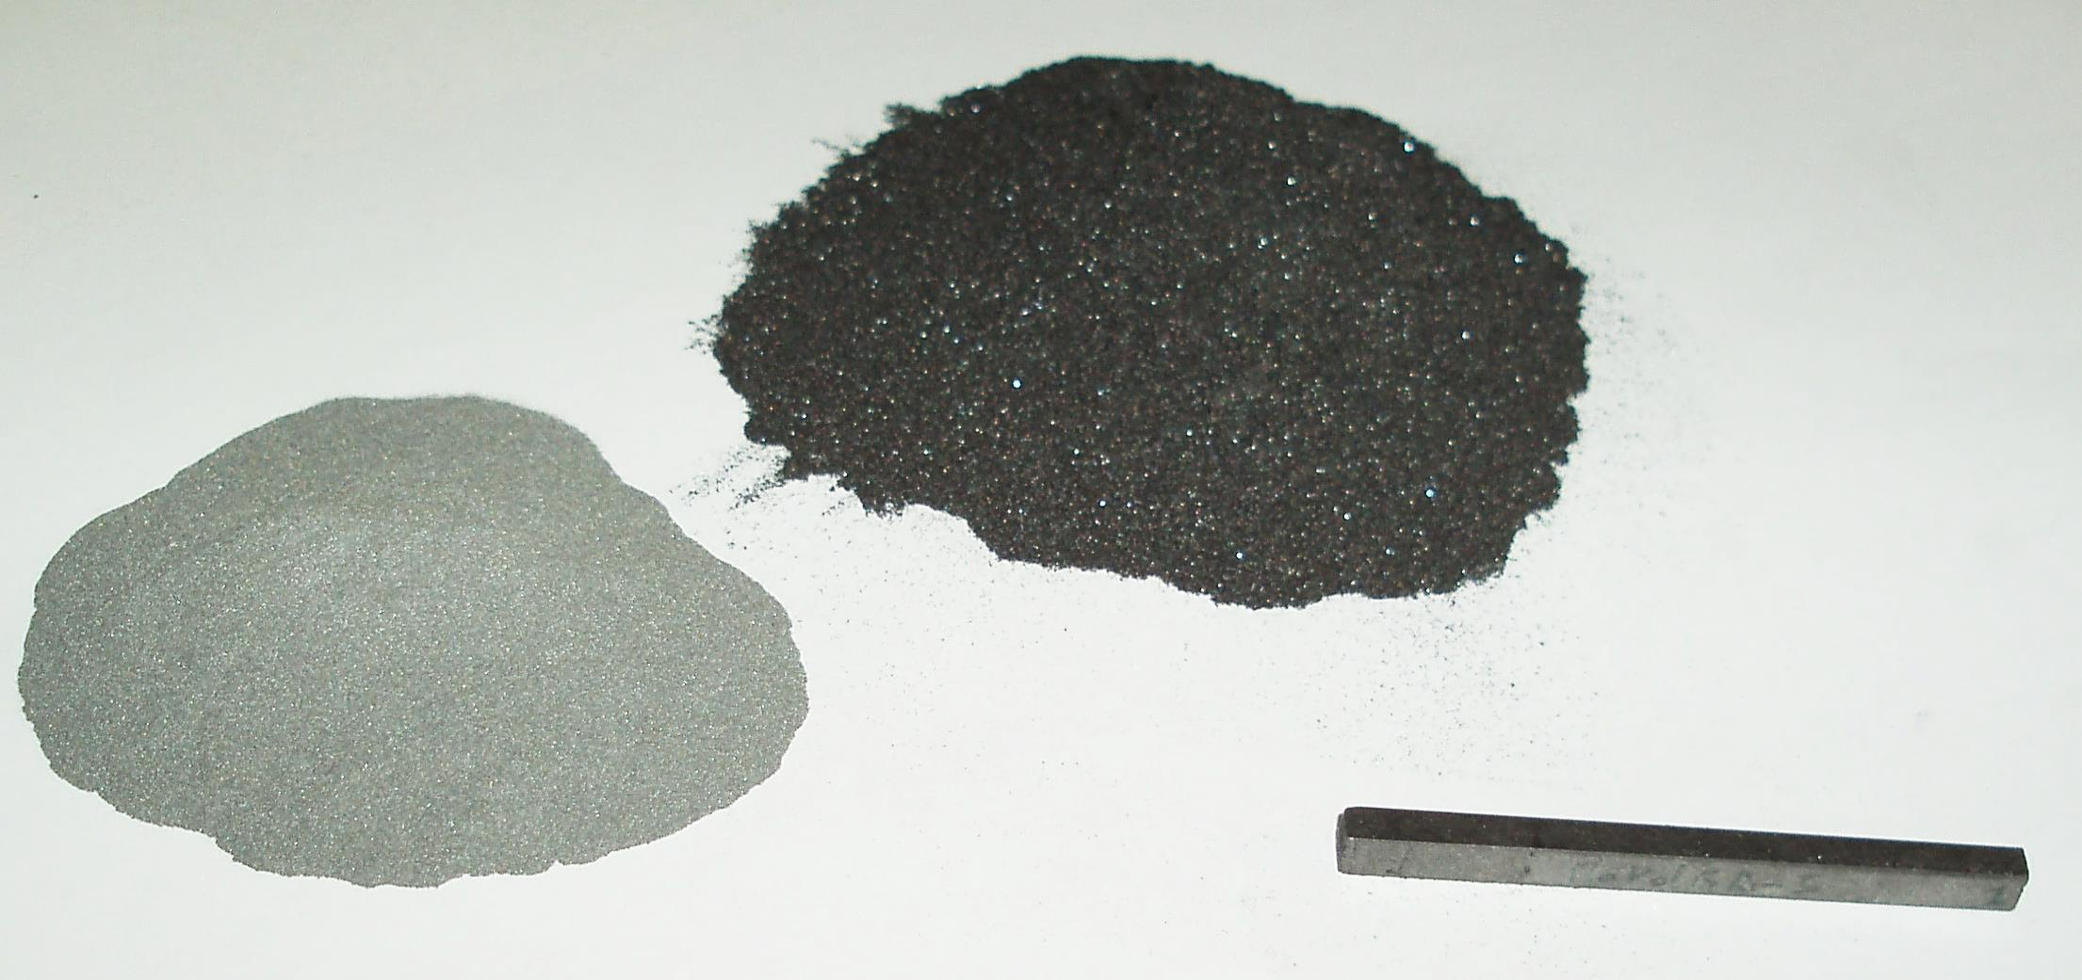
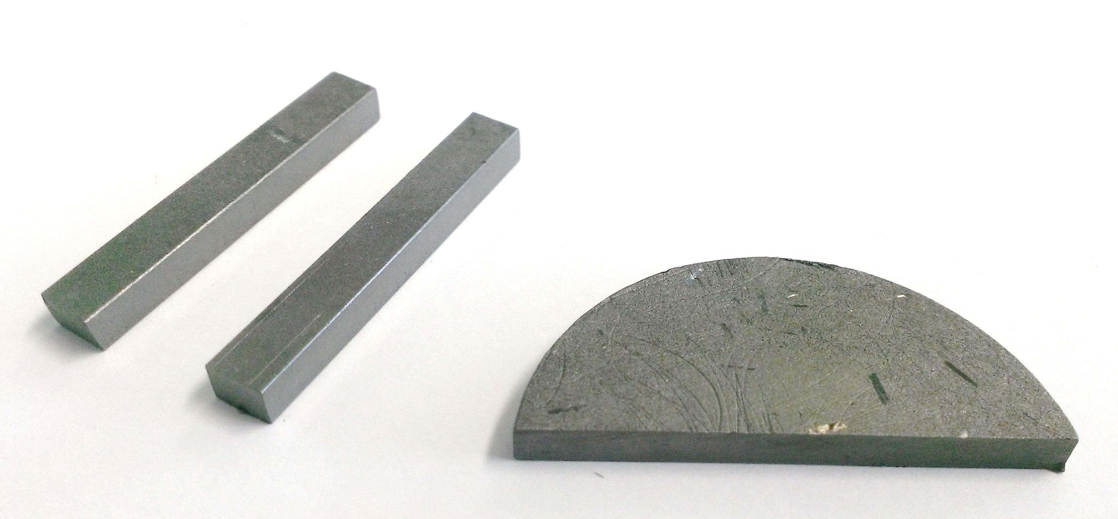
Molybdenum-Graphite Composites
Co-developed by CERN and Brevetti Bizz.
Why Molybdenum?
Refractory metal
High mechanical strength
Density lower than Tungsten
Why Graphite?
Low CTE
Low Density
High Thermal Conductivity (natural graphite flakes)
Very High Service Temperatures (also allowing elevated processing temperatures)
High Shockwave Damping
Composite Features
Very high melting point (2500+°C)
Low Density (can be tailored)
Very high thermal conductivity
Highly stable (forms MoC_{1-x} carbides)
Fair electrical conductivity
Mechanical strength to be improved …

Slide 7
Molybdenum-Graphite Composites
Addition of mesophase pitch-base carbon fibers
Liquid Phase Spark Plasma Sintering (>2500° C)
Advantages of Carbon Fibers addition
Increase mechanical strength
Contribute to high thermal conductivity (mesophase pitch grade)
Along with MoC_{1-x} , catalyze graphitization process

Slide 8
Mo-Gr-CF Microstructures
Homogeneous distribution of graphite, fibers and fine MoC_{1-x} grains
Recrystallization of graphite and CF
Highly Oriented Graphene planes
Strong fiber-matrix bonding
➔ Improved Mechanical Strength
Thermal Conductivity 700+ Wm⁻¹K⁻¹
… almost twice pure Cu !!!
(97% of theoretical value)
Mechanical Strength > 75 MPa.

Slide 9
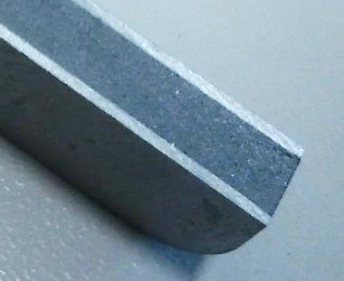
Mo-coated Mo-Gr
Co-developed by CERN and Brevetti Bizz.
Molybdenum – Graphite core with pure Mo cladding.
Sandwich structure drastically increases electrical conductivity.
Excellent adhesion of Mo cladding thanks to carbide interface.
… no surprise a full Collimator prototype is requested in LHC by 2016!
N. Mounet et al., Impedance @ 2013 Collimation Review, May 2013
Core:
1 MS/m
Carbide layer: 1.5 MS/m
Mo Coating:
18 MS/m
Collimator impedance reduced by a factor 10 through Mo-coated Mo-Gr.

Slide 10
Outline
    Context
    Partners (WP11 and beyond)
    WP11 Tasks and Deliverables
    WP11 Status and upcoming activities
    Summary and Perspectives

Slide 11













The Partners (WP11 and beyond)
    WP 11 Partners (ColMat-HDED)
    Partnership agreement with CERN (KN2045)
    Collaboration with US-LARP

Slide 12
Outline
    Context
    Partners (WP11 and beyond)
    WP11 Tasks and Deliverables
    WP11 Status and upcoming activities
    Summary and Perspectives

Slide 13
WP11 Tasks and Deliverables
Work Package subdivided in 4 Tasks
  Coordination and Communication
  (A. Rossi and J. Stadlmann)
  Material testing for fast energy density deposition and high irradiation doses
  (A. Bertarelli)
  Material mechanical modelling
  (A. Bertarelli)
  Material Specification (A. Rossi)

Slide 14
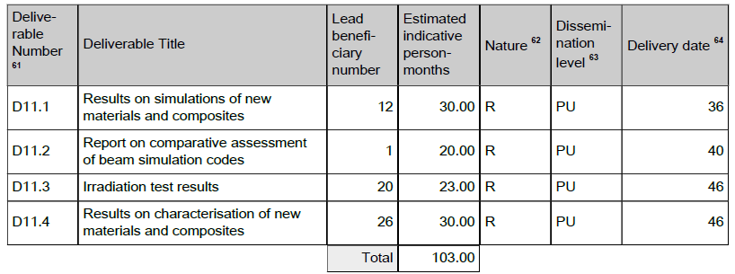
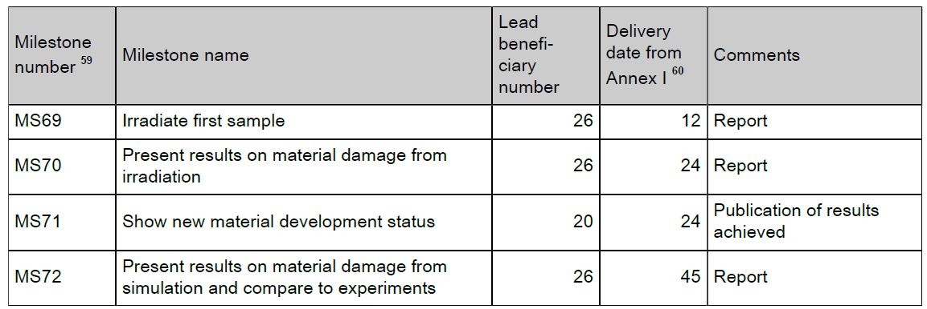
WP11 Tasks and Deliverables
Deliverables and Milestons

Slide 15
Outline
    Context
    Partners (WP11 and beyond)
    WP11 Tasks and Deliverables
    WP11 Status and upcoming activities
    Summary and Perspectives

Slide 16

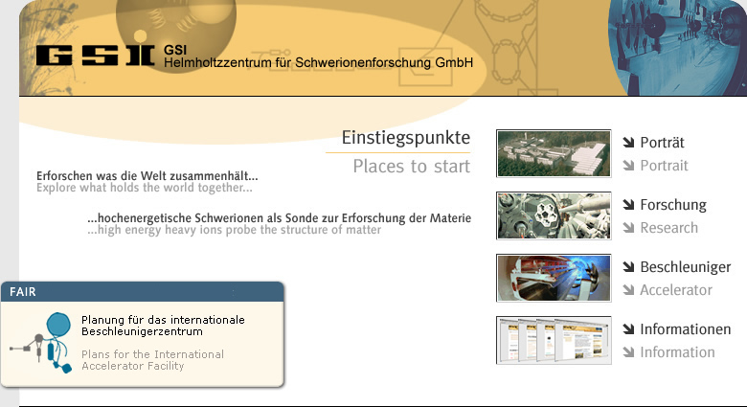


WP Time Framework
“Global” Collimation objectives (relevant to WP11) and (very aggressive) timing
  Choose a novel, robust (low-Z) material for HL-LHC Primary and Secondary Collimators (TCSx) – Mid 2014
  Design, build and install a test bench for one or more HL-LHC Collimator full jaws in HiRadMat² – Early 2015
  Investigate alternative, more robust materials for Tertiary Collimators and Absorbers – Mid 2014
  Design, build and install a test bench to assess and qualify a palette of materials samples in HiRadMat² – Mid/Late 2015
  Design, build and install in the LHC a prototype of HL-LHC Secondary Collimator embarking novel advanced materials – 2016
Notes:
Make a distinction of what does who, why it is complementary to have different sources.

Slide 17
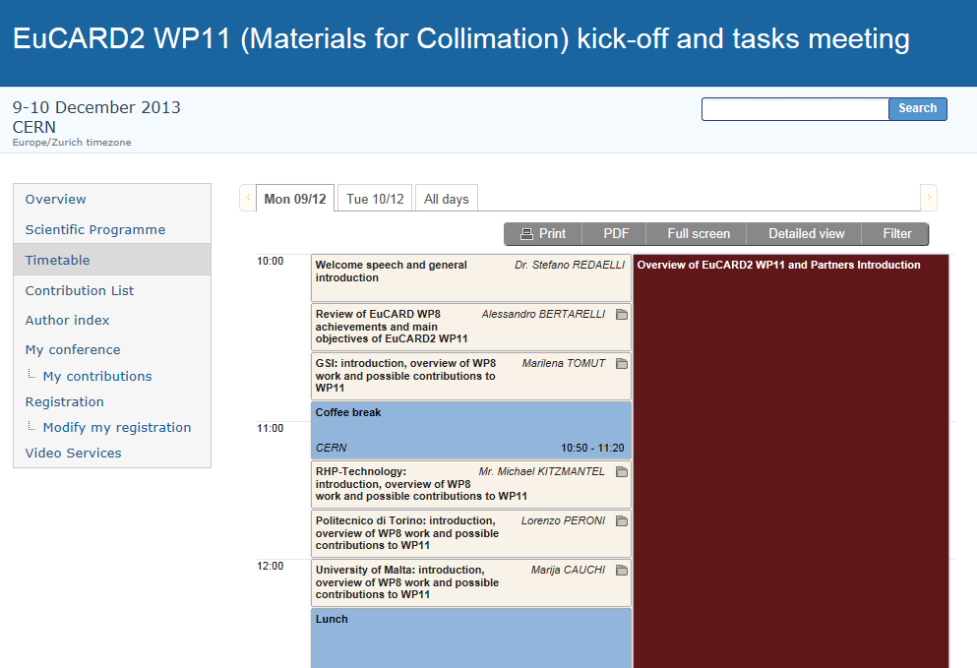
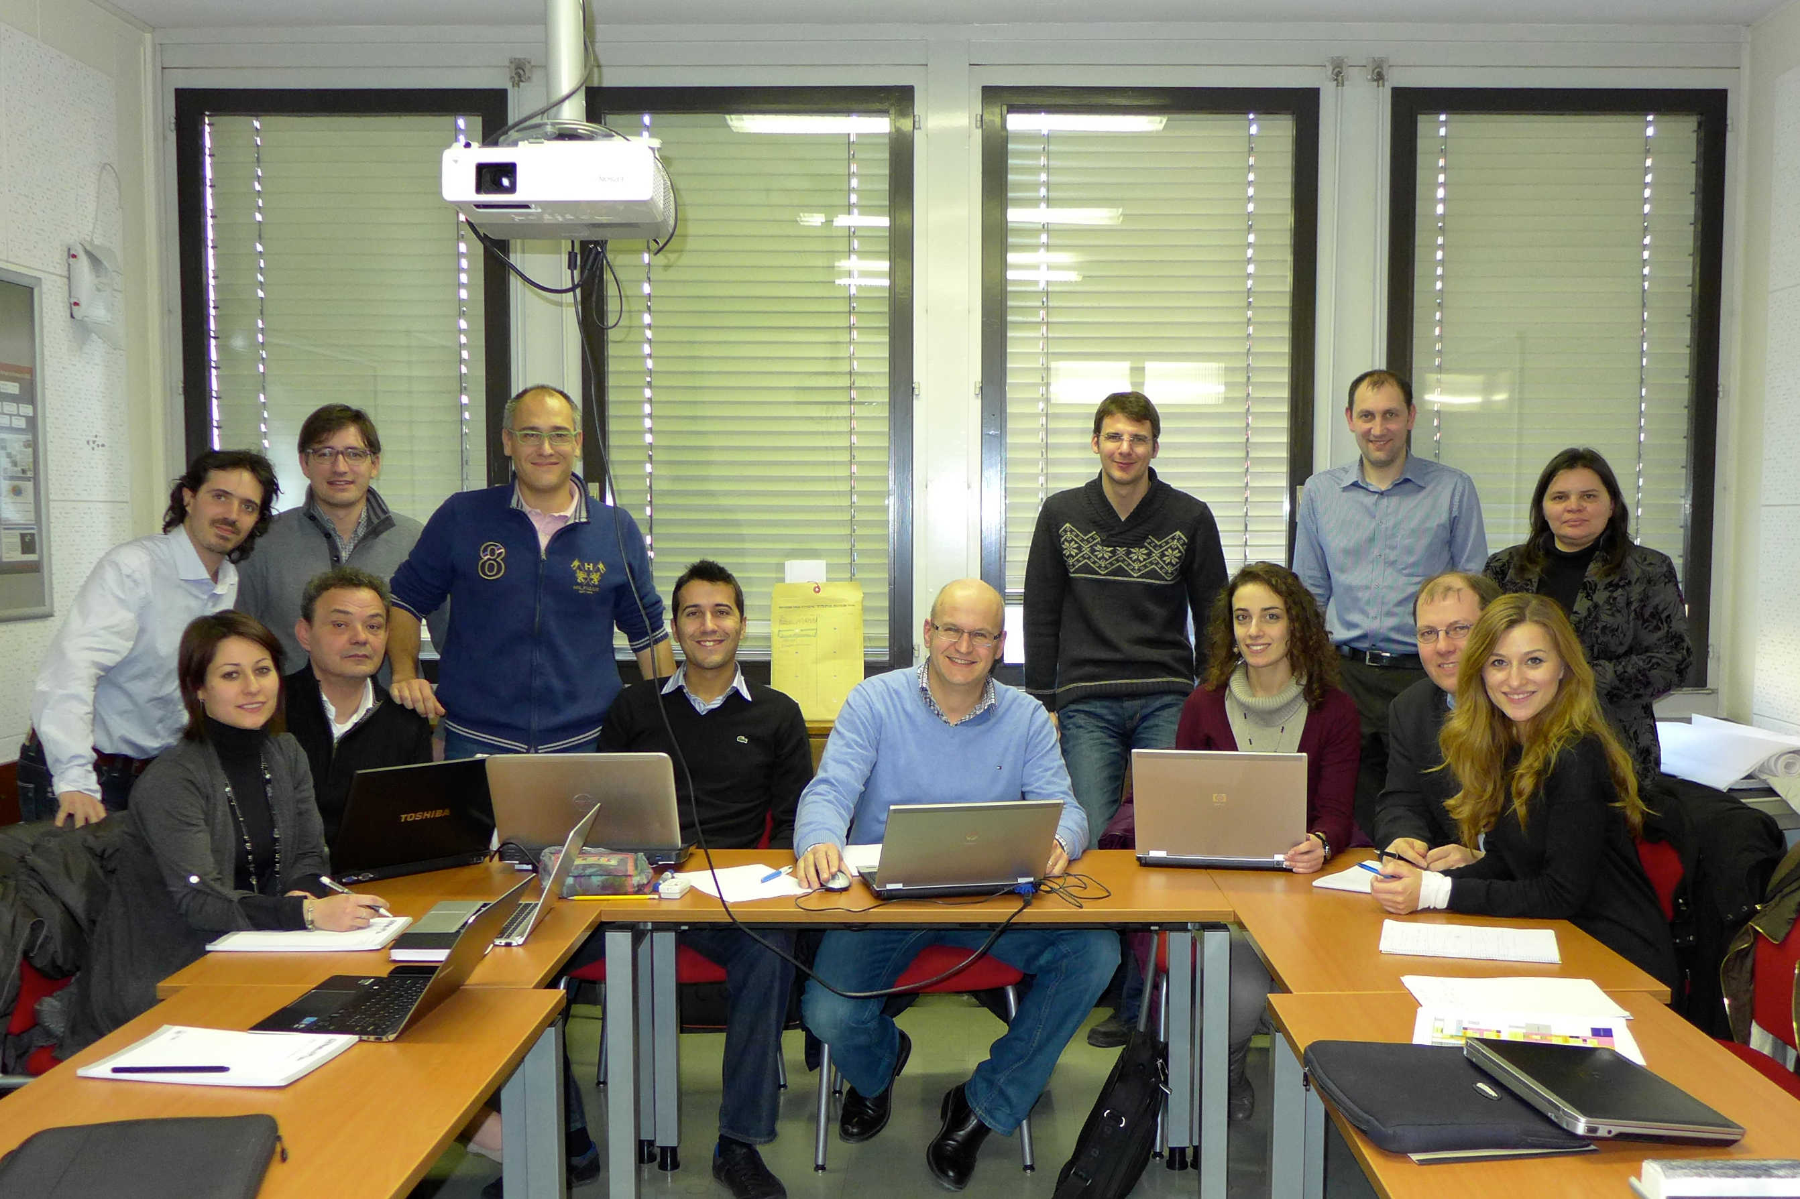
Task 11.1: Status and Next Events
Kick-off Meeting held on 9.12.13
Participation (direct or remote) by all partners (20 participants)
Indico Site online (https://indico.cern.ch/conferenceTimeTable.py?confId=286096#20131209)

Slide 18
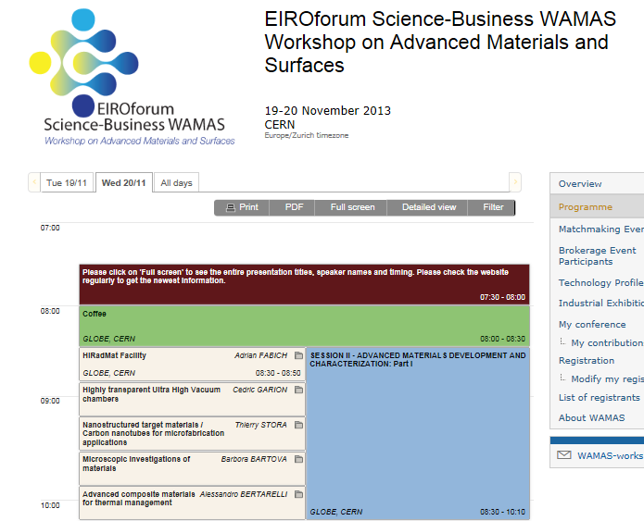
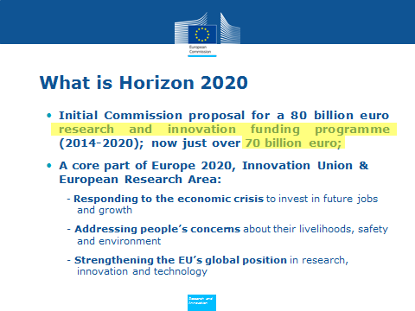
Task 11.1: Status and Next Events
Participation to WAMAS (Workshop on Advanced Materials and Surfaces).
WP 11 website online: https://lhc-collimation-upgrade-spec.web.cern.ch/lhc-collimation-upgrade-spec/WP11.php
Roughly 1 BEUR for Materials R&D

Slide 19
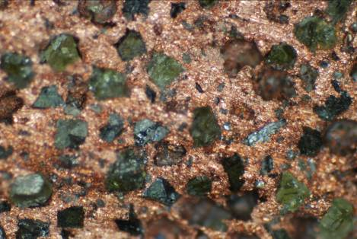
Task 11.2: Next Activities (~6 ÷ 8 mo)
Research and Development of Novel Materials
  Continue development of Mo-Gr and Mo-coated Mo-Gr in view of optimizing performances and identifying optimal grade by Summer 2014 (CERN / Brevetti Bizz)
  Produce specimens of Mo-Gr and Mo-coated Mo-Gr for irradiation tests in GSI starting in February 2014 (CERN / Brevetti Bizz)
  Produce specimens of Cu-CD for irradiation tests in GSI starting in February 2014 (RHP Technology)
  Continue investigations on existing “traditional” materials (particularly Carbon-based) (CERN / GSI)
Notes:
Make a distinction of what does who, why it is complementary to have different sources.

Slide 20
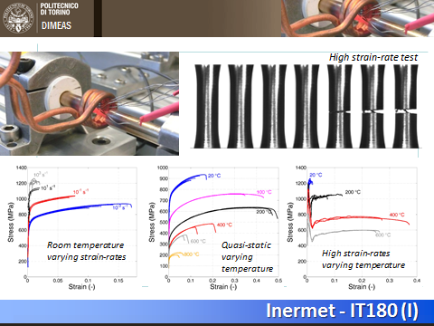
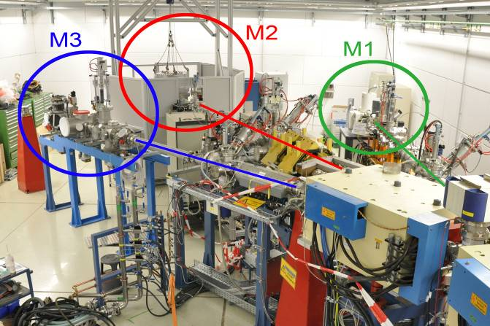
Task 11.2: Next Activities (~6 ÷ 8 mo)
Characterization and physio-mechanical testing of Collimator Materials (novel and existing)
  Microscopic Analyses (CERN)
  Thermo-physical characterization up to 2000° C (CERN)
  Mechanical Testing of Mo, Inermet and Graphite (Polito)
  Irradiation and radiation damage characterization in situ and off-line as of February ‘14 (GSI) – Milestone 69)
Notes:
Make a distinction of what does who, why it is complementary to have different sources.

Slide 21
Task 11.2: Next Activities (~6 ÷ 8 mo)
Irradiation Campaign in GSI
  High Energy Ion Irradiation (300 MeV/u) on C/C, Mo-Gr and Cu-CD
    Block 1 (Au and/or U): 19 February - 9 March ’14
    Block 2 (Au or Xe): April ’14
    Block 3 (Au): July ‘14
    Block 4 (Pb): September ’14
  Evolution of properties to be measured with dose:
    Thermal Conductivity
    Thermal Diffusivity
    Hardness
    Swelling
Notes:
Make a distinction of what does who, why it is complementary to have different sources.

Slide 22
Task 11.2: Next Activities (~6 ÷ 8 mo)
CERN to prepare 80 C/C discs Ø10 mm x 2 mm, by 20.02.2014. Additionally, a number of carbon fiber samples (Phase 1 and present).
Brevetti Bizz to prepare 65 Mo-Gr specimens:
  20 discs Ø10 mm x 1 mm available at GSI by 19.02.2014
  15 discs Ø20 mm x 30 mm available at GSI by 19.02.2014
  5 discs Ø32 mm x 30 mm available at GSI by 19.02.2014
  20 discs or squares 10 mm x 1 mm available at GSI by 07.04.2014
  5 discs Ø10 mm x 3 mm by September
RHP-Technology to prepare 65 Cu-CD specimens:
  20 discs Ø10 mm x 1 mm available at GSI by 19.02.2014
  15 discs Ø20 mm x 30 mm available at GSI by 19.02.2014
  5 discs Ø32 mm x 30 mm available at GSI by 19.02.2014
  20 discs or squares 10 mm x 1 mm available at GSI by 07.04.2014
  5 discs Ø10 mm x 3 mm by September
Notes:
Make a distinction of what does who, why it is complementary to have different sources.

Slide 23
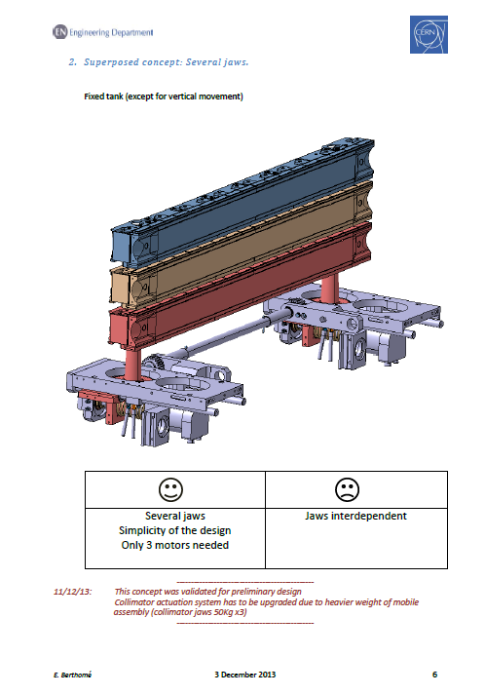
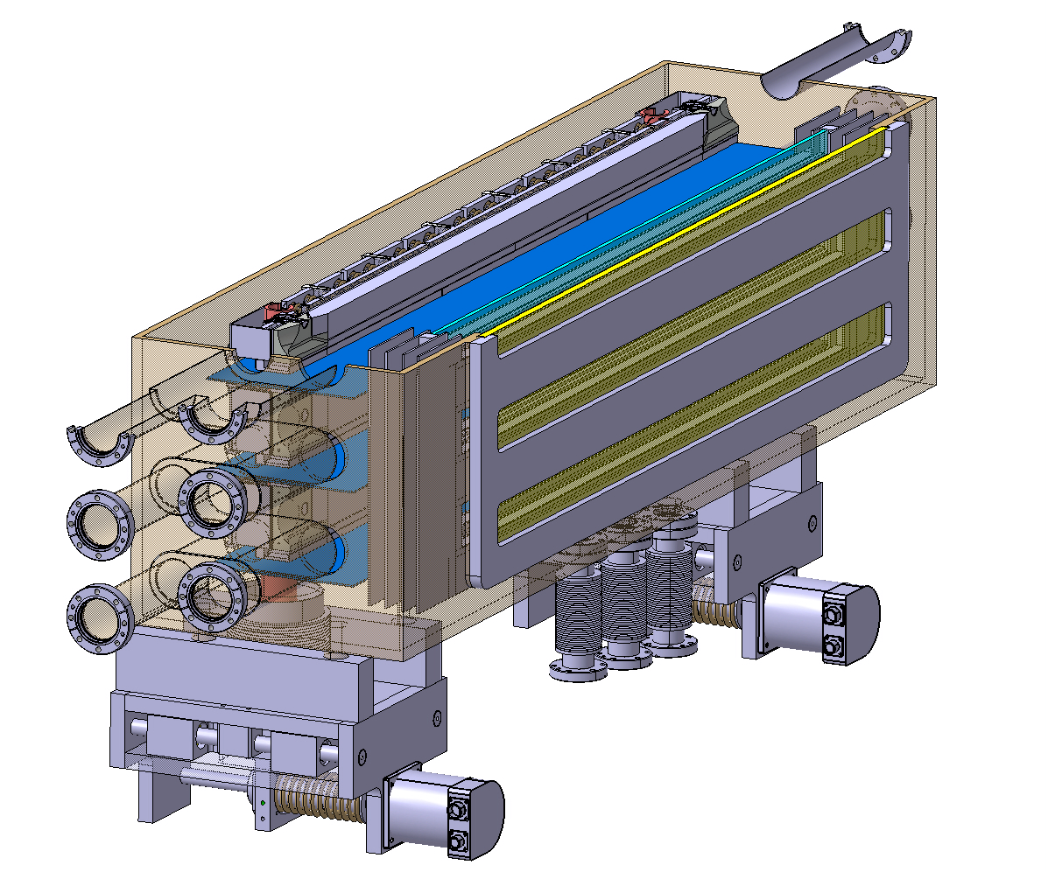
Task 11.2: Next Activities (~12÷15 mo)
Experimental tests at HiRadMat²
  2012 experiments in HiRadMat (HRMT-14 and HRM-09) were very successful and useful …… e.g. they allowed to define new beam limits for Tertiary Collimators.
  However a number of improvements is due, particularly for low-Z materials (having “weak” responses to beam impacts).
  A number of novel materials is yet to test …
  New designs must be qualified
Notes:
Make a distinction of what does who, why it is complementary to have different sources.

Slide 24
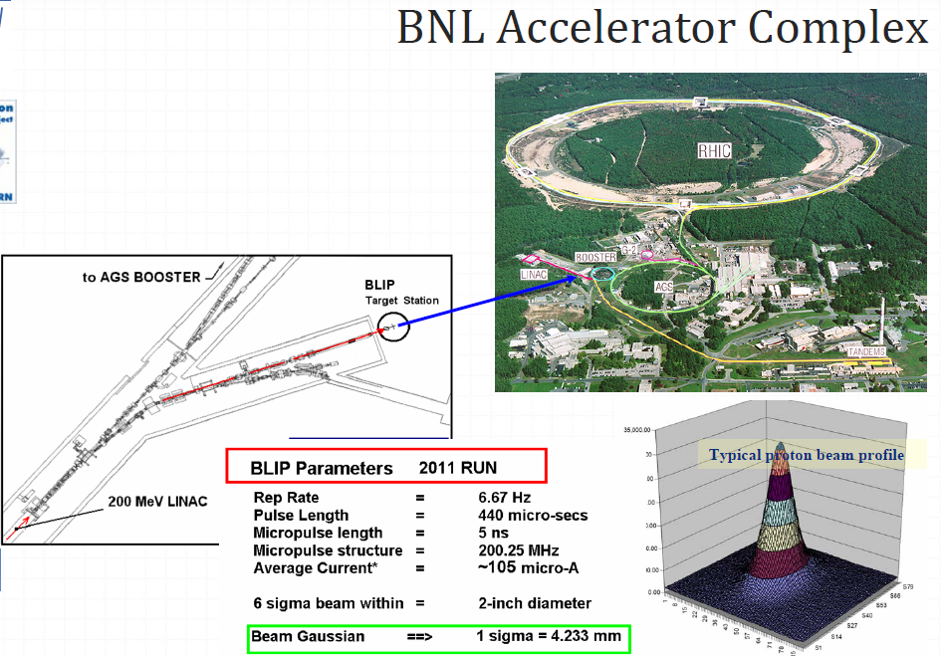
Task 11.2: Ongoing/Next Activities
Long-term irradiation tests and assessment of material property changes
  Continuation of Irradiation studies at KI-RRC and reports
    Cu-CD
    MoCuCD
    SiC
  Continuation of Irradiation studies
  at BNL and reports
    Cu-CD
    Mo-Gr
    Molybdenum
    Glidcop
  Open issue is the scalability of
  results for 10÷100 MeV to the
  TeV level …
Notes:
Make a distinction of what does who, why it is complementary to have different sources.

Slide 25
Tasks 11.3: Ongoing/Next Activities
Theoretical modelling of materials and novel composites (Equations of State, Strength models, Failure models).
Energy deposition calculations (FLUKA) and coupling with hydrocodes.
Modelling of dynamic phenomena (stress and shock waves, spall, melting, fragmentation, tunnelling …) induced by fast abnormal beam loss events.
Modelling of long-term radiation damage. Equivalence between high fluence, low energy and lower fluence, high energy irradiation with various species.
Benchmark numerical results with experimental data.
Notes:
CERN, GSI, POLITO, RHP, RRC KI, UM

Slide 26
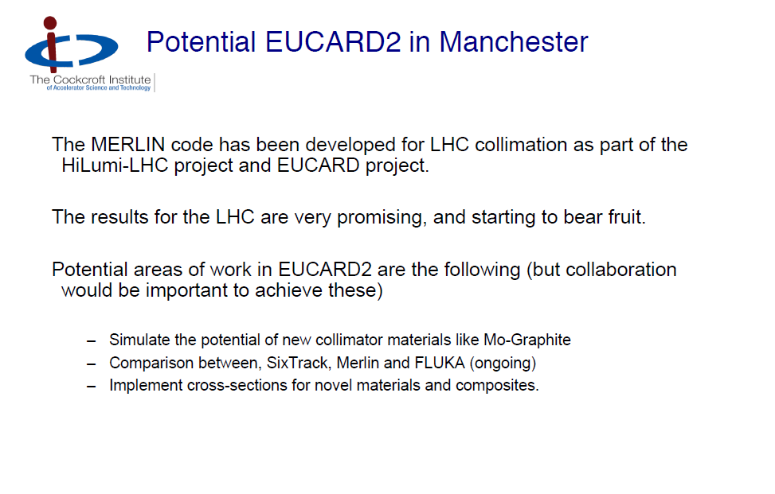
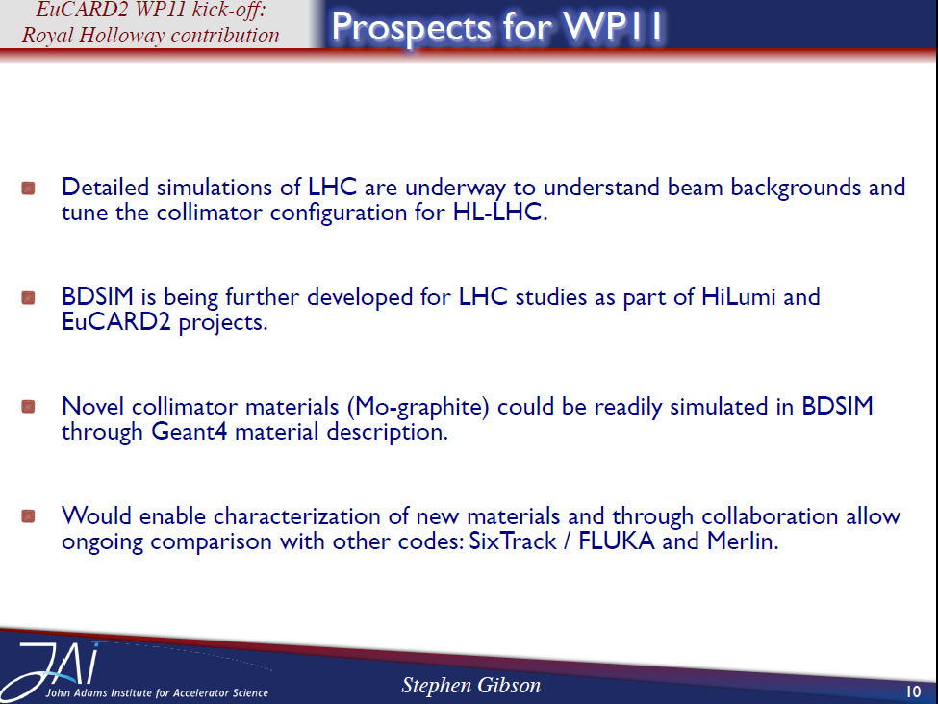
Task 11.4: Status and Next Activities
Material specification (Beam simulation codes)
  Ad-hoc meeting in Daresbury on 15 November after HiLumi 3rd meeting
  Comparison between SixTrack, Merlin and FLUKA.
  Implement cross-sections for novel materials and composites.
Notes:
Scattering routine FLUKA- Merlin-SixTrack presente e futuri materiali
Absorber after crystals

Slide 27
Outline
    Context
    Partners (WP11 and beyond)
    WP11 Tasks and Deliverables
    WP11 Status and upcoming activities
    Summary and Perspectives

Slide 28

Summary and Perspectives
WP11 is up and running with and ambitious program aiming at the development of novel advanced materials for the next generation of collimators.
Very motivated and committed partners (11 within EuCARD2 plus 2 “external” ones).
1st WP meeting recently held: a program was agreed aiming in particular to materials irradiation in GSI starting in February 2014.
Very intense and challenging program, driven not only by EuCARD2 deadlines but also by “hard” machine-related constraints (full LHC Collimator with new materials to be installed around 2016 …)
Contributions from all partners are essential, given the challenging goals in a framework of limited resources and funds. First milestone is in sight …
Materials being developed are also appealing for a broad range of industrial applications and have the potential for a real impact on society …

Slide 29
Thank you for your attention!

Slide 30
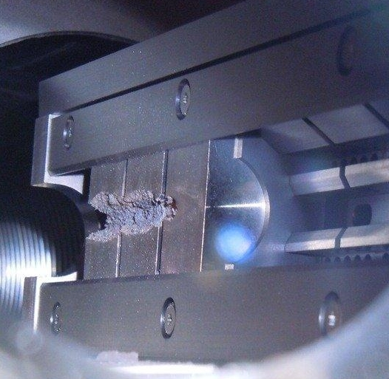
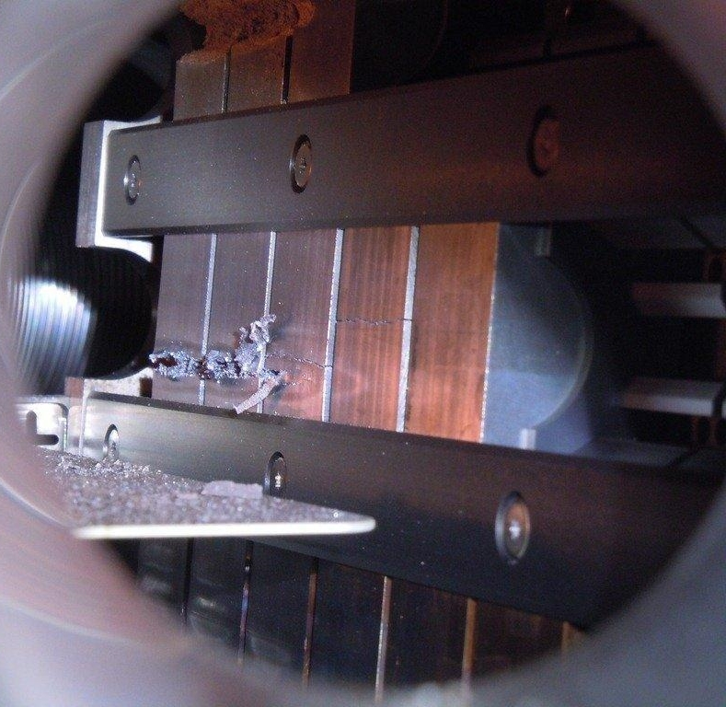
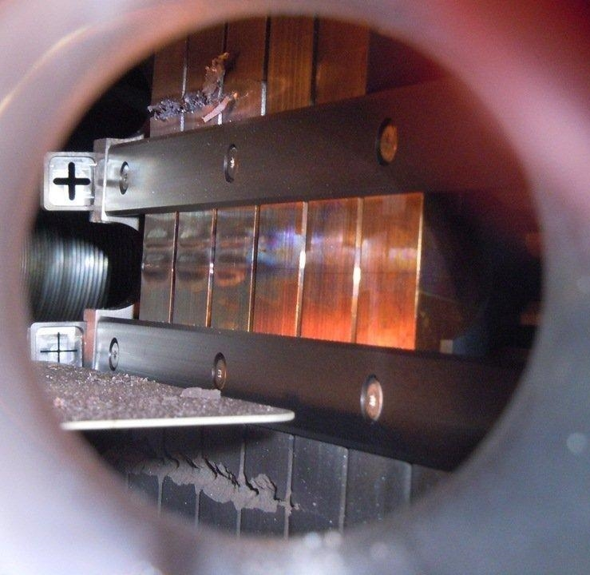
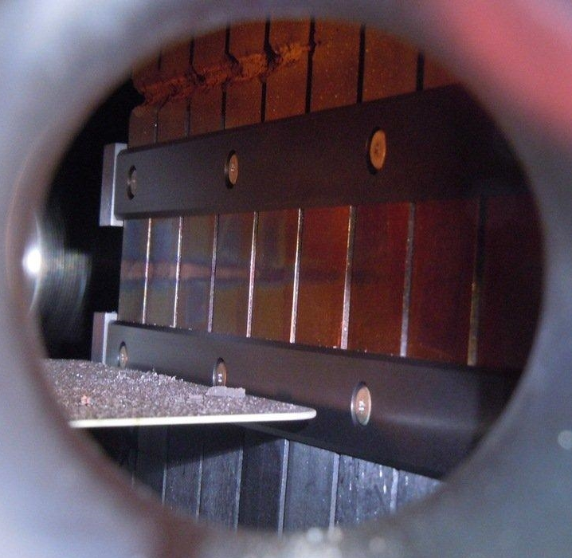
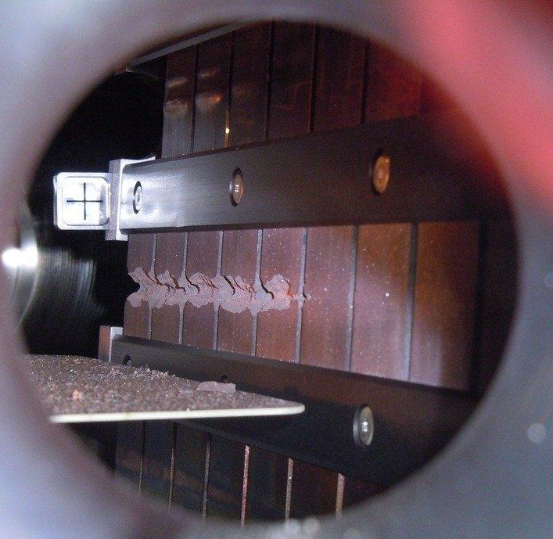
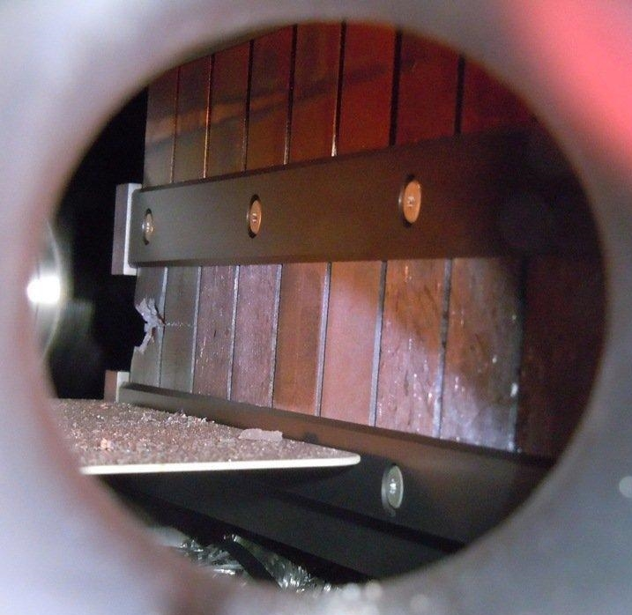
HRMT14: High Intensity Tests
    Inermet 180, 72 bunches
  Molybdenum, 72 & 144 bunches
  Glidcop, 72 bunches (2 x)
  Copper-Diamond
  144 bunches
  Molybdenum-Copper-Diamond 144 bunches
  Molybdenum-Graphite (3 grades)
  144 bunches

Slide 31
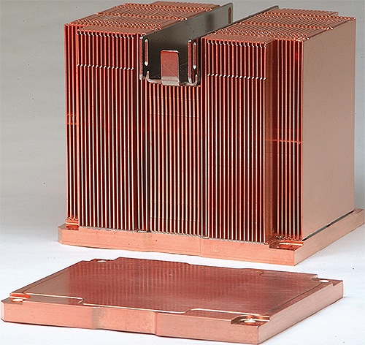
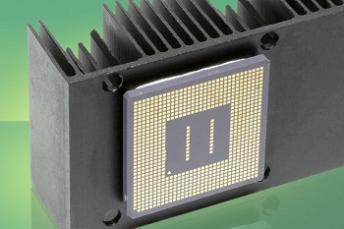
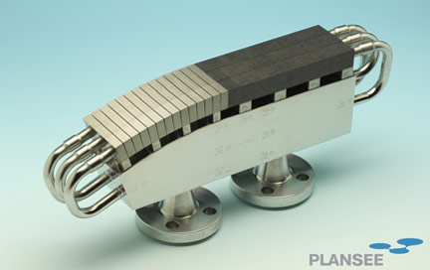
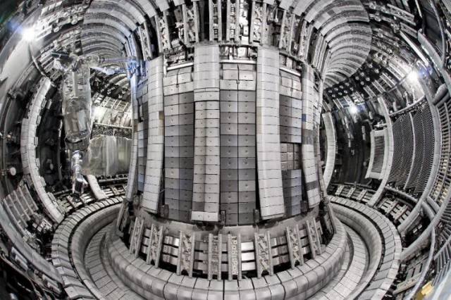
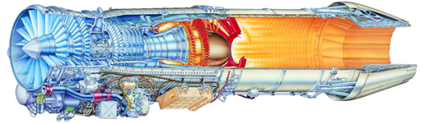

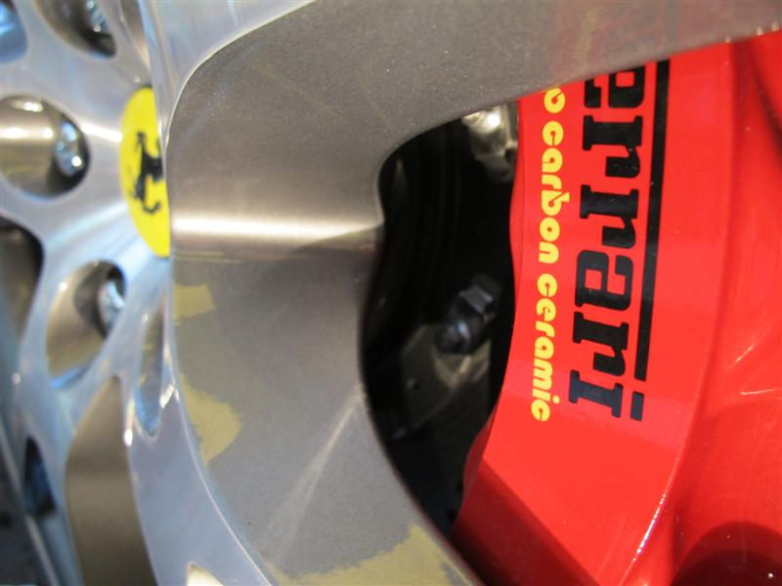
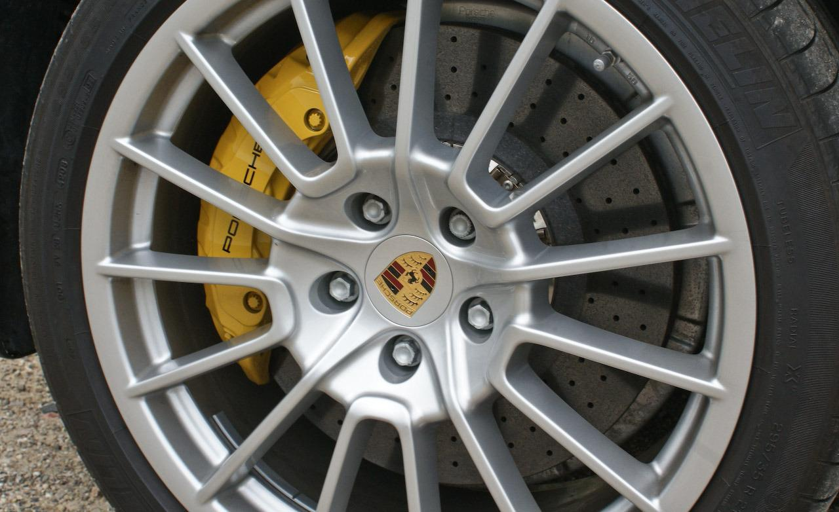
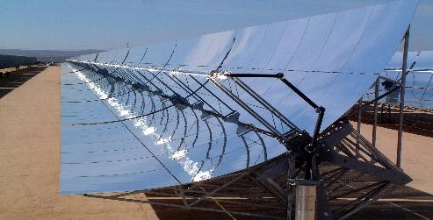
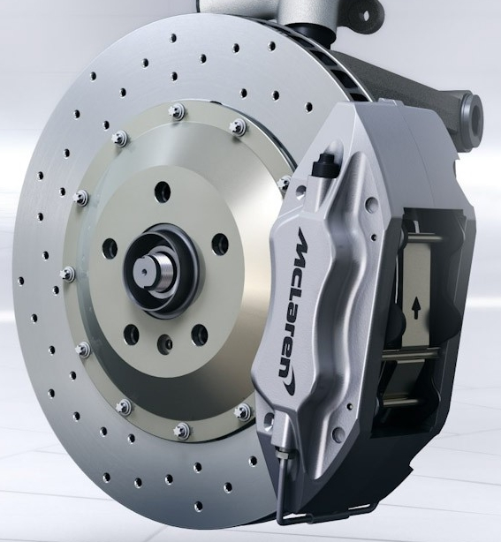
Novel Materials Future Application?
Thermal Management for High Power Electronics
Potential range of applications can be further expanded particularly thanks to the tailoring possibilities of Molybdenum-Graphite composites
…
International Patent filed (C31891PCT)!
High temperature Aerospace Applications
Fusion Engineering
Solar Energy Applications
Advanced Braking Systems

Slide 32
GSI Irradiation: Specimens
CERN to prepare 80 C/C discs Ø10 mm x 2 mm, by 20.02.2014. Additionally, a number of carbon fiber samples from Phase 1 and present R&D.
Brevetti Bizz to prepare 65 Mo-Gr specimens:
a. 20 discs Ø10 mm x 1 mm available at GSI by 19.02.2014
b. 15 discs Ø20 mm x 30 μm available at GSI by 19.02.2014
c. 5 discs Ø32 mm x 30 μm available at GSI by 19.02.2014
d. 20 discs or squares 10 mm x 1 mm available at GSI by 07.04.2014
e. 5 discs Ø10 mm x 3 mm by September
RHP-Technology to prepare 65 Cu-CD specimens:
a. 20 discs Ø10 mm x 1 mm available at GSI by 19.02.2014
b. 15 discs Ø20 mm x 30 μm available at GSI by 19.02.2014
c. 5 discs Ø32 mm x 30 μm available at GSI by 19.02.2014
d. 20 discs or squares 10 mm x 1 mm available at GSI by 07.04.2014
e. 5 discs Ø10 mm x 3 mm by September

