Slide 1
BDSIM Update
L.Nevay, S.Boogert, S.Gibson, R.Kwee-Hinzmann
24th Jan 2014

Slide 2
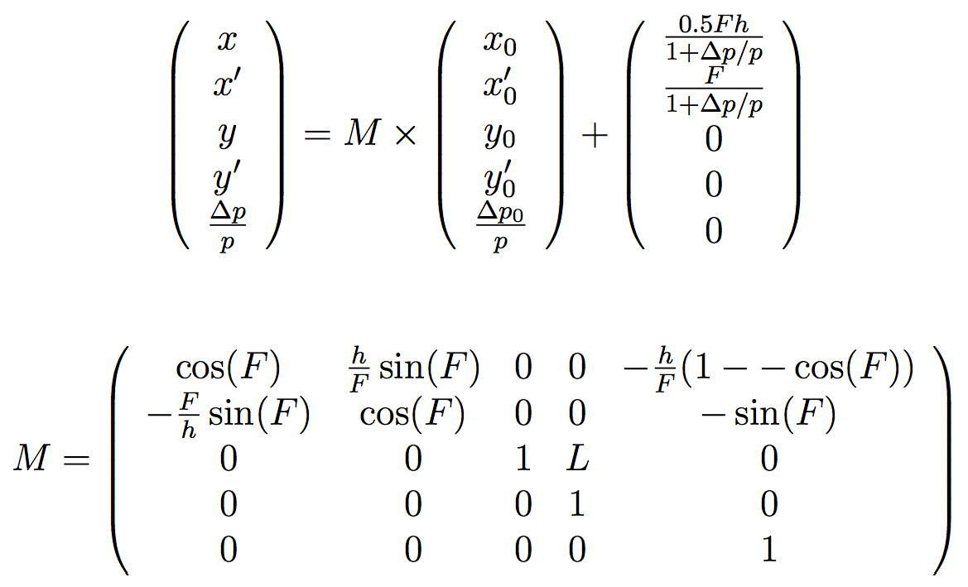
BDSIM Tracking
All elements (inc. multipoles) are implemented in tracking
Only quadrupoles are symplectic just now
Quadrupole, Sector Bend, Rect. Bend use map
Sextupole & Octupole use approximations
General multipole uses 4th order Runge-Kutta
Quadrupole
Drift
Sector Bend

Slide 3
Status & Direction
Implement symplectic routine for other elements
Use generic geometry for machine (elements & collimators)
Geometry conversion software ongoing
Validate tracking w.r.t. SixTrack
define the exact comparison plots
Comparative tracking studies to SixTrack

