Slide 1

Collimator failure losses for various HL-LHC configurations
ColUSM #31
Friday, 1st November 2013
L. Lari
IFIC (CSIC-UV) & CERN
R. Bruce, S. Redaelli
Thanks to C. Bracco and B. Goddard

Slide 2
Outline
Asynchronous dump: what is this?
Tools used in the simulations
Validation of the simulation set-up
Risks by using the HiLumi optics with nominal and 2 σ retraction collimation setting:
  Beam1
  Beam2 + including optics errors
Conclusions

Slide 3
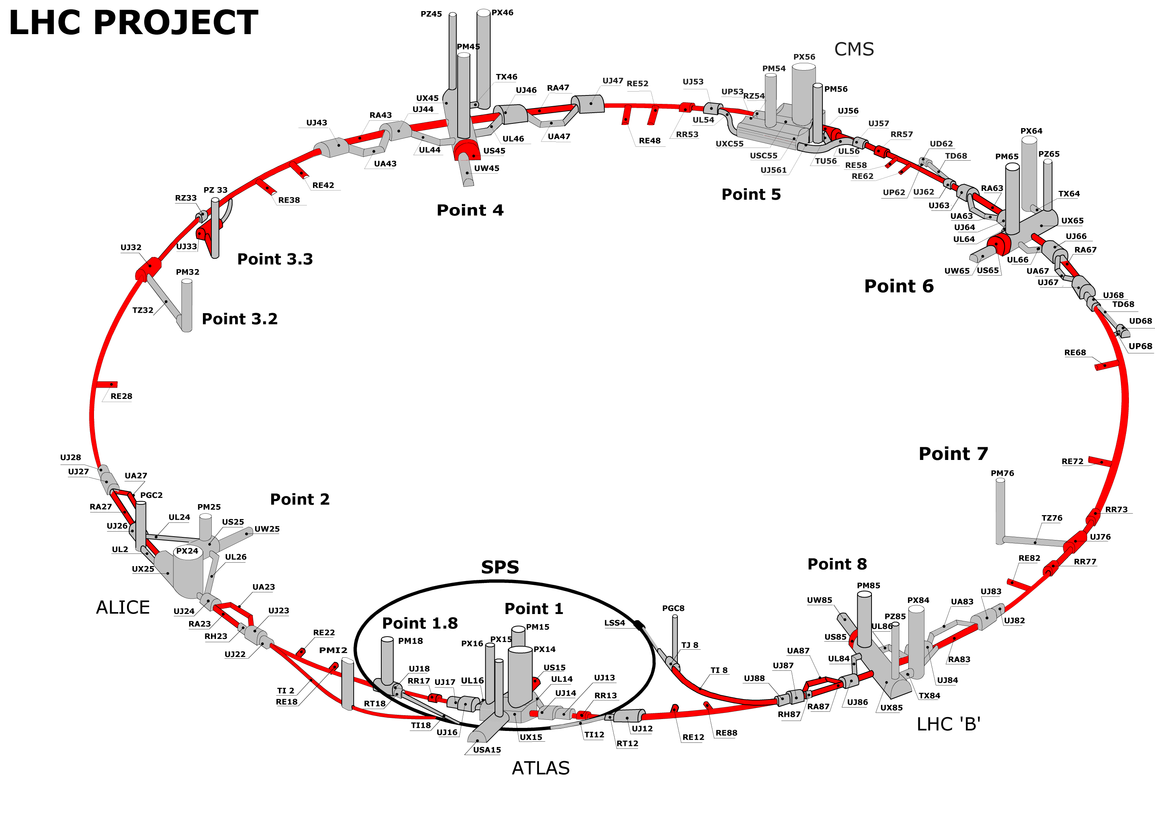
Asynchronous dump: what is it?
<3 μs extraction kicker rise time (abort gap)
Fast losses happens when one or all of MKDs firing not synchronously with the abort gap.

Slide 4
Tools used in the simulations
A modified SixTrack collimation routine to allow studies of asynchronous dump with the whole collimation system in place, including set-up and optics errors.
MKD pulse form
Courtesy B.Goddard
1st turn
IP1 2nd turn IP8
IP1 3rd turn IP8
The collimator are put in place with respect to the optic scenario under study
IP6
IP6
[See also: L.Lari et al. Asynchronous beam dump treatment, Sixtrack for collimation: new available features meeting, 7th June 2013, CERN]

Slide 5
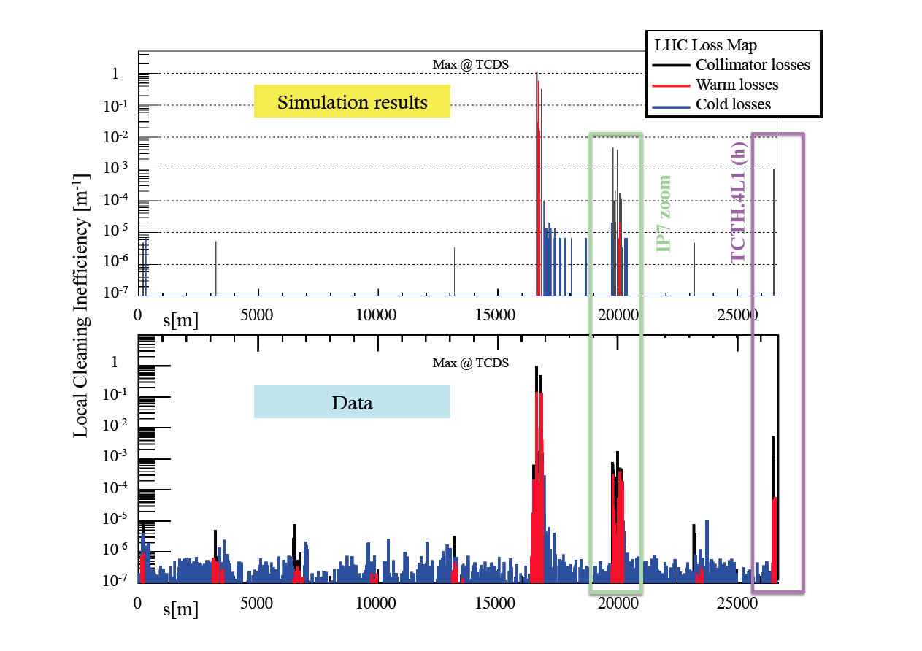
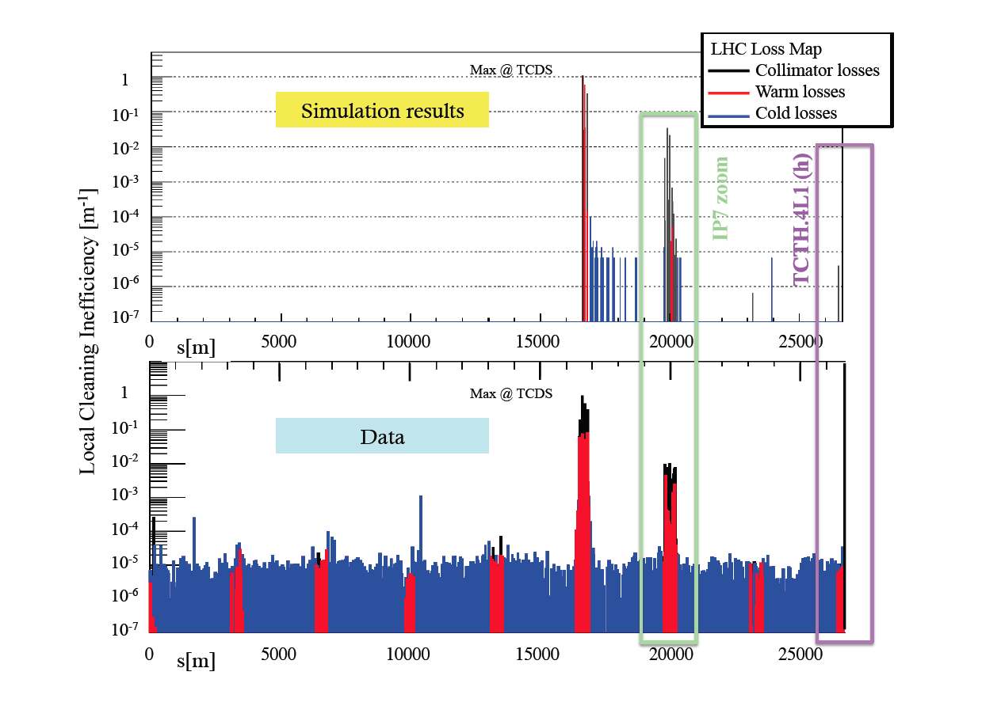
Validation of the simulation set-up
June 2012
4TeV nom. Optics + out 1.5 mm @IP6
+ 1 mm out 3 TCSG +1 TCLA @IP7
+1σ in the most exposed TCT @IP1
November 2012
4TeV nom. Optics + out 1.5 mm @IP6
+1σ in the most exposed TCT @IP1
[REF: L.Lari et al. Simulations and Measurements of Beam Losses on LHC Collimators during Beam Abort Failures, IPAC13, Shanghai, China]

Slide 6

Past studies
+ out 1.5 mm @IP6
+ 1 mm out 3 TCSGs + 1 TCLA @IP7
+1σ in the most exposed TCT @IP1
Beam2
+ out 1.5 mm @IP6
+1σ in the most exposed TCT @IP5
Beam1
ATS (i.e. SLHC_3.1b)
[REF: L.Lari et al. Studies of Thermal Loads on Collimators for HL-LHC Optics in case of Fast Losses, IPAC13, Shanghai, China]

Slide 7

Phase advance
Calculated form the MKD.4O6 (the furthest away form TCDQs)
 | 7TeV nominal | ATS (i.e. SLHC_3.1b) | HLLHCV1
Beam1
TCTH.4L1.B1 | 55.8 | 97.2 | 208.8
TCTH.4L2.B1 | 257.3 | 182.8 | 265.7
TCTH.4L5.B1 | 47.3 | 145.6 | 244.6
TCTH.4L8.B1 | 335.7 | 166.5 | 213.1
Beam2
TCTH.4R1.B2 | 198.1 | 303.2 | 139.6
TCTH.4R2.B2 | 170.4 | 184.7 | 230.9
TCTH.4R5.B2 | 175.8 | 220.4 | 103.5
TCTH.4R8.B2 | 18.7 | 225.2 | 215.2
[See also R.Bruce et al. Collimation requirements for the IR1/5 layout and on-going WP5 studies, 8th HL-LHC Extended Steering Committee meeting, 13/08/2013, CERN]

Slide 8
Collimation system aperture
Updated ATS optics for Hi-Lumi
(i.e. HLLHCV1 optics)
For Beam1 and Beam2
Nom. setting
2σ retraction
Asynchronous dump accident scenarios studied:
Perfect machine;
+ Retraction of 1.2 mm @IP6;
+ Retraction of 1mm of the of 11 most critical coll. (TCSGs) @ IP7 + TCTHs @IP1 and @IP5 in of 1 σ more;
Optics error (for the most critical Beam2) for 1. and 3. scenarios;
TCDQs misalignment (precision in alignment = 100urad → max offset of ~0.946 mm (2 preliminary cases studied);
TCP.IP7 | 6 | 5.7
TCSG.IP7 | 7 | 7.7
TCLA.IP7 | 10 | 10.7
2*80cm W DS @IP7 | 10 | 10.7
TCP.IP3 | 15 | 15
TCSG.IP3 | 18 | 18
TCLA.IP3 | 20 | 20
TCT.IP1/IP5 | 8.3 | 10.5
TCT.IP2/IP8 | 30 | 30
TCL.IP1/IP5 (2 Cu +1 W) | 15 | 15
TCLI/TDI.IP2 | Tot opened | Tot opened
TCDQ.IP6 | 8 | 9
TCSG.IP6 | 7.5 | 8.5
TCDQ
3TCDQs
TCDQ
TCDQ

Slide 9
1. Perfect machine
Beam1
2σ retraction
IP6
[REF: A. Bertarelli et al. Updated robustness limits for collimator material, LHC Machine Protection Workshop, Annecy, France]
IP7
  Onset of plastic damage on Tungsten collimators : 5x10⁹ p
Nom. setting
Beam 1
  Results are normalized to 2.2x10¹¹ p+ (25 ns)

Slide 10
1. Perfect machine
Beam1
2σ retraction
Zoom in IP7
Nom. setting

Slide 11
2. + Retraction of 1.2 mm @IP6
Beam1
2σ retraction
IP6
IP7
Nom. setting

Slide 12
2. + Retraction of 1.2 mm @IP6
Beam1
2σ retraction
TCSG.B5L7.B1 (s)
Zoom in IP7
TCSG.A5L7.B1 (s)
Nom. setting
TCSG.6R7.B1 (h)
TCSG.B4L7.B1 (h)

Slide 13
3. + Retraction of 1mm @IP7
+ TCTHs @IP1 and @IP5 in of 1 σ.
Beam1
2σ retraction
IP6
IP5
IP7
Nom. setting

Slide 14
3. + Retraction of 1mm @IP7
+ TCTHs @IP1 and @IP5 in of 1 σ.
Beam1
2σ retraction
Zoom in IP7
Nom. setting
TCLAs and DS coll.

Slide 15
1. Perfect machine
Beam2
2σ retraction
IP6
IP7
IP5
Nom. setting
IP1
IP6
IP7
IP5
Beam 2
IP1

Slide 16
Nom. setting
Beam2
+ Retraction of 1.2 mm @IP6
IP6
IP7
IP5
Perfect Machine

Slide 17

Conclusions
As shown, the TCTH@IP5 is the most exposed location for both beams – in particular B2 - for the HLLHCV1 optics.
2 σ retraction collimation settings is found as better than the nominal one in terms of protection from an asynchronous dump accident, including setting and error scenarios.
On going studies on optics errors and TCDQs misalignment will give us more complete picture of the failure scenarios.

