Slide 1
Updated Design of TCLD whit reduced jaw length Collimation Upgrade Specification meeting 18-10-2013 L. GENTINI

Slide 2
Contents
Overview
Preliminary design study
Actuation system
Vacuum tank
Jaws
Cooling system
Instrumentation
Status

Slide 3
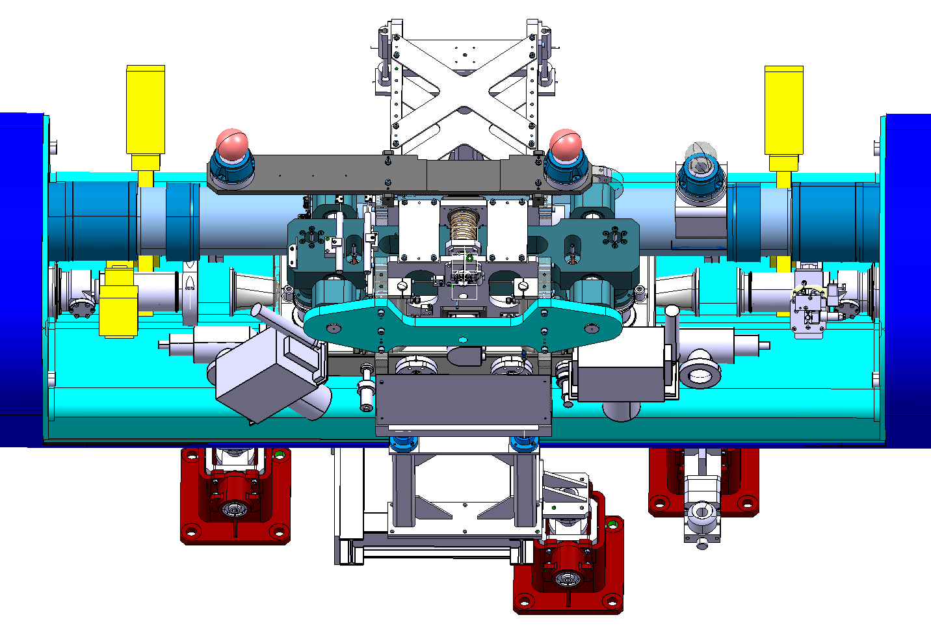
Overview
Manual quick connecting flange: unavailable remote handling
TCLD
Sector valves
QTC
Ion pumps
Unchanged length
Unchanged length
100 mm
New collimator length 1280 mm
100 mm
Current QTC

Slide 4
Collimator assembly
Alignment assembly
Actuation system
Collimator
Support assembly
“V” interconnection points. Collimator replacement without realignment
The support assembly will be the same of the TCDQ

Slide 5
Actuation system
Frame
Partially recovered from existing TCLD actuation system
Movement
No jaw tilting
Stroke: 0 → 25 mm
One step motor each jaw
Spring-back: in case of electrical short-cut the jaws must not go in beam direction
Instrumentation
3x LVDT (1x each jaw, 1x anti-collision)
3x switch assemblies (1x each jaw, 1x anti-collision)
Alignment
Adjusting assembly with 2x laser trackers
Recovered
Recovered
Recovered
To be changed
To be changed
To be changed
Jaw actuation
To be changed

Slide 6
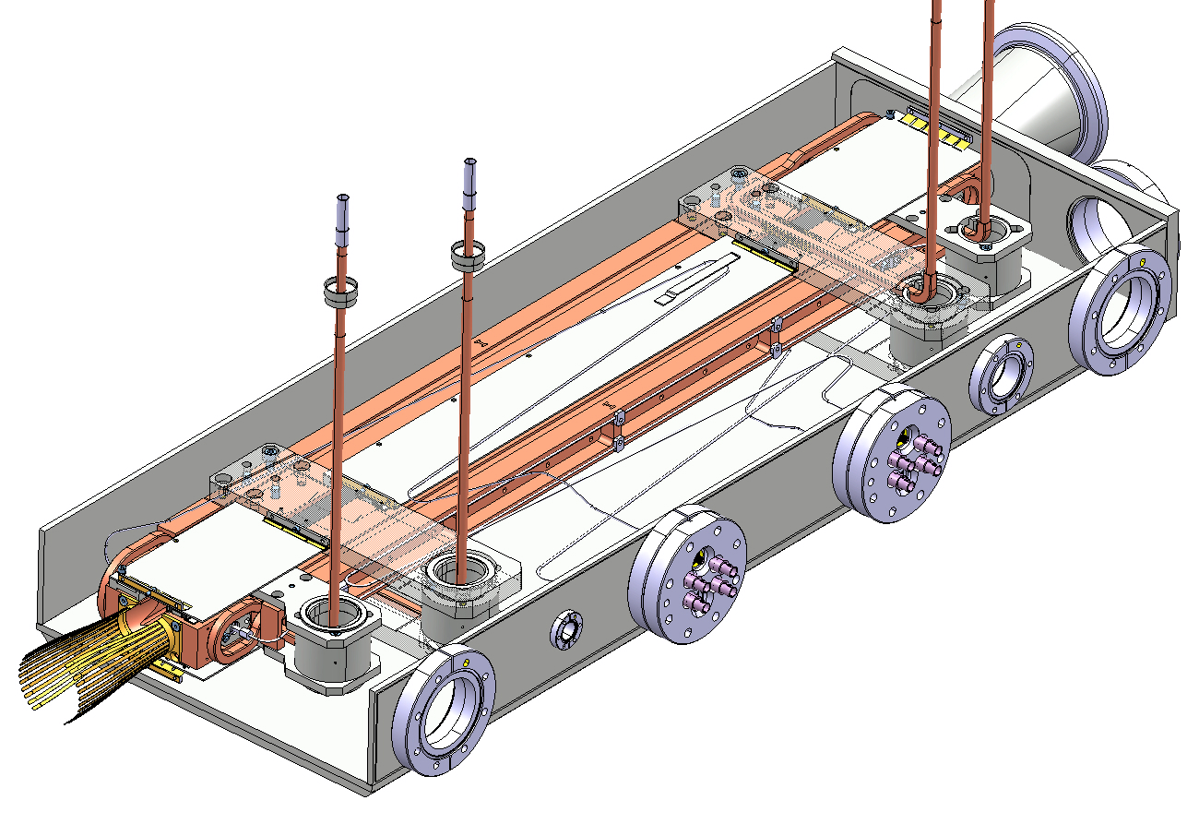
jaws
1000 mm
Old design
New design
General
Active length reduced by 200 mm (1000 → 800 mm)
Brazed jaws
4x screwed tungsten blocs each jaw
Tapering slopes 10°and 15°
Cantilever jaws
Cooling system
Square pipes (9 mm edge, CuNi)
3x cooling pipes in the central cross-section
Instrumentation
2x temperature probes (TP100) each jaw
2x Beam Position Monitor each jaw
BPM cables: same electrical length of TCTP with different shape
RF system
Ferrite tiles + St. steel screens
Vacuum tank based on Ph.II collimator
800 mm
BPM cables
BPM
Extremity RF contacts

Slide 7
Jaw details
Tank axis
RF screens St. Steel
Ferrite tiles
Cooling pipes CuNi
40
Back stiffener Glidcop
Bloc Support Glidcop
RF screens St. Steel
Tungsten blocs
Ferrite tiles

Slide 8
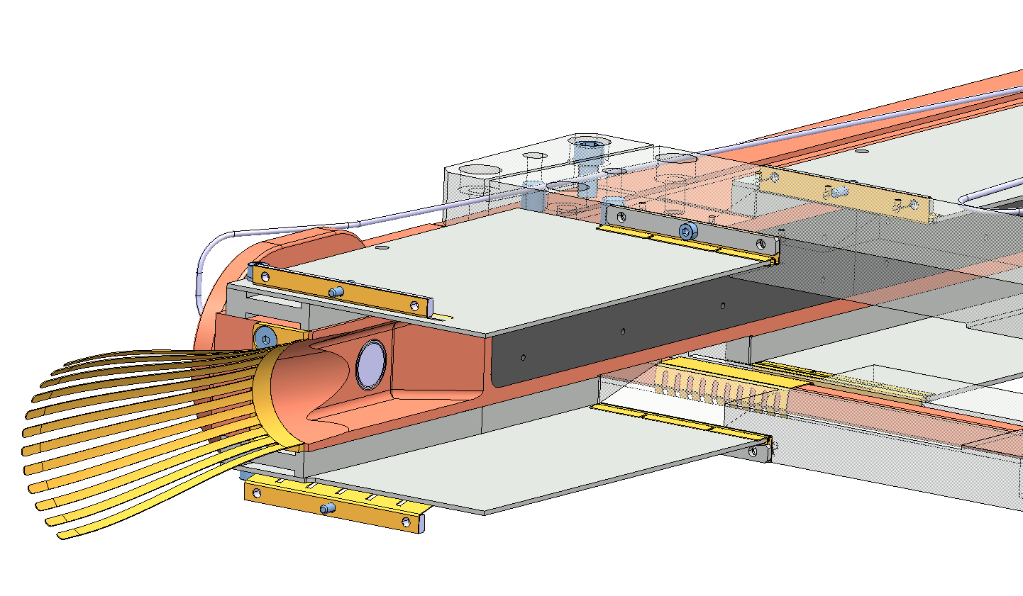
Jaw details
Screen RF contact CuBe C17410
RF contact CuBe C17410
RF screen St. Steel
Screen RF contact CuBe C17410
Tapering slope : 15°
BPM
Extremity RF contact CuBe C17410
Tapering slope : 10°

Slide 9
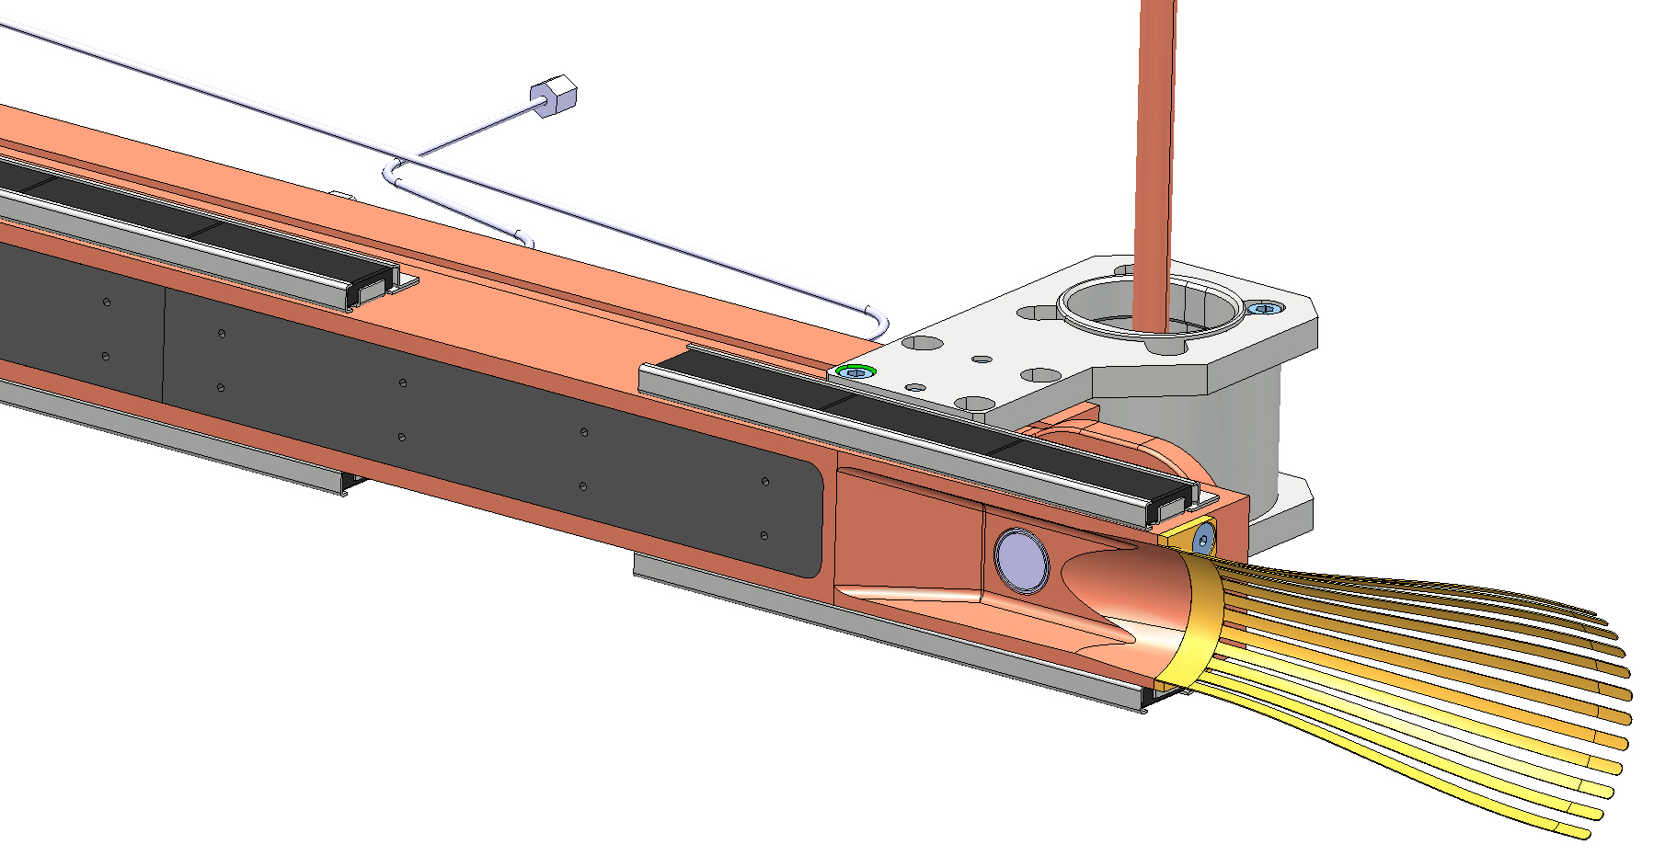
Jaw details
Tungsten blocs
Ferrite tiles
Ferrite tiles

Slide 10
Tcld updated design status
18-10-2013 | Study | 3D models | Drawings | Controls | Manufacturing
Actuation System | 100% | 95% | 70% | 70% | 60%
Jaws | 80% | 70% | 30% | 0% | 0%
Tank | 100% | 100% | 50% | 0% | 0%
Support | 100% | 100% | 0% | 0% | 0%
Jacks | 70% | 70% | 70% | 70% | 70%
Test tools | 30% | 30% | 20% | 20% | 20%

Slide 11
Thank you for your attention!

