Slide 1
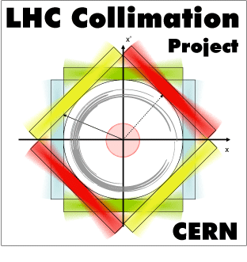
EuCARD² ColMat-HDED kick-off meeting
Adriana Rossi

Slide 2
ColMat-HDED (Collimator Materials for fast High Density Energy Deposition)
The collimators determine the LHC impedance
Tight collimator settings (2012-13) necessary to improve cleaning performance limited beam lifetime.
The β* reach is determined by collimation constraints
Retraction between beam dump and horizontal TCTs (BPM collimators) and TCT robustness.
LHC challenges: 360MJ design ➔ 500MJ HiLumi and 1E16 p/y doses in IR7 (betatron cleaning)
Improve impedance and robustness
State-of-the-art material and new design for secondary collimator jaws
Improved robustness at critical locations (like tertiary collimators - close to experimental IRs)
Accelerator performance with ever increasing beam brightness and stored energies pushes material requirements for collimators into more challenging grounds.
Accidental energy deposition can be very fast (over a few nanoseconds) and with high density: peak energy densities of 15 GJ/mm² are now imaginable in the LHC beam, so even a small fraction of it would cause discontinuous change in the medium pressure, temperature and density.
Requirements on impedance are even more strict.
Notes:
Accelerators as for the CERN projects of LIU and HL-LHC, and other projects such as FAIR or future neutrino facilities.
Contesto
L’hc: challenges 500MJ + 10e16p/y in ir7 irradiation
In 2012-13 tight collimator setting (cleaning ineff 1E-5 in most cold apertures of LHC) required to reach smaller beta* caused shorter beam lifetime

Slide 3
ColMat-HDED (Collimator Materials for fast High Density Energy Deposition)
Building upon the results of EuCARD and pushing them into a new and even more innovative regime, the collimation WP in EuCARD² will support progress with material developments for collimators and targets.
The new availability of irradiation facility such as HiRadMat (in 2012 at CERN) and M-branch (2011 in GSI), together with well-established irradiation facilities (Kurchatov), will allow to fully characterising promising candidate materials like metal-diamond and metal-graphite composites and new types of silicon carbide.
These studied have also a wide range of possible applications starting from thermal management for electronics, to nuclear industry, fusion research, and high temperature space applications.
Note complementarity with irradiation tests at BLN, different energies and additional materials tested (see A.Bertarelli presentation) within the USLARP program
Notes:
Accelerators as for the CERN projects of LIU and HL-LHC, and other projects such as FAIR or future neutrino facilities.

Slide 4
ColMat-HDED collaboration (Collimator Materials for fast High Density Energy Deposition)
Main founding to Kurchatov lab. From CERN Collimation Project

Slide 5
WP11 Objectives
Task 11.1. Coordination and Communication (A. Rossi and J. Stadlmann)
Task 11.2. Material testing for fast energy density deposition and high irradiation doses (A. Bertarelli)
Aim of this task is to review the best modern materials and to perform experimental tests on material robustness and mechanical behaviour after high energetic beam impact and high thermal stresses.
Task 11.3. Material mechanical modelling (A. Bertarelli)
Theoretical modelling of new materials and composites, the calculation of energy deposition following accidents and the modelling of shock-induced and radiation damage.

Slide 6
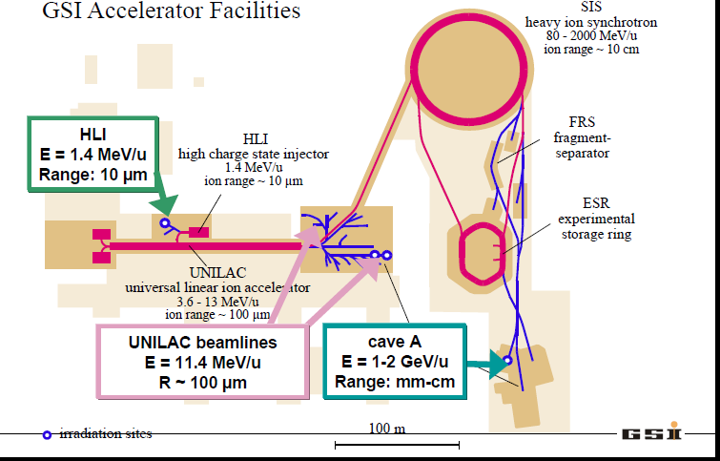
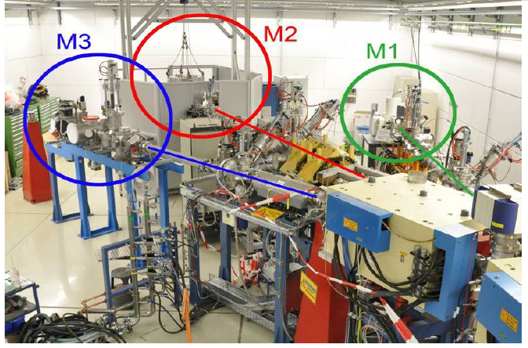
Material testing, some examples
Material irradiation at M-branch – UNILAC GSI
Energies close to Bragg peak to maximize energy deposition and damage and to avoid activation
Ion species C, Xe, U with flux up to 10¹⁰ ions/cm² s and typical energies of 3.6 / 4.8 / 5.6 / 8.6 / 11.4 MeV/u
Online and in-situ monitoring available: video camera, fast IR camera, SEM, XRD, IR spectroscopy
Characterisation of mechanical properties degradation as a function of dose using nano-indentation: hardness, Young modulus, impact resistance, fatigue behaviour, creep- material response to fast extracted ion beam
Spall strength studies of different materials in ultrafast experiment using the the Petawatt laser at GSI
Courtesy of M. Tomut

Slide 7
WP11 Objectives
Task 11.4. Material specification (A. Rossi)
The increasing beam intensity in accelerators requires ever better cleaning efficiency, and lower collimator impedance. Aim of this task is to evaluate the potential, advantages and disadvantages of materials and report on comparative assessment of beam simulation codes and iterate on material specifications to address the needs of future accelerator developments.
New request from Collimation Project Leader: are the irradiation tests at high intensity and low energies relevant to LHC like beams? -> Simulations on DPA and re-crystallisation.

Slide 8
WP11 Objectives
Citing from http://en.wikipedia.org/wiki/Radiation_material_science
Main aim of radiation material science
Some of the most profound effects of irradiation on materials … (is that) atoms comprising the structural components are displaced numerous times over the course of their engineering lifetimes (DPA). The consequences of radiation to core components includes changes in shape and volume by tens of percent, increases in hardness by factors of five or more, severe reduction in ductility and increased embrittlement, and susceptibility to environmentally induced cracking, change in conductivity. For these structures to fulfill their purpose, a firm understanding of the effect of radiation on materials is required in order to account for irradiation effects in design, …, or to serve as a guide for creating new, more radiation-tolerant materials that can better serve their purpose.
For composite materials re-crystallisation may enhance these effects.

Slide 9
Kick-off meeting
“Restart the engine” by meeting together
Push for GSI measurements which represent the added value of EuCARD²
Mainly focussed on the Material tests and modelling
Daresbury meeting on beam computations

