Slide 1
Ion impact distributions on DS collimators in IP2
Michaela Schaumann
(some changes and presented by John Jowett)
ColUSM
12/04/2013

Slide 2
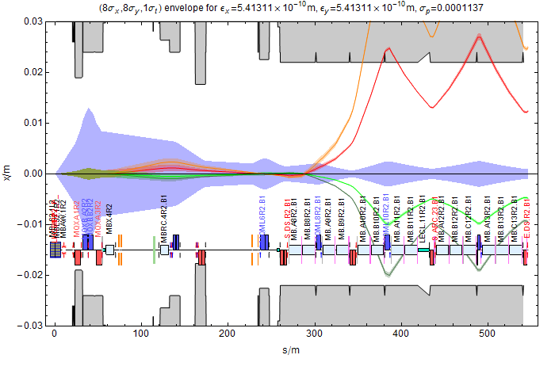
Motivation
Installation of collimators in the Dispersion Suppressor (DS) to both sides of ALICE (IP2) to intercept secondary beams from bound-free pair production (BFPP) and electromagnetic dissociation (EMD) .
Main: 208-Pb-82+
BFPP1: 208-Pb-81+
BFPP2: 208-Pb-80+
EMD1: 207-Pb-82+
EMD2: 206-Pb-82+
The rigidity of each
beam changed by
Interactive model: \\cern.ch\dfs\Users\j\jowett\Public\DSCollimatorBFPP.cdf

Slide 3
General Procedure
Modifying the layout to add DS collimator in IP2.
Generation of the luminosity source distribution at the IP.
Calculating the off-momentum transfer matrix from IP to start of collimator with MADX.
Tracking of source distribution to front jaw of collimator.
Conversion of MADX coordinates to desired coordinates for FLUKA.

Slide 4
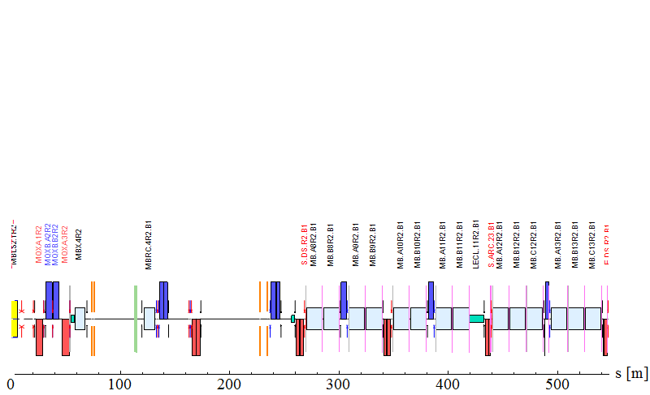
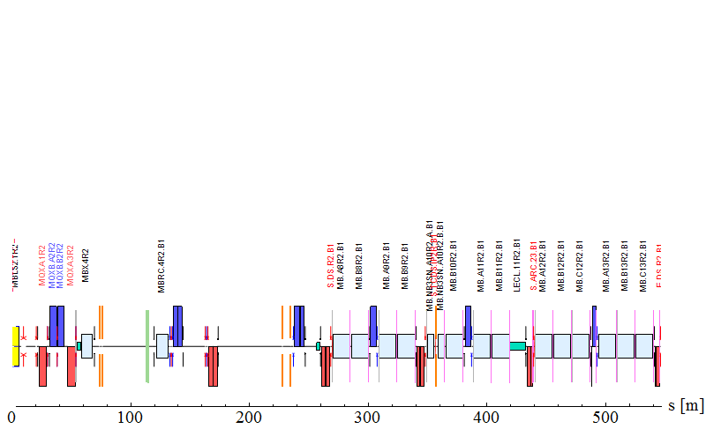
1. Modified layout of DS around IR2
Magnet to be replaced MB.A10R2
Nominal Beam Line
IP2
Modified Sequence
2 $×$11T dipole with L = 5.3m
Collimator jaw with L = 1m

Slide 5
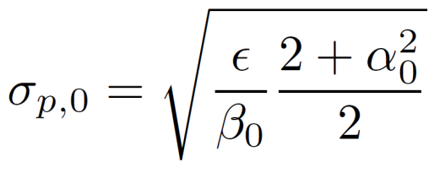
2. Generating distribution @ IP
R. Bruce et al., Beam losses from ultraperipheral nuclear collisions between 208Pb82+ ions in the Large Hadron Collider and their alleviation, Phys. Rev. ST Accel. Beams 12, 071002 (2009)
Generate $x_{0}, {x′}_{0} \& y_{0}, {y′}_{0}$
Assume Gaussian Distribution of the main beam:
Distribution of collision point at the IP:
→ Gaussian distribution with smaller standard deviation $σ_{λ,0}$.
→ The standard deviation of the angular distribution $σ_{p,0}$ is similar to the main beam.

Slide 6
2. Generating distribution @ IP
Generate $t_{0}, {pt}_{0}$
The longitudinal positions of the particles are not important for this analysis, since the impact point (front plane of the collimator) is fixed for this first attempt:
→ set them all to t = 0 at the IP.
Assume that the p_{t} values are Gaussian distributed around <p_{t}>=0 at the IP,
→ take the change in rigidity into account when generating the transfer
matrix for a beam with a given $δ≠0$.

Slide 7
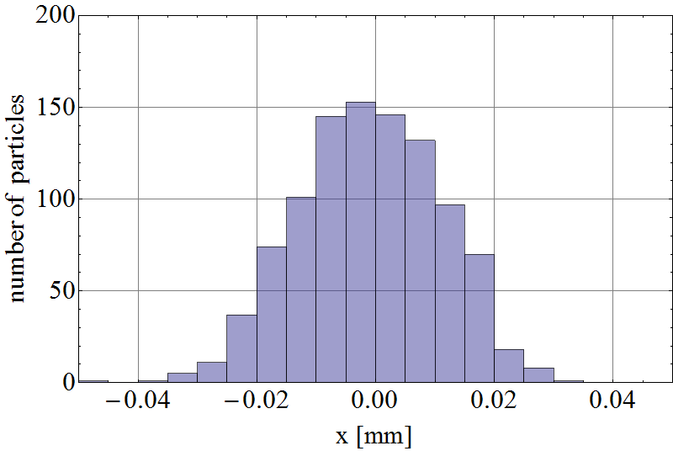
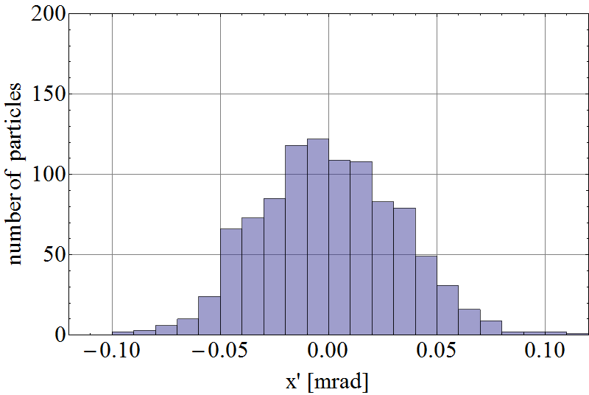
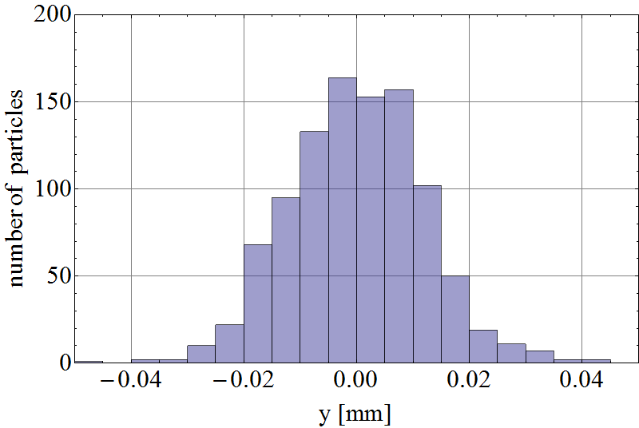
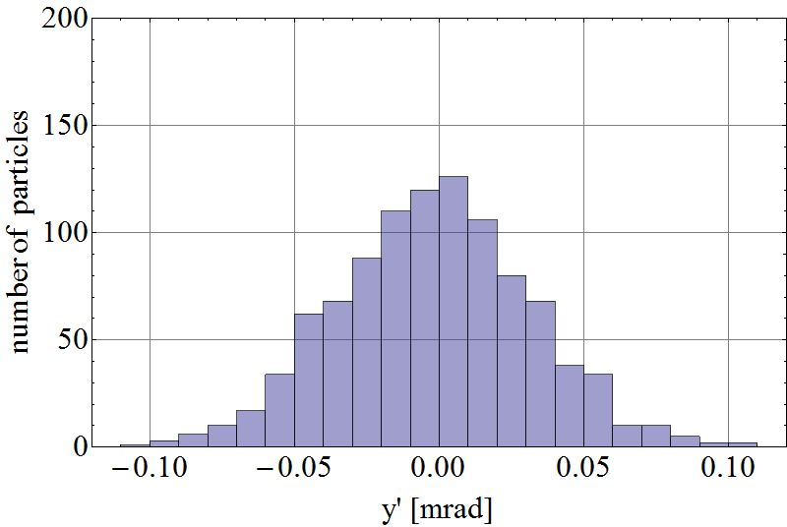
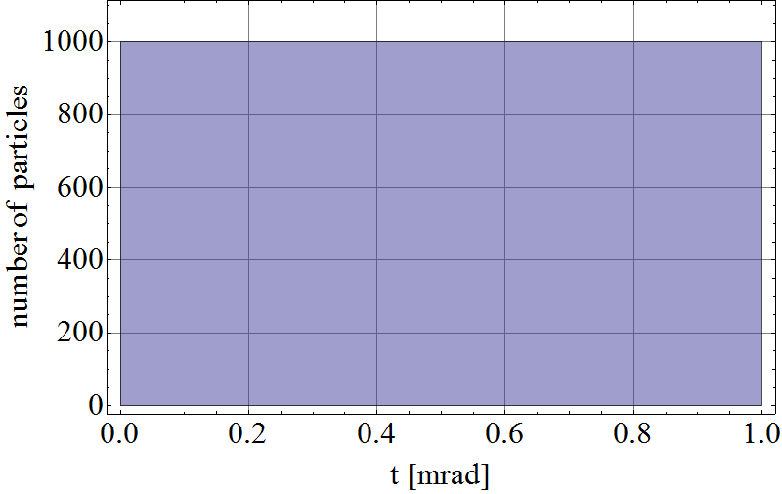
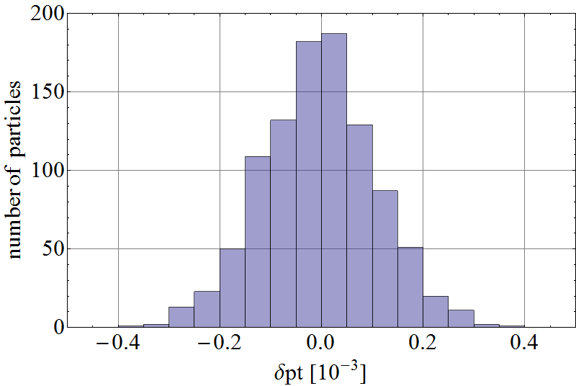
2. Generating distribution @ IP
x
x’
Example
coordinates
of 1000
particles at
the IP
y
y’
t
δpt

Slide 8
3. Transfer Matrix
Do TWISS with initial conditions at the IP and RMATRIX flag on:
→$δ$p= ${δ\text{p}}_{BFPP}, β_{x,y}, α_{x,y},$ x, y, px/(1+$δ$), py/(1+$δ$)
with $β_{x,y}, α_{x,y},$ x, y, px, py of the main beam orbit at IP2.
This generates TWISS table with transfer matrix elements after each element in the sequence.
MADX 6D Transfer Matrix:
→ form IP2 @ s = 0m
→ to new front plane of collimator @ s = 356.27m

Slide 9
4. Tracking
$x_{coll}= x_{co, coll}+M x_{IP2}$
where x = (x, px, y, py, t, pt)
and M = (6 $×$6 ) matrix
Since the $δ$p was considered in the TWISS calculation, but the pt variable given by MADX is only the variation around the $δ$p of the main beam, therefore $δ$p has to be added to all pt coordinates to get the correct energy.

Slide 10
4. Tracking
Coordinates of the orbit for a beam with $δ$p = $δp$BFPP:
Mean tracked Coordinates :
(0.0115, 0.00046 ,-0.000023, 2.04×10⁻⁷,0.0014 ,0.01234}

Slide 11
5. Conversion to FLUKA coordinates
Positions and angles on collimator
Energy in GeV

Slide 12
Things to be done…
Discuss how to proceed with FLUKA runs: Initial model of simple jaw
Calculations for B2 on left side of IP2.
Intercept other secondary beams from IP (EMD1, BFPP2, EMD2, …) as function of collimator gap (reduce losses in IR3 and elsewhere).
Other positions of the collimator?
Other optics cases

