Slide 1

Nuclear Beams at HL-LHC
Plans, requirements, solutions
John Jowett, Django Manglunki,
Michaela Schaumann, Reine Versteegen
Thanks for input to:
M. Blaskiewicz, R. Bruce, T. Mertens, R. Garoby, D. Kuchler, S. Hancock, T. Bohl, H. Damerau, S. Redaelli, M. Lamont, J. Wenninger, R. De Maria,
E. Calvo Giraldo, W. Hofle, P. Baudrenghien, R. Alemany, E. Shaposhnikova,
M. Giovannozzi, M. Wendt, J. Uythoven, F. Cerutti, D. Macina, E. Meschi,
B. Gorini, J. Wessels, W. Riegler, S. Bertolucci, …

Slide 2
Physics Programme
Europe’s top priority should be the exploitation of the full potential of the LHC, including the high-luminosity upgrade of the machine and detectors with a view to collecting ten times more data than in the initial design, by around 2030. This upgrade programme will also provide further exciting opportunities for the study of flavour physics and the quark-gluon plasma.
Pattern of 1 month heavy-ion run at the end of each year will continue through HL-LHC period.
ALICE, ATLAS, CMS for full programme
LHCb joins for p-Pb

Slide 3
Outline
Pb-Pb and p-Pb collisions
  LHC has already entered a high burn-off, high IBS, regime
  Luminosity levelling will be required after LS1
  Foretaste of p-p operation several years later after LS3
Run 2 will already exceed design performance
Future high-luminosity heavy ion operation of LHC depends on a somewhat different set of (more modest) upgrades to LHC and its injectors from p-p.
The high-luminosity phase of the heavy-ion programme will start sooner, in Run 3, when necessary upgrades to detectors should be completed.
It follows that the upgrades for HI operation need high priority in LS2
How to make really small colliding beams

Slide 4
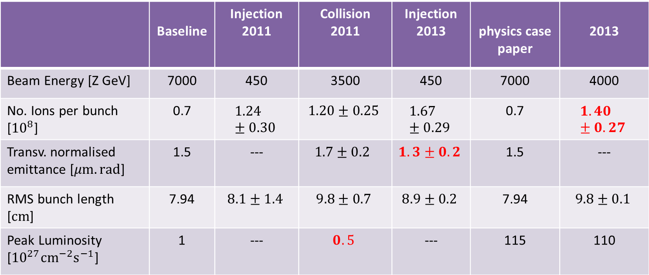
Design Baseline and Performance Achieved
“p-Pb not part of baseline”
Pb-Pb
p-Pb
 | Baseline | Injection 2011 | Collision 2011 | Injection 2013 | physics case paper | 2013
Beam Energy [Z GeV] | 7000 | 450 | 3500 | 450 | 7000 | 4000
No. Ions per bunch [${10}^{8}$] | 0.7 | $$1.24±0.30$$ | $$1.20±0.25$$ | $$1.67±0.29$$ | 0.7 | $$1.40±0.27$$
Transv. normalised emittance [$μm.rad$] | 1.5 | --- | $$1.7±0.2$$ | $$1. 3±0.2$$ | 1.5 | ---
RMS bunch length [$cm$] | 7.94 | $$8.1±1.4$$ | $$9.8±0.7$$ | $$8.9±0.2$$ | 7.94 | $$9.8±0.1$$
Peak Luminosity [${10}^{27}{cm}^{−2}s^{−1}$] | 1 | --- | $$0.5$$ | --- | 115 | 110

Slide 5
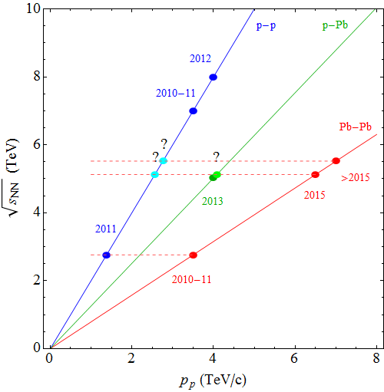
Future runs and species
2017? ~2021
Mainly Pb-Pb operation with p-Pb roughly every 3rd year.
More efficient to do p-Pb at same p_{p} energy as preceding p-p but may need to lower it to an equivalent CM energy.
Reference data in p-p also required at equivalent CM energies, should ideally track integrated Pb-Pb luminosity.
Lighter species not considered for now.
2017?
2011, 2013

Slide 6
Possible injection schemes for Pb ions
Reference: achieved performance of the ion injector chain
Baseline upgrade scheme
  100ns batch compression in the PS
  100ns batch spacing into the SPS (kicker)
Additional improvements, potential for 50 ns spacing in LHC
  Intensity increases from source, Linac 3, LEIR
  Splitting and/or additional batch compression in the PS
  Momentum Slip Stacking in the SPS
Expectations for 2015
  Alternating 100ns/225ns

Slide 7
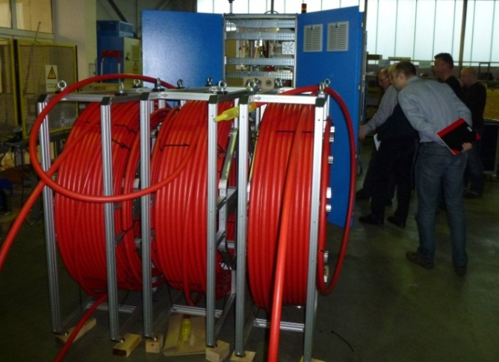
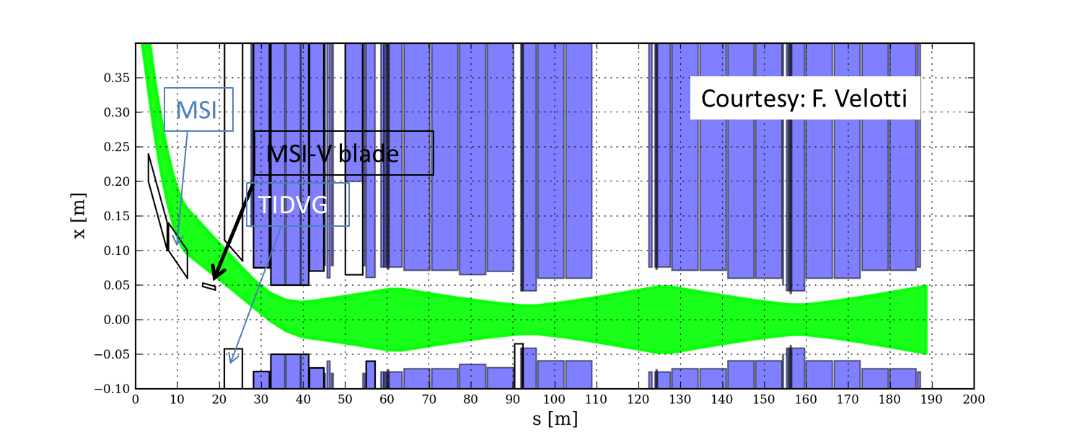
SPS injection system kicker upgrade 100 ns
Recent review https://indico.cern.ch/conferenceDisplay.py?confId=263338
Install a faster pulser & switch on MKP-S system in parallel to the present one
Supplement septum by new MSI-V
  No additional kicker magnets to be installed in the tunnel
  Maximum voltage of 40 kV
  Installation of MSI-V, recuperated from PSB recombination septa, one winter shutdown after LS2 (but spares can be used)
  With the MSI-V one can run at low voltages on the MKP-S and MSI-V, very comfortable, and no problems with Q20 optics
  Development time and lab tests needed

Slide 8
Run 2 nucleus-nucleus performance projections

Slide 9
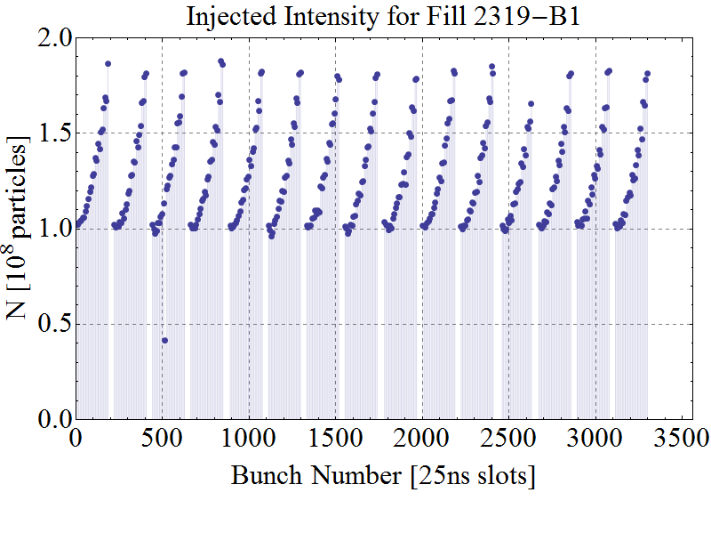
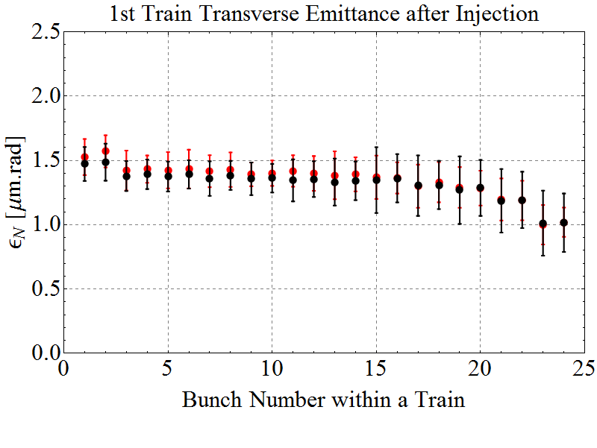
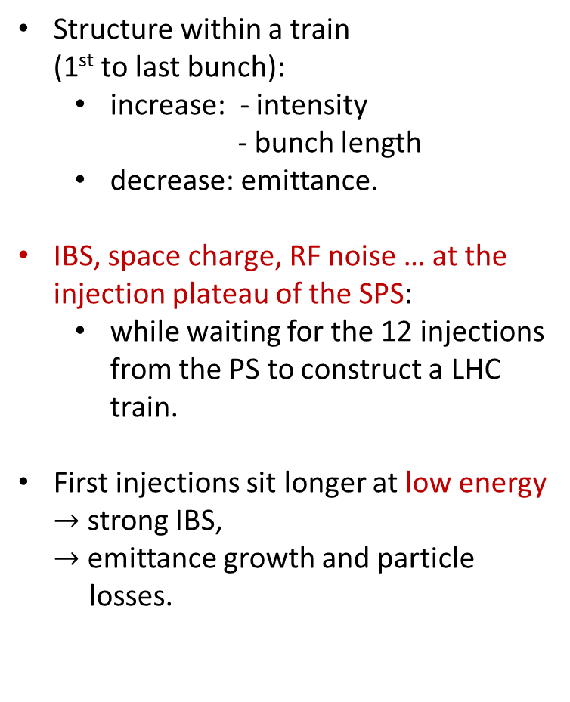
Bunch-by-Bunch Differences after Injection in the LHC
E = 450 Z GeV
Structure within a train
(1st to last bunch):
  increase: - intensity
  - bunch length
  decrease: emittance.
IBS, space charge, RF noise … at the injection plateau of the SPS:
  while waiting for the 12 injections
  from the PS to construct a LHC
  train.
First injections sit longer at low energy
$→$ strong IBS,
$→$ emittance growth and particle
losses.
Design
1 train
Intensity
Design
Horizontal / Vertical
Emittance

Slide 10
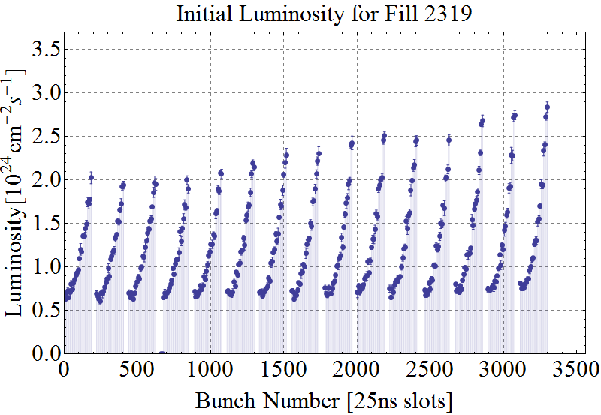
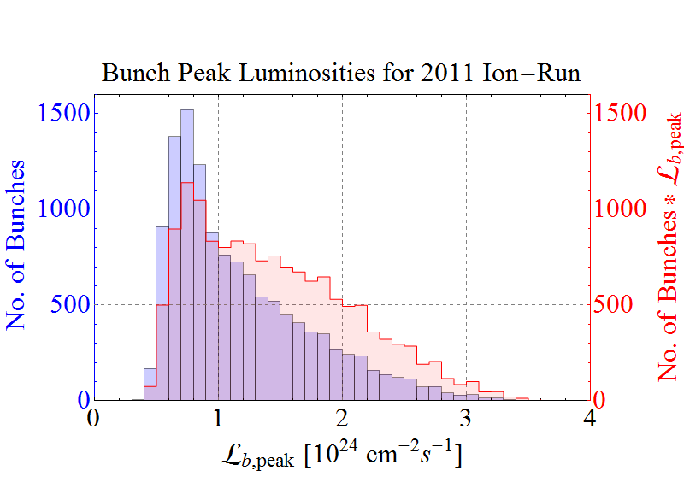
Bunch-by-Bunch Luminosity
E = 3.5Z TeV
Initial Luminosity
ATLAS data

Slide 11
General features of Pb-Pb in Run 2 and HL-LHC
Running 3 experiments at β*=0.5 m (also for Run 3,…)
  No ATS optics etc.
  Generally, we should be able to take over most of ramp and squeeze from p-p run for fast commissioning
    Additional squeeze and crossing angle configuration for ALICE
  Usual run length each year
    2015 & 2016: Pb-Pb
    2017: p-Pb (with LHCb)
    2018: Pb-Pb

Slide 12
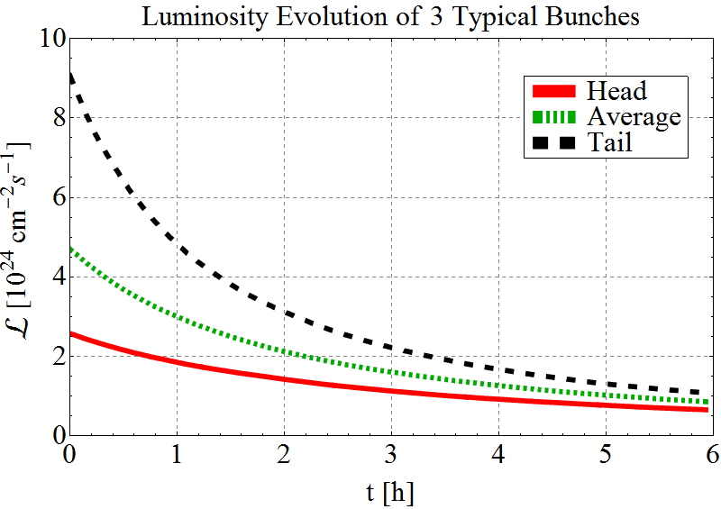
Spectrum of bunches in physics
In the following integrated luminosity estimates are made by summing over simulation results (CTE program) which includes effects of :
Emittance growth and debunching from IBS (stronger for heavy ions) , model of non-gaussian longitudinal distribution
Radiation damping (twice as strong for heavy ions)
Luminosity burn-off (much stronger for heavy ions)
Spectrum of bunch intensities and emittances implies a spectrum of bunch luminosities and luminosity lifetimes.
Distribution over bunch train from phenomenological model based on ATLAS 2011 data – described in following slides.
Work by Michaela Schaumann

Slide 13
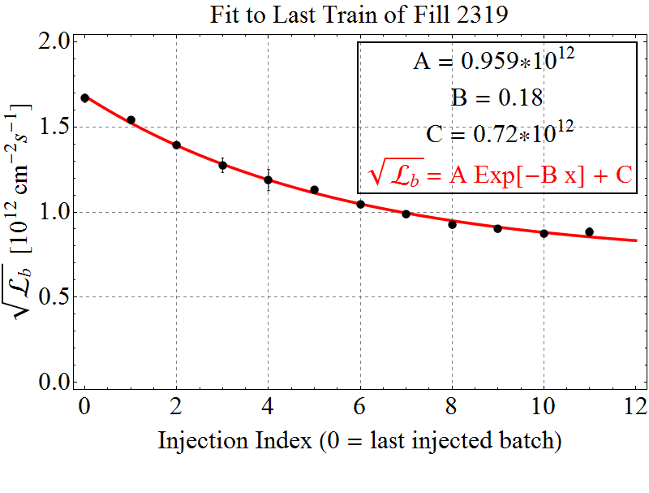

Bunch-by-Bunch Luminosity Model
Initial Luminosity
ATLAS data
LHC
SPS
SPS Effect:
→ Last train does not see degradation due to LHC injection plateau.
→ Cleanest picture of what happens “to the luminosity” in the SPS.
Fit to both effects:
LHC Effect:
→ Group bunches of equivalent PS batches from all trains, which saw the same SPS injection plateau length.

Slide 14
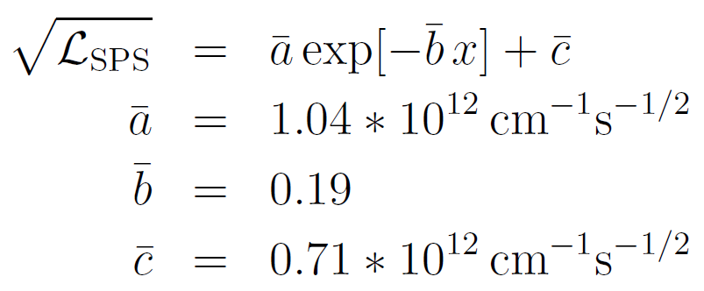
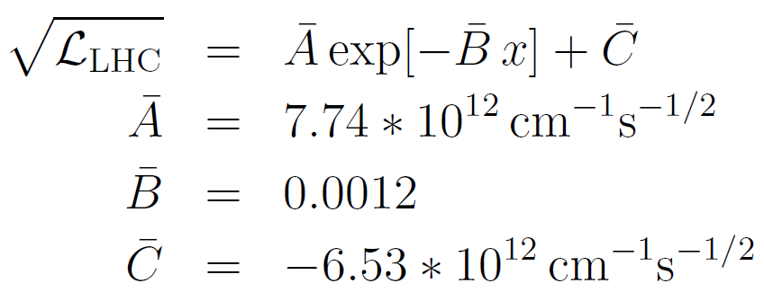

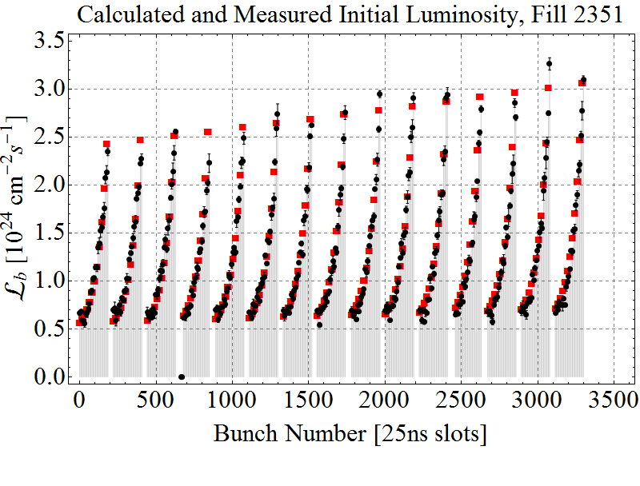
Complete Parametrisation
Intensity scaling factor
Normalisation factor
Average over all proper fills of 2011
Data
Model
Only takes variations due to SPS and LHC into account.
LEIR, PS are assumed to have cycles similar as in 2011.

Slide 15
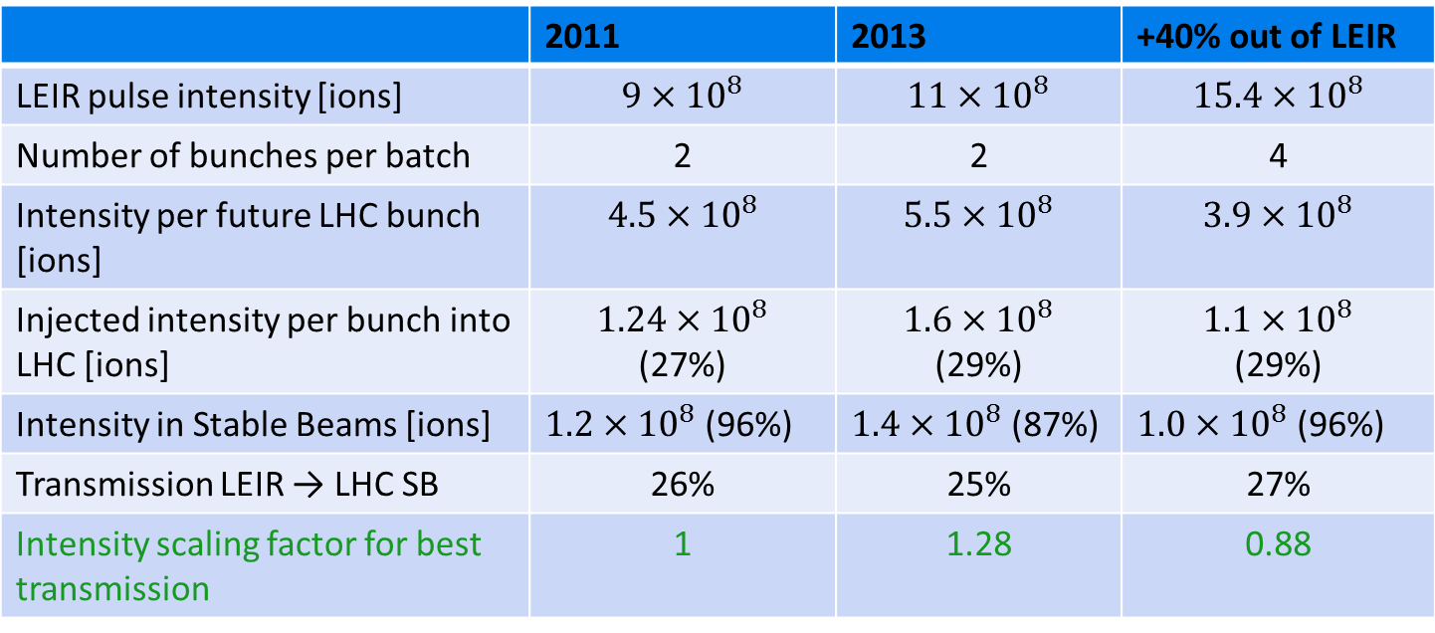
Intensity Scaling
Measured Bunch Intensities and Scaling
 | 2011 | 2013 | +40% out of LEIR
LEIR pulse intensity [ions] | $$9×{10}^{8}$$ | $$11×{10}^{8}$$ | $$15.4×{10}^{8}$$
Number of bunches per batch | 2 | 2 | 4
Intensity per future LHC bunch [ions] | $4.5×{10}^{8}$ | $5.5×{10}^{8}$ | $3.9×{10}^{8}$
Injected intensity per bunch into LHC [ions] | $1.24×{10}^{8}$ (27%) | $1.6×{10}^{8}$ (29%) | $1.1×{10}^{8}$ (29%)
Intensity in Stable Beams [ions] | $1.2×{10}^{8}$ (96%) | $1.4×{10}^{8}$ (87%) | $1.0×{10}^{8}$ (96%)
Transmission LEIR → LHC SB | 26% | 25% | 27%
Intensity scaling factor for best transmission | 1 | 1.28 | 0.88
Intensity scaling factor for best transmission means:
29% from LEIR to LHC injection,
96% from LHC injection to Stable Beams,
→ 27% from LEIR to LHC Stable Beams
taken for all cases labelled “2013 performance”.
taken for all cases labelled “+40%”.

Slide 16
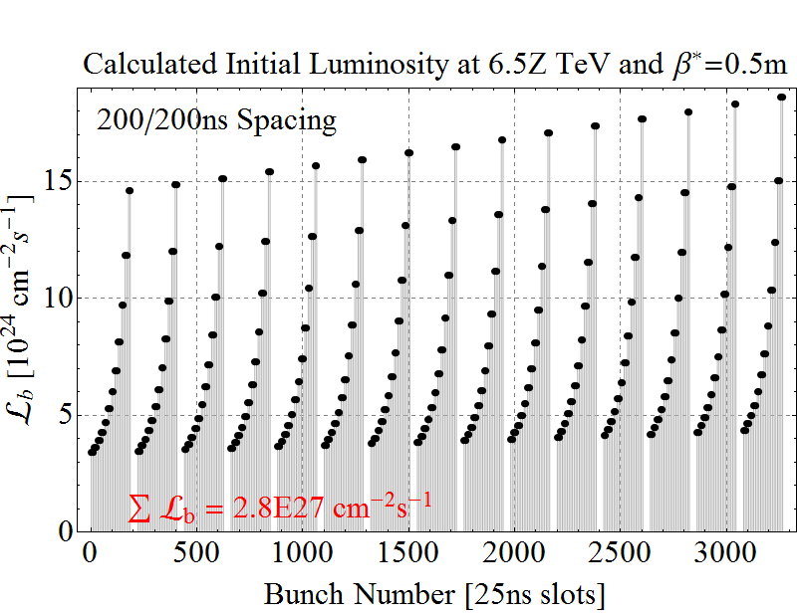
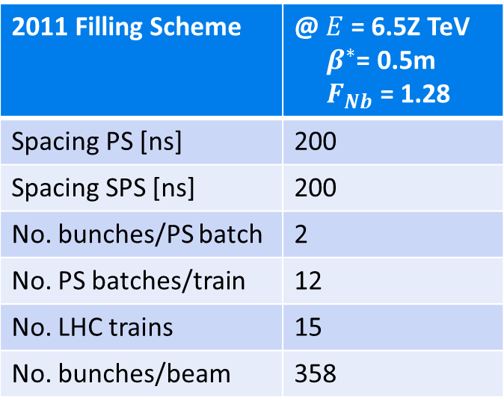

Estimates for after LS1 – 2011 Scheme, scaled N_{b}
2011 Filling Scheme | @ $E$ = 6.5Z TeV ${ β}^{∗}$= 0.5m $F_{Nb}$ = 1.28
Spacing PS [ns] | 200
Spacing SPS [ns] | 200
No. bunches/PS batch | 2
No. PS batches/train | 12
No. LHC trains | 15
No. bunches/beam | 358
E = 6.5 Z TeV
2011 filling scheme
2013 bunch performance
2011 injection→ stable beams
Max. peak luminosity (ATLAS/CMS)
$$2.8×{10}^{27}{cm}^{−2}s^{−2}$$

Slide 17
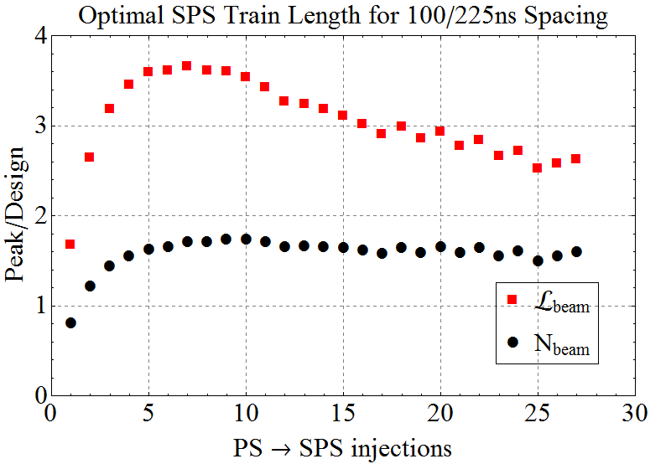
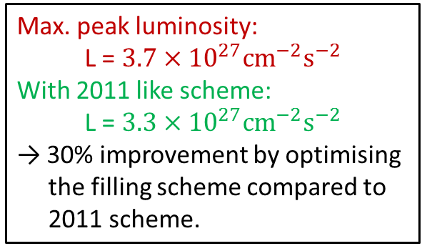
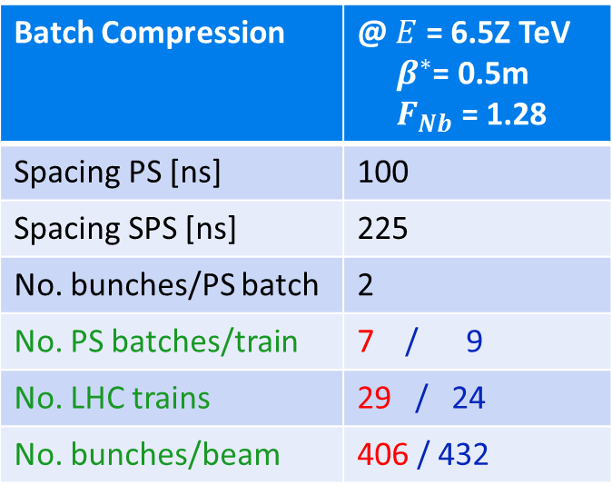
Estimates for after LS1 – 100ns Batch Compression
Batch Compression | @ $E$ = 6.5Z TeV ${ β}^{∗}$= 0.5m $F_{Nb}$ = 1.28
Spacing PS [ns] | 100
Spacing SPS [ns] | 225
No. bunches/PS batch | 2
No. PS batches/train | 7 / 9
No. LHC trains | 29 / 24
No. bunches/beam | 406 / 432
Filling schemes are not exact!
Takes into account:
Not more than 40% of the SPS is filled.
3.3μs abort gap.
900ns LHC kicker gap.
All bunches are colliding with an equal partner.
max. Luminosity
max. Intensity
Max. peak luminosity:
L = $3.7×{10}^{27}{cm}^{−2}s^{−2}$
With 2011 like scheme:
L = $3.3×{10}^{27}{cm}^{−2}s^{−2}$
→ 30% improvement by optimising the filling scheme compared to 2011 scheme.
2013 bunch performance
2011 injection→ stable beams

Slide 18
Levelling in Run 2
Before the upgrade (LS2), ALICE luminosity must be levelled at
ATLAS and CMS are not limited in peak L.
Luminosity decay dominated by burn-off: largely a conversion of stored beam particles to events.
Compare 3 possibilities
  Levelling only in ALICE
  Levelling all experiments to
  Levelling ATLAS, CMS at

Slide 19
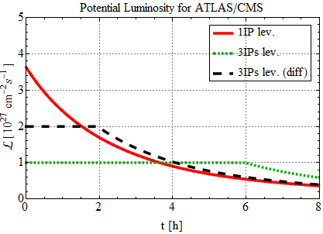
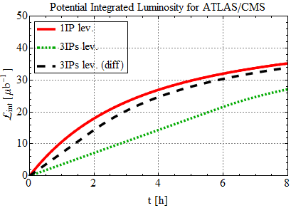
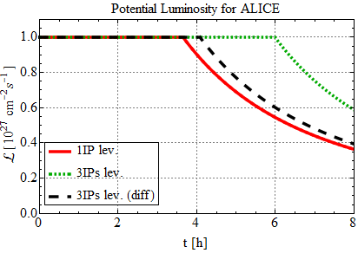
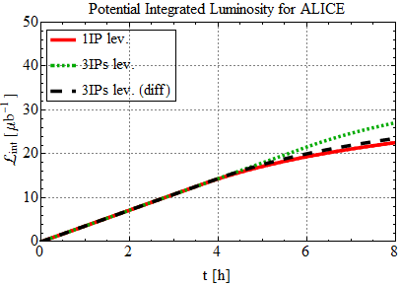
Comparison of levelling scenarios for Run 2
Few fills last this long?

Slide 20
Remarks on levelling
Some of the initial very high luminosity likely to be lost anyway during collision setup time (> 10 min)
  Favours some level of levelling for all experiments – very similar to future high luminosity p-p
Experience in 2013 p-Pb run was similar because of initial minimum-bias operation of ALICE
  Solution was 2 catch-up fills with beam separated in ATLAS and CMS – this remains an option
Optimum also depends on real turn-around times
Levelling can be done by standard separation method (or β*)

Slide 21
Run 3 & beyond, nucleus-nucleus performance projections

Slide 22
Estimates for after LS2
E = 7 Z TeV
Increasing the Luminosity by increasing the total number of bunches.
Reduce bunch spacing within batches.
Decrease SPS kicker rise time to reduce batch spacing.
Increase intensity out of LEIR by 40% and perform bunch splitting in the PS.
PS Spacing [ns] | SPS Spacing [ns] | No. Bunches/PS Batch
50 or 100 | 225 | 2 (unsplit) or 4 (split) | Present with batch compression (100ns)
50 or 100 | 100 | 2 or 4 | Baseline Batch compression (50ns) with split bunches
50 or 100 | 75 | 2 or 4
50 or 100 | 50 | 2 or 4 | Slip stacking with split bunches

Slide 23
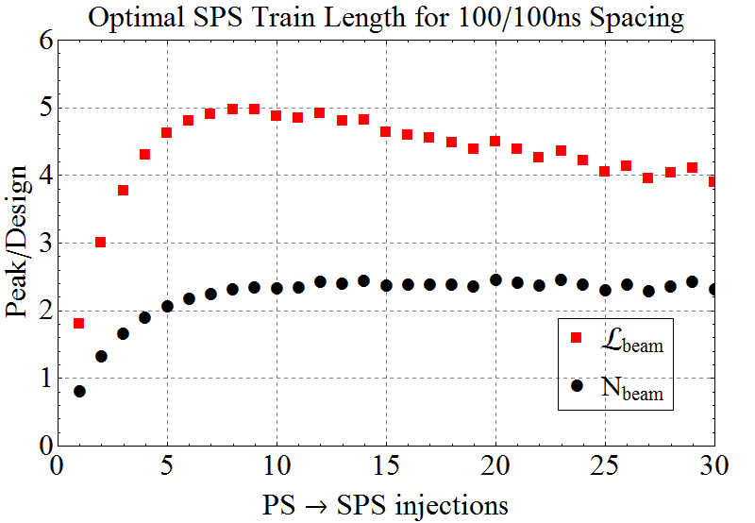
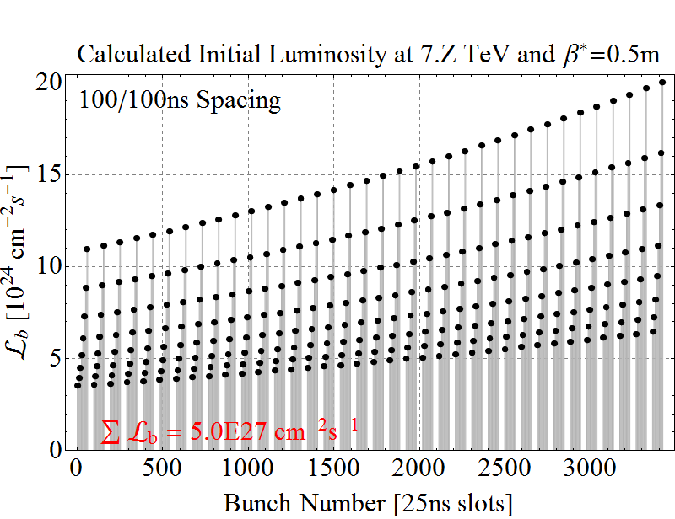
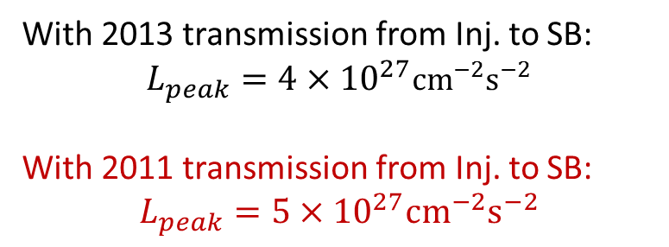
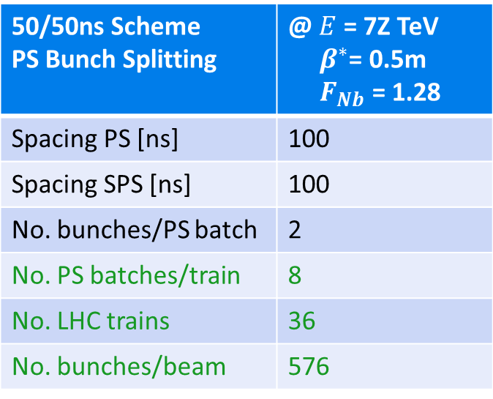
Estimates for after LS2 – 100/100ns Baseline Scheme
50/50ns Scheme PS Bunch Splitting | @ $E$ = 7Z TeV ${ β}^{∗}$= 0.5m $F_{Nb}$ = 1.28
Spacing PS [ns] | 100
Spacing SPS [ns] | 100
No. bunches/PS batch | 2
No. PS batches/train | 8
No. LHC trains | 36
No. bunches/beam | 576
With 2013 transmission from Inj. to SB:
$$L_{peak}=4×{10}^{27}{cm}^{−2}s^{−2}$$
With 2011 transmission from Inj. to SB:
$$L_{peak}=5×{10}^{27}{cm}^{−2}s^{−2}$$

Slide 24
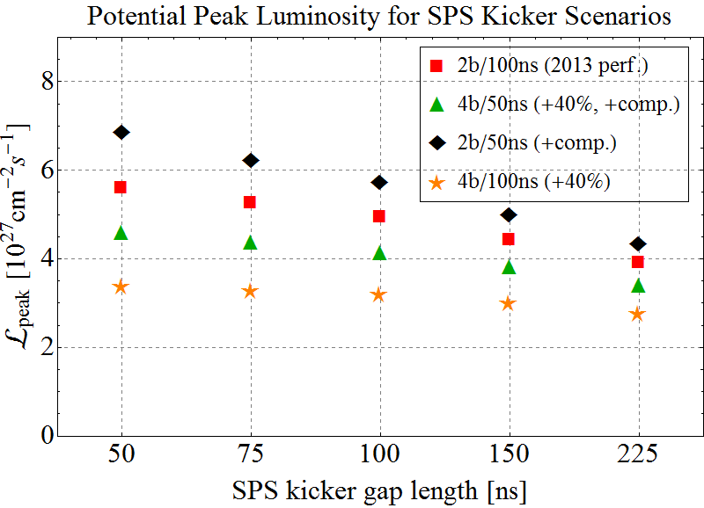
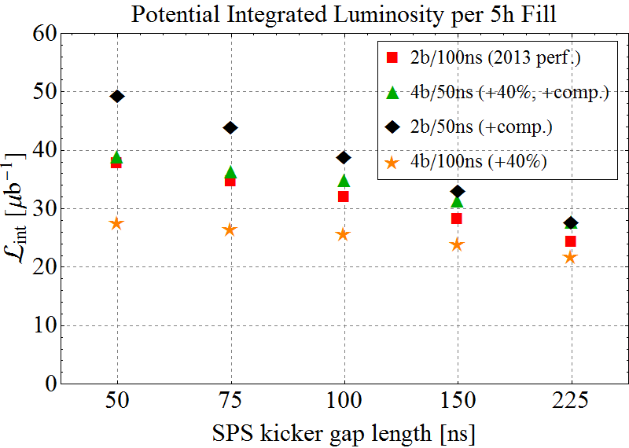
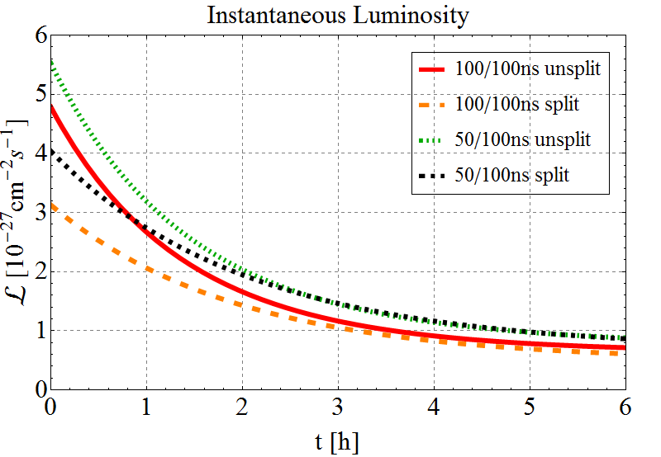
Estimates for after LS2
Peak luminosity higher for 100ns PS spacing with unsplit bunches.
→ Higher brightness bunches decay faster.
→ Higher integrated luminosity for 50ns PS spacing with split bunches.
Peak Luminosity
50/100ns split → ~1000 bunches/beam
100/100ns unsplit → ~600 bunches/beam
Integrated Luminosity

Slide 25
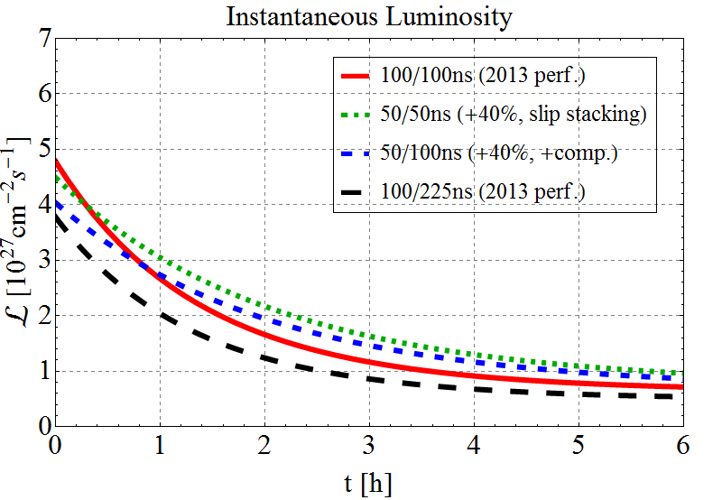
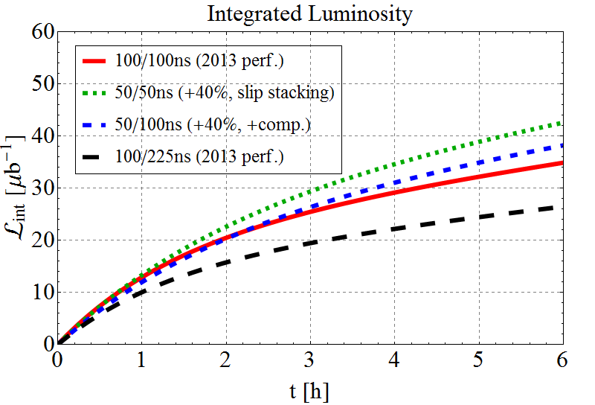
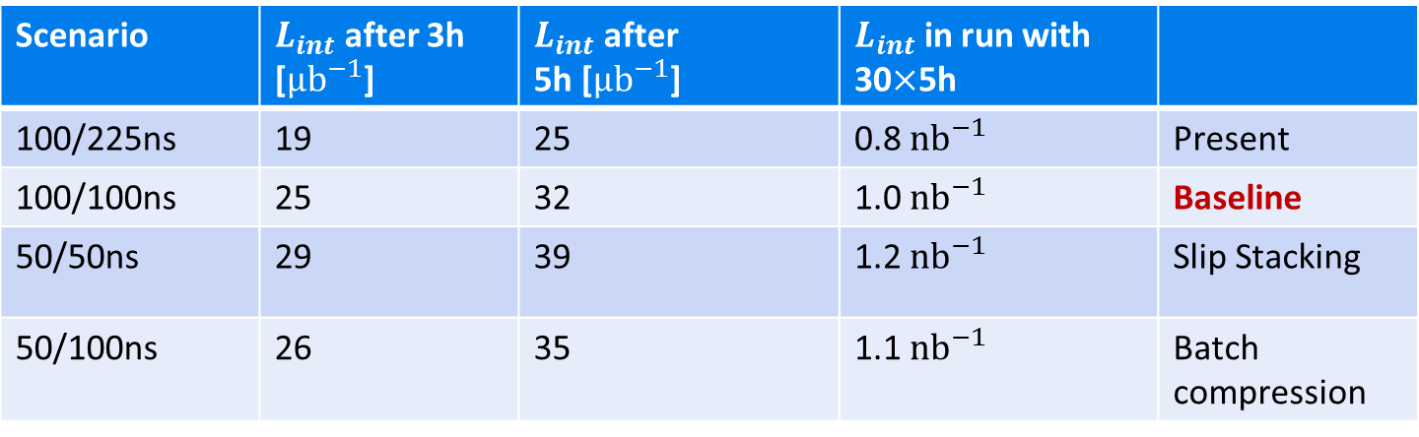
Luminosity Evolution for main Upgrade Scenarios
Takes into account different initial bunch luminosities and bunch luminosity decay times.
Scenario | $L_{int}$ after 3h [${μb}^{−1}$] | $L_{int}$ after 5h [${μb}^{−1}$] | $L_{int}$ in run with 30$×$5h
100/225ns | 19 | 25 | 0.8 ${nb}^{−1}$ | Present
100/100ns | 25 | 32 | 1.0 ${nb}^{−1}$ | Baseline
50/50ns | 29 | 39 | 1.2 ${nb}^{−1}$ | Slip Stacking
50/100ns | 26 | 35 | 1.1 ${nb}^{−1}$ | Batch compression

Slide 26
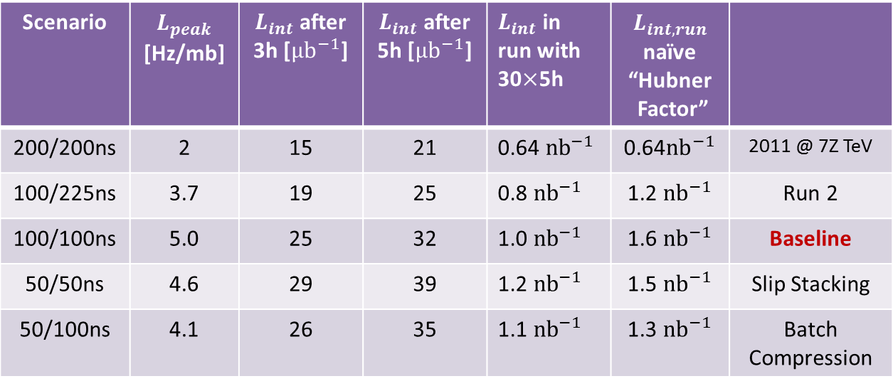
Luminosity projection summary
  Does not include any improvements beyond injection schemes and natural change of β*=0.5 m and beam size at 7 Z TeV. Some will be mentioned on next slide.
  Model will be re-fitted to real injector chain performance in the run-up to a given Pb-Pb run to re-optimise the length of the SPS trains. Improvements on SPS flat bottom can have a big impact.
Scenario | $L_{peak}$ [Hz/mb] | $L_{int}$ after 3h [${μb}^{−1}$] | $L_{int}$ after 5h [${μb}^{−1}$] | $L_{int}$ in run with 30$×$5h | $L_{int,run}$ naïve “Hubner Factor”
200/200ns | 2 | 15 | 21 | 0.64 ${nb}^{−1}$ | 0.64${nb}^{−1}$ | 2011 @ 7Z TeV
100/225ns | 3.7 | 19 | 25 | 0.8 ${nb}^{−1}$ | 1.2 ${nb}^{−1}$ | Run 2
100/100ns | 5.0 | 25 | 32 | 1.0 ${nb}^{−1}$ | 1.6 ${nb}^{−1}$ | Baseline
50/50ns | 4.6 | 29 | 39 | 1.2 ${nb}^{−1}$ | 1.5 ${nb}^{−1}$ | Slip Stacking
50/100ns | 4.1 | 26 | 35 | 1.1 ${nb}^{−1}$ | 1.3 ${nb}^{−1}$ | Batch Compression

Slide 27
Caveats and anti-caveats on luminosity projections
Assumed no peak luminosity limit
  May have to level ATLAS, CMS with no DS collimators (but see later)
  Integrated luminosity estimates are always very sensitive to a few days down-time in a 24 day run (so far we have been fairly lucky …)
  No time deducted for possible p-p reference data runs
Assumed no improvements beyond injection schemes
  200 MHz RF system in LHC potentially very beneficial for heavy ions (reduce IBS, better injection capture, …)
  Greater operational efficiency than 2011 would help, obviously
  Some possibilities later in this talk

Slide 28
Run 2 proton-nucleus performance projections

Slide 29
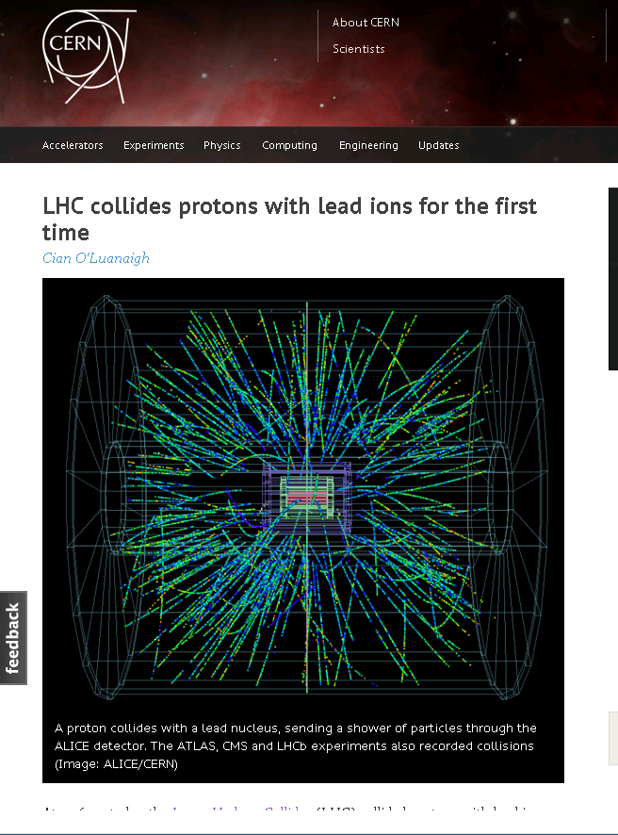
Single pilot fill, night of 13-14 September 2012
Injection and ramp of p and Pb beams with unequal revolution frequencies.
RF frequencies locked, collision points moved to experiments.
Setup of collimation, declaration of Stable Beams with unsqueezed optics.
4 hours physics, 2 more hours with IPs displaced by +- 0.5 m.
Largest increase of centre-of-mass energy in history of accelerators.
+ unexpected physics discoveries

Slide 30

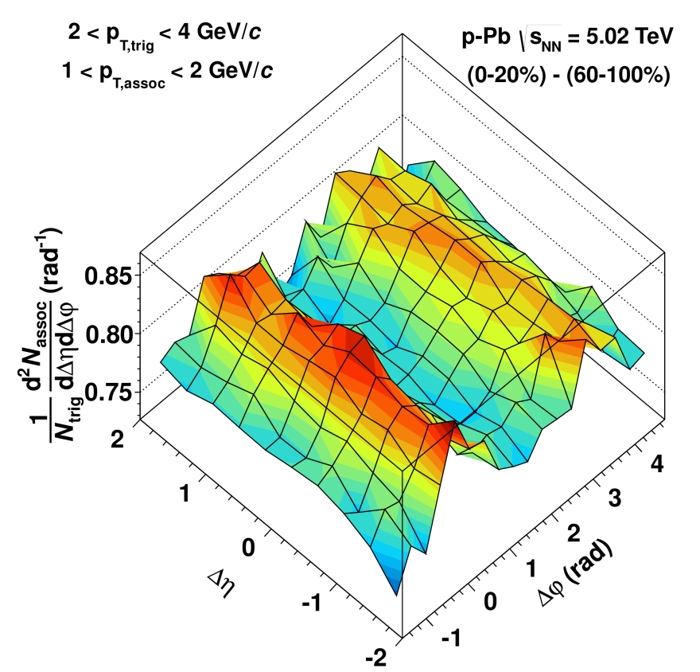
Correlations in pA: subtracting low-mult from the high-mult…
A double-ridge structure appears, with remarkable properties:
  Can be expressed in terms of v2,3 , Fourier coefficients of single particle azimuthal distribution, with v2,3 increasing with p_{T} and v2 also with multiplicity
  Same yield near and away side for all classes of p_{T} and multiplicity: suggest common underlying process
  Width independent of yield
  No suppression of away side observed (its observation at similar x-values at RHIC is considered a sign of saturation effects)
  In agreement with viscous hydro calculations ?!
Similar results published by CMS (first) and ATLAS.
Low multiplicity event class
High multiplicity event class
P. Giubellino, Evian Dec 2012
Double-ridge structure

Slide 31
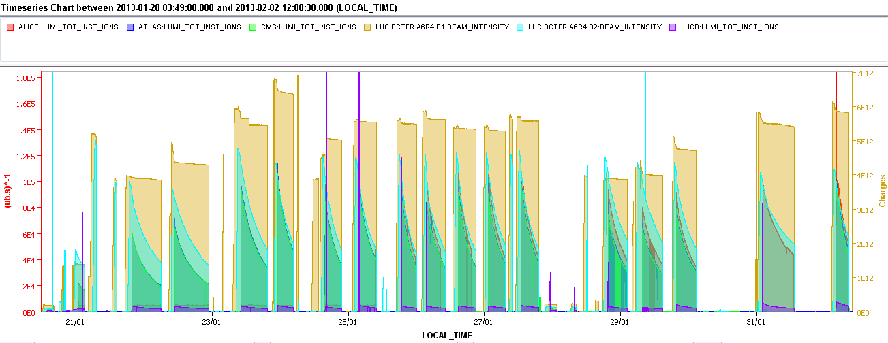
Reminder: p-Pb luminosity production in 2013
ALICE min. bias
IP1,5 separated
VdM scans
1x10²⁹cm⁻².s⁻¹
338 bunches
ALICE polarity reversal
272 bunches
Source refill
96 bunches
Increase of BLM monitor factor (losses during cogging)
TOTEM Roman Pots moved in
ALFA Roman Pots moved in
Problem of losses during cogging solved
Longitudinal blow up ON
R. Versteegen

Slide 32
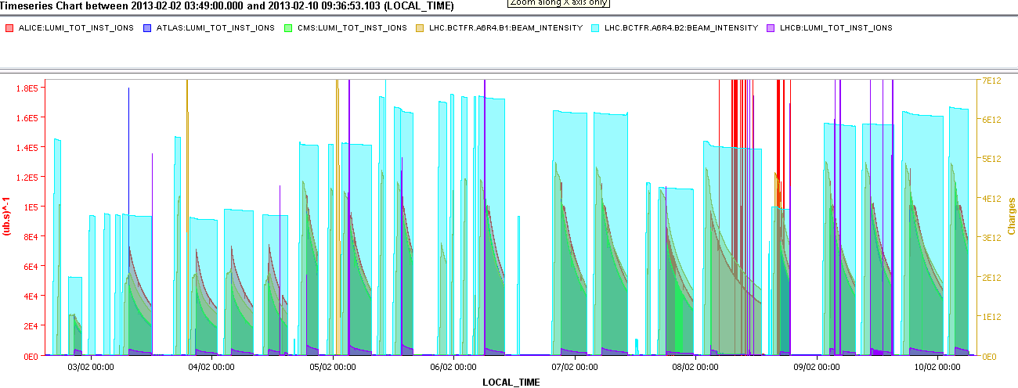
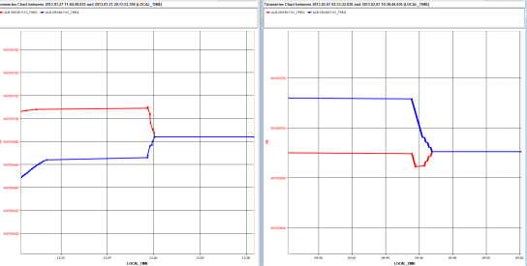
Reminder: Pb-p luminosity production in 2013
Max. peak luminosity 1.15x10²⁹cm⁻².s⁻¹!
Intermediate filling scheme to limit the losses
IP1,5 separated
VdM scans
The LHC experiments asked us to increase luminosity by factor 1000 over pilot fill and change operating conditions every few days.
1x10²⁹cm⁻².s⁻¹
Operating experience in all previous colliders has taught us that gradual optimisation of constant operating conditions is the path to high luminosity.
Increase of BLM monitor factor (losses end of ramp + squeeze)
Increase of BLM monitor factor (losses at the start of the ramp), rematch injection energy to the SPS
Increase bandwidth of orbit feedback
reduction of longitudinal blow-up at injection
Nevertheless we fulfilled all requests, thanks to
the quality of the LHC, meticulous planning and
some judicious risk-taking (with performance, I hasten to add).
So we do not need to fear “complicated” physics requests.
Increase of BLM monitor factor (losses during the squeeze),
Common frequency trimmed by -10Hz
27/01
07/02
RF frequencies

Slide 33
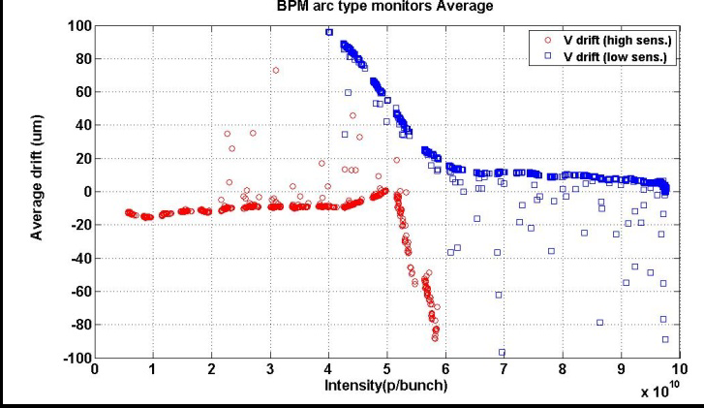
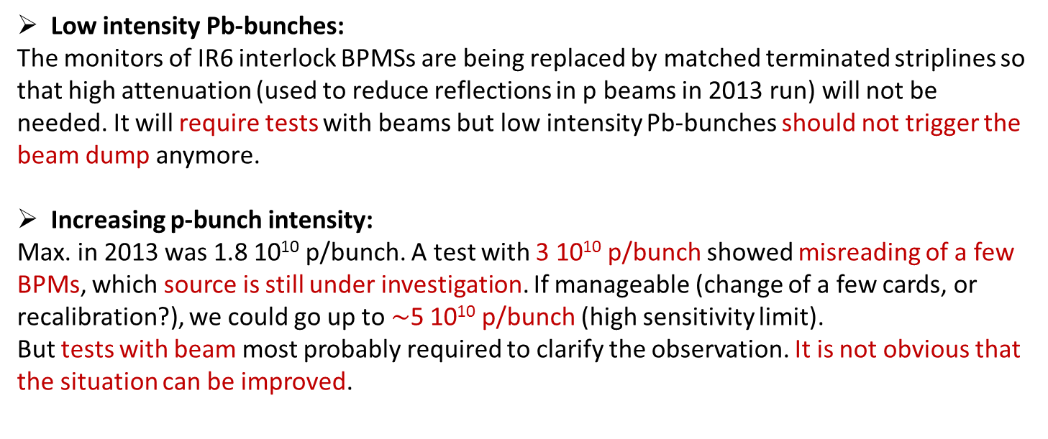
Bunch by bunch intensity ranges for p-Pb operation
Bunch by bunch intensity ranges for p-Pb operation
Low intensity Pb-bunches:
The monitors of IR6 interlock BPMSs are being replaced by matched terminated striplines so that high attenuation (used to reduce reflections in p beams in 2013 run) will not be needed. It will require tests with beams but low intensity Pb-bunches should not trigger the beam dump anymore.
Increasing p-bunch intensity:
Max. in 2013 was 1.8 10¹⁰ p/bunch. A test with 3 10¹⁰ p/bunch showed misreading of a few BPMs, which source is still under investigation. If manageable (change of a few cards, or recalibration?), we could go up to $\sim$5 10¹⁰ p/bunch (high sensitivity limit).
But tests with beam most probably required to clarify the observation. It is not obvious that the situation can be improved.
E. Calvo Giraldo, et al.,
DIPAC2011, TUPD12
Sensitivity range transition

Slide 34
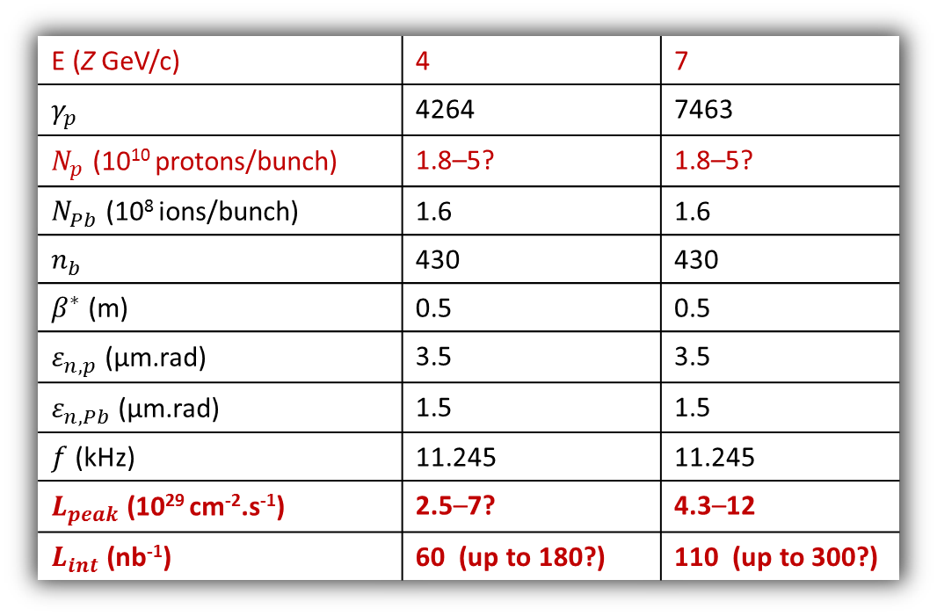
Performance for p-Pb in Run 2
p-Pb luminosity estimates for 2017
E (Z GeV/c) | 4 | 7
$γ_{p}$ | 4264 | 7463
$N_{p}$ (10¹⁰ protons/bunch) | 1.8–5? | 1.8–5?
$N_{Pb}$ (10⁸ ions/bunch) | 1.6 | 1.6
$n_{b}$ | 430 | 430
$β^{∗}$ (m) | 0.5 | 0.5
$ε_{n,p}$ (μm.rad) | 3.5 | 3.5
$ε_{n,Pb}$ (μm.rad) | 1.5 | 1.5
$f$ (kHz) | 11.245 | 11.245
$L_{peak}$ (10²⁹ cm⁻².s⁻¹) | 2.5–7? | 4.3–12
$L_{int}$ (nb⁻¹) | 60 (up to 180?) | 110 (up to 300?)
Increasing the proton intensity is constrained by Pb stability (moving long range encounters), and arc BPMs capabilities (still uncertain),
5 10¹⁰ p/bunch is the maximum reachable in any case,
Number of bunches per beam is taken from “baseline scenario” for Pb-Pb run in 2015-2016,
Integrated luminosity assumes same integrated over peak luminosity ratio as in 2013.
ALICE will level at ~10²⁸ and 10²⁹ cm⁻²s⁻¹ in Run 2

Slide 35
Performance for p-Pb in Run 2 and beyond
A run at the same energy as preceding p-p will be more efficient in several ways (less setup time, smaller momentum shifts, …) than a run at reduced energy
p-Pb runs are complicated, many changes of configuration, higher risk …
Hope to increase LHCb luminosity in Run 2
and possible adjustments of filling scheme
  Possibility of to be confirmed.
Further increases of p-Pb luminosity in Run 3 and beyond depend mainly on more bunches but other limits (eg BFPP) will come into play

Slide 36
Peak Luminosity limits

Slide 37
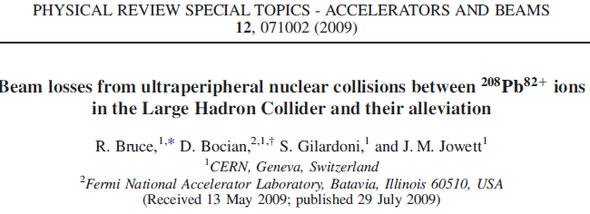
Electromagnetic processes in Pb-Pb collisions
Discussed since Chamonix 2003 …
Each of these makes a secondary beam emerging from the IP with rigidity change
Hadronic cross section is 8 b (so much less power in debris).

Slide 38
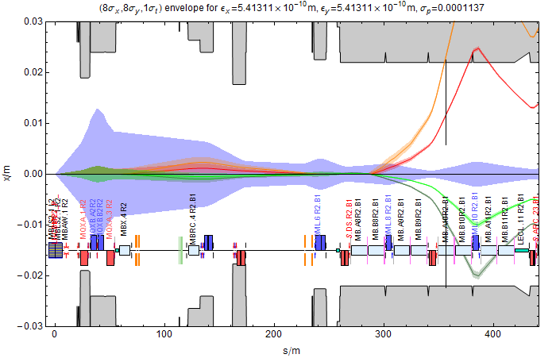
Secondary beams from Beam 1 in IR2
BFPP2
BFPP1
TCLD (DS collimator)
EMD1
EMD2
Cannot separate BFPP and main beam in warm area (TCLs not useful)
BFPP beam is smaller than main beam (source is luminous region).

Slide 39
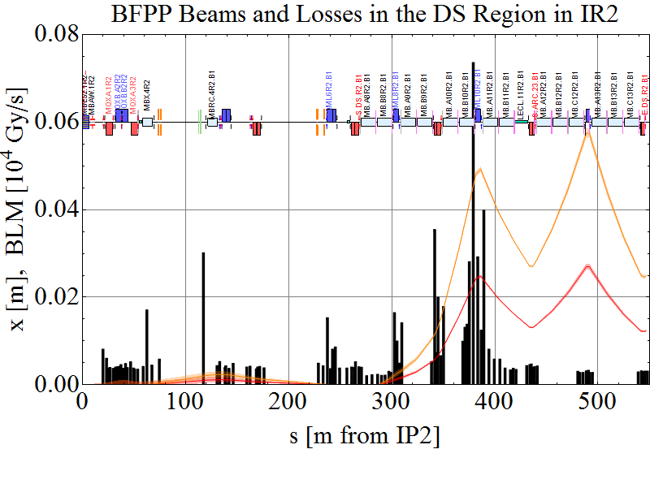
2011 Pb-Pb operation

Slide 40
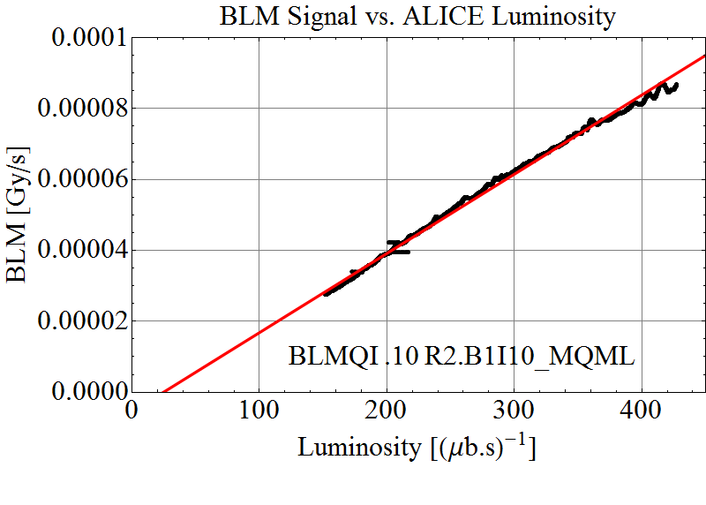
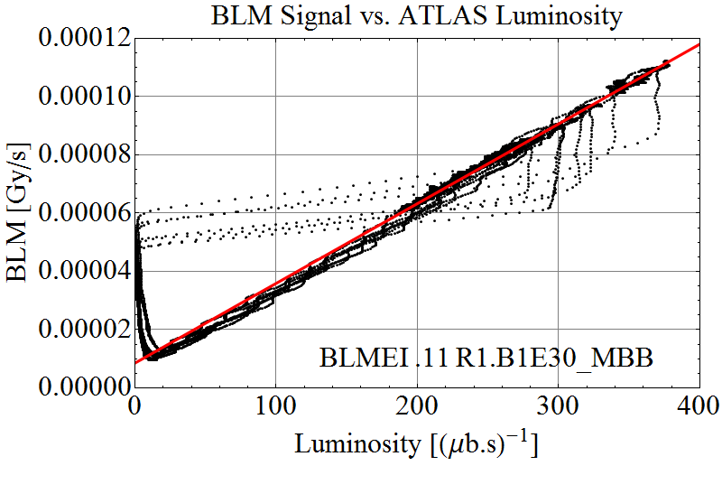
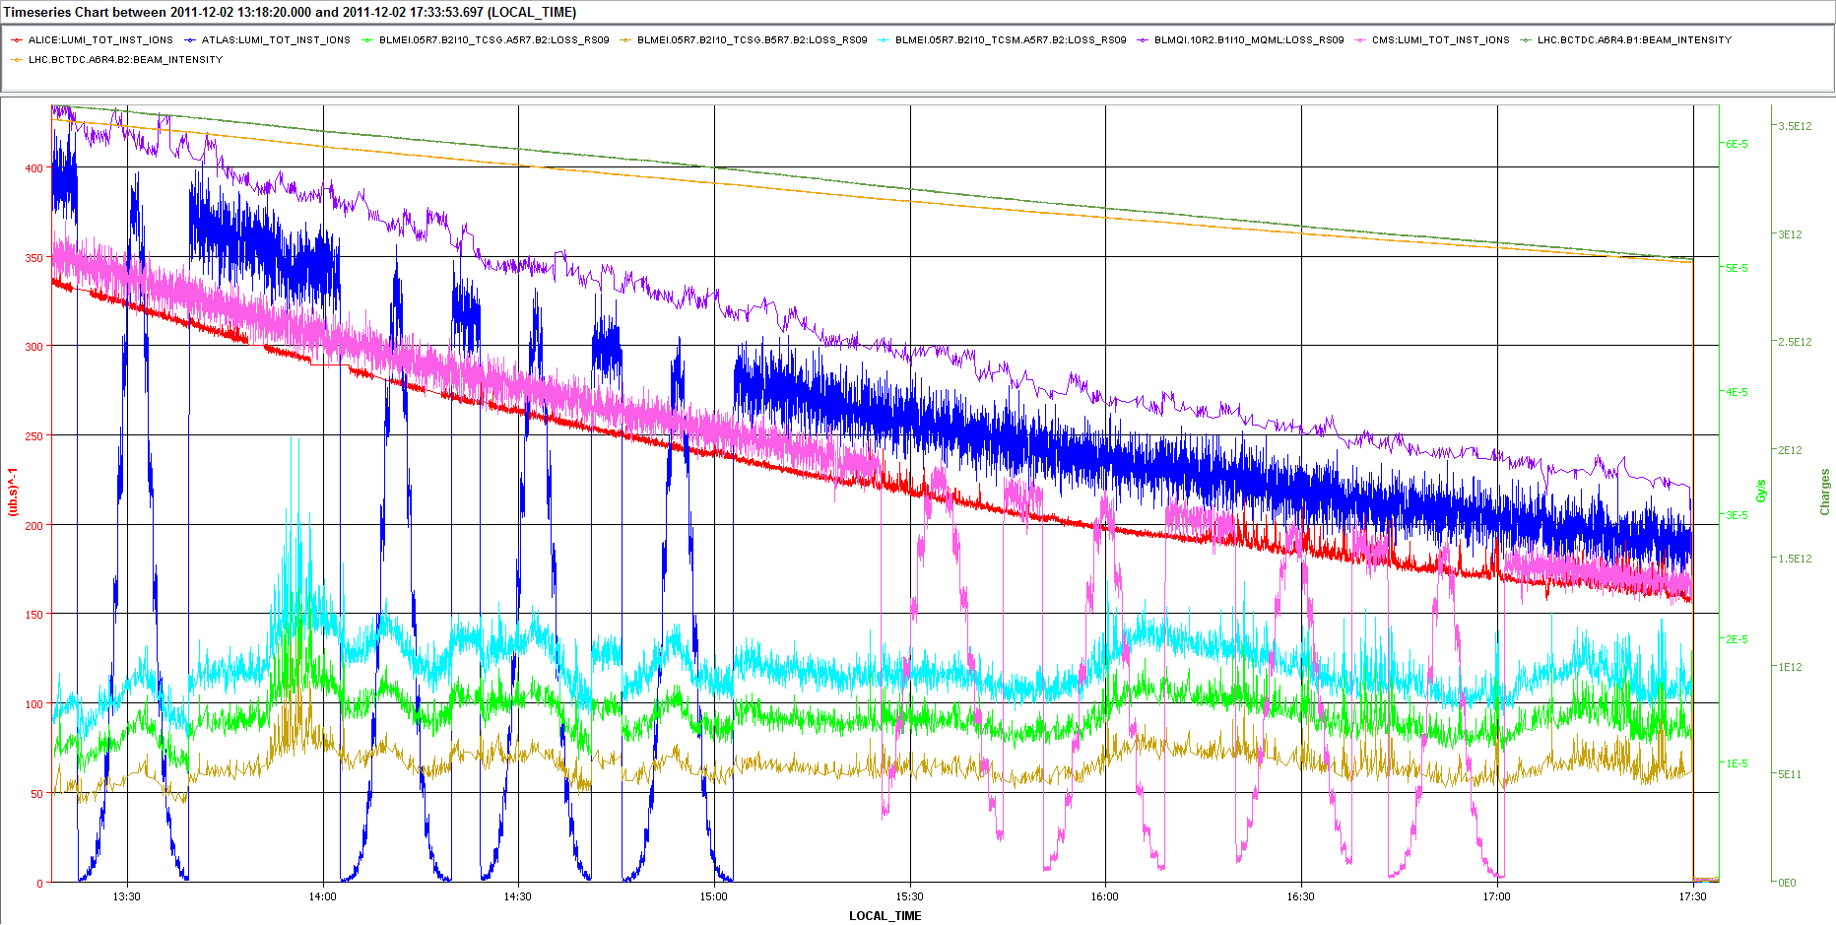
Main losses in DS are due to luminosity
Regular physics fill
From van der Meer scans

Slide 41
HL-LHC Performance Goals for Pb-Pb collisions
With upgrade of Pb injectors, etc, indicative parameter goals:
ATLAS and CMS also taking luminosity (high burn-off).
Levelling strategies may reduce peak luminosity but we must aim for high intensity.
Comparison data: p-Pb runs at high luminosity may become comparable to Pb-Pb (on one side of IP).

Slide 42
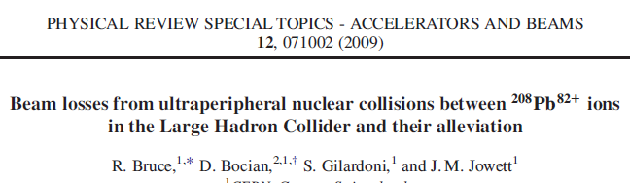

Power density in superconducting cable
FLUKA shower simulation
See other talks!
Nevertheless, expect to quench MB and possibly MQ!
Newer FLUKA studies – see talk by A. Lechner

Slide 43
Radiation damage
Discussion on nuclide fluences in coils following talk by Paolo Fessia – to be confirmed.

Slide 44



DS collimator installation in IR2
Magnet to be replaced MB.A10R2
Nominal Beam Line
IP2
Modified Sequence
2 $×$11T dipole with L = 5.3m
Collimator jaw with L = 1m

Slide 45
ATLAS and CMS ?
ATLAS and CMS also take high-luminosity Pb-Pb
The same problem of BFPP losses exists in the DSs around IP1 and IP5
  Details of loss locations somewhat different
  Highest BLM signals from BFPP in 2011 were right of IP5
  We have some scope for mitigation using the orbit bump method tested in 2011 (will be made operational for Run 2 anyway) - backup slides

Slide 46

DS Collimator locations around ATLAS or CMS
Different from IR2 but various locations would be effective

Slide 47

Steady-state losses during Pb-Pb Collisions in 2011
Bound-free pair production secondary beams from IPs
IBS & Electromagnetic dissociation at IPs, taken up by momentum collimators
Losses from collimation inefficiency, nuclear processes in primary collimators
??

Slide 48

Collimation Inefficiency
Discussed extensively in the past
Mainly a limit on total intensity
  Some situations (Pb beam sizes larger than p, putting beams into collision, off-momentum p-Pb orbits more critical)
  Mitigation – some success with bump strategy – backup slides
  New simulation activity starting

Slide 49

Higher harmonic (800 MHz) RF system, Pb-Pb 7 Z TeV
800 MHz RF system provides useful gain in luminosity.
Tom Mertens
http://cds.cern.ch/record/1377067

Slide 50
Lower Harmonic (200 MHz) RF system
Will be studied in Collider Time Evolution (CTE) program
  Expect reduction of IBS growth and debunching losses in LHC at both injection and collision
Longer bunches will reduce bandwidth and kicker voltage requirements for stochastic cooling system (see later)
Injection requirements
Likely more useful than 800 MHz (to be confirmed)

Slide 51
Stochastic cooling

Slide 52


Stochastic cooling of Pb beams
Inspired by spectacular luminosity enhancement by 3D stochastic cooling of bunched Au and U beams at RHIC
First study with Mike Blaskiewicz during visit in June
Simulations and paper at COOL’13 workshop

Slide 53




Stochastic Cooling Simulations, Pb beam at 7 Z TeV
IBS horizontal growth time $≈$ 8h.
Radiation damping time $≈$ 13h
→ radiation damping not included in the simulations on this slide.
Assuming a stochastic cooling system with a 5-20GHz bandwidth and average 2013 Pb bunches [4]:
First estimate for RMS voltage per cavity (assuming a system with 16 cavities as in RHIC):
Integrated luminosity could be increased by a factor 2.
Larger bandwidth and higher upper frequency, lead to higher integrated luminosity.
M. Schaumann

Slide 54

ALICE, ATLAS, CMS illuminated
Simulations include (very high) luminosity burn-off, IBS, 3D bunched-beam stochastic cooling, etc.
What is happening here? See next slide …
M. Schaumann

Slide 55



Bunch parameters with cooling (3 experiments)
Much more efficient use of injected intensity and beam time!
IBS comes back
Extremely small vertical beam sizes, vertical orbit stability may become the limit (we can always reduce vertical cooling).
Parametric study of betatron coupling: although it is usually small in LHC, may be desirable to introduce some.
Need new definition of “operational efficiency.”

Slide 56
How to proceed - tentative
Further studies on feasibility and to define necessary hardware systems
  Space reservation in IR4 (kicker systems) and elsewhere (IR4, IR2, IR6 …?) for pickups
  Challenge: kicker cavities that open and close (only at Pb physics energy) and can co-exist with LHC proton beam
Demonstration of longitudinal cooling in ~2015-16
  Existing Schottky as pickup
  “Off-the-shelf” 5 GHz amplifier (to be checked)
  Replace existing unused shaker chamber in IR4 with kicker (when ready) in technical stop/end-of-year shutdown
Collaboration with BNL, benefit from their experience to define fast-track implementation
200 MHz RF system proposed for p-p should improve cooling

Slide 57
Conclusions
Run2
  Pb-Pb and p-Pb luminosities already beyond design, should exceed LHC Phase 1 goal of 1 nb⁻¹ in Pb-Pb
Run3 and beyond
  Further gains from injectors, stochastic cooling (?)
High priority developments to achieve 10 nb⁻¹
  SPS injection kicker upgrade
  Other LIU … source intensity, LEIR intensity limits
  Injection schemes for more, and brighter, bunches (50 ns)
  Reduce intensity decay in SPS !?!
  Dispersion suppressor collimators (ALICE, …)
  Initiate fast track to stochastic cooling implementation
  200 MHz RF system proposed for p-p should also help Pb beams in several ways (to be quantified)
  Potential p-Pb performance depends critically on resolution of BPM problems

Slide 58
BACKUP SLIDes

Slide 59




More detail on emittances from wire scans
IBS mainly horizontal
M. Schaumann

Slide 60




Beam parameter evolution, not the best fill
M. Schaumann

Slide 61
Momentum offset required to equalise frequencies (2-in-1 magnets!)
Would move beam by 35 mm in QF!!
Limit with pilot beams
Limit in normal operation
Injection and acceleration with unequal revolution frequencies
Revolution frequencies must be equal for collisions.
Lower limit on energy of p-Pb collisions, E_{p} ~ 2.7 TeV .
Notes:
Straightforward engineering solution: fill SPS with some extra LHC dipoles to boost injection energy

Slide 62

Batch by batch blow up measurements analysis (M. Schaumann)

Slide 63
ALICE Crossing Angle
Possible upgrade of TCLIA collimator for ZDC
  Up to now always had crossing angle constraint
  Aperture clearance for spectator neutrons from IP to ZDC
  Possibly inadequate beam-beam separation for 50 ns (also parasitic luminosity)
  Under study …

