Slide 1
Lessons learnt at
5th High-Power Targetry Workshop
Fermilab, 20-23 May 2015
Federico Carra EN-MME
ColUSM 6.6.2014

Slide 2
Outline
Workshop structure and objectives
Topics of interest for collimators:
      Materials radiation resistance: RaDIATE
      Numerical simulations
      Remote handling
Conclusions

Slide 3
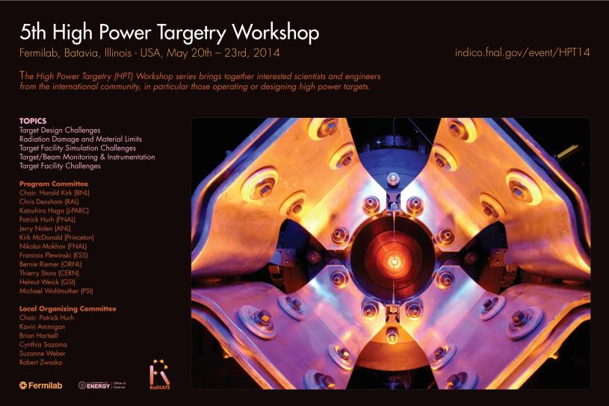
Workshop Structure

Slide 4
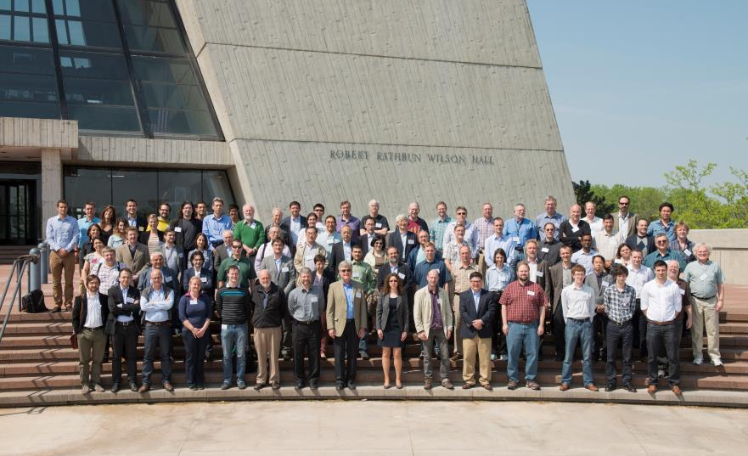
Workshop Structure
Strong CERN presence!

Slide 5
RaDIATE Collaboration
Objective:
  Form an inter-disciplinary team between STFC, Fermilab and allied institutions to foster long term expertise in understanding the response of materials to radiation damage in the high energy proton regime
Website: http://www-radiate.fnal.gov/index.html
Materials studied:
  Graphite and Carbon-Carbon Composites
  Beryllium
  Tungsten (with or without tantalum cladding)
  Titanium alloys
  Other

Slide 6
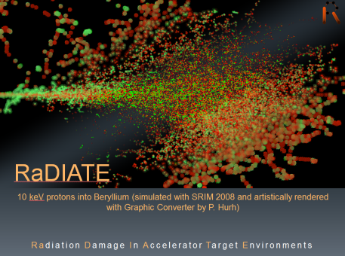
RaDIATE Collaboration
The ultimate ambition is to be able to predict operating lifetimes for as many of the aforementioned materials as possible in terms of integrated proton fluence for the high energy proton accelerator parameter space
Open to collaborations
Even without a formal collaboration, people interested can be added to the mailing list (contact Patrick Hurh or Chris Densham)
Proposal: one (or more) persons from the collimation project to be added to the mailing list, to follow-up advancements, future meetings, etc.

Slide 7
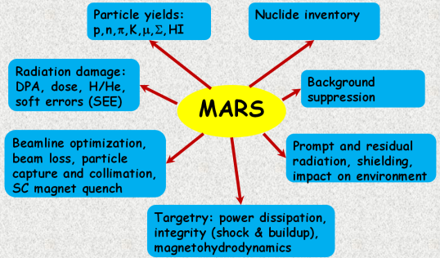
Numerical simulations
Focus Session: Target Facility Simulation Challenges (chairman: N. Mokhov)
Particle physics simulations: MARS
In majority of real-life complex applications, FLUKA and MARS15 energy deposition results coincide within 10% and agree with data

Slide 8
Numerical simulations
Thermo-mechanical simulations
  Several software and methods are used to predicted the thermo-mechanical response of targets impacted by high-energy particle beams:
    Implicit codes (e.g. ANSYS)
    Explicit codes (e.g. Autodyn, BIG2, LS-Dyna)
    Fluid dynamics and acoustic codes (e.g. OpenFOAM)
My personal outcome: CERN is at the state of the art in simulating all the complex phenomena involved during a particle beam impact on solids or fluid targets (explosion, spallation, phase changes, etc.), predicting the survival or failure of the component.

Slide 9
Remote handling
Focus Session on Remote handling and Target facility challenges (chairman: R. Losito)
Very interesting presentations; in particular, Dr. A. Rolfe (Oxford Tecnologies Ltd) showed videos of remote handling operations done at CERN
Lessons learnt: RH requirements should be taken into account during the design phase
  If components are designed for RH, then operations take the same time or less than with human
  If not: 5 to 10 times more!
More about remote handling for collimators → R. Losito

Slide 10
Conclusions
HPTW 14: particularly interesting for my personal education (design of targets and target facilities) and for my PhD (simulations, tests, materials, …)
Collimation Project, fields of interest:
  Materials and study of radiation damage → RaDIATE collaboration
  Numerical simulations:
    Particle physics → MARS15, FLUKA good benchmarking (10% difference in the results)
    Thermo-mechanical simulations → CERN methods are at the state of the art
  Remote Handling (even more important now, with access to the collimators becoming more and more difficult due to the high radiation)

Slide 11
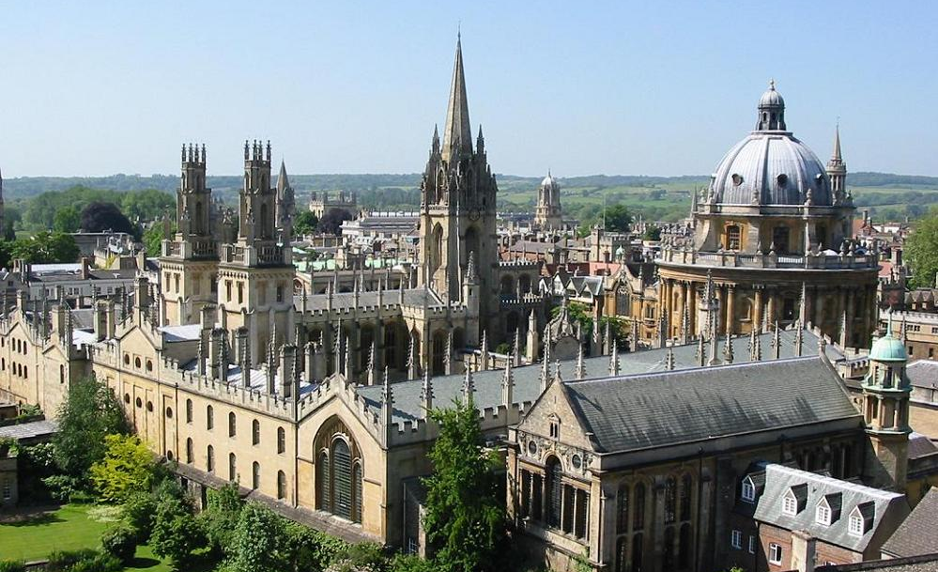
Next Stop: Oxford!
(HPTW 2016 at RAL)

Slide 12
Thank You For your attention!

