Slide 1

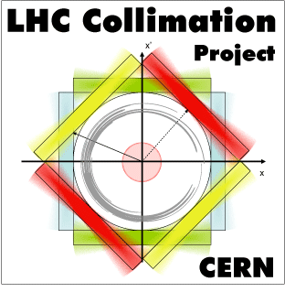
Comparisons between simulations and data for crystal-assisted collimation
Daniele Mirarchi,
Stefano Redaelli, Walter Scandale, Roberto Rossi

Slide 2
Introduction
Preliminary tests of Crystal-assisted Collimation are foreseen after the machine commissioning in 2015
Crystals were installed in the IR7 at beginning of April
Extensive campaign of simulation needed to prepare them in the best way
Location for gonimeters installation
Crystal parameters
Layout configuration
Simulations made using the Collimation version of SixTrack, in which a routine to simulate interactions with bent crystals is implemented
Crucial to benchmark the simulation tools for reliable predictions for the LHC

Slide 3
Benchmark strategy
Two main main “blocks” to be tested:
Crystal routine itself
Coupling with complete set of tools
to generate loss maps for the LHC
Simulations to be compared w.r.t.
data taken on SPS extraction line (H8)
(and other simulation tools for energy scaling)
data taken on the SPS during
crystal-assisted collimation tests
All the experimental data are taken in the framework of the UA9 Collaboration

Slide 4
Crystal routine

Slide 5
Crystal routine itself
Crystal routine: pure Monte Carlo emulator of interactions between protons and bent crystals
Benchmark carried out w.r.t. experimental data at 400 GeV, and analytical crystal routine for scaling to higher energy (made by A. Taratin and demonstrated to be predictive)
What has been done:
Improved scattering routine for amorphous interaction
(based on the one used in SixTrack to treat interaction with standard collimator jaws)
Improved calculation of ionization energy loss in crystals
Implementation of nuclear interactions for channeled protons
Fine tuning of free parameters used to reproduce the Nuclear Dechanneling
Everything performed w.r.t. experimental data already published by the UA9 Coll.
Plans for the next short term:
Systematic comparisons w.r.t. new data analysis performed by R. Rossi has been started
Introduction of improved parameterizations arising from this new analysis

Slide 6
Benchmark done
SixTrack Simulations
From the papers
Single pass channeling efficiency:
Agreement within 2%
w.r.t. Taratin’s sim (dots).
And %5 w.r.t data (blue).
Nuclear interaction rate:
Difference due to inelastic cross section:
In SixTrack taken from PDG
Better agreement in Glauber’s approx.
Much better agreement w.r.t. Tartin’s code.
Discrepancy w.r.t. exp. data (3) due to
resolution of goniometer and telescope
We are mainly interested to very low angles for collimation studies

Slide 7
Benchmark done
SixTrack Simulations
From the papers
Nuclear Dechanneling length:
Simulated Ld = ~ 0.9mm before fine tuning
~1.35mm after
Measured L_{d} = ~ 1.5mm
Agreement w.r.t. data increased from ~60% to ~90%

Slide 8
Ongoing Benchmark
Comparisons w.r.t. data not yet published and still under analysis has been started
Preliminary benchmarking performed:
Experimental conditions reproduced and simulated. Then results were compared
for any crystal tested in H8
Key features compared:
Single pass channeling efficiency
Found an agreement within the 5%
Angular distributions of kicks given by the crystal to the impinging protons
Examples are reported in the next two slides

Slide 9
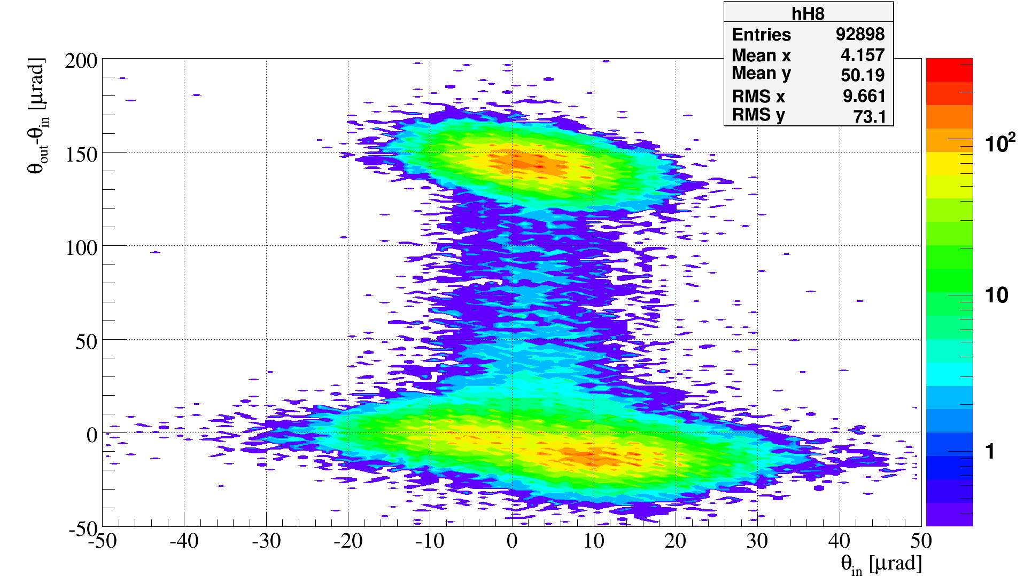
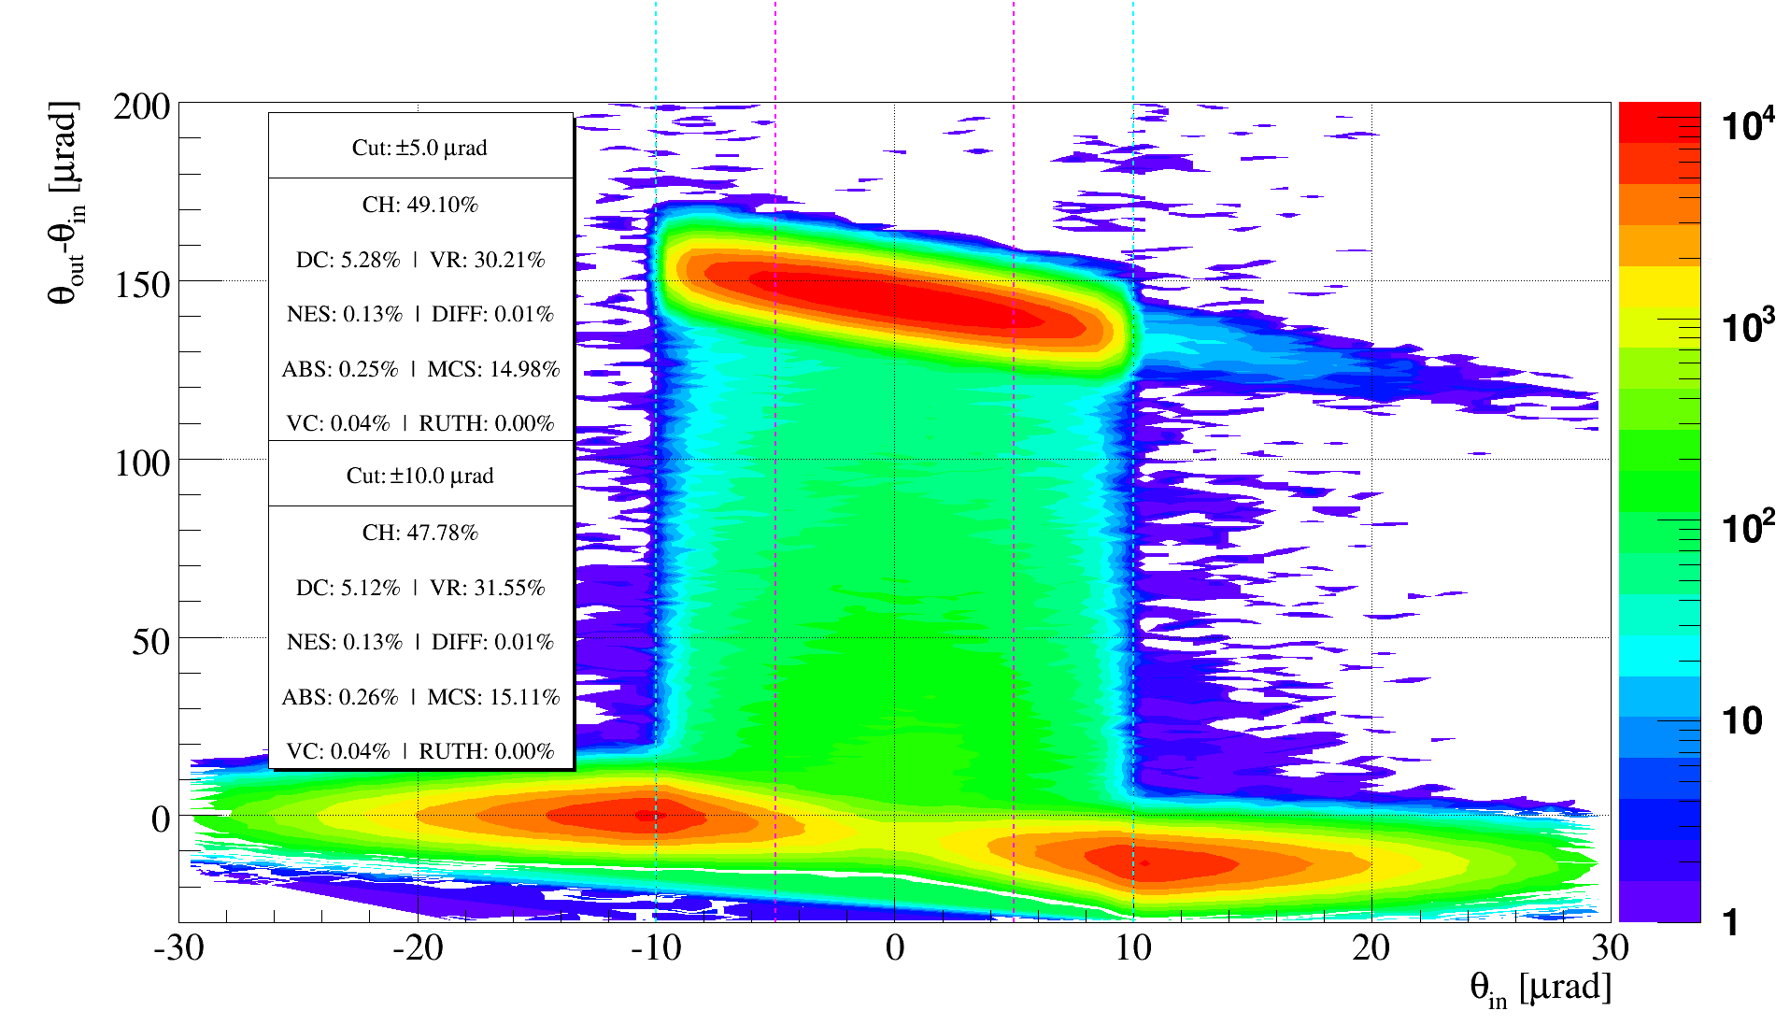
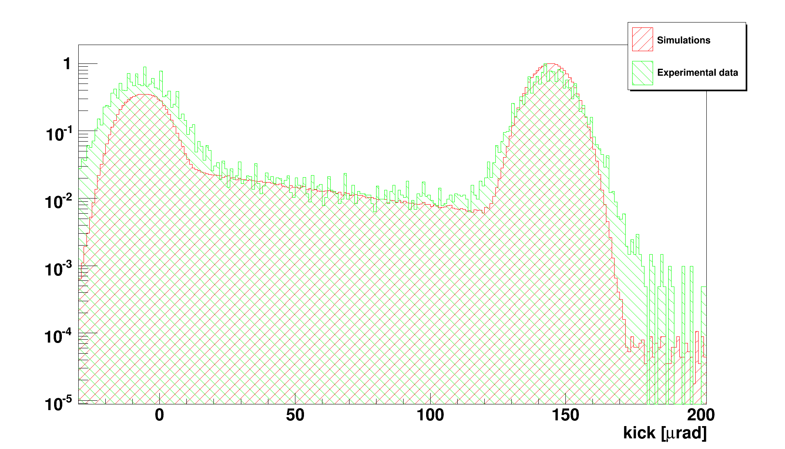
Ongoing Benchmark
Kicks distribution in hi-stat channeling run related to the crystal STF45 (look Roberto’s slide)
Exp. Data
Simulation
Kicks distr. superimposed in key angular range:

Slide 10
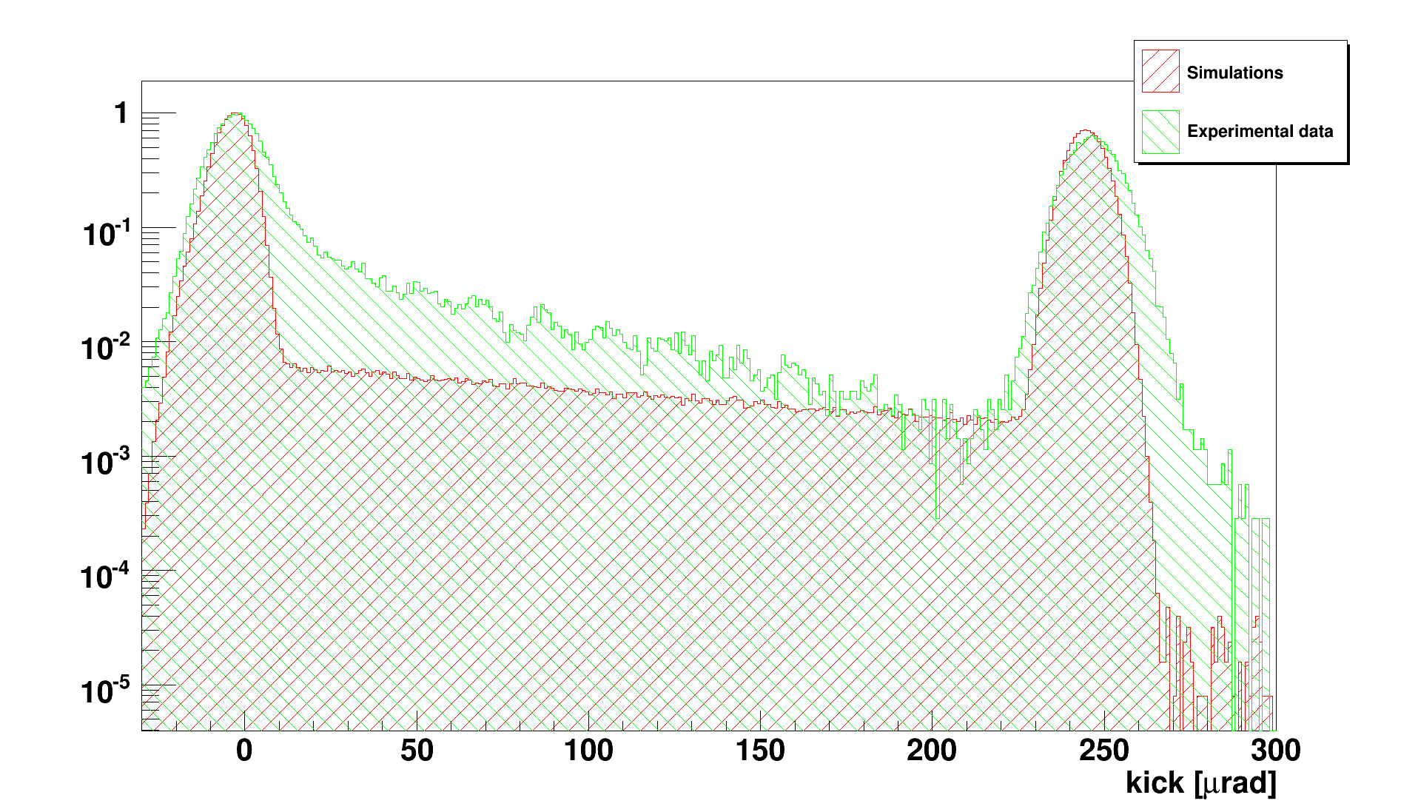
Ongoing Benchmark
As expected the models in the crystal routine are not enough accurate to describe crystals where the nuclear contribution is strong: bending radius close to the critical one.
Crystal STF49 taken as example:
(bending radius ~3m, critical bending at 400GeV ~2m)

Slide 11
Multiturn simulations

Slide 12

UA9 schematic layout in SPS
UA9 is placed in the SPS LSS5 (old UA1 cavern), key regions are:
Upstream scraper to study what comes back after a revolution
Crystal-assisted collimation insertion
High-dispersive area to study the production of off-momentum particles by the system
~ 45 m , Δμ = 60∘
~ 67 m , Δμ = 90∘
~ 60 m , Δμ = 90∘
Roman Pot
(Medipix)
Scraper
~ 45 m , Δμ = 60∘
Collimator
Scraper
Beam
Crystal
+ goniometer
Deflected beam
Collimator
Absorber
Scraper
(W, 10 cm)
BLM
BLM
BLM
(W, 60 cm)
BLM
(graphite, 1 m)
Roman Pots
(Medipix)
Roman Pot
(Medipix)
Scraper (W, 10 cm)
Non-dispersive area for measurements “far” from the collimation system
Crystal collimation system (in two stages)
With instrumentation for loss rate and efficiency measurement
High-dispersion area for measurements on off-momentum halo

Slide 13
Key Benchmark
Crucial to understand and reproduce the UA9 results in the SPS,
in view of predictions for the LHC
Main efforts focused on the comparison of:
Loss rate at the crystal location
Loss rate in the high-dispersive area
Dependence of the loss rate in the high-dispersive area from clearance between
crystal and absorber
Beam loss pattern around the whole ring
Unfortunately due to a electricity cut happened yesterday the hard-drive used as storage was damaged. Was impossible to recover it on time for today: “proper plots” are not available today for what in the next. Please “stay with me” and don’t get lost in the text!! Text is there only as reference, to say by word what should be drawn…

Slide 14
Loss rate studies
Key point: loss maps simulations give us the density of primary protons lost on the aperture
Direct comparison w.r.t. measured beam loss rate by BLMs valid only in first approx.
Since BLM signal is due to the convolution of hadronic showers generated by primary protons lost on the aperture:
Present studies focused on integrated losses and not on single peaks on loss maps
SPS ring divided in 5 Region of Interest (RoI)
Compared the losses around the whole SPS for different crystal orientation
Crucial for the next:
Simulated nuclear interaction rate at the crystal for different crystal orientation
(normalized to the protons intercepted by the system)
Crystal orientation | rate
Channeling | 1.72e-3
Amorphous | 1.23e-1
Reduction of ~70 when in channeling w.r.t. amorphous orientation

Slide 15
Region of Interest (RoI)
ID | s [m] | Commenti
1 | 5180 -> 5240 | Region between crystal and Abs., pure betatronic losses
2 | 5240 -> 5264 | Almost zero D_{x}, purely betatronic losses
3 | 5264 -> 5307 | D_{x} starts to be not negligible. Mainly betatronic losses, dispersive losses arising.
4 | 5307 -> 5314 | High Dx region. Purely dispersive losses.
5 | 5314 -> 5180 | Rest of the machine. Mix of betatronic and dispersive losses.
Crucial RoI for comparison with measurements is the # 4, where an LHC-BLM type is present

Slide 16
Loss sharing
Studied how the losses on the aperture are shared between the RoI as function of the crystal orientation, looking at their “origin”:
If crystal in Channeling orint.
If crystal in Amorphous orint.
ID | From Cr | From Abs.
1 | 65.81% | 0.02%
2 | 8.9% | 31.2%
3 | 1.6% | 28.5%
4 | 0.3% | 7.6%
5 | 23.3% | 32.7%
ID | From Cr | From Abs.
1 | 64.25% | 0.2%
2 | 9.0% | 22.2%
3 | 1.5% | 26.4%
4 | 0.3% | 9.4%
5 | 25.0% | 41.8%
Percentage of total losses in that region coming directly from:
The crystal without touching anything else.
The Absorber, i.e. particles are kicked by the crystal and imping on the Abs. but are not absorbed.

Slide 17
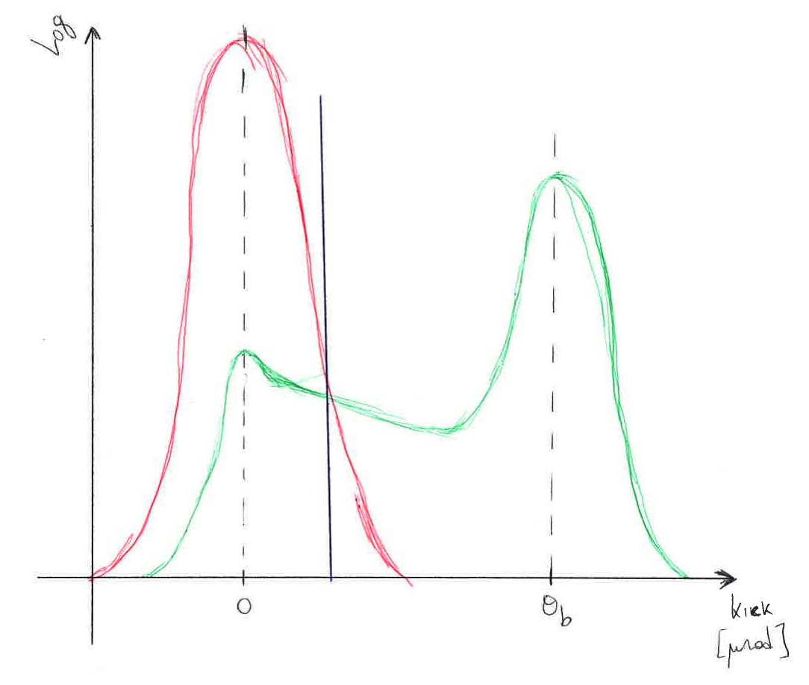
Loss sharing interpretation
Let’s focus on the protons lost after interacting only with the crystal
Kick distr. given by the crystal if in amorphous orient.
Angular cut performed by the Abs. Everything got higher kick is intercepted by the Abs.
Kick distr. given by the crystal if in channeling orient.
Where θ_{b} is the crystal bending.
Differential eq. theory tells us that with same starting condition, particles will follow same trajectory.
Purely betatronic losses due to particles which interacted only with the crystal will be shared in the same way. (i.e. losses due to protons in this range)

Slide 18
Loss rate
Previous considerations are crucial to understand the measured loss rate reduction when crystal in channeling w.r.t. in amorphous orient.
Simulated loss rate in the RoI, normalized to the protons intercepted by the system:
If crystal in Channeling orint.
If crystal in Amorphous orint.
ID | From Cr | From TAL
1 | 1.54e-4 | 3.83e-7
2 | 2.09e-5 | 7.07e-4
3 | 3.73e-6 | 6.44e-4
4 | 7.66e-7 | 1.73e-4
5 | 5.44e-5 | 7.39e-4
ID | From Cr | From TAL
1 | 1.0e-2 | 2.55e-5
2 | 1.41e-3 | 2.86e-3
3 | 2.42e-4 | 3.39e-3
4 | 4.67e-5 | 1.21e-3
5 | 3.91e-3 | 5.38e-3
Loss rate reduction given by: loss rate in AM orient./loss rate in CH orient. (see next slide)
Key point on these tables: loss rate in any place of the ring dominated by losses due to protons which emerge from the Abs. (unless in RoI 1, i.e. between crystal and Abs.)

Slide 19
Loss rate reduction
ID | Loss rate reduction
 | From Cr | From TAL | Convolution
1 | 64.9 | 66.6 | 64.9
2 | 67.4 | 4.0 | 5.9
3 | 64.9 | 5.3 | 5.6
4 | 60.9 | 7.0 | 7.2
5 | 71.8 | 7.3 | 11.7
Direct comparison
w.r.t. exp. BLM data
Reduction given by the convolution of the two contributes in well agreement with exp. Data
(sorry again plots and data are not available today since are in the hard-drive too,
however they can be found in literature)
Different integration range were probed mainly for the RoI 4: no particular dependence was found.
Final integration range taken around the BLM location in that area, where a significant distribution of particle loss in present.

Slide 20
Considerations
Seems that the loss rate measured in the SPS is dominated by losses due to protons able to emerge from the Abs.
Loss rate reduction all around the ring seems coherent with what measured.
In case of protons the measured reduction was always in the range 5-10 either at the crystal location and high dispersive area (RoI 4)
This gives us the feeling that the reduction seen in the SPS is mainly due to the efficiency with which the extracted halo is absorbed.
Only in the region between crystal and Abs. simulations says we are dominated by losses coming directly from the crystal. Here we should expect a reduction really proportional to the reduction of inelastic interaction at the crystal. This is not seen experimentally, maybe due to a strong contribution of the multiturn effect. Work is on-going and in promising direction.

Slide 21
As support
To test the effect of the extracted halo which is not absorbed, simulations with Abs. as black absorber were performed: loss rate reduction all around the SPS found to be about the same of the reduction of nuclear interaction at the crystal.
It means that if this was the experimental situation we should measure a loss rate reduction around the ring of a factor ~50 when in channeling w.r.t. in amorphous.
Moreover it means that if losses from crystal are dominant we should expect a flat reduction of losses around the ring (at least where the betatronic one are dominant), while the convolution with what coming from the Abs. gives a modulation of the loss reduction around the ring. Experimentally a flat reduction is not seen.
Simulations for the LHC predictions support it as well.
In the IR7 DS losses are purely dispersive and due to the complexity of the system (here the extracted halo sees at least 1m of CFC and 3m of W instead then only 1m of W as in the SPS) contribution of losses coming directly from the crystal or after interaction with any other collimator are comparable.
Here a factor about 50 is expected in the level of losses in the DS when crystal in different orientation.

Slide 22
Conclusions
Crystal routine benchmarked and upgraded according with experimental data on SPS extraction line (H8) already published by the UA9 Collaboration.
Further benchmarking and upgrades based on new sets of H8 data have been started.
Simulations to reproduce the experimental tests of crystal-assisted collimation in the SPS arise a new possible way to interpret the experimental results, which seems in agreement with them.
Work is still on-going to reproduce the dependence of off-momentum particles leakage from the system, as function of the clearance between crystal and absorber

