Slide 1
MME studies for the Elena cooler
Diego Perini 27.03.2014
1
Notes:
Method:
individual interviews with group leaders based on the April schedule -> to gather bottom-up data,
EN retreat on 1st July -> the aim was to bring the MTP in line with the last schedule & saving requests from the Council in June
ENMB on 26th July -> validate with group leaders the top-down arbitration

Slide 2
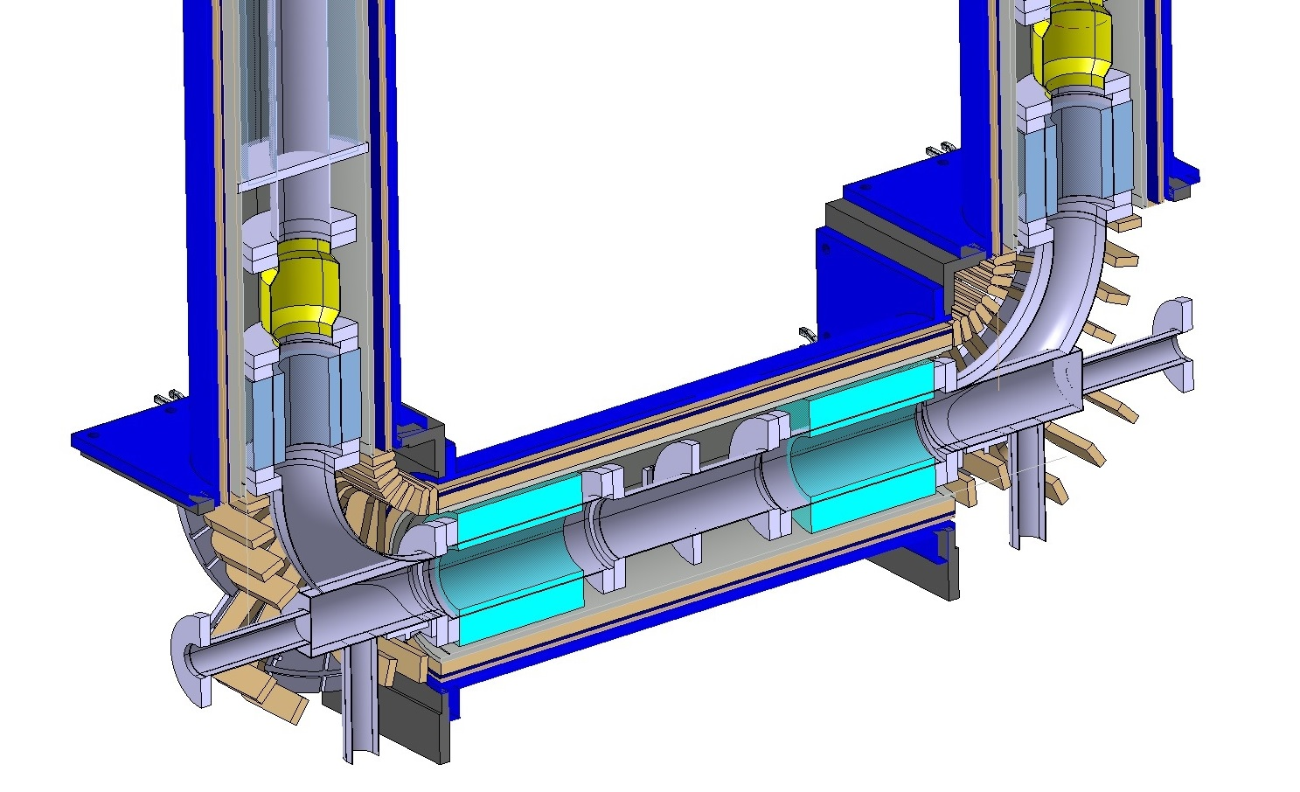
ELENA electron cooler
A. Kolhemainen, M. timmins

Slide 3
First questions to start
Field quality? Do we need a lot of correction coils => space
Do we need a cold vacuum chamber?
Instrumentation
Maintenance
Evolution of prototypes

Slide 4
Room temperature vacuum pipe and SC solenoid
~ Ø 160
~ Ø 340
RT
4.2 K
Th. screen

Slide 5
