Slide 1
Collimator Materials for LHC Luminosity Upgrade: Status of Irradiation Studies at BNL Collimation Upgrade Specification Meeting 21/06/2013 N. Mariani (CERN EN/MME/PE)

Slide 2
Summary
Radiation Hardness Studies at KI and BNL
Goals of Irradiation at BNL
Equipment
Specimen Types & Identification
Summary of Tests
Vacuum Capsules Accident
Summary of Actions
Conclusions

Slide 3
Radiation Hardness Studies
Radiation Hardness is a key requirement.
Benefit from complementary studies in two research centers with different irradiation parameters, different materials and approaches
Results Benchmarking
Ongoing Characterization Program in RRC- Kurchatov Institute (Moscow) to assess the radiation damage on:
CuCD
MoCuCD
SiC
Features:
Irradiation with protons and carbon ions at 35 MeV and 80 MeV respectively
Direct water cooling and T~100°C
Thermo-physical and mechanical characterization at different fluencies (10¹⁶, 10¹⁷, 10¹⁸ p/cm²)
Theoretical studies of damage formation
Proposal for Characterization Program in Brookhaven National Laboratory (New York) to assess the radiation damage on:
Molybdenum
Glidcop
CuCD
MoGRCF
Features:
Irradiation with proton beam at 200 MeV
Indirect water cooling and T~100°C (samples encapsulated with inert gas)
Thermo-physical and mechanical characterization for fluence up to 10²⁰ p/cm²
Possibility to irradiate with neutrons (simulate shower on secondary coll.)

Slide 4
Goals of Irradiation in BNL
Assess degradation of physical and mechanical properties of selected materials (Molybdenum, Glidcop, CuCD, MoGRCF) as a function of dpa (up to 1.0).
Key physical and mechanical properties to be monitored :
Stress Strain behavior up to failure (Tensile Tests on metals, Flexural Tests on composites)
Thermal Conductivity
Thermal Expansion Coefficient (CTE) and swelling
Electrical Conductivity
Possible damage recovery after thermal annealing
Compare dpa level to expected dpa level in LHC at nominal/ultimate operating conditions
Is dpa a sufficient indicator to compare different irradiation environments?

Slide 5
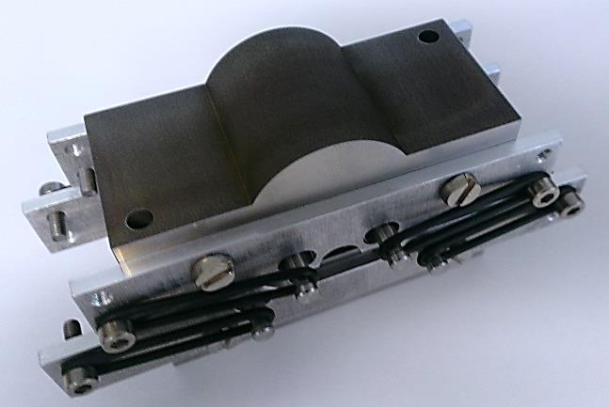
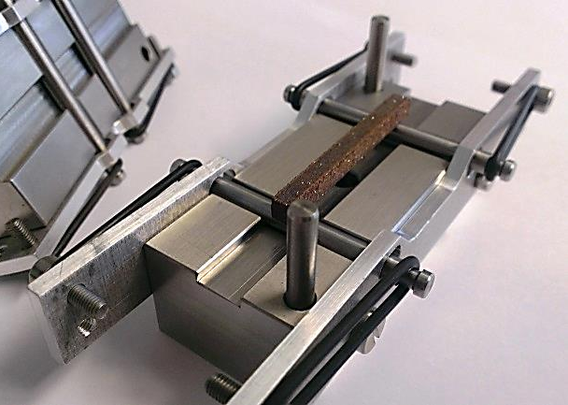
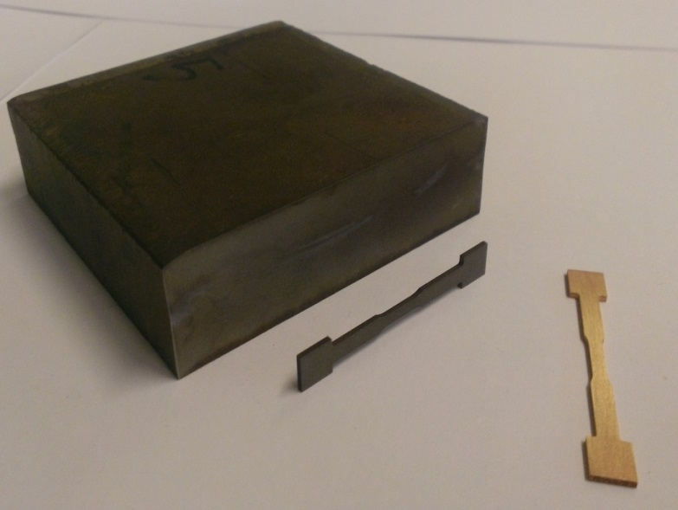
Equipment
Test | Instrument
Stress Strain behaviour up to failure (Tensile Tests on metals, Flexural Tests on composites) | Tinius-Olsen mechanical tester + CERN Fixture for Flexural tests
Thermal Conductivity | ? (BNL to give indications on available equipment)
Thermal Expansion Coefficient (CTE) and swelling | LINSEIS dilatometer
Electrical Conductivity | 4-point electrical resistance apparatus
Damage recovery after thermal annealing | LINSEIS dilatometer (for annealing and CTE verification after irradiation), 4-point electrical resistivity apparatus and Thermal Conductivity apparatus

Slide 6
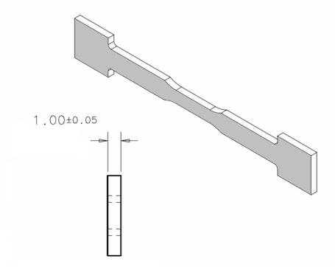
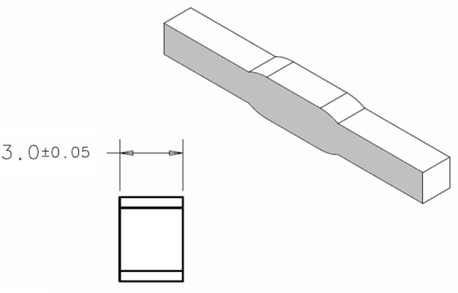
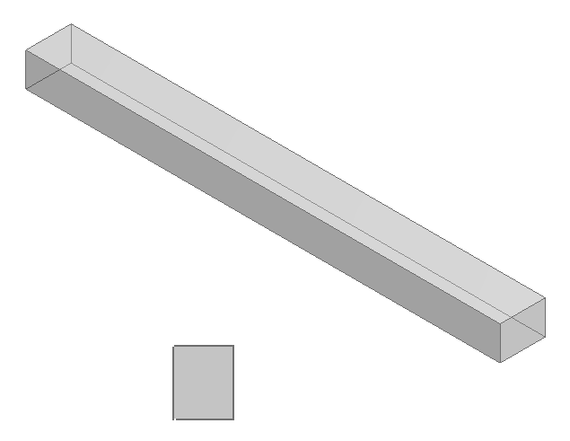
Specimen Types
Several Materials shapes exist for Metals and Composites
Different Sample manufacturing methods and tests techniques
Metallic materials samples:
Molybdenum + Glidcop
Composite materials samples:
CuCD + MoGRCF
4.00+/-0.05
Tensile tests
Other
Parallelepiped shape for all tests
Material | Sample | Dimensions | Number X capsule
Metals | Tensile | 42x6x1 mm | 21
 | Physical | 29x4x3 mm | 6
Composites | Flexural | 40.9x4x4 mm | 10
 | Physical | 20.5x4x4 mm | 10

Slide 7
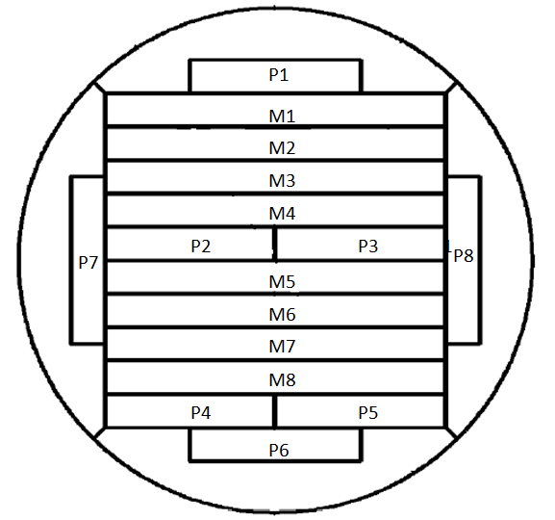
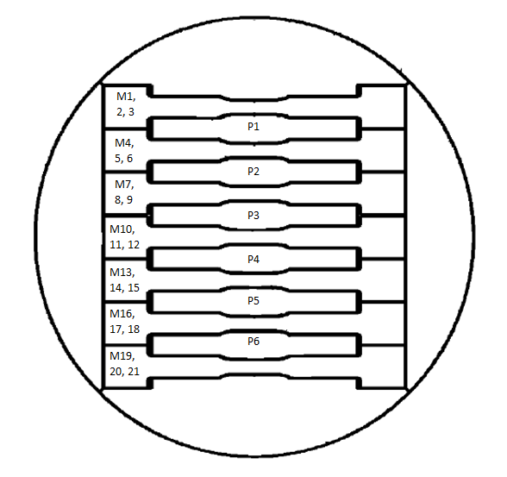
Samples Identification
For each material capsule the samples will be identified as following once the capsules are opened (top and bottom are arbitrary since the radiation profile is axial symmetric)
Mo: 2 capsules
Glidcop: 1 capsule
MoGR: 1 capsules
CuCD: 1 capsules
example: Mo1-P2 = Mo capsule 1 (higher Energy), 2nd physical sample

Slide 8
Summary of Tests
Summary of Reference tests
Material | Mechanical | CTE (+ Annealing) | Th. Cond. | El. Cond.
Glidcop | 8 | 2 | 2
Molybdenum | 8 | 2 | 2
CuCD | 4 | 2 | 2
MoGRCF | 4 | 2 | 2
Notes:
Not all MoGR and CuCD reference samples ready yet;
Irradiation Levels to be extensively defined for each sample in terms of dpa by Fluka Experts:
L. Lari BE/ABP/LCU,
M. Brugger EN/STI/EET.
Summary of After Irradiation tests
Material | Mechanical | CTE (+ Annealing) | Th. Cond. | El. Cond.
Glidcop | 21 | 3 | 3
Molybdenum | 42 | 6 | 6
CuCD | 8 | 4 | 4
MoGRCF | 8 | 4 | 4
Metallic Samples After Irradiation Tests Definition
Tests | Irradiation Level 1 |  | Irradiation Level 2 |  | Irradiation Level 3 |  | Irradiation Level 4
 | Position | N. | Position | N. | Position | N. | Position | N.
Mechanical | M10, 11, 12 | 3 | M7, 8, 9, 13, 14, 15 | 6 | M4, 5, 6, 16, 17, 18 | 6 | M1, 2, 3, 19, 20, 21 | 6
CTE (+ Annealing) | P3 | 1 | P2 | 1 | P1 | 1 | - | -
Thermal and Electrical Conductivity | P4 | 1 | P5 | 1 | P6 | 1 | - | -
Composite Materials Samples After Irradiation Tests Definition
Tests | Irradiation Level 1 |  | Irradiation Level 2 |  | Irradiation Level 3 |  | Irradiation Level 4
 | Position | N. | Position | N. | Position | N. | Position | N.
Mechanical | M4, 5, 6 | 3 | M3, 7 | 2 | M2, 8 | 2 | M1 | 1
CTE (+ Annealing) | P2 | 1 | P4 | 1 | P1, 6 | 2 | - | -
Thermal and Electrical Conductivity | P3 | 1 | P5 | 1 | P7, 8 | 2 | - | -

Slide 9
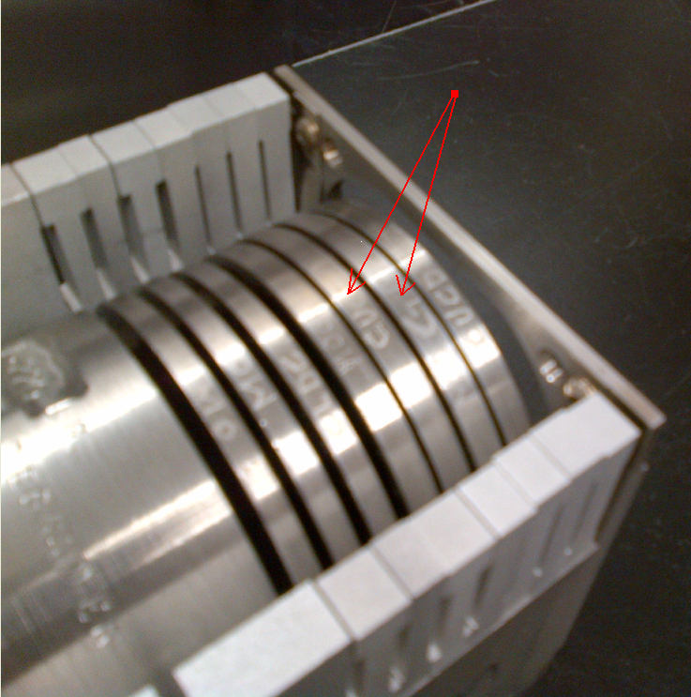
Materials Specimens Holding Box
The specimens are encapsulated into special vacuum tight capsules (vacuum or inert gas), the different capsules being mounted into a Holding Box.
The cooling is made by water flow between adjacent capsules
Insufficient cooling between CuCD and MoGR capsules provoked the expansion of CuCD1 capsule, that damaged both CuCD1 and MoGR1 capsules (with isotopes contamination);
Emergency stop and layout modifications to allow better cooling.
➔ Final layout:
1 Holding Box
5 capsules x Holding Box
Picture and status report by N. Simos (BNL)

Slide 10
Summary of Actions I
BNL – Complete SRIM energy deposition calculations and MCNPX isotope production calculations - DONE
BNL – Complete Thermo-mechanical analysis of whole holding box - DONE
CERN – perform FLUKA energy deposition calculations - DONE
BNL – Present the calculations to the safety committee - DONE
BNL – CERN: validate the proposed samples geometry and number - DONE
CERN – Composite materials production in RHP Technology and in BrevettiBizz + samples preparation at CERN. - DONE
CERN – Machine metallic samples at CERN Atelier. – DONE
BNL – Weld the vacuum capsules and mount them in holding box – DONE
BNL – Insert the holding box in BLIP Facility – DONE

Slide 11
Summary of Actions II
CERN – Prepare specification document for tests. – DONE
CERN – Produce Flexural tests fixture for composite materials. – DONE
CERN – Produce reference samples for characterization before irradiation – Ongoing (not all CuCD and MoGR produced now)
CERN – provide the expected dpa level and absorbed dose for each sample – Ongoing
CERN - Provide Materials Certificates – Ongoing (only Molybdenum available!)
BNL – Start Irradiation at BLIP – Started
Insufficient cooling damaged CuCD1 and MoGR1 capsules
Irradiation restarted after layout modifications and damaged capsules removal

Slide 12
Conclusions
Beam-induced material damages (both due to instantaneous high intensity impacts and long-term irradiation) are one of the most serious threats to High-energy, High-intensity accelerators, as stated by RRC-KI and BNL Irradiation Studies on Phase I Materials.
A first irradiation campaign is already ongoing at KI on selected novel advanced materials of interest for Phase II Collimators.
A new irradiation campaign at BNL just started to complement the material characterization from the radiation hardness point of view for future collimators design.
The campaign suffered from technical issues, that have been promptly resolved by BNL in a very short time.
Samples irradiation restarted at nominal proton current (105-110 µA),
irradiation phase end foreseen in 9-10 weeks.
To be discussed with BNL if it will be possible to check the contaminated samples and to re-use them for further testing.

Slide 13
Thanks for Your Attention
Acknowledgements:
N. Simos BNL
A. Bertarelli, S. Redaelli, L. Lari, M. Brugger, CERN

