Slide 1


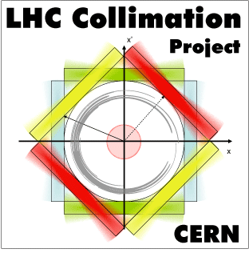
FLUKA Energy deposition simulations for quench tests
E.Skordis, F. Cerutti , A. Lechner, A. Mereghetti
On behalf of the FLUKA team
With essential input from R. Bruce, S. Redaelli , B.M. Salvachua
On behalf of the Collimation team

Slide 2
Talk Overview
IR7 modeling
SixTrack (beam tracking) and FLUKA (interaction and secondary shower) interplay
4TeV (February 2013 quench test) and 6.5TeV (post-LS1 operation)
  Warm Section Simulation
  Cold Section Simulation (peak power (dose) in the SC coils, BLM pattern)

Slide 3
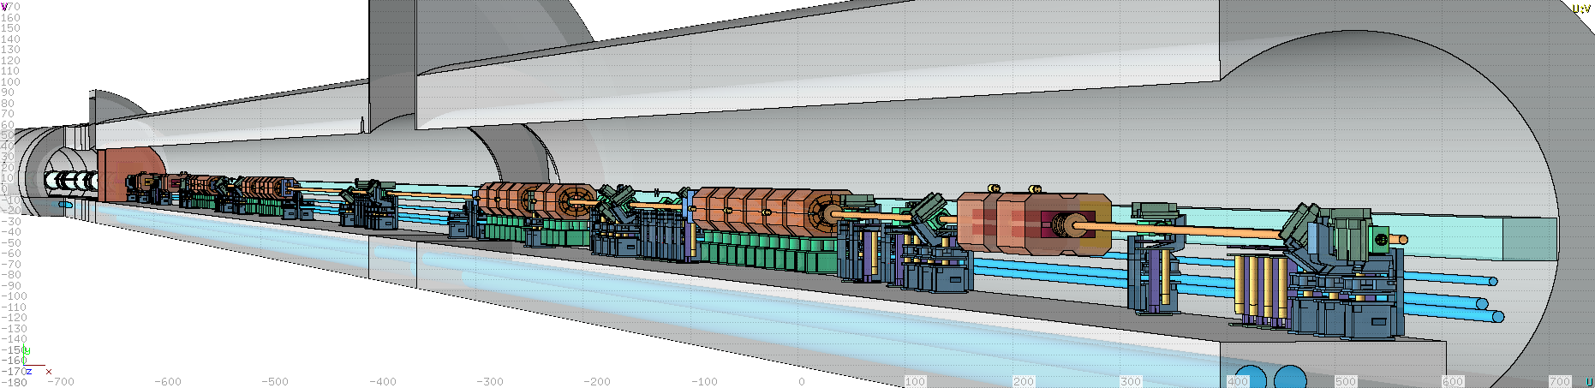
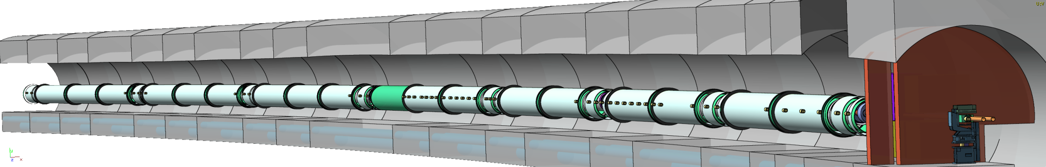
IR7 FLUKA geometry
Beam 2 (internal)
Long Straight Section
Left Dispersion Suppressor + Arch up to cell 14

Slide 4
BLM response factors
Significant differences in BLM response depending on many parameters:
Correspondence between monitor signal (what we see) and relevant quantities (what we care about, e.g. energy deposition in the coils) not universal
Position of the BLM
Geometry surrounding the BLM
Crosstalk shower

Slide 5
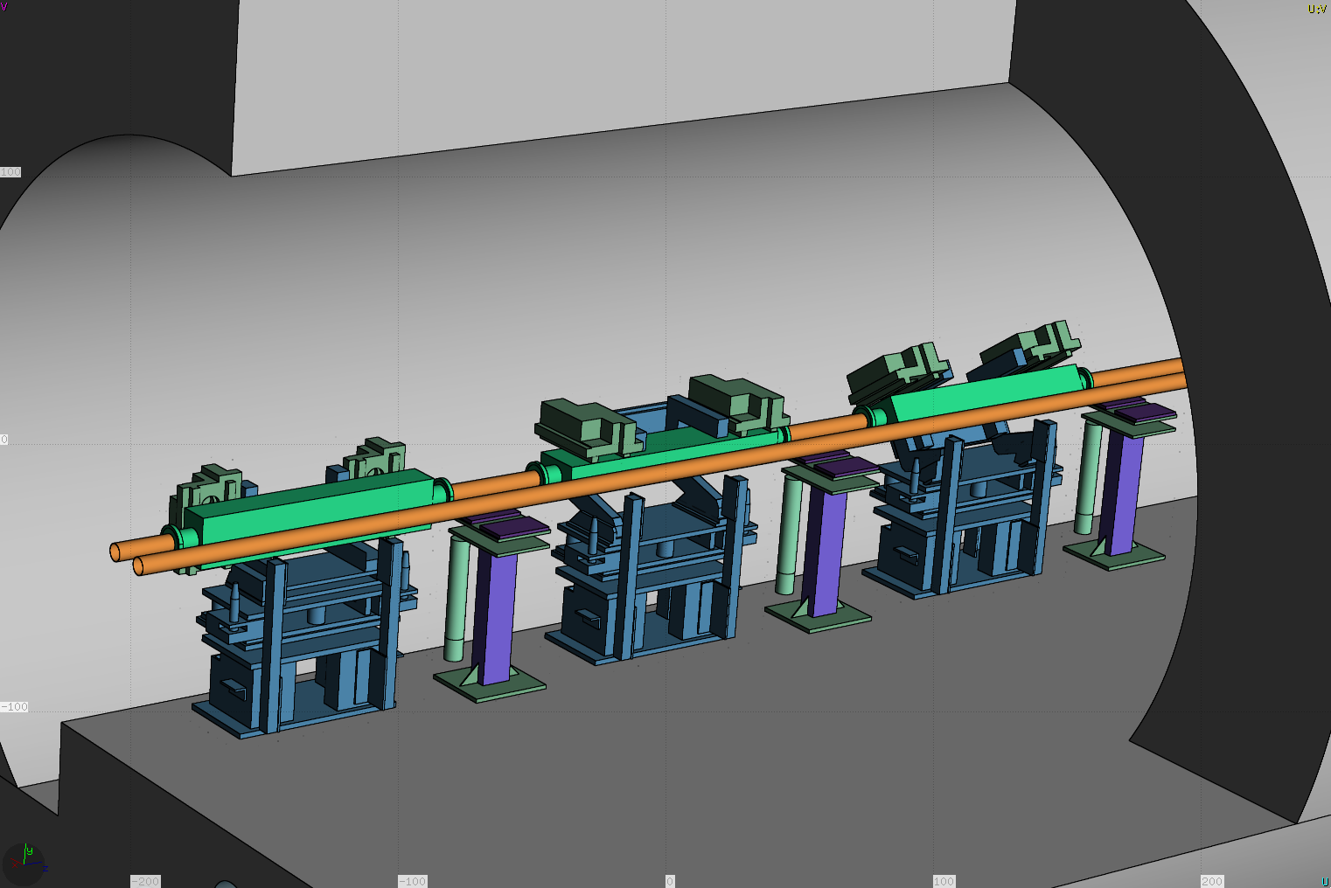
SixTrack and FLUKA interplay
TCP.D (Vertical)
TCP.C (Horizontal)
TCP.B (Skew)
Beam
BLM_TCP.D
BLM_TCP.C
BLM_TCP.B

Slide 6
BLMs at the TCTs
R.Bruce, Proc. of IPAC13, MOODB202, Shanghai, China, 2013.

Slide 7
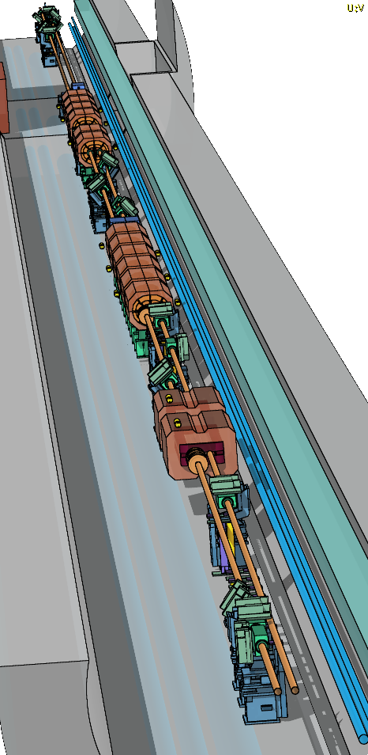
Warm Section Simulation
IP7
Horizontal loss scenario (main impact on TCP.C)
At 4 TeV peak loss rate of 1.6*10^12 p/s (1MW)
At 6.5 TeV peak loss rate of 4.5*10^11 p/s (0.2h beam lifetime)
Q5
Beam 2 Primary Collimators
Beam 2 Direction

Slide 8
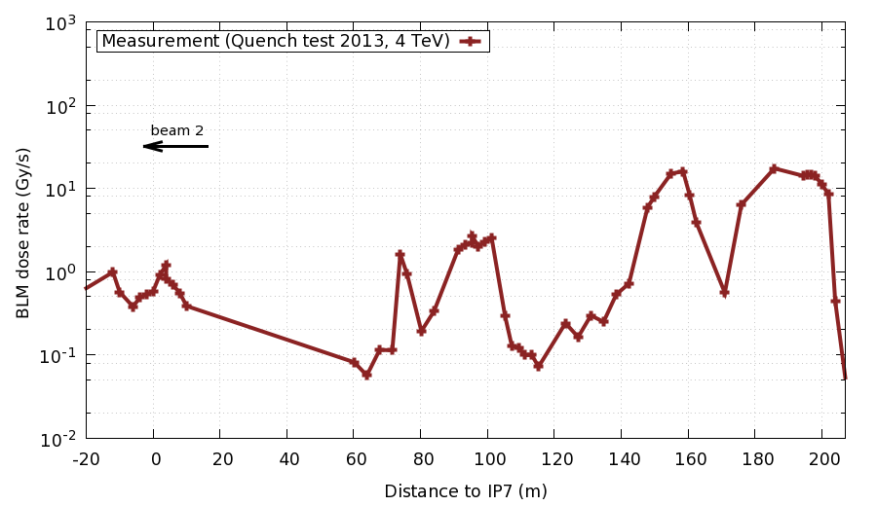
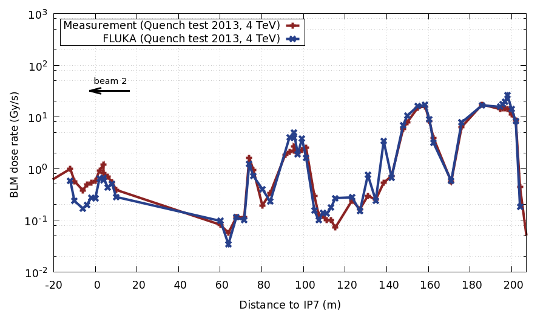
Warm Section Simulation
TCP
Q5
Q4
IP7

Slide 9
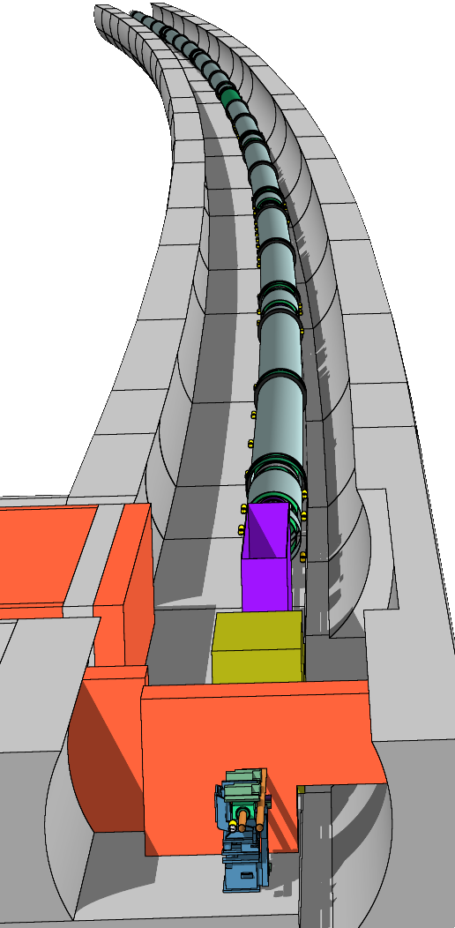
Cold Section Simulation
Connection Cryostat
For every 1000 of protons lost in the Primary collimators we have only 1 in the DS
2 step Simulation to acquire enough statistics:
Generation of distribution of particles impacting the aperture at the DS and TCLA
Use the above distribution to simulate the energy deposition on the Magnet Coils and BLM response
MB.A9L7
TCLA

Slide 10
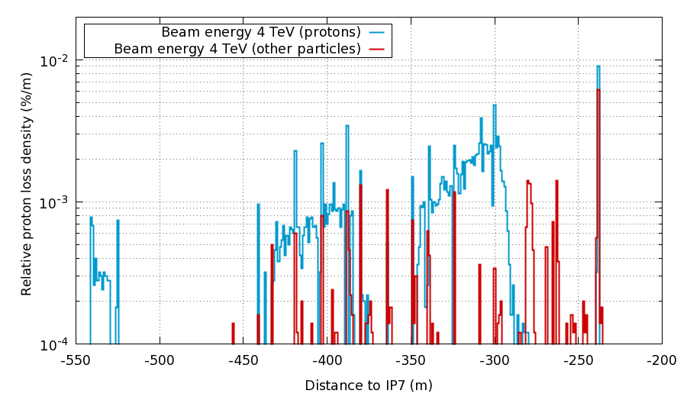
Distribution of impacts TCLA -> Cell14
Cell 8-9
TCLA
Beam 2
Cell 10-11
Cell 14

Slide 11
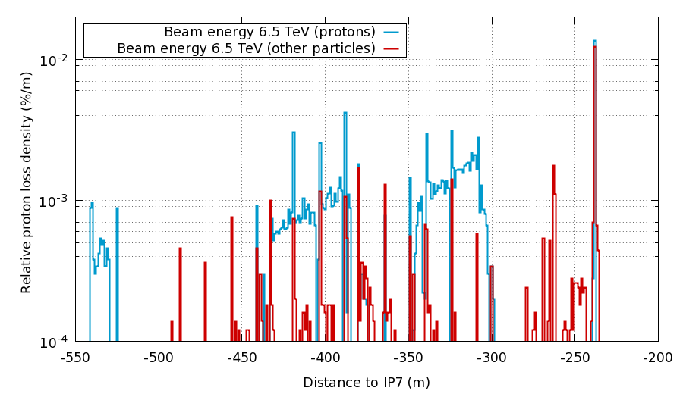
Distribution of impacts TCLA -> Cell14
Cell 8-9
TCLA
Beam 2
Cell 10-11
Cell 14

Slide 12
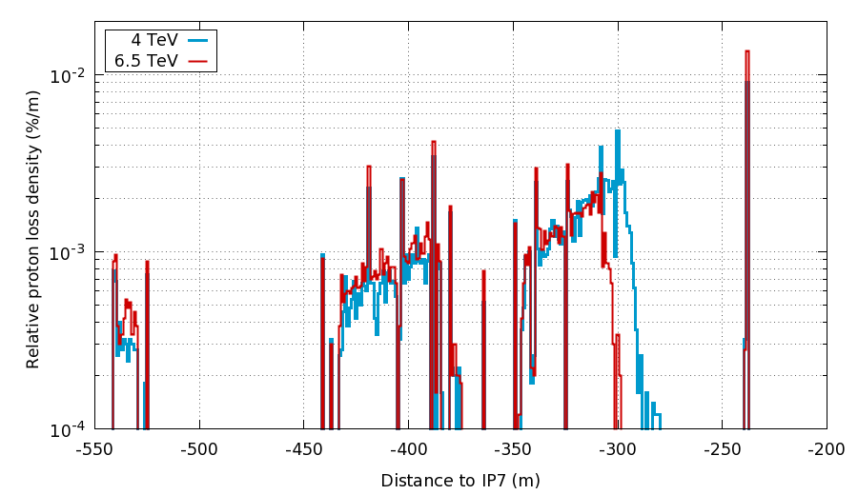
Distribution of impacts TCLA -> Cell14
Cell 8-9
TCLA
Beam 2
Cell 10-11
Cell 14

Slide 13
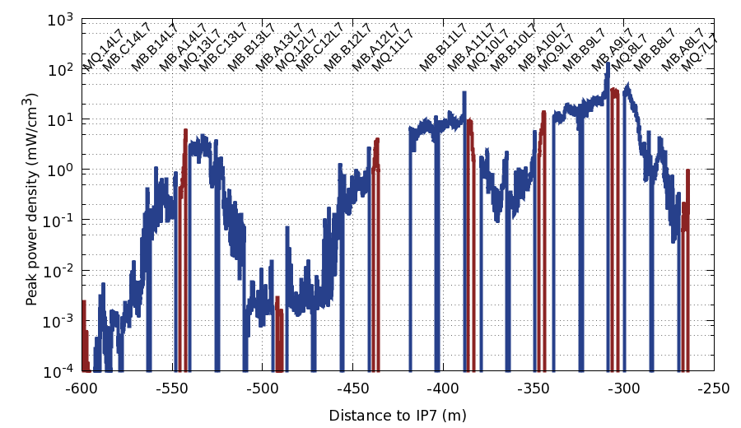
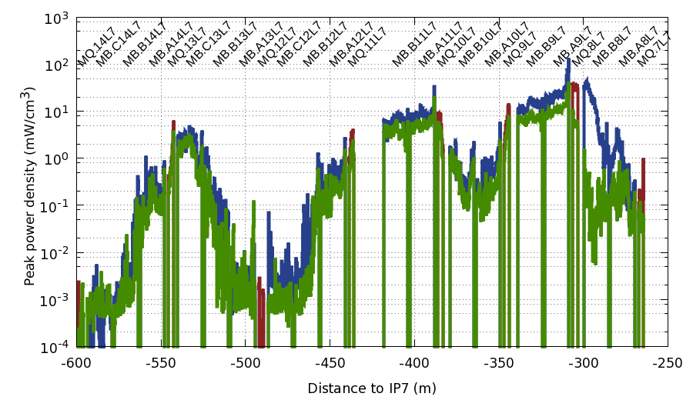
Magnet coils energy deposition
4 TeV Quench Test
6.5 TeV (0.2 h beam lifetime)
Beam 2

Slide 14
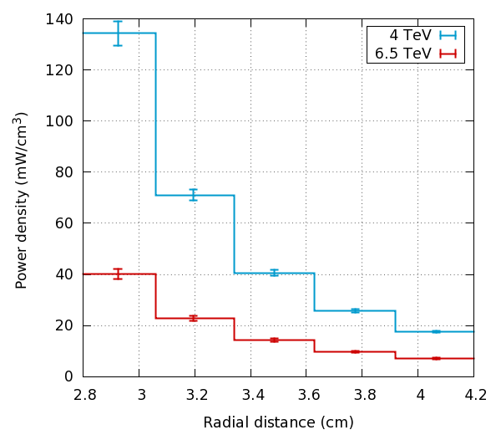
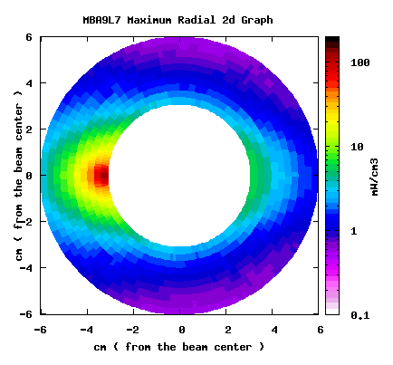
Cold Section Simulation
Total Power on MB9.A : 280 W
Total Power on MQ8 : 70 W

Slide 15
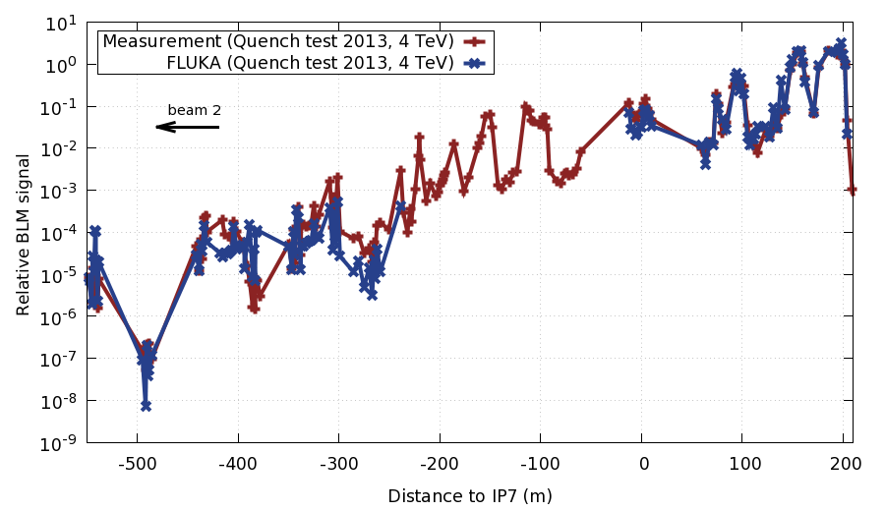
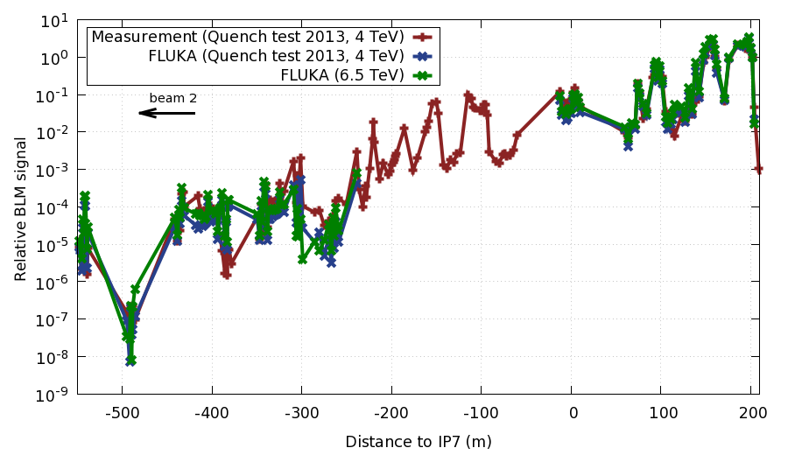
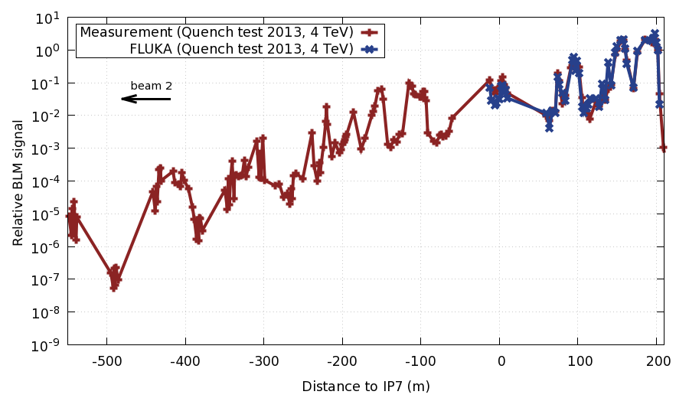
Cold Section Simulation
TCP.C
Cell 8-9
Cell 13
Cell 10-11
TCLA
Cold Section
Warm Section
Cell 12
Values are normalised to the signal of the BLM at the TCP.C (horizontal)

Slide 16
Conclusions
The quench test at 4TeV was investigated, yielding an encouraging agreement with respect to the measured BLM pattern and a peak power in magnet coils compatible with the lack of quench (see Arjan’s talk)
The study at 6.5 TeV gives an estimate of peak power as a function of beam lifetime and allows to relate it to the BLM signal

Slide 17
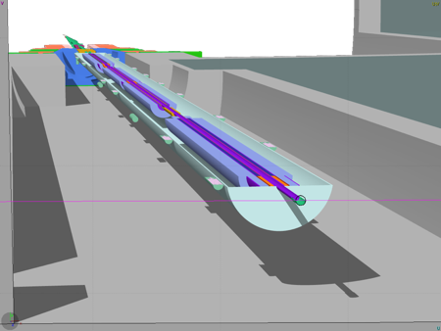
FLUKA simulation benchmark against Inner Triplet BLM response
IP
BLM response along IR5 triplet
Q3
BLM dose per collision assuming CMS luminosity measurement and 73.5 mb proton-proton
cross-section from TOTEM [1]
[1] EPL, 96 (2011) 21002
L. Esposito

