Slide 1
11 T Nb₃Sn magnet thermal model (1/5)
Equations: energy equations considered for solid and superfluid helium
One heat exchanger at 1.9 K 25 % wetted by liquid HeII
Homogenization of the cable at the first order taking account of the copper, the
Nb₃Sn and the resin: effective thermal conductivity k_{cable}(T)
Cable insulation (G-10 – 100 µm thick) modeled by a thermal resistance
Between inner/outer coil: 3 layers of G-10 168 µm thick modeled by
one layer 504 µm thick
Between the coils and collars: 5 layers of kapton 125 µm thick modeled by one layer
625 µm thick
Titanium pole piece is taken 4 % open
Collars and yoke laminations are taken 2 % open
Annular space 1 – 1.5 mm

Slide 2
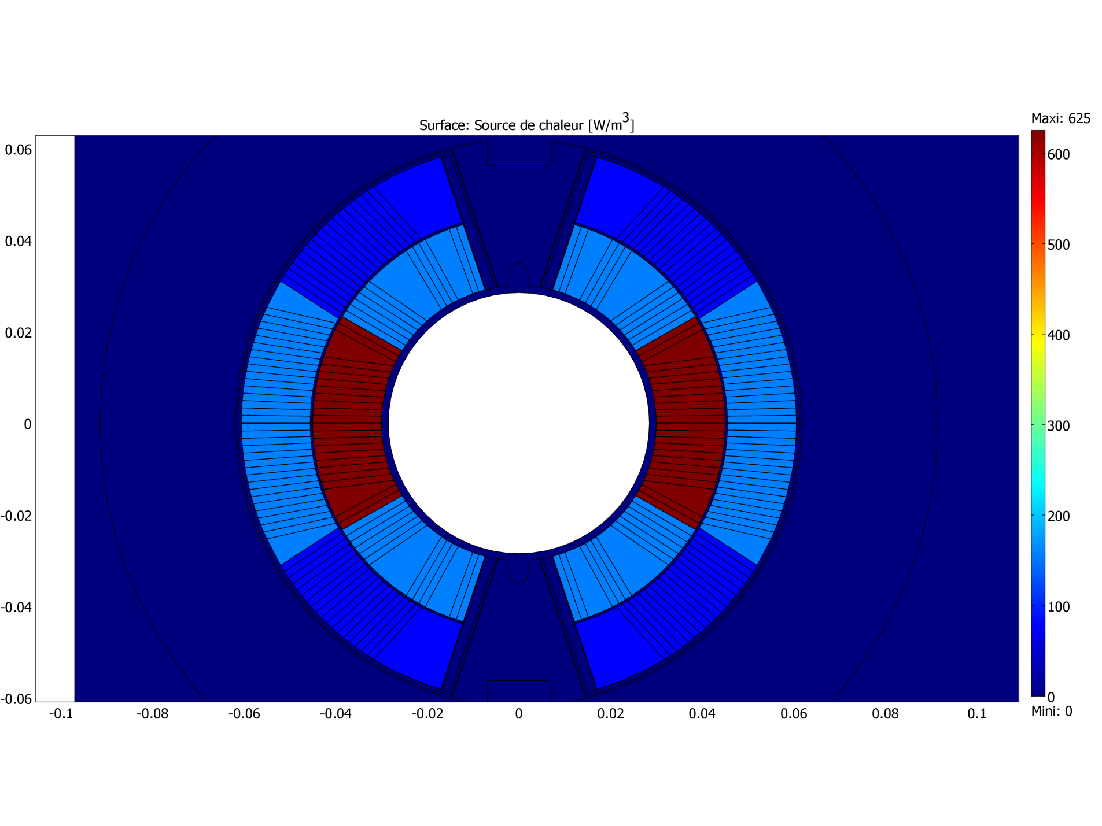
11 T Nb₃Sn magnet thermal model (2/5)
Input: assumed heat load distribution corresponding to 1.5 W/m

Slide 3
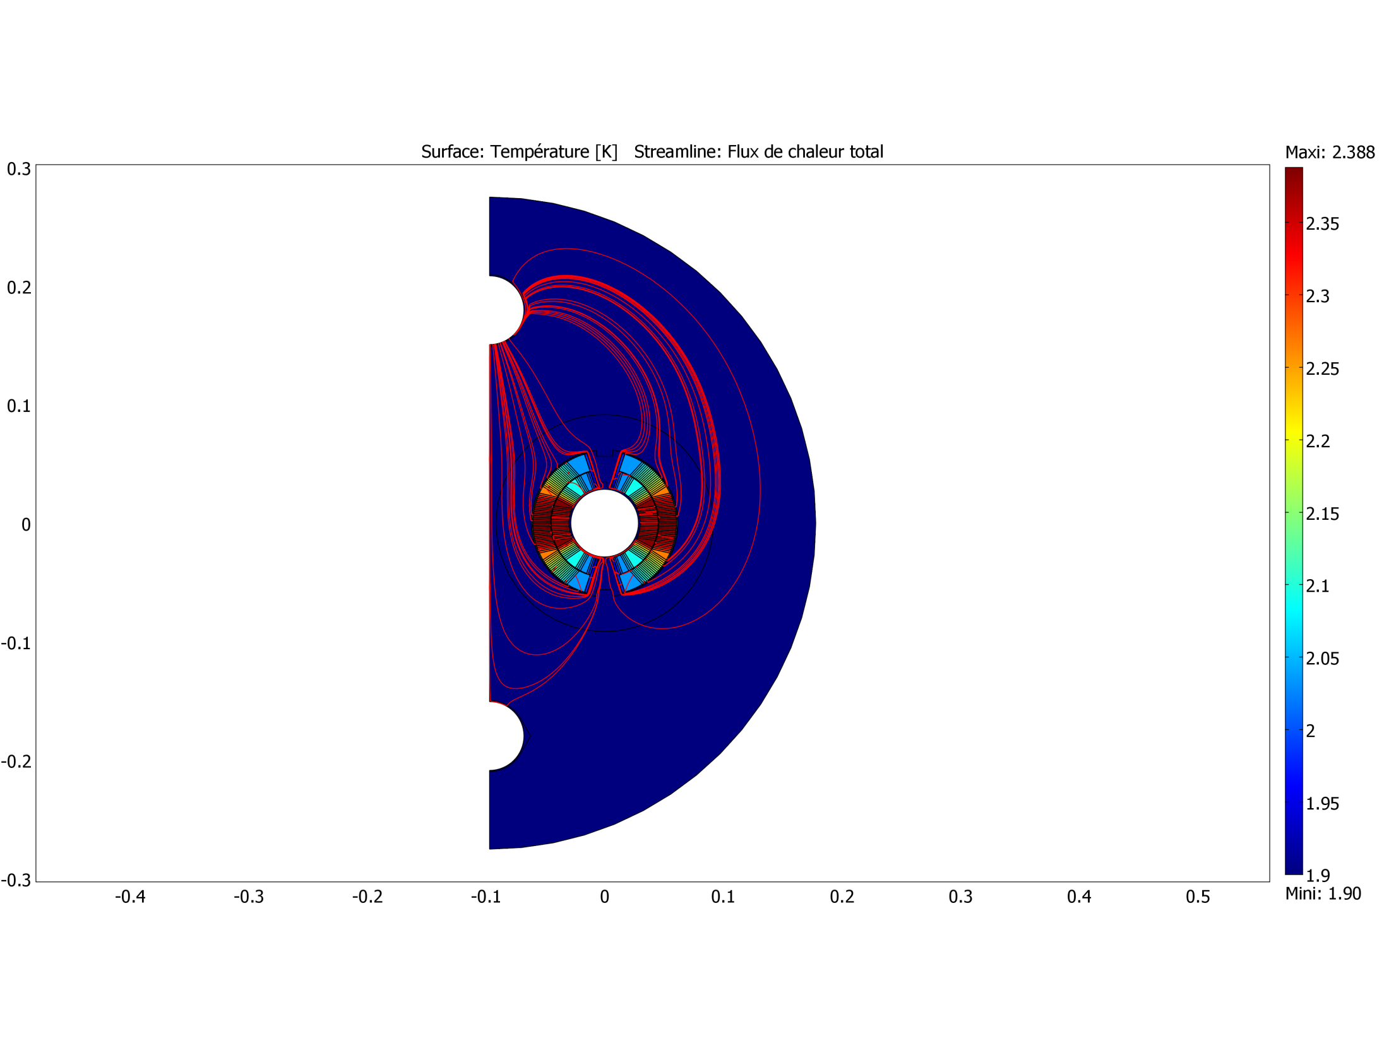
11 T Nb₃Sn magnet thermal model (3/5)

Slide 4
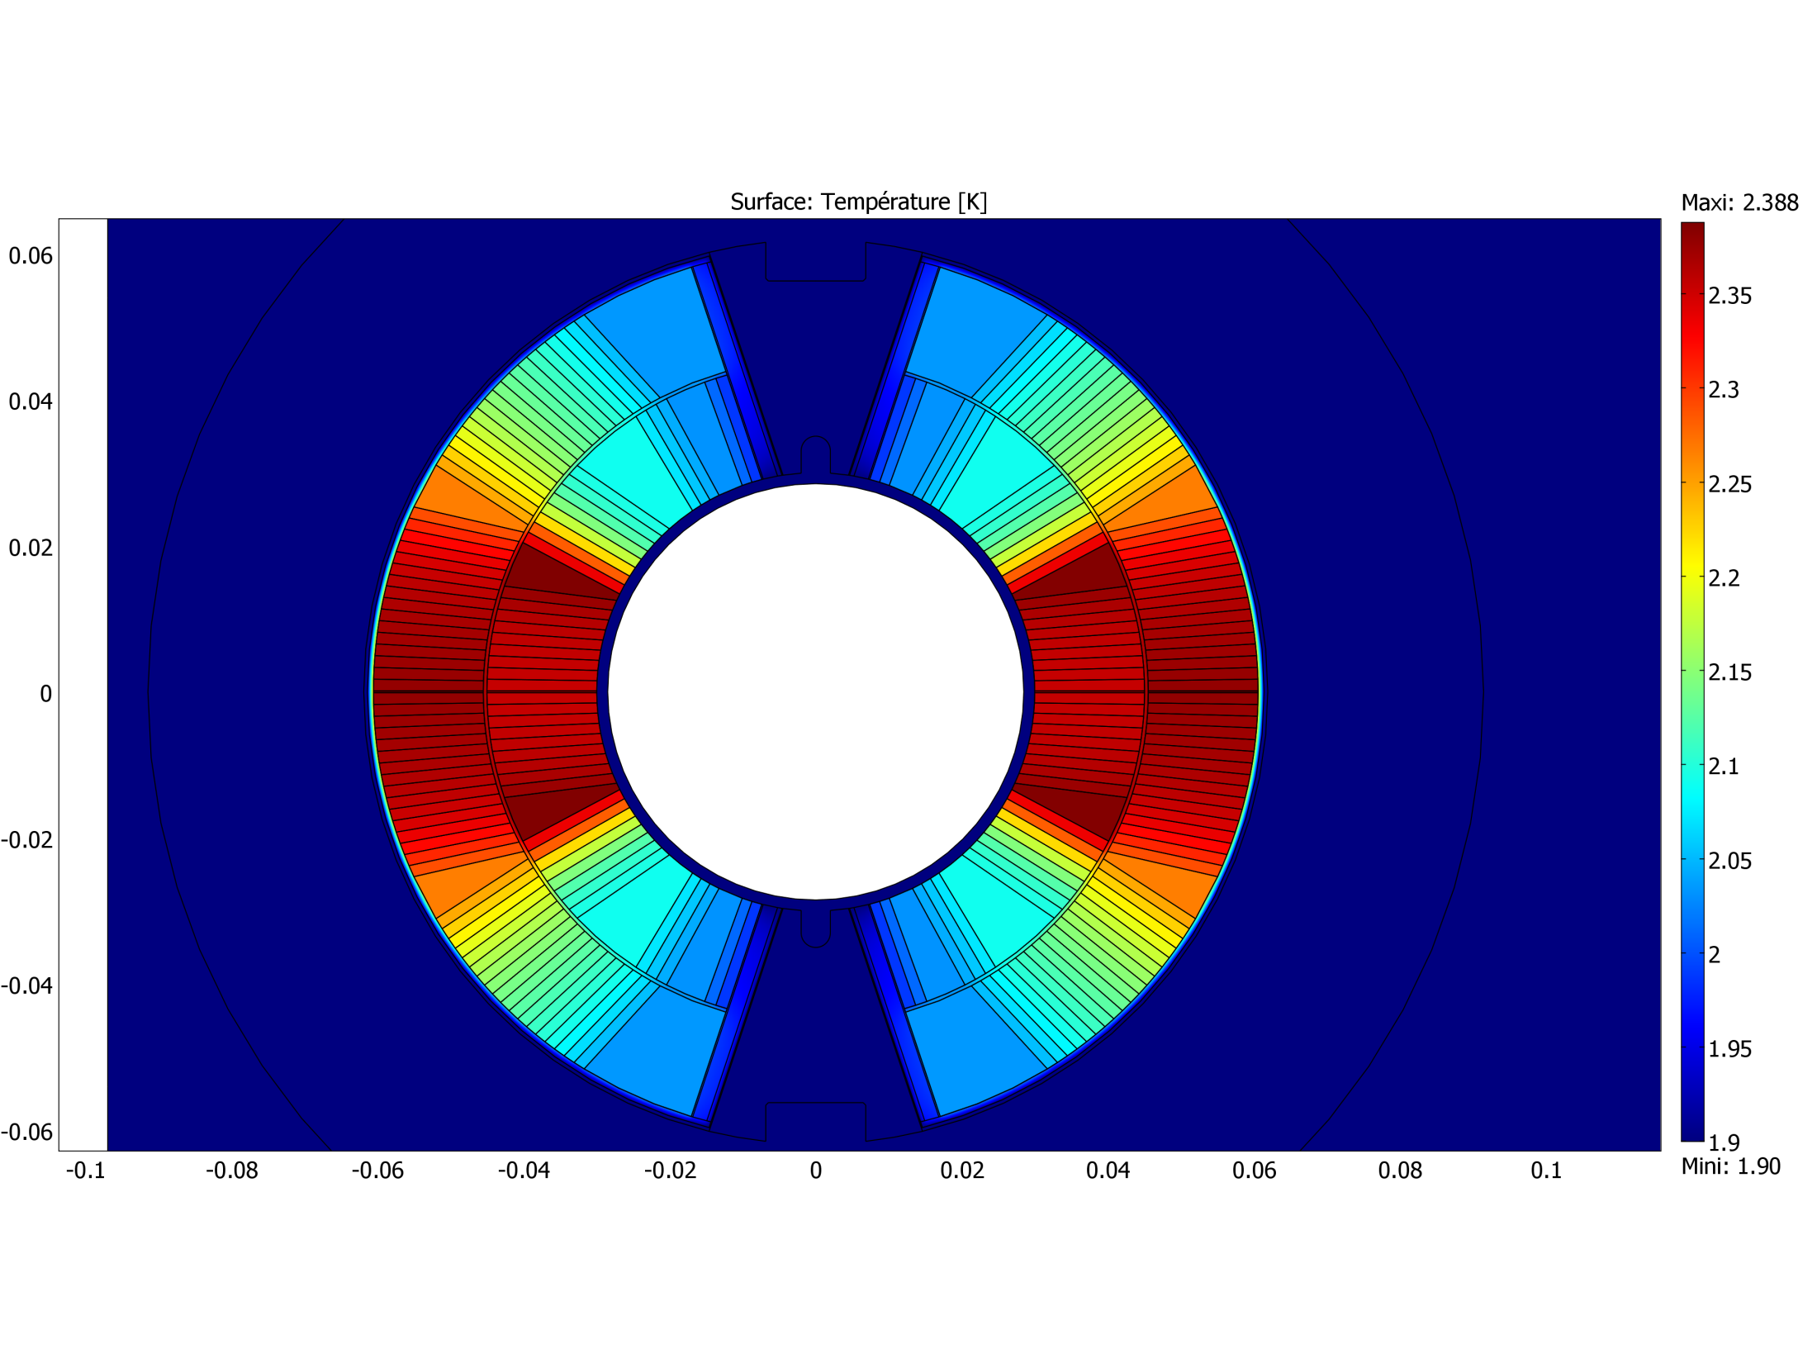
11 T Nb₃Sn thermal model (4/5)
Maximum Temperature 2.39 K at midplane

Slide 5
11 T Nb₃Sn thermal model (5/5)
Conclusions:
T-map-results invariant of annular space in range 1 – 1.5 mm
T-map-results invariant pole piece opening in range 1 – 4 %
With respect to LHC main dipole construction we assume that 1.5 mm annular space and 4 % pole piece opening are safe to cope with quench overpressure.
Could be minimized, but would need verification (to be done)
Next to be done:
simulations with the real heat load
more precise homogenization of the cable
quench analysis to determine:
- holes in titanium piece needed
- maximum pressure reached
transient analysis

